Slide 1
Introduction to MapReduce
Mahmoud Parsian
Ph.D. in Computer Science

Slide 2
MapReduce?
A programming model or abstraction.
It is not a programming language
A novel way of thinking about designing a solution to certain big data problems…
It enables us to
1. Partition data into small chunks (called partitions)
2. Execute tasks in parallel by:
Mappers
Reducers

Slide 3
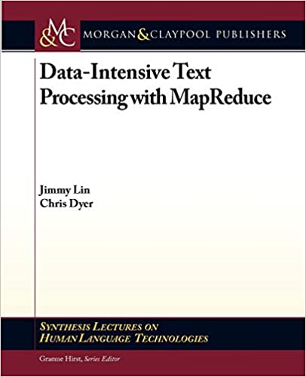
How to Understand MapReduce? This book is an excellent source on MapReduce

Slide 4
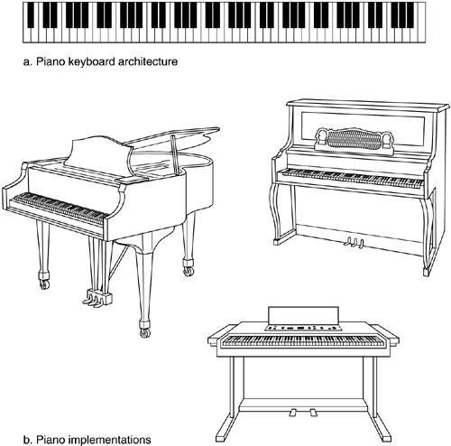
MapReduce: as a Model/Architecture

Slide 5
MapReduce as a Model/Paradigm/Architecture
Implementations of MapReduce:
Google App Engine
Apache Hadoop
Apache Tez
Apache Spark (implements superset of MapReduce)
Snowflake
Amazon Athena

Slide 6
Motivation of MapReduce
Process lots of data in parallel
Google processed about 24 petabytes of data per day in 2009.
Facebook processed 60 petabytes of data per day in 2020
A single machine cannot serve all the data
You need a distributed system (called cluster computing) to store and process in parallel
Parallel programming

Slide 7
Motivation
Parallel programming?
Concurrency/Threading/Parallelism is hard!
How do you facilitate communication between servers/nodes?
How do you scale to more machines?
How do you handle machine failures?
How do we handle disk failures?
MapReduce uses cluster computing and enables parallelism

Slide 8
What is a Cluster Computing?
MapReduce uses cluster computing and enables parallelism
A computer cluster is a set of computers (nodes or servers) that work together so that they can be viewed as a single system.
Example: A cluster of 101 nodes:
One Master (as a cluster manager)
100 worker nodes

Slide 9
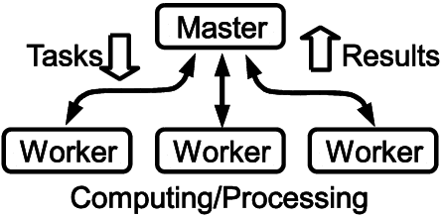
What is a Cluster Computing? Perform tasks in parallel using a set of computers

Slide 10
MapReduce reintroduced…
Google created the awareness by publishing a paper
Apache Hadoop made it into a sensation
Apache Hadoop is an open-source MapReduce implementation based on Google’s paper.
Spark implements superset of MapReduce
MapReduce: Simplified Data Processing on Large Clusters
By Jeffrey Dean and Sanjay Ghemawat, Google
OSDI'04: Sixth Symposium on Operating System Design and Implementation. December, 2004.

Slide 11
MapReduce reintroduced…
Apache Hadoop is an open-source MapReduce implementation based on Google’s paper.
We will NOT study Apache Hadoop: since it is very complicated and it has lots of moving parts,
BUT, instead, we will study the fundamentals of MapReduce paradigm by using/studying
Jimmy Lin’s book on MapReduce.
Write pseudo-code in MapReduce

Slide 12
MapReduce reintroduced…
Google’s big problem:
Index billions of web documents everyday!
Takes too much time and effort!
Solution:
Use MapReduce to utilize 100’s or 1000’s of servers (cluster computing) to index billions of documents

Slide 13
(key, value) in MapReduce
For MapReduce, everything (input and output) is expressed as a tuple of 2 values: (key, value)
NOTE: key and value can be any data types
Mapper:
map(key, value)
key: as a partition number, or a record number
value: an actual input record
Outputs { {k2, v2), … }
Reducer:
reduce(key2, value2)
key2 : a k2 in mappers
value2 : Iterable<objects> OR list of objects
Outputs: { (k3, v3), …}

Slide 14
Hadoop implements MapReduce
Partition input into small chunks
Parallelize chunks in many servers
Apply map()and reduce()

Slide 15
Components of MapReduce Job
Partition input into small chunks
Parallelize chunks in many serers
Apply map()and reduce()

Slide 16
Word Count: Notation
() denotes a Tuple
Example-1: (1, 2, 4) denotes tuple of 3 integers
Example-2: (”fox”, 3) denotes a (key, value) pair
Where key is “fox” and value is 3
Example-3: () denotes an empty tuple
[] denotes a List of 0, 1, 2, … items/objects
Example-1: [1, 2, 6] is a list of 3 integers
Example-2: [“to”, “be”] is a list of 2 strings
Example-3: [] denotes an empty list
{} denotes a Set of 0, 1, 2, … or more objects
Example-1: { (“a”, 2), (“b”, 3), (“z”, 9) }
denotes a set of 3 pair objects
Example-2: {} denotes an empty set

Slide 17
Word Count: Notation
Iterable<object> denotes a list of objects
Example-1: Iterable<Integer>
[1, 2, 2, 3, 4]
[1, 1, 1, 1, 1, 1, 1]
Example-2: Iterable<String>
[“a”, “fox”, “jumped”]
[“a”, “a”, “b”, “b”, “b”]
Example-3: Iterable<(String, Integer)>
[(“a”, 10), (“fox”, 7), (“jumped”, 8)]
[(“key1”, 10), (“key200”, 700)]

Slide 18
MapReduce flow… 1
Input is partitioned and passed to mappers
Mappers get input as (key, value) pairs
key might be a partition number or record number and might be ignored (if not needed)
value: as an input record (as a String)
map(key, value): emits a set of
{(key2, value2)} pairs
3. Output of mappers is passed into Sort & Shuffle system (provided by MapReduce implementation)

Slide 19
MapReduce flow… 2
4. Assume that output from all mappers are:
(there are N unique keys: {Key_1, Key_2, …, Key_N})
(Key_1, v_11), (Key_1, v_12), …
(Key_2, v_21), (Key_2, v_22), …
…
(Key_N, v_N1), (Key_N, v_N2), …
Then Sort & Shuffle groups values of mappers by their associated keys. Sort & Shuffle outputs (key, value) pairs as:
(Key_1, [v_11, v_12, …])
(Key_2, [v_21, v_22, …])
…
(Key_N, [v_N1, v_N2, …])
Sort & Shuffle ←→ SQL’s GROUP BY

Slide 20
MapReduce flow… 3
5. Output of Sort & Shuffle is passed to reducers:
(Key_1, [v_11, v_12, …])
(Key_2, [v_21, v_22, …])
…
6. A reducer will operate/execute on (key, value) produced by Sort & Shuffle
# key : one of Key_1 or Key_2, …
# values: associated values for a given key Key_1 or Key_2, …
reduce(key, values){
<reducer’s logic, which may emit any number
of (K3, V3) pairs>
}

Slide 21
MapReduce Example: word count
MapReduce works with (key, value) pairs
Mappers Input: as (key, value) pair
map(123, “fox jumped and fox jumped and jumped and jumped”)
key: 123 as a key is a record number (ignored here)
value: “fox jumped and fox jumped and jumped and jumped”
Mappers output as (K, V) pairs: K is a word, V is a frequency
(fox, 1), (jumped, 1), (and, 1),
(fox, 1), (jumped, 1), (and, 1),
(jumped, 1), (and, 1), (jumped, 1)

Slide 22
MapReduce Example continued…
Mappers output:
(fox, 1), (jumped, 1), (and, 1),
(fox, 1), (jumped, 1), (and, 1),
(jumped, 1), (and, 1), (jumped, 1)
Sort & Shuffle output:
GROUP BY mapper’s output KEY
(fox, [1, 1])
(jumped, [1, 1, 1, 1])
(and, [1, 1, 1])

Slide 23
MapReduce Example continued…
Sort&Shuffle output: (used as input to reducers)
(fox, [1, 1])
(jumped, [1, 1, 1, 1])
(and, [1, 1, 1])
Reducers output:
(fox, 2)
(jumped, 4)
(and, 3)

Slide 24
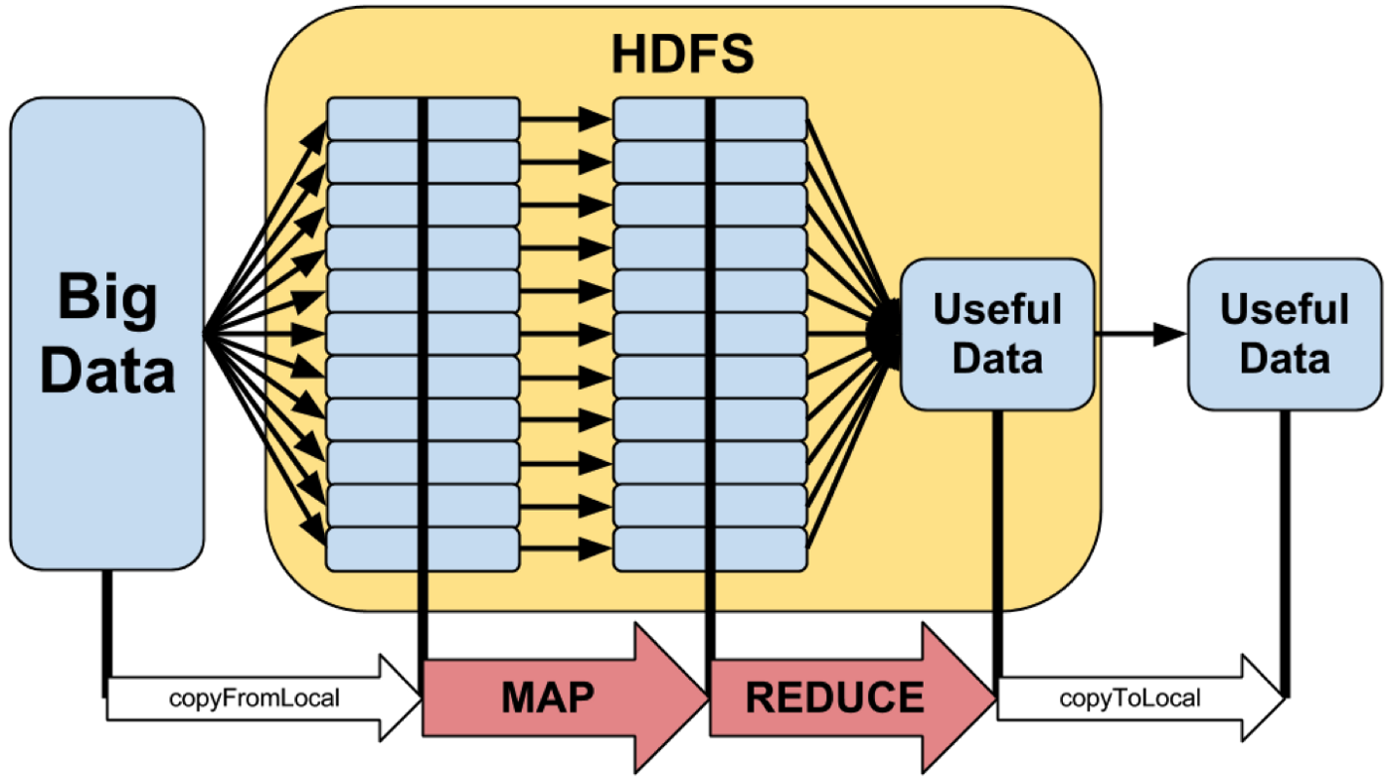
MapReduce Model: Hadoop Implementation

Slide 25
MapReduce provides:
Partition data into small chunks
Automatic parallelization, distribution
I/O scheduling
Load balancing
Network and data transfer optimization
Fault tolerance
Handling of machine failures

Slide 26
MapReduce provides:
Fault tolerance
Handling of machine failures
Fault tolerance refers to the ability of a system (computer, network, cloud cluster, etc.) to continue operating without interruption when one or more of its components (disk, computer, …) fail.

Slide 27
MapReduce: Scale-Out, but do NOT Scale-Up
Need more power: Scale-Out
Large number of commodity servers
Not expensive to add or replace servers
Add more servers any time
Do NOT Scale-Up
Do NOT use high end specialized servers
Very Expensive
Replacement very costly

Slide 28
MapReduce: Scale-Out, but do NOT Scale-Up
Need more power: Scale-Out
Large number of commodity servers
Not expensive to add or replace servers
Add more servers any time
A commodity server is a commodity computer that is dedicated to running server programs and carrying out associated tasks. In many environments, multiple low-end servers share the workload. Commodity servers are often considered disposable and, as such, are replaced rather than repaired.

Slide 29
MapReduce Implementations
Google App Engine
(proprietary, not open-source)
Apache Hadoop:
implementation of MapReduce
(open-source, based on Google’s paper)
Apache Spark:
open-source, superset of MapReduce
In-memory computing, very fast

Slide 30
Typical problem solved by MapReduce
Read a lot of data
Partition data into small chunks
map(key, value): extract something you care about from each record
output: set of (key2, value2) pairs
Shuffle and Sort [done by MapReduce Implementation]
Output as (key2, [value_21, value_22, value_23, …])
reduce(key2, values): aggregate, summarize, filter, or transform
Output: set of (key3, value3) pairs
Write the results

Slide 31
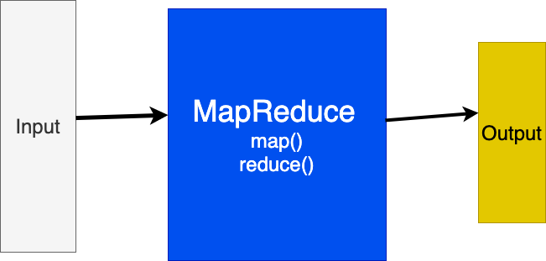
MapReduce model

Slide 32
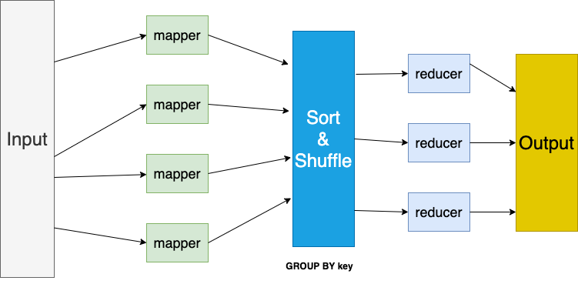
MapReduce model

Slide 33
Mappers in parallel
map() function run in parallel.
Each mapper operates on a set of chunks assigned to it by the job tracker.
Mappers write to local disk.
# key: a record number or hash of a record
# value: a single record (actual data)
map(key, value):
can emit any number of (K, V) pairs:
(K_1, V_1), (K_2, V_2), … (K_n, V_n)

Slide 34
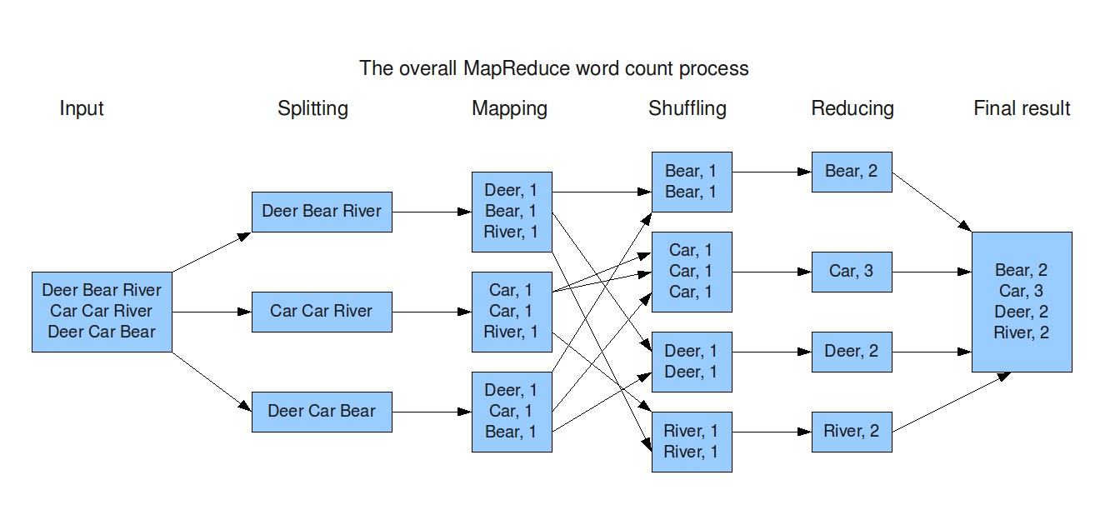
MapReduce model

Slide 35
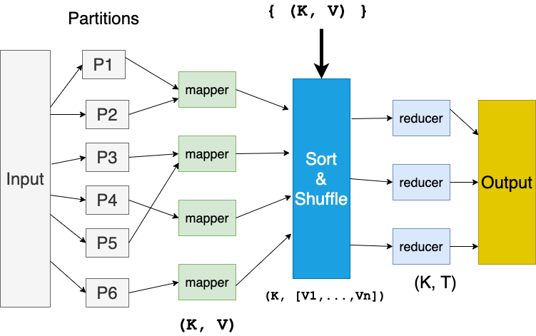
MapReduce model

Slide 36
Reducers in parallel
reduce() function run in parallel.
Each reducer() operates on
(key, [V_1, V_2, …, V_n])
reduce((key, [V_1, V_2, …, V_n]):
Reducers create final outputs as:
(K1, T1)
(K2, T2)
…

Slide 37
MapReduce workflow
Input Data
Output Data
Worker
write
Output
File 0
local
write
Worker
Split 1
read
Split 2
Worker
Output
File 1
Split 3
Worker
Split 4
Worker
remote
read,
sort
Map
extract something you care about from each record
Reduce aggregate, summarize, filter, or transform

Slide 38
Mappers and Reducers
Need to handle more data?
Just add more Mappers/Reducers!
No need to handle multithreaded code ☺
Mappers and Reducers are typically single threaded and deterministic
Determinism allows for restarting of failed jobs
Mappers/Reducers run entirely independent of each other
Mappers/Reducers run in separate JVM processes

Slide 39
Word Count Problem: solve it by MapReduce
INPUT: Given a set of text documents/files
OUTPUT: Find frequencies of each unique word
Input: “gray fox red fox jumped over red gray fox”
Output: dictionary[(word, frequency)]
(gray, 2)
(red, 2)
(fox, 3)
(jumped, 1)
(over, 1)

Slide 40
Mapper: map(key, value)
Reads in input pair as (Key, Value)
Outputs a set of pairs (K’, V’)
Let’s count number of each word in user queries (or Tweets/Blogs)
The input to the mapper will be (Query_ID, Query_Text):
<Q1,“the teacher went to the store. the store was closed; the store opens in the morning. the store opens at 9am.” >
The mappers output would be:
(the, 1) (teacher, 1) (went, 1) (to, 1) (the, 1) (store, 1) (the, 1) (store, 1) (was, 1) (closed, 1) (the, 1) (store,1) (opens, 1) (in, 1) (the, 1) (morning, 1) (the 1) (store, 1) (opens, 1) (at, 1) (9am, 1)

Slide 41
Sort & Shuffle: SQL’s GROUP BY
Accepts the Mapper output, and aggregates values on the key
For our example, the mappers output would be:
(the, 1) (teacher, 1) (went, 1) (to, 1) (the, 1) (store, 1) (the, 1) (store, 1) (was, 1) (closed, 1) (the, 1) (store, 1) (opens,1) (in, 1) (the, 1) (morning, 1) (the, 1) (store, 1) (opens, 1) (at, 1) (9am, 1)
The output of Sort & Shuffle would be:
(the, [1, 1, 1, 1, 1, 1])
(store, [1, 1, 1])
…
Notes:
Input is typically sorted, output is output exactly as is
All inputs with the same key must go to the same reducer!

Slide 42
Reducer: reduce(key, values)
Accepts the Sort & Shuffle output,
and aggregates values on the key
Input to reducer: (store, [1, 1, 1])
Output: (store, 3)
Input to reducer : (the, [1, 1, 1, 1, 1, 1])
Output: (the, 6)
…
Notes:
Input is typically sorted, output is output exactly as is
All inputs with the same key must go to the same reducer!

Slide 43
MapReduce Job Components
1. Input path (identify your input files)
2. Output path (where to write output)
3. map() function
map(key, value)
emits {(K2, V2), …}
3.5 [Sort & Shuffle is done by MapReduce]
4. reduce() function
reduce(K2, [value_1, value_2, …])
emits {(K3, V3), …}
5. OPTIONAL combine() function
Notes:
Input is typically sorted, output is output exactly as is
All inputs with the same key must go to the same reducer!

Slide 44
MapReduce Job: Input Path
Input path: 3 files will be read
Example: s3://my_bucket/project7/
s3://my_bucket/project7/file1.txt
s3://my_bucket/project7/file2.txt
s3://my_bucket/project7/file3.txt
Notes:
Input is typically sorted, output is output exactly as is
All inputs with the same key must go to the same reducer!

Slide 45
MapReduce Job: Output Path Reducers output will be written to output path
Output path:
Example: s3://my_bucket/output7/
s3://my_bucket/output7/_SUCCESS
s3://my_bucket/output7/part1
s3://my_bucket/output7/part2
s3://my_bucket/output7/part3
s3://my_bucket/output7/part4
Notes:
Input is typically sorted, output is output exactly as is
All inputs with the same key must go to the same reducer!

Slide 46
MapReduce Job: map() function for Word Count
# pseudo-code
# key: may be a record number and ignored here
# value: a single record of your input data
# “fox jumped and jumped”
map(key, value) {
# tokenize record
words = value.split(“ “)
# array index: 0 1 2 3
# words = [“fox”, “jumped”, “and”, “jumped”]
for word in words {
emit (word, 1)
}
}
Notes:
Input is typically sorted, output is output exactly as is
All inputs with the same key must go to the same reducer!

Slide 47
MapReduce Job: map() function
# pseudo-code
# key: may be a record number and ignored here
# value: a single record of your input data
# “fox jumped and jumped”
map(key, value) {
# tokenize record
words = value.split(“ “)
# array index: 0 1 2 3
# words = [“fox”, “jumped”, “and”, “jumped”]
for word in words {
emit (word, 1)
}
}
Output of a mapper:
(fox, 1)
(jumped, 1)
(and, 1)
(jumped, 1)
Notes:
Input is typically sorted, output is output exactly as is
All inputs with the same key must go to the same reducer!

Slide 48
MapReduce Job: map() function
# 103 is a record number
INPUT: (103, “a fox of jumped over red fox and jumped”)
Mappers output:
(a, 1)
(fox, 1)
(of, 1)
(jumped, 1)
(over, 1)
(red, 1)
(fox, 1)
(and, 1)
(jumped, 1)

Slide 49
MapReduce Job: map() function FILTER: Ignore words with length of less than 3 Chars.
# pseudo-code
# key: may be a record number
# value: the entire record such
# as “fox jumped and jumped”
map(key, value) {
words = value.split(“ “)
for word in words {
# filter non-desired words
if (len(word) > 2) {
emit( word, 1)
}
}
}
Notes:
Input is typically sorted, output is output exactly as is
All inputs with the same key must go to the same reducer!

Slide 50
MapReduce Job: map() function Ignore words with length of less than 3 Chars.
INPUT: (103, “a fox of jumped over red fox and jumped”)
Mappers output:
(fox, 1)
(jumped, 1)
(over, 1)
(red, 1)
(fox, 1)
(and, 1)
(jumped, 1)
NOTE: FILTERING: “a” and “of” were dropped
since their length is less than 3
Notes:
Input is typically sorted, output is output exactly as is
All inputs with the same key must go to the same reducer!

Slide 51
MapReduce Job: map() function FILTER-1: Ignore records with length of less than 80 chars FILTER-2: ignore words less than 3 characters
# pseudo-code
# key: may be a record number
# value: the entire record such as “fox jumped and jumped”
map(key, value) {
# filter-1
if (len(value) < 80) {
# no (K, V) is emitted at all
return
}
words = value.split(“ “)
for word in words {
# filter-2
if (len(word) > 2) {
emit( word, 1) # filter non-desired words
}
}
}

Slide 52
MapReduce Job: map() function
# key: may be a record number such as 100 (is ignored)
# value: the entire record such as
# (103, “fox jumped and jumped”)
map(key, value) output:
(fox, 1)
(jumped, 1)
(and, 1)
(jumped, 1)

Slide 53
MapReduce Job: map() function
# key: may be a record number such as 1234 (is ignored)
# value: the entire record such as
# (1234, “fox jumped over fox”)
map(key, value) output:
(fox, 1)
(jumped, 1)
(over, 1)
(fox, 1)

Slide 54
Sort & Shuffle: Receives Mappers Output
Sort & Shuffle is the genie of MapReduce
Similar to SQL’s “GROUP BY”
Output of Sort & Shuffle:
(key_1, [V_11, V_12, …])
(key_2, [V_21, V_22, …])
…
(key_N, [V_N1, V_N2, …])
Therefore, N reducers are required.

Slide 55
Input to Reducers
(key_1, [V_11, V_12, …])
(key_2, [V_21, V_22, …])
…
(key_N, [V_N1, V_N2, …])
NOTE:
All keys {key_1, key_2, …, key_N} are unique
A key may have any number of values
Values are not sorted (they can be in any order)

Slide 56
MapReduce Job Components: reduce()
Reducers receive output of Sort & Shuffle phase.
reduce(key, values) accepts a
key: a single unique key
values: [V_1, V_2, …, V_n]
Creates any number of new (K’, V’) pairs

Slide 57
MapReduce Job: reduce() function for Word Count
# pseudo-code
# handle (key, [v1, v2, …])
# key: is a unique word
# values: Iterable<Integer>
# such as [1, 1, …, 1]
reduce(key, values) {
count = 0
# iterate values
for v in values {
count += v
}
emit(key, count)
}

Slide 58
MapReduce Job: reduce() function + FILTER: ignore words with frequencies of less than 5
# pseudo-code
# key: is a unique word
# values: [1, 1, …, 1]
reduce(key, values) {
count = 0
for v in values {
count += v
}
# filter
if (count >= 5) {
emit(key, count)
}
}

Slide 59
MapReduce Job: reduce() function + what if we want to ignore words with frequencies of less than 5 Ignore words with length of less than 3 Chars.
# pseudo-code
# key: is a unique word
# values: [1, 1, …, 1]
reduce(key, values) {
# not a proper filter for reducer (should be done in mapper)
if (len(key) <= 2) {
return
}
count = 0
for v in values {
count += v
}
# proper filter
if (count < 5) {
return
}
else {
emit(key, count)
}
}

Slide 60
MapReduce Job: reduce() function and output length of key
# pseudo-code
# key: is a unique word
# values: [1, 1, …, 1]
reduce(key, values) {
count = 0
for v in values {
count += v
}
# create a new composite value
new_value = (len(key), count)
emit(key, new_value)
}

Slide 61
MapReduce
Hadoop
Program
fork
fork
fork
Master
assign
map
assign
reduce
Input Data
Output Data
Transfer peta-scale data through network
Worker
write
Output
File 0
local
write
Worker
Split 0
read
Split 1
Worker
Split 2
Output
File 1
Worker
Worker
remote
read,
sort
Map
Reduce

Slide 62
Failure in MapReduce
Failures are norm in commodity hardware
Worker failure
Detect failure via periodic heartbeats
Re-execute in-progress map/reduce tasks
Master failure
Single point of failure; Resume from Execution Log
Robust
Google’s experience: lost 1600 of 1800 machines once!, but finished fine

Slide 63
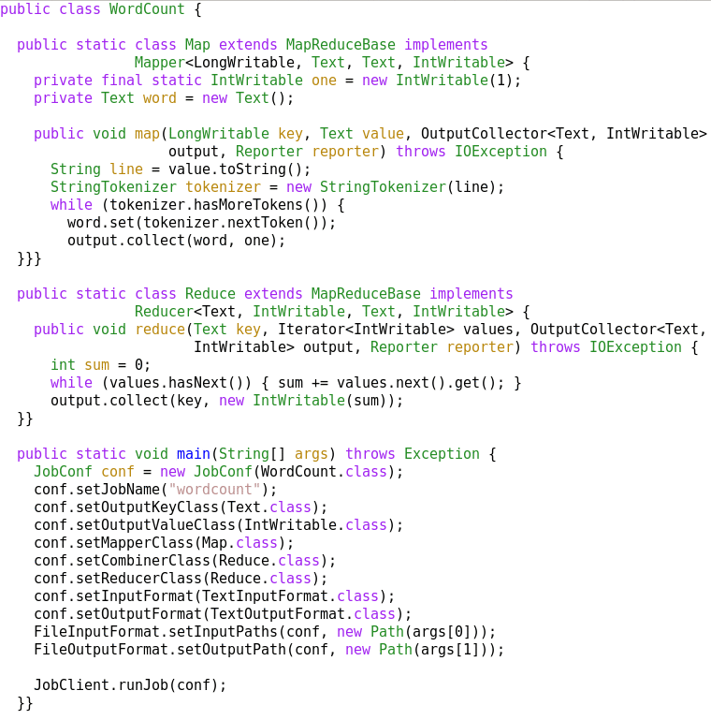
A MapReduce Job
Mapper
Reducer
Run this program as
a MapReduce job

Slide 64
Complete Word Count Solution in MapReduce/Hadoop
Word Count Solution in MapReduce/Hadoop
Driver Program
Mapper Program
Reducer Program

Slide 65
Summary: MapReduce
Programming paradigm for data-intensive computing
Distributed & parallel execution model
Simple to program
The MapReduce framework automates many tedious tasks:
Data partitioning
Machine selection,
Failure handling
Sort & Shuffle

Slide 66
Word Count in Hadoop/MapReduce
We will NOT study Hadoop
For reference, I am including a pointer to MapReduce Tutorial in Hadoop, which can help you to understand an implementation of MapReduce.

