Slide 1

Word Count in MapReduce
Mahmoud Parsian
Ph.D. in Computer Science

Slide 2
Outline
Problem Statement / Motivation
An Example Program
MapReduce vs Hadoop
GFS / HDFS
MapReduce Fundamentals
Example Code
Workflows
Conclusion / Questions

Slide 3
Why MapReduce?
Before MapReduce
Large Concurrent Systems
Grid Computing
Rolling Your Own Custom Solution
Considerations
Threading is hard!
How do you scale to more machines?
How do you handle machine failures?
How do you facilitate communication between nodes?
Does your solution scale?
Scale out, not up!
MapReduce is a scale-out architecture.
Notes:
Examples? Prior state of the art. Grid computing, hand coded

Slide 4
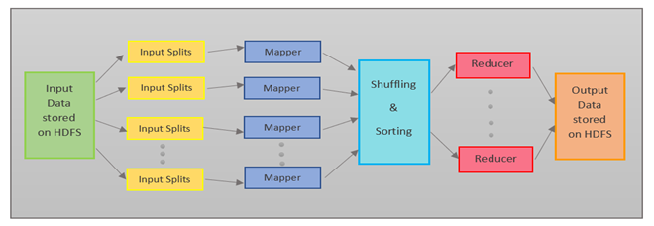
MapReduce Architecture Input/Output Data Can be stored on HDFS/S3/…
Notes:
Examples? Prior state of the art. Grid computing, hand coded

Slide 5
Word Count: An Example
Word Count is a simple and easy to understand algorithm which can be easily implemented as a MapReduce application.
Given a set of text documents (set of text files), the MapReduce program counts the number of occurrences of each word.
We will focus on Mapper and Reducer components of Word Count program
The algorithm consists of three main sections:
1. Driver
Identify input path (set of text files)
Identify output path (output directory)
Identify Mapper
Identify Reducer
2. Mapper (will provide a pseudo-code for map() function)
3. Reducer (will provide a pseudo-code for reduce() function)

Slide 6
Word Count: An Example
Present the concepts of MapReduce: Word Count
The input of this program is a volume of raw text, of unspecified size (could be KB, MB, TB, PB, …)
MapReduce algorithm will work for any size data
For example, the input can be a directory comprised of many text files.
The output is a list of words, and their occurrence count. Assume that words are split correctly, ignoring capitalization and punctuation.
Therefore, output is a dictionary of (key, value), where key is a unique word, and value is an associated frequency.

Slide 7
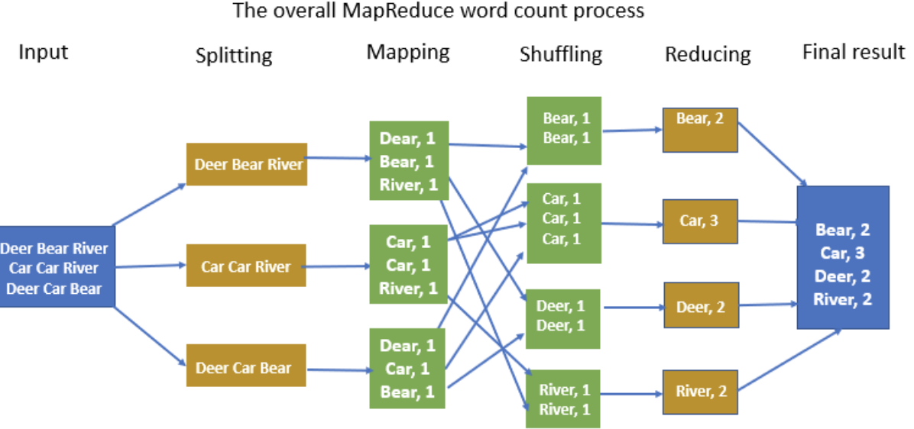
Word Count: Process Splitting input and Shuffling is provided by MapReduce implementation User only provides map() and reduce() functions

Slide 8
Word Count: An Example
INPUT:
“the doctor went to the store to see the doctor“
OUTPUT:
Output is not sorted by keys and the order of output is not important
Output is a set of (KEY, VALUE), where KEY is a unique word and VALUE is the frequency
(the, 3)
(doctor, 2)
(went, 1)
(to, 2)
(store, 1)
(see, 1)

Slide 9
Word Count: Notation
() denotes a Tuple
Example-1: (1, 2, 4) denotes tuple of 3 integers
Example-2: (”fox”, 3) denotes a (key, value) pair
Where key is “fox” and value is 3
Example-3: () denotes an empty tuple
[] denotes a List of 0, 1, 2, … items/objects
Example-1: [1, 2, 6] is a list of 3 integers
Example-2: [“to”, “be”] is a list of 2 strings
Example-3: [] denotes an empty list
{} denotes a Set of 0, 1, 2, … or more objects
Example-1: { (“a”, 2), (“b”, 3), (“z”, 9) }
denotes a set of 3 pair objects
Example-2: {} denotes an empty set

Slide 10
Word Count: Notation
Iterable<object> denotes a list of objects
Example-1: Iterable<Integer>
[1, 2, 2, 3, 4]
[1, 1, 1, 1, 1, 1, 1]
Example-2: Iterable<String>
[“a”, “fox”, “jumped”]
[“a”, “a”, “b”, “b”, “b”]
Example-3: Iterable<(String, Integer)>
[(“a”, 10), (“fox”, 7), (“jumped”, 8)]
[(“key1”, 10), (“key200”, 700)]

Slide 11
(key, value) in MapReduce
For MapReduce, everything (input and output) is expressed
as a tuple of 2 values: (key, value)
NOTE: key and value can be any data type
Examples of (key, value):
(“fox”, 3)
(“fox”, [1, 1, 1, 1, 1, 1])
(“jumped”, [3, 6, 10, 12])
(“record 57”, (1, 1))
(127, (“movie_id”, 67))
(“fox”, [(“R”, 2), (“R”, 3), (“T”, 4)])
((“fox”, 3), [1, 1, 1, 1, 1])

Slide 12
(key, value) in Mapper and Reducer
# key: a partition number or record number or filename
# (which might be ignored)
# value: a single input record
map(key, value) {
<emit a set of (K2, V2) pairs>
}
# key: a unique key as K2
# values: Iterable<object> (all associated values for K2)
# object can be Integer, String, Double, or any other data types
reduce(key, values) {
<emit a set of (K3, V3) pairs>
}

Slide 13
(key, value) in MapReduce
For MapReduce, everything (input and output) is expressed as a tuple of 2 values: (key, value) where key and value can be any type.
Mapper:
map(key, value)
key: as a partition number, or a record number
value: an actual input record (String)
Outputs { {k2, v2), … }
Reducer:
reduce(key2, value2)
key2 : a k2 in mappers output
value2 : Iterable<objects> (list of values)
Outputs: { (k3, v3), …}

Slide 14
Word Count: An Example For Input, 1, 2, 3, … denotes record numbers, and are ignored
INPUT:
1 “fox jumped and jumped”
2 “fox jumped over fox and jumped”
3 “fox jumped over fence”
OUTPUT:
(fox, 4)
(jumped, 5)
(and, 2)
(over, 2)
(fence, 1)

Slide 15
Word Count: An Example
INPUT:
1 “fox jumped and jumped”
2 “fox jumped over fox and jumped”
3 “fox jumped over fence”
Input is split into chunks and sent to mappers.
For this example, assume that we split this into 3 chunks: Each chunk has one record.
Mappers will be run in parallel
map(key, value)
key: record number, will be ignored
value: an actual input record

Slide 16
Word Count: Mapper map(key, value) → {(K1, V1), (K2, V2), …}
A mapper accepts a (key, value) pair and can emit any number (0, 1, 2, …) of new (K, V) pairs.
If a mapper does not emit any (K, V) pairs: this means that the whole input record is filtered out.
# key: 1 (as a record number, which is ignored here)
# value: “fox jumped and jumped” (an actual record)
map(1, “fox jumped and jumped”):
(fox, 1), (jumped, 1),
(and, 1), (jumped, 1)

Slide 17
Word Count: Mapper map(key, value) → {(K1, V1), (K2, V2), …}
# key: 1
# value: “fox jumped and jumped”
map(1, “fox jumped and jumped”):
(fox, 1), (jumped, 1),
(and, 1), (jumped, 1)
# key: 2
# value: “fox jumped over fox and jumped”)
map(2, “fox jumped over fox and jumped”)
(fox, 1), (jumped, 1), (over, 1),
(fox, 1), (and, 1), (jumped, 1)
# key: 3
# value: “fox jumped over fence”
map(3, “fox jumped over fence”)
(fox, 1), (jumped, 1),
(over, 1), (fence, 1)

Slide 18
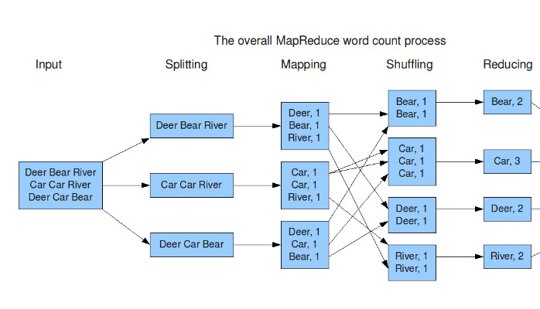
Mapper’s output → Sort & Shuffle Sort & Shuffle output → Input to Reducers

Slide 19
How Many Mappers Are Needed? (1)
The answer depends on the number of mappers available in the cluster and the number of partitions for the input.
Let our entire input to have 100,000,000,000 records
Let the number of partitions to be 50,000
Therefore, each partition may have about 2,000,000 records
100,000,000,000 = 50,000 x 2,000,000
The optimal number of mappers is 50,000 and they may be run in parallel (they are independent of each other)
What if our cluster is small and we do not have 50,000 mappers

Slide 20
How Many Mappers Are Needed? (2)
What if our cluster is small and we do not have 50,000 mappers
OK, assume that our cluster can handle 10,000 mappers at a time (at most 10,000 mappers can run in parallel).
How does it work?
Initially, Cluster manager will assign one partition to each 10,000 mappers and they will run in parallel. Once a mapper completes its task, then Cluster manager will assign another partition to a mapper until we exhaust all 50,000 partitions.

Slide 21
Word Count: Mappers Output → Sort & Shuffle
{
(fox, 1), (jumped, 1), (and, 1), (jumped, 1)
(fox, 1) (jumped, 1) (over, 1) (fox, 1) (and, 1) (jumped, 1)
(fox, 1) (jumped, 1) (over, 1) (fence, 1)
}
Sort & Shuffle Phase function: GROUP BY mappers’s KEY
Output of Sort & Shuffle:
(fox, [1, 1, 1, 1])
(jumped, [1, 1, 1, 1, 1])
(and, [1, 1])
(over, [1, 1])
(fence, [1])

Slide 22
Word Count: reducers: reduce(K, V)
Output of Sort & Shuffle → Reducers
Reducers will be run in parallel
reduce(fox, [1, 1, 1, 1]) → (fox, 4)
reduce((jumped, [1, 1, 1, 1, 1]) → (jumped, 5)
reduce(and, [1, 1]) → (and, 2)
reduce(over, [1, 1]) → (over, 2)
reduce(fence, [1]) → (fence, 1)

Slide 23
MapReduce: Map and Reduce
Mappers: read in data from the filesystem as (key, value), and output modified data as a set of (key2, value2) pairs
Sort & Shuffle:
Gets all mappers output
Creates (key, [value_1, value_2, …, value_n]) pairs
Groups values for key(s) created by all mappers
Reducers collect all of the Sort & Shuffle output on the keys, and output (typically) reduced data
reduce(key, [value_1, value_2, …, value_n])
Emits a new set of {(key3, value3)} pairs
The outputted data is written to disk

Slide 24
How many Reducers are needed?
Imagine that Sort & Shuffle has created N unique keys:
(note that the number of values per key will NOT be the same)
(key_1, [value_11, value_12, …])
(key_2, [value_21, value_22, …])
…
(key_N, [value_N1, value_N2, …])
Question? How many reducers are needed to handle the output of the Sort & Shuffle phase?
Answer: The optimal solution is to have N reducers and let them run in parallel

Slide 25
How many Reducers are needed?
Imagine that Sort & Shuffle has created N unique keys:
(note that the number of values per key will NOT be the same)
(key_1, [value_11, value_12, …])
(key_2, [value_21, value_22, …])
…
(key_N, [value_N1, value_N2, …])
Question? What if we do not have enough computing resources to run N reducers at the same time (in parallel)

Slide 26
How many Reducers are needed?
Imagine that Sort & Shuffle has created N unique keys:
(note that the number of values per key will NOT be the same)
(key_1, [value_11, value_12, …])
(key_2, [value_21, value_22, …])
…
(key_N, [value_N1, value_N2, …])
Question? What if we do not have enough computing resources to run N reducers at the same time (in parallel)
Answer: Let’s say, N = 7,000, and we can only run 500 reducers in parallel and at the same time. Initially, Cluster manager will assign one reduce operation to each 500 reducers and they will run in parallel. Once a reducer completes its task, then Cluster manager will assign another reduce operation to a reducer until we exhaust all 7,000 reduce operations.

Slide 27
MapReduce: Map and Reduce
map(key, value) → { (key2, value2) }
(done by programmer)
Sort & Shuffle: → GROUP BY key2
(key2, [v1, v2, …])
(done by MapReduce system, automatically)
reduce(key2, [v1, v2, …]) →
{ (key3, value3) }
(done by programmer)

Slide 28
MapReduce: Reducer’s Output
reduce(key2, [v1, v2, …]) →
{ (key3, value3) }
(done by programmer)
Filters in Reducers:
If a reducer does not emit any { (key3, value3) },
then it means that the entire input (key2, [v1, v2, …])
is filtered out.

Slide 29
Outline
Problem Statement / Motivation
An Example Program
MapReduce vs Hadoop
GFS / HDFS
MapReduce Fundamentals
Example Code
Workflows
Conclusion / Questions

Slide 30
MapReduce Implementations?
Google implementation:
Google App Engine (proprietary, not available to public)
Written in C++
Open-Source implementation: Apache Hadoop
Developed by Yahoo
An Apache project
Written in Java
Open-Source implementation: Apache Tez
Apache Spark: implements superset of MapReduce

Slide 31
GFS/HDFS/S3: to store huge data
GFS: Google Distributed File System
Proprietary
NOT open-source
HDFS: Hadoop Distributed File System
Open-source
Are fault tolerant through replication
Allows data to be local to computation
Amazon S3 (Simple Storage Service): is an object storage service that offers industry-leading scalability, data availability, security, and performance.

Slide 32
Outline
Problem Statement / Motivation
An Example Program
MapReduce vs Hadoop
GFS / HDFS
MapReduce Fundamentals
Example Code
Workflows
Conclusion / Questions

Slide 33
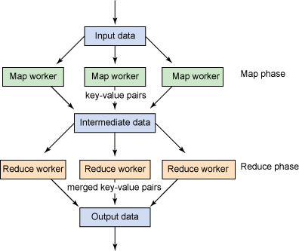
Major Components
User Components:
Mapper
Reducer
Combiner (Optional)
Partitioner (Optional)
Writable(s) (Optional)
System Components:
Master
Sort & Shuffle
Input Splitter*
Output Committer*
* You can use your own if you really want!
Image source: http://www.ibm.com/developerworks/java/library/l-hadoop-3/index.html

Slide 34
Key Notes
Mappers and Reducers are typically single threaded and deterministic
Determinism allows for restarting of failed jobs, or speculative execution
Need to handle more data? Just add more Mappers/Reducers!
No need to handle multithreaded code
Since they’re all independent of each other, you can run (almost) arbitrary number of nodes
Mappers/Reducers run on arbitrary machines. A machine typically multiple map and reduce slots available to it, typically one per processor core
Mappers/Reducers run entirely independent of each other
In Hadoop, they run in separate JVMs
Notes:
Describing the specifics, not the reasoning behind the decisions

Slide 35
Basic Concepts: data
All data is represented in key value pairs of an arbitrary type:
(key, value)
Data is read in from a file or list of files, from HDFS or Amazon S3
Data is chunked based on an input split
A typical chunk is 64MB (can be configured depending on your use case)
For example, if the input has 800,000,000,000 records, then based on available resources, it might be partitioned into 80,000 chunks, where each chunk/partition will have about 10,000,000 records
800,000,000,000 = 80,000 x 10,000,000
Notes:
Within first ~5 slides, cover the basics of Map and Reduce
Mapper takes in a set of K,V emits a new set of K,V
Intermediate data is distributed among reducers
Reducers aggregate based on key
Design decisions and justification
Be able to write pseudo code for a MR job
Understanding of what functionality they want to provide
Why did they make the decisions that they did

Slide 36
Basic Concepts: Mappers and Reducers
Mappers read in a chunk of data as (key, value) pairs
Mappers emit (write out) a set of data (as a set of (key2, value2) pairs), typically derived from its input
Output of mappers is passed into Sort & Shuffle phase, which will group values based on the mapper’s keys
(key2, [value_21, value_22, value_23, …, value_2M])
This means for key2, mappers have created M outputs as (order is not important):
(key2, value_21),
(key2, value_22),
(key2, value_23),
…
(key2, value_2M)
Notes:
Within first ~5 slides, cover the basics of Map and Reduce
Mapper takes in a set of K,V emits a new set of K,V
Intermediate data is distributed among reducers
Reducers aggregate based on key
Design decisions and justification
Be able to write pseudo code for a MR job
Understanding of what functionality they want to provide
Why did they make the decisions that they did

Slide 37
Basic Concepts: Mappers and Reducers
Reducers receive each key of data, key2, along with ALL of the values associated with it (this means each key must always be sent to the same reducer)
Essentially,
(key2, [value_21, value_22, value_23, …, value_2M])
Reducers emit a set of data, typically reduced from its input which is written to disk
A reducer may emit any number of (key3, value3) pairs
# key: key2
# value: [value_21, value_22, value_23, …, value_2M]
reduce(key, value) {
< reducer-logic>
}
Notes:
Within first ~5 slides, cover the basics of Map and Reduce
Mapper takes in a set of K,V emits a new set of K,V
Intermediate data is distributed among reducers
Reducers aggregate based on key
Design decisions and justification
Be able to write pseudo code for a MR job
Understanding of what functionality they want to provide
Why did they make the decisions that they did

Slide 38
MapReduce Data Flow
Split 1
Mapper 1
Input
Reducer 1
Output 1
Split 2
Mapper 2
Reducer 2
Output 2
Split 3
Mapper 3
Notes:
Mappers = selection; reducer = group by aggregate

Slide 39
Input Splitter
Is responsible for splitting your input into multiple chunks
These chunks are then used as input for your mappers
Splits on logical boundaries. The default is 64MB per chunk
Depending on what you’re doing, 64MB might be a LOT of data! You can change it (this is configurable)
Typically, you can just use one of the built in splitters, unless you are reading in a specially formatted file
Notes:
Why?
Example for a text input splitter

Slide 40
Input Splitter
Data is partitioned into chunks
Partitioning is based on
The size of data,
Cluster resources,
Cluster configurations
Example:
Input size= 80,000,000,000 records
Number of partitions/chunks: 40,000
Each partition: about 2,000,000 records
80,000,000,000 = 40,000 x 2,000,000
INPUT DATA
Partition-001
Partition-002
…
Partition-100
Notes:
Why?
Example for a text input splitter

Slide 41
Mapper is implemented by map(key, value)
Reads in input pair (K, V)
Outputs a set of pairs (K’, V’)
# key: a record number or partition number
# key might be ignored if you do not care about it
# value: an actual input record
map(key, value) {
< logic will emit a set of (K’, V’) pairs>
}

Slide 42
Mapper
Reads in input pair (K, V) (a section as split by the input splitter)
Outputs a set of pairs (K’, V’)
Example for Word Count example, with the following input:
“the red fox jumped and fox jumped over red fox”
The Mapper output would be:
(the, 1), (red, 1), (fox, 1), (jumped, 1), (and, 1),
(fox, 1) (jumped, 1), (over, 1), (red, 1), (fox, 1)

Slide 43
Sort & Shuffle: GROUP BY KEY
Mappers output:
(the, 1), (red, 1), (fox, 1), (jumped, 1), (and, 1),
(fox, 1) (jumped, 1), (over, 1), (red, 1), (fox, 1)
NOTE: Mappers output is used as an input to Sort & Shuffle phase:
Sort & Shuffle output:
(the, [1])
(red, [1, 1])
(fox, [1, 1, 1])
(jumped, [1, 1])
(over, [1])
(and, [1])

Slide 44
Reducer: Accepts the Sort & Shuffle’s Output
Sort & Shuffle output:
(the, [1])
(red, [1, 1])
(fox, [1, 1, 1])
(jumped, [1, 1])
(over, [1])
(and, [1])
Reducers Output:
(the, 1)
(red, 2)
(fox, 3)
(jumped, 2)
(over, 1)
(and, 1)

Slide 45
Combiner in MapReduce paradigm
Essentially an intermediate reducer (so called mini-reducer)
Is optional
Reduces output from each mapper, reducing bandwidth and sorting
Cannot change the type of its input
Input types must be the same as output types
Notes:
Example equiv to

Slide 46
Combiner Example: word count : combiners in one node
Let mappers in worker-1/server-1 create:
(A, 1), (A, 1), (A, 1), (B, 1), (B, 1), (C, 1), (D, 1)
Then without combiners, Sort & Shuffle will create:
(A, [1, 1, 1])
(B, [1, 1])
(C, [1])
(D, [1])
Then with combiners, , Sort & Shuffle will create:
(A, [3])
(B, [2])
(C, [1])
(D, [1])
Notes:
Example equiv to

Slide 47
Combiner Example: word count: combiners with 2 nodes
Let mappers in worker-1/server-1 create:
(A, 1), (A, 1), (A, 1), (B, 1), (B, 1), (C, 1), (D, 1)
Let mappers in worker-2/server-2 create:
(A, 1), (A, 1), (B, 1), (B, 1), (B, 1), (B, 1), (B, 1), (C, 1)
Then without combiners, Sort & Shuffle will create:
(A, [1, 1, 1, 1, 1])
(B, [1, 1, 1, 1, 1, 1, 1])
(C, [1, 1])
(D, [1])
Then with combiners, , Sort & Shuffle will create:
(A, [3, 2])
(B, [2, 5])
(C, [1, 1])
(D, [1])
Notes:
Example equiv to

Slide 48
Combiner Example: word count
Advantage of Combiners:
mini-reducers
User-defined, user provides combine(key, value)
happens on worker-level
which reduces network traffic/contentions
Notes:
Example equiv to

Slide 49
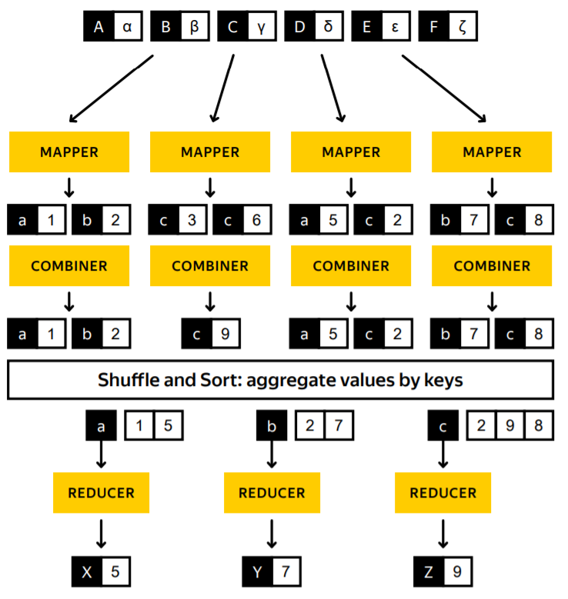
Combiner: a mini-reducer in action (key: c)
Notes:
Example equiv to

Slide 50
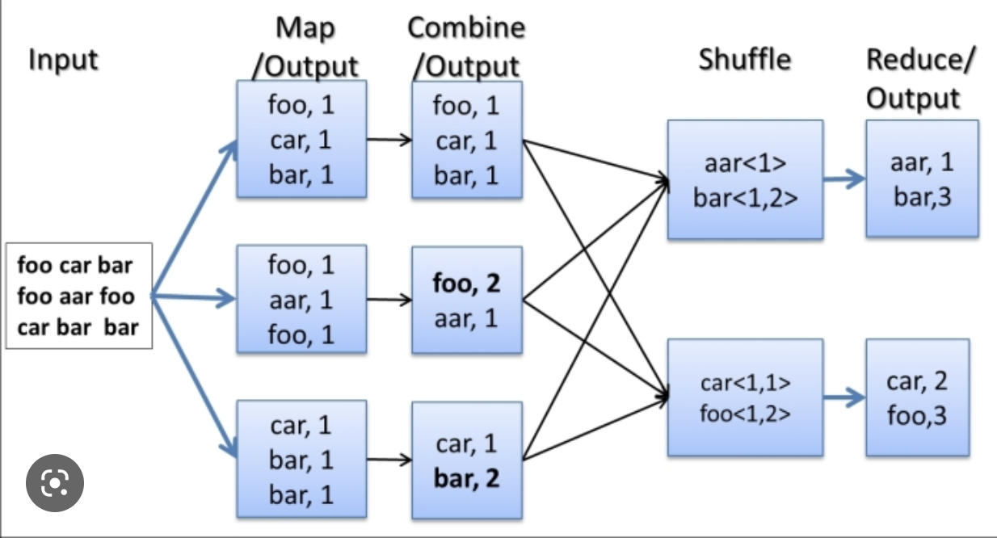
Combiner: a mini-reducer in action: (key: foo)
Notes:
Example equiv to

Slide 51
Output Committer
Is responsible for taking the reduce output, and committing it to a file
Typically, this committer needs a corresponding input splitter (so that another job can read the input)
Again, usually built-in splitters are good enough, unless you need to output a special kind of file

Slide 52
Partitioner (Shuffler)
Decides which pairs are sent to which reducer
Default is simply:
Key.hashCode() % numOfReducers
User can override to:
Provide (more) uniform distribution of load between reducers
Some values might need to be sent to the same reducer
Ex. To compute the relative frequency of a pair of words <W1, W2> you would need to make sure all of word W1 are sent to the same reducer
Binning of results

Slide 53
MapReduce job is run in a Computing Cluster
Cluster = {Master node, N worker nodes} => cluster of N+1 nodes
Master node is responsible for the whole cluster
Master manages all N worker nodes
Typically, a master node acts as a manager and does not do much computations, the bulk of computations (such as mapper and reducers) are carried out by the N worker nodes.
If a worker node fails, then those tasks are given to another worker node
Notes:
HDFS will replicate data if necessary to be local
Mention why determinism is required
Mention speculative execution

Slide 54
Master
Responsible for scheduling & managing jobs
Scheduled computation should be close to the data if possible
Bandwidth is expensive! (and slow)
This relies on a Distributed File System (GFS / HDFS)!
If a task fails to report progress (such as reading input, writing output, etc), crashes, the machine goes down, etc, it is assumed to be stuck, and is killed, and the step is re-launched (with the same input)
The Master is handled by the framework, no user code is necessary
Notes:
HDFS will replicate data if necessary to be local
Mention why determinism is required
Mention speculative execution

Slide 55
Master Continued…
HDFS can replicate data to be local if necessary for scheduling
Because our nodes are (or at least should be) deterministic
The Master can restart failed nodes
Nodes should have no side effects!
If a node is the last step, and is completing slowly, the master can launch a second copy of that node
This can be due to hardware issuses, network issues, etc.
First one to complete wins, then any other runs are killed

Slide 56
Writables: Hadoop Concept
Are types that can be serialized / deserialized to a stream
Are required to be input/output classes, as the framework will serialize your data before writing it to disk
User can implement this interface, and use their own types for their input/output/intermediate values
There are default for basic values, like Strings, Integers, Longs, etc.
Can also handle store, such as arrays, maps, etc.
Your application needs at least six writables
2 for your input
2 for your intermediate values (Map <-> Reduce)
2 for your output
Notes:
collections

Slide 57
Outline
Problem Statement / Motivation
An Example Program
MapReduce vs Hadoop
GFS / HDFS
MapReduce Fundamentals
Example Code
Workflows
Conclusion / Questions

Slide 58
Mapper Code for Word Count in MapReduce (pseudo code)
# key : the position (or record number) in the document
# key is not needed and therefore it is ignored here
# value : actual input record
map(key, value) {
# tokenize input record by a single space
words = value.split(“ “)
# for each word create (word, 1) as an ouput
for word in words {
emit(word, 1)
}
}
Our output is a bunch of (key, value) pairs, where the key is the token (a word) , and the value is the count. This is always 1 (for a word count).
Note that emit(K, V) creates a pair of (K, V) as an output of a mapper.

Slide 59
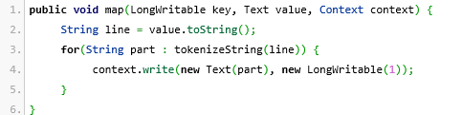
Mapper Code in MapReduce/Hadoop (Java code)
Our input to our mapper is <LongWritable, Text>
The key (the LongWritable) can be assumed to be the position in the document our input is in. This doesn’t matter for this example.
Our output is a bunch of <Text, LongWritable>. The key is the token, and the value is the count. This is always 1.
For the purpose of this demonstration, just assume Text is a fancy String, and LongWritable is a fancy Long. In reality, they’re just the Writable equivalents.

Slide 60
Sort & Shuffle Phase: similiar to GROUP BY in SQL
Sort & Shuffle is provided by MapReduce Implementation
Output of mappers as (key, value) pairs is passed as an input to the Sort & Shuffle phase. Let’s assume that all mappers have created n unique keys as: {K_1, K-2, …, K_n}. Therefore, we have n unique words in our input.
Therefore, output of Sort & Shuffle will be n key-value pairs as:
(K_1, [v1, v2, …])
Where v1, v2, … are associated values for key K_1
…
(K_n, [t1, , t2, …])
Where t1, t2, … are associated values for key K_n

Slide 61
Output of Sort & Shuffle Phase: similiar to GROUP BY in SQL
Output of the Sort & Shuffle phase.
(K_1, [v1, v2, …])
Where v1, v2, … are associated values for key K_1
…
(K_n, [t1, , t2, …])
Where t1, t2, … are associated values for key K_n
Output of Sort & Shuffle phase is passed as an input to reducers, therefore, we will execute n reducers.
The reducers can be executed in parallel.

Slide 62
Reducer Code for Word Count in MapReduce (pseudo code)
Our input to reducers is the output of Sort & Shuffle Phase
# key: is in {K_1, K_2, …, K_n}: a unique word
# values : [value_1, value_2, …]
# values : Iterable<Integer> such as [1, 1, 1, 1, 1]
reduce(key, values) {
total = 0
for v in values {
total += v
}
# create the final output
emit(key, total)
}

Slide 63
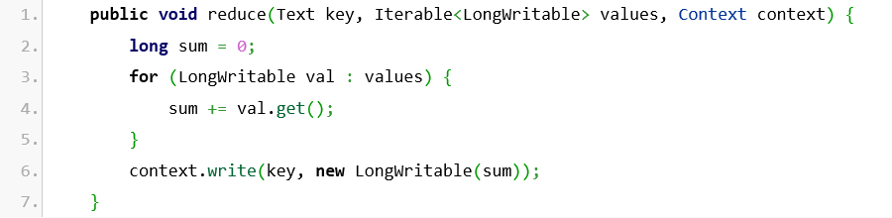
Reducer Code in MapReduce/Hadoop (Java code)
Our input to reducers is the output of Sort & Shuffle Phase
key : a unique word
Example of key: “fox”
values: Iterable<Long>
Example of values: [1, 1, 1, 1, 1]

Slide 64
Combiner Code
Do we need a combiner?
No, but it reduces bandwidth.
Our reducer can actually be our combiner in this case though!

Slide 65
That’s it!
All that is needed to run the above code is an extremely simple runner class (in MapReduce/Hadoop environment)
Simply specifies which components to use,
What is a mapper
What is a reducer
Identify your input directories
Identify your output directory

Slide 66
Workflows
Sometimes you need multiple steps to express your design
MapReduce does not directly allow for this, but there are solutions that do
Hadoop YARN allows for a Directed Acyclic Graph of nodes
Oozie also allows for a graph of nodes
Notes:
Workflows

Slide 67
Handling Data By Type
Process Data A
Fetch Data
Merge
Input
Output
Process Data B

Slide 68
Conclusion
MapReduce provides a simple way to scale your big data application
Scales out to more machines, rather than scaling up
Effortlessly scale from a single machine to thousands
Fault tolerant & High performance
If you can fit your use case to its paradigm, scaling is handled by the MapReduce framework

