Slide 1
Combiners in MapReduce
Mahmoud Parsian
Ph.D. in Computer Science

Slide 2
MapReduce Job Components
Input path (set of directories and files)
Output path (output directory)
map() function
reduce() function
combine() [OPTIONAL]

Slide 3
MapReduce Job Components
map() function
accept a (key, value)
convert (key, value) to a set of (key2, value2) pairs
reduce() function
accept (key2, [V_1, V_2, …, V_n])
convert (key2, [V_1, V_2, …, V_n])
to a set of (key3, value3) pairs

Slide 4
Typical MapReduce Job
A typical MapReduce job has two functions:
map()
reduce()
But you can further optimize the output of mappers by adding a combiner function (works very similar to the reduce() function):
combine()

Slide 5
What is a Combiner?
combine() [OPTIONAL]
Combiner is also known as “Mini-Reducer” that summarizes the mappers output with the same key before passing to the Reducer.
The primary job of Combiner is to process the output data from the mappers, before passing it to reducer.
The combine() function runs after the mapper and before the reducer

Slide 6
Informal Example
Mappers output:
Partition-1: (K, v1), (K, v2), (K, v3)
Partition-2: (K, t1), (K, t2), (K, t3), (K, t4)
Rather than sending (K, [v1, v2, v3, t1, t2, t3, t4]) to a reduce() function, we can send (K, [V, T])
Where:
V = combine([v1, v2, v3])
T = combine([t1, t2, t3, t4])

Slide 7
Informal Example
Mappers output:
Partition-1: (K, v1), (K, v2), (K, v3)
Partition-2: (K, t1), (K, t2), (K, t3), (K, t4)
Rather than sending (K, [v1, v2, v3, t1, t2, t3, t4]) to a reduce() function, we can send (K, [V, T])
where
V = combine([v1, v2, v3])
T = combine([t1, t2, t3, t4])
Note that you have to guarantee 4 properties:
1. Type(V) = Type(v1) = Type(v2) = Type(v3)
2. Type(T) = Type(t1) = Type(t2) = Type(t3) = Type(t4)
3. combine() MUST be a commutative function.
4. combine() MUST be an associative function.

Slide 8
Combiner Example: find sum of values per key
Mappers output:
Partition-1: (K, 2), (K, 3), (K, 4)
Partition-2: (K, 5), (K, 6), (K, 7), (K, 8)
Rather than sending (K, [2, 3, 4, 5, 6, 7, 8]) to a reduce() function, we can send (K, [9, 26]), where
9 = combine([2, 3, 4])
26 = combine([5, 6, 7, 8])
Note the the addition (+) is a commutative and an associative function.

Slide 9
What about Combiners?
Combiner is also known as “Mini-Reducer” that summarizes the mapper output record with the same Key before passing to the Reducer.
Mappers → Combiners → Reducers

Slide 10
Combiner Example
In the following figure (next slide), for
the 2nd partition, mappers have created:
(c, 3)
(c, 6)
The combiner function combines
these two (with the SAME key as “c”) into
(c, 9), where 9 = 3 + 6

Slide 11
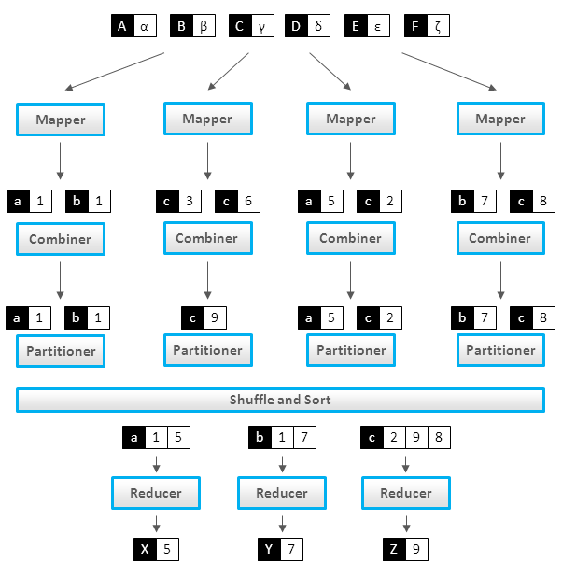
What about Combiners?

Slide 12
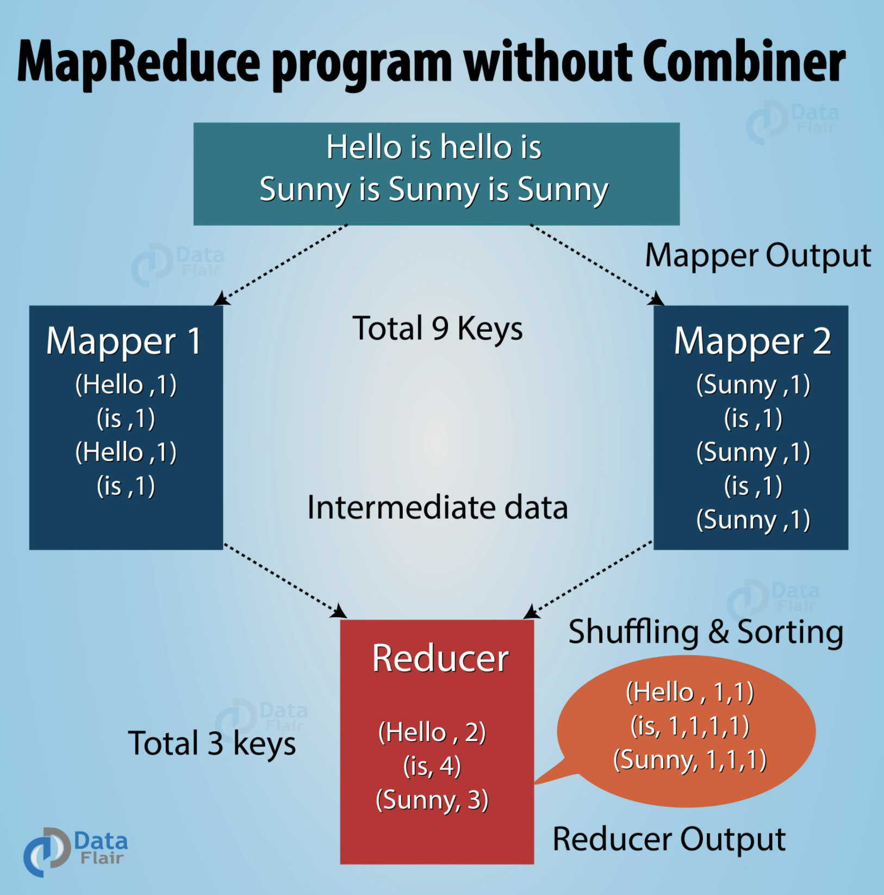
MapReduce without Combiners

Slide 13
Combiner Example
In the following figure (next slide),
Mapper 1 Mapper 2
(Hello, 1) (Sunny, 1)
(Hello, 1) (Sunny, 1)
(Sunny, 1)
The combiner function combines these two into
(Hello, 2) (Sunny, 3)

Slide 14

MapReduce with Combiners

Slide 15
EXAMPLE-1: Find Sum of Values per Key
Solution-1: Without Combiners
map()
reduce()
Solution-2: With Combiners
map()
combine()
reduce()

Slide 16
EXAMPLE-1: Find Sum of Values (ratings) per Key (movie_id)
Solution-1: Without Combiners
# K: record number: ignored
# V: record as “<movie_id><,><rating>”
map(K, V) {
tokens = V.split(“,”)
movie_id = tokens[0]
rating = int(tokens[1])
emit (movie_id, rating)
}

Slide 17
EXAMPLE-1: Find Sum of Values (ratings) per Key (movie_id)
Solution-1: Without Combiners
Sort & Shuffle phase will produce:
(movie_id_1, [2, 4, 5, 1, 1, 3])
(movie_id_2, [1, 1, 3, 5])
(movie_id_3, [1, 1, 1, 1, 2, 2])
…

Slide 18
EXAMPLE-1: Find Sum of Values (ratings) per Key (movie_id)
Solution-1: Without Combiners
# K: a unique movie_id
# V: [v_1, v_2, …, v_n] (all ratings for K)
# V denotes all ratings for K (a unique movie_id)
reduce(K, V) {
sum_of_ratings = sum(V)
emit (K, sum_of_ratings)
}

Slide 19
EXAMPLE-1: Find Sum of Values per Key
Solution-2: With Combiners
map()
combine()
reduce()

Slide 20
EXAMPLE-1: Find Sum of Values (ratings) per Key (movie_id)
Solution-2: With Combiners
# K: record number: ignored
# V: record as “<movie_id><,><rating>”
map(K, V) {
tokens = V.split(“,”)
movie_id = tokens[0]
rating = int(tokens[1])
emit (movie_id, rating)
}

Slide 21
EXAMPLE-1: Find Sum of Values (ratings) per Key (movie_id)
Solution-2: With Combiners
combine() function combines output of mappers per worker node for the same key:
# K: a unique movie_id
# V: [v_1, v_2, …, v_n]
# V denotes all ratings for K
combine(K, V) {
sum_of_ratings = sum(V)
emit (K, sum_of_ratings)
}

Slide 22
EXAMPLE-1: Find Sum of Values (ratings) per Key (movie_id)
Solution-2: With Combiners
reduce(): reducer function
# K: a unique movie_id
# V: [v_1, v_2, …, v_n]
# V denotes all ratings for K
reduce(K, V) {
sum_of_ratings = sum(V)
emit (K, sum_of_ratings)
}

Slide 23
How do we write Combiners? For Averages?
We need to write 3 functions:
map()
combine()
reduce()
BUT Note that
“average of an average is not an average”
What does this mean?

Slide 24
Average of an Average is not an Average
Let say we have 2 partitions
Partition-1: (K, 6), (K, 7)
Average of Partition-1: (6+7)/2 = 6.5
Partition-2: (K, 8)
Average of Partition-2: (8)/1 = 8.0
Average of Partition-1 and Partition-2:
(6.5 + 8.0)/2 = 7.25 => NOT CORRECT
Average(6, 7, 8) = (6+7+8)/3 = 21/3 = 7.0
Hmmmmmm? How to solve this?

Slide 25
Make Average of an Average as an Average By Changing Output of Mappers
Let say we have 2 partitions
Partition-1: (K, 6), (K, 7)
Partition-2: (K, 8)
(K, V) → (K, (V, 1))
Change map() to create (K, (sum, count))
(K, 6) --> (K, (6, 1))
(K, 7) --> (K, (7, 1))
(K, 8) --> (K, (8, 1))

Slide 26
Make Average of an Average as an Average
Let say we have 2 partitions:
Partition-1: (K, (6, 1)), (K, (7, 1))
Partition-2: (K, (8, 1))
Average(Partition-1): (K, (6+7, 1+1)) = (K, (13, 2))
Average(Partition-2): (K, (8, 1))
Average(Partition-1, Partition-2) =
(K, (13+8, 2+1)) =
(K, (21, 3)) =
(K, (sum, count))
=> (K, 21/3) = (K, 7)

Slide 27
Sample output of Mappers
Let say we have 2 partitions:
Partition-1: (K, (6, 1)), (K, (7, 1))
Partition-2: (K, (8, 1))
combine(Partition-1): (K, (6+7, 1+1)) = (K, (13, 2))
combine(Partition-2): (K, (8, 1))

Slide 28
Combine must be Associative & Commutative
Commutative:
(a + b) = (b + a)
F(a, b) = F(b, a)
(sum1, count1) + (sum2, count2) = (sum2, count2) + (sum1, count1)
(sum1+sum2, count1+count2) = (sum2+sum1, count2+count1)
= (sum1+sum2, count1+count2)
Associative:
(a + (b + c)) = ((a + b) + c)
F(a, F(b, c)) = F(F(a, b), c)
(sum1, count1) + ((sum2, count2) + (sum3, count3)) =
((sum1, count1) + (sum2, count2)) + (sum3, count3)

Slide 29
Tuples in Python
>>> a = (78, 3)
>>> a[0]
78
>>> a[1]
3

Slide 30
What to consider for combiners & reducers
Make their functions to be associative and commutative:
Let + be a binary function
Commutative Laws
a + b = b + a
Associative Laws
(a + b) + c = a + (b + c)

Slide 31
Commutative Example
Addition is commutative
2 + 3 = 3 + 2 = 5
100 + 200 = 200 + 100 = 300
Multiplication is commutative
2 * 5 = 5 * 2 = 10
20 * 30 = 30 *20

Slide 32
Subtraction and Division is NOT Commutative
Subtraction
F (a, b) != F(b, a)
5 - 3 = 2
3 - 5 = -2
2 NOT EQUAL to -2
Division
10 / 2 = 5
2 / 10 = 0.2
5 NOT EQUAL to 0.2

Slide 33
Average function is not Associative
Avg (1, 2, 3) = 2.0
Avg(1, Avg(2, 3)) = Avg(1, 2.5) = 1.75
2.0 NOT EQUAL to 1.75

Slide 34
References
1. Monoidify! Monoids as a Design Principle for Efficient MapReduce Algorithms by Jimmy Lin
2. Data Algorithms (book) by Mahmoud Parsian
3. Data Algorithms with Spark (book) by Mahmoud Parsian

