Slide 1
Introduction to Big Data
Mahmoud Parsian
Ph.D. in Computer Science

Slide 2
What is Big Data?
Large datasets, complex and changeable
Cannot be stored, managed, and processed adequately by traditional software management and software tools.

Slide 3
Solutions? Cluster Computing
Relying on the Technology that handle , process and analyze large quantities of data:
MapReduce
Hadoop
Spark
Snowflake
Amazon Athena
Google BigQuery

Slide 4
Solutions? Types of Data
Technology that handle , process and analyze large quantities of data:
Types of Data:
Structured
XML
CSV
Parquet
Semi-Structured
JSON
XML
Unstructured
Text files, log files

Slide 5


The need of Big Data…
Data growth:
Social networking (Twitter, Facebook, ..)
Media (Netflix, Cable TV, …)
Commerce sites (Amazon, Ebay, …)
Health and genomics, data growth increasing exponentially and so on for the future.
Analyzing and managing these data properly is the key to business expansion and growth.

Slide 6
Example of Big Data?
Credit Card Transactions
Billions of documents indexed for search engine
Logs generated by web servers
DNA & Genomics data
Twitter feeds
Facebook Messages
Medical records
COVID data

Slide 7
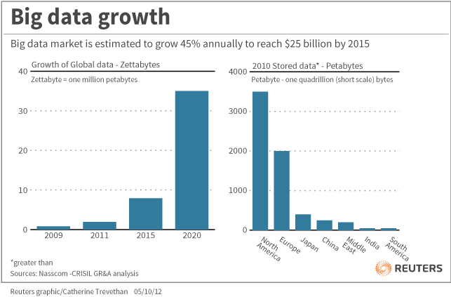
Data Creation
Every Year, the world created
more and more Zeta bytes of data
Managing this data became crucial to extract more value in retail, finance, media and publishing.

Slide 8
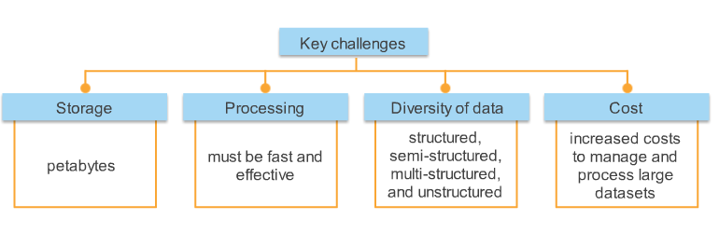
Big Data Challenges

Slide 9
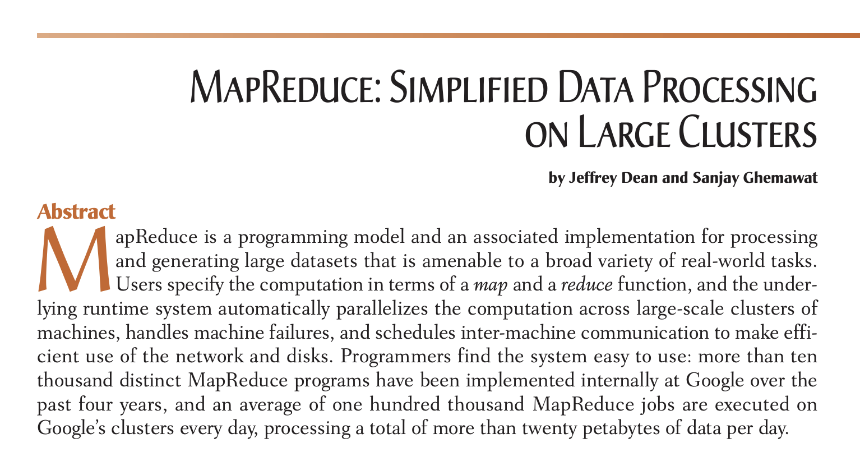
Google MapReduce Paper Revolutionized Big Data (2004)

Slide 10
Google MapReduce Paper → Hadoop
Google implemented MapReduce (2004)
index billions of documents for its search engine
Google did NOT release any MapReduce code to public
Hadoop was implemented based on Google’s MapReduce paper
Hadoop became an open-source Apache project (2006)

Slide 11

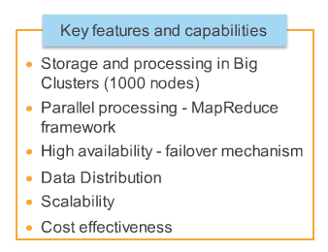
Hadoop came as the answer of software framework that would support technologies, tools and infrastructure and also more effective and efficient management and analysis of large datasets.
Hadoop tools and services working together in completing its tasks, forming a Hadoop ecosystem.

Slide 12
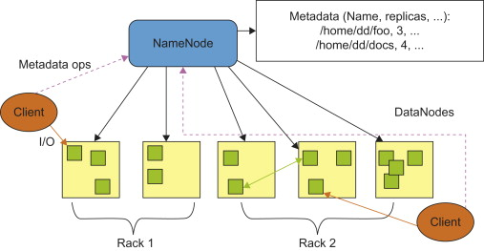
Hadoop Architecture

Slide 13
Problems with Hadoop
Complex: write lots of code
Low level API
Uses disk I/O extensively
Did not use memory/RAM (RAM is 100 times faster than Disk I/O)
Only supported Text files
Not Multi-language support (Python, Java, Scala, SQL)
Hadoop Problems → Apache Spark
Spark addresses Hadoop Problems

Slide 14

Apache
Spark is a unified engine for large-scale data analytics
Spark is a multi-language engine for executing data engineering, data science, and machine learning on single-node machines or clusters.
Use memory/RAM first, Then Disk
Parallel Processing (superset of MapReduce)
Data Partitioning
Scalability
Multi-language support (Python, Java, Scala, SQL)
Data Abstractions: RDDs and DataFrames
Enables SQL access to Big Data

Slide 15
Apache Example
Solving Classic Word Count Problem:
# word_frequencies : {(word1, freq1), (word2, freq2), …}
input_path = “s3://my_bucket/project23/”
word_frequencies =
spark.sparkContext.textFile(input_path)\
.flatMap(lambda x: x.split(' ')) \
.map(lambda x: (x, 1)) \
.reduceByKey(lambda a,b : a+b)

Slide 16

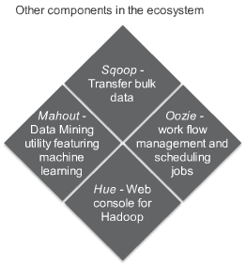
Ecosystem Component
Primary component:
HDFS – Distributed file system for storage
MapReduce –Parallel processing framework
Spark: superset of MapReduce
Typical Hadoop eco-system project might use
ZooKeeper –Coordination framework
Hive – SQL-like inferface for querying
Pig – High level scripting language for batch processing and ETL
Hbase – Tabular/column storage (non-relational, distribution database)
Flume – Distribution, reliable, service for collecting,aggregating, and moving large data

Slide 17
Hadoop vs. Spark
Hadoop: very hard to write MapReduce programs
Long programs (complex, low-level API)
Spark: very simple to write distributed programs and beyond
Short programs (simple, powerful, high-level API)
Hadoop: Java support
Spark: Multi-language support (Python, Java, Scala, SQL)
Hadoop: slow, uses disk I/O
Spark: fast, uses RAM as much as possible
Hadoop: Parallel Processing
Spark: Parallel Processing
Spark is (new technology, fast, de facto standard)
superior to Hadoop (old technology, slow)

Slide 18
Big Data’s Characteristic
Volume
Variety
Velocity
Complexity
Validity

Slide 19
Stored Data Processing
Batch-based stored
Real-Time Data-stream processing

Slide 20
Batch Based Stored Data Processing
Process large volumes of data
Can be periodic or one-time processing
Batch results are produced after data is collected, entered and processed
Separate techniques or programs for input, processing and output

Slide 21
Real Time Data Processing
Data captured, processed, and acted 24/7
Computing data real-time
Advantages of Real-time:
System scales elastically based on need
Instant Results
Parallel processing is available

Slide 22
Tools and Techniques for analyzing big Data
The choice of tools mostly driven by:
Who is going to use the data
+
the business requirement for a particular scenario

Slide 23
Where to Store Big Data
While traditional RDBMSs has many limitations, Big Data provide alternatives address some of these limitations.
HDFS (Hadoop Distributed File System)
Amazon S3
Database alternatives:
Document Stores – Apache CouchDB, MongoDB
Graph stores –Neo4j
Key-Value Stores –Apache Cassandra, Riak
Tabular stores –Apache Hbase

Slide 24
Accessing the Big Data
SQL like connectivity initiates for big data:
Amazon Athena (JDBC), Snowflake (JDBC), Impala, Hive and Stinger
SQL access to Spark DataFrames (table of named columns)
These big data later can be used in:
Sandboxes for data science projects
Analytics development using MapReduce
Analytics-query performance enablers
Search indexes on multi structured data in Hadoop
Analyzing multi structured Big data Using search
Data visualization and in memory data in big data environment

Slide 25
Considering Using big Data
Does your problem require a Big Data Solution?
Does the solution need to handle data variety?
Does the solution require ability to deal with high data velocity?
Does the solution handle high data volume?
Can the solution handle complexity?
How can you optimize the solution?

Slide 26
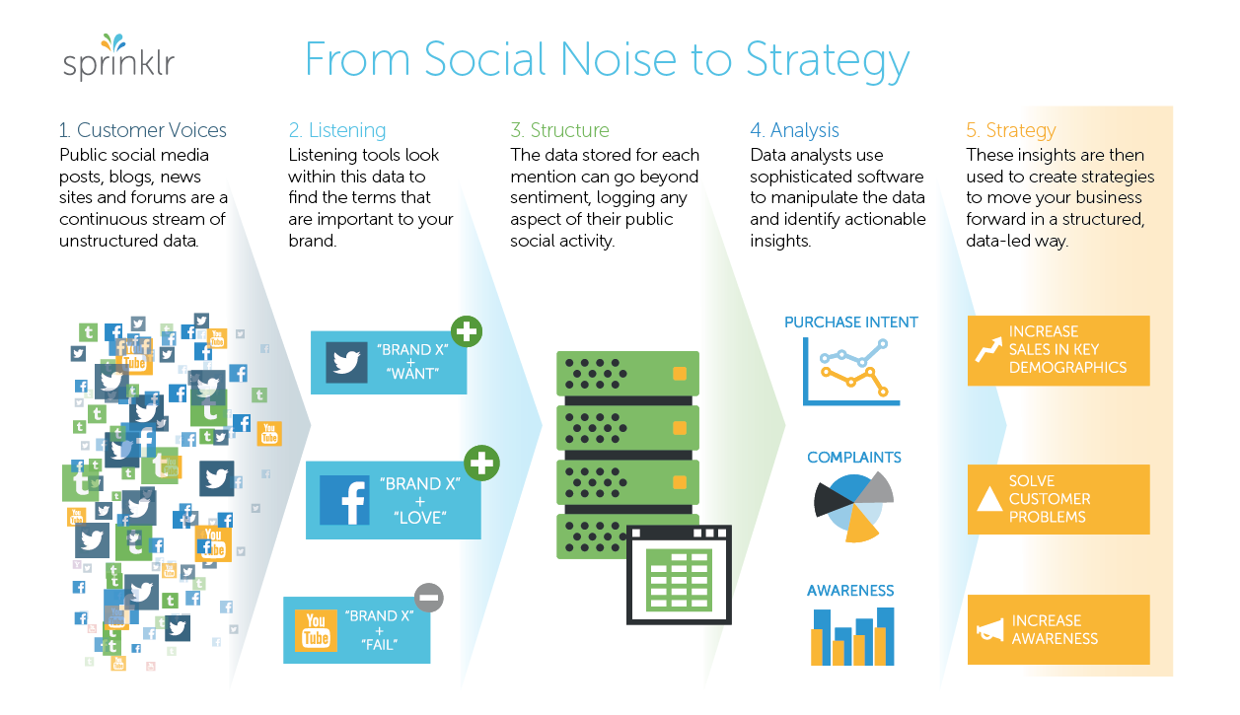
Case Study: Social Media Analytics
Using people’s history on internet, what they buy, what they search giving a rough view of attitude on a product. More, these output can be used to study: customer satisfaction, churn prediction, financial performance, stock performance.

