Slide 1
An Introduction to
Big Data Concepts
and Terminology
Mahmoud Parsian
Ph.D. in Computer Science
Notes:
Introduce myself: 8 years data engineering, data analytics (make sense)

Slide 2
What’s Big Data
Big Data is a blanket term for the non-traditional
strategies and technologies needed to
Gather
Organize
Process, Analyze, and
Gather insights from LARGE Data Sets:
Data Sets of billions of elements
Peta & Tera bytes of data

Slide 3
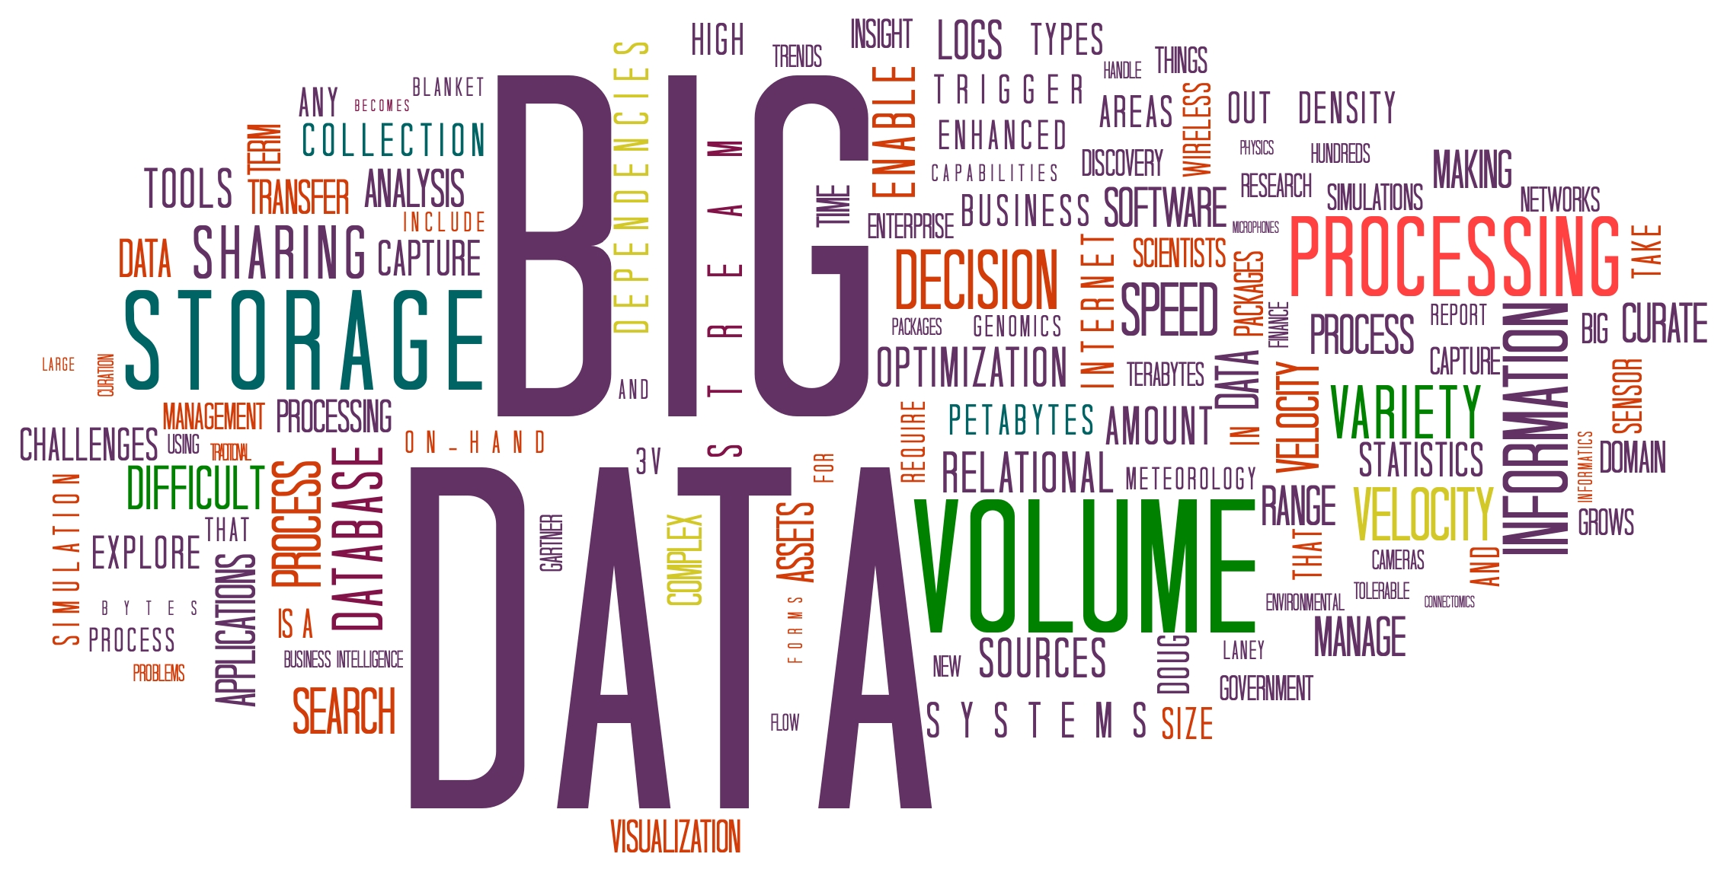
What’s Big Data: Many Related Technologies

Slide 4
What’s Big Data – working with Big Data
While the problem of working with data that exceeds the computing power or storage of a single computer is not new, the pervasiveness, scale, and value of this type of computing has greatly expanded in recent years.
Big Data → Cluster Computing
Terabytes → Scale
Petabytes → Use 100’s or 1000’s of computer servers
Replication → Handle Fault Tolerant

Slide 5
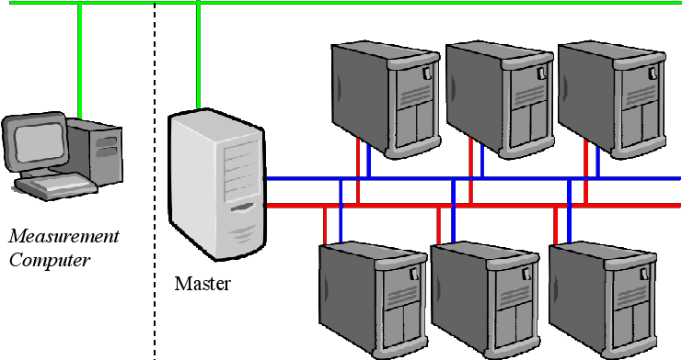
What’s Big Data → Cluster Computing

Slide 6
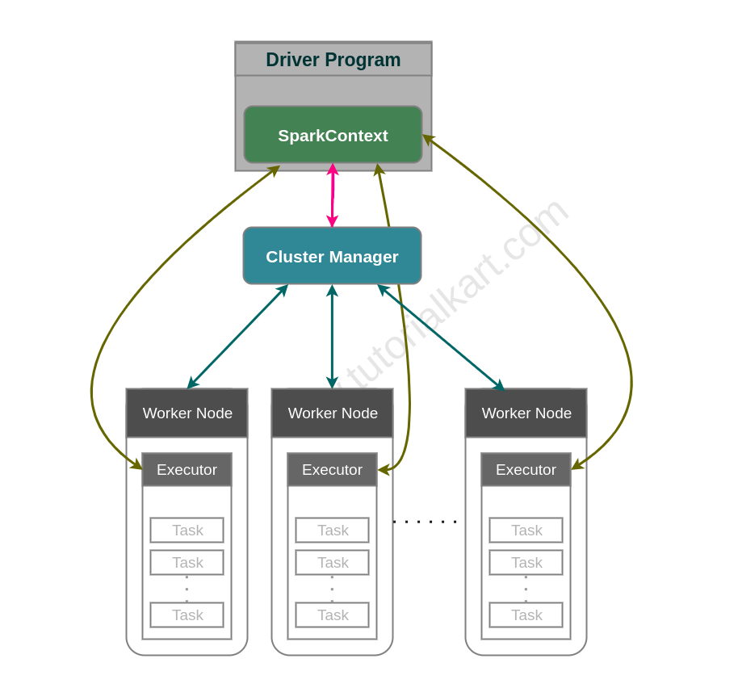
Spark Cluster Manager

Slide 7
What’s Big Data?
Question: What is the definition of “big data”
Answer: It is is difficult to nail down because projects, vendors, practitioners, and business professionals use it quite differently.
There is no single answer!
There are many answers!

Slide 8
What’s Big Data?
Generally speaking, big data is:
Large datasets (can not fit in a single server)
Cluster computing (network of 10’s, 100’s, 1000’s of connected computers)
Distributed File System (handle Petabytes and Terabytes of data)
The category of computing strategies and technologies that are used to handle large datasets
Cluster Computing
Apache Hadoop
Apache Spark

Slide 9
The category of computing strategies?
MapReduce is a model/paradigm
Partition data into smaller chunks, and
Parallelize transformations on chunked data
Apache Hadoop
Apache Spark
Apache Tez
Amazon Athena
Google BiqQuery
Snowflake

Slide 10
What’s Big Data? Large datasets
Large Dataset means a dataset too large to reasonably process or store with traditional tooling or on a single computer.
Indexing billions of documents for search engine
Finding cancer patterns in 1 million DNA Samples
Twitter data
Facebook messages
This means that the common scale of big datasets is constantly shifting and may vary significantly from organization to organization.

Slide 11
Large datasets → Distributed File System
NFS = Network File Server
Consider NFS with 100 file servers
Each file server can store: 200 TB
Therefore: total space = 100 x 200 TB = 20,000 TB
= 20,000 TB with replication of 1
= 10,000 TB with replication of 2
= 5,000 TB with replication of 4
→ Replication of data costs $money

Slide 12
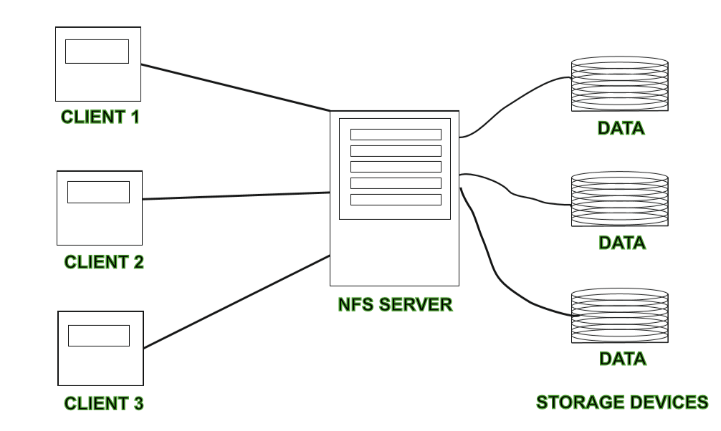
Large datasets → Distributed File System

Slide 13
Where do we store Large datasets?
Amazon S3
Distributed File Systems:
Hadoop Distributed File Systems (HDFS)
Google File System
NetWare
NFS (Network File System)

Slide 14
Why Are Big Data Systems Different?
4 V’s of Big Data:
Volume of Big Data (size of data)
Velocity of Big Data (speed of data creation)
Variety of Big Data (structured, unstructured)
Veracity of Big Data (validity of data)

Slide 15
Volume of Big Data
The volume of data refers to the size of the data sets that need to be analyzed and processed, which are now frequently larger than
Terabytes (1 TB = 1,024 GB = 1,048,576 MB)
Petabytes (1 PB = 1,024 TB = 1,048,576 GB)
The sheer volume of the data requires distinct and different processing technologies than traditional storage and processing capabilities. In other words, this means that the data sets in Big Data are too large to process with a regular laptop or desktop processor.
Cluster Computing
Distributed File System

Slide 16
Volume of Big Data: Example, Credit Card
Credit Card Transactions:
An example of a high-volume data set would be all credit card transactions on a day within Europe.
2. There were 369 billion purchase transactions for goods and services worldwide in 2018

Slide 17
Volume of Big Data: Example, DNA Samples
Processing 1000,000 DNA samples,
One sample has 5000,000 records
All samples : 1000,000 x 5000,000
= 5,000,000,000,000
= 5 Trillion data points

Slide 18
Velocity of Big Data
Velocity refers to the speed with which data is generated.
High velocity data is generated with such a pace that it requires distinct (distributed) processing techniques.
An example of a data that is generated with high velocity
Text messages
Twitter messages
Facebook posts

Slide 19
Variety of Big Data
Variety makes Big Data really big.
Big Data comes from a great variety of sources and generally is one out of three types of data:
Structured (table of rows and named columns)
Semi structured (JSON, XML)
Unstructured (Text files, log files)
The variety in data types frequently requires distinct processing capabilities and specialist algorithms. An example of high variety data sets would be the audio and video files that are generated at various locations in a city.

Slide 20
Veracity of Big Data
Quality of Data is Very Important
Veracity refers to the quality of the data that is being analyzed.
If data quality is not good, then ERROR in decision making
High veracity data has many records that are valuable to analyze and that contribute in a meaningful way to the overall results.
Low veracity data, on the other hand, contains a high percentage of meaningless data. The non-valuable in these data sets is referred to as noise.
An example of a high veracity data set would be data from a medical experiment or trial.

Slide 21
What Does a Big Data Life Cycle Look Like?
The general categories of activities involved with big data processing are:
1. Creating data from many data sources
2. Ingesting data into the system
3. Persisting the data in storage
4. Computing and Analyzing data
5. Visualizing & Presenting the results

Slide 22
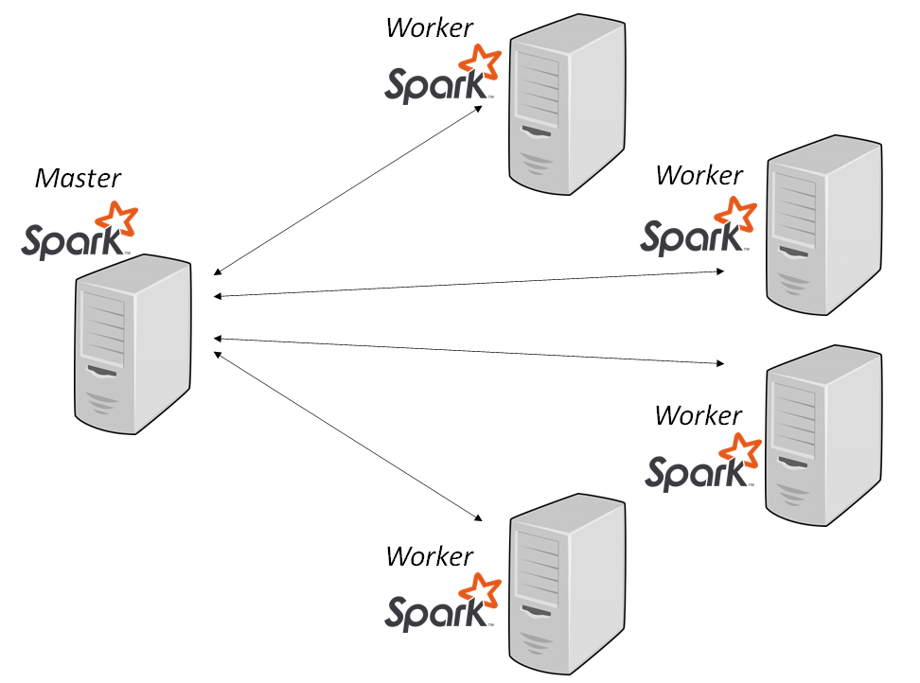
Clustered Computing
Because of the volume of big data, individual computers are often inadequate for handling the data at most stages. To better address the high storage and computational needs of big data, computer clusters are a better fit.

Slide 23
Clustered Computing Benefits
Resource Pooling: Combining the available storage space to hold data is a clear benefit, but CPU and memory pooling is also extremely important. Processing large datasets requires large amounts of all three of these resources.
High Availability: Clusters can provide varying levels of fault tolerance and availability guarantees to prevent hardware or software failures from affecting access to data and processing. This becomes increasingly important as we continue to emphasize the importance of real-time analytics.
Scalability: Clusters make it easy to scale horizontally by adding additional machines to the group. This means the system can react to changes in resource requirements without expanding the physical resources on a machine.

Slide 24
Ingesting Data into the System
Data ingestion is the process of taking raw data and adding it to the system.
The complexity of this operation depends heavily on the format and quality of the data sources and how far the data is from the desired state prior to processing.
One way that data can be added to a big data system are dedicated ingestion tools. Technologies like Apache Sqoop can take existing data from relational databases and add it to a big data system.
Examples:
Apache Flume
Apache Chukwa
Apache Kafka
Gobblin
Notes:
NameNode and DataNode each run an internal web server in order to display basic information about the current status of the cluster

Slide 25
Persisting the Data in Storage
The ingestion processes typically hand the data off to the components that manage storage, so that it can be reliably persisted to disk. While this seems like it would be a simple operation, the volume of incoming data, the requirements for availability, and the distributed computing layer make more complex storage systems necessary.
Persisting Solutions:
Amazon S3
Hadoop’s HDFS
Google File System
NFS
Notes:
NameNode and DataNode each run an internal web server in order to display basic information about the current status of the cluster

Slide 26
Computing and Analyzing Data
Once the data is available, the system can begin processing the data to surface actual information. The computation layer is perhaps the most diverse part of the system as the requirements and best approach can vary significantly depending on what type of insights desired. Data is often processed repeatedly, either iteratively by a single tool or by using a number of tools to surface different types of insights.
Batch processing is one method of computing over a large dataset. The process involves breaking work up into smaller pieces, scheduling each piece on an individual machine, reshuffling the data based on the intermediate results, and then calculating and assembling the final result. These steps are often referred to individually as splitting, mapping, shuffling, reducing, and assembling, or collectively as a distributed map reduce algorithm. This is the strategy used by Apache Hadoop’s MapReduce. Batch processing is most useful when dealing with very large datasets that require quite a bit of computation.
Real-time processing: While batch processing is a good fit for certain types of data and computation, other workloads require more real-time processing. Real-time processing demands that information be processed and made ready immediately and requires the system to react as new information becomes available. One way of achieving this is stream processing, which operates on a continuous stream of data composed of individual items. Another common characteristic of real-time processors is in-memory computing, which works with representations of the data in the cluster’s memory to avoid having to write back to disk.
Apache Storm, Apache Flink, and Apache Spark provide different ways of achieving real-time or near real-time processing. There are trade-offs with each of these technologies, which can affect which approach is best for any individual problem. In general, real-time processing is best suited for analyzing smaller chunks of data that are changing or being added to the system rapidly.
Notes:
NameNode and DataNode each run an internal web server in order to display basic information about the current status of the cluster

Slide 27
Visualizing the Results
Visualizing data is one of the most useful ways to spot trends
and make sense of a large number of data points.
Final Results may be saved in:
ElasticSearch
Relational Databases
Snowflake
Visualization tools:
Jupyter Notebook
Apache Zeppelin
Notes:
NameNode and DataNode each run an internal web server in order to display basic information about the current status of the cluster

Slide 28
Big Data Glossary
Big data: Big data is an umbrella term for datasets that cannot reasonably be handled by traditional computers or tools due to their volume, velocity, and variety. This term is also typically applied to technologies and strategies to work with this type of data.
Batch processing: Batch processing is a computing strategy that involves processing data in large sets. This is typically ideal for non-time sensitive work that operates on very large sets of data. The process is started and at a later time, the results are returned by the system.
Cluster computing: Clustered computing is the practice of pooling the resources of multiple machines and managing their collective capabilities to complete tasks. Computer clusters require a cluster management layer which handles communication between the individual nodes and coordinates work assignment.
Notes:
NameNode and DataNode each run an internal web server in order to display basic information about the current status of the cluster

Slide 29
Big Data Glossary
Data lake: Data lake is a term for a large repository of collected data in a relatively raw state. This is frequently used to refer to the data collected in a big data system which might be unstructured and frequently changing. This differs in spirit to data warehouses (defined below).
Data mining: Data mining is a broad term for the practice of trying to find patterns in large sets of data. It is the process of trying to refine a mass of data into a more understandable and cohesive set of information.
Data warehouse: Data warehouses are large, ordered repositories of data that can be used for analysis and reporting. In contrast to a data lake, a data warehouse is composed of data that has been cleaned, integrated with other sources, and is generally well-ordered. Data warehouses are often spoken about in relation to big data, but typically are components of more conventional systems.
ETL: ETL stands for extract, transform, and load. It refers to the process of taking raw data and preparing it for the system’s use. This is traditionally a process associated with data warehouses, but characteristics of this process are also found in the ingestion pipelines of big data systems.
Notes:
NameNode and DataNode each run an internal web server in order to display basic information about the current status of the cluster

Slide 30
Big Data Glossary: Apache Hadoop
Hadoop can process big data using MapReduce paradigm
Hadoop is a framework that is used to efficiently store and process large datasets ranging in size from gigabytes to petabytes of data.
Hadoop consists of a distributed file system called HDFS, with a cluster management and resource scheduler on top called YARN (Yet Another Resource Negotiator).
Batch processing capabilities are provided by the MapReduce computation engine.
Notes:
NameNode and DataNode each run an internal web server in order to display basic information about the current status of the cluster

Slide 31
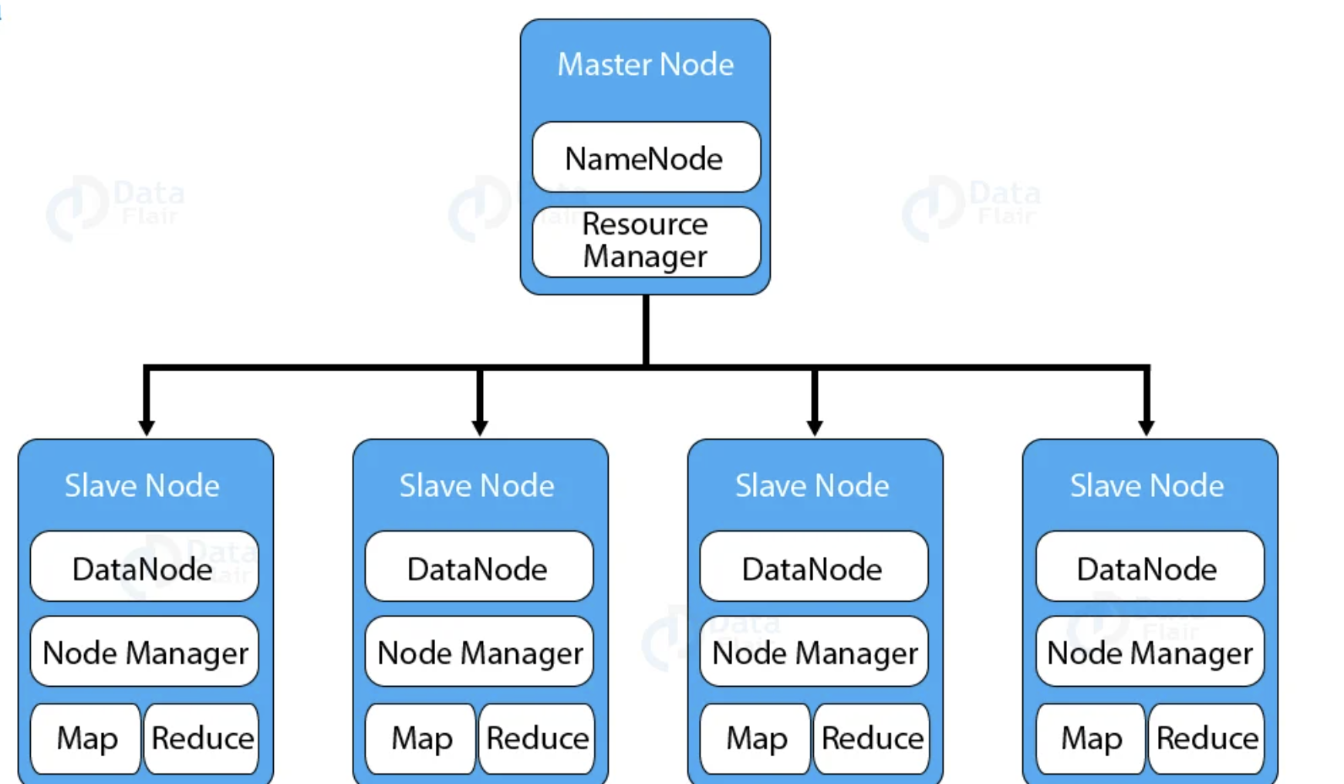
Big Data Glossary: Hadoop Architecture
Notes:
NameNode and DataNode each run an internal web server in order to display basic information about the current status of the cluster

Slide 32

Big Data Glossary: Hadoop HDFS Architecture
Notes:
NameNode and DataNode each run an internal web server in order to display basic information about the current status of the cluster

Slide 33
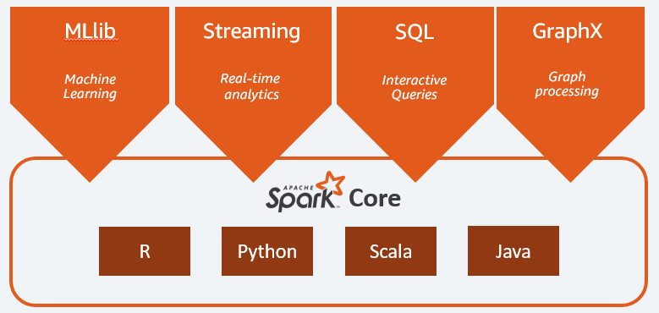
Big Data Glossary
Spark: Unified engine for large-scale data analytics
Spark is a multi-language engine for executing data engineering, data science, and machine learning on single-node machines or clusters.
Notes:
NameNode and DataNode each run an internal web server in order to display basic information about the current status of the cluster

Slide 34
Big Data Glossary: In-memory computing
In-memory computing is a strategy that involves moving the working datasets entirely within a cluster’s collective memory.
Intermediate calculations are not written to disk and are instead held in memory.
This gives in-memory computing systems like Apache Spark a huge advantage in speed over I/O bound systems like Hadoop’s MapReduce.
Memory access is 100+ times faster than Disk access
Notes:
NameNode and DataNode each run an internal web server in order to display basic information about the current status of the cluster

Slide 35
Big Data Glossary: Machine Learning
Machine learning is the study and practice of designing systems that can learn, adjust, and improve based on the data fed to them.
This typically involves implementation of predictive and statistical algorithms that can continually zero in on “correct” behavior and insights as more data flows through the system.
Notes:
NameNode and DataNode each run an internal web server in order to display basic information about the current status of the cluster

Slide 36
Big Data Glossary
MapReduce (big data algorithm):
MapReduce is an algorithm for scheduling work on a computing cluster.
The process involves splitting the problem set up (mapping it to different nodes) and computing over them to produce intermediate results, shuffling the results to align like sets, and then reducing the results by outputting a single value for each set.
map(input) → {(key1, value1), (key2, value2), …}
reduce(key, [V1, V2, …]) →
{(K1, final_value), (K2, final_value2), …}
Notes:
NameNode and DataNode each run an internal web server in order to display basic information about the current status of the cluster

Slide 37
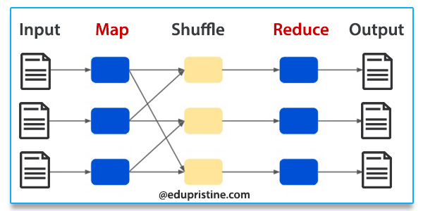
Big Data Glossary: MapReduce Model
Notes:
NameNode and DataNode each run an internal web server in order to display basic information about the current status of the cluster

Slide 38
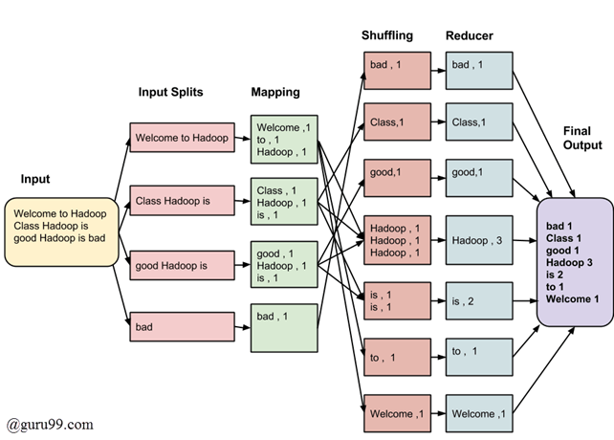
Big Data Glossary: MapReduce Example
Notes:
NameNode and DataNode each run an internal web server in order to display basic information about the current status of the cluster

Slide 39
Big Data Glossary: NoSQL
NoSQL is a broad term referring to databases designed outside of the traditional relational model.
NoSQL databases have different trade-offs compared to relational databases, but are often well-suited for big data systems due to their flexibility and frequent distributed-first architecture.
NoSQL Examples:
Spark SQL
Amazon Athena
Google BigQuery
Snowflake
Notes:
NameNode and DataNode each run an internal web server in order to display basic information about the current status of the cluster

Slide 40
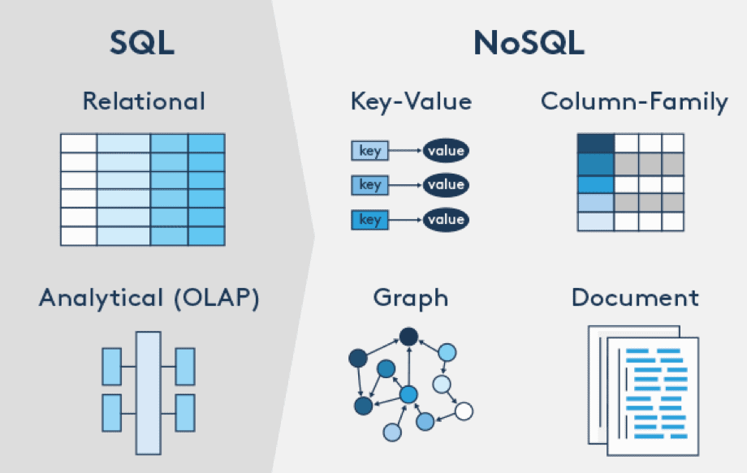
Big Data Glossary: NoSQL
Notes:
NameNode and DataNode each run an internal web server in order to display basic information about the current status of the cluster

Slide 41
Big Data Glossary: Stream processing
Stream processing is the practice of computing over individual data items as they move through a system.
This allows for real-time analysis of the data being fed to the system and is useful for time-sensitive operations using high velocity metrics.
Stream processing examples:
Text Messaging
Engine data
Twitter data
Facebook Data
Credit Card Transactions data
DNA Sequencing Machines
Notes:
NameNode and DataNode each run an internal web server in order to display basic information about the current status of the cluster

Slide 42
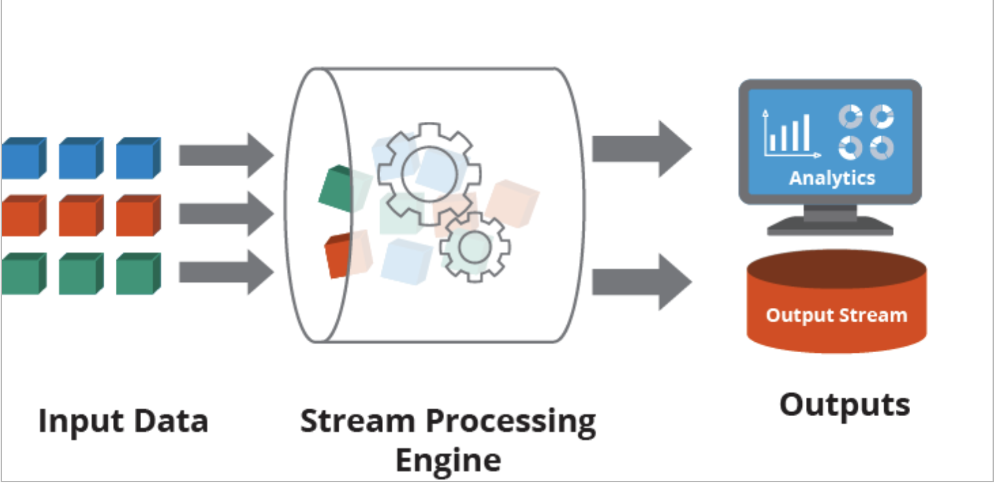
Big Data Glossary: Stream processing
Notes:
NameNode and DataNode each run an internal web server in order to display basic information about the current status of the cluster

