Slide 1

Introduction to https://spark.apache.org
Mahmoud Parsian
Ph.D. in Computer Science

Slide 2
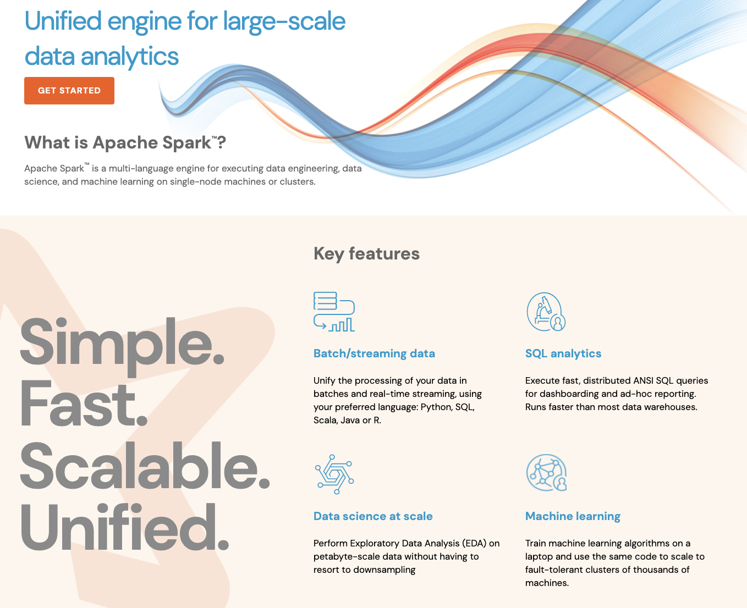
What is

Slide 3
What is
Fast and expressive cluster computing engine
Compatible with Hadoop File System
HDFS
Compatible with many data sources
Amazon S3 (Simple Storage System)
Parquet File (columnar data format)
CSV file, Text File
Relational Database Systems
…

Slide 4
What is
Improves efficiency through in-memory computing:
1 second = 1000 milliseconds
Memory data access: 10 milliseconds
Disk data access: 1000 milliseconds
General computation graphs (DAG)
No need to write MANY “map-then-reduce” jobs
Write one job to do MANY things
As much as 100x faster

Slide 5
What is
Apache Spark is a multi-language engine (Python, Java, Scala, SQL) for executing data engineering, data science, and machine learning on
Single-node machine or
Cluster of nodes

Slide 6
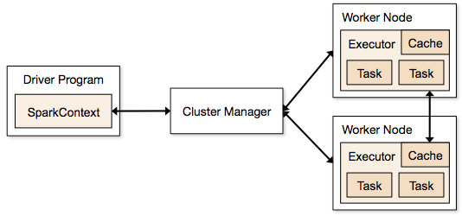
Architecture of

Slide 7
What is
Spark Cluster:
a collection of machines or nodes in the public cloud or on-premise in a private data center on
which Spark is installed.
Among those machines are Spark workers, a Spark Master (also a cluster manager in a Standalone mode), and at least one Spark Driver.

Slide 8
What is
Spark Master:
As the name suggests, a Spark Master JVM acts as a cluster manager in a Standalone deployment mode to which Spark workers register themselves as part of a quorum. Depending on the deployment mode, it acts as a resource manager and decides where and how many Executors to launch, and on what Spark workers in the cluster.

Slide 9
What is
Spark Worker:
Upon receiving instructions from Spark Master, the Spark worker JVM launches Executors on the worker on behalf of the Spark Driver.
Spark applications, decomposed into units of tasks, are executed on each worker’s Executor. In short, the worker’s job is to only launch an Executor on behalf of the master.

Slide 10
What is
Spark Executor :
A Spark Executor is a JVM container with an allocated amount of cores and memory on which Spark runs its tasks.
Each worker node launches its own Spark Executor, with a configurable number of cores (or threads).
Besides executing Spark tasks, an Executor also stores and caches all data partitions in its memory.
Task: A unit of work that will be sent to one executor.

Slide 11
What is
Spark Driver :
Once it gets information from the Spark Master of all the workers in the cluster and where they are, the driver program distributes Spark tasks to each worker’s Executor.
The driver also receives computed results from each Executor’s tasks.

Slide 12
What is
Improves usability by rich API
Scala
Java
Python (simple & expressive API)
PySpark: Python API for Spark
PySpark: interactive shell and batch
SQL
Often 2-10x less code

Slide 13
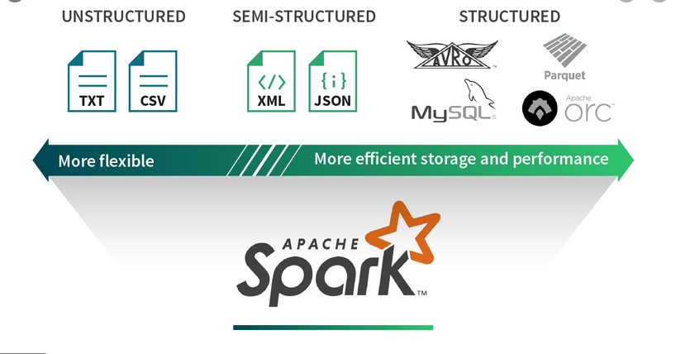
Spark Data Sources

Slide 14
Language Support
Python
# sc : SparkContext: Main entry point for Spark functionality.
# A SparkContext represents the connection to a Spark cluster
# lines : RDD[String]
input_path = ”/Users/mparsian/data/fox.txt”
lines = sc.textFile(input_path) lines.filter(lambda s: “ERROR” in s).count()
Standalone Programs
Python, Scala, & Java
Interactive Shells
Python & Scala
Performance
Java & Scala are faster due to static typing
…but Python is often fine
Scala
val lines = sc.textFile(input_path) lines.filter(x => x.contains(“ERROR”)).count()
Java
JavaRDD<String> lines = sc.textFile(input_path); lines.filter(new Function<String, Boolean>(){ Boolean call(String s) { return s.contains(“ERROR”); } }).count();

Slide 15
Data Abstractions in
Data Abstractions in PySpark
RDDs: Resilient Distributed Datasets
Use a SparkContext to READ your data and represent it as an RDD (set of elements)
Ideal for unstructured and semi-structured data
DataFrames
Use a SparkSession to READ your data and represent it as a DataFrame (a table of rows and named columns)
Ideal for structured and semi-structured data

Slide 16
Data Abstractions in
RDDs: Resilient Distributed Datasets
Immutable (read-only, avoid synchronization)
Partitioned collection of objects
Partitioned for distributed and parallel processing
Low-level API
DataFrames
A table of named columns
Partitioned for distributed and parallel processing
High-Level API

Slide 17
Data Abstractions in
RDDs: Resilient Distributed Datasets
Example: keep records longer than 80 characters
# sc: SparkContext
# READ input and represent it as an RDD
rdd = sc.textFile(“/tmp/samples.txt”)
# rdd : source RDD as RDD[String]
# RDD[String] means that every
# element is a String object
# filter() is a transformation
# x refers to an element of rdd
rdd2 = rdd.filter(lambda x: len(x) > 80)
# rdd2: target RDD as RDD[String]

Slide 18
Data Abstractions in
RDDs: Resilient Distributed Datasets
Immutable, partitioned collection of objects
Partitioned for distributed and parallel processing
Low-level API
# rdd : source RDD as RDD[String]
# filter() is a transformation
rdd2 = rdd.filter(lambda x: len(x) > 80)
# rdd2: target RDD as RDD[String]
Transformation: source_RDD → target_RDD
Transformation is a function (such as filter()) which transforms a source_RDD into a target_RDD

Slide 19
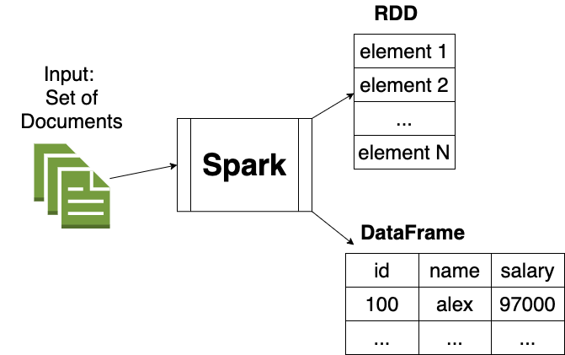
Data Abstractions in

Slide 20
RDDs in
Resilient Distributed Datasets
Immutable,
Partitioned collection of objects
Basic mechanism for distributed and parallel processing
RDD Notation:
RDD[T] means that every element
of RDD is of data type T
RDD[String] means that every element
of RDD is of data type String

Slide 21
RDDs in
Resilient Distributed Datasets
Immutable,
Partitioned collection of objects
Basic mechanism for distributed and parallel processing
RDD[String]
RDD[(String, Integer)]
RDD[(String, (Integer, Integer))
RDD[((String, Integer), (Double, Double))]
RDD[(String, String, Integer)]
RDD[(String, Integer, String, Float)]

Slide 22
RDDs in
RDD[String]
Every element is a String
RDD[(String, Integer)]
Every element is a tuple of 2 elements
RDD[(String, (Integer, Integer))
Every element is (K, V) pair
K is String
V is (Integer, Integer)
RDD[(String, Integer, Integer)]
Every element is a triplet

Slide 23
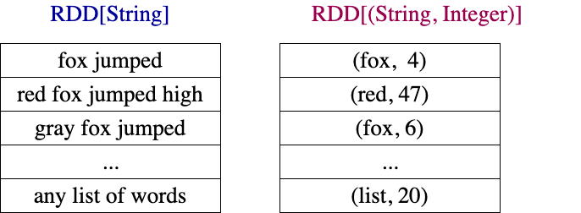
RDDs Examples

Slide 24
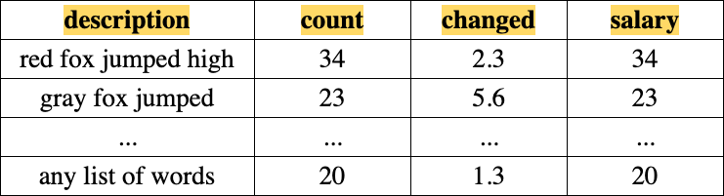
DataFrame Example: with 4 columns and Billions of rows

Slide 25
Operations in
RDDs support two types of operations
1. Transformations
transformation: RDD → RDD
2. Actions
action: RDD → NON-RDD

Slide 26
Operations in
Transformations
map()
flatMap()
mapPartitions()
filter()
reduceByKey()
groupByKey()
rdd1.join(rdd2)
…
Actions
count()
collect()
save()
…

Slide 27
Working With RDDs
# sc : SparkContext
textFile = sc.textFile(”SomeFile.txt”)
RDD
RDD
Action
RDD
Transformations
RDD
Value
linesWithSpark.count()
74
linesWithSpark.first()
# Apache Spark
linesWithSpark = textFile.filter(lambda line: "Spark” in line)

Slide 28
Key Concepts in Spark
Write programs in terms of transformations on distributed datasets
RDDs & DataFrames
Collections of objects spread across a cluster, stored in RAM or on Disk
Built through parallel transformations
Automatically rebuilt on failure
Operations
Transformations (e.g. map, filter, groupBy)
Actions (e.g. count, collect, save)
Notes:
RDD ➔ Colloquially referred to as RDDs
(e.g. caching in RAM)
Lazy operations to build RDDs from other RDDs
Return a result or write it to storage

Slide 29
DataFrame API
DataFrames evolve Spark’s RDD model, making operations with structured datasets even faster and easier.
# Constructs a DataFrame from a JSON dataset.
users = spark.load("s3n://path/to/users.json", "json")
# Create a new DataFrame that contains “young users” only
young = users.filter(users.age < 21)
# Alternatively, using Pandas-like syntax
young = users[users.age < 21]
# DataFrame's support existing RDD operators
print("Young users: " + young.count())

Slide 30
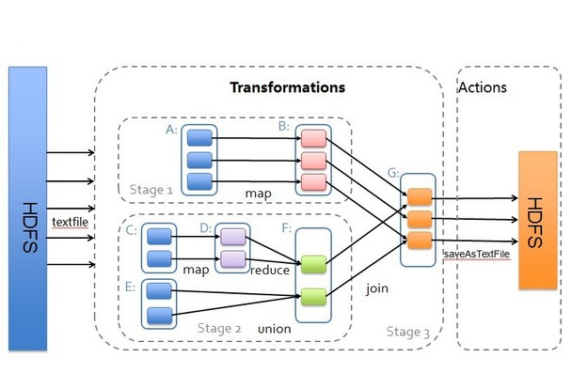
Transformations & Actions

Slide 31

Example: Log Mining
Load error messages from a log into memory, then interactively search for various patterns
Base RDD
Transformed RDD
Cache 1
lines = spark.textFile(“hdfs://...”)
errors = lines.filter(lambda s: “ERROR” in s)
messages = errors.map(lambda s: s.split(“\t”)[2])
messages.cache()
results
Worker
tasks
Block 1
Driver
Action
messages.filter(lambda s: “mysql” in s).count()
Cache 2
messages.filter(lambda s: “php” in s).count()
Worker
Cache 3
. . .
Full-text search of Wikipedia
60GB on 20 EC2 machine
0.5 sec vs. 20s for on-disk
Worker
Block 2
Block 3
Notes:
Add “variables” to the “functions” in functional programming

Slide 32
Interactive Shell
The Fastest Way to Learn Spark and PySpark
Available in Python and Scala
SPARK_HOME points to Spark’s installation directory
Python: PySpark ($SPARK_HOME/bin/pyspark)
Scala: Spark-Shell
Runs as an application on an existing Spark Cluster…
OR Can run locally
Run Spark in your laptop/MacBook/Windows

Slide 33
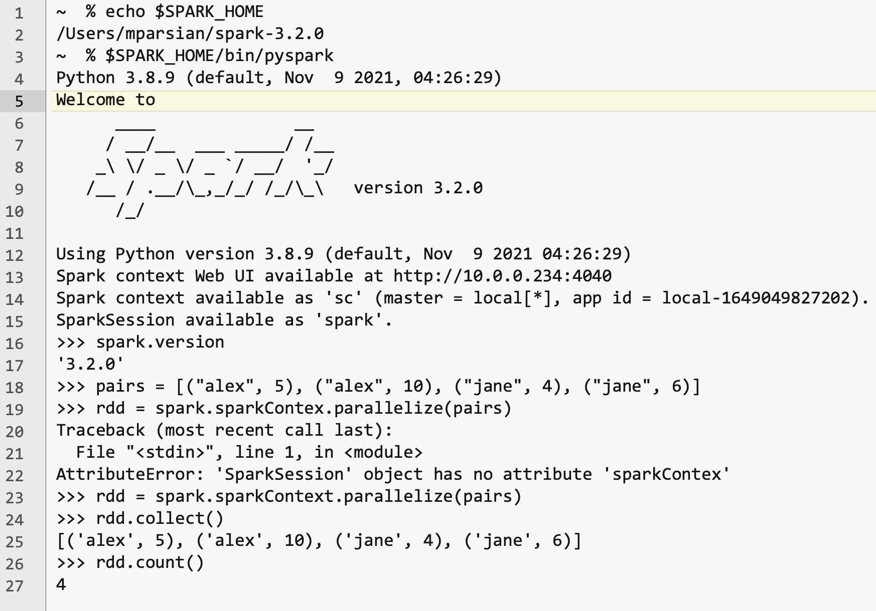
Interactive Shell

Slide 34
PySpark: interactive shell
Write Spark jobs in Python
Run interactive jobs in the shell
Create the following text file with 3 records:
$ cat /tmp/data.txt
fox jumped high
fox is crazy
crazy fox is here

Slide 35
PySpark: interactive shell
Write Spark jobs in Python
Run interactive jobs in the shell
$ cat data.txt
fox jumped high
fox is crazy
crazy fox is here
$SPARK_HOME/bin/pyspark
>>> # read input and create a new RDD as rdd : RDD[String]
>>> rdd = spark.sparkContext.textFile("/tmp/data.txt")
>>> rdd.collect()
[
'fox jumped high’,
'fox is crazy’,
'crazy fox is here’
]
>>> # Count the number of elements
>>> rdd.count()
3

Slide 36
SparkContext (sc)
Main entry point to Spark functionality
Available in shell as variable sc
# use sc for RDDs
# spark : SparkSession
# sc : SparkContext
sc = spark.sparkContext

Slide 37
Creating RDDs from Collections
# sc : SparKContext
# Turn a Python collection into an RDD
# nums_rdd : RDD[Integer]
nums_rdd = sc.parallelize([1, 2, 3])
# Turn (key, value) pairs into an RDD
pairs = [(‘A’, 2), (‘A’, 3), (‘B’, 4)]
# rdd : RDD[(String, Integer)]
rdd = sc.parallelize(pairs)

Slide 38
Creating RDDs from Text Files
# sc : SparkContext
# Load text file from local FS, HDFS, or S3
# 1. read a single file
rdd1 = sc.textFile(“file.txt”)
# 2. read many files ending with “.txt”
rdd2 = sc.textFile(“directory/*.txt”)
# 3. read a file from Hadoop’s HDFS
rdd3 = sc.textFile(“hdfs://namenode:9000/path/file”)

Slide 39
Basic Transformations
# Create an RDD[Integer]
nums = sc.parallelize([1, 2, 3, 4, 5, 6])
# [1, 2, 3, 4, 5, 6]
# Pass each element through a function
# squares : RDD[Integer]
# x refers to an element of nums
squares = nums.map(lambda x: x*x)
# [1, 4, 9, 16, 25, 36]
# Keep elements passing a predicate
# even : RDD[Integer]
even = squares.filter(lambda x: x % 2 == 0)
# {4, 16, 36}
Notes:
All lazy

Slide 40
Basic Transformations
# sc : SparkContext
# nums : RDD[Integer]
nums = sc.parallelize([1, 2, 3, 4])
nums.count() 4
# map each element to zero or more others
rdd = nums.flatMap(lambda x: => range(x))
rdd.collect()
{0, 0, 1, 0, 1, 2, 0, 1, 2, 3}
rdd.count()
10
Range object (sequence of numbers 0, 1, …, x-1)
Notes:
All lazy

Slide 41
Basic Actions
# nums : RDD[Integer]
nums = sc.parallelize([1, 2, 3, 4])
# Retrieve RDD contents as a local collection
my_list= nums.collect() # => [1, 2, 3, 4]
# Return first K elements
nums.take(2) # => [1, 2]
# Count number of elements
nums.count() # => 4
# Merge elements with an associative function
nums.reduce(lambda x, y: x + y) # => 10
# Write elements to a text file
nums.saveAsTextFile(“hdfs://file.txt”)
Notes:
Launch computations

Slide 42
Working with Key-Value Pairs
Spark’s “distributed reduce” transformations operate on RDDs of key-value pairs
Python: pair = (a, b) pair[0] # => a pair[1] # => b
Scala: val pair = (a, b) pair._1 // => a pair._2 // => b
Java: Tuple2 pair = new Tuple2(a, b); pair._1 // => a pair._2 // => b

Slide 43
Working with Key-Value Pairs
Spark’s distributed reduceByKey(), groupByKey(), combineByKey() transformations operate on RDDs of (key, value) pairs
Python: pair = (a, b) pair[0] # => a as KEY pair[1] # => b as VALUE
Examples of (key, value):
(“fox”, 1)
(“gene_77”, [1, 2, 4, 3, 2, 7])
(“alex”, (20, 30))
((“USA”, “Cupertino”), (1, 3, 8))

Slide 44
Some Key-Value Operations
# rdd : RDD[(String, Integer)]
pets = [(“cat”, 2), (“dog”, 3), (“dog”, 5), (“cat”, 4)])
rdd = = sc.parallelize(pets)
# apply reduction on (key, value) pairs
reduced = pets.reduceByKey(lambda x, y: x + y) # => {(cat, 6), (dog, 8)}
# apply reduction on (key, value) pairs
grouped = pets.groupByKey()
# => {(cat, [2, 4]), (dog, [3, 5])}
sorted = pets.sortByKey()
=> {(cat, 2), (cat, 4), (dog, 3) (dog, 5)}
NOTE: reduceByKey() also automatically implements combiners on the map side

Slide 45
Example: Word Count
# sc : SparkContext
lines = sc.textFile(“hamlet.txt”)
counts = lines.flatMap(lambda line: line.split(“ ”))\ .map(lambda word => (word, 1))\ .reduceByKey(lambda x, y: x + y)
“to” “be” “or”
(to, 1) (be, 1) (or, 1)
(be, 2) (not, 1)
“to be or”
“not” “to” “be”
(not, 1) (to, 1) (be, 1)
(or, 1)
(to, 2)
“not to be”

Slide 46
Word Count in Java/JDK8
JavaSparkContext sc = new JavaSparkContext();
JavaRDD<String> rdd = sc.textFile(inputPath);
// counts = (word: K, frequencey: V)
JavaPairRDD<String, Integer> counts = rdd
.flatMap(x -> Arrays.asList(x.split(" ")))
.mapToPair(x -> new Tuple2<String, Integer>(x, 1))
.reduceByKey((x, y) -> x + y);
counts.saveAsTextFile(outputPath);

Slide 47
Other Key-Value Operations
visits = sc.parallelize([ (“index”, “4”), (“about”, “6”), (“index”, “1”) ])
pageNames = sc.parallelize([ (“index”, “Home”), (“about”, “About”) ])
visits.join(pageNames) # (“index”, (“4”, “Home”)) # (“index”, (“1”, “Home”)) # (“about”, (“6”, “About”))
visits.cogroup(pageNames) # (“index”, ([“4”, “1”], [“Home”])) # (“about”, ([“6”], [“About”]))

Slide 48
PageRank Performance
Notes:
54 GB Wikipedia dataset

Slide 49
Other Iterative Algorithms
Time per Iteration (s)
Notes:
100 GB datasets

Slide 50
Conclusion
Spark offers a rich API to make data analytics fast: both fast to write and fast to run
Achieves 100x speedups in real applications
Growing community with 50+ companies contributing

Slide 51
SUMMARY: What is Spark?
Fast and Expressive Cluster Computing System Compatible with Apache Hadoop
Up to 10× faster on disk, 100× in memory
2-5× less code
Efficient
Usable
General execution graphs
In-memory storage
Rich APIs in Java, Scala, Python
Interactive shell
Notes:
Generalize the map/reduce framework

Slide 52
Get Started on Spark
Up and Running in a Few Steps
Download
Unzip
Shell
Project Resources
Examples on the Project Site
Examples in the Distribution
Documentation
http://spark.apache.org

Slide 53
Demo of PySpark

