Slide 1
Big Data Modeling & Analytics (course outline)
Mahmoud Parsian
Ph.D. in Computer Science
1

Slide 2
Big Data Modeling & Analytics?
What is Big Data?
What is Big data Modeling?
3. What is Big Data Modeling & Analytics?
4. Solutions to Big Data Modeling & Analytics
MapReduce paradigm
Spark/PySpark
Amazon Athena & Google’s Big Query
…
2

Slide 3
1. What is Big Data?
Big Data refers to datasets that are so massive,
fast-moving, and complex that traditional data-processing
software cannot capture, store, or analyze them effectively.
Instead of relying on a single computer ,
big data requires specialized frameworks like
Apache Spark
Cluster Computing
Snowflake
Amazon Athena / Google’s BigQuery
3

Slide 4
What is a Big Data Modeling?
Big data modeling is the process of organizing large,
fast-moving, and diverse datasets so they can be stored,
processed, analyzed, and understood efficiently.
Key Characteristics of Big Data:
1. Volume: Handles massive amounts of data
2. Velocity: Supports rapidly generated and processed data
3. Variety: Combines structured, semi-structured, and unstructured data
4. Veracity: The quality, reliability, and trust of the data
5. Scalability: Adapts as data and user demand grow
4

Slide 5
What is a Big Data Modeling?
# Common Models
- Data lakes and Lake-Houses
- NoSQL models: document, key-value, column, and graph
- Distributed data warehouses (Snowflake)
- Batch and streaming architectures (Spark)
> Goal: Turn complex raw data into a reliable structure for analysis and decision-making.
5

Slide 6
What is a Big Data Modeling & Analytics?
Big data analytics uses modeled data to discover patterns,
explain outcomes, predict future events, and recommend actions.
## Analytics Types
- Descriptive: What happened?
- Diagnostic: Why did it happen?
- Predictive: What is likely to happen?
- Prescriptive: What action should be taken?
## Typical Workflow
Collect → Clean → Model → Process → Analyze → Visualize → Act
6

Slide 7
Business Value of Big Data Modeling & Analytics?
Faster, evidence-based decisions
Improved customer experiences
Fraud and risk detection
Operational efficiency
Forecasting and innovation
Building AI-LLM models
Strong analytics depends on a scalable, accurate,
and well-governed data model.
7

Slide 8
Big Data Modeling Course Components:
1. Introduction to MapReduce Paradigm (25%)
2. Spark and PySpark (60%)
3. Serverless SQL Access to Big Data (15%)
8

Slide 9
Big Data Analysis
1. MapReduce
2.
Spark/PySpark
RDD/DataFrame
3.
Amazon
Athena (SQL)
Input
1. Text
2. Transactions
3. DNA Data
4. Cancer data
…
Data Analysis
Transformations & Actions
Mappers
Filters
Reducers
Desired
Output
9

Slide 10
1. MapReduce Paradigm
MapReduce is a programming paradigm/model that enables massive scalability across hundreds or thousands of servers in a cluster.
MapReduce has 3 functions:
map()
reduce()
combine()
10

Slide 11
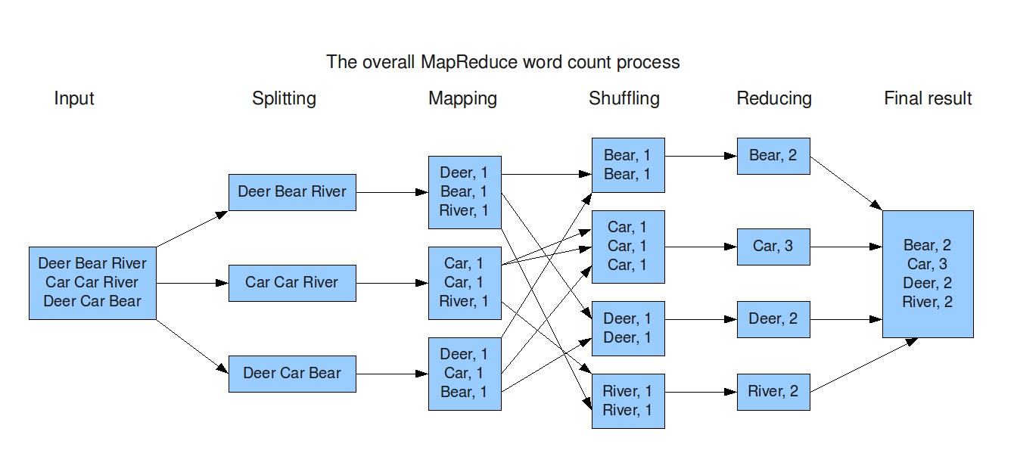
1. MapReduce Paradigm: split data into chunks: then parallelize
11

Slide 12
1. MapReduce Programs
For MapReduce, we will use:
Pseudo code (not executable)
PySpark code (runs on Spark)
For MapReduce, we will focus on learning MapReduce paradigm/model that enables massive scalability across hundreds or thousands of servers in a cluster.
For MapReduce, pseudo-code
examples are given in Lin, J., & Dyer, C. (2010). Data-intensive text processing with MapReduce
12

Slide 13
1. MapReduce Components
MapReduce:
split data into chunks and then
use 3 functions:
map()
Mapper function
reduce()
Reducer function
combine()
Optional combiner function
13

Slide 14
MapReduce Paradigm
MapReduce is a foundation model/paradigm for distributed computing using clusters
MapReduce implementations:
Apache Hadoop implements MapReduce
Apache Spark implements superset of MapReduce
Apache Tez implements MapReduce
Amazon Athena: Serverless SQL service
Google BigQuery: distributed execution graph and shuffle architecture
14

Slide 15
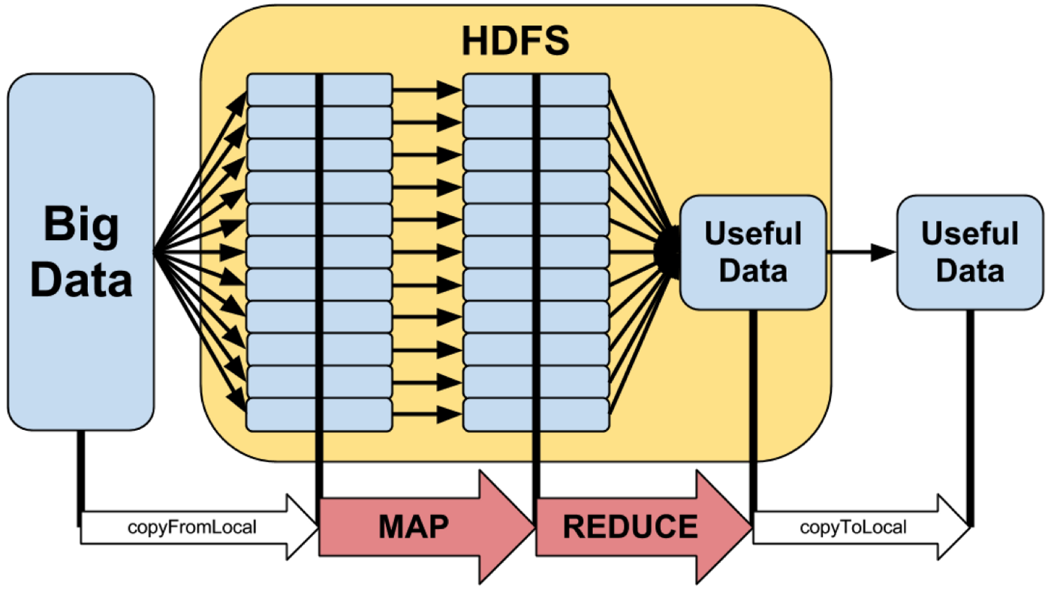
MapReduce Paradigm: High-Level
15

Slide 16
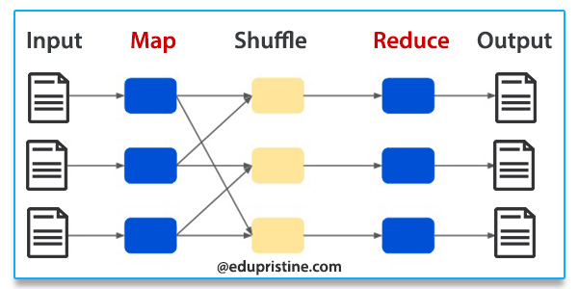
MapReduce Paradigm
16

Slide 17
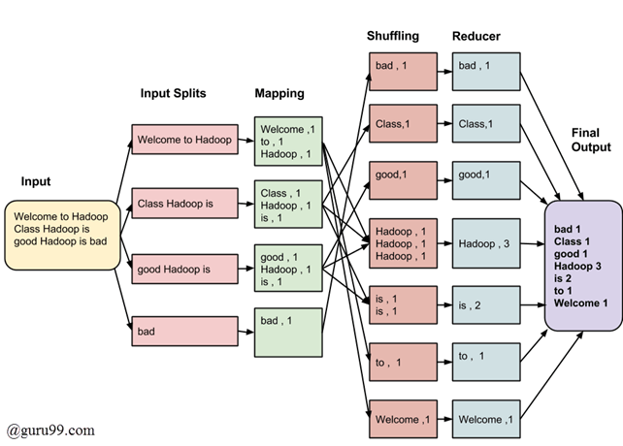
MapReduce Paradigm Example-1
17

Slide 18
MapReduce Paradigm Example-2
18

Slide 19
Solving a Big Data Problem with MapReduce (1)
Input data is partitioned by a partitioner into chunks and sent to Mappers
Assume your input is comprised of 80,000,000,000 records, which might be partitioned into 40,000 chunks
Number of partitions: 40,000
Each partition will have about 2,000,000 records
Maximum mapper parallelism can be 40,000 mappers
80,000,000,000 = 40,000 x 2,000,000
A mapper function, map(K, V) is executed on all partitions in parallel (as much as possible – depends on resources available).
The map(K, V) generates any number of (key, value) pairs such as:
{(K1, V1), (K2, V2), …}. For example, K can be a record number and V can be the actual input record
19

Slide 20
Solving a Big Data Problem with MapReduce (2)
All mappers output go to Sort & Shuffle phase, which groups values by unique keys (similar to GROUP BY in SQL).
Sort & Shuffle creates (key, value) pairs as:
(key_1, [v1, v2, …])
(key_2, [u1, u2, …])
…
(key_n, [t1, t2, …])
Where { key_1, key_2, … key_n }
are the unique keys created by all mappers
20

Slide 21
Solving a Big Data Problem with MapReduce (3)
Output of Sort & Shuffle goes to reducers
A reducer operates on (key, value) pairs where key is in
{ key_1, key_2, …, key_n }
and value is an associated value for the key.
Therefore, the following reducers can be executed in parallel:
reduce(key_1, [v1, v2, …])
reduce(key_2, [u1, u2, …])
…
reduce(key_n, [t1, t2, …])
Each reducer can create any number
of new (key, value) pairs.
21

Slide 22
2. Apache Spark
Apache Spark is a multi-language (Java, Python, Scala) engine for executing data engineering, data science, and machine learning on single-node machines or clusters.
PySpark is a Python API for Spark
Spark is a superset of MapReduce
Spark web site: https://spark.apache.org
22

Slide 23
2. Apache Spark Programs
For Apache Spark , we will use PySpark and
write actual executable programs:
>>> # spark is an instance of SparkSession object
>>> rdd = spark.sparkContext
.parallelize(range(0, 100))
>>> rdd.count()
100
>>> sum_of_values = rdd.reduce(lambda x, y: x+y)
>>> sum_of_values
4950
23

Slide 24
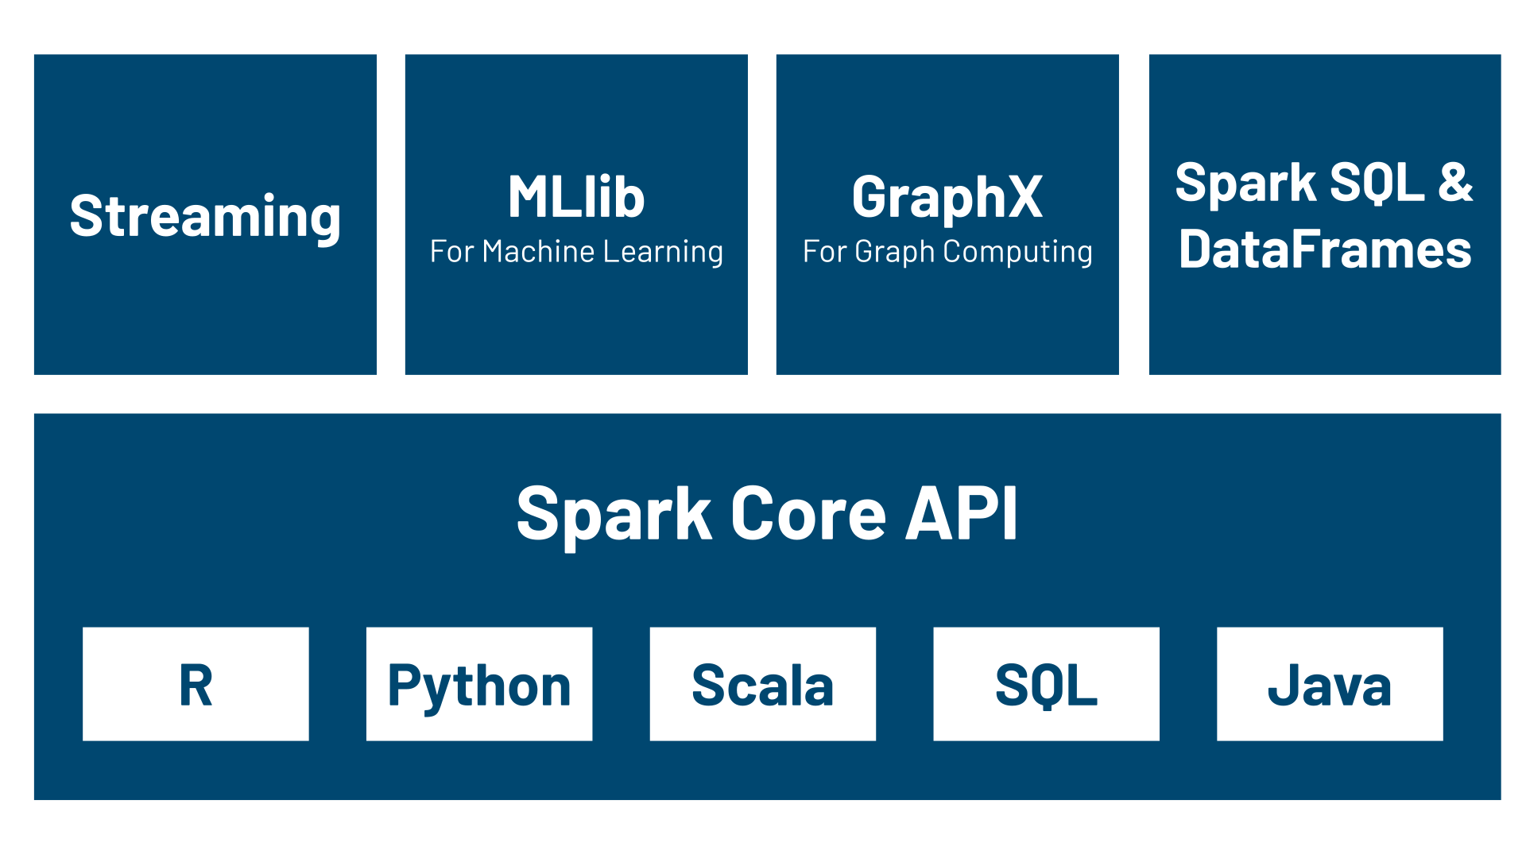
Apache Spark: Components
24

Slide 25
Spark run modes
Local Mode Single machine:
Runs entirely on a single computer or laptop.
Threads for execution: Uses local threads to simulate worker nodes.
Testing and development: Best used for debugging and running quick tests.
Cluster Modes:
In cluster modes, the main distinction is where the Spark Driver (the program that coordinates the work) runs.
Client Mode: External driver: The driver runs on the machine where the job was submitted. Interactive use: Best for interactive shells, notebooks, and local debugging. Network dependent: If your local machine disconnects, the job fails.
Cluster Mode: Internal driver: The driver runs inside a worker node within the cluster. Production standard: Best for scheduled production jobs. Independent: You can close your laptop and the job will keep running.
25

Slide 26
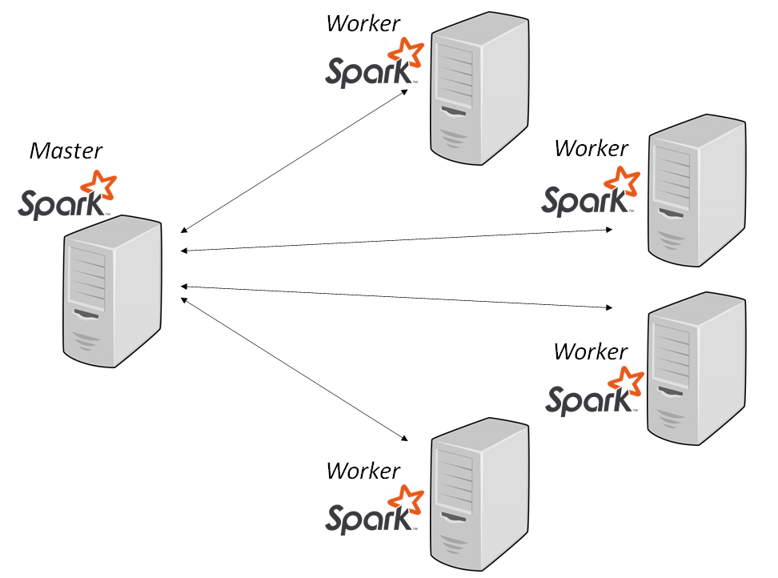
Apache Spark: runs in a cluster
26

Slide 27
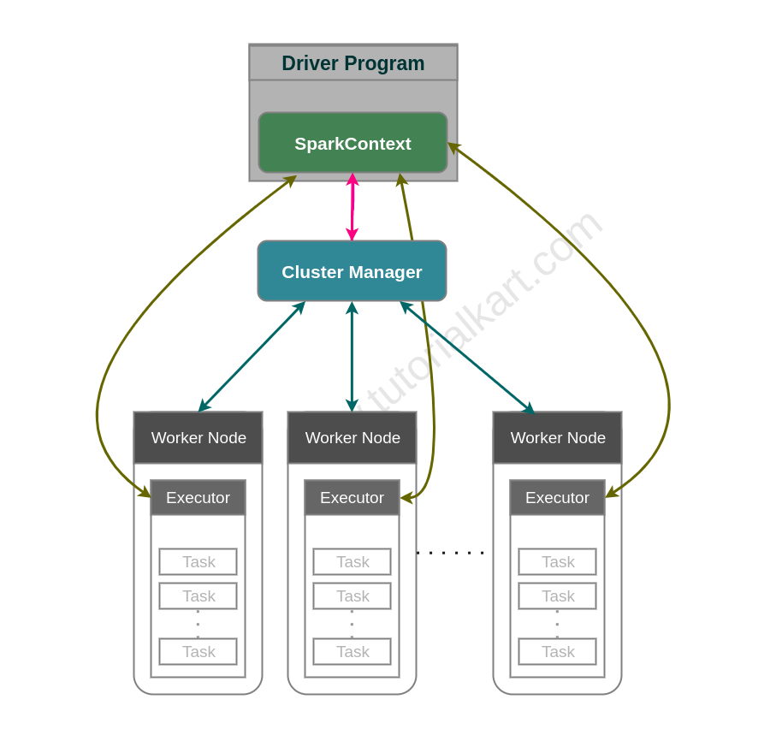
Apache Spark: Cluster Manager
27

Slide 28
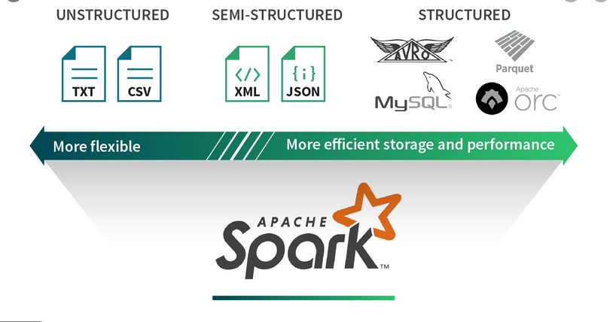
Spark Data Abstractions: Read/Write from/to Many Data Sources
28

Slide 29
Spark Data Abstractions
Your data can be represented as an RDD and DataFrame
1. Resilient Distributed Datasets (RDD)
Data is represented as a data type T
(integer, string, tuples, arrays, dictionary, …)
Billions of data points (elements/records)
2. DataFrame
Data is represented as a table of rows and named columns
Billions of rows of data
29

Slide 30
Spark Data Abstractions: RDDs Billions of data elements Each RDD element: (String, (Float, Float))
(gene-1, (3.0, 4.5))
Element-1:
Element-2:
(gene-2, (1.0, 1.5))
Element-3:
(gene-1, (2.1, 1.6))
…
(gene-8, (3.1, 5.1))
30

Slide 31
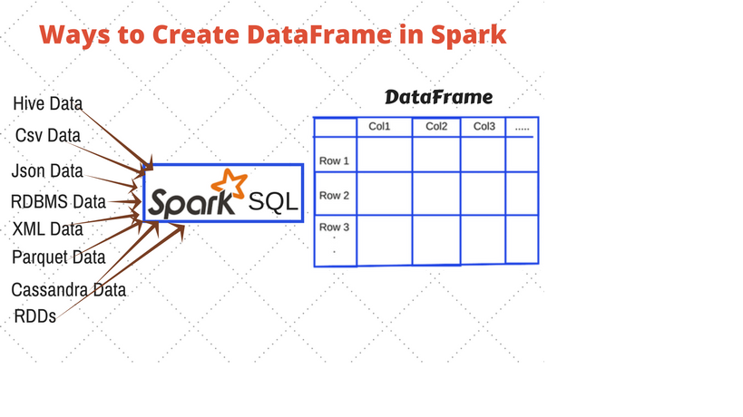
Spark Data Abstractions: DataFrame
31

Slide 32
PySpark DataFrame Example-1
from pyspark.sql import SparkSession
# 1. Initialize a SparkSession
spark = SparkSession.builder.appName("demo").getOrCreate()
# 2. Create a sample DataFrame as df
data = [ ("Alice", "Sales", 45000),
("Bob", "Engineering", 60000), …]
columns = ["name", "department", "salary"]
df = spark.createDataFrame(data, columns)
# 3. Register the DataFrame as a Temporary SQL View
df.createOrReplaceTempView("employees")
32

Slide 33
PySpark DataFrame Example-1 continued…
# 4. Run an SQL query using spark.sql()
query_result = spark.sql("""
SELECT
department,
COUNT(*) as total_employees,
AVG(salary) as average_salary
FROM employees
GROUP BY department
HAVING average_salary > 42000
ORDER BY average_salary DESC
""")
# 5. Display the results
query_result.show()
33

Slide 34
PySpark: create a DataFrame from a CSV File
# Read data from a CSV file with a header
INPUT_PATH = "path/to/your/file.csv"
df = spark.read.csv(
INPUT_PATH,
header=True,
inferSchema=True)
# Show the first few rows of the CSV data
df.show()
34

Slide 35
PySpark DataFrame Example-2 - 01
# This example introduces key intermediate concepts
# like aggregation (groupBy), built-in column functions
# (when, avg), and handling null values (na.fill).
# 1. Import required libraries
from pyspark.sql import SparkSession
from pyspark.sql import functions as F
# 2. Initialize a SparkSession
spark = SparkSession.builder.appName("demo").getOrCreate()
35

Slide 36
PySpark DataFrame Example-2 - 02
# 3. Sample e-commerce transaction data
# (with some missing values)
data = [ ("User_A", "Electronics", 1200.0, "US"),
("User_B", "Clothing", 45.50, "CA"),
("User_C", "Electronics", None, "US"),
("User_A", "Electronics", 150.0, "US"),
("User_D", "Books", 22.00, "UK"),
("User_B", "Clothing", 80.00, "CA"),
("User_E", "Books", 15.75, None),
]
schema = ["UserID", "Category", "Amount", "Country"]
36

Slide 37
PySpark DataFrame Example-2 - 03
# 4. Create a DataFrame
df = spark.createDataFrame(data, schema=schema)
print("--- Raw Data ---")
df.show()
--- Raw Data ---
+------+-----------+------+-------+
|UserID| Category|Amount|Country|
+------+-----------+------+-------+
|User_A|Electronics|1200.0| US|
|User_B| Clothing| 45.5| CA|
|User_C|Electronics| null| US|
|User_A|Electronics| 150.0| US|
|User_D| Books| 22.0| UK|
|User_B| Clothing| 80.0| CA|
|User_E| Books| 15.75| null|
+------+-----------+------+-------+
37

Slide 38
PySpark DataFrame Example-2 - 04
# 5. Data Cleaning: Handle missing values
# Fill missing Amounts with 0.0, and
# Fill missing Countries with 'Unknown’
df_cleaned = df.na.fill({"Amount": 0.0, "Country": "Unknown"})
# 6. Data Transformation: Add a conditional "Customer_Segment" column
# High spenders (> $500), Medium spenders (> $0), and Inactive ($0)
df_transformed = df_cleaned.withColumn( "Segment",
F.when(F.col("Amount") > 500, "High")
.when(F.col("Amount") > 0, "Medium")
.otherwise("Inactive"))
print("--- Cleaned and Transformed Data ---")
df_transformed.show()
38

Slide 39
PySpark DataFrame Example-2 - 05
--- Cleaned and Transformed Data ---
+------+-----------+------+-------+-------+
|UserID| Category|Amount|Country|Segment|
+------+-----------+------+-------+-------+
|User_A|Electronics|1200.0| US| High|
|User_B| Clothing| 45.5| CA| Medium|
|User_C|Electronics| 0.0| US|Inactive|
|User_A|Electronics| 150.0| US| Medium|
|User_D| Books| 22.0| UK| Medium|
|User_B| Clothing| 80.0| CA| Medium|
|User_E| Books| 15.75|Unknown| Medium|
+------+-----------+------+-------+-------+
39

Slide 40
PySpark DataFrame Example-2 - 06
# 7. Data Aggregation: Calculate metrics by Category
# Total spend, average spend, and distinct customer count per category
df_metrics = df_transformed.groupBy("Category").agg(
F.sum("Amount").alias("Total_Revenue"),
F.round(F.avg("Amount").alias("Average_Spend"),
F.countDistinct("UserID").alias("Unique_Customers")
).orderBy(F.desc("Total_Revenue"))
print("--- Aggregated Category Metrics ---")
df_metrics.show()
40

Slide 41
PySpark DataFrame Example-2 - 07
--- Aggregated Category Metrics ---
+-----------+-------------+-------------+----------------+
| Category|Total_Revenue|Average_Spend|Unique_Customers|
+-----------+-------------+-------------+----------------+
|Electronics| 1350.0| 450.0| 2|
| Clothing| 125.5| 62.75| 1|
| Books| 37.75| 18.88| 2|
+-----------+-------------+-------------+----------------+
41

Slide 42
3. Main Course Components Serverless SQL Access to Big Data (15%)
Amazon Athena
Google BigQuery
Snowflake
42

Slide 43
Amazon Athena
Interactive query service
Serverless. Zero infrastructure. Zero administration.
Put your data in S3
Access your data by SQL
Pay by query
Fast performance
43

Slide 44
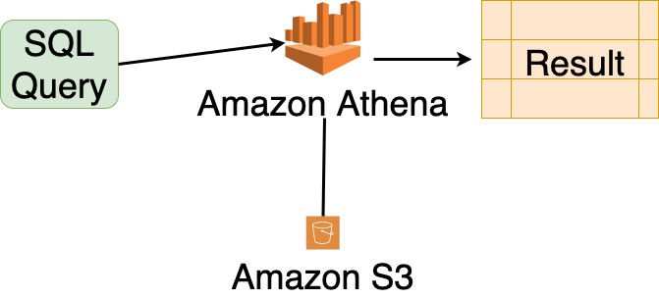
Amazon Athena
44

