Slide 1
Big Data
Modeling & Analytics
10 Weeks Course Outline
Mahmoud Parsian
Ph.D. in Computer Science
1

Slide 2
Big Data Modeling & Analytics?
What is Big Data?
What is Big data Modeling?
3. What is Big Data Modeling & Analytics?
4. Solutions to Big Data Modeling & Analytics
1. MapReduce paradigm
2. Spark/PySpark
3. Amazon Athena & Google’s BigQuery
2

Slide 3
1. What is Big Data?
Big Data refers to datasets that are so massive,
fast-moving, and complex that traditional data-processing
software cannot capture, store, or analyze them effectively.
Instead of relying on a single computer ,
big data requires cluster computing frameworks like
Apache Spark
Snowflake
Amazon Athena
Google’s BigQuery
3

Slide 4
What is a Big Data Modeling?
Big data modeling is the process of organizing large,
fast-moving, and diverse datasets so they can be stored,
processed, analyzed, and understood efficiently.
Key Characteristics of Big Data:
1. Volume: Handles massive amounts of data
2. Velocity: Supports rapidly generated and processed data
3. Variety: Combines structured, semi-structured, and unstructured data
4. Veracity: The quality, reliability, and trust of the data
5. Scalability: Adapts as data and user demand grow
4

Slide 5
What is a Big Data Modeling?
# Common Models
- Data lakes and Lake-Houses
- NoSQL models: document, key-value, column, and graph
- Distributed data warehouses (Snowflake)
- Batch and streaming architectures (Spark)
> Goal: Turn complex raw data into a reliable structure for analysis and decision-making.
5

Slide 6
What is a Big Data Modeling & Analytics?
Big data analytics uses modeled data to discover patterns,
explain outcomes, predict future events, and recommend actions.
## Analytics Types
- Descriptive: What happened?
- Diagnostic: Why did it happen?
- Predictive: What is likely to happen?
- Prescriptive: What action should be taken?
## Typical Workflow
Collect → Clean → Model → Process → Analyze → Visualize → Act
6

Slide 7
Business Value of Big Data Modeling & Analytics?
Faster, evidence-based decisions
Improved customer experiences
Fraud and risk detection
Operational efficiency
Forecasting and innovation
Building AI-LLM models
Strong analytics depends on a scalable, accurate,
and well-governed data model.
7

Slide 8
🎯 Query-Driven Schema Design
Unlike traditional relational modeling — where the schema is normalized first and queries are written against it afterward — big data modeling typically works in the opposite order:
1. Study the Requirements. Identify who needs the data and why: which dashboards, reports, ML features, or applications will consume it.
2. Enumerate the Access Patterns. Determine exactly how the data will be queried — which fields are filtered on, which are aggregated, how the data is expected to grow, and how fresh it needs to be.
3. Design the Schema to Fit those Queries. Choose partition keys, denormalization strategy, and physical layout so the known queries run fast — even if that means duplicating data or shaping the same entity differently across multiple tables.
8

Slide 9
Big Data Modeling
Course Components:
1. Introduction to Big Data (5%)
2. Introduction to MapReduce Paradigm (20%)
3. Spark and PySpark (60%)
4. Serverless SQL Access to Big Data (15%)
9

Slide 10
Big Data Analysis
1. MapReduce
2.
Spark/PySpark
RDD/DataFrame
3.
Amazon
Athena (SQL)
Input
1. Text
2. Transactions
3. DNA Data
4. Cancer data
…
Data Analysis
Transformations & Actions
Mappers
Filters
Reducers
Joins
Desired
Output
10

Slide 11
1. MapReduce Paradigm
MapReduce is a programming paradigm/model that enables massive scalability across hundreds or thousands of servers in a cluster.
MapReduce has 3 functions:
  map()
  reduce()
  combine() [optional function]
11

Slide 12
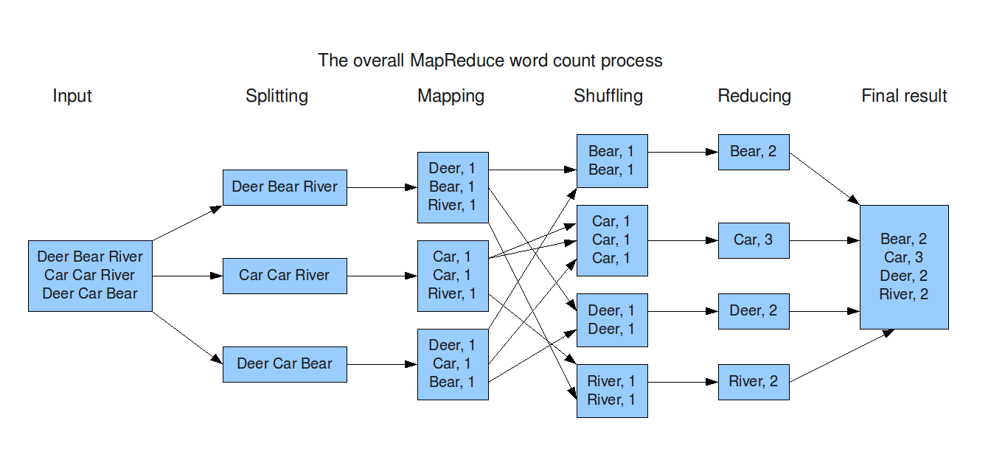
1. MapReduce Paradigm in Action: split data into chunks: then parallelize
12

Slide 13
1. MapReduce Programs
For MapReduce, we will use:
  Pseudo code (not executable)
  PySpark code (runs on Spark)
For MapReduce, we will focus on learning MapReduce paradigm/model that enables massive scalability across hundreds or thousands of servers in a cluster.
For MapReduce, pseudo-code
  examples are given in Lin, J., & Dyer, C. (2010). Data-intensive text processing with MapReduce
13

Slide 14
1. MapReduce Components
MapReduce:
split data into chunks and then
use 3 functions and execute tasks in parallel:
  map()
    Mapper function
  reduce()
    Reducer function
  combine()
    [Optional combiner function]
14

Slide 15
MapReduce Paradigm
MapReduce is a foundation model/paradigm for distributed computing using clusters
MapReduce Implementations:
  Apache Hadoop implements MapReduce
  Apache Spark implements superset of MapReduce
  Apache Tez implements MapReduce
  Amazon Athena: Serverless SQL service
  Google BigQuery: distributed execution graph and shuffle architecture
15

Slide 16
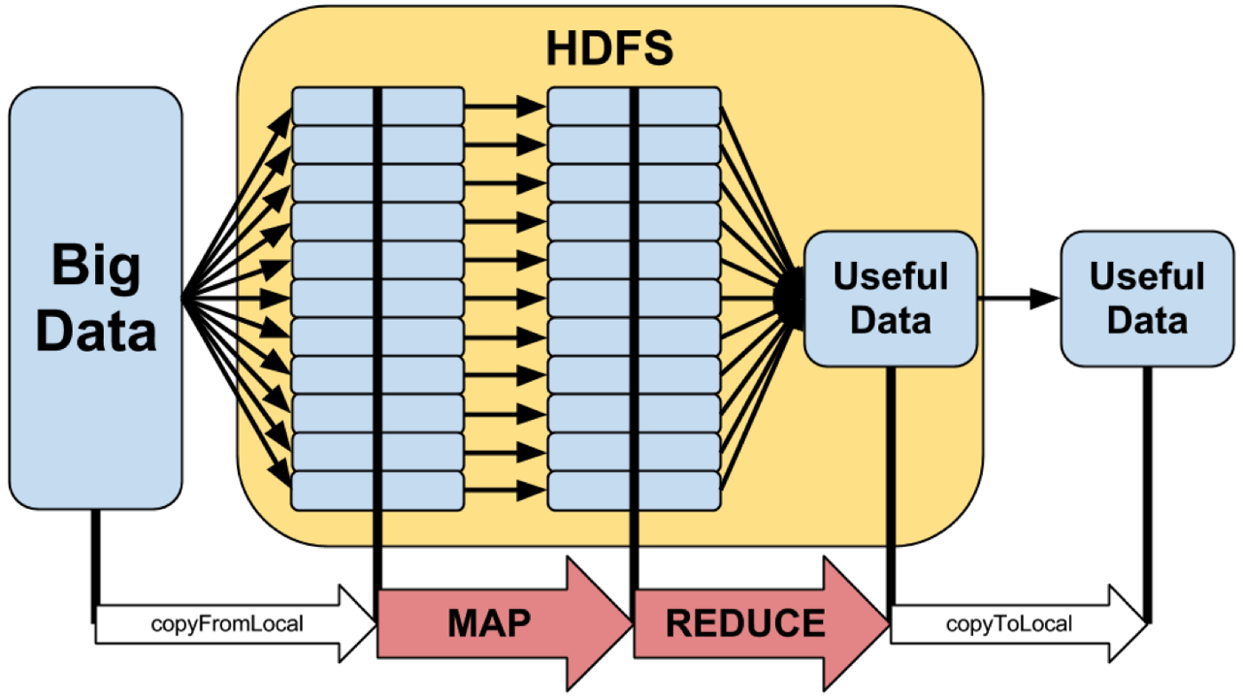
MapReduce Paradigm: High-Level
16

Slide 17
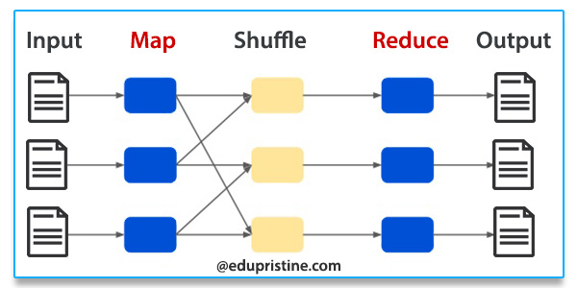
MapReduce Paradigm
17

Slide 18
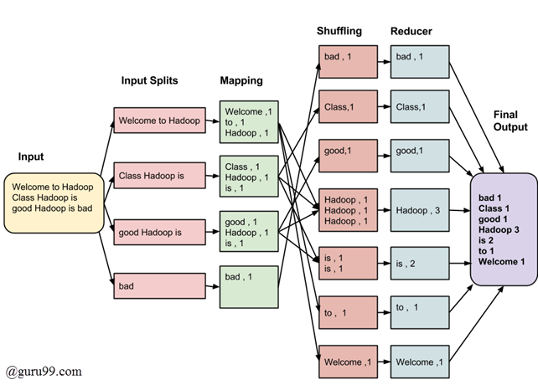
MapReduce Paradigm Example-1
18

Slide 19
MapReduce Paradigm Example-2
19

Slide 20
Solving a Big Data Problem with MapReduce (1)
Input data is partitioned by a partitioner into chunks and sent to Mappers
Assume your input is comprised of 80,000,000,000 records, which might be partitioned into 40,000 chunks
  Number of partitions: 40,000
  Each partition will have about 2,000,000 records
  Maximum mapper parallelism can be 40,000 mappers
  80,000,000,000 = 40,000 x 2,000,000
A mapper function, map(K, V) is executed on all partitions in parallel (as much as possible – depends on resources available).
The map(K, V) generates any number of (key, value) pairs such as:
{(K1, V1), (K2, V2), …}. For example, K can be a record number and V can be the actual input record
20

Slide 21
Solving a Big Data Problem with MapReduce (2)
All mappers output go to Sort & Shuffle phase, which groups values by unique keys (similar to GROUP BY in SQL).
Sort & Shuffle creates (key, value) pairs as:
(key_1, [v1, v2, …])
(key_2, [u1, u2, …])
…
(key_n, [t1, t2, …])
Where { key_1, key_2, … key_n }
are the unique keys created by all mappers
21

Slide 22
Solving a Big Data Problem with MapReduce (3)
Output of Sort & Shuffle goes to reducers
A reducer operates on (key, value) pairs where key is in
{ key_1, key_2, …, key_n }
and value is an associated value for the key.
Therefore, the following reducers can be executed in parallel:
reduce(key_1, [v1, v2, …])
reduce(key_2, [u1, u2, …])
…
reduce(key_n, [t1, t2, …])
Each reducer can create any number
of new (key, value) pairs.
22

Slide 23
2. Apache Spark: engine for large-scale data analytics
Spark is a multi-language (Java, Python, Scala) engine for executing data engineering, data science, and machine learning on single-node machines or clusters.
PySpark is a Python API for Spark
Spark is a superset of MapReduce
Spark web site: https://spark.apache.org
23

Slide 24
2. Apache Spark Programs
For Apache Spark , we will use PySpark and
write actual executable programs:
>>> # spark is an instance of SparkSession object
>>> rdd = spark.sparkContext
.parallelize(range(0, 100))
>>> rdd.count()
100
>>> sum_of_values = rdd.reduce(lambda x, y: x+y)
>>> sum_of_values
4950
24

Slide 25
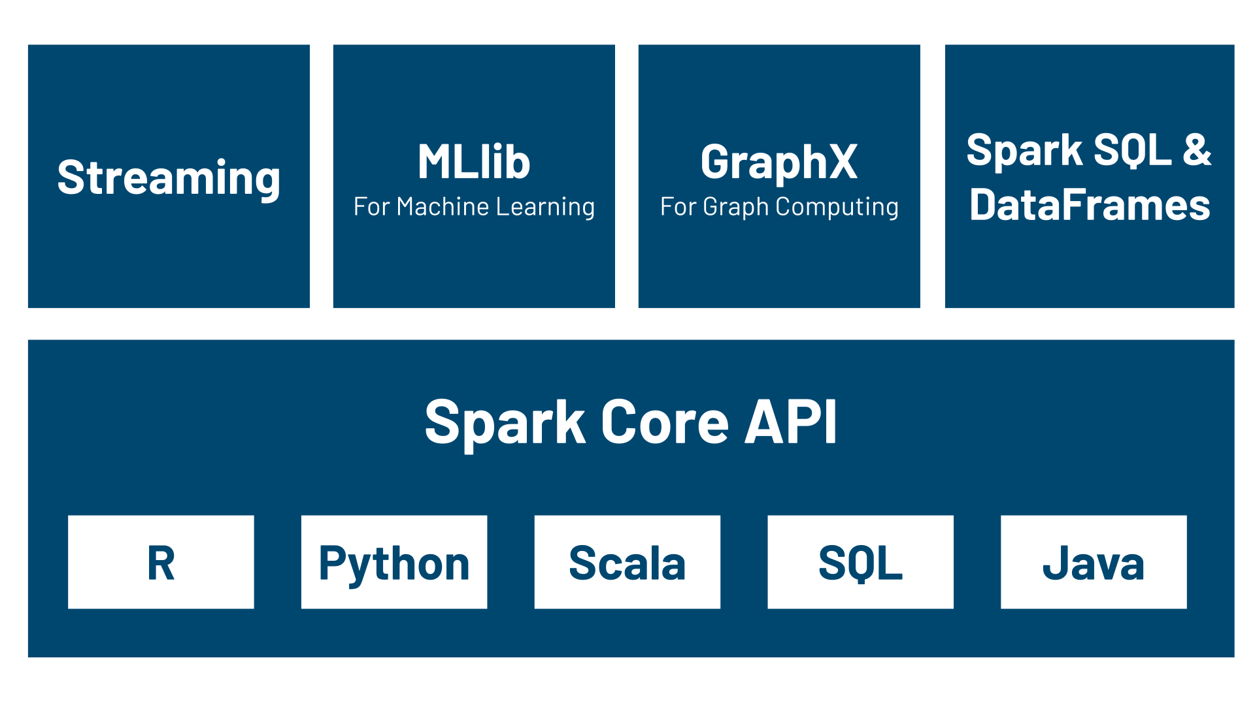
Apache Spark: Components
25

Slide 26
Spark Run Modes
Local Mode Single machine:
Runs entirely on a single computer or laptop.
Threads for execution: Uses local threads to simulate worker nodes.
Testing and development: Best used for debugging and running quick tests.
Cluster Modes:
In cluster modes, the main distinction is where the Spark Driver (the program that coordinates the work) runs.
Client Mode: External driver: The driver runs on the machine where the job was submitted. Interactive use: Best for interactive shells, notebooks, and local debugging. Network dependent: If your local machine disconnects, the job fails.
Cluster Mode: Internal driver: The driver runs inside a worker node within the cluster. Production standard: Best for scheduled production jobs. Independent: You can close your laptop and the job will keep running.
26

Slide 27
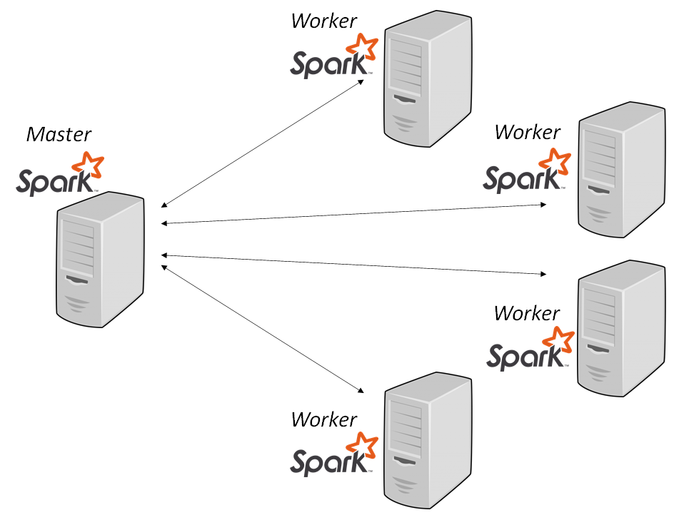
Apache Spark: runs in a cluster
27

Slide 28
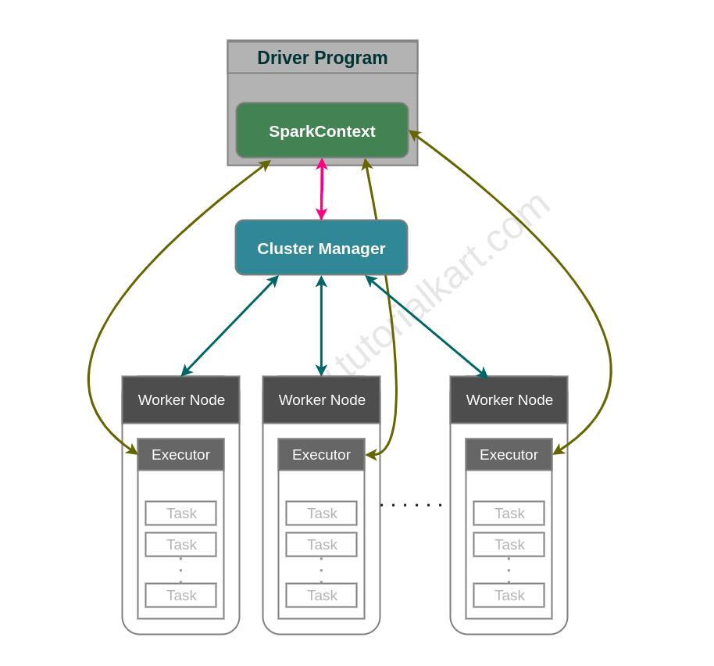
Apache Spark: Cluster Manager
28

Slide 29
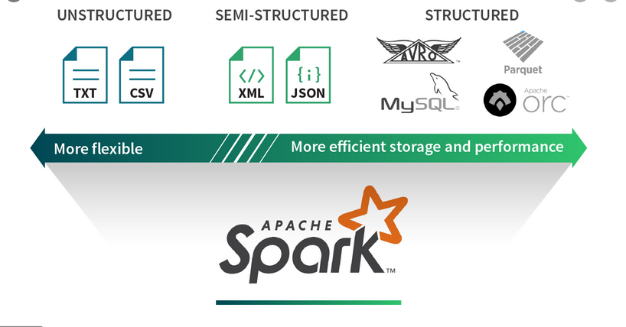
Spark Data Abstractions:
Read/Write from/to Many Data Sources
29

Slide 30
Spark Data Abstractions
Your data can be represented as an RDD and DataFrame
1. Resilient Distributed Datasets (RDD)
  Data is represented as a data type T
  (integer, string, tuples, arrays, dictionary, …)
  Billions of data points (elements/records)
2. DataFrame
  Data is represented as a table of rows and named columns
  Billions of rows of data
30

Slide 31
Spark Data Abstractions: RDDs
Billions of data elements
Each RDD element: (String, (Float, Float))
(gene-1, (3.0, 4.5))
Element-1:
Element-2:
(gene-2, (1.0, 1.5))
Element-3:
(gene-1, (2.1, 1.6))
…
(gene-8, (3.1, 5.1))
31

Slide 32
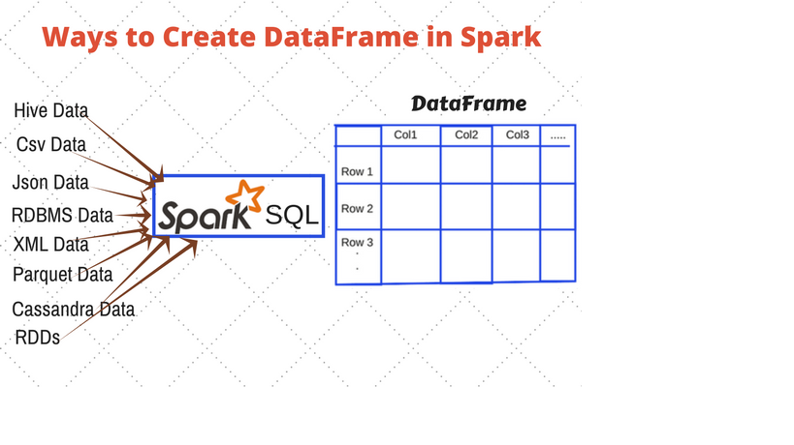
Spark Data Abstractions: DataFrame
32

Slide 33
PySpark DataFrame Example-1
# 1. Import required libraries
from pyspark.sql import SparkSession
# 2. Create a SparkSession object
spark = SparkSession.builder.appName("demo").getOrCreate()
# 3. Create a sample DataFrame as df
data = [ ("Alice", "Sales", 45000),
("Bob", "Engineering", 60000), …]
columns = ["name", "department", "salary"]
df = spark.createDataFrame(data, columns)
# 4. Register the DataFrame as a Temporary SQL View
df.createOrReplaceTempView("employees")
33

Slide 34
PySpark DataFrame Example-1 continued…
# 5. Run an SQL query using spark.sql()
query_result = spark.sql("""
SELECT
department,
COUNT(*) as total_employees,
AVG(salary) as average_salary
FROM employees
GROUP BY department
HAVING average_salary > 42000
ORDER BY average_salary DESC
""")
# 6. Display the results
query_result.show()
34

Slide 35
PySpark: create a DataFrame from a CSV File
# 1. Define your data
INPUT_PATH = "path/to/your/file.csv"
# 2. Read data from a CSV file with a header and create a DataFrame
df = spark.read.csv(
INPUT_PATH,
header=True,
inferSchema=True)
# 3. Find number of rows
df.count()
# 4. Show the first 10 rows of the DataFrame
df.show(10)
35

Slide 36
PySpark DataFrame Example-2 - 01
# This example introduces key intermediate concepts
# like aggregation (groupBy), built-in column functions
# (when, avg), and handling null values (na.fill).
# 1. Import required libraries
from pyspark.sql import SparkSession
from pyspark.sql import functions as F
# 2. Initialize a SparkSession
spark = SparkSession.builder.appName("demo").getOrCreate()
36

Slide 37
PySpark DataFrame Example-2 - 02
# 3. Sample e-commerce transaction data
# (with some missing values)
data = [ ("User_A", "Electronics", 1200.0, "US"),
("User_B", "Clothing", 45.50, "CA"),
("User_C", "Electronics", None, "US"),
("User_A", "Electronics", 150.0, "US"),
("User_D", "Books", 22.00, "UK"),
("User_B", "Clothing", 80.00, "CA"),
("User_E", "Books", 15.75, None),
]
Column_names = ["UserID", "Category", "Amount", "Country"]
37

Slide 38
PySpark DataFrame Example-2 - 03
# 4. Create a DataFrame
df = spark.createDataFrame(data, schema=column_names)
print("--- Raw Data ---")
df.show()
--- Raw Data ---
+------+-----------+------+-------+
|UserID| Category|Amount|Country|
+------+-----------+------+-------+
|User_A|Electronics|1200.0| US|
|User_B| Clothing| 45.5| CA|
|User_C|Electronics| null| US|
|User_A|Electronics| 150.0| US|
|User_D| Books| 22.0| UK|
|User_B| Clothing| 80.0| CA|
|User_E| Books| 15.75| null|
+------+-----------+------+-------+
38

Slide 39
PySpark DataFrame Example-2 - 04
# 5. Data Cleaning: Handle missing values
# Fill missing Amounts with 0.0, and
# Fill missing Countries with 'Unknown’
df_cleaned = df.na.fill({"Amount": 0.0, "Country": "Unknown"})
# 6. Data Transformation: Add a conditional "Customer_Segment" column
# High spenders (> $500), Medium spenders (> $0), and Inactive ($0)
df_transformed = df_cleaned.withColumn( "Segment",
F.when(F.col("Amount") > 500, "High")
.when(F.col("Amount") > 0, "Medium")
.otherwise("Inactive")
)
# 7. Show the first 20 rows
print("--- Cleaned and Transformed Data ---")
df_transformed.show(20)
39

Slide 40
PySpark DataFrame Example-2 - 05
--- Cleaned and Transformed Data ---
+------+-----------+------+-------+--------+
|UserID| Category|Amount|Country|Segment |
+------+-----------+------+-------+--------+
|User_A|Electronics|1200.0| US| High |
|User_B| Clothing| 45.5| CA| Medium |
|User_C|Electronics| 0.0| US|Inactive|
|User_A|Electronics| 150.0| US| Medium |
|User_D| Books| 22.0| UK| Medium |
|User_B| Clothing| 80.0| CA| Medium |
|User_E| Books| 15.75|Unknown| Medium |
+------+-----------+------+-------+--------+
40

Slide 41
PySpark DataFrame Example-2 - 06
# 8. Data Aggregation: Calculate metrics by Category
# Total spend, average spend, and distinct customer count per category
df_metrics = df_transformed.groupBy("Category").agg(
F.sum("Amount").alias("Total_Revenue"),
F.round(F.avg("Amount").alias("Average_Spend"),
F.countDistinct("UserID").alias("Unique_Customers")
).orderBy(F.desc("Total_Revenue"))
# 9. Show the first 20 rows
print("--- Aggregated Category Metrics ---")
df_metrics.show(20)
41

Slide 42
PySpark DataFrame Example-2 - 07
--- Aggregated Category Metrics ---
+-----------+-------------+-------------+----------------+
| Category|Total_Revenue|Average_Spend|Unique_Customers|
+-----------+-------------+-------------+----------------+
|Electronics| 1350.0| 450.0| 2|
| Clothing| 125.5| 62.75| 1|
| Books| 37.75| 18.88| 2|
+-----------+-------------+-------------+----------------+
42

Slide 43
3. Main Course Components
Serverless SQL Access to Big Data (15%)
    Amazon Athena
    Google BigQuery
    Snowflake
43

Slide 44
Amazon Athena: built from PrestoDB
Amazon Athena is a serverless, interactive query service provided by AWS that uses PrestoDB as its underlying distributed SQL query engine.
44

Slide 45
Amazon Athena: built from PrestoDB
Interactive query service
Serverless. Zero infrastructure. Zero administration.
Put your data in S3
Access your data by SQL
Pay by query
Fast performance
45

Slide 46
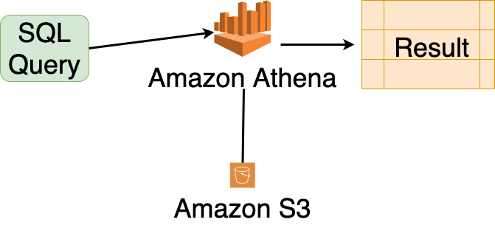
Amazon Athena
46

