Slide 1
DISTRIBUTED DATA PARADIGM SHIFT
Transitioning from MapReduce to PySpark
Evolving purely functional map, combine, and reduce patterns into high-performance Spark execution

Slide 2
FUNCTIONAL FOUNDATIONS
The Classic MapReduce Triad
map()
combine()
reduce()
Transforms individual records into key-value intermediate tuples.
Performs local in-memory pre-aggregation before network shuffle.
Aggregates partitioned values globally across key boundary groups.

Slide 3

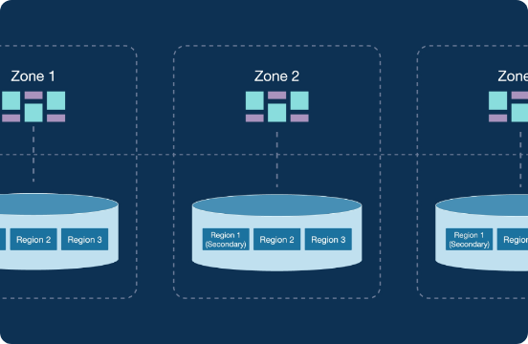
PARADIGM LIMITATIONS
Traditional MapReduce Bottlenecks
Disk Overhead: Mandatory intermediate disk writes between map and reduce stages.
High Latency: Strict barrier synchronization slows multi-step data pipelines.
Rigid Chaining: Complex workflows require manual multi-job stringing.

Slide 4
IN-MEMORY REVOLUTION
The Spark Core Advantage
100x
Faster in-memory computation compared to disk-bound execution
RAM Caching
Lazy Execution
In-memory state persistence across iterations.
Optimized DAG graphs compiled before execution.

Slide 5
DIRECT EQUIVALENCE
Mapping Primitives to PySpark RDDs
# Idiomatic PySpark RDD word_counts = ( lines.flatMap(lambda line: line.split(" ")) .map(lambda word: (word, 1)) .reduceByKey(lambda a, b: a + b) )
# Conceptual functional flow words = map(split_words, lines) pairs = map(make_pair, words) combined = combine(local_sum, pairs) result = reduce(global_sum, combined)
PySpark RDD Pipeline
Conceptual MapReduce
# Conceptual functional flow words = map(split_words, lines) pairs = map(make_pair, words) combined = combine(local_sum, pairs) result = reduce(global_sum, combined)
# Idiomatic PySpark RDD word_counts = ( lines.flatMap(lambda line: line.split(" ")) .map(lambda word: (word, 1)) .reduceByKey(lambda a, b: a + b) )

Slide 6
MAP-SIDE AGGREGATION
Replacing combine() with combineByKey()
Zero Spill Shuffle
Aggregates records locally before partition transfer.
# PySpark combineByKey for average calculation rdd.combineByKey( createCombiner=lambda v: (v, 1), mergeValue=lambda acc, v: (acc[0] + v, acc[1] + 1), mergeCombiners=lambda a, b: (a[0] + b[0], a[1] + b[1]) )
# PySpark combineByKey for average calculation rdd.combineByKey( createCombiner=lambda v: (v, 1), mergeValue=lambda acc, v: (acc[0] + v, acc[1] + 1), mergeCombiners=lambda a, b: (a[0] + b[0], a[1] + b[1]) )
Type Transformation
Converts raw inputs into distinct tuple accumulators.

Slide 7
MODERN SPARK ARCHITECTURE
Beyond RDDs: Modern Spark DataFrames
Low-Level RDDs
DataFrame API
Catalyst Engine
Explicit functional lambda transformations.
Schema-aware declarative query operations.
Automatic physical query plan optimization.

Slide 8
EXECUTION LIFECYCLE
PySpark Execution Stage Flow
STAGE 1
STAGE 2
STAGE 3
STAGE 4
Input Read
Lazy Transforms
Shuffle Exchange
Action Trigger
Loads data into initial RDD partitions.
Builds transformation lineage graph.
Re-partitions data across network nodes.
Executes DAG and writes output result.

Slide 9
PARADIGM MATRIX
Architectural Paradigm Comparison
Feature | Classic MapReduce | PySpark RDD | PySpark DataFrame
Data Storage | Disk Storage | In-Memory RAM | In-Memory Off-Heap
Aggregation | combine() / reduce() | reduceByKey() | groupBy().agg()
Optimization | Manual Control | DAG Lineage | Catalyst Optimizer

Slide 10
SUMMARY & NEXT STEPS
Key Migration Takeaways
1. Combine Early: Use reduceByKey() or combineByKey() to reduce shuffle overhead.
2. Eliminate Disk I/O: Leverage Spark's in-memory caching for iterative computations.
3. Adopt DataFrames: Transition from low-level RDD operations to catalyst-optimized DataFrames.
Ready to transform your distributed pipelines?

Slide 11

Image Sources
https://static.pingcap.com/files/2023/08/17235704/Distributed-SQL-Databases.png
Source: www.pingcap.com

