Slide 1

Data-Intensive Computing
with MapReduce
Session 2: Hadoop Nuts and Bolts
Jimmy Lin
University of Maryland
Thursday, January 31, 2013
This work is licensed under a Creative Commons Attribution-Noncommercial-Share Alike 3.0 United States
See http://creativecommons.org/licenses/by-nc-sa/3.0/us/ for details

Slide 2

Source: Wikipedia (The Scream)

Slide 3

Source: Wikipedia (Japanese rock garden)

Slide 4

Source: Wikipedia (Keychain)

Slide 5
How will I actually learn Hadoop?
This class session
Hadoop: The Definitive Guide
RTFM
RTFC(!)

Slide 6
Materials in the course
The course homepage
Hadoop: The Definitive Guide
Data-Intensive Text Processing with MapReduce
Cloud⁹
Take advantage of GitHub!
clone, branch, send pull request

Slide 7
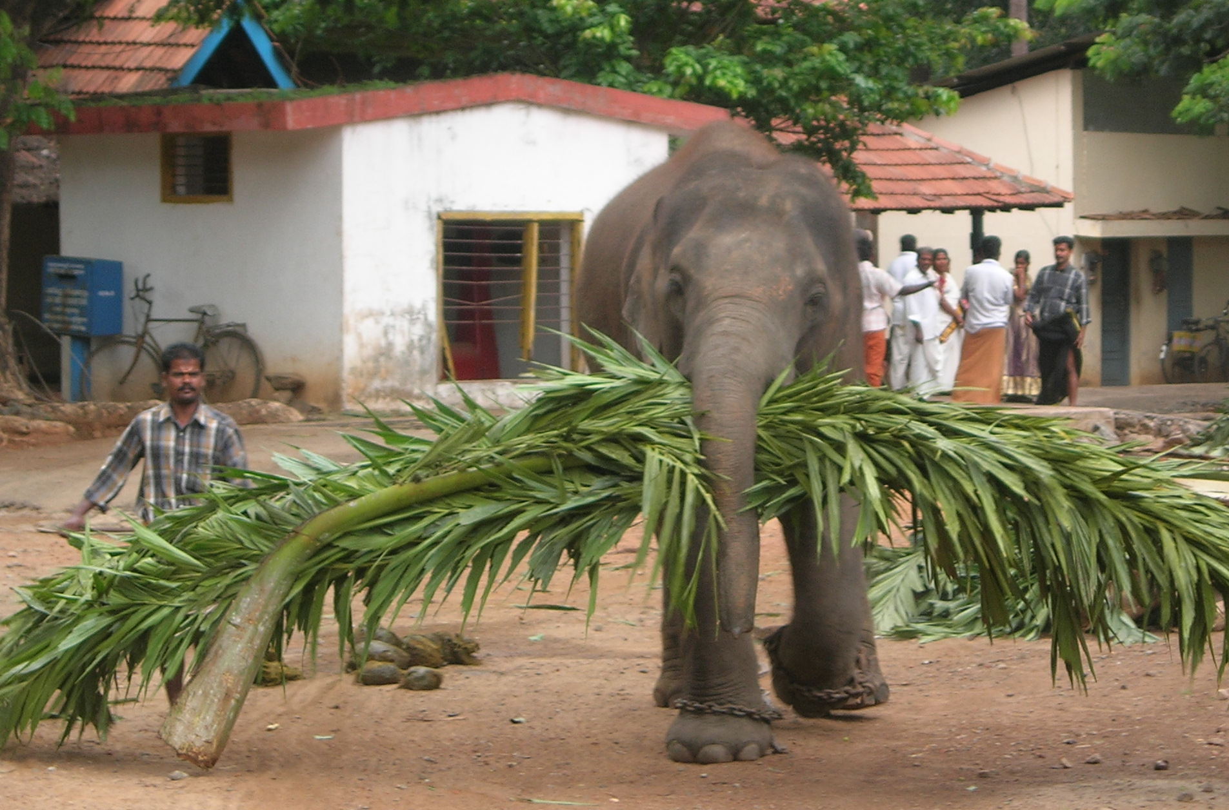
Source: Wikipedia (Mahout)

Slide 8
Basic Hadoop API*
Mapper
  void setup(Mapper.Context context)
  Called once at the beginning of the task
  void map(K key, V value, Mapper.Context context)
  Called once for each key/value pair in the input split
  void cleanup(Mapper.Context context)
  Called once at the end of the task
Reducer/Combiner
  void setup(Reducer.Context context)
  Called once at the start of the task
  void reduce(K key, Iterable<V> values, Reducer.Context context)
  Called once for each key
  void cleanup(Reducer.Context context)
  Called once at the end of the task
*Note that there are two versions of the API!

Slide 9
Basic Hadoop API*
Partitioner
  int getPartition(K key, V value, int numPartitions)
  Get the partition number given total number of partitions
Job
  Represents a packaged Hadoop job for submission to cluster
  Need to specify input and output paths
  Need to specify input and output formats
  Need to specify mapper, reducer, combiner, partitioner classes
  Need to specify intermediate/final key/value classes
  Need to specify number of reducers (but not mappers, why?)
  Don’t depend of defaults!
*Note that there are two versions of the API!

Slide 10

A tale of two packages…
org.apache.hadoop.mapreduce
org.apache.hadoop.mapred
Source: Wikipedia (Budapest)

Slide 11
Data Types in Hadoop: Keys and Values
Writable
Defines a de/serialization protocol. Every data type in Hadoop is a Writable.
WritableComprable
Defines a sort order. All keys must be of this type (but not values).
IntWritable
LongWritable
Text
…
Concrete classes for different data types.
SequenceFiles
Binary encoded of a sequence of
key/value pairs

Slide 12
“Hello World”: Word Count
Map(String docid, String text):
for each word w in text:
Emit(w, 1);
Reduce(String term, Iterator<Int> values):
int sum = 0;
for each v in values:
sum += v;
Emit(term, value);

Slide 13
“Hello World”: Word Count
private static class MyMapper extends
Mapper<LongWritable, Text, Text, IntWritable> {
private final static IntWritable ONE = new IntWritable(1);
private final static Text WORD = new Text();
@Override
public void map(LongWritable key, Text value, Context context)
throws IOException, InterruptedException {
String line = ((Text) value).toString();
StringTokenizer itr = new StringTokenizer(line);
while (itr.hasMoreTokens()) {
WORD.set(itr.nextToken());
context.write(WORD, ONE);
}
}
}

Slide 14
“Hello World”: Word Count
private static class MyReducer extends
Reducer<Text, IntWritable, Text, IntWritable> {
private final static IntWritable SUM = new IntWritable();
@Override
public void reduce(Text key, Iterable<IntWritable> values,
Context context) throws IOException, InterruptedException {
Iterator<IntWritable> iter = values.iterator();
int sum = 0;
while (iter.hasNext()) {
sum += iter.next().get();
}
SUM.set(sum);
context.write(key, SUM);
}
}

Slide 15
Three Gotchas
Avoid object creation at all costs
  Reuse Writable objects, change the payload
Execution framework reuses value object in reducer
Passing parameters via class statics

Slide 16
Getting Data to Mappers and Reducers
Configuration parameters
  Directly in the Job object for parameters
“Side data”
  DistributedCache
  Mappers/reducers read from HDFS in setup method

Slide 17
Complex Data Types in Hadoop
How do you implement complex data types?
The easiest way:
  Encoded it as Text, e.g., (a, b) = “a:b”
  Use regular expressions to parse and extract data
  Works, but pretty hack-ish
The hard way:
  Define a custom implementation of Writable(Comprable)
  Must implement: readFields, write, (compareTo)
  Computationally efficient, but slow for rapid prototyping
  Implement WritableComparator hook for performance
Somewhere in the middle:
  Cloud⁹ offers JSON support and lots of useful Hadoop types
  Quick tour…

Slide 18
Basic Cluster Components*
One of each:
  Namenode (NN): master node for HDFS
  Jobtracker (JT): master node for job submission
Set of each per slave machine:
  Tasktracker (TT): contains multiple task slots
  Datanode (DN): serves HDFS data blocks
* Not quite… leaving aside YARN for now

Slide 19
Putting everything together…
namenode
job submission node
namenode daemon
jobtracker
tasktracker
tasktracker
tasktracker
datanode daemon
datanode daemon
datanode daemon
Linux file system
Linux file system
Linux file system
…
…
…
slave node
slave node
slave node

Slide 20
Anatomy of a Job
MapReduce program in Hadoop = Hadoop job
  Jobs are divided into map and reduce tasks
  An instance of running a task is called a task attempt (occupies a slot)
  Multiple jobs can be composed into a workflow
Job submission:
  Client (i.e., driver program) creates a job, configures it, and submits it to jobtracker
  That’s it! The Hadoop cluster takes over…

Slide 21
Anatomy of a Job
Behind the scenes:
  Input splits are computed (on client end)
  Job data (jar, configuration XML) are sent to JobTracker
  JobTracker puts job data in shared location, enqueues tasks
  TaskTrackers poll for tasks
  Off to the races…

Slide 22
Input File
Input File
InputSplit
InputSplit
InputSplit
InputSplit
InputSplit
InputFormat
RecordReader
RecordReader
RecordReader
RecordReader
RecordReader
Mapper
Mapper
Mapper
Mapper
Mapper
Intermediates
Intermediates
Intermediates
Intermediates
Intermediates
Source: redrawn from a slide by Cloduera, cc-licensed

Slide 23
Client
Records
…
…
InputSplit
InputSplit
InputSplit
RecordReader
RecordReader
RecordReader
Mapper
Mapper
Mapper

Slide 24
Mapper
Mapper
Mapper
Mapper
Mapper
Intermediates
Intermediates
Intermediates
Intermediates
Intermediates
Partitioner
Partitioner
Partitioner
Partitioner
Partitioner
(combiners omitted here)
Intermediates
Intermediates
Intermediates
Reducer
Reducer
Reduce
Source: redrawn from a slide by Cloduera, cc-licensed

Slide 25
Reducer
Reducer
Reduce
OutputFormat
RecordWriter
RecordWriter
RecordWriter
Output File
Output File
Output File
Source: redrawn from a slide by Cloduera, cc-licensed

Slide 26
Input and Output
InputFormat:
  TextInputFormat
  KeyValueTextInputFormat
  SequenceFileInputFormat
  …
OutputFormat:
  TextOutputFormat
  SequenceFileOutputFormat
  …

Slide 27
Shuffle and Sort in Hadoop
Probably the most complex aspect of MapReduce
Map side
  Map outputs are buffered in memory in a circular buffer
  When buffer reaches threshold, contents are “spilled” to disk
  Spills merged in a single, partitioned file (sorted within each partition): combiner runs during the merges
Reduce side
  First, map outputs are copied over to reducer machine
  “Sort” is a multi-pass merge of map outputs (happens in memory and on disk): combiner runs during the merges
  Final merge pass goes directly into reducer

Slide 28
Shuffle and Sort
Mapper
intermediate files
(on disk)
merged spills
(on disk)
Combiner
Reducer
circular buffer
(in memory)
Combiner
other reducers
spills (on disk)
other mappers

Slide 29

Hadoop Workflow
1. Load data into HDFS
2. Develop code locally
3. Submit MapReduce job
3a. Go back to Step 2
Hadoop Cluster
You
4. Retrieve data from HDFS

Slide 30
Recommended Workflow
Here’s how I work:
  Develop code in Eclipse on host machine
  Build distribution on host machine
  Check out copy of code on VM
  Copy (i.e., scp) jars over to VM (in same directory structure)
  Run job on VM
  Iterate
  …
  Commit code on host machine and push
  Pull from inside VM, verify
Avoid using the UI of the VM
  Directly ssh into the VM

Slide 31
Actually Running the Job
$HADOOP_CLASSPATH
hadoop jar MYJAR.jar
-D k1=v1 ...
-libjars foo.jar,bar.jar
my.class.to.run arg1 arg2 arg3 …

Slide 32
Debugging Hadoop
First, take a deep breath
Start small, start locally
Build incrementally

Slide 33
Code Execution Environments
Different ways to run code:
  Plain Java
  Local (standalone) mode
  Pseudo-distributed mode
  Fully-distributed mode
Learn what’s good for what

Slide 34
Hadoop Debugging Strategies
Good ol’ System.out.println
  Learn to use the webapp to access logs
  Logging preferred over System.out.println
  Be careful how much you log!
Fail on success
  Throw RuntimeExceptions and capture state
Programming is still programming
  Use Hadoop as the “glue”
  Implement core functionality outside mappers and reducers
  Independently test (e.g., unit testing)
  Compose (tested) components in mappers and reducers

Slide 35
Questions?
Assignment 2 due in two weeks…
Source: Wikipedia (Japanese rock garden)

