Slide 1
MySQL Data Types
Novice-Friendly Guide with Examples

Slide 2
Introduction to MySQL Data Types
Define what kind of values a column can store
Important for storage, integrity, and performance

Slide 3
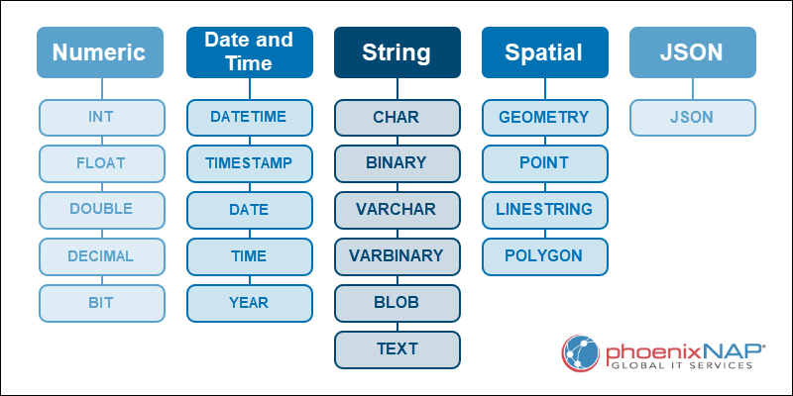
MySQL Data Types in a Nutshell

Slide 4
MySQL Data Types Explained
A MySQL table can store many different data types. The most used types include:
Numeric. Integer and decimal values of varying precision.
Date and time. Time-based data using various formats.
String. Textual data with different lengths.
Spatial. Geometric-based information for geographic data.
JSON. Stores JSON documents.

Slide 5
Categories of Data Types
1. Numeric Types (INT, DECIMAL, FLOAT)
2. String Types (CHAR, VARCHAR, TEXT)
3. Date & Time Types
DATE,
TIME,
DATETIME,
TIMESTAMP
4. Other Types (JSON, BLOB, advanced)

Slide 6
Integer Types
TINYINT, SMALLINT, INT, BIGINT
Example:
CREATE TABLE students(
id INT PRIMARY KEY,
age TINYINT
);

Slide 7
Decimal vs Float
DECIMAL(p,s): exact numbers, good for money
FLOAT/DOUBLE: approximate, good for scientific data
Example:
CREATE TABLE products(
price DECIMAL(8,2),
weight FLOAT
);

Slide 8
Character Types
CHAR(n): fixed length (postal codes)
VARCHAR(n): variable length
Example:
CREATE TABLE customers (
country_code CHAR(2),
name VARCHAR(50)
);

Slide 9
Text Types
TEXT: longer strings (up to 65,535 chars)
Example:
CREATE TABLE reviews(
review_id INT,
review_text TEXT
);

Slide 10
Date and Time Types
DATE: '2025-10-09'
TIME: '14:30:00'
DATETIME: '2025-10-09 14:30:00'
TIMESTAMP: auto-updates
Example:
CREATE TABLE orders(
order_id INT,
order_date DATE,
created_at TIMESTAMP
);

Slide 11
Boolean (TinyInt)
No real BOOLEAN in MySQL
Use TINYINT(1): 0 = false, 1 = true
Example:
CREATE TABLE tasks(
done TINYINT(1)
);

Slide 12
ENUM in MySQL
ENUM is a string object with a predefined set of values.
Used when a column should accept only specific values.
Example:
CREATE TABLE employees (
id INT,
gender ENUM('MALE','FEMALE'),
degree ENUM('PHD', 'MBA', 'MS')
);

Slide 13
ENUM Pros and Cons
Advantages
Ensures only valid values are stored
Saves space compared to VARCHAR
Easy to read and query
Disadvantages
Hard to extend if values change (need ALTER TABLE)
Not portable across databases (non-standard SQL)
CHECK constraints or lookup tables are often preferred

Slide 14
How to Change Data Type in MySQL
Use the ALTER TABLE statement to change a MySQL column data type.
The MODIFY keyword enables changing the column definition, which includes the data type.

Slide 15
How to Change Data Type in MySQL: example
Suppose we have a table:
CREATE TABLE students (
student_id INT PRIMARY KEY,
name VARCHAR(50),
age INT
);
Example: Change age column from INT to TINYINT
ALTER TABLE students
MODIFY age TINYINT;

Slide 16
Choosing Data Types Wisely
Use smallest type that fits
Avoid numbers as strings
Use DECIMAL for money
CHAR for fixed size strings
VARCHAR for variable size string

Slide 17
Summary
Numeric, String, Date/Time, Others
Choose wisely: accuracy, range, storage
Practice designing with correct types

