Slide 1
Introduction to Relational Databases

Slide 2
Introduction
Database – collection of persistent data
Database Management System (DBMS) – software system that supports creation, population, and querying of a database

Slide 3
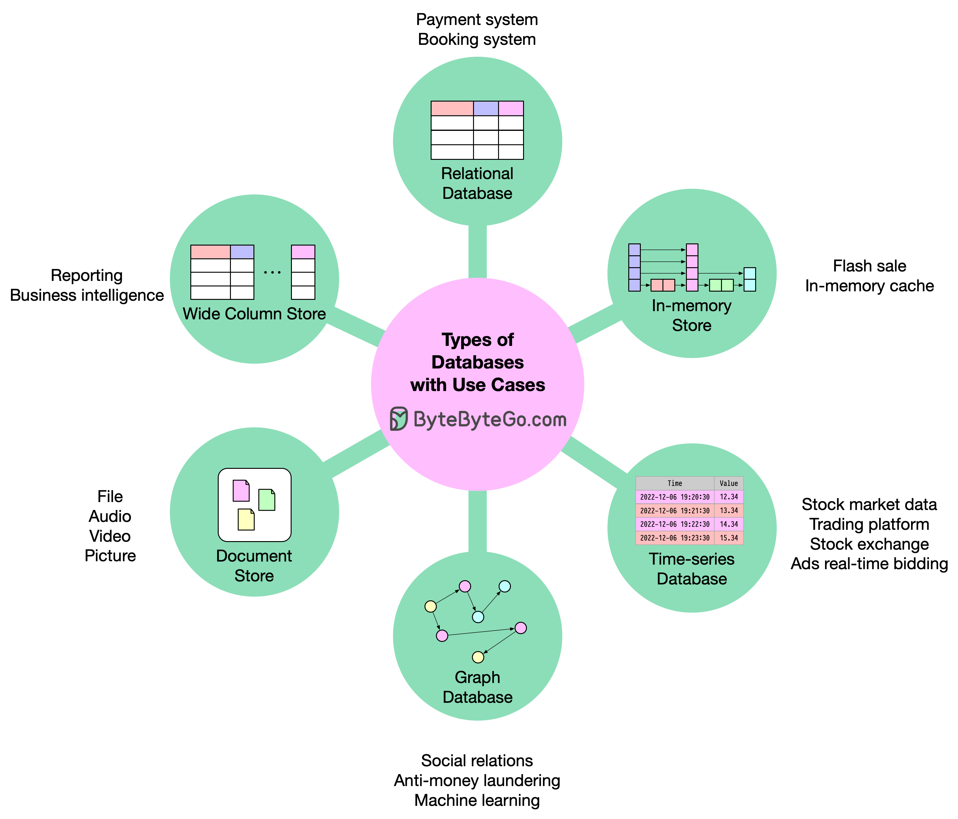
Types of Databases

Slide 4
Key Concepts to Understand
What is a Database?
Table = Relation = rows & columns
Tables, Rows, and Columns:
Columns (Fields)
Rows (Records)

Slide 5
Key Concepts to Understand
What is a Database?
A database is a structured collection of data, like a digital filing cabinet, that allows for organized storage, retrieval, and management of information.
Database = set of related Tables

Slide 6
Key Concepts to Understand
What is a Database?
Database = set of Tables
Tables: has Rows, and Columns:
Row = Record = Tuple

Slide 7
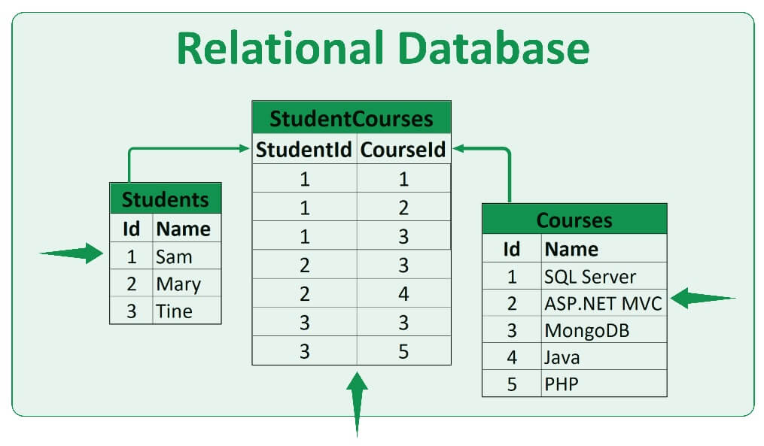
Key Concepts to Understand
What is a Database?
Database = set of Tables
Tables: has Rows, and Columns:
Row = Record = Tuple

Slide 8
Relational Database
Relational Database Management System (RDBMS)
Consists of a number of tables and single schema (definition of tables and attributes)
Students (sid, name, login, age, gpa)
Students identifies the table
sid, name, login, age, gpa identify attributes
sid is primary key

Slide 9
An Example Table
Students (sid: string, name: string, login: string, age: integer, gpa: real)
sid | name | login | age | gpa
50000 | Dave | dave@cs | 19 | 3.3
53666 | Jones | jones@cs | 18 | 3.4
53688 | Smith | smith@ee | 18 | 3.2
53650 | Smith | smith@math | 19 | 3.8
53831 | Madayan | madayan@music | 11 | 1.8
53832 | Guldu | guldu@music | 12 | 2.0

Slide 10
Another example: Courses
Courses (cid, instructor, quarter, dept)
cid | instructor | quarter | dept
Carnatic101 | Jane | Fall 06 | Music
Reggae203 | Bob | Summer 06 | Music
Topology101 | Mary | Spring 06 | Math
History105 | Alice | Fall 06 | History

Slide 11
Keys
Primary key – minimal subset of fields that is unique identifier for a tuple/row/record
sid is primary key for Students
cid is primary key for Courses
Foreign key –connections between tables
Courses (cid, instructor, quarter, dept)
Students (sid, name, login, age, gpa)
How do we express which students take each course?

Slide 12
Many to many relationships
In general, need a new table
Enrolled(cid, grade, studid)
Studid is foreign key that references sid in Student table
Student
Enrolled
Foreign
key
sid | name | login
50000 | Dave | dave@cs
53666 | Jones | jones@cs
53688 | Smith | smith@ee
53650 | Smith | smith@math
53831 | Madayan | madayan@music
53832 | Guldu | guldu@music
cid | grade | studid
Carnatic101 | C | 53831
Reggae203 | B | 53832
Topology112 | A | 53650
History 105 | B | 53666

Slide 13
Keys in Relational Databases
Key = a field (or set of fields) used to identify rows or link tables.
Types of keys:
Primary Key (PK) → uniquely identifies a row.
Foreign Key (FK) → establishes a relationship between two tables.
Other keys → Unique Key, Composite Key, etc.

Slide 14
Keys in Relational Databases
Primary Key (PK)
A unique identifier for each row in a table.
Cannot be NULL.
Each table can have only one PK.
CREATE TABLE customers (
customer_id INT PRIMARY KEY,
name VARCHAR(50),
email VARCHAR(100)
);

Slide 15
Keys in Relational Databases
Foreign Key (FK)
A column that references the PK of another table.
Used to maintain referential integrity.
CREATE TABLE orders (
order_id INT PRIMARY KEY,
customer_id INT,
FOREIGN KEY (customer_id)
REFERENCES customers(customer_id)
);

Slide 16
Relational Algebra
1. Collection of operators for specifying queries
2. Query describes step-by-step procedure for computing answer (i.e., operational)
3. Each operator accepts one or two relations as input and returns a relation as output
4. Relational algebra expression composed of multiple operators

Slide 17
Basic operators
Selection – return rows that meet some condition
Projection – return column values
Union
Cross product
Difference
Other operators can be defined in terms of basic operators

Slide 18
Example Schema
Courses (cid, instructor, quarter, dept)
Students (sid, name, gpa)
Enrolled (sid, cid, grade)
cid = Course ID
sid = Student ID

Slide 19
Selection
Select students with gpa higher than 3.3 from Students
σ_{gpa>3.3}(S1)
Students
sid | name | gpa
50000 | Dave | 3.3
53666 | Jones | 3.4
53688 | Smith | 3.2
53650 | Smith | 3.8
53831 | Madayan | 1.8
53832 | Guldu | 2.0
sid | name | gpa
53666 | Jones | 3.4
53650 | Smith | 3.8

Slide 20
Select students with gpa higher than 3.3 from Students
_{SELECT sid, name, gpa}
_{FROM students}
_{Where gpa > 3.3;}
sid | name | gpa
50000 | Dave | 3.3
53666 | Jones | 3.4
53688 | Smith | 3.2
53650 | Smith | 3.8
53831 | Madayan | 1.8
53832 | Guldu | 2.0
sid | name | gpa
53666 | Jones | 3.4
53650 | Smith | 3.8

Slide 21
Projection
Project name and gpa of all students in Students:
Π_{name, gpa}(Students)
Sid | name | gpa
50000 | Dave | 3.3
53666 | Jones | 3.4
53688 | Smith | 3.2
53650 | Smith | 3.8
53831 | Madayan | 1.8
53832 | Guldu | 2.0
name | gpa
Dave | 3.3
Jones | 3.4
Smith | 3.2
Smith | 3.8
Madayan | 1.8
Guldu | 2.0

Slide 22
Project name and gpa of all students in Students:
SELECT name, gpa
FROM Students;
Sid | name | gpa
50000 | Dave | 3.3
53666 | Jones | 3.4
53688 | Smith | 3.2
53650 | Smith | 3.8
53831 | Madayan | 1.8
53832 | Guldu | 2.0
name | gpa
Dave | 3.3
Jones | 3.4
Smith | 3.2
Smith | 3.8
Madayan | 1.8
Guldu | 2.0

Slide 23
Combine Selection and Projection
Project name and gpa of students in S1 with gpa higher than 3.3:
Π_{name,gpa}(σ_{gpa>3.3}(S1))
Sid | name | gpa
50000 | Dave | 3.3
53666 | Jones | 3.4
53688 | Smith | 3.2
53650 | Smith | 3.8
53831 | Madayan | 1.8
53832 | Guldu | 2.0
name | gpa
Jones | 3.4
Smith | 3.8

Slide 24
Project name and gpa of students in Students with gpa higher than 3.3:
SELECT name, gpa
FROM students
WHERE gpa > 3.3;
Sid | name | gpa
50000 | Dave | 3.3
53666 | Jones | 3.4
53688 | Smith | 3.2
53650 | Smith | 3.8
53831 | Madayan | 1.8
53832 | Guldu | 2.0
name | gpa
Jones | 3.4
Smith | 3.8

Slide 25
Set Operations
Union (R U S)
All tuples in R or S (or both)
R and S must have same number of fields
Corresponding fields must have same domains
Intersection (R ∩ S)
All tuples in both R and S
Set difference (R – S)
Tuples in R and not S

Slide 26
Set Operations (continued)
Cross product or Cartesian product (R x S)
All fields in R followed by all fields in S
One tuple (r,s) for each pair of tuples r ∈ R, s ∈ S

Slide 27
Example: Intersection
S1
S2
sid | name | gpa
50000 | Dave | 3.3
53666 | Jones | 3.4
53688 | Smith | 3.2
53650 | Smith | 3.8
53831 | Madayan | 1.8
53832 | Guldu | 2.0
sid | name | gpa
53666 | Jones | 3.4
53688 | Smith | 3.2
53700 | Tom | 3.5
53777 | Jerry | 2.8
53832 | Guldu | 2.0
sid | name | gpa
53666 | Jones | 3.4
53688 | Smith | 3.2
53832 | Guldu | 2.0
S1 ∩ S2 =

Slide 28
Joins
Combine information from two or more tables
Example: students enrolled in courses:
S1 _{S1.sid=E.studid}E
S1
E
Sid | name | gpa
50000 | Dave | 3.3
53666 | Jones | 3.4
53688 | Smith | 3.2
53650 | Smith | 3.8
53831 | Madayan | 1.8
53832 | Guldu | 2.0
cid | grade | studid
Carnatic101 | C | 53831
Reggae203 | B | 53832
Topology112 | A | 53650
History 105 | B | 53666

Slide 29
Joins
S1
Sid | name | gpa
50000 | Dave | 3.3
53666 | Jones | 3.4
53688 | Smith | 3.2
53650 | Smith | 3.8
53831 | Madayan | 1.8
53832 | Guldu | 2.0
E
cid | grade | studid
Carnatic101 | C | 53831
Reggae203 | B | 53832
Topology112 | A | 53650
History 105 | B | 53666
sid | name | gpa | cid | grade | studid
53666 | Jones | 3.4 | History105 | B | 53666
53650 | Smith | 3.8 | Topology112 | A | 53650
53831 | Madayan | 1.8 | Carnatic101 | C | 53831
53832 | Guldu | 2.0 | Reggae203 | B | 53832
Notes:
Note that join can also be thought of as cross product and select

Slide 30
Relational Algebra Summary
Algebras are useful to manipulate data types (relations in this case)
Set-oriented
Brings some clarity to what needs to be done
Opportunities for optimization
May have different expressions that do same thing
We will see examples of algebras for other types of data in this course

Slide 31
Introduction to SQL SQL = Structured Query Language
CREATE DATABASE
CREATE TABLE
Create a new table, e.g., students, courses, enrolled
SELECT-FROM-WHERE
List all CS courses
INSERT
Add a new student, course, or enroll a student in a course

Slide 32
Create Database
CREATE DATABASE company_db;
USE company_db;
CREATE TABLE employees(…);
CREATE TABLE departments(…);
CREATE TABLE projects(…);
NOW, company_db has 3 tables.

Slide 33
Create Table: Example-1
USE company_db;
CREATE TABLE employees (
emp_id INT PRIMARY KEY,
email VARCHAR(70),
salary INT(20),
department VARCHAR(10)
);

Slide 34
Create Table: Example-2
USE company_db;
CREATE TABLE Enrolled (
sid CHAR(20), -- student ID
cid CHAR(20), -- course ID
grade CHAR(20),
PRIMARY KEY (sid, cid)
);

Slide 35
Select-From-Where query
“Find all students who are under 18”
SELECT *
FROM Students S
WHERE S.age < 18;

Slide 36
Queries across multiple tables (joins)
“Return the student name and course ID where the student received an ‘A’ in the course”
SELECT S.name, E.cid
FROM Students S, Enrolled E
WHERE (S.sid = E.sid) AND
(E.grade = ‘A’);

Slide 37
Other SQL features
MIN, MAX, AVG
Find highest grade in fall database course
COUNT, DISTINCT
How many students enrolled in CS courses in the fall?
ORDER BY, GROUP BY
Rank students by their grade in fall database course

Slide 38
Views
Virtual table defined on base tables defined by a query
Single or multiple tables
Security – “hide” certain attributes from users
Show students in each course but hide their grades
Ease of use – expression that is more intuitively obvious to user
Views can be materialized to improve query performance

Slide 39
Views
Suppose we often need names of students who got a ‘B’ in some course:
CREATE VIEW B_Students(name, sid, course) AS
SELECT S.sname, S.sid, E.cid
FROM Students S, Enrolled E
WHERE (S.sid = E.sid) and (E.grade = ‘B’);
name | sid | course
Jones | 53666 | History105
Guldu | 53832 | Reggae203

Slide 40
Indexes
Idea: speed up access to desired data
“Find all students with gpa > 3.3
May need to scan entire table
Index consists of a set of entries pointing to locations of each search key

Slide 41
Types of Indexes
Clustered vs. Unclustered
Clustered- ordering of data records same as ordering of data entries in the index
Unclustered- data records in different order from index
Primary vs. Secondary
Primary – index on fields that include primary key
Secondary – other indexes

Slide 42
Example: Clustered Index
Sorted by sid
sid | name | gpa
50000 | Dave | 3.3
53650 | Smith | 3.8
53666 | Jones | 3.4
53688 | Smith | 3.2
53831 | Madayan | 1.8
53832 | Guldu | 2.0
50000
53600
53800

Slide 43
Example: Unclustered Index
Sorted by sid
Index on gpa
sid | name | gpa
50000 | Dave | 3.3
53650 | Smith | 3.8
53666 | Jones | 3.4
53688 | Smith | 3.2
53831 | Madayan | 1.8
53832 | Guldu | 2.0
1.8
2.0
3.2
3.3
3.4
3.8

Slide 44
Comments on Indexes
Indexes can significantly speed up query execution
But inserts more costly
May have high storage overhead
Need to choose attributes to index wisely!
What queries are run most frequently?
What queries could benefit most from an index?

Slide 45
Summary: Why are RDBMS useful?
Data independence – provides abstract view of the data, without details of storage
Efficient data access – uses techniques to store and retrieve data efficiently
Reduced application development time – many important functions already supported
Centralized data administration
Data Integrity and Security
Concurrency control and recovery

