Slide 1
Slide 1: Relational Databases 101
A 7-Week Journey into SQL and Data Management
Create Databases, Tables, …
Populate Tables with data
Query data from Tables
Create Databases/Tables from Data Requirements
Analyze data using relational database systems.

Slide 2
Slide 2: What is a Database?
A database stores data in an organized way.
Then we use a database to
Read an existing data
Write new data
Delete an existing data
Relational DBs use **tables** (rows and columns).
Examples: MySQL, PostgreSQL, Oracle.

Slide 3
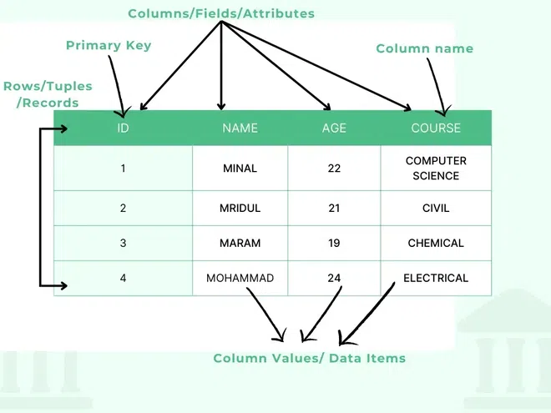
Example: a Table with 4 Rows of Data

Slide 4
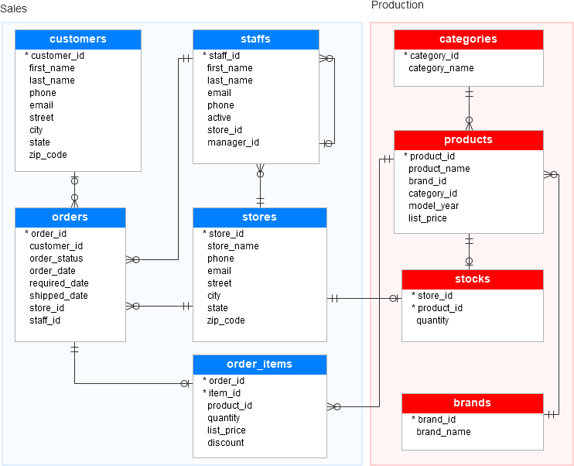
Database: a set of Tables

Slide 5
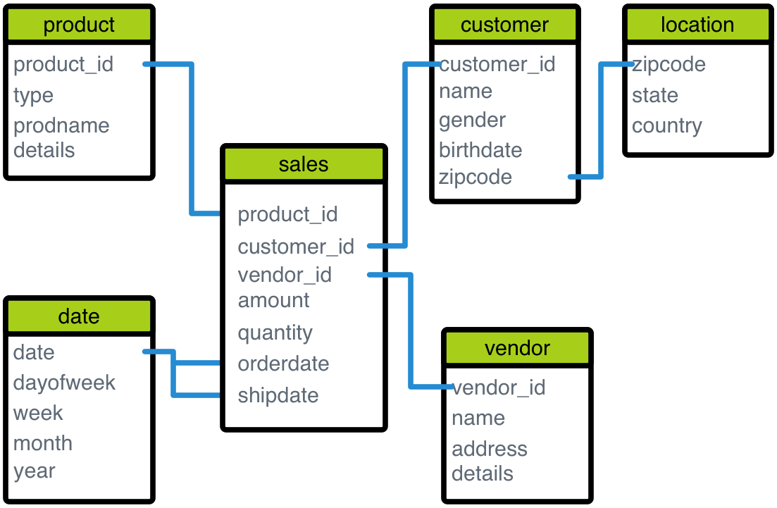
Database: a Set of Tables

Slide 6
What is a Relational Database System
A relational database system organizes
data into interconnected tables, each with
rows (records) and columns (attributes),
that use a common field to establish relationships between them.

Slide 7
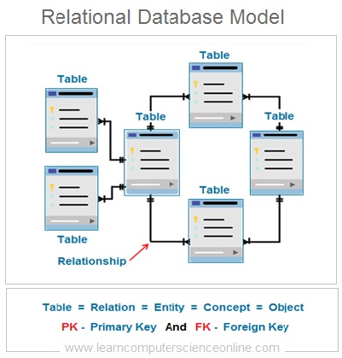

Slide 8
What is a Relational Database System
a Relational Database Management System (RDBMS) to store, manage, and retrieve data using SQL (Structured Query Language).
They provide data integrity, consistency, and flexibility through primary keys, foreign keys, and ACID properties (Atomicity, Consistency, Isolation, Durability).

Slide 9
Slide 3: Why Relational Databases?
Standardized (SQL)
Ensure data integrity
Support complex queries
Used in businesses worldwide

Slide 10
Slide 4: Database vs Spreadsheet
Spreadsheet = good for small tasks
Database = scalable, structured, queryable
Example: Excel vs MySQL

Slide 11
Slide 5: Basic Terminology
Database = set of related Tables
Table = collection of related data = set of rows/records
Row (record) = one data item
Column (field) = attribute
Primary Key = unique identifier

Slide 12
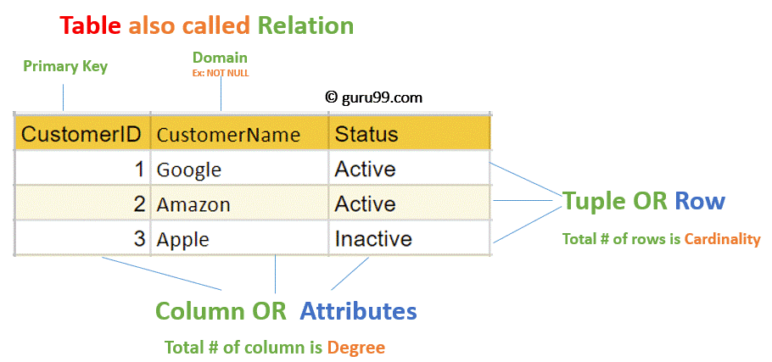
Table = Relation

Slide 13
Slide 6: Employee Table
Employee Table
| emp_id | name | dept | salary |
|--------|---------|---------|--------|
| 1 | Alice | Sales | 60000 |
| 2 | Bob | HR | 55000 |
| 3 | Carol | IT | 70000 |
3 Rows/records
4 Columns (emp_id, name, dept, salary)
emp_id: as a Primary Key (PK)
A primary key is a column or set of columns in a database table that uniquely identifies each row.

Slide 14
Slide 7: Tables and Primary Keys (PK)
Every row must have a unique identifier
Example: `emp_id` is a PK
MySQL syntax: create a table
CREATE TABLE employees (
emp_id INT PRIMARY KEY,
name VARCHAR(30),
dept VARCHAR(20),
salary INT
);

Slide 15
Add New Records
CREATE TABLE employees (
emp_id INT PRIMARY KEY,
name VARCHAR(30),
dept VARCHAR(20),
salary INT
);
-- ADD 3 NEW RECORDS using SQL:
INSERT INTO employees (emp_id, name, dept, salary)
VALUES
(100, ‘Alex’, ‘Sales’, 67000),
(200, ‘Jenny’, ‘Business’, 89000),
(400, ‘Rafa’, ‘Sales’, 45000);

Slide 16
Slide 8: Foreign Keys: Link between two tables
CREATE TABLE employees (
emp_id INT PRIMARY KEY, -- PK: unique employee id
name VARCHAR(50),
dept_id INT -- FK: links to departments table
);
Primary Key (PK): emp_id → ensures each employee has a unique identifier.
Foreign Key (FK): dept_id → points to the department the employee belongs to.

Slide 17
PK & FK
CREATE TABLE departments (
-- PK: unique department id
dept_id INT PRIMARY KEY,
-- Name of department
dept_name VARCHAR(50)
);
Primary Key (PK): dept_id → ensures each department is unique.

Slide 18
Adding the Foreign Key Constraint
ALTER TABLE employees
ADD CONSTRAINT fk_dept
FOREIGN KEY (dept_id) REFERENCES departments(dept_id);

Slide 19
Example: 2 Tables
departments
dept_id dept_name
1 Sales
2 HR
3 IT
employees
emp_id name dept_id
101 Alice 1
102 Bob 2
103 Carol 3

Slide 20
Revised Tables: PK & FK
-- departments table
CREATE TABLE departments (
dept_id INT PRIMARY KEY, -- PK: unique department id
dept_name VARCHAR(50)
);
-- employees table with FK to departments
CREATE TABLE employees (
emp_id INT PRIMARY KEY, -- PK: unique employee id
name VARCHAR(50),
dept_id INT, -- FK: links to departments table
CONSTRAINT fk_dept
FOREIGN KEY (dept_id) REFERENCES departments(dept_id)
);

Slide 21
Slide 9: Relationships: Between Tables
One-to-Many (Dept → Employees)
Many-to-Many (Students ↔ Courses)
One-to-One (Passport ↔ Person)

Slide 22
Slide 10: SQL Basics
SQL = Structured Query Language
Used to interact with databases
Example:
SELECT name, salary
FROM employees
WHERE salary > 85000;

Slide 23
Slide 11: Inserting Data Into a Table
INSERT 2 New Rows/Records:
INSERT INTO employees(id, name, dept, salary)
VALUES (1,'Alice','Sales',60000);
INSERT INTO employees(id, name, dept, salary)
VALUES (2,'Bob','HR',55000);
OR
INSERT INTO employees(id, name, dept, salary)
VALUES
(1,'Alice','Sales',60000),
(2,'Bob','HR',55000);

Slide 24
Slide 12: Updating Data by SQL
-- Set a new salary for emp_id of 2
UPDATE employees
SET salary = 89000
WHERE emp_id = 2;

Slide 25
Slide 13: Deleting Data
-- Delete an Existing Record
DELETE FROM employees
WHERE emp_id = 2;

Slide 26
Slide 14: Query with WHERE
-- List all employees from IT department
SELECT name, salary
FROM employees
WHERE dept = 'IT';

Slide 27
Slide 15: Aggregation Functions
Aggregation Functions:
COUNT, SUM, AVG, MIN, MAX
Example: find average salary per department
SELECT dept, AVG(salary)
FROM employees
GROUP BY dept;

Slide 28
Slide 16: JOINs
Combine data across tables
SELECT e.name,
d.dept_name
FROM employees e
JOIN departments d ON e.dept_id = d.dept_id;

Slide 29
Story of JOIN Operation Employees & Departments -- 1
departments
CREATE TABLE departments (
dept_id INT PRIMARY KEY,
dept_name VARCHAR(50)
);
INSERT INTO departments VALUES
(1, 'Sales'),
(2, 'HR'),
(3, 'IT');

Slide 30
Story of JOIN Operation Employees & Departments -- 2
employees
CREATE TABLE employees (
emp_id INT PRIMARY KEY,
name VARCHAR(50),
dept_id INT,
CONSTRAINT fk_dept FOREIGN KEY (dept_id)
REFERENCES departments(dept_id)
);
INSERT INTO employees VALUES
(101, 'Alice', 1),
(102, 'Bob', 2),
(103, 'Carol', 3),
(104, 'David', 1);

Slide 31
Story of JOIN Operation Employees & Departments -- 3
INNER JOIN Query:
SELECT e.emp_id, e.name, d.dept_name
FROM employees e
INNER JOIN departments d
ON e.dept_id = d.dept_id;
Result
emp_id name dept_name
101 Alice Sales
102 Bob HR
103 Carol IT
104 David Sales

Slide 32
Slide 17: Constraints
NOT NULL
UNIQUE
CHECK
DEFAULT
Example:
salary INT NOT NULL CHECK (salary > 0)

Slide 33
Slide 18: Transactions
Ensure reliability with ACID properties
Example: money transfer requires 2 updates
COMMIT and ROLLBACK in SQL

Slide 34
Slide 19: Why MySQL?
Simple to use, but powerful
Free, open-source, widely used
Good for beginners & production
Compatible with many platforms

Slide 35
Slide 20: Wrap-Up
Databases = backbone of apps
SQL is essential skill
In next 7 weeks: deeper dive into
SELECTs
Aggregations
Joins
Subqueries
Indexes
Advanced SQL & optimization

