Slide 1
Introduction to Database Management Systems
Mahmoud Parsian
Ph.D. in Computer Science

Slide 2
Outline
Database-System Applications
Purpose of Database Systems
View of Data
Database Languages
Database Design
Database Engine
Database Architecture
Database Users and Administrators
History of Database Systems

Slide 3
Database Systems
DBMS contains information about a particular enterprise
Collection of interrelated data
Set of programs to access the data
An environment that is both convenient and efficient to use
Database systems are used to manage collections of data that are:
Highly valuable
Relatively large
Accessed by multiple users and applications, often at the same time.
A modern database system is a complex software system whose task is to manage a large, complex collection of data.
Databases touch all aspects of our lives

Slide 4
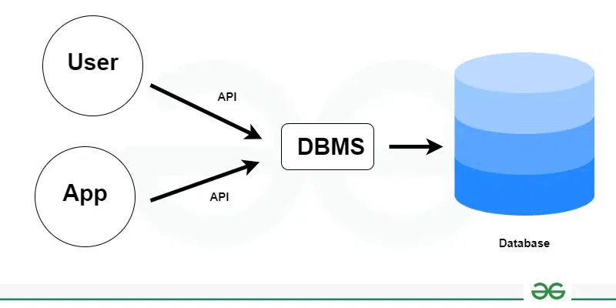
DBMS: Database Management System

Slide 5
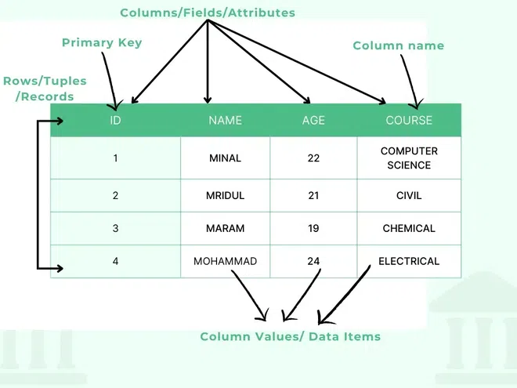
A Sample Table with 4 rows of Data

Slide 6
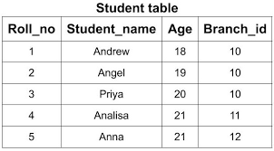
A Table in DBMS

Slide 7
Database Application Examples
Enterprise Information
Genomics: DNA data
Sales: customers, products, purchases
Accounting: payments, receipts, assets
Human Resources: Information about employees, salaries, payroll taxes.
Manufacturing: management of production, inventory, orders, supply chain.
Banking and finance
customer information, accounts, loans, and banking transactions.
Credit card transactions
Finance: sales and purchases of financial instruments (e.g., stocks and bonds; storing real-time market data
Universities: registration, grades

Slide 8
Database Application Examples (continued…)
Airlines: reservations, schedules
Telecommunication: records of calls, texts, and data usage, generating monthly bills, maintaining balances on prepaid calling cards
Web-based services
Online retailers: order tracking, customized recommendations
Online advertisements
Document databases
Navigation systems: For maintaining the locations of varies places of interest along with the exact routes of roads, train systems, buses, etc.

Slide 9
Purpose of Database Systems Database systems offer solutions to all the following problems
Data redundancy and inconsistency: data is stored in multiple file formats resulting induplication of information in different files
Difficulty in accessing data
Need to write a new program to carry out each new task
Data isolation
Multiple files and formats
Integrity problems
Integrity constraints (e.g., account balance > 0) become “buried” in program code rather than being stated explicitly
Hard to add new constraints or change existing ones

Slide 10
Purpose of Database Systems (continued…) Database systems offer solutions to all the following problems
Atomicity of updates
Failures may leave database in an inconsistent state with partial updates carried out
Example: Transfer of funds from one account to another should either complete or not happen at all
Concurrent access by multiple users
Concurrent access needed for performance
Uncontrolled concurrent accesses can lead to inconsistencies
Ex: Two people reading a balance (say 100) and updating it by withdrawing money (say 50 each) at the same time
Security problems
Hard to provide user access to some, but not all, data

Slide 11
University Database Example
Data consists of information about:
Students
Instructors
Classes
Application program examples:
Add new students, instructors, and courses
Register students for courses, and generate class rosters
Assign grades to students, compute grade point averages (GPA) and generate transcripts

Slide 12
University Database Example
Example-1:
https://www.uky.edu/~dsianita/622/university.html
Example-2:
https://dunglai.github.io/2017/06/27/UniversityMySQL

Slide 13
Database Activities
Create
Add new data to the database
Read
Read current data from the database
Update
Update or modify current database data
Delete
Remove current data from the database

Slide 14
View of Data
A Database System is a collection of interrelated data and a set of programs that allow users to access and modify these data.
A major purpose of a database system is to provide users with an abstract view of the data.
Data models
A collection of conceptual tools for describing data, data relationships, data semantics, and consistency constraints.
Data abstraction
Hide the complexity of data structures to represent data in the database from users through several levels of data abstraction.

Slide 15
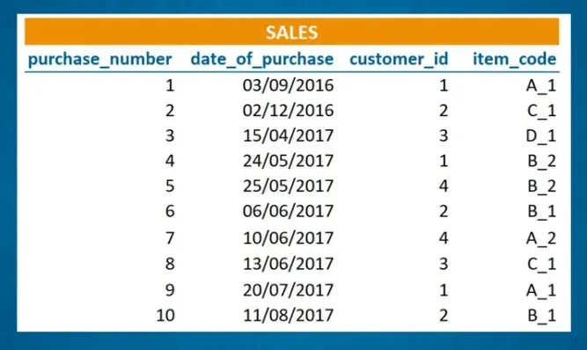
View of Data – Example 1

Slide 16
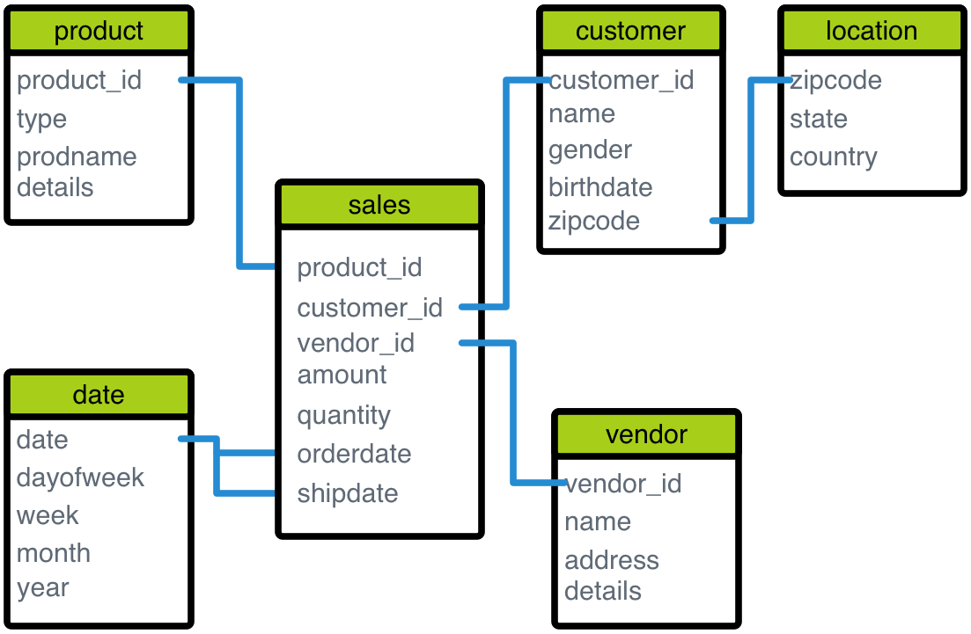
View of Data – Example 2

Slide 17
Data Models
A collection of tools for describing
Data
Data relationships
Data semantics
Data constraints
Relational model
Entity-Relationship data model (mainly for database design)
Object-based data models (Object-oriented and Object-relational)
Semi-structured data model (XML)
Other older models:
Network model
Hierarchical model

Slide 18
Relational Model
Relation = Table of Rows and Columns
Relational Model = { set of Tables}
All the data is stored in various tables.
Example of tabular data in the relational model

Slide 19
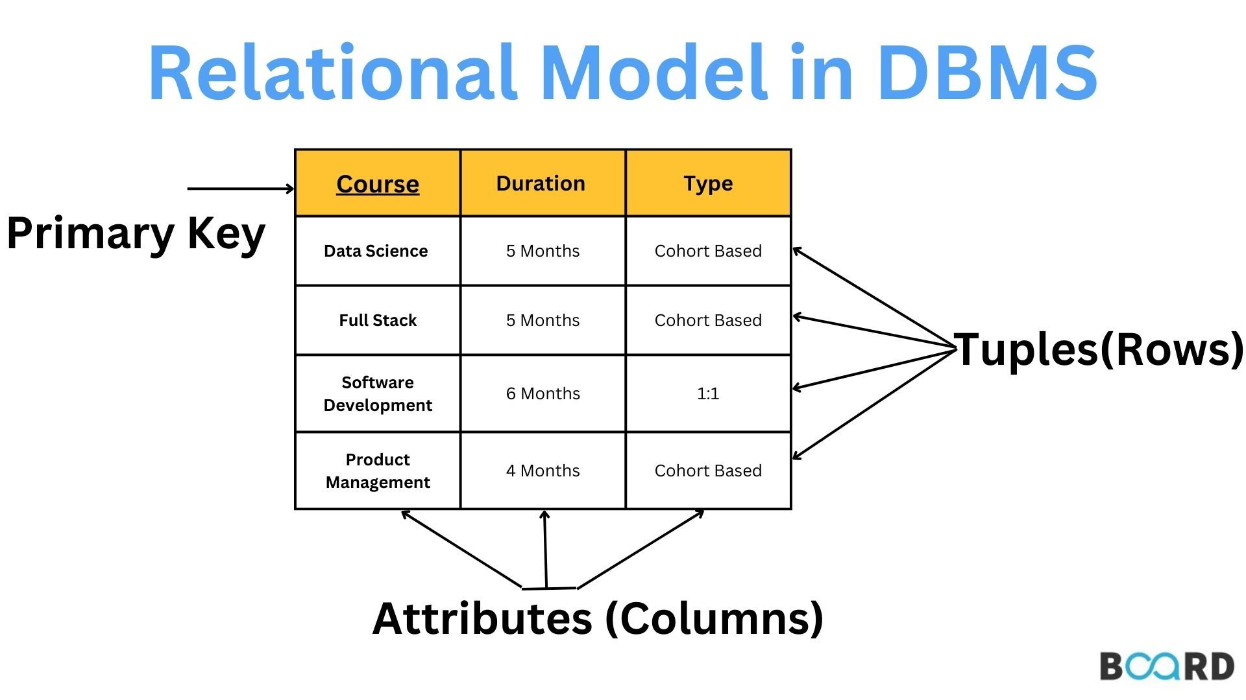
Relational Model

Slide 20
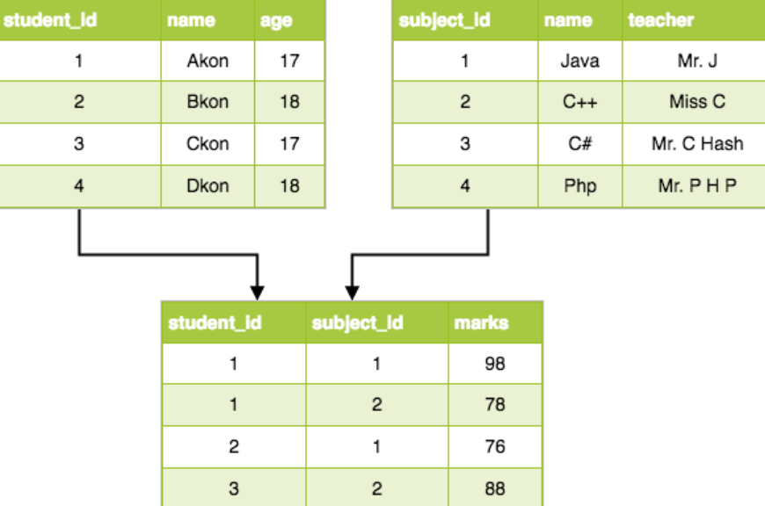
Relational Model

Slide 21
Relational Model
A relational data model organizes data into two-dimensional tables, also known as relations,
composed of rows (tuples) and
columns (attributes) to represent real-world entities.
This widely used model, described by Edgar F. Codd in 1969, provides a logical, flexible, and consistent structure for managing and accessing data, making it a fundamental concept for relational databases.

Slide 22
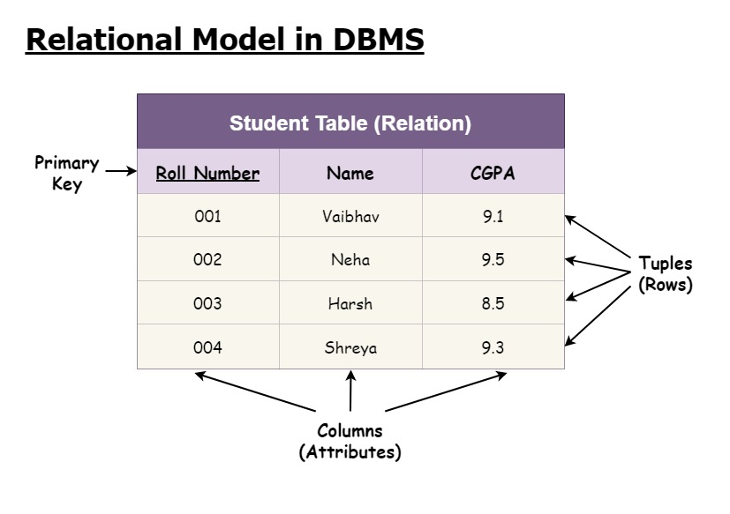
Example of tabular data in the relational model

Slide 23
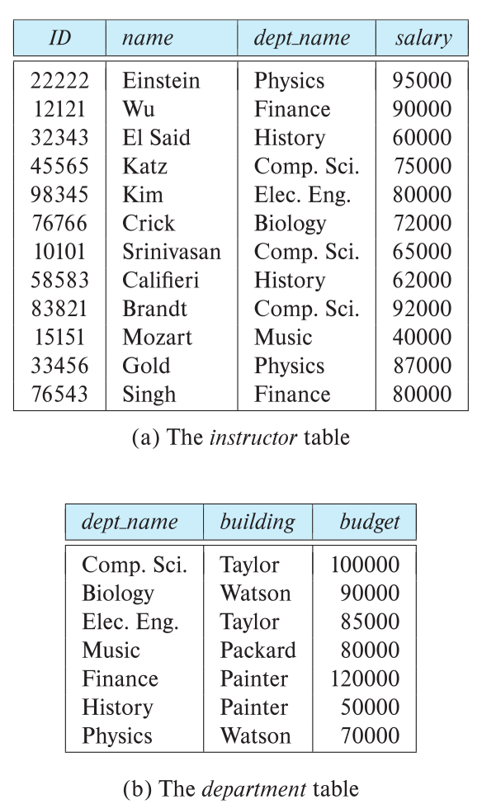
Relational Model: 12 rows, 4 columns

Slide 24
A Sample Relational Database: 2 Tables

Slide 25
A Sample Relational Database Levels of Abstraction
Physical level: describes how a record (e.g., instructor) is stored.
Logical level: describes data stored in database, and the relationships among the data.
type instructor = record
ID : string;
name : string;
dept_name : string;
salary : integer;
end;
View level: application programs hide details of data types. Views can also hide information (such as an employee’s salary) for security purposes.

Slide 26
View of Data: Instances and Schemas
Similar to types and variables in programming languages
Logical Schema – the overall logical structure of the database
Example: The database consists of information about a set of customers and accounts in a bank and the relationship between them
Analogous to type information of a variable in a program
Physical schema – the overall physical structure of the database
Instance – the actual content of the database at a particular point in time
Analogous to the value of a variable

Slide 27
View of Data: Architecture of a Database System

Slide 28
Data Definition Language (DDL)
Specification notation for defining the database schema
Example:
create table instructor ( ID char(5), name varchar(20), dept_name varchar(20), salary numeric(8,2)
);

Slide 29
Data Manipulation Language (MDL)
Language for accessing and updating the data organized by the appropriate data model
DML also known as query language
There are basically two types of data-manipulation language
Procedural DML -- require a user to specify what data are needed and how to get those data.
Declarative DML -- require a user to specify what data are needed without specifying how to get those data.
Declarative DMLs are usually easier to learn and use than are procedural DMLs.
Declarative DMLs are also referred to as non-procedural DMLs
The portion of a DML that involves information retrieval is called a query language.

Slide 30
SQL Query Language
SQL, which stands for Structured Query Language, is a standardized programming language designed for managing and manipulating relational databases.
SQL is the primary language used to interact with and extract information from databases that store data in a structured, tabular format, similar to spreadsheets with rows and columns.

Slide 31
SQL Query Language
SQL query language is nonprocedural.
A query takes as input several tables (possibly only one) and always returns a single table.
Example to find all instructors in Comp. Sci. dept
select name from instructor where dept_name = 'Comp. Sci.'
To be able to compute complex functions SQL is usually embedded in some higher-level language
Application programs generally access databases through one of
Language extensions to allow embedded SQL
Application program interface (e.g., ODBC/JDBC) which allow SQL queries to be sent to a database

Slide 32
Key functions of SQL include:
Querying data: Retrieving specific information from a database using SELECT statements.
Manipulating data: Adding new records (INSERT), updating existing records (UPDATE), and deleting records (DELETE) within tables.
Defining data structures: Creating, modifying, and deleting database objects like tables, views, and indexes using commands like CREATE TABLE and DROP TABLE.
Controlling data access: Managing user permissions and security within the database.

Slide 33
Database Access from Application Program
Non-procedural query languages such as SQL are not as powerful as a universal Turing machine.
SQL does not support actions such as input from users, output to displays, or communication over the network.
Such computations and actions must be written in a host language, such as C/C++/Java/Python, with embedded SQL queries that access the data in the database.
Application programs -- are programs that are used to interact with the database in this fashion.

Slide 34
Database Design
Logical Design – Deciding on the database schema. Database design requires that we find a “good” collection of relation schemas.
Business decision – What attributes should we record in the database?
Computer Science decision – What relation schemas should we have and how should the attributes be distributed among the various relation schemas?
Physical Design – Deciding on the physical layout of the database

Slide 35
Database Engine
A database system is partitioned into modules that deal with each of the responsibilities of the overall system.
The functional components of a database system can be divided into
1. The storage manager,
2. The query processor component,
3. The transaction management component.

Slide 36
Storage Manager
A program module that provides the interface between the low-level data stored in the database and the application programs and queries submitted to the system.
The storage manager is responsible to the following tasks:
Interaction with the OS file manager
Efficient storing, retrieving and updating of data
The storage manager components include:
Authorization and integrity manager
Transaction manager
File manager
Buffer manager

Slide 37
Storage Manager (continued…)
The storage manager implements several data structures as part of the physical system implementation:
Data files -- store the database itself
Data dictionary -- stores metadata about the structure of the database, in particular the schema of the database.
Indices -- can provide fast access to data items. A database index provides pointers to those data items that hold a particular value.

Slide 38
Query Processor
The query processor components include:
DDL interpreter -- interprets DDL statements and records the definitions in the data dictionary.
DML compiler -- translates DML statements in a query language into an evaluation plan consisting of low-level instructions that the query evaluation engine understands.
The DML compiler performs query optimization; that is, it picks the lowest cost evaluation plan from among the various alternatives.
Query evaluation engine -- executes low-level instructions generated by the DML compiler.

Slide 39
Query Processing
1. Parsing and translation
2. Optimization
3. Evaluation

Slide 40
Query Processing
1. Parsing and translation
2. Optimization
3. Evaluation

Slide 41
Transaction Management
A transaction is a collection of operations that performs a single logical function in a database application
Transaction-management component ensures that the database remains in a consistent (correct) state despite system failures (e.g., power failures and operating system crashes) and transaction failures.
Concurrency-control manager controls the interaction among the concurrent transactions, to ensure the consistency of the database.

Slide 42
Database Architecture
Centralized databases
One to a few cores, shared memory
Client-server
One server machine executes work on behalf of multiple client machines.
Parallel databases
Many core shared memory
Shared disk
Shared nothing
Distributed databases
Geographical distribution
Schema/data heterogeneity

Slide 43
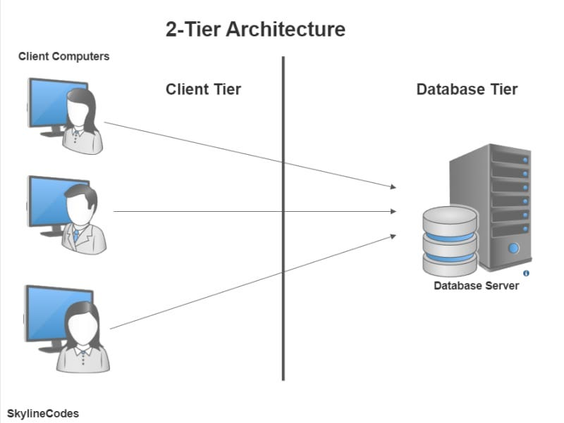
2-Tier Database Architecture

Slide 44
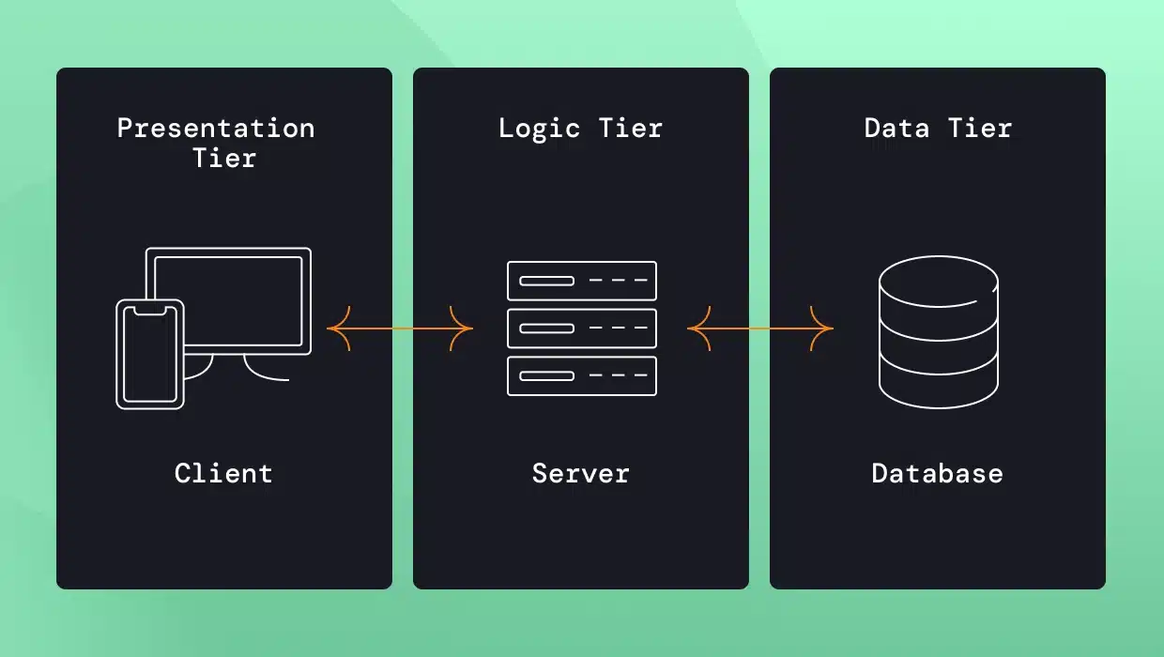
3-Tier Database Architecture

Slide 45
Database Applications
Two-tier architecture --
the application resides at the client machine,
where it invokes database system functionality at the server machine
Three-tier architecture –
1. The client machine acts as a front end and does not contain any direct database calls.
2. The client end communicates with an application server, usually through a forms interface.
3. The application server in turn communicates with a database system to access data.

Slide 46
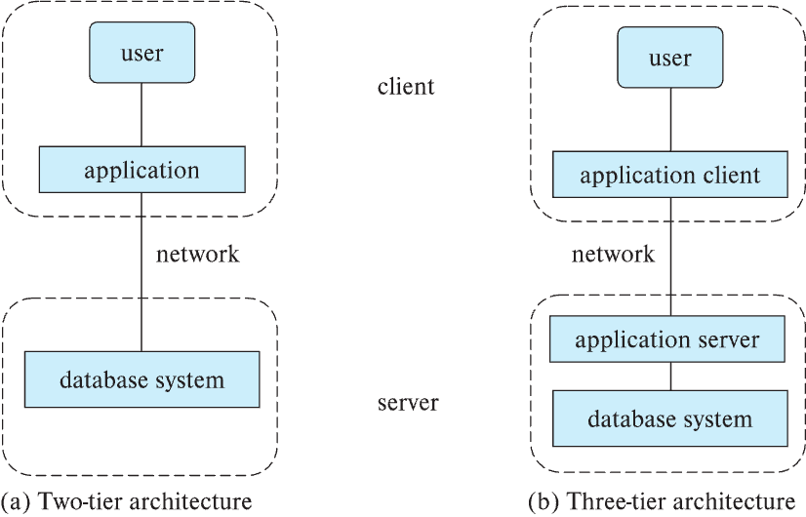
2-tier & 3-tier Architectures

Slide 47
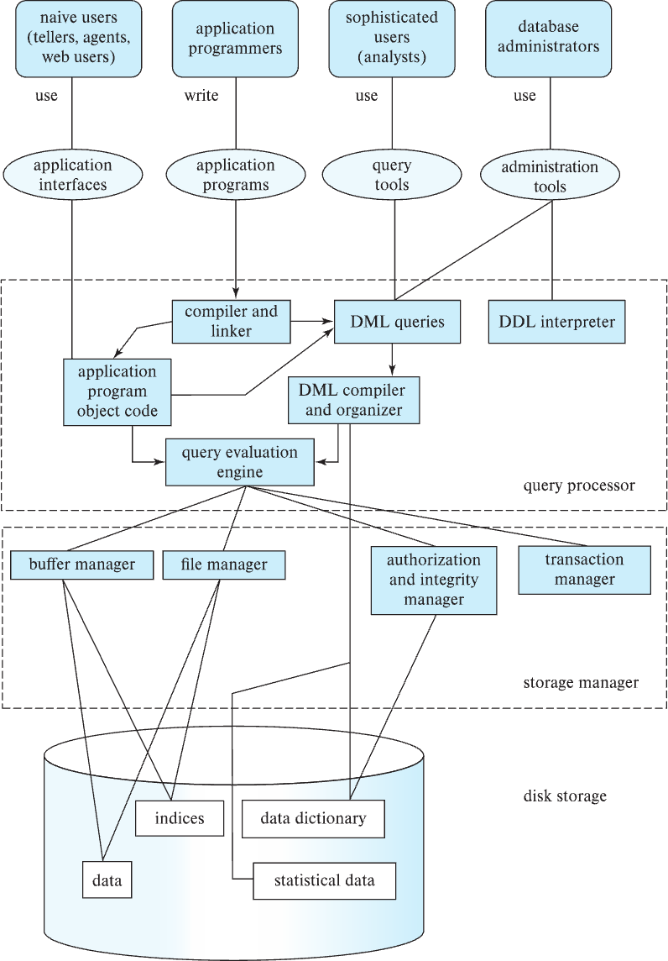
Database Users

Slide 48
Database Administrator
A person who has central control over the system is called a database administrator (DBA). Functions of a DBA include:
Schema definition
Storage structure and access-method definition
Schema and physical-organization modification
Granting of authorization for data access
Routine maintenance
Periodically backing up the database
Ensuring that enough free disk space is available for normal operations, and upgrading disk space as required
Monitoring jobs running on the database

Slide 49
History of Database Systems -1
Foundations (1960s–1970s)
Early Ideas and Relational Model
1960s: Data stored in hierarchical (IMS, IBM) and network (CODASYL) databases.
1970: E. F. Codd (IBM) proposes the Relational Model — data organized in tables with rows and columns.
1974: First query language SEQUEL (later SQL) is introduced at IBM.
Late 1970s: Prototype relational systems appear (System R at IBM, Ingres at UC Berkeley).

Slide 50
History of Database Systems -2
Commercialization & Standardization (1980s–2000s)
Relational Databases Take Over
1980s: Major vendors launch RDBMS products:
Oracle (1979), IBM DB2 (1983), Sybase (1984), Microsoft SQL Server (1989).
SQL becomes the standard (ANSI SQL, 1986).
1990s–2000s:
Widespread adoption across enterprises.
Optimization techniques (indexes, query planners, transaction management).
Rise of open-source RDBMS: MySQL (1995), PostgreSQL (1996).

Slide 51
History of Database Systems -3
Modern Era & Future (2010s–2025)
Cloud, Scale, and Beyond Relational
2010s:
Shift to cloud databases (Amazon RDS, Azure SQL, Google Cloud SQL).
Rise of distributed SQL (CockroachDB, Google Spanner).
Integration with NoSQL systems for scalability.
2020s:
AI & ML powered query optimization and self-tuning databases.
Serverless RDBMS (Aurora Serverless, AlloyDB).
Hybrid systems combining SQL + NoSQL + analytics in one engine.
2025: Relational DBs remain the backbone of enterprise data, evolving to support real-time analytics, AI integration, and multi-cloud deployments.

Slide 52
Evolution of Relational Database Systems (1960 → 2025)
1960s ── Hierarchical (IMS, IBM) & Network DBs (CODASYL)
1970 ── E. F. Codd proposes Relational Model
1974 ── SEQUEL (early SQL) at IBM
1978 ── Prototypes: System R, Ingres
1979 ── Oracle V2 released
1983 ── IBM DB2 launched
1984 ── Sybase founded
1986 ── ANSI SQL standard
1989 ── Microsoft SQL Server
1995 ── MySQL released
1996 ── PostgreSQL released
2010 ── Cloud RDBMS (Amazon RDS, Azure SQL, Google Cloud SQL)
2012 ── Google Spanner (Distributed SQL)
2015 ── CockroachDB (Distributed SQL)
2020 ── Serverless RDBMS (Aurora Serverless, AlloyDB)
2025 ── AI-integrated, multi-cloud, real-time RDBMS

Slide 53
We will use MySQL
Relational Database
SQL-based
Open-Source
Versatile and Scalable
Cross-Platform Compatibility:
MySQL runs on various operating systems, including Linux, macOS, and Microsoft Windows.
Rich set of Features
Ownership:
Initially developed by MySQL AB, it was acquired by Sun Microsystems in 2008 and subsequently by Oracle Corporation in 2009.

