Slide 1
Introduction to Relational Model
Mahmoud Parsian
Ph.D. in Computer Science

Slide 2
Outline
Structure of Relational Databases
Database Schema
Keys
Schema Diagrams
Relational Query Languages
The Relational Algebra

Slide 3
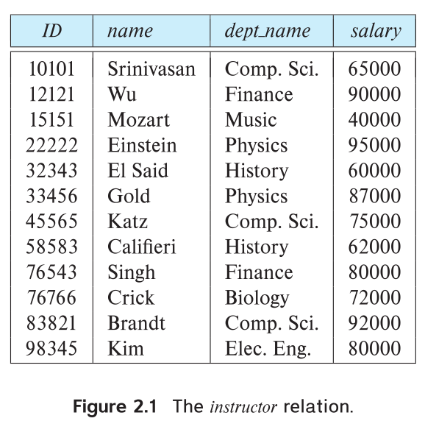
Example of an Instructor Relation/Table Number of Rows: 12 Columns: ID, name, dept_name, salary

Slide 4
Relation Schema and Instance
A₁, A₂, …, A_{n} are attributes
R = (A₁, A₂, …, A_{n} ) is a relation schema
Example:
instructor = (ID, name, dept_name, salary)
A relation instance r defined over schema R is denoted by r (R).
The current values a relation are specified by a table
An element t of relation r is called a tuple and is represented by a row in a table

Slide 5
Attributes
The set of allowed values for each attribute is called the domain of the attribute
Attribute values are (normally) required to be atomic; that is, indivisible
The special value null (or NULL) is a member of every domain. Indicated that the value is “unknown/missing”
The null value causes complications in the definition of many operations

Slide 6
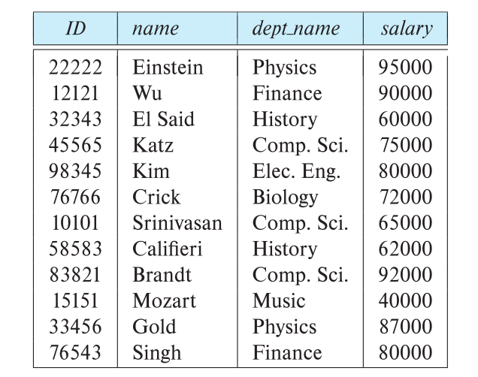
Relations are Unordered
Order of tuples is irrelevant
tuples may be stored in an arbitrary order
Example: instructor relation with unordered tuples

Slide 7
Database Schema
Database schema:
is the logical structure of the database.
Database instance: is a snapshot of the data in the database at a given instant in time.
Example:
schema:
instructor (ID, name, dept_name, salary)

Slide 8
Database Instance: actual data in tables

Slide 9
What is a Primary Key (PK)? A Primary Key (PK) is a column (or set of columns) that uniquely identifies each row in a table. Properties: 1. Must be unique (no duplicates). 2. Can NOT be NULL. 3. Every table should have one primary key. Example (Employee Table): emp_id: PK
emp_id | name | dept_id
1 | John | 10
2 | Jane | 20
3 | Robert | 10

Slide 10
What is a Foreign Key (FK)?
A Foreign Key (FK) is a column (or set of columns) in one table that refers to the Primary Key in another table.
Ensures referential integrity (values must exist in the parent table).
Example:
In Employee table, dept_id refers to the Department table’s dept_id.

Slide 11
PK & FK: Example with Two Tables
Department Table:
Employee Table:
dept_id (PK) | dept_name
10 | Engineering
20 | HR
emp_id (PK) | emp_name | dept_id (FK)
100 | Alex | 10
200 | Jane | 10
300 | Dave | 20

Slide 12
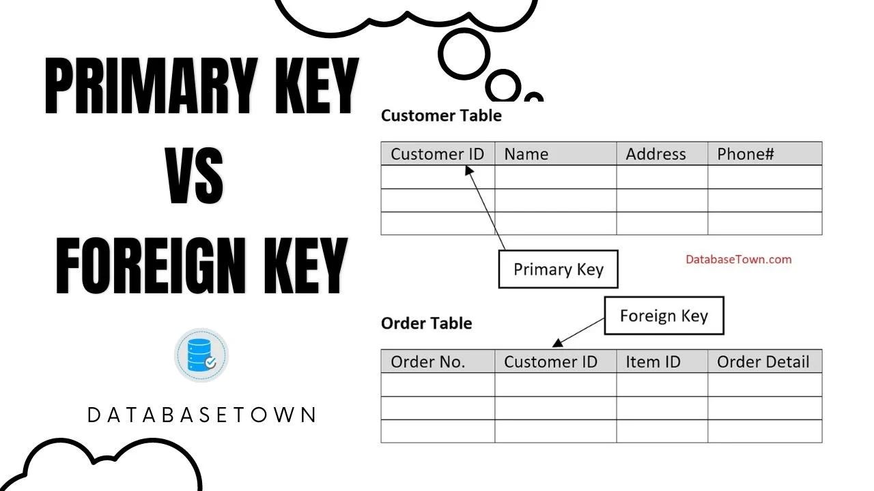
PK and FK

Slide 13
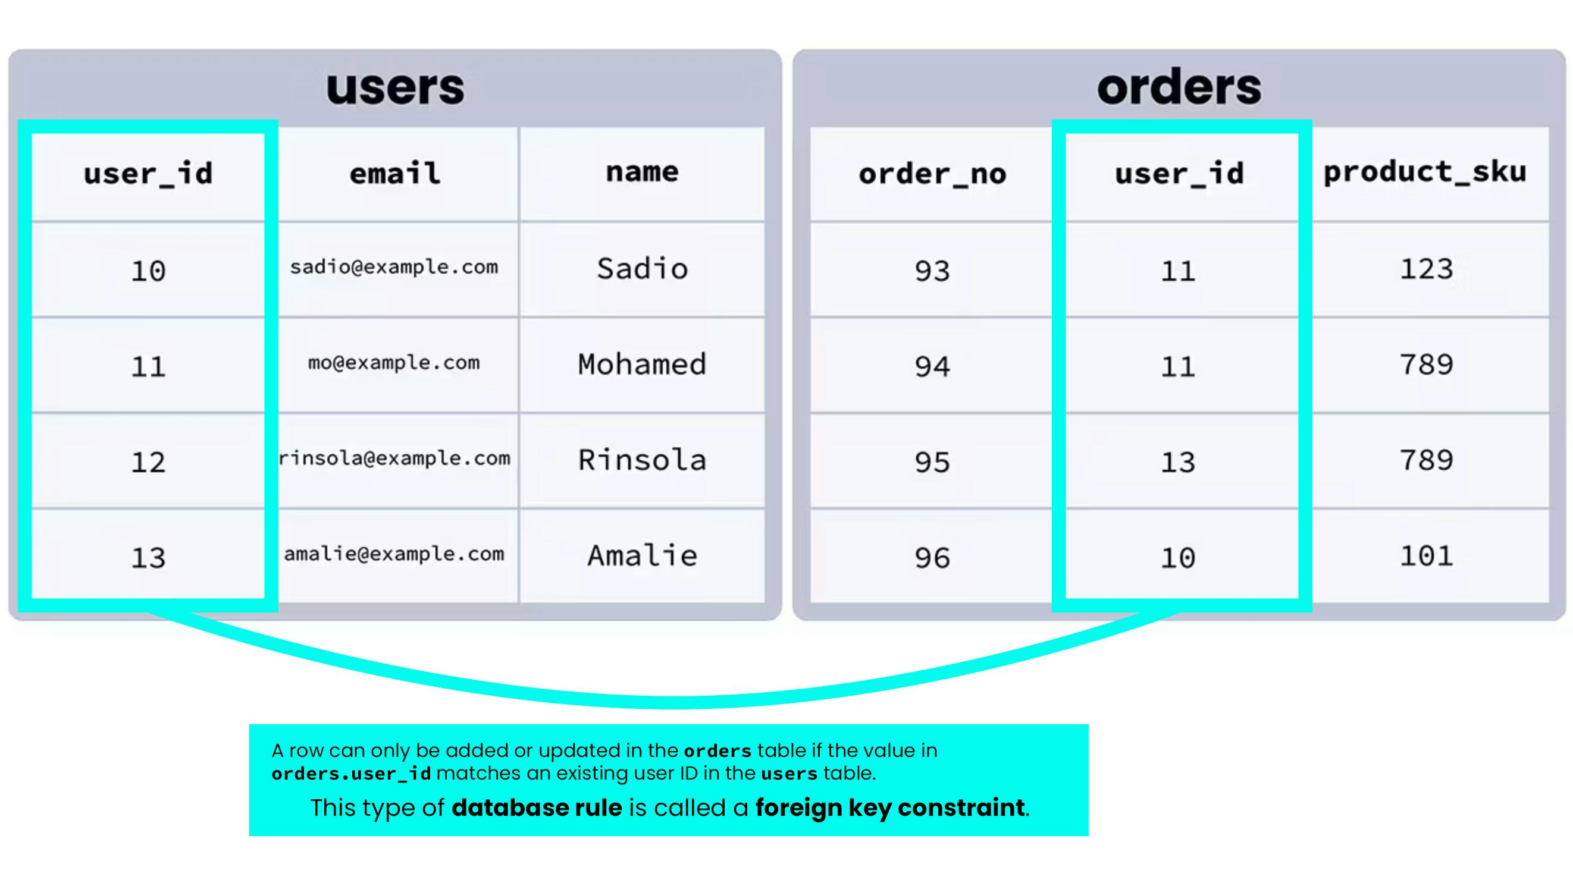
PK & FK

Slide 14
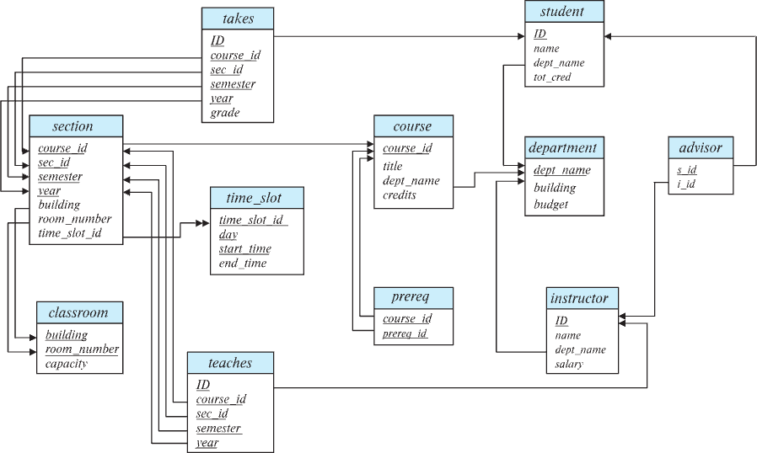
Schema Diagram for University Database

Slide 15
Relational Algebra
A procedural language consisting of a set of operations that take one or two relations as input and produce a new relation as their result.
Six basic operators
select: σ
project: ∏
union: ∪
set difference: –
Cartesian product: x
rename: ρ

Slide 16
SQL SELECT Explained
The SELECT statement is used to retrieve data from one or more tables in a relational database.
You can select all columns or specific columns.
Optional clauses: WHERE, ORDER BY, GROUP BY, etc.
SELECT emp_name, emp_salary, dept_id
FROM employees
WHERE dept_id > 100;

Slide 17
SELECT by Example-1
We have an Employee table:
emp_id name dept_id salary
1 John 10 75000
2 Jane 20 60000
3 Robert 10 82000
4 Linda 30 70000
Query 1: Select All Rows and Columns
SELECT * FROM Employee;
Result (after query) → same as original table (all rows, all columns).
emp_id name dept_id salary
1 John 10 75000
2 Jane 20 60000
3 Robert 10 82000
4 Linda 30 70000

Slide 18
SELECT by Example-2
We have an Employee table:
emp_id name dept_id salary
1 John 10 75000
2 Jane 20 60000
3 Robert. 10 82000
4 Linda 30 70000
Query 2: Select All Columns where salary is greater than 70000
SELECT * FROM Employee WHERE salary > 70000;
Result (after query) →
emp_id name dept_id salary
1 John 10 75000
3 Robert 10 82000

Slide 19
SELECT by Example-3
We have an Employee table:
emp_id name dept_id salary
1 John 10 75000
2 Jane 20 60000
3 Robert 10 82000
4 Linda 30 70000
Query 2: Select only 2 employees with IDs of 1 and 4.
SELECT * FROM Employee WHERE emp_id in (1, 4);
Result (after query) →
emp_id name dept_id salary
1 John 10 75000
4 Linda 30 70000

Slide 20
SELECT operation with 6 Examples
Refer to
select_operation_examples.md

Slide 21
Select Operation (Continued…)
We allow comparisons using
=, ≠, >, ≥. <. ≤
in the selection predicate.
We can combine several predicates into a larger predicate by using the connectives:
∧ (and), ∨ (or), ¬ (not)
Example: Find the instructors in Physics with a salary greater $90,000, we write:
SELECT * from instructors
WHERE dept_name = ‘physics’ AND
salary > 90000;

Slide 22
Project Operation in SQL
In Relational Algebra, the Project (π) operation selects specific columns (attributes) from a relation (table).
In SQL, this is done with the SELECT clause (without *).
Purpose: Reduce the table to only the attributes of interest, removing unnecessary columns.
Duplicate rows removed from result, since relations are sets

Slide 23
Project Operation in SQL: Example
Suppose we have an Employee table:
emp_id name dept_id salary hire_date
1 John 10 75000 2018-03-15
2 Jane 20 60000 2019-06-01
3 Robert 10 82000 2017-11-20
4 Linda 30 70000 2020-05-10
SQL Query — Projection on name and salary
SELECT name, salary
FROM Employee;
Result (after projection)
name salary
John 75000
Jane 60000
Robert 82000
Linda 70000

Slide 24
Composition of Relational Operations
Refer to
composition_of_relational_operations.md

Slide 25
Cartesian-Product Operation
Refer to
cartesian_product_example.md

Slide 26
Join Operation
Let instructor and teaches to be two tables:
The Cartesian-Product
instructor X teaches
associates every tuple of instructor with every tuple of teaches.
Most of the resulting rows have information about instructors who did NOT teach a particular course.
To get only those tuples of “instructor X teaches “ that pertain to instructors and the courses that they taught, we write:
σ _{instructor.id = teaches.id} (instructor x teaches ))
We get only those tuples of “instructor X teaches” that pertain to instructors and the courses that they taught.
The result of this expression, shown in the next slide

Slide 27
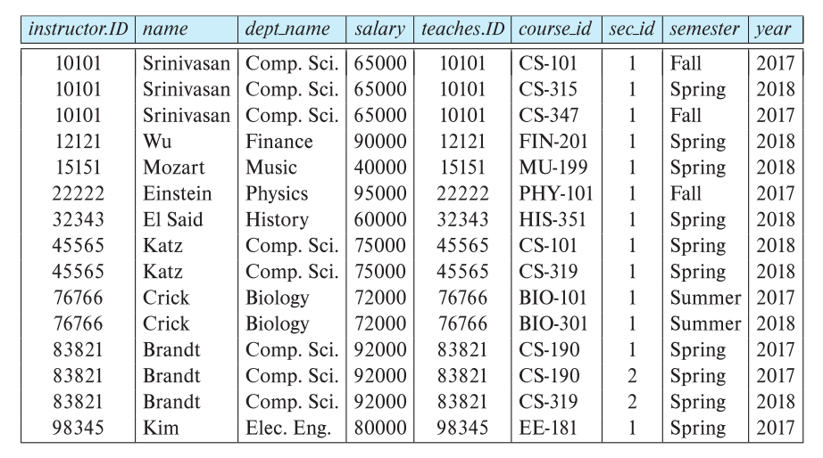
Join Operation (continued…)
The table corresponding to:
σ _{instructor.id = teaches.id} (instructor x teaches))

Slide 28
UNION Operation
The union operation allows us to combine two relations
Notation: r ∪ s
For r ∪ s to be valid.
1. r, s must have the same arity (same number of attributes)
2. The attribute domains must be compatible (example: 2nd
column of r deals with the same type of values as does the
2nd column of s)
Example: to find all courses taught in the Fall 2017 semester, or in the Spring 2018 semester, or in both ∏_{course_id} (σ _{semester=“Fall” Λ year=2017} (section)) ∪ ∏_{course_id} (σ _{semester=“Spring” Λ year=2018} (section))

Slide 29
UNION Operation with Examples
Refer to
union_operations.md

Slide 30
Set-Intersection Operation
The set-intersection operation allows us to find tuples that are in both the input relations.
Notation: r ∩ s
Assume:
r, s have the same arity
attributes of r and s are compatible

Slide 31
Set-Intersection Operation with Examples
Refer to
intersection_operation.md

Slide 32
Set Difference Operation
The set-difference operation allows us to find tuples that are in one relation but are not in another.
Notation r – s
Set differences must be taken between compatible relations.
r and s must have the same arity
attribute domains of r and s must be compatible

Slide 33
Set Difference Operation with an Example
Refer to
difference_of_two_sets.md

Slide 34
The Assignment Operation
mysql> SET @variable_name = 2;
Query OK, 0 rows affected (0.00 sec)
mysql> select @variable_name;
+----------------+
| @variable_name |
+----------------+
| 2 |
+----------------+
1 row in set (0.00 sec)

Slide 35
The Assignment Operation
mysql> select * from departments;
+----+-------------+---------------+
| id | name | location |
+----+-------------+---------------+
| 2 | Marketing | San Francisco |
| 5 | Research | Cupertino |
+----+-------------+---------------+
5 rows in set (0.00 sec)
mysql> select * from departments where id = @variable_name;
+----+-----------+---------------+
| id | name | location |
+----+-----------+---------------+
| 2 | Marketing | San Francisco |
+----+-----------+---------------+
1 row in set (0.00 sec)

Slide 36
The Rename Operation

Slide 37
Equivalent Queries

