Slide 1
Introduction to SQL
Mahmoud Parsian
Ph.D. in Computer Science

Slide 2
Outline…
Overview of The SQL Query Language
SQL Data Definition
Basic Query Structure of SQL Queries
Additional Basic Operations
Set Operations
NULL22 Values
Aggregate Functions
Nested Subqueries
Modification of the Database

Slide 3
SQL usage…
SQL remains the de facto standard for relational databases
MySQL,
PostgreSQL,
Oracle,
MS SQL Server, etc.
Modern extensions handle
Big Data,
NoSQL integration,
cloud-native databases,
…

Slide 4
SQL History
1970 – Birth of the Relational Model by Edgar F. Codd at IBM
1973 – SEQUEL at IBM
1977 – SQL Emerges
1979 – First Commercial SQL Database
1980s – Industry Adoption
1986 – Standardization (ANSI SQL-86)
1989 – SQL-89
1992 – SQL-92 (SQL2)
1999 – SQL:1999 (SQL3)
2003 – SQL:2003
Adds XML support, window functions, and new data types.
2006 – SQL:2006
Focus on XQuery and XML integration.
2008 / 2011 – SQL:2008 & SQL:2011
Add temporal databases (valid time, transaction time), better diagnostics, and richer analytical functions.
2016 – SQL:2016
Introduces JSON support, polymorphic tables, and further enhancements for analytics.

Slide 5
SQL Parts
DML (data manipulation language) -- provides the ability to query information from the database and to insert tuples into, delete tuples from, and modify tuples in the database.
Integrity – the DDL includes commands for specifying integrity constraints.
View definition -- The DDL includes commands for defining views.
Transaction control –includes commands for specifying the beginning and ending of transactions.
Embedded SQL and dynamic SQL -- define how SQL statements can be embedded within general-purpose programming languages.
Authorization – includes commands for specifying access rights to relations and views.

Slide 6
Data Definition Language (DDL)
The SQL data-definition language (DDL) allows the specification of information about relations, including:
The schema for each relation.
The type of values associated with each attribute.
The Integrity constraints
The set of indices to be maintained for each relation.
Security and authorization information for each relation.
The physical storage structure of each relation on disk.

Slide 7
Domain Types in SQL
char(n). Fixed length character string, with user-specified length n.
varchar(n). Variable length character strings, with user-specified maximum length n.
int. Integer (a finite subset of the integers that is machine-dependent).
smallint. Small integer (a machine-dependent subset of the integer domain type).
numeric(p,d). Fixed point number, with user-specified precision of p digits, with d digits to the right of decimal point. (ex., numeric(3,1), allows 44.5 to be stores exactly, but not 444.5 or 0.32)
real, double precision. Floating point and double-precision floating point numbers, with machine-dependent precision.
float(n). Floating point number, with user-specified precision of at least n digits.

Slide 8
Create Table Construct in SQL
CREATE TABLE instructor ( ID char(5), name varchar(20), dept_name varchar(20), salary numeric(8,2)
);

Slide 9
Create Table Construct with PK, FK
CREATE TABLE instructor ( ID char(5), name varchar(20), dept_name varchar(20), salary numeric(8,2),
primary key (ID), foreign key (dept_name) references department);
);

Slide 10
Create Table Construct with PK, FK
Refer to
create_table_with_PK_and_FK.md

Slide 11
INSERT
The SQL INSERT creates a new row/record in a table:
CREATE TABLE names(id int, name varchar(20));
-- Insert 3 Rows of data
INSERT INTO names(id, name) values
(1, ‘dave’),
(3, ‘max’),
(4, ‘alex’);

Slide 12
INSERT
mysql> CREATE TABLE names(id int, name varchar(20));
Query OK, 0 rows affected (0.00 sec)
mysql> INSERT INTO names(id, name) values (1, 'dave'), (3, 'max'), (4, 'alex');
Query OK, 3 rows affected (0.00 sec)
Records: 3 Duplicates: 0 Warnings: 0
mysql> select * from names;
+------+------+
| id | name |
+------+------+
| 1 | dave |
| 3 | max |
| 4 | alex |
+------+------+
3 rows in set (0.00 sec)

Slide 13
DELETE: Remove all tuples from the relation
mysql> select * from names;
+------+------+
| id | name |
+------+------+
| 1 | dave |
| 3 | max |
| 4 | alex |
+------+------+
3 rows in set (0.00 sec)
mysql> delete from names;
Query OK, 3 rows affected (0.00 sec)
mysql> select * from names;
Empty set (0.00 sec)

Slide 14
DELETE: remove using the WHERE clause
mysql> select * from names;
+------+------+
| id | name |
+------+------+
| 1 | dave |
| 3 | max |
| 4 | alex |
+------+------+
3 rows in set (0.00 sec)
mysql> delete from names where id > 2;
Query OK, 2 rows affected (0.00 sec)
mysql> select * from names;
+------+------+
| id | name |
+------+------+
| 1 | dave |
+------+------+
1 row in set (0.00 sec)

Slide 15
Drop Table: delete data & metadata
mysql> select * from names;
+------+------+
| id | name |
+------+------+
| 1 | dave |
| 2 | max |
+------+------+
2 row2 in set (0.00 sec)
mysql> drop table names;
Query OK, 0 rows affected (0.01 sec)
mysql> select * from names;
ERROR 1146 (42S02): Table 'company.names' doesn't exist

Slide 16
Alter Table: TBDL
TBDL

Slide 17
Basic Query Structure
A typical SQL query has the form: SELECT A₁, A₂, ..., A_{n} FROM r₁, r₂, ..., r_{m} WHERE P
A_{i} represents an attribute
R_{i} represents a relation
P is a predicate.
The result of an SQL query is a relation.

Slide 18
The SELECT Clause: with DISTINCT
mysql> select id, name from names;
+------+------+
| id | name |
+------+------+
| 1 | dave |
| 3 | max |
| 1 | dave |
| 3 | max |
+------+------+
4 rows in set (0.00 sec)
mysql> select DISTINCT id, name from names;
+------+------+
| id | name |
+------+------+
| 1 | dave |
| 3 | max |
+------+------+
2 rows in set (0.00 sec)

Slide 19
The SELECT Clause: with * : All Columns
mysql> select id, name from names;
+------+------+
| id | name |
+------+------+
| 1 | dave |
| 3 | max |
+------+------+
2 rows in set (0.00 sec)
mysql> select * from names;
+------+------+
| id | name |
+------+------+
| 1 | dave |
| 3 | max |
+------+------+
2 rows in set (0.00 sec)

Slide 20
The SELECT Clause: with WHERE clause
mysql> SELECT id, name FROM names;
+------+------+
| id | name |
+------+------+
| 1 | dave |
| 3 | max |
| 8 | alex |
+------+------+
3 rows in set (0.00 sec)
mysql> SELECT * FROM names
WHERE id < 5;
+------+------+
| id | name |
+------+------+
| 1 | dave |
| 3 | max |
+------+------+
2 rows in set (0.00 sec)

Slide 21
The SELECT Clause: with FROM clause
mysql> SELECT id, name FROM names;
+------+------+
| id | name |
+------+------+
| 1 | dave |
| 3 | max |
| 8 | alex |
+------+------+
3 rows in set (0.00 sec)
mysql> SELECT * FROM names WHERE id < 5;
+------+------+
| id | name |
+------+------+
| 1 | dave |
| 3 | max |
+------+------+
2 rows in set (0.00 sec)

Slide 22
The SELECT Clause: with FROM clause: JOIN
mysql> select * from names;
+------+------+
| id | name |
+------+------+
| 1 | dave |
| 3 | max |
| 4 | alex |
+------+------+
mysql> select * from names A, names B;
+------+------+------+------+
| id | name | id | name |
+------+------+------+------+
| 4 | alex | 1 | dave |
| 3 | max | 1 | dave |
| 1 | dave | 1 | dave |
| 4 | alex | 3 | max |
| 3 | max | 3 | max |
| 1 | dave | 3 | max |
| 4 | alex | 4 | alex |
| 3 | max | 4 | alex |
| 1 | dave | 4 | alex |
+------+------+------+------+
9 rows in set (0.00 sec)

Slide 23
The SELECT Clause: with FROM clause: JOIN
mysql> select * from names;
+------+------+
| id | name |
+------+------+
| 1 | dave |
| 3 | max |
| 4 | alex |
+------+------+
mysql> select A.id as id_A, A.name as name_A, B.id as id_B, B.name as name_B from names A, names B;
+------+--------+------+--------+
| id_A | name_A | id_B | name_B |
+------+--------+------+--------+
| 4 | alex | 1 | dave |
| 3 | max | 1 | dave |
| 1 | dave | 1 | dave |
| 4 | alex | 3 | max |
| 3 | max | 3 | max |
| 1 | dave | 3 | max |
| 4 | alex | 4 | alex |
| 3 | max | 4 | alex |
| 1 | dave | 4 | alex |
+------+--------+------+--------+
9 rows in set (0.00 sec)

Slide 24
Query Example-1
Find the names of all instructors who have taught some course and the course_id
SELECT name,
course_id FROM
instructor,
teaches WHERE
instructor.ID = teaches.ID;

Slide 25
Query Example-2
Find the names of all instructors in the Art department who have taught some course and the course_id
SELECT name, course_id FROM instructor, teaches WHERE instructor.ID = teaches.ID AND
instructor.dept_name = 'Art’;

Slide 26
Set Operations (MySQL)
Set operators in MySQL allow you to manage and compare data sets.
Set operations are:
UNION
UNION ALL
INTERSECT
EXCEPT

Slide 27
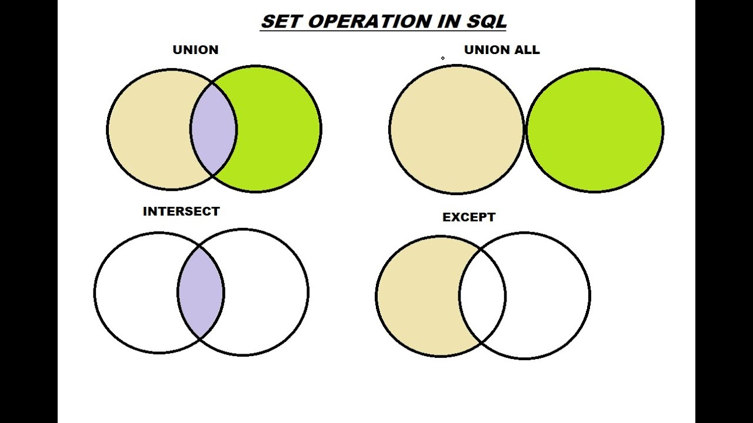
Set Operations (MySQL)

Slide 28
UNION operator
The UNION operator is one of the most often-used set operators in MySQL. It combines the results of two or more SELECT operations into a single result set.
The syntax for using the UNION operator is as follows:
SELECT column1, column2, ...
FROM table1
UNION
SELECT column1, column2, ...
FROM table2

Slide 29
Set Operations (MySQL)
Refer to
set_operations_MATH.md
set_operations_mysql.md

Slide 30
NULL values
It is possible for tuples to have a NULL value, denoted by NULL, for some of their attributes
NULL signifies an unknown value or that a value does not exist.
The result of any arithmetic expression involving null is null
Example: 5 + null returns null
The predicate IS NULL can be used to check for null values.
Example: Find all instructors whose salary is null.
select name from instructor where salary IS NULL;
The predicate is not null succeeds if the value on which it is applied is not null.

Slide 31
NULL values
Refer to
null_values_in_sql.md

Slide 32
Aggregate Functions
Aggregate functions operate on the multiset of values of a column of a relation, and return a value
avg: average value
min: minimum value
max: maximum value
sum: sum of values
count: number of values

Slide 33
Aggregate Functions
Refer to
aggregate_functions.md

Slide 34
Set Membership
Refer to
set_membership.md

Slide 35
Set Comparison
Refer to
set_comparison.md

Slide 36
Test for Empty Relations
The exists construct returns the value true if the argument subquery is nonempty.
exists r ⇔ r ≠ Ø
not exists r ⇔ r = Ø

Slide 37
Using EXISTS and NOT EXISTS in MySQL
Refer to
using_EXISTS_and_NOT_EXISTS_in_MySQL.md

Slide 38
Testing for Absence of Duplicate Tuples in MySQL
testing_for_absence_of_duplicate_tuples_in_MySQL.md

Slide 39
Detecting & Removing Duplicate Rows
detecting_and_removing_duplicate_rows_in_MySQL.md

Slide 40
Sub Queries using WITH
sub_queries_using_WITH.md

Slide 41
Modification of the Database
Deletion of tuples from a given relation.
Insertion of new tuples into a given relation
Updating of values in some tuples in a given relation

Slide 42
Modification of the Database
insert_update_delete_in_mysql.md

Slide 43
CASE Statement
case_statement_in_mysql.md

