Slide 1
SQL Joins by Examples

Slide 2
Types of Joins
Inner Join
Natural Join
Left (Outer) Join
Right (Outer) Join
)Full) Outer Join
Left (Outer) Join Excluding Inner Join
Right (Outer) Join Excluding Inner Join
(Full) Outer Join Excluding Inner Join
Cross Join

Slide 3
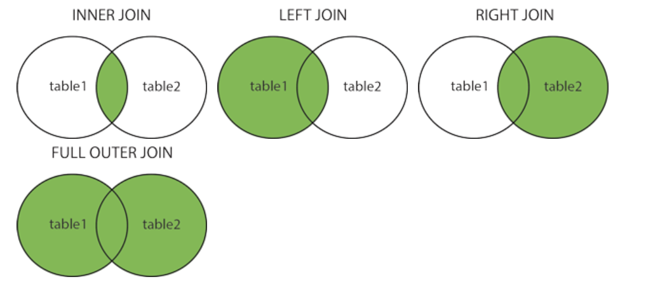
Different Types of SQL JOINs
Here are the different types of the JOINs in SQL:
(INNER) JOIN: Returns records that have matching values in both tables
LEFT (OUTER) JOIN: Returns all records from the left table, and the matched records from the right table
RIGHT (OUTER) JOIN: Returns all records from the right table, and the matched records from the left table
FULL (OUTER) JOIN: Returns all records when there is a match in either left or right table

Slide 4
Sample Tables
TableA
TableB
PK | Value
1 | FOX
2 | COP
3 | TAXI
6 | WASHINGTON
7 | DELL
5 | ARIZONA
4 | LINCOLN
10 | LUCENT
PK | Value
1 | TROT
2 | CAR
3 | CAB
6 | MONUMENT
7 | PC
8 | MICROSOFT
9 | APPLE
11 | SCOTCH

Slide 5
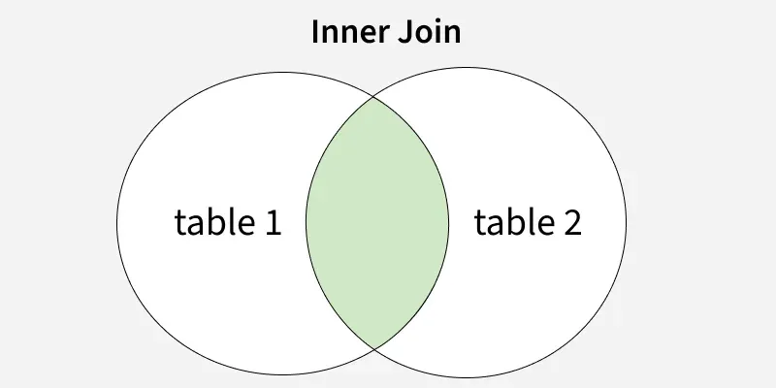
Inner Join

Slide 6
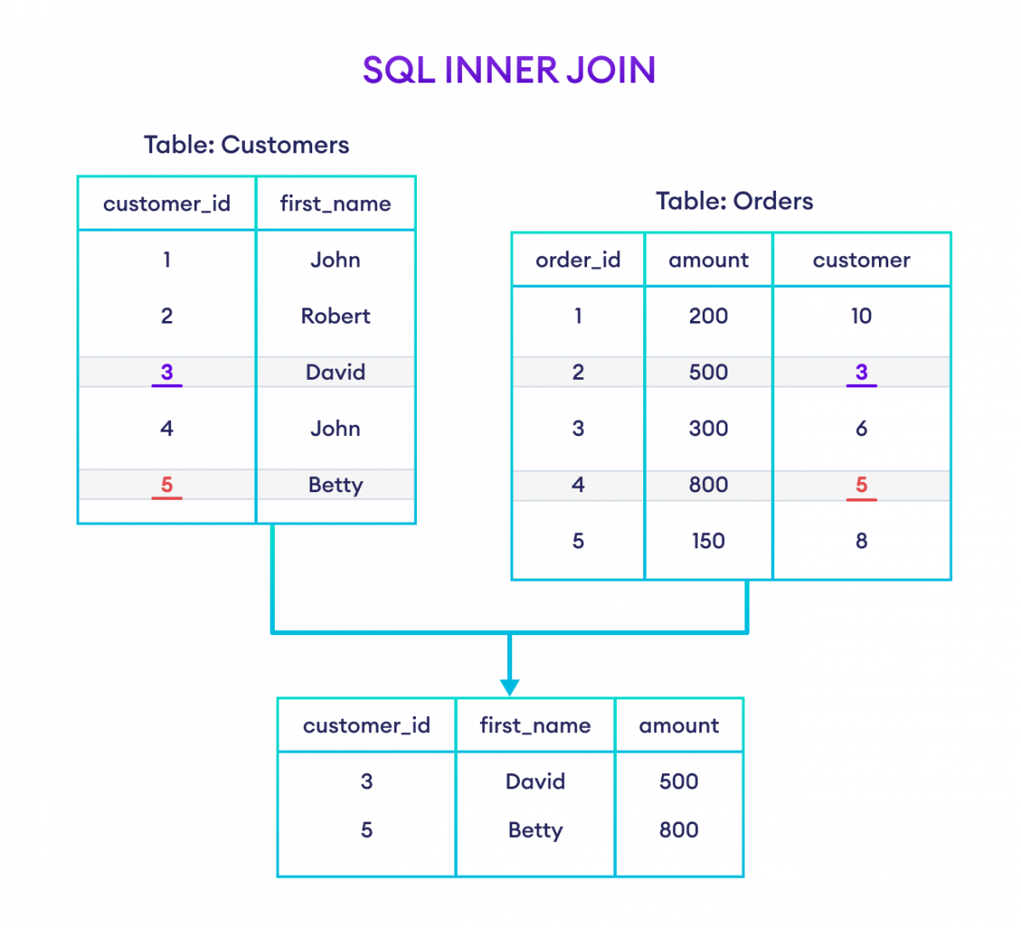
Inner Join Example-1

Slide 7
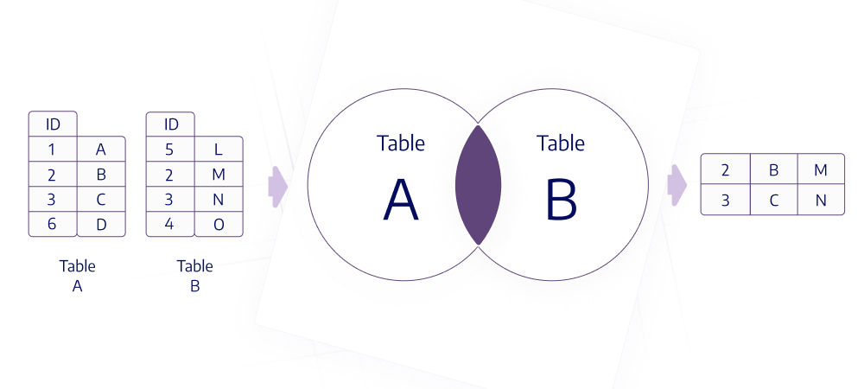
Inner Join Example-2

Slide 8
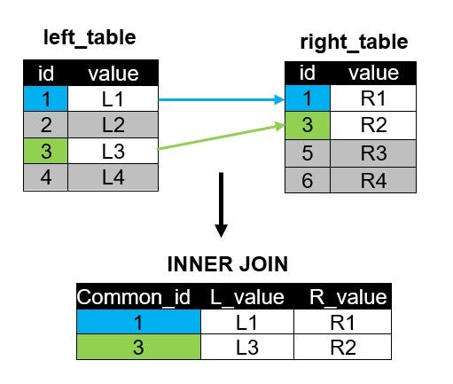
Inner Join Example-3

Slide 9
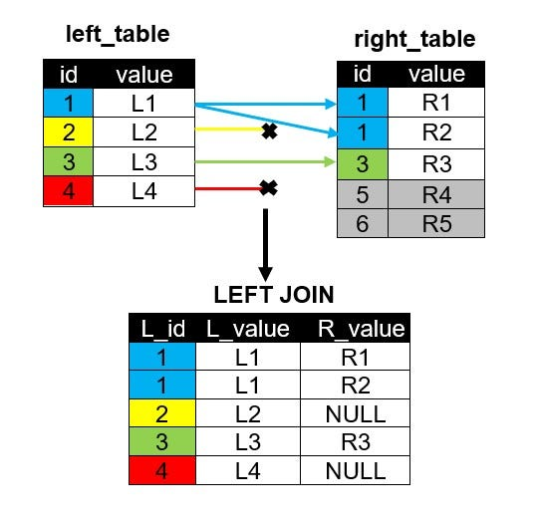
Inner Join Example-4

Slide 10
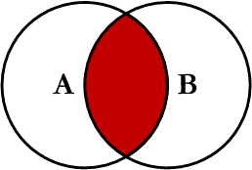
Inner Join
Inner join produces only the set of records that match in both Table A and Table B
Most commonly used, best understood join
Note:
Inner Joins do not have to use equality to join the fields
Can use <, >, <>
INNER JOIN Syntax
SELECT column_name(s) FROM table1 INNER JOIN table2 ON table1.column_name = table2.column_name;

Slide 11
Inner Join
TableA Value | PK | TableB PK | Value
FOX | 1 | 1 | TROT
COP | 2 | 2 | CAR
TAXI | 3 | 3 | CAB
WASHINGTON | 6 | 6 | MONUMENT
DELL | 7 | 7 | PC
SELECT *
FROM TableA INNER JOIN TableB
ON TableA.PK = TableB.PK;
This is the same as doing
SELECT *
FROM TableA, TableB
WHERE TableA.PK = TableB.PK;

Slide 12
Inner Join (continued)
TableA PK | Value | TableB PK | Value
2 | COP | 1 | TROT
3 | TAXI | 1 | TROT
3 | TAXI | 2 | CAR
4 | LINCOLN | 1 | TROT
4 | LINCOLN | 2 | CAR
4 | LINCOLN | 3 | CAB
5 | ARIZONA | 1 | TROT
5 | ARIZONA | 2 | CAR
5 | ARIZONA | 3 | CAB
… | More… | Rows…
SELECT *
FROM TableA
INNER JOIN TableB
ON TableA.PK > TableB.PK;

Slide 13
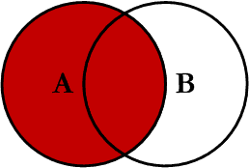
Left Outer Join
Left outer join produces a complete set of records from Table A, with the matching records (where available) in Table B. If there is no match, the right side will contain null.

Slide 14
Left Outer Join
TableA Value | PK | TableB PK | Value
FOX | 1 | 1 | TROT
COP | 2 | 2 | CAR
TAXI | 3 | 3 | CAB
LINCOLN | 4 | NULL | NULL
ARIZONA | 5 | NULL | NULL
WASHINGTON | 6 | 6 | MONUMENT
DELL | 7 | 7 | PC
LUCENT | 10 | NULL | NULL
SELECT *
FROM TableA LEFT OUTER JOIN TableB
ON TableA.PK = TableB.PK

Slide 15
SQL Joins…Example
SELECT S.name, E.classid
FROM Students S LEFT OUTER JOIN Enrolled E
ON S.sid=E.sid
S
S.name | S.sid
Jones | 11111
Smith | 22222
Brown | 33333
E
E.sid | E.classid
11111 | History105
11111 | DataScience194
22222 | French150
44444 | English10
S.name | E.classid
Jones | History105
Jones | DataScience194
Smith | French150
Brown | NULL
Notes:
Missing (unmatched) key values

Slide 16
Left Join Example-1

Slide 17
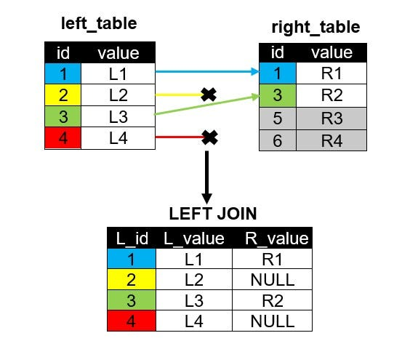
Left Join Example-2

Slide 18
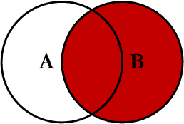
Right Outer Join
Right outer join produces a complete set of records from Table B, with the matching records (where available) in Table A. If there is no match, the left side will contain null.

Slide 19
Right Outer Join
Note: RIGHT are not currently supported
TableA Value | PK | TableB PK | Value
FOX | 1 | 1 | TROT
COP | 2 | 2 | CAR
TAXI | 3 | 3 | CAB
WASHINGTON | 6 | 6 | MONUMENT
DELL | 7 | 7 | PC
NULL | NULL | 8 | MICROSOFT
NULL | NULL | 9 | APPLE
NULL | NULL | 11 | SCOTCH
SELECT *
FROM TableA RIGHT OUTER JOIN TableB
ON TableA.PK = TableB.PK

Slide 20
SQL Joins…..example
SELECT S.name, E.classid
FROM Students S RIGHT OUTER JOIN Enrolled E
ON S.sid=E.sid
S
S.name | S.sid
Jones | 11111
Smith | 22222
Brown | 33333
E
E.sid | E.classid
11111 | History105
11111 | DataScience194
22222 | French150
44444 | English10
S.name | E.classid
Jones | History105
Jones | DataScience194
Smith | French150
NULL | English10
Notes:
Missing (unmatched) key values

Slide 21
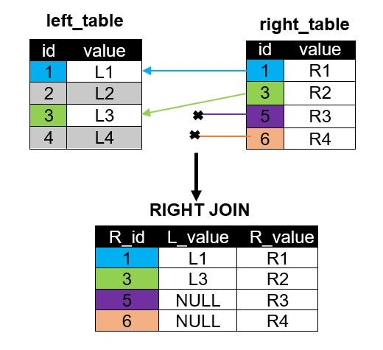
Right Join Example-1

Slide 22
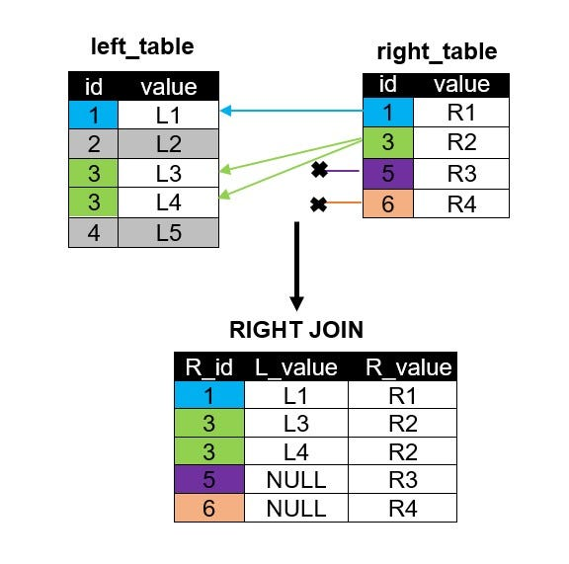
Right Join Example-2

Slide 23
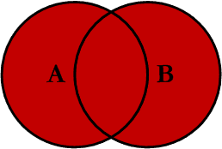
Full Outer Join
Full outer join produces the set of all records in Table A and Table B, with matching records from both sides where available. If there is no match, the missing side will contain null.

Slide 24
Full Outer Join
TableA Value | PK | TableB PK | Value
FOX | 1 | 1 | TROT
COP | 2 | 2 | CAR
TAXI | 3 | 3 | CAB
LINCOLN | 4 | NULL | NULL
ARIZONA | 5 | NULL | NULL
WASHINGTON | 6 | 6 | MONUMENT
DELL | 7 | 7 | PC
LUCENT | 10 | NULL | NULL
NULL | NULL | 8 | MICROSOFT
NULL | NULL | 9 | APPLE
NULL | NULL | 11 | SCOTCH
SELECT * FROM TableA FULL OUTER JOIN TableB ON TableA.PK
= TableB.PK

Slide 25
SQL Joins….. Example
SELECT S.name, E.classid
FROM Students S FULL OUTER JOIN Enrolled E
ON S.sid=E.sid
S
S.name | S.sid
Jones | 11111
Smith | 22222
Brown | 33333
E
E.sid | E.classid
11111 | History105
11111 | DataScience194
22222 | French150
44444 | English10
S.name | E.classid
Jones | History105
Jones | DataScience194
Smith | French150
NULL | English10
Brown | NULL
Notes:
Missing (unmatched) key values

Slide 26
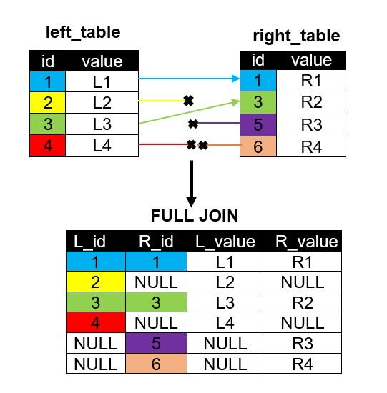
Full Join by Example

Slide 27
Cross Join
A cross join is a Cartesian Product join – it is every record in Table A combined with every record in Table B.
It gives the same results as not using a WHERE clause when querying two tables in MySQL
SELECT * from TableA CROSS JOIN TableB
SELECT * from TableA, TableB

Slide 28
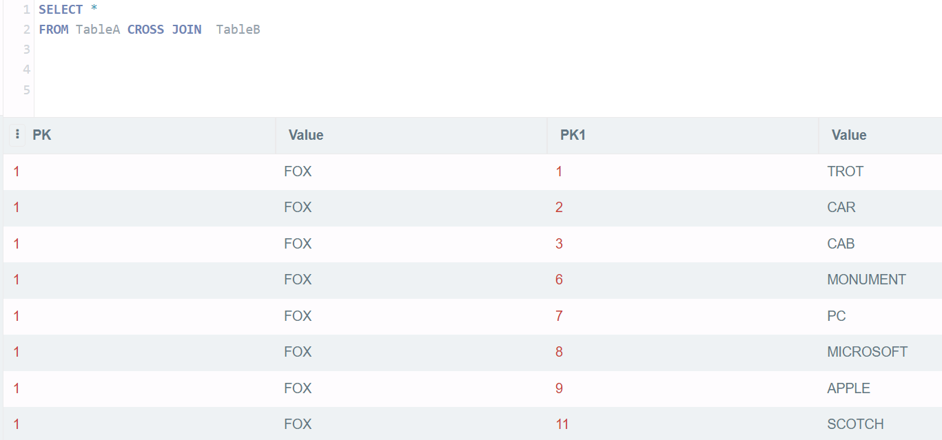
Cross Join

Slide 29
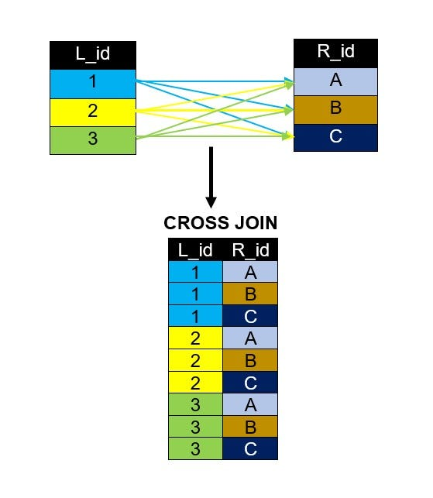
Cross Join by Example

Slide 30
SQL Joins
SELECT *
FROM Students S CROSS JOIN Enrolled E
S
S.name | S.sid
Jones | 11111
Smith | 22222
E
E.sid | E.classid
11111 | History105
11111 | DataScience194
22222 | French150
S.name | S.sid | E.sid | E.classid
Jones | 11111 | 11111 | History105
Jones | 11111 | 11111 | DataScience194
Jones | 11111 | 22222 | French150
Smith | 22222 | 11111 | History105
Smith | 22222 | 11111 | DataScience194
Smith | 22222 | 22222 | French150

Slide 31
Theta Joins
SELECT *
FROM Students S, Enrolled E
WHERE S.sid <= E.sid
S
S.name | S.sid
Jones | 11111
Smith | 22222
E
E.sid | E.classid
11111 | History105
11111 | DataScience194
22222 | French150
S.name | S.sid | E.sid | E.classid
Jones | 11111 | 11111 | History105
Jones | 11111 | 11111 | DataScience194
Jones | 11111 | 22222 | French150
Smith | 22222 | 22222 | French150

Slide 32
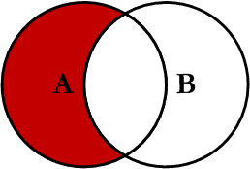
Left Join Excluding Inner Join
This query will return all of the records in the left table (table A) that do not match any records in the right table (table B).

Slide 33
Left Join Excluding Inner Join
TableA Value | PK | TableB PK | Value
LINCOLN | 4 | NULL | NULL
ARIZONA | 5 | NULL | NULL
LUCENT | 10 | NULL | NULL
SELECT * FROM TableA LEFT JOIN TableB
ON TableA.PK = TableB.PK
WHERE TableB.PK IS NULL;
Perform left outer join, then exclude the records we don't want from the right side via a where clause.

Slide 34
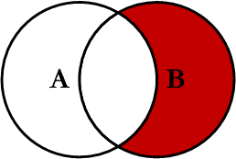
Right Join Excluding Inner Join
This query will return all of the records in the right table (table B) that do not match any records in the left table (table A).

Slide 35
Right Join Excluding Inner Join
TableA Value | PK | TableB PK | Value
NULL | NULL | 8 | MICROSOFT
NULL | NULL | 9 | APPLE
NULL | NULL | 11 | SCOTCH
SELECT * FROM TableA RIGHT JOIN TableB
ON TableA.PK = TableB.PK
WHERE TableA.PK IS NULL
Perform right outer join, then exclude the records we don't want from the left side via a where clause.

Slide 36
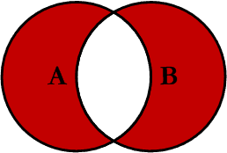
Full Outer Excluding Inner Join
This query will return all of the records in Table A and Table B that do not have a matching record in the other table.
In general, Not used

Slide 37
Full Outer Excluding Inner Join
TableA Value | PK | TableB PK | Value
NULL | NULL | 8 | MICROSOFT
NULL | NULL | 9 | APPLE
NULL | NULL | 11 | SCOTCH
LINCOLN | 4 | NULL | NULL
ARIZONA | 5 | NULL | NULL
LUCENT | 10 | NULL | NULL
SELECT * FROM TableA FULL OUTER JOIN TableB
ON TableA.PK = TableB.PK
WHERE TableA.PK IS NULL OR TableB.PK IS NULL

