Slide 1
OMIS-113 Data WareHousing & Business Inlelligence
Mahmoud Parsian
PH.D in Computer Science

Slide 2
Welcome!
OMIS-113:
Data Warehousing &
Business Intelligence
Today’s lecture
Introductions
Introducing Teaching Assistant (TA)
Course administration
What to expect
Introduction and motivation

Slide 3
Introductions: Instructor
NAME: Mahmoud PARSIAN
EDUCATION: Ph.D. in Computer Science
Work: Lead Big Data Architect @Illumina
Teaching: @SCU for 10 Years
Teaching 30+ years, @ISU, Virginia Tech
Publications: Published 5 books
Email: mparsian@scu.edu

Slide 4

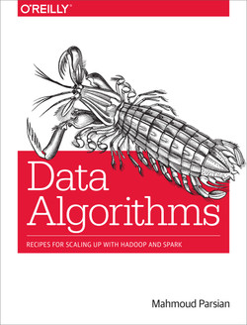
Introductions: books

Slide 5
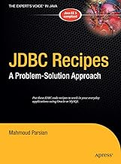
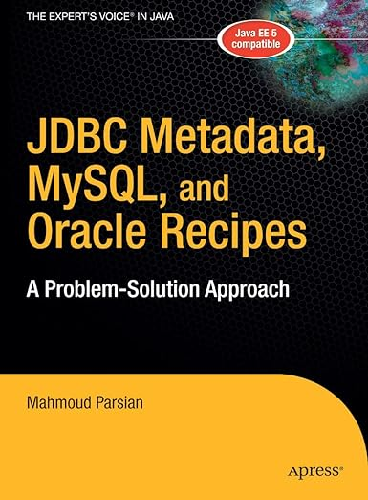
Introductions: books

Slide 6
About TA: Teaching Assistant
Teaching Assistant: Ms. Prachi Kotkar
LinkedIn: https://www.linkedin.com/in/prachi-kotkar/
MSIS Graduate Student @SCU
Expected to Graduate: June 2025

Slide 7
Course Format
1. Lectures
Tuesday: 5:45pm – 7:20pm PST
Thursday: 5:45pm – 7:20pm PST
2. Office Hours: to be announced
3. Homework assignments (8)
4. Exam-1
5. Exam-2
6. Final Exam

Slide 8
Grading
Assignment/Homework/Exam | %
HomeWorks | 60
Exam-1 | 10
Exam-2 | 10
Final Exam | 20

Slide 9
Administration
Web page: OMIS-113 GitHub
Syllabus (course information)
Lecture notes will be available there
Homework assignments, quizzes, midterm, and final exams will be available in Camino

Slide 10
Weekly Lectures
week_01: Introduction to DW, and Business Intelligence
week_02: Introduction to Relational Databases week_03: Introduction to SQL and Business Intelligence week_04: Data Modeling, Normalization, and Star Schema week_05: Python MySQL Connector, ETL, and ELT week_06: Introduction to Data Warehousing week_07: Introduction to Star Schema week_08: Star Schema examples: Book Seller and Stock Market week_09: Business Intelligence week_10: OLAP Operations: Cube, Roll-up, Roll-down, Dice, Slice

Slide 11
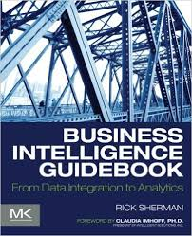
Required Textbook
Sherman, Rick “Business Intelligence Guidebook: From Data Integration to Analytics,” Morgan Kaufman Publisher, 2014. eBook ISBN: 9780124115286, Paperback ISBN: 9780124114616

Slide 12
Required Tutorial
Data Warehousing Tutorial
by https://www.tutorialspoint.com
PDF format, 86 pages
Price $9.99

Slide 13
Assignments
H1: Install MySQL, MySQL Workbench, Create a Table, Queries
H2: Tableau: Install Tableau, analyze a Table
H3: SQL, Group By, ROLLUP, Aggregations
Exam-1: on Camino
H4: Tableau: Group By, ROLLUP
H5:
H6:
H7:
Exam-2: on Camino
H8:
Final Exam
Notes:
Practical assignments. Look at important technologies….
Lots of new tools. This can be exhausting.
All homeworks are to be done on your own.

Slide 14
About the Assignments
You will learn/practice the course material:
SQL
Tableau
Business Intelligence
OLAP Operations
Star Schema
ETL
ELT
The time spent learning the new technology is very useful: write everything on your CV!

Slide 15
Deadlines and Late Days
Assignments are expected to be done on time,
but things happen, so…
You have up to 24 hours
No more than 24 hours on any one assignment
Late hours = safety net, not convenience!
You should not plan on using them
If you use all 24 hours, then you are doing it wrong

Slide 16
Camino Exams
Exams
Exam-1
Exam-2
Final Exam
No late submissions

Slide 17
Lectures
Slides contain vital information for
Exams
Homework
Posted after lecture
Associated readings
Good for alternate explanations
Responsible for assigned readings
Notes:
ASK HERE WHO IS TAKING 311 and 331? If a lot, then move midterm to friday

Slide 18
Exams
Dates
TBDL
Preparation
Exam review
Notes:
ASK HERE WHO IS TAKING 311 and 331? If a lot, then move midterm to friday

Slide 19
Expectations About you
Learn deeply and practice
SQL → Business Intelligence
Hands-on: SQL, Tableau, ETL
Ask questions
Academic Honesty
Participation
Discussions on Camino

Slide 20
Class Goals
1. The world is drowning in data!
2. Need data analysts to help manage this data
Help domain scientists achieve new discoveries
Help companies provide better services (e.g., Facebook)
Help governments (and universities!) become more efficient
3. Learn how to analyze data for Business Intelligence
Notes:
Give examples of how we helped astronomers with SQL Server then MapReduce.
LSST will produce 30TB of data per night! Or 9PB per year.
Large Hadron Collider (LHC) looking for the Higgs particle, produced 25PB of data in 2012!

Slide 21
Why Data WAREHOUSING?
To boost company's decision-making abilities
Support Business Intelligence and AI initiatives.
It is crucial to have a flexible and trusted data foundation.
Notes:
Give examples of how we helped astronomers with SQL Server then MapReduce.
LSST will produce 30TB of data per night! Or 9PB per year.
Large Hadron Collider (LHC) looking for the Higgs particle, produced 25PB of data in 2012!

Slide 22
Database & Data WareHouse
What is a database?
What is a data warehouse?

Slide 23
Database
What is a database ?
A collection of files storing related data
Give examples of databases

Slide 24
Database
What is a database ?
A collection of files storing related data
Give examples of databases
Accounts database; payroll database; UW’s students database; Amazon’s products database; airline reservation database

Slide 25
Database Management System
What is a DBMS ?

Slide 26
Database Management System
What is a DBMS ?
A big program written by someone else that allows us to manage efficiently a large database and allows it to persist over long periods of time
Examples of DBMSs
Oracle, IBM DB2, Microsoft SQL Server, Vertica, Teradata
Open source: MySQL (Sun/Oracle), PostgreSQL, CouchDB
Open source library: SQLite
We will focus on relational DBMSs most quarter

Slide 27
An Example: Online Bookseller
What data do we need?

Slide 28
An Example: Online Bookseller
What data do we need?
Data about books, customers, pending orders, order histories, trends, preferences, etc.
Data about sessions (clicks, pages, searches)
Note: data must be persistent! Outlive application
Also note that data is large… won’t fit all in memory

Slide 29
An Example: Online Bookseller
What data do we need?
Data about books, customers, pending orders, order histories, trends, preferences, etc.
Data about sessions (clicks, pages, searches)
Note: data must be persistent! Outlive application
Also note that data is large… won’t fit all in memory
What capabilities on the data do we need?

Slide 30
An Example: Online Bookseller
What data do we need?
Data about books, customers, pending orders, order histories, trends, preferences, etc.
Data about sessions (clicks, pages, searches)
Note: data must be persistent! Outlive application
Also note that data is large… won’t fit all in memory
What capabilities on the data do we need?
Insert/remove books, find books by author/title/etc., analyze past order history, recommend books, …
Data must be accessed efficiently, by many users
Data must be safe from failures and malicious users

Slide 31
An Example: Online Bookseller
What can go wrong?

Slide 32
An Example: Online Bookseller
What can go wrong?
It depends on how well you store the data
Suppose we store everything we need in a big text file (or a .csv if we get fancy)

Slide 33
An Example: Online Bookseller
What can go wrong?
It depends on how well you store the data
Suppose we store everything we need in a big text file (or a .csv if we get fancy)
Related data?
Concurrent access?
Consistency?
Runtime?
Planning?

Slide 34
What a DBMS Does
Describe real-world entities in terms of stored data
Persistently store large datasets
Efficiently query & update
Must handle complex questions about data
Must handle sophisticated updates
Performance matters
Change structure (e.g., add attributes)
Concurrency control: enable simultaneous updates
Crash recovery
Security and integrity

Slide 35
The players
DB application developer: writes programs that query and modify data
DB designer: establishes schema
DB administrator: loads data, tunes system, keeps whole thing running
Data analyst: data mining, data integration
DBMS implementor: builds the DBMS

Slide 36
What is this class about?
What is a Data Warehouse
How to build a Data Warehouse
Purpose of building a Data Warehouse
What is a Business Intelligence
SQL and Business Intelligence
Tableau and Business Intelligence
Data Modeling
Star Schema
OLAP Operations
Notes:
For each item, say why we are learning about it.

Slide 37




What we will Use

Slide 38
What to Expect soon
Course Website
Syllabus
The first HW assignment

