Slide 2
What is Tableau
1. Data Visualization Tool : Tableau is a powerful data visualization software that allows users to create interactive and shareable dashboards, graphs, charts, and maps from various data sources without needing extensive programming knowledge.
2. User-Friendly Interface: One of Tableau's key strengths is its intuitive and user-friendly interface, making it accessible to both technical and non-technical users. The drag-and-drop functionality enables users to easily manipulate and analyze data visually.
3. Data Integration: Tableau can connect to a wide range of data sources including databases, spreadsheets, cloud services, and big data platforms. It allows users to blend and transform data on-the-fly, enabling seamless integration and analysis of disparate datasets.

Slide 3
4. Advanced Analytics: Beyond basic data visualization, Tableau offers advanced analytical capabilities such as forecasting, trend analysis, statistical modeling, and predictive analytics. Users can leverage these features to gain deeper insights and make data-driven decisions.
5. Collaboration and Sharing: Tableau facilitates collaboration among team members by allowing users to share interactive dashboards and visualizations securely within the organization or publicly. It supports real-time collaboration, commenting, and annotations, fostering a data-driven culture within teams and organizations.

Slide 4
Benefits of Tableau
Transform complex data into clear insights
Improve decision-making processes
Easy to share and collaborate on data
Wide range of chart types and visualizations

Slide 5
Key Features of Tableau
Data Connectivity: Connect to various data sources (CSV, Excel, databases)
Drag-and-Drop Functionality: Build visualizations with ease
Interactive Dashboards: Create dynamic dashboards with filters and actions
Data Analysis: Perform calculations and aggregations
Storytelling with Data: Communicate insights effectively

Slide 6
The Tableau Workflow
Connect to Data: Import data from various sources
Clean and Prepare Data: Address data quality issues
Build Views: Create charts and visualizations
Create Dashboards: Combine multiple views for storytelling
Share and Collaborate: Share dashboards with others

Slide 7
Types of Charts in Tableau
Bar charts, line charts, pie charts, scatter plots
Maps, heat maps, histograms, box plots
Treemaps, bullet charts, etc.

Slide 8
Creating Interactive Dashboards
Use filters, actions, and parameters for user interaction
Create dashboards that tell a story

Slide 9
Real World Use Cases

Slide 10
Healthcare
Track hospital readmission rates to identify high-risk patients.
Analyze patient demographics and treatment outcomes to improve care delivery.
Monitor resource utilization and optimize staffing levels.

Slide 11
Finance
Visualize sales trends and identify profitable customer segments.
Analyze financial performance metrics and identify areas for improvement.
Create interactive dashboards for real-time budget tracking and forecasting

Slide 12
Retail
Analyze customer purchase behavior and product popularity.
Track inventory levels and identify potential stockouts.
Optimize product placement and pricing strategies based on sales data.

Slide 13
Marketing
Evaluate the effectiveness of marketing campaigns across different channels.
Identify customer segments with high engagement and target them with personalized campaigns.
Track website traffic and analyze user behavior to improve conversion rates.

Slide 14
Visualization Workshop

Slide 15
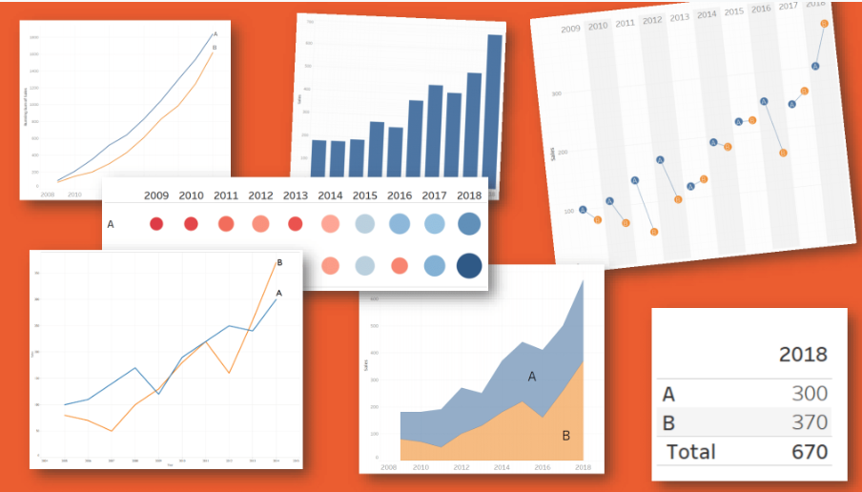
Choosing a Chart Type
Notes:
There are five primary types of visual mappings that content creators and consumers should understand:
Comparison, represented as a bar
Spatial, represented as a map
Temporal, represented as a line
Compare two measures, represented as a scatterplot
Precise number, represented as a text table
Line — Viewing trends in data over time. Examples: Stock price change over a five-year period, website page views during a month, revenue growth by quarter.
Bar — Comparing data across categories. Examples: Volume of shirts in different sizes, website traffic by origination site, percent of spending by department.
Heat Map — Showing the relationship between two factors. Examples: Segmentation analysis of target market, product adoption across regions, sales leads by individual rep.
Highlight Table — Providing detailed information on heat maps. Examples: The percent of a market for different segments, sales numbers in a particular region, population of cities in different years.
Treemap — Showing hierarchical data as a proportion of a whole. Examples: Storage usage across computer machines, managing the number and priority of technical support cases, comparing fiscal budgets between years.
Gantt — Showing duration over time. Examples: Project timeline, duration of a machine’s use, availability of players on a team.
Bullet — Evaluating performance of a metric against a goal. Examples: Sales quota assessment, actual spending vs. budget, performance spectrum (great/good/poor).
Scatterplot — Investigating the relationship between different variables. Examples: Male versus female likelihood of having lung cancer at different ages, technology early adopters’ and laggards’ purchase patterns of smart phones, shipping costs of different product categories to different regions.
Histogram — Understanding the distribution of your data. Examples: Number of customers by company size, student performance on an exam, frequency of a product defect.
Symbol maps — Use for totals rather than rates. Be careful, as small differences will be hard to see. Examples: Number of customers in different geographies.
Area maps — Use for rates rather than totals. Use sensible base geography. Examples: Rates of internet-usage in certain geographies, house prices in different neighborhoods.
Box-and-Whisker — Showing the distribution of a set of a data. Examples: Understanding your data at a glance, seeing how data is skewed towards one end, identifying outliers in your data.

Slide 16
Chart Type
Notes:
One of the biggest challenges people face – how do I display my data in a meaningful way that isn’t just a crosstab. In this section we will review some common but not all chart types and explore if they are conveying the correct message.

Slide 17

The Creative Process
Notes:
We’re going to start things a little differently today. We’re going to do an art project. There should be paper and pens at everyone’s seat. When I say go, I want you to draw a picture of your neighbor, in 60 seconds. Ready, set, go.
How did you feel? What was going through your head? Were you nervous? Apprehensive? Did you apologize to your neighbor? Did you think, are we really doing this?
Why does the idea of making a simple sketch make us so uncomfortable? It’s not technically challenging. Everyone in this room is highly educated. Why is it so hard?
(60-90 seconds)

Slide 18
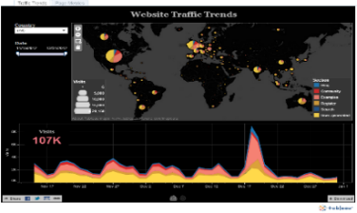
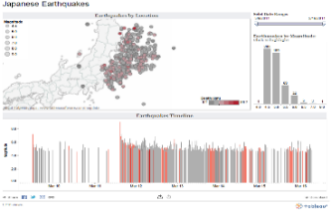
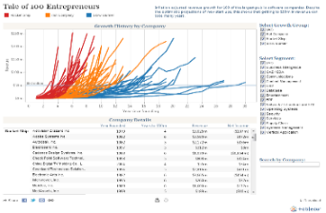
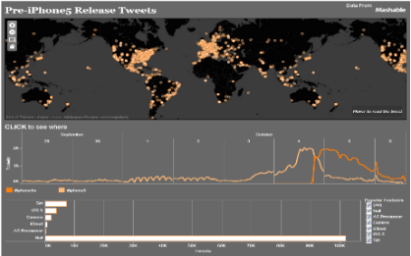
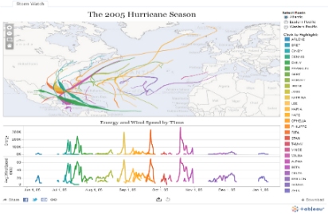
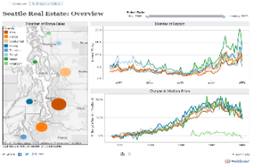
What question are you trying to answer?
Notes:
We are going to do 1 more quick exercise. Everyone was asked to bring a dashboard that is either complete or close to complete. Take your pen and paper and write down the question(s) your dashboard is trying to answer.
We maybe referring back to these questions throughout the workshop and challenging you if your content is answering your intended questions or new questions.
This is really important…many times we throw the kitchen sink and try to solve 100 problems in one dashboard. We need to take a minute and reflect on the problem we are trying to solve.

Slide 19
Comparison
Distribution
Relationship
Notes:
Comparison charts are designed to set one variable apart from another
These charts also display how the two variables interact with each other.
They can compare items or one another or show differences over time.

Slide 20
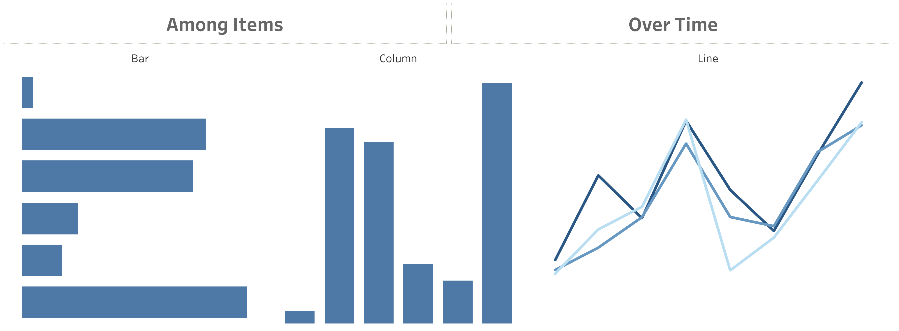
Comparison
Notes:
Comparison charts are designed to set one variable apart from another
These charts also display how the two variables interact with each other.
They can compare items or one another or show differences over time.

Slide 21
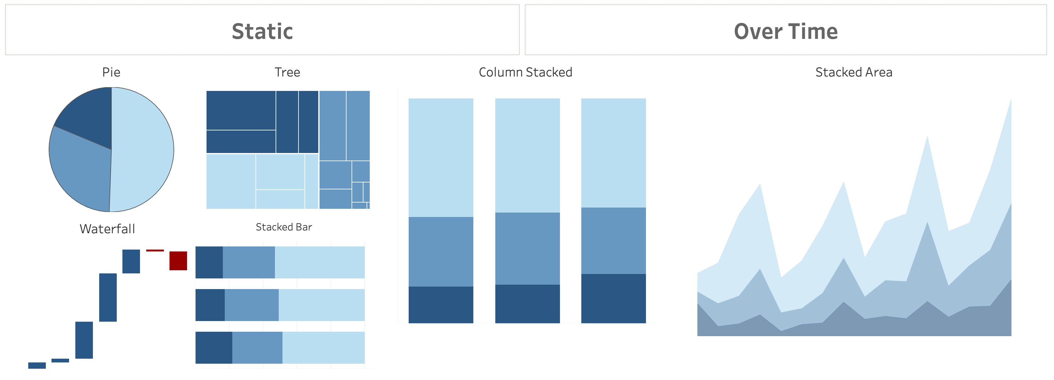
Composition
Notes:
Composition charts are used to display parts of a whole and change over time.
Pie charts callout: friends don’t let friends use pie charts (or 3D charts)… but if you must, use when comparing no more than 3 variables at a time.
Audience participation opportunity: why don’t we love pie or 3D charts when performing visual analysis?
Answer: We are not as good at noticing area and angle, and those just so happen to be the two main aspects of a pie chart. (swag opportunity for participant)
https://interworks.com/blog/rcurtis/2018/01/19/friends-dont-let-friends-make-pie-charts/

Slide 22
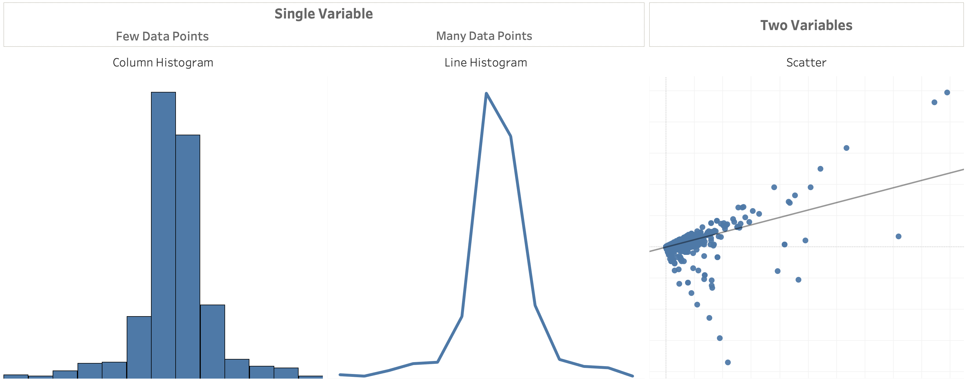
Distribution
Notes:
Distribution charts are used to show how variables are distributed over time, helping identify outliers and trends.

Slide 23
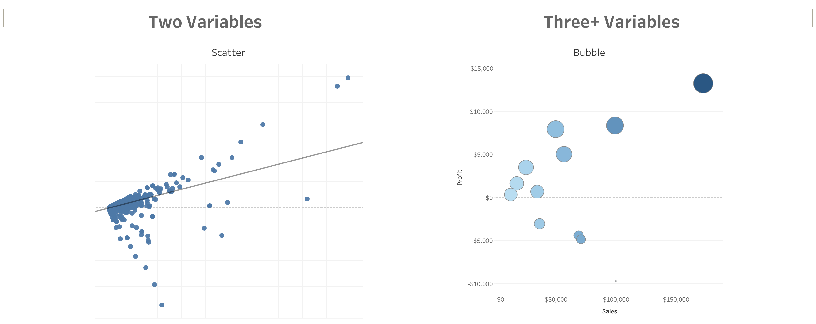
Relationship
Notes:
Relationship charts are used to show a connection or correlation between two or more variables.
When thinking about the right chart type for the question your dashboard is trying to answer, consider these additional resources:
Additional resources from Public:
Tableau Cookbook – navigate to a line chart, ask if anyone knows who the creator named is? (swag opportunity for participant)
BBC Style Guide
100 chart types
Call to action: ensure every participant has their own Tableau Public site and is subscribed to the viz of the day

Slide 24
Dashboard Flow

Slide 25
What is a dashboard?
A dashboard is a visual display of the most important information needed to achieve one or more objectives; consolidated and arranged on a single screen so the information can be monitored at a glance.
Notes:
Plenty of definitions. Here’s one from Stephen Few. And if you haven’t read his Info Dash Design book – you must!
Right info to the right audience in the right medium so they can digest the information in the shortest time possible.

Slide 26
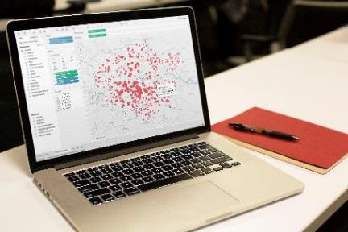

What makes a good dashboard?
Answers a set of questions
Follows a flow and invites interactivity
Condensed; primarily in the form of summaries and exceptions
Specific to and customized for the dashboard’s audience and objectives
Provides appropriate text for clarity and direction, if needed
Makes strategic use of color
Notes:
When it comes to visual best practices, there aren’t any hard and fast rules, such as “do this and never do that.” It isn’t a black and white process. There are, however, guidelines that make sense most of the time. Many of these derive from studies done on how we as humans process things like color, shape, and size. When you really understand the concepts driving these guidelines, only then should you break them.

Slide 27

Notes:
Full Page Image w Color Bar

Slide 28
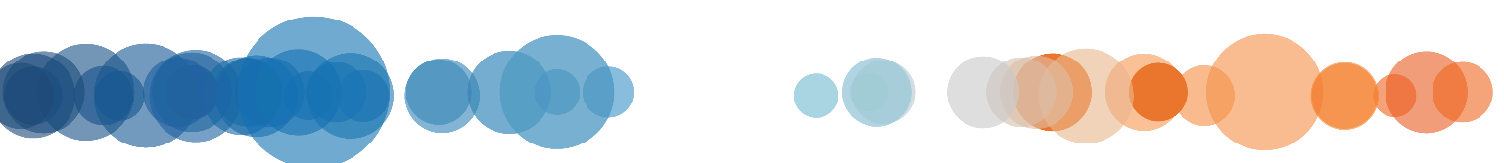
THANK YOU!
Notes:
Full Page Image w Color Bar

