Slide 1
Introduction to Relational Databases

Slide 2
Introduction
Database – collection of persistent data
Database Management System (DBMS) – software system that supports creation, population, and querying of a database

Slide 3
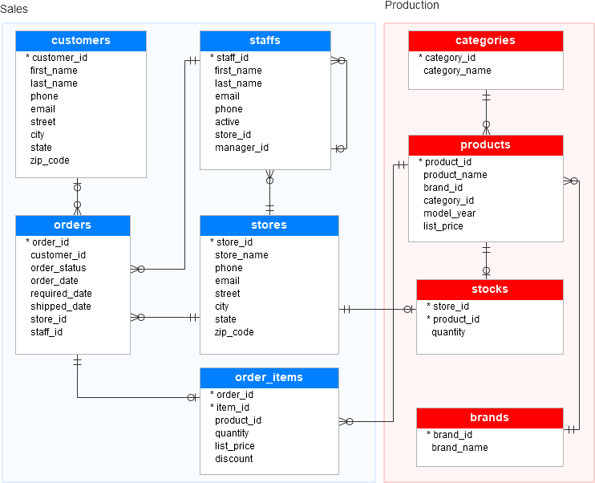
Database: example

Slide 4
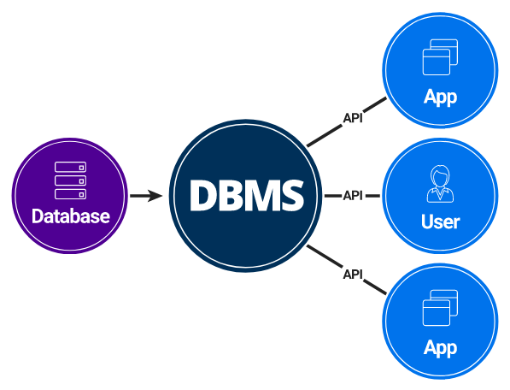
DBMS: DataBase Management System

Slide 5
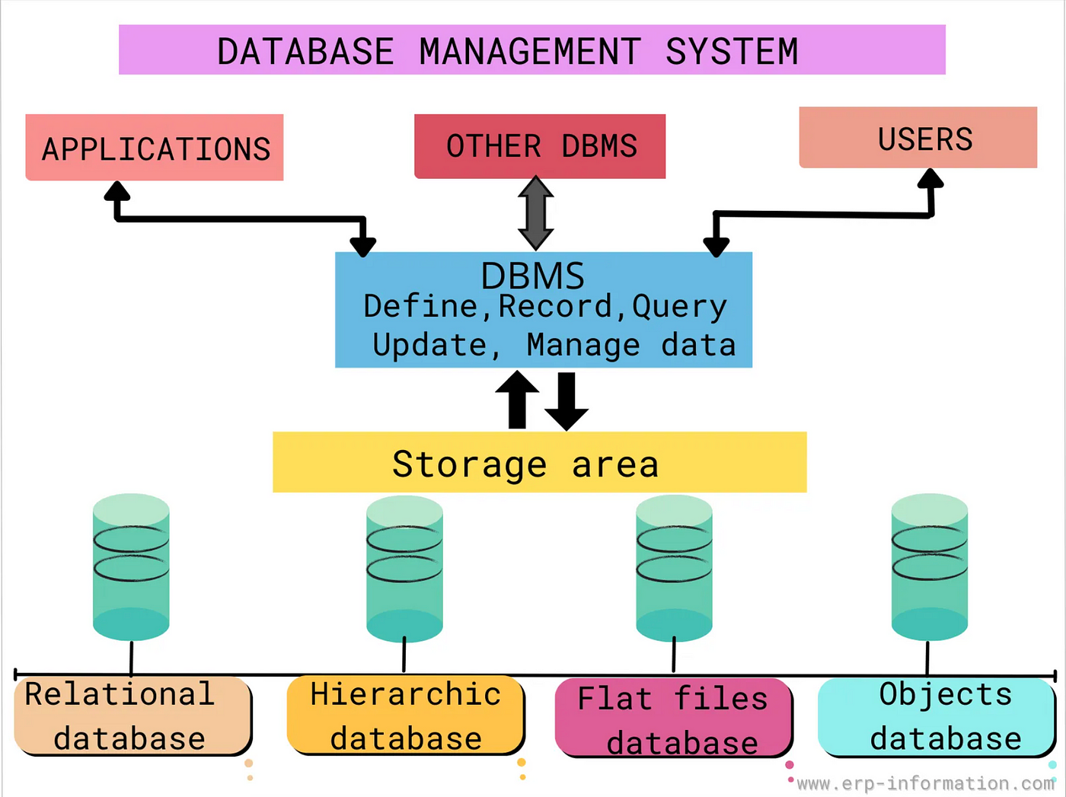
What is a DBMS?

Slide 6
Introduction
A database is an organized collection of structured information, or data, typically stored electronically in a computer system.
A database is usually controlled by a database management system (DBMS).
Together, the data and the DBMS, along with the applications that are associated with them, are referred to as a database system, often shortened to just database.

Slide 7
Relational Database
Relational Database Management System (RDBMS)
Consists of a number of tables and single schema (definition of tables and attributes)
Students (sid, name, login, age, gpa)
Students identifies the table
sid, name, login, age, gpa identify attributes
sid is primary key

Slide 8
Examples of Relational Databases
MySQL
Oracle
PostgreSQL
MariaDB
Microsoft SQL Server
IBM DB2
…

Slide 9
An Example Table
Students (sid: string, name: string, login: string,
age: integer, gpa: real)
sid | name | login | age | gpa
50000 | Dave | dave@cs | 19 | 3.3
53666 | Jones | jones@cs | 18 | 3.4
53688 | Smith | smith@ee | 18 | 3.2
53650 | Smith | smith@math | 19 | 3.8
53831 | Madayan | madayan@music | 11 | 1.8
53832 | Guldu | guldu@music | 12 | 2.0

Slide 10
Another example: Courses
Courses (cid, instructor, quarter, dept)
cid: Primary Key (PK)
cid | instructor | quarter | dept
Carnatic101 | Jane | Fall 06 | Music
Reggae203 | Bob | Summer 06 | Music
Topology101 | Mary | Spring 06 | Math
History105 | Alice | Fall 06 | History

Slide 11
Keys
Primary key (PK) – minimal subset of fields that is unique identifier for a tuple
sid is primary key for Students
cid is primary key for Courses
Foreign key (FK) – connections between tables
Courses (cid, instructor, quarter, dept)
Students (sid, name, login, age, gpa)
How do we express which students take each course?

Slide 12
Many to Many relationships
In general, need a new table
Enrolled(cid, grade, studid)
studid is foreign key that references sid in Student table
Student
Enrolled
Foreign
key
sid | name | login
50000 | Dave | dave@cs
53666 | Jones | jones@cs
53688 | Smith | smith@ee
53650 | Smith | smith@math
53831 | Madayan | madayan@music
53832 | Guldu | guldu@music
cid | grade | studid
Carnatic101 | C | 53831
Reggae203 | B | 53832
Topology112 | A | 53650
History105 | B | 53666

Slide 13
Relationship Types
There are 3 types of relationships between entities (tables) in data modeling:
One-to-Many relationships
denoted as 1:M
Many-to-Many relationships
Denoted as M:N
One-to-One relationships
Denoted as 1:1

Slide 14
One-to-One relationship
First, what is a one-to-one relationship?
It’s a relationship where a record in one entity (table) is associated with exactly one record in another entity (table).
Country - capital city: Each country has exactly one capital city. Each capital city is the capital of exactly one country.
Person - their fingerprints. Each person has a unique set of fingerprints. Each set of fingerprints identifies exactly one person.

Slide 15
One-to-Many relationship
The most common type of relationship is a ONE-TO-MANY RELATIONSHIP, where a record in one entity can be referenced by multiple records in another entity.
Example: Many employees work for the SAME department

Slide 16
Many-to-Many relationship
A many-to-many relationship exists when one or more items in one table can have a relationship to one or more items in another table.
Example-1 : Your Order table contains orders placed by multiple customers (who are listed in the Customers table), and a customer may place more than one order.
Example-2: Students and Courses: In a university setting, students can enroll in multiple courses, and courses can have multiple students

Slide 17
Many-to-Many relationship Example
You (the follower) follow a person A (the followee). You also follow person B, person C, etc..., but you are not the only one who may follow person A, as well as not the only one who may follow person B, person C, etc... Alex or other people may as well follow them too.
Follower | Followee
---------|--------------
... | ...
You | A
You | B
You | C
Alex | A
Alex | B
Alex | C
... | ...

Slide 18
Relational Algebra
Collection of operators for specifying queries
Query describes step-by-step procedure for computing answer (i.e., operational)
Each operator accepts one or two relations as input and returns a relation as output
Relational algebra expression composed of multiple operators

Slide 19
Basic Operators
Selection – return rows that meet some condition
Projection – return column values
Union
Cross product
Difference
Other operators can be defined in terms of basic operators

Slide 20
Example Schema (simplified)
Courses (cid, instructor, quarter, dept)
Students (sid, name, gpa)
Enrolled (cid, grade, sid)
(cid, sid) is a PK

Slide 21
Selection
Select students with gpa higher than 3.3 from S1:
σ_{gpa>3.3}(S1)
S1
sid | name | gpa
50000 | Dave | 3.3
53666 | Jones | 3.4
53688 | Smith | 3.2
53650 | Smith | 3.8
53831 | Madayan | 1.8
53832 | Guldu | 2.0
sid | name | gpa
53666 | Jones | 3.4
53650 | Smith | 3.8

Slide 22
Selection
Select students with gpa higher than 3.3 from table S1:
SELECT *
FROM S1
WHERE gpa > 3.3;

Slide 23
Projection
Project name and gpa of all students in S1:
Π_{name, gpa}(S1)
S1
sid | name | gpa
50000 | Dave | 3.3
53666 | Jones | 3.4
53688 | Smith | 3.2
53650 | Smith | 3.8
53831 | Madayan | 1.8
53832 | Guldu | 2.0
name | gpa
Dave | 3.3
Jones | 3.4
Smith | 3.2
Smith | 3.8
Madayan | 1.8
Guldu | 2.0

Slide 24
Projection
Project name and gpa of all students in S1:
SELECT name, gpa
FROM S1;

Slide 25
Combine Selection and Projection
Project name and gpa of students in S1 with gpa higher than 3.3:
Π_{name,gpa}(σ_{gpa>3.3}(S1))
Sid | name | gpa
50000 | Dave | 3.3
53666 | Jones | 3.4
53688 | Smith | 3.2
53650 | Smith | 3.8
53831 | Madayan | 1.8
53832 | Guldu | 2.0
name | gpa
Jones | 3.4
Smith | 3.8

Slide 26
Combine Selection and Projection
Project name and gpa of all students in S1:
SELECT name, gpa
FROM S1
WHERE gpa > 3.3;

Slide 27
Set Operations
Union (R U S)
All tuples in R or S (or both)
R and S must have same number of fields
Corresponding fields must have same domains
Intersection (R ∩ S)
All tuples in both R and S
Set difference (R – S)
Tuples in R and not S

Slide 28
Set Operations (continued)
Cross product or Cartesian product (R x S)
All fields in R followed by all fields in S
One tuple (r,s) for each pair of tuples r ∈ R, s ∈ S

Slide 29
Example: Intersection
S1
S2
sid | name | gpa
50000 | Dave | 3.3
53666 | Jones | 3.4
53688 | Smith | 3.2
53650 | Smith | 3.8
53831 | Madayan | 1.8
53832 | Guldu | 2.0
sid | name | gpa
53666 | Jones | 3.4
53688 | Smith | 3.2
53700 | Tom | 3.5
53777 | Jerry | 2.8
53832 | Guldu | 2.0
sid | name | gpa
53666 | Jones | 3.4
53688 | Smith | 3.2
53832 | Guldu | 2.0
S1 ∩ S2 =

Slide 30
Intersection in MySQL
mysql> TABLE a; mysql> TABLE b;
+------+------+ +------+------+
| m | n | | m | n |
+------+------+ +------+------+
| 1 | 2 | | 1 | 2 |
| 2 | 3 | | 3 | 4 |
| 3 | 4 | | 8 | 9 |
+------+------+ | 5 | 6 |
+------+------+
mysql> TABLE a INTERSECT TABLE b;
+------+------+
| m | n |
+------+------+
| 1 | 2 |
| 3 | 4 |
+------+------+

Slide 31
Set Operations (continued)
Cross product or Cartesian product (R x S)
All fields in R followed by all fields in S
One tuple (r,s) for each pair of tuples r ∈ R, s ∈ S

Slide 32
Cartesian Product in MySQL
SELECT * FROM table1; SELECT * FROM table2;
+--------+ +--------+
| field1 | | field2 |
+--------+ +--------+
| 1 | | 3 |
| 2 | | 4 |
+--------+ +--------+
SELECT table1.field1, table2.field2
FROM table1
CROSS JOIN table2;
+--------+--------+
| field1 | field2 |
+--------+--------+
| 1 | 3 |
| 2 | 3 |
| 1 | 4 |
| 2 | 4 |
+--------+--------+

Slide 33
UNION
Select column1, column2
from Table1
UNION
Select column1, column2
from Table2;
That final result set contains all rows returned by the SELECT statements involved in that UNION query but
without duplicate values.

Slide 34
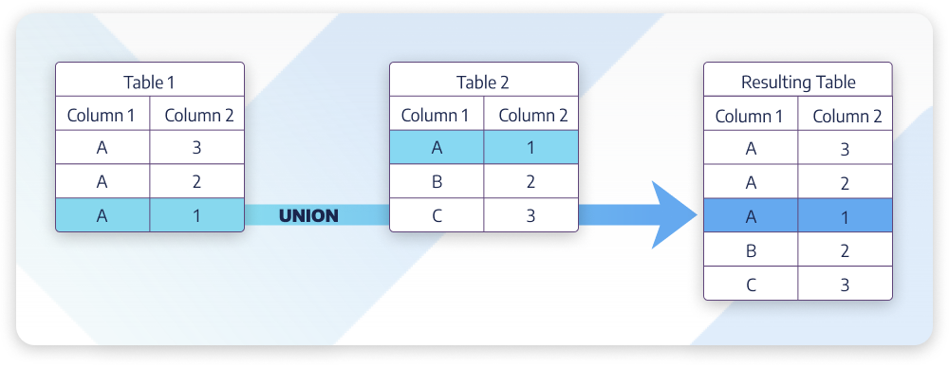
UNION: example

Slide 35
UNION ALL
Select column1, column2
from Table1
UNION ALL
Select column1, column2
from Table2;
That final result set contains all rows returned by the SELECT statements involved in that UNION query but
with duplicate values.

Slide 36
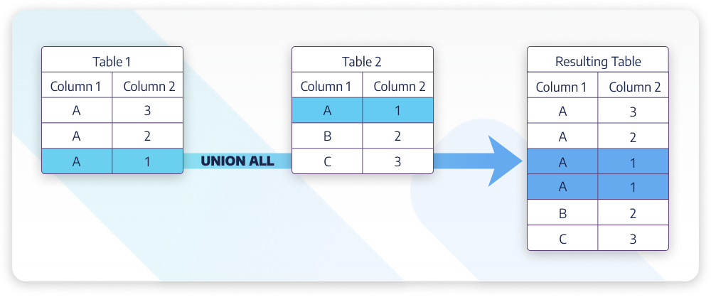
UNION ALL: example

Slide 37
Joins
Combine information from two or more tables
Example: students enrolled in courses:
S1 _{S1.sid=E.studid}E
S1
E
sid | name | gpa
50000 | Dave | 3.3
53666 | Jones | 3.4
53688 | Smith | 3.2
53650 | Smith | 3.8
53831 | Madayan | 1.8
53832 | Guldu | 2.0
cid | grade | studid
Carnatic101 | C | 53831
Reggae203 | B | 53832
Topology112 | A | 53650
History105 | B | 53666

Slide 38
Joins
Students
Sid | name | gpa
50000 | Dave | 3.3
53666 | Jones | 3.4
53688 | Smith | 3.2
53650 | Smith | 3.8
53831 | Madayan | 1.8
53832 | Guldu | 2.0
Enrolled
cid | grade | studid
Carnatic101 | C | 53831
Reggae203 | B | 53832
Topology112 | A | 53650
History105 | B | 53666
sid | name | gpa | cid | grade | studid
53666 | Jones | 3.4 | History105 | B | 53666
53650 | Smith | 3.8 | Topology112 | A | 53650
53831 | Madayan | 1.8 | Carnatic101 | C | 53831
53832 | Guldu | 2.0 | Reggae203 | B | 53832
Notes:
Note that join can also be thought of as cross product and select

Slide 39
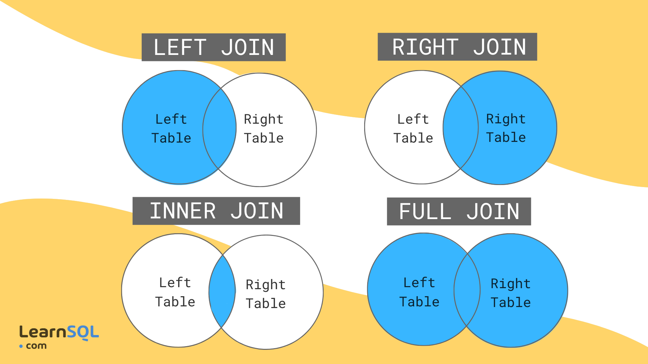
JOIN Operations

Slide 40
Relational Algebra Summary
Algebras are useful to manipulate data types (relations in this case)
Set-oriented
Brings some clarity to what needs to be done
Opportunities for optimization
May have different expressions that do same thing
We will see examples of algebras for other types of data in this course

Slide 41
Introduction to SQL
CREATE TABLE
Create a new table, e.g., students, courses
SELECT-FROM-WHERE
List all CS courses
SELECT-FROM-WHERE-GROUP-BY
INSERT
Add a new student, course, or enroll a student in a course
DELETE
Delete rows

Slide 42
Introduction to SQL
Structured Query Language (SQL) is a standard language for database creation and manipulation.
EXAMPLE-1: MySQL is a relational database program that uses SQL queries.
EXAMPLE-2: Snowflake is a database program that uses SQL queries.

Slide 43
Create Table
CREATE TABLE Enrolled (
student_id CHAR(20),
course_id CHAR(20),
grade CHAR(20), PRIMARY KEY (student_id, course_id),
FOREIGN KEY (student_id)
references Students
);

Slide 44
Create Table in MySQL
CREATE TABLE symbols (
symbol_id VARCHAR(4) NOT NULL
PRIMARY KEY,
symbol VARCHAR(4) NOT NULL,
date_added DATE NOT NULL,
listed_at VARCHAR(10) NOT NULL
)
ENGINE=InnoDB
DEFAULT CHARSET=utf8 COLLATE=utf8_unicode_ci;

Slide 45
Select-From-Where query
“Find all students who are under 18”
SELECT *
FROM Students S
WHERE S.age < 18
S is an alias name
for table Students

Slide 46
Queries across multiple tables (joins)
“Print the student's name and course ID where the student received an ‘A’ in the course”
SELECT S.name, E.cid
FROM Students S, Enrolled E
WHERE S.sid = E.studid AND
E.grade = ‘A’

Slide 47
SQL features: Aggregation
MIN, MAX, AVG
Find highest grade in fall database course
COUNT, DISTINCT
How many students enrolled in CS courses in the fall?
ORDER BY, GROUP BY
Rank students by their grade in fall database course

Slide 48
SQL features: Aggregation for Data Warehousing
GROUP BY & ROLL-UP
Find total sales for ALL states and ALL products
GROUP BY & CUBE
Find total sales for ALL states and ALL products
Find total sales per state and ALL products
Find total sales for ALL states and “TV”
Find total sales for ALL states and “Laptop”

Slide 49
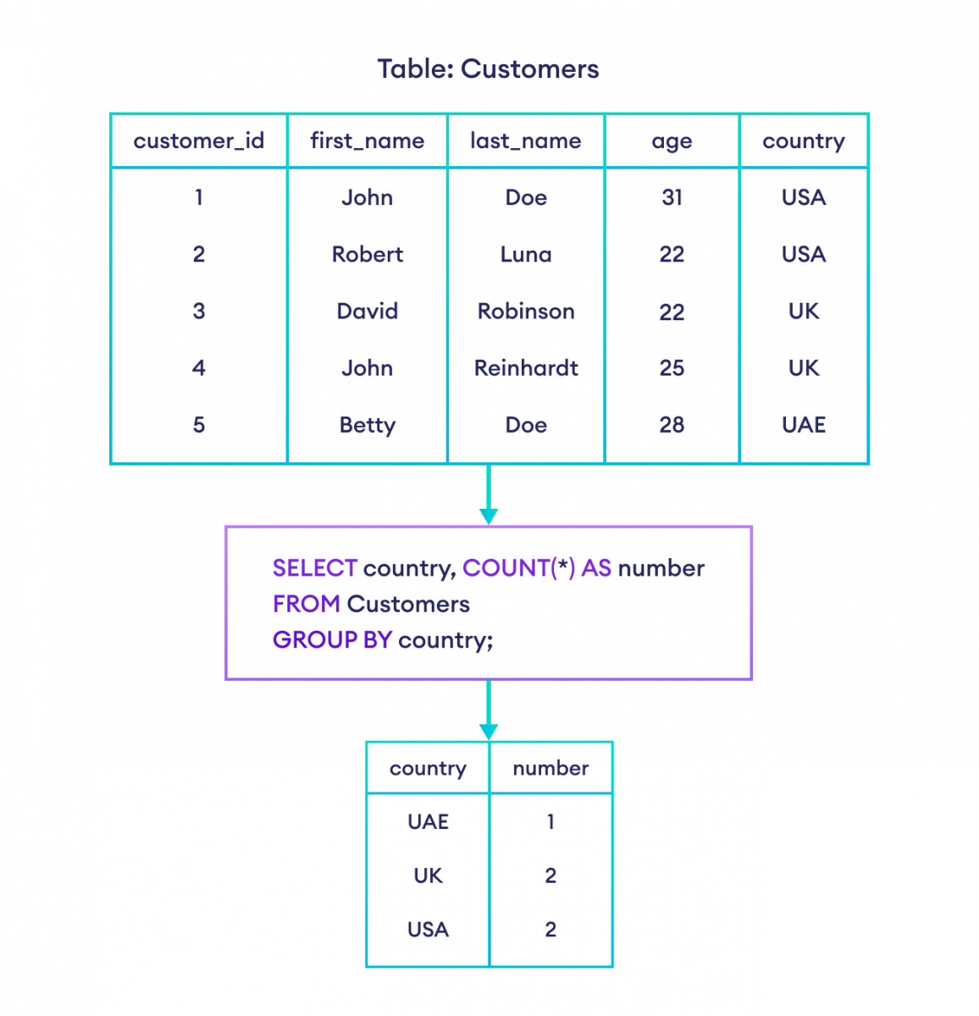
SQL features: GROUP BY

Slide 50
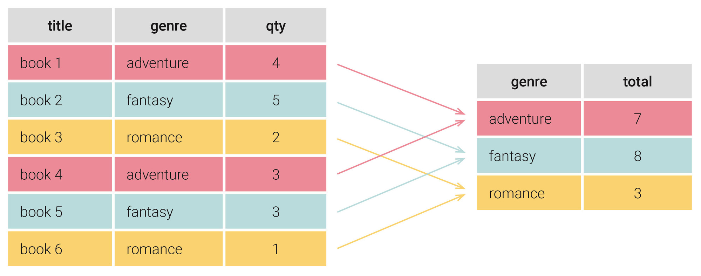
GROUP BY example
SELECT genre, SUM(qty) as total
FROM Table_Name
GROUP BY genre;

Slide 51
Views
Virtual table defined on base tables defined by a query
Single or multiple tables
Security – “hide” certain attributes from users
Show students in each course but hide their grades
Ease of use – expression that is more intuitively obvious to user
Views can be materialized to improve query performance

Slide 52
Views
Suppose we often need names of students who got a ‘B’ in some course:
CREATE VIEW B_Students(name, sid, course)
AS SELECT S.sname, S.sid, E.cid
FROM Students S, Enrolled E
WHERE S.sid = E.studid and
E.grade = ‘B’
name | sid | course
Jones | 53666 | History105
Guldu | 53832 | Reggae203

Slide 53
Indexes
Idea: speed up access to desired data
“Find all students with gpa > 3.3
May need to scan entire table
Index consists of a set of entries pointing to locations of each search key

Slide 54
Types of Indexes
Clustered vs. Unclustered
Clustered- ordering of data records same as ordering of data entries in the index
Unclustered- data records in different order from index
Primary vs. Secondary
Primary – index on fields that include primary key
Secondary – other indexes

Slide 55
Example: Clustered Index
Sorted by sid
sid | name | gpa
50000 | Dave | 3.3
53650 | Smith | 3.8
53666 | Jones | 3.4
53688 | Smith | 3.2
53831 | Madayan | 1.8
53832 | Guldu | 2.0
50000
53600
53800

Slide 56
Example: Unclustered Index
Sorted by sid
Index on gpa
sid | name | gpa
50000 | Dave | 3.3
53650 | Smith | 3.8
53666 | Jones | 3.4
53688 | Smith | 3.2
53831 | Madayan | 1.8
53832 | Guldu | 2.0
1.8
2.0
3.2
3.3
3.4
3.8

Slide 57
Comments on Indexes
Indexes can significantly speed up query execution
But inserts more costly
May have high storage overhead
Need to choose attributes to index wisely!
What queries are run most frequently?
What queries could benefit most from an index?

Slide 58
Summary: Why are RDBMS useful?
Data independence – provides abstract view of the data, without details of storage
Efficient data access – uses techniques to store and retrieve data efficiently
Reduced application development time – many important functions already supported
Centralized data administration
Data Integrity and Security
Concurrency control and recovery

Slide 59
So, why don’t scientists use them?
“I tried to use databases in my project, but they were just too [slow | hard-to-use | expensive | complex] . So I use files”.
Gray and Szalay, Where Rubber Meets the Sky: Bridging the Gap Between Databases and Science

Slide 60
Some other limitations of RDBMS
Arrays
Hierarchical data

Slide 61
Example: Taxonomy of Organisms
Hierarchy of categories:
Kingdom - phylum – class – order – family – genus - species
How would you design a relational schema for this?
Animals
Chordates
Arthropods
Vertebrates
insects
spiders
crustaceans
birds
reptiles
mammals

