Slide 1
Data Warehousing and OLAP
What is a data warehouse?
A multi-dimensional data model
Data warehouse architecture
Data warehouse implementation
Extensions of data cubes
From data warehousing to data mining

Slide 2
What is a Data Warehouse? Defined in many different ways
A decision support database that is maintained separately from the organization’s operational database
Support information processing by providing a solid platform of consolidated, historical data for analysis.
“A data warehouse is a subject-oriented, integrated, time-variant, and nonvolatile collection of data in support of management’s decision-making process.”—W. H. Inmon

Slide 3
What is a Data Warehousing?
The process of constructing and using data warehouses
OLAP Analytics
OLAP Operations
Using Tableau
SQL queries

Slide 4
Data Warehouse—Subject-Oriented
Subject Oriented
Integrated
Time variant
Non Volatile

Slide 5
Data Warehouse — 1. Subject-Oriented
Organized around major subjects, such as
customer, product, sales, dates, …
Focusing on the modeling and analysis of data for decision makers, not on daily operations or transaction processing.
Provide a simple and concise view around particular subject issues by excluding data that are not useful in the decision support process.

Slide 6
Data Warehouse — 2. Integrated
Constructed by integrating multiple, heterogeneous data sources
relational databases, flat files, on-line transaction records
Data cleaning and data integration techniques are applied.
Ensure consistency in naming conventions, encoding structures, attribute measures, etc. among different data sources
E.g., Hotel price: currency, tax, breakfast covered, etc.
When data is moved to the warehouse, it is converted.

Slide 7
Data Warehouse — 3. Time Variant
The time horizon for the data warehouse is significantly longer than that of operational systems.
Operational database: current value data.
Data warehouse data: provide information from a historical perspective (e.g., past 5-10 years)
Every key structure in the data warehouse
Contains an element of time, explicitly or implicitly
But the key of operational data may or may not contain “time element”.

Slide 8
Data Warehouse — 4. Non-Volatile
A physically separate store of data transformed from the operational environment.
Operational update of data does not occur in the data warehouse environment.
Does not require transaction processing, recovery, and concurrency control mechanisms
Requires only two operations in data accessing:
initial loading of data and access of data.

Slide 9
Data Warehouse vs. Heterogeneous DBMS
Traditional heterogeneous DB integration:
Build wrappers/mediators on top of heterogeneous databases
Query driven approach
When a query is posed to a client site, a meta-dictionary is used to translate the query into queries appropriate for individual heterogeneous sites involved, and the results are integrated into a global answer set
Complex information filtering, compete for resources
Data warehouse: update-driven, high performance
Information from heterogeneous sources is integrated in advance and stored in warehouses for direct query and analysis

Slide 10
Data Warehouse vs. Operational DBMS
OLTP (on-line transaction processing)
Major task of traditional relational DBMS
Day-to-day operations: purchasing, inventory, banking, manufacturing, payroll, registration, accounting, etc.
OLAP (on-line analytical processing)
Major task of data warehouse system
Data analysis and decision making

Slide 11
Data Warehouse vs. Operational DBMS
Distinct features (OLTP vs. OLAP):
User and system orientation: customer vs. market
Data contents: current, detailed vs. historical, consolidated
Database design: ER + application vs. star schema + subject
View: current, local vs. evolutionary, integrated
Access patterns: update vs. read-only but complex queries

Slide 12
OLTP vs. OLAP

Slide 13
Why Separate Data Warehouse?
High performance for both systems
DBMS— tuned for OLTP: access methods, indexing, concurrency control, recovery
Warehouse—tuned for OLAP: complex OLAP queries, multidimensional view, consolidation.

Slide 14
Why Separate Data Warehouse?
Different functions and different data:
missing data: Decision support requires historical data which operational DBs do not typically maintain
data consolidation: DS requires consolidation (aggregation, summarization) of data from heterogeneous sources
data quality: different sources typically use inconsistent data representations, codes and formats which have to be reconciled

Slide 15
Data Warehousing and OLAP
What is a data warehouse?
A multi-dimensional data model
Data warehouse architecture
Data warehouse implementation
Extensions of data cubes
From data warehousing to data mining

Slide 16
From Tables and Spreadsheets to Data Cubes
A data warehouse is based on a multidimensional data model which views data in the form of a data cube
A data cube, such as sales, allows data to be modeled and viewed in multiple dimensions
Dimension tables, such as item (item_name, brand, type), or time(day, week, month, quarter, year)
Fact table contains measures (such as dollars_sold) and keys to each of the related dimension tables
In data warehousing literature, an n-D base cube is called a base cuboid. The topmost 0-D cuboid, which holds the highest-level of summarization, is called the apex cuboid. The lattice of cuboids forms a data cube.

Slide 17
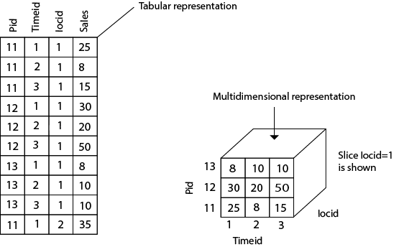
multidimensional data model

Slide 18
Cube: A Lattice of Cuboids
all
0-D(apex) cuboid
time
item
location
supplier
1-D cuboids
time,item
time,location
item,location
location,supplier
2-D cuboids
time,supplier
item,supplier
time,item,location
time,location,supplier
3-D cuboids
time,item,supplier
item,location,supplier
4-D(base) cuboid
time, item, location, supplier

Slide 19
Modeling of Data Warehouses
Modeling data warehouses: dimensions & measures
Star schema: A fact table in the middle connected to a set of dimension tables
Snowflake schema: A refinement of star schema where some dimensional hierarchy is normalized into a set of smaller dimension tables, forming a shape similar to snowflake
Fact constellations: Multiple fact tables share dimension tables, viewed as a collection of stars, therefore called galaxy schema or fact constellation

Slide 20
Example of Star Schema
time
time_key
day
day_of_the_week
month
quarter
year
item
item_key
item_name
brand
type
supplier_type
Sales Fact Table
time_key
item_key
branch_key
branch
location
location_key
branch_key
branch_name
branch_type
location_key
street
city
province_or_street
country
units_sold
dollars_sold
avg_sales
Measures

Slide 21
Example of Snowflake Schema
time
item
time_key
day
day_of_the_week
month
quarter
year
item_key
item_name
brand
type
supplier_key
supplier
Sales Fact Table
supplier_key
supplier_type
time_key
item_key
branch_key
branch
location
location_key
location_key
street
city_key
branch_key
branch_name
branch_type
units_sold
city
dollars_sold
city_key
city
province_or_street
country
avg_sales
Measures

Slide 22
Example of Fact Constellation
time
time_key
day
day_of_the_week
month
quarter
year
item
Shipping Fact Table
item_key
item_name
brand
type
supplier_type
Sales Fact Table
time_key
time_key
item_key
shipper_key
item_key
branch_key
from_location
branch
location_key
location
to_location
branch_key
branch_name
branch_type
units_sold
location_key
street
city
province_or_street
country
dollars_cost
dollars_sold
units_shipped
avg_sales
shipper
Measures
shipper_key
shipper_name
location_key
shipper_type

Slide 23
Measures: Three Categories
distributive: if the result derived by applying the function to n aggregate values is the same as that derived by applying the function on all the data without partitioning.
E.g., count(), sum(), min(), max().
algebraic: if it can be computed by an algebraic function with M arguments (where M is a bounded integer), each of which is obtained by applying a distributive aggregate function.
E.g., avg(), min_N(), standard_deviation().
holistic: if there is no constant bound on the storage size needed to describe a subaggregate.
E.g., median(), mode(), rank().

Slide 24
A Concept Hierarchy: Dimension (location)
all
all
region
Europe
...
North_America
country
Germany
...
Spain
Canada
...
Mexico
city
Frankfurt
...
Vancouver
...
Toronto
office
L. Chan
...
M. Wind

Slide 25
Specification of Hierarchies
Schema hierarchy
day < {month < quarter; week} < year
Set_grouping hierarchy
{1..10} < inexpensive

Slide 26
Multidimensional Data
Sales volume as a function of product, month, and region
Dimensions: Product, Location, Time
Hierarchical summarization paths
Region
Industry Region Year
Category Country Quarter
Product City Month Week
Office Day
Product
Month

Slide 27
A Sample Data Cube
Date
Total annual sales
of TV in U.S.A.
1Qtr
2Qtr
3Qtr
4Qtr
sum
Product
TV
PC
U.S.A
VCR
sum
Canada
Country
Mexico
sum
All, All, All

Slide 28
Cuboids Corresponding to the Cube
all
0-D(apex) cuboid
product
date
country
1-D cuboids
product,date
product,country
date, country
2-D cuboids
3-D(base) cuboid
product, date, country

Slide 29
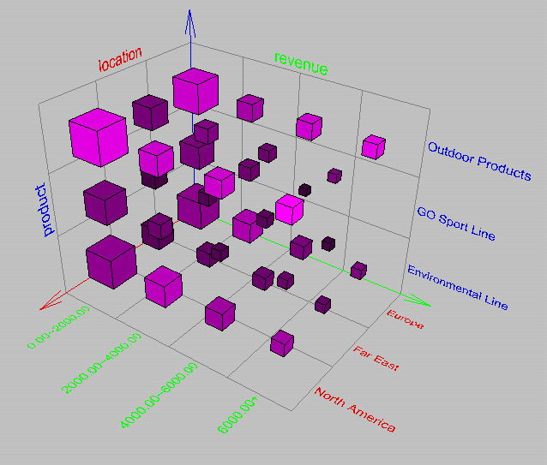
Browsing a Data Cube
Visualization
OLAP capabilities
Interactive manipulation

Slide 30
Typical OLAP Operations
Roll up (drill-up): summarize data
by climbing up hierarchy or by dimension reduction
Drill down (roll down): reverse of roll-up
from higher level summary to lower level summary or detailed data, or introducing new dimensions
Slice and dice:
project and select
Pivot (rotate):
reorient the cube, visualization, 3D to series of 2D planes.
Other operations
drill across: involving (across) more than one fact table
drill through: through the bottom level of the cube to its back-end relational tables (using SQL)

Slide 31
A Starnet Query Model
Customer Orders
Shipping Method
Customer
CONTRACTS
AIR-EXPRESS
ORDER
TRUCK
PRODUCT LINE
Time
Product
ANNUALY
QTRLY
DAILY
PRODUCT ITEM
PRODUCT GROUP
CITY
SALES PERSON
COUNTRY
DISTRICT
REGION
DIVISION
Location
Each circle is called a footprint
Promotion
Organization

Slide 32
Data Warehousing and OLAP
What is a data warehouse?
A multi-dimensional data model
Data warehouse architecture
Data warehouse implementation
Extensions of data cubes
From data warehousing to data mining

Slide 33
Data Warehouse Design Process
Choose the grain (atomic level of data) of the business process
Choose a business process to model, e.g., orders, invoices, etc.
Choose the dimensions that will apply to each fact table record
Choose the measure that will populate each fact table record

Slide 34
Multi-Tiered Architecture
Monitor
&
Integrator
OLAP Server
other
sources
Metadata
Analysis
Query
Reports
Data mining
Operational
DBs
Extract
Transform
Load
Refresh
Data
Warehouse
Serve
Data Marts
Data Sources
Data Storage
OLAP Engine
Front-End Tools

Slide 35
Three Data Warehouse Models
Enterprise warehouse
collects all of the information about subjects spanning the entire organization
Data Mart
a subset of corporate-wide data that is of value to a specific groups of users. Its scope is confined to specific, selected groups, such as marketing data mart
Independent vs. dependent (directly from warehouse) data mart
Virtual warehouse
A set of views over operational databases
Only some of the possible summary views may be materialized

Slide 36
Data Warehouse Development: A Recommended Approach
Multi-Tier Data Warehouse
Distributed Data Marts
Enterprise Data Warehouse
Data Mart
Data Mart
Model refinement
Model refinement
Define a high-level corporate data model

Slide 37
OLAP Server Architectures
Relational OLAP (ROLAP)
Use relational or extended-relational DBMS to store and manage warehouse data and OLAP middle ware to support missing pieces
Include optimization of DBMS backend, implementation of aggregation navigation logic, and additional tools and services
greater scalability
Multidimensional OLAP (MOLAP)
Array-based multidimensional storage engine (sparse matrix techniques)
fast indexing to pre-computed summarized data
Hybrid OLAP (HOLAP)
User flexibility, e.g., low level: relational, high-level: array
Specialized SQL servers
specialized support for SQL queries over star/snowflake schemas

Slide 38
Data Warehousing and OLAP
What is a data warehouse?
A multi-dimensional data model
Data warehouse architecture
Data warehouse implementation
Extensions of data cubes
From data warehousing to data mining

Slide 39
Efficient Data Cube Computation
Data cube can be viewed as a lattice of cuboids
The bottom-most cuboid is the base cuboid
The top-most cuboid (apex) contains only one cell
How many cuboids in an n-dimensional cube with L levels?
Materialization of data cube
Materialize every (cuboid) (full materialization), none (no materialization), or some (partial materialization)
Selection of which cuboids to materialize
Based on size, sharing, access frequency, etc.

Slide 40
Cube Operation
Transform it into SQL-like language (with new operator cube by, introduced by Gray et al.’96)
SELECT item, city, year, SUM (amount)
FROM SALES
CUBE BY item, city, year
Need compute the following Group-Bys
(item, city, year),
(item, city), (item, year), (city, year),
(item), (city), (year)
()
()
(city)
(item)
(year)
(city, item)
(city, year)
(item, year)
(city, item, year)

Slide 41
Cube Operation
SELECT item, city, year, SUM (amount)
FROM SALES
CUBE BY item, city, year
Need compute the following GROUP-BYs
(item, city, year),
(item, city),
(item, year),
(city, year),
(item),
(city),
(year)
()
()
(city)
(item)
(year)
(city, item)
(city, year)
(item, year)
(city, item, year)

Slide 42
Efficient Processing of OLAP Queries
Determine which operations should be performed on the available cuboids:
transform drill, roll, etc. into corresponding SQL and/or OLAP operations, e.g, dice = selection + projection
Determine to which materialized cuboid(s) the relevant operations should be applied.
Exploring indexing structures and compressed vs. dense array structures in MOLAP

Slide 43
Metadata Repository
Meta data is the data defining warehouse objects. It has the following kinds
Description of the structure of the warehouse
schema, view, dimensions, hierarchies, derived data defn, data mart locations and contents
Operational meta-data
data lineage (history of migrated data and transformation path), currency of data (active, archived, or purged), monitoring information (warehouse usage statistics, error reports, audit trails)
The algorithms used for summarization
The mapping from operational environment to the data warehouse
Data related to system performance
Business data
business terms and definitions, ownership of data, charging policies

Slide 44
Data Warehouse Back-End Tools and Utilities
Data extraction:
get data from multiple, heterogeneous, and external sources
Data cleaning:
detect errors in the data and rectify them when possible
Data transformation:
convert data from legacy or host format to warehouse format
Load:
sort, summarize, consolidate, compute views, check integrity, and build indicies and partitions
Refresh
propagate the updates from the data sources to the warehouse

Slide 45
Data Warehousing and OLAP
What is a data warehouse?
A multi-dimensional data model
Data warehouse architecture
Data warehouse implementation
Extensions of data cubes
From data warehousing to data mining

Slide 46
Discovery-Driven Exploration of Data Cubes
Hypothesis-driven: exploration by user, huge search space
Discovery-driven (Sarawagi et al.’98)
pre-compute measures indicating exceptions, guide user in the data analysis, at all levels of aggregation
Exception: significantly different from the value anticipated, based on a statistical model
Visual cues such as background color are used to reflect the degree of exception of each cell
Computation of exception indicator (modeling fitting and computing SelfExp, InExp, and PathExp values) can be overlapped with cube construction

Slide 47
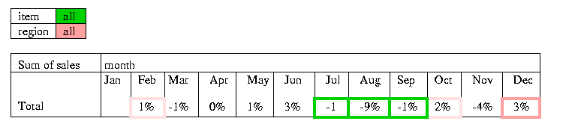
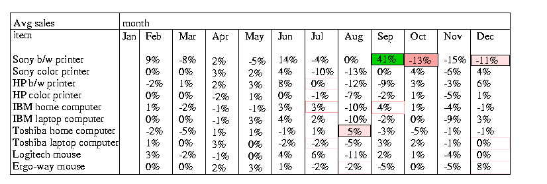
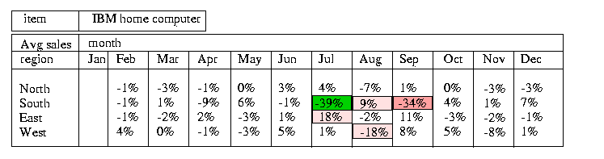
Examples: Discovery-Driven Data Cubes

Slide 48
Complex Aggregation at Multiple Granularities: Multi-Feature Cubes
Multi-feature cubes (Ross, et al. 1998): Compute complex queries involving multiple dependent aggregates at multiple granularities
Ex. Grouping by all subsets of {item, region, month}, find the maximum price in 1997 for each group, and the total sales among all maximum price tuples
select item, region, month, max(price), sum(R.sales)
from purchases
where year = 1997
cube by item, region, month: R
such that R.price = max(price)
Continuing the last example, among the max price tuples, find the min and max shelf life, and find the fraction of the total sales due to tuple that have min shelf life within the set of all max price tuples

Slide 49
Data Warehousing and OLAP
What is a data warehouse?
A multi-dimensional data model
Data warehouse architecture
Data warehouse implementation
Extensions of data cubes
From data warehousing to data mining

Slide 50
Data Warehouse Usage
Three kinds of data warehouse applications
Information processing
supports querying, basic statistical analysis, and reporting using crosstabs, tables, charts and graphs
Analytical processing
multidimensional analysis of data warehouse data
supports basic OLAP operations, slice-dice, drilling, pivoting
Data mining
knowledge discovery from hidden patterns
supports associations, constructing analytical models, performing classification and prediction, and presenting the mining results using visualization tools.
Differences among the three tasks

Slide 51
From Online Analytical Processing to Online Analytical Mining (OLAM)
Why online analytical mining?
High quality of data in data warehouses
DW contains integrated, consistent, cleaned data
Available information processing structure surrounding data warehouses
ODBC, OLEDB, Web accessing, service facilities, reporting and OLAP tools
OLAP-based exploratory data analysis
mining with drilling, dicing, pivoting, etc.
On-line selection of data mining functions
integration and swapping of multiple mining functions, algorithms, and tasks.
Architecture of OLAM

Slide 52
An OLAM Architecture
Mining query
Mining result
Layer4
User Interface
User GUI API
OLAM
Engine
OLAP
Engine
Layer3
OLAP/OLAM
Data Cube API
Layer2
MDDB
MDDB
Meta Data
Filtering&Integration
Database API
Filtering
Layer1
Data Repository
Data cleaning
Data
Warehouse
Databases
Data integration

Slide 53
Summary
Data warehouse
A subject-oriented, integrated, time-variant, and nonvolatile collection of data in support of management’s decision-making process
A multi-dimensional model of a data warehouse
Star schema, snowflake schema, fact constellations
A data cube consists of dimensions & measures
OLAP operations: drilling, rolling, slicing, dicing and pivoting
OLAP servers: ROLAP, MOLAP, HOLAP
Efficient computation of data cubes
Partial vs. full vs. no materialization
Multiway array aggregation
Bitmap index and join index implementations
Extensions of data cubes
Discovery-drive and multi-feature cubes
From OLAP to OLAM (on-line analytical mining)

