Slide 1
OLAP and
Data Mining

Slide 2
OLTP Compared With OLAP
On Line Transaction Processing – OLTP
  Maintains a database that is an accurate model of some real-world enterprise. Supports day-to-day operations. Characteristics:
    Short simple transactions
    Relatively frequent updates
    Transactions access only a small fraction of the database
On Line Analytic Processing – OLAP
  Uses information in database to guide strategic decisions. Characteristics:
    Complex queries
    Infrequent updates
    Transactions access a large fraction of the database
    Data need not be up-to-date

Slide 3
The Internet Grocer
OLTP-style transaction:
  John Smith, from Schenectady, N.Y., just bought a box of tomatoes; charge his account; deliver the tomatoes from our Schenectady warehouse; decrease our inventory of tomatoes from that warehouse
OLAP-style transaction:
  How many cases of tomatoes were sold in all northeast warehouses in the years 2000 and 2001?

Slide 4
OLAP: Traditional Compared with Newer Applications
Traditional OLAP queries
  Uses data the enterprise gathers in its usual activities, perhaps in its OLTP system
  Queries are ad hoc, perhaps designed and carried out by non-professionals (managers)
Newer Applications (e.g., Internet companies)
  Enterprise actively gathers data it wants, perhaps purchasing it
  Queries are sophisticated, designed by professionals, and used in more sophisticated ways

Slide 5
The Internet Grocer
Traditional
  How many cases of tomatoes were sold in all northeast warehouses in the years 2000 and 2001?
Newer
  Prepare a profile of the grocery purchases of John Smith for the years 2000 and 2001 (so that we can customize our marketing to him and get more of his business)

Slide 6
Data Mining
Data Mining is an attempt at knowledge discovery – to extract knowledge from a database
Comparison with OLAP
  OLAP:
    What percentage of people who make over $50,000 defaulted on their mortgage in the year 2000?
  Data Mining:
    How can information about salary, net worth, and other historical data be used to predict who will default on their mortgage?

Slide 7
Data Warehouses
OLAP and data mining databases are frequently stored on special servers called data warehouses:
  Can accommodate the huge amount of data generated by OLTP systems
  Allow OLAP queries and data mining to be run off-line so as not to impact the performance of OLTP

Slide 8
OLAP, Data Mining, and Analysis
The “A” in OLAP stands for “Analytical”
Many OLAP and Data Mining applications involve sophisticated analysis methods from the fields of mathematics, statistical analysis, and artificial intelligence
Our main interest is in the database aspects of these fields, not the sophisticated analysis techniques

Slide 9
Fact Tables
Many OLAP applications are based on a fact table
For example, a supermarket application might be based on a table
Sales (Market_Id, Product_Id, Time_Id, Sales_Amt)
The table can be viewed as multidimensional
  Market_Id, Product_Id, Time_Id are the dimensions that represent specific supermarkets, products, and time intervals
  Sales_Amt is a function of the other three

Slide 10
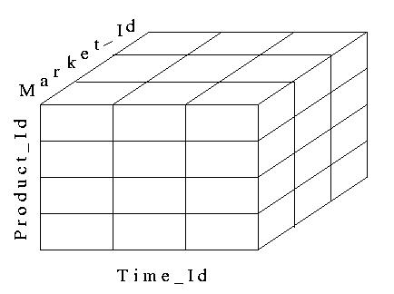
A Data Cube
Fact tables can be viewed as an N-dimensional data cube (3-dimensional in our example)
  The entries in the cube are the values for Sales_Amts

Slide 11
Dimension Tables
The dimensions of the fact table are further described with dimension tables
Fact table:
  Sales (Market_id, Product_Id, Time_Id, Sales_Amt)
Dimension Tables:
  Market (Market_Id, City, State, Region)
  Product (Product_Id, Name, Category, Price)
  Time (Time_Id, Week, Month, Quarter)

Slide 12
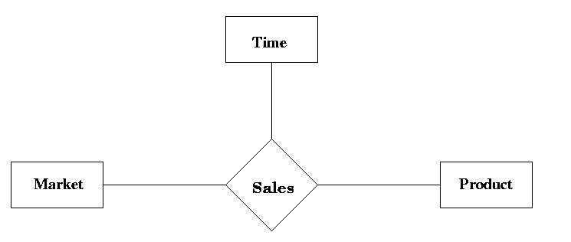
Star Schema
The fact and dimension relations can be displayed in an E-R diagram, which looks like a star and is called a star schema

Slide 13
Aggregation
Many OLAP queries involve aggregation of the data in the fact table
For example, to find the total sales (over time) of each product in each market, we might use
  SELECT S.Market_Id, S.Product_Id, SUM (S.Sales_Amt)
  FROM Sales S
  GROUP BY S.Market_Id, S.Product_Id
The aggregation is over the entire time dimension and thus produces a two-dimensional view of the data

Slide 14
Aggregation over Time
The output of the previous query
Market_Id
SUM(Sales_Amt) | M1 | M2 | M3 | M4
P1 | 3003 | 1503 | …
P2 | 6003 | 2402 | …
P3 | 4503 | 3 | …
P4 | 7503 | 7000 | …
P5 | … | … | …
Product_Id

Slide 15
Drilling Down and Rolling Up
Some dimension tables form an aggregation hierarchy
  Market_Id → City → State → Region
Executing a series of queries that moves down a hierarchy (e.g., from aggregation over regions to that over states) is called drilling down
  Requires the use of the fact table or information more specific than the requested aggregation (e.g., cities)
Executing a series of queries that moves up the hierarchy (e.g., from states to regions) is called rolling up
  Note: In a rollup, coarser aggregations can be computed using prior queries for finer aggregations

Slide 16
Drilling Down
Drilling down on market: from Region to State
  Sales (Market_Id, Product_Id, Time_Id, Sales_Amt)
  Market (Market_Id, City, State, Region)
SELECT S.Product_Id, M.Region, SUM (S.Sales_Amt)
  FROM Sales S, Market M
  WHERE M.Market_Id = S.Market_Id
  GROUP BY S.Product_Id, M.Region
SELECT S.Product_Id, M.State, SUM (S.Sales_Amt)
  FROM Sales S, Market M
  WHERE M.Market_Id = S.Market_Id
  GROUP BY S.Product_Id, M.State,

Slide 17
Rolling Up
Rolling up on market, from State to Region
  If we have already created a table, State_Sales, using
  SELECT S.Product_Id, M.State, SUM (S.Sales_Amt)
  FROM Sales S, Market M
  WHERE M.Market_Id = S.Market_Id
  GROUP BY S.Product_Id, M.State
  then we can roll up from there to:
  2. SELECT T.Product_Id, M.Region, SUM (T.Sales_Amt)
  FROM State_Sales T, Market M
  WHERE M.State = T.State
  GROUP BY T.Product_Id, M.Region

Slide 18
Pivoting
When we view the data as a multi-dimensional cube and group on a subset of the axes, we are said to be performing a pivot on those axes
  Pivoting on dimensions D₁,…,D_{k} in a data cube D₁,…,D_{k},D_{k+1},…,D_{n} means that we use GROUP BY A₁,…,A_{k} and aggregate over A_{k+1},…A_{n}, where A_{i} is an attribute of the dimension D_{i}
  Example: Pivoting on Product and Time corresponds to grouping on Product_id and Quarter and aggregating Sales_Amt over Market_id:
  SELECT S.Product_Id, T.Quarter, SUM (S.Sales_Amt)
  FROM Sales S, Time T
  WHERE T.Time_Id = S.Time_Id
  GROUP BY S.Product_Id, T.Quarter
Pivot

Slide 19
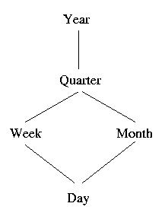
Time Hierarchy as a Lattice
Not all aggregation hierarchies are linear
  The time hierarchy is a lattice
    Weeks are not contained in months
    We can roll up days into weeks or months, but we can only roll up weeks into quarters

Slide 20
Slicing-and-Dicing
When we use WHERE to specify a particular value for an axis (or several axes), we are performing a slice
  Slicing the data cube in the Time dimension (choosing sales only in week 12) then pivoting to Product_id (aggregating over Market_id)
  SELECT S.Product_Id, SUM (Sales_Amt)
  FROM Sales S, Time T
  WHERE T.Time_Id = S.Time_Id AND T.Week = ‘Wk-12’
  GROUP BY S. Product_Id
Slice
Pivot

Slide 21
Slicing-and-Dicing
Typically slicing and dicing involves several queries to find the “right slice.”
For instance, change the slice and the axes:
    Slicing on Time and Market dimensions then pivoting to Product_id and Week (in the time dimension)
  SELECT S.Product_Id, T.Quarter, SUM (Sales_Amt)
  FROM Sales S, Time T
  WHERE T.Time_Id = S.Time_Id
  AND T.Quarter = 4
  AND S.Market_id = 12345
  GROUP BY S.Product_Id, T.Week
Slice
Pivot

Slide 22
The CUBE Operator
To construct the following table, would take 3 queries (next slide)
Market_Id
SUM(Sales_Amt) | M1 | M2 | M3 | Total
P1 | 3003 | 1503 | … | …
P2 | 6003 | 2402 | … | …
P3 | 4503 | 3 | … | …
P4 | 7503 | 7000 | … | …
Total | … | … | … | …
Product_Id

Slide 23
The Three Queries
For the table entries, without the totals (aggregation on time)
  SELECT S.Market_Id, S.Product_Id, SUM (S.Sales_Amt)
  FROM Sales S
  GROUP BY S.Market_Id, S.Product_Id
For the row totals (aggregation on time and supermarkets)
  SELECT S.Product_Id, SUM (S.Sales_Amt)
  FROM Sales S
  GROUP BY S.Product_Id
For the column totals (aggregation on time and products)
  SELECT S.Market_Id, SUM (S.Sales)
  FROM Sales S
  GROUP BY S.Market_Id

Slide 24
Definition of the CUBE Operator
Doing these three queries is wasteful
  The first does much of the work of the other two: if we could save that result and aggregate over Market_Id and Product_Id, we could compute the other queries more efficiently
The CUBE clause is part of SQL:1999
  GROUP BY CUBE (v1, v2, …, vn)
  Equivalent to a collection of GROUP BYs, one for each of the 2^{n} subsets of v1, v2, …, vn

Slide 25
Example of CUBE Operator
The following query returns all the information needed to make the previous products/markets table:
SELECT S.Market_Id, S.Product_Id, SUM (S.Sales_Amt)
FROM Sales S
GROUP BY CUBE (S.Market_Id, S.Product_Id)

Slide 26
ROLLUP
ROLLUP is similar to CUBE except that instead of aggregating over all subsets of the arguments, it creates subsets moving from right to left
GROUP BY ROLLUP (A₁,A₂,…,A_{n}) is a series of these aggregations:
  GROUP BY A₁ ,…, A_{n-1} ,A_{n}
  GROUP BY A₁ ,…, A_{n-1}
  … … …
  GROUP BY A₁, A₂
  GROUP BY A₁
  No GROUP BY
ROLLUP is also in SQL:1999

Slide 27
Example of ROLLUP Operator
  SELECT S.Market_Id, S.Product_Id, SUM (S.Sales_Amt)
  FROM Sales S
  GROUP BY ROLLUP (S.Market_Id, S. Product_Id)
  first aggregates with the finest granularity:
  GROUP BY S.Market_Id, S.Product_Id
  then with the next level of granularity:
  GROUP BY S.Market_Id
  then the grand total is computed with no GROUP BY clause

Slide 28
ROLLUP vs. CUBE
The same query with CUBE:
  - first aggregates with the finest granularity:
    GROUP BY S.Market_Id, S.Product_Id
  - then with the next level of granularity:
  GROUP BY S.Market_Id
  and
    GROUP BY S.Product_Id
  - then the grand total with no GROUP BY

Slide 29
Materialized Views
The CUBE operator is often used to precompute aggregations on all dimensions of a fact table and then save them as a materialized views to speed up future queries

Slide 30
ROLAP and MOLAP
Relational OLAP: ROLAP
  OLAP data is stored in a relational database as previously described. Data cube is a conceptual view – way to think about a fact table
Multidimensional OLAP: MOLAP
  Vendor provides an OLAP server that implements a fact table as a data cube using a special multi-dimensional (non-relational) data structure

Slide 31
MOLAP
No standard query language for MOLAP databases
Many MOLAP vendors (and many ROLAP vendors) provide proprietary visual languages that allow casual users to make queries that involve pivots, drilling down, or rolling up

Slide 32
Implementation Issues
OLAP applications are characterized by a very large amount of data that is relatively static, with infrequent updates
  Thus, various aggregations can be precomputed and stored in the database
  Star joins, join indices, and bitmap indices can be used to improve efficiency (recall the methods to compute star joins in Chapter 14)
  Since updates are infrequent, the inefficiencies associated with updates are minimized

Slide 33
Data Mining
An attempt at knowledge discovery
Searching for patterns and structure in a sea of data
Uses techniques from many disciplines, such as statistical analysis and machine learning
  These techniques are not our main interest

Slide 34
Associations
An association is a correlation between certain values in a database (in the same or different columns)
  In a convenience store in the early evening, a large percentage of customers who bought diapers also bought beer
This association can be described using the notation
Purchase_diapers => Purchase_beer

Slide 35
Confidence and Support
To determine whether an association exists, the system computes the confidence and support for that association
Confidence in A => B
  The percentage of transactions (recorded in the database) that contain B among those that contain A
    Diapers => Beer:
    The percentage of customers who bought beer among those who bought diapers
Support
  The percentage of transactions that contain both items among all transactions
    100* (customers who bought both Diapers and Beer)/(all customers)

Slide 36
Ascertain an Association
To ascertain that an association exists, both the confidence and the support must be above a certain threshold
  Confidence states that there is a high probability, given the data, that someone who purchased diapers also bought beer
  Support states that the data shows a large percentage of people who purchased both diapers and beer (so that the confidence measure is not an accident)

Slide 37
A Priori Algorithm for Computing Associations
Based on this observation:
  If the support for A => B is larger than T, then the support for A and B must separately be larger than T
Find all items whose support is larger than T
  Requires checking n items
  If there are m items with support > T, find all pairs of such items whose support is larger than T
  Requires checking m(m-1) pairs
If there are p pairs with support > T, compute the confidence for each pair
  Requires checking p pairs

Slide 38
Other Types of Information
In addition to association rules, data mining is used to uncover other types of information
  Sequential Patterns
    Associations over time: Is a customer who purchased a garbage can likely to purchase fillers for that can later?
  Classification Rules
    Associations based on ranges of values: Can ranges of income be used to classify individuals into groups which predict their likelihood of defaulting on their mortgage?
  Time Series
    Similarities between sequences: Is the pattern of temperature fluctuation in the Pacific Ocean similar to the pattern of climate variation over the west coast of the US?

Slide 39
Another Data Mining Approach
Machine Learning
  A mortgage broker believes that several factors might affect whether or not a customer is likely to default on mortgage, but does now know how to weight these factors
  Use data from past customers to “learn” a set of weights to be used in the decision for future customers
    Neural networks, a technique studied in the context of Artificial Intelligence, provides a model for analyzing this problem

Slide 40
Data Warehouse
Data (often derived from OLTP) for both OLAP and data mining applications is usually stored in a special database called a data warehouse
Data warehouses are generally large and contain data that has been gathered at different times from DBMSs provided by different vendors and with different schemas
Populating such a data warehouse is not trivial

Slide 41
Issues Involved in Populating a Data Warehouse
Transformations
  Syntactic: syntax used in different DMBSs for the same data might be different
    Attribute names: SSN vs. Ssnum
    Attribute domains: Integer vs. String
  Semantic: semantics might be different
    Summarizing sales on a daily basis vs. summarizing sales on a monthly basis
Data Cleaning
  Removing errors and inconsistencies in data

Slide 42
Metadata
As with other databases, a warehouse must include a metadata repository
  Information about physical and logical organization of data
  Information about the source of each data item and the dates on which it was loaded and refreshed

Slide 43
Incremental Updates
The large volume of data in a data warehouse makes loading and updating a significant task
For efficiency, updating is usually incremental
  Different parts are updated at different times
Incremental updates might result in the database being in an inconsistent state
  Usually not important because queries involve only statistical summaries of data, which are not greatly affected by such inconsistencies

Slide 44
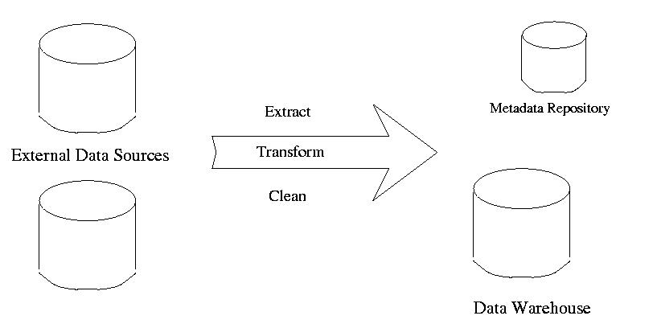
Loading Data into A Data Warehouse

