Slide 1
OLAP Operations in DBMS and Data Warehouses
prepared by: Mahmoud Parsian Ph.D in Computer Science

Slide 2
OLAP Operations in DBMS
OLAP stands for OnLine Analytical Processing Server.
It is a software technology that allows users to analyze information from multiple database systems at the same time.
It is based on multidimensional data model and allows the user to query on multi-dimensional data
OLAP databases are divided into one or more cubes (3-dimensions) and these cubes are known as Hyper-cubes.

Slide 3
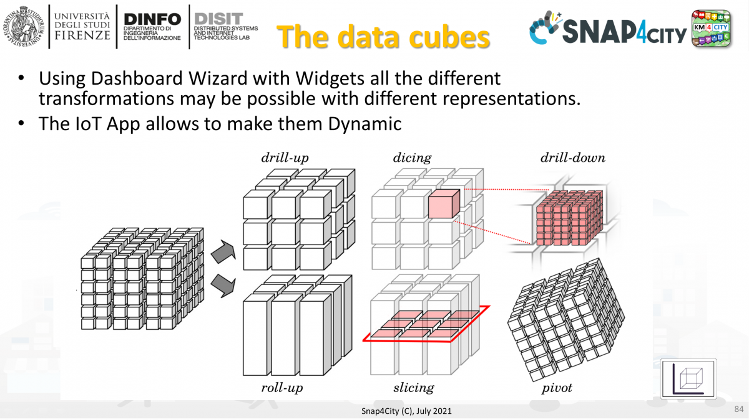
Data Cubes

Slide 4
OLAP Conceptual Data Model
Goal of OLAP is to support ad-hoc querying for the business analyst
Business analysts are familiar with spreadsheets
Extend spreadsheet analysis model to work with warehouse data
Multidimensional view of data is the foundation of OLAP

Slide 5
OLTP vs. OLAP
On-Line Transaction Processing (OLTP):
technology used to perform updates on operational or transactional systems (e.g., point of sale systems)
On-Line Analytical Processing (OLAP):
technology used to perform complex analysis of the data in a data warehouse
OLAP is a category of software technology that enables analysts, managers, and executives to gain insight into data through fast, consistent, interactive access to a wide variety of possible views of information that has been transformed from raw data to reflect the dimensionality of the enterprise as understood by the user. [source: OLAP Council: www.olapcouncil.org]

Slide 6
OLTP vs. OLAP
O L T P
O L A P
User
Function
DB Design
Data
View
Usage
Unit of work
Access
Operations
# Records accessed
#Users
Db size
Metric
Clerk, IT Professional
Day to day operations
Application-oriented (E-R based)
Current, Isolated
Detailed, Flat relational
Structured, Repetitive
Short, Simple transaction
Read/write
Index/hash on prim. Key
Tens
Thousands
100 MB-GB
Trans. throughput
Knowledge worker
Decision support
Subject-oriented (Star, snowflake)
Historical, Consolidated
Summarized, Multidimensional
Ad hoc
Complex query
Read Mostly
Lots of Scans
Millions
Hundreds
100GB-TB
Query throughput, response

Slide 7
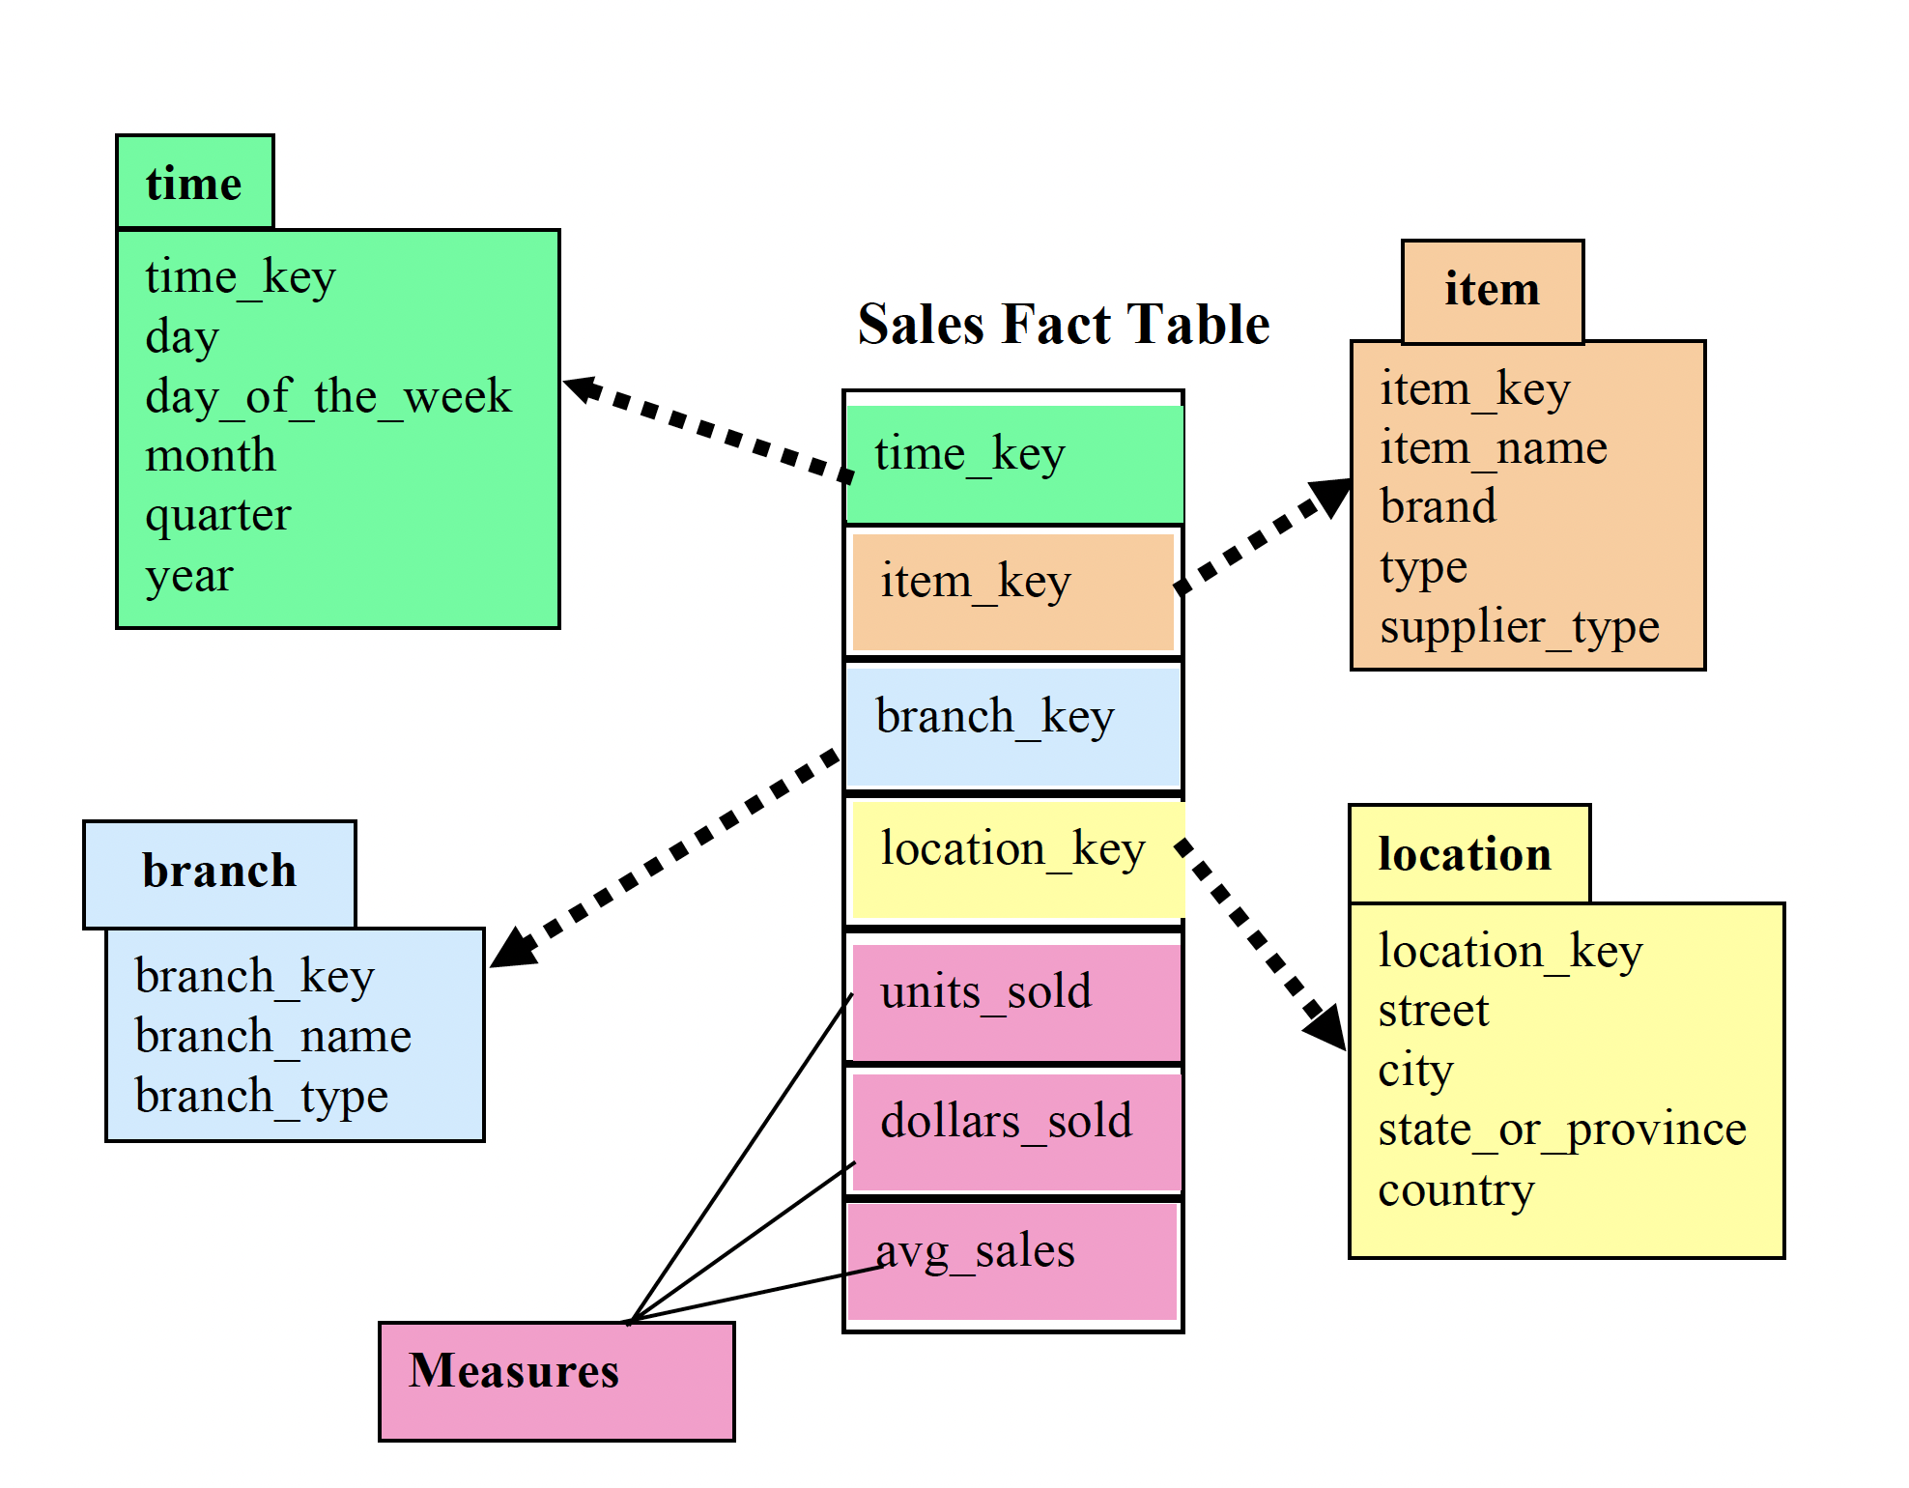
Star Schema and Dimensions

Slide 8
What is a Data Cube?
A data cube is a data structure that, contrary to tables and spreadsheets, can store data in more than 2 dimensions.
They are mainly used for fast retrieval of aggregated data.
The key elements of a data cube are
dimensions,
attributes,
facts and
measures.

Slide 9
Data Cube? Example
A multidimensional cube for reporting sales might be, for example, composed of 7 Dimensions:
sales_person,
sales_amount,
region,
product,
month,
year
quarter

Slide 10
Multidimensional Data
Sales Volume as a function of time, city and product
NY
LA
SF
Juice
Cola
Milk
Cream
10
47
30
12
3/1 3/2 3/3 3/4
Date

Slide 11
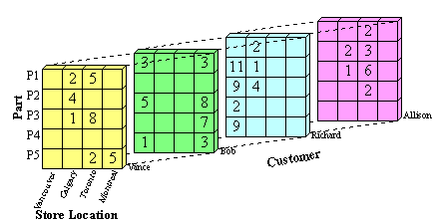
Data Cube? Example

Slide 12
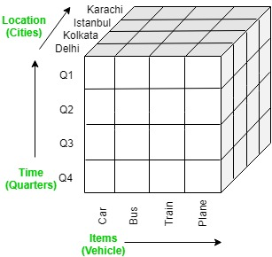
OLAP Operations in DBMS

Slide 13
Snowflake Cube Example
-- Create some tables and insert some rows.
CREATE TABLE products (product_ID INTEGER, wholesale_price REAL);
INSERT INTO products (product_ID, wholesale_price) VALUES
(1, 1.00),
(2, 2.00);
CREATE TABLE sales (product_ID INTEGER, retail_price REAL,
quantity INTEGER, city VARCHAR, state VARCHAR);
INSERT INTO sales (product_id, retail_price, quantity, city, state) VALUES
(1, 2.00, 1, 'SF', 'CA'),
(1, 2.00, 2, 'SJ', 'CA'),
(2, 5.00, 4, 'SF', 'CA'),
(2, 5.00, 8, 'SJ', 'CA'),
(2, 5.00, 16, 'Miami', 'FL'),
(2, 5.00, 32, 'Orlando', 'FL'),
(2, 5.00, 64, 'SJ', 'PR');

Slide 14
Snowflake Run a Cube Query
Run a cube query that shows profit by city, state, and total across all states. The example below shows a query that has three “levels”:
Each city.
Each state.
All revenue combined.
This example uses ORDER BY state, city NULLS LAST to ensure that each state’s rollup comes immediately after all of the cities in that state, and that the final rollup appears at the end of the output.

Slide 15
Snowflake Run a Cube Query
SELECT state, city, SUM((s.retail_price - p.wholesale_price) * s.quantity) AS profit
FROM products AS p, sales AS s
WHERE s.product_ID = p.product_ID
GROUP BY CUBE (state, city)
ORDER BY state, city NULLS LAST;
+-------+---------+--------+
| STATE | CITY | PROFIT |
|-------+---------+--------|
| CA | SF | 13 |
| CA | SJ | 26 |
| CA | NULL | 39 | 39 = 13+26 (per state of CA)
| FL | Miami | 48 |
| FL | Orlando | 96 |
| FL | NULL | 144 | 144 = 48+96 (per state of FL)
| PR | SJ | 192 |
| PR | NULL | 192 | 192 = 192 (per state of PR)
| NULL | Miami | 48 |
| NULL | Orlando | 96 |
| NULL | SF | 13 |
| NULL | SJ | 218 | 218 = 26+192
| NULL | NULL | 375 | 375 = 39+144+192 (all States and Cities)
+-------+---------+--------+

Slide 16
Snowflake Run a Cube Query: Explanation
Some rollup rows contain NULL values.
For example, the last row in the table contains a NULL value for the city and a NULL value for the state because the data is for all cities and states, not a specific city and state.
Both GROUP BY CUBE and GROUP BY ROLLUP produce one row for each (city, state) pair, and both GROUP BY clauses also produce rollup rows for each individual state and for all states combined.
The difference between the two GROUP BY clauses is that GROUP BY CUBE also produces an output row for each city name (‘Miami’, ‘SJ’, etc.).

Slide 17
OLAP Operations in DBMS
There are five basic analytical operations that can be performed on an OLAP cube:
Drill down (Roll down)
Roll Up
Dice
Slice
Pivot

Slide 18
Drill Down / Roll Down
In drill-down operation, the less detailed data is converted into highly detailed data.
It can be done by:
Moving down in the concept hierarchy
Adding a new dimension
In the cube given in overview section, the drill down operation is performed by moving down in the concept hierarchy of Time dimension (Quarter -> Month).

Slide 19
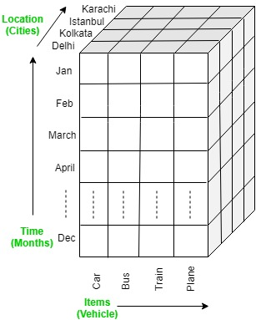
Drill Down

Slide 20
1. Drill Down Example-1
This is a reverse of the ROLL UP operation.
The data is aggregated from a higher-level summary to a lower-level summary/detailed data.
Query Syntax:
SELECT … GROUP BY ROLLDOWN(columns);
Example:
SELECT time, location, product,
sum(revenue) AS profit
FROM sales
GROUP BY ROLLDOWN(time, location, product);

Slide 21
1. Drill/Roll Down Example-2: step-1: ROLLUP
Roll down operation is reverse of the roll-up.
This operation is performed by either of the following way: a) By stepping down a concept hierarchy for a dimension b) By introducing new dimension In order to understand how rolldown works, we will first show rollup for particular movie. Here I took ATONEMENT movie as it has more awards. SELECT Y.year, M.movie, COUNT(A.AwardType) as NumAwards FROM AwardCollectionFact as ACF , Years as Y,
Categories as C, Movie as M, Awards as A WHERE ACF.idYear = Y.idYear and ACF.idcategory = C.idcategories and ACF.idMovie = M.idMovie and ACF.idAward = A.idAward and M.movie='Atonement' GROUP BY year, movie with ROLLUP;

Slide 22
1. Drill/Roll Down Example-2: Step-1: Roll UP
SELECT Y.year, M.movie, COUNT(A.AwardType) as NumAwards FROM AwardCollectionFact as ACF , Years as Y,
Categories as C, Movie as M, Awards as A WHERE ACF.idYear = Y.idYear and ACF.idcategory = C.idcategories and ACF.idMovie = M.idMovie and ACF.idAward = A.idAward and M.movie='Atonement' GROUP BY year, movie with ROLLUP;
3 rows selected
Year Movie NumAwards
Atonement 28
2007 NULL 28
NULL NULL 28

Slide 23
1. Drill/Roll Down Example-2: Step-2: Roll Down
Now we apply rolldown to see a more detailed data about Atonement movie.
SELECT category, movie, year, COUNT(AwardType) as NumAwards, name FROM Categories as C LEFT JOIN ( SELECT ACF.idcategory as idc, category as ca,
movie, year, AwardType,name FROM AwardCollectionFact as ACF, Movie as M,
Years as Y, Awards as A, Categories as C WHERE ACF.idMovie=M.idMovie and M.movie='Atonement’
and ACF.idYear=Y.idYear and ACF.idAward=A.idAward
and ACF.idcategory=C.idcategories
) as FACT on C.idcategories=FACT.idc GROUP BY category, year, movie;

Slide 24
2. Roll Up : GROUP BY & ROLLUP
Roll up: It is just opposite of the drill-down operation.
It performs aggregation on the OLAP cube.
It can be done by:
1. Climbing up in the concept hierarchy
2. Reducing the dimensions
3. In the cube given in the overview section, the roll-up operation is performed by climbing up in the concept hierarchy of Location dimension (City -> Country).

Slide 25
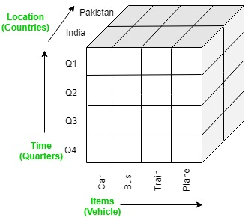
Roll Up

Slide 26
Roll Up in MySQL
Roll Up can be implemented in MySQL by
GROUP BY, and
WITH ROLLUP

Slide 27
Roll Up in MySQL: Example
SELECT year(order_date) as Year,
quarter( order_date) as Quarter,
count(*) as Orders
FROM sales_order
GROUP BY (Year, Quarter) WITH ROLLUP
ORDER BY Year, Quarter;

Slide 28
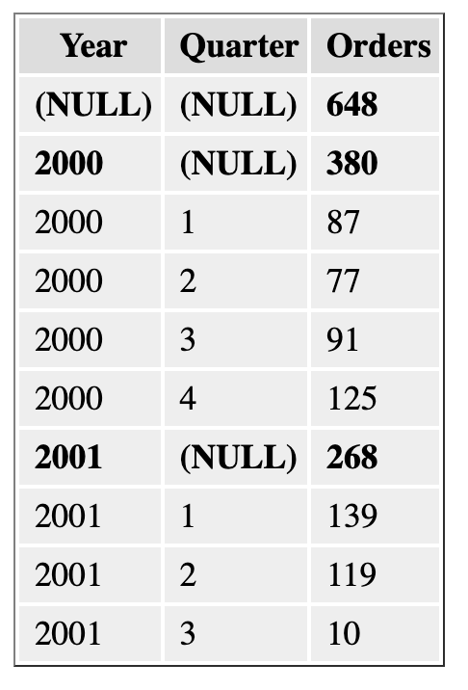
Roll Up in MySQL: Example

Slide 29
3. Dice
Dice: It selects a sub-cube from the OLAP cube by selecting two or more dimensions.
In the cube given in the overview section, a sub-cube is selected by selecting following dimensions with criteria:
Location = “Delhi” or “Kolkata”
Time = “Q1” or “Q2”
Item = “Car” or “Bus”

Slide 30
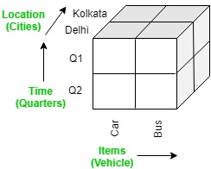
Dice example

Slide 31
Dice Example
Query Syntax:
Selection conditions on some attributes
using <WHERE clause>
Group by and aggregation on some attribute
Example:
SELECT product, sum(revenue)
FROM sales
WHERE product = ‘EL’ AND
location = ’Europe’
GROUP BY product;

Slide 32
4. Slice
Slice: It selects a single dimension from the OLAP cube which results in a new sub-cube creation.
In the cube given in the overview section,
Slice is performed on the dimension Time = “Q1”.

Slide 33
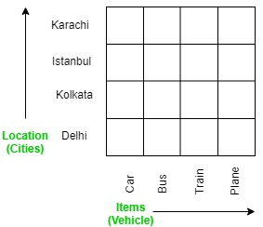
4. Slice

Slide 34
Slice Example
Query Syntax:
Selection conditions on some attributes
using <WHERE clause> <Group by> and
aggregation on some attribute
Example:
SELECT product_name, SUM(revenue)
FROM sales
WHERE product_name = ‘flat_tv’
GROUP BY product_name ;

Slide 35
5. Pivot
Pivot: It is also known as rotation operation as it rotates the current view to get a new view of the representation.
In the sub-cube obtained after the slice operation, performing pivot operation gives a new view of it.

Slide 36
A Visual Operation: Pivot (Rotate)
NY
LA
SF
Month
Juice
Cola
Milk
Cream
10
Region
47
30
12
Product
3/1 3/2 3/3 3/4
Date

Slide 37
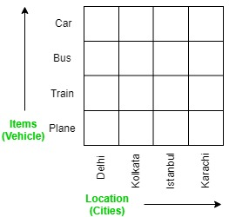
5. Pivot: rotation operation

Slide 38
Pivot Example in Snowflake
PIVOT rotates a table by turning the unique values from one column in the input expression into multiple columns and aggregating results where required on any remaining column values.
In a query, it is specified in the FROM clause after the table name or subquery.

Slide 39
Pivot Example in Snowflake
CREATE OR REPLACE TABLE monthly_sales(emp_id INT, amount INT, month TEXT)
AS SELECT * FROM VALUES
(1, 10000, 'JAN'),
(1, 400, 'JAN'),
(2, 4500, 'JAN'),
(2, 35000, 'JAN'),
(1, 5000, 'FEB'),
(1, 3000, 'FEB'),
(2, 200, 'FEB'),
(2, 90500, 'FEB'),
(1, 6000, 'MAR'),
(1, 5000, 'MAR'),
(2, 2500, 'MAR'),
(2, 9500, 'MAR'),
(1, 8000, 'APR'),
(1, 10000, 'APR'),
(2, 800, 'APR'),
(2, 4500, 'APR');

Slide 40
Pivot Example in Snowflake
SELECT *
FROM monthly_sales
PIVOT(SUM(amount) FOR MONTH IN ('JAN', 'FEB', 'MAR','APR'))
AS p
ORDER BY EMP_ID;
+-------+-------+-------+-------+-------+
| EMP_ID| 'JAN' | 'FEB' | 'MAR' | 'APR' |
|-------+-------+-------+-------+-------|
| 1 | 10400 | 8000 | 11000 | 18000 |
| 2 | 39500 | 90700 | 12000 | 5300 |
+-------+-------+-------+-------+-------+

Slide 41
Pivot Example in Snowflake: revised 1
SELECT *
FROM monthly_sales
PIVOT(SUM(amount) FOR MONTH IN ('JAN', 'FEB', 'MAR', 'APR'))
AS p (EMP_ID_renamed, JAN, FEB, MAR, APR)
ORDER BY EMP_ID_renamed;
+----------------+-------+-------+-------+-------+
| EMP_ID_RENAMED | JAN | FEB | MAR | APR |
|----------------+-------+-------+-------+-------|
| 1 | 10400 | 8000 | 11000 | 18000 |
| 2 | 39500 | 90700 | 12000 | 5300 |
+----------------+-------+-------+-------+-------+

Slide 42
Pivot Example in Snowflake: revised 2
SELECT EMP_ID,
"'JAN'" AS JANUARY,
"'FEB'" AS FEBRUARY,
"'MAR'" AS MARCH,
"'APR'" AS APRIL
FROM monthly_sales
PIVOT(sum(amount) FOR MONTH IN ('JAN', 'FEB', 'MAR', 'APR'))
AS p
ORDER BY EMP_ID;
+--------+---------+----------+-------+-------+
| EMP_ID | JANUARY | FEBRUARY | MARCH | APRIL |
|--------+---------+----------+-------+-------|
| 1 | 10400 | 8000 | 11000 | 18000 |
| 2 | 39500 | 90700 | 12000 | 5300 |
+--------+---------+----------+-------+-------+

Slide 43
MySQL : How To Generate a Pivot Table
1. In MySQL, there is no PIVOT feature or keyword.
2. Fortunately, we can still generate this pivot table output.
https://www.databasestar.com/mysql-pivot/
In MySQL, use the following to create a Pivot
the SUM function (or other aggregate functions)
the CASE statement

