Slide 1
Review: Normalization and data anomalies
CSCI 2141 W2013
Slide set modified from courses.ischool.berkeley.edu/i257/f06/.../Lecture06_257.ppt

Slide 2
Housekeeping
Assignment 3 on normalization due by 9:35 am on Friday morning
  MUST be emailed to the TA – the scanner is located on the 1st floor by the help desk
Quiz 3 on normalization on Friday
IS 257 – Fall 2008

Slide 3
Normalization
Normalization theory is based on the observation that relations with certain properties are more effective in inserting, updating and deleting data than other sets of relations containing the same data
Normalization is a multi-step process beginning with an “unnormalized”relation
  Hospital example from Atre, S. Data Base: Structured Techniques for Design, Performance, and Management.
IS 257 – Fall 2008

Slide 4
Normal Forms
First Normal Form (1NF)
Second Normal Form (2NF)
Third Normal Form (3NF)
Boyce-Codd Normal Form (BCNF)
Fourth Normal Form (4NF)
Fifth Normal Form (5NF)
IS 257 – Fall 2008

Slide 5
Normalization
Unnormalized Relations
First normal form
Functional dependencyof nonkey attributes on the primary key - Atomic values only
No transitive dependency between nonkey attributes
Second normal form
Third normal form
Boyce-
Codd and
Higher
All determinants are candidate keys - Single multivalued dependency
Full Functional dependencyof nonkey attributes on the primary key
IS 257 – Fall 2008

Slide 6
Functional Dependencies
Functional dependencies (FDs) are used to specify formal measures of the "goodness" of relational designs
FDs and keys are used to define normal forms for relations
FDs are constraints that are derived from the meaning and interrelationships of the data attributes

Slide 7
Functional Dependency definition
A set of attributes X functionally determines a set of attributes Y if the value of X determines a unique value for Y
X →Y holds if whenever two tuples have the same value for X, they must have the same value for Y
  If t1[X]=t2[X], then t1[Y]=t2[Y] in any relation instance r(R)
X → Y in R specifies a constraint on all relation instances r(R)
FDs are derived from the real-world constraints on the attributes

Slide 8
Examples of FD constraints
Social Security Number determines employee name
  SSN → ENAME
Project Number determines project name and location
  PNUMBER → {PNAME, PLOCATION}
Employee SSN and project number determines the hours per week that the employee works on the project
  {SSN, PNUMBER} → HOURS

Slide 9
Functional Dependencies and Keys
An FD is a property of the attributes in the schema R
The constraint must hold on every relation instance r(R)
If K is a key of R, then K functionally determines all attributes in R (since we never have two distinct tuples with t1[K]=t2[K])

Slide 10
Inference Rules for FDs
Given a set of FDs F, we can infer additional FDs that hold whenever the FDs in F hold
Armstrong's inference rules
  A1. (Reflexive) If Y subset-of X, then X → Y
  A2. (Augmentation) If X → Y, then XZ → YZ
  (Notation: XZ stands for X U Z)
  A3. (Transitive) If X → Y and Y → Z, then X → Z
A1, A2, A3 form a sound and complete set of inference rules

Slide 11
Additional Useful Inference Rules
Decomposition
  If X → YZ, then X → Y and X → Z
Union
  If X → Y and X → Z, then X → YZ
Psuedotransitivity
  If X → Y and WY → Z, then WX → Z
Closure of a set F of FDs is the set F+ of all FDs that can be inferred from F

Slide 12
Introduction to Normalization
Normalization: Process of decomposing unsatisfactory "bad" relations by breaking up their attributes into smaller relations
Normal form: Condition using keys and FDs of a relation to certify whether a relation schema is in a particular normal form
  2NF, 3NF, BCNF based on keys and FDs of a relation schema
  4NF based on keys, multi-valued dependencies

Slide 13
Unnormalized Relations
First step in normalization is to convert the data into a two-dimensional table
In unnormalized relations data can repeat within a column
IS 257 – Fall 2008

Slide 14
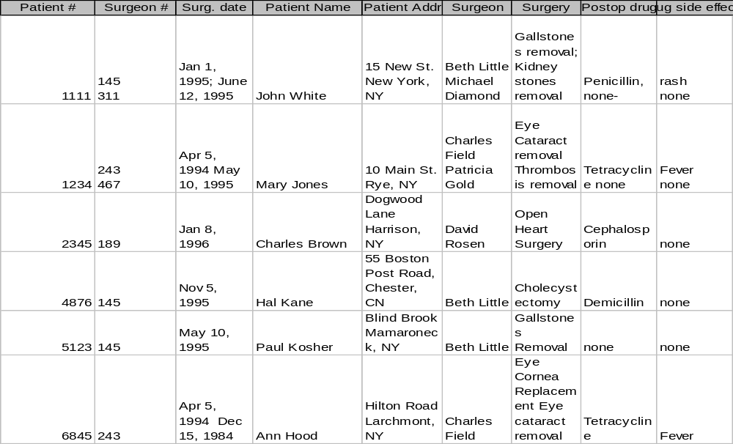
Unnormalized Relation
IS 257 – Fall 2008

Slide 15
First Normal Form
To move to First Normal Form a relation must contain only atomic values at each row and column.
  No repeating groups
  A column or set of columns is called a Candidate Key when its values can uniquely identify the row in the relation.
IS 257 – Fall 2008

Slide 16
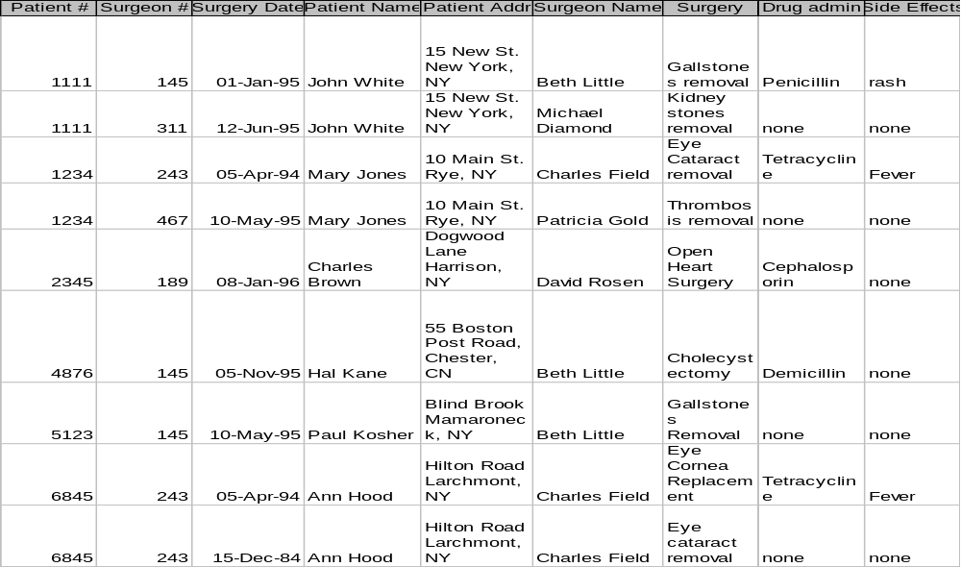
First Normal Form
IS 257 – Fall 2008

Slide 17
1NF Storage Anomalies
Insertion: A new patient has not yet undergone surgery -- hence no surgeon # -- Since surgeon # is part of the key, we cannot insert.
Insertion: If a surgeon is newly hired and has not operated yet -- there will be no way to include that person in the database.
Update: If a patient comes in for a new procedure, and has moved, we need to change multiple address entries.
Deletion (type 1): Deleting a patient record may also delete all info about a surgeon.
Deletion (type 2): When there are functional dependencies (like side effects and drug) changing one item eliminates other information.
IS 257 – Fall 2008

Slide 18
Second Normal Form
A relation is said to be in Second Normal Form when every non-key attribute is fully functionally dependent on the primary key.
  That is, every non-key attribute needs the full primary key for unique identification
IS 257 – Fall 2008

Slide 19
Why is this not in 2NF?
IS 257 – Fall 2008

Slide 20
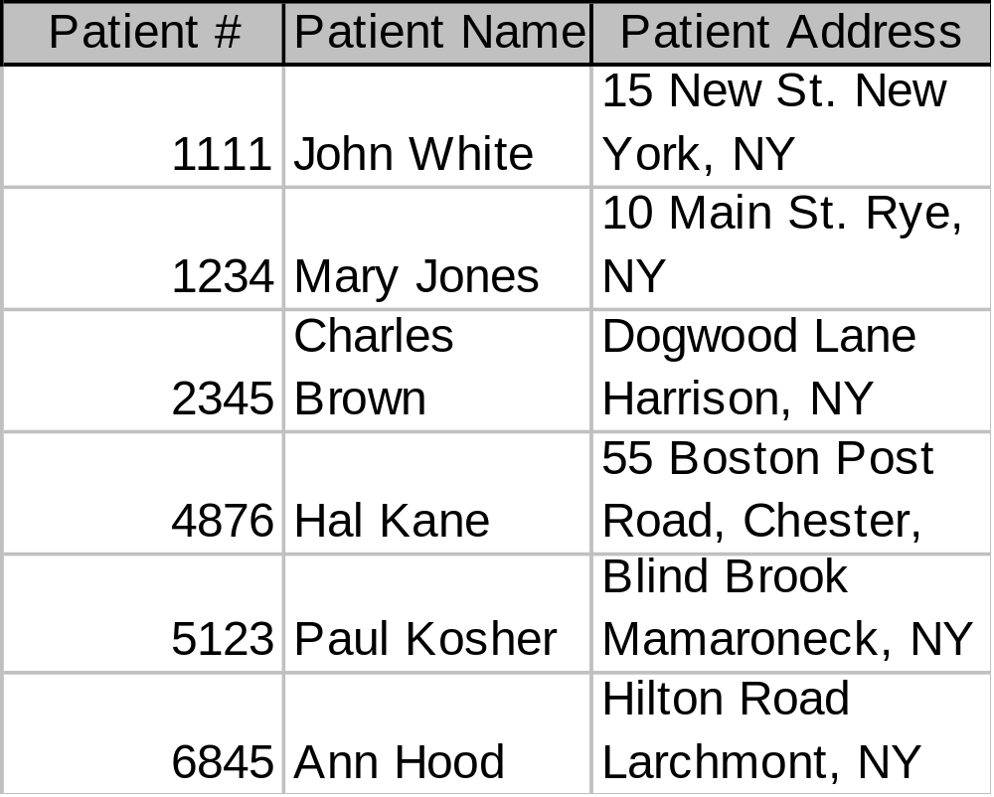
Second Normal Form
IS 257 – Fall 2008

Slide 21
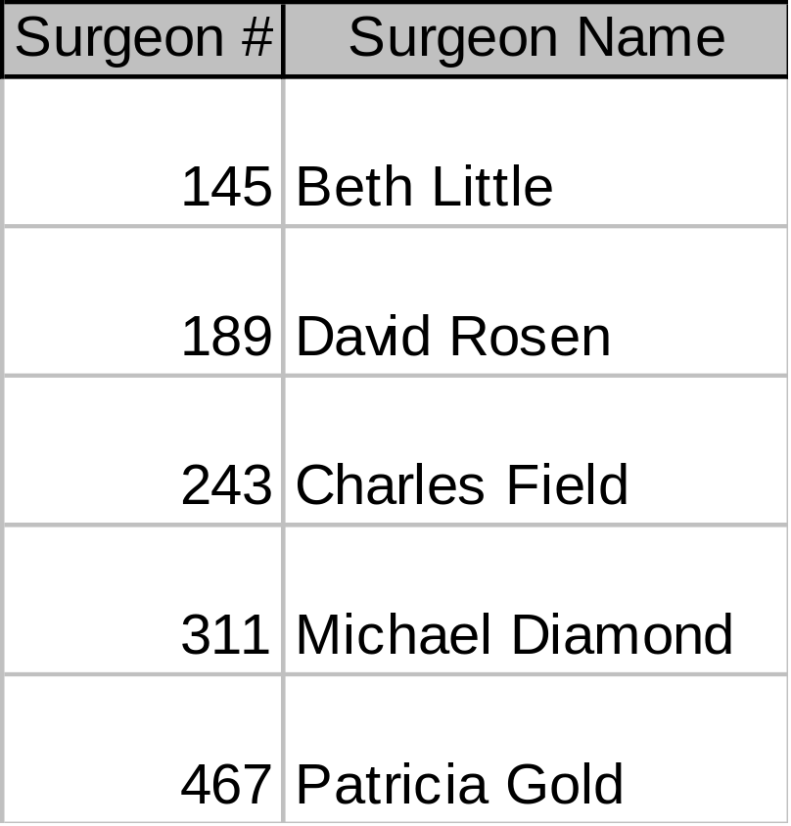
Second Normal Form
IS 257 – Fall 2008

Slide 22
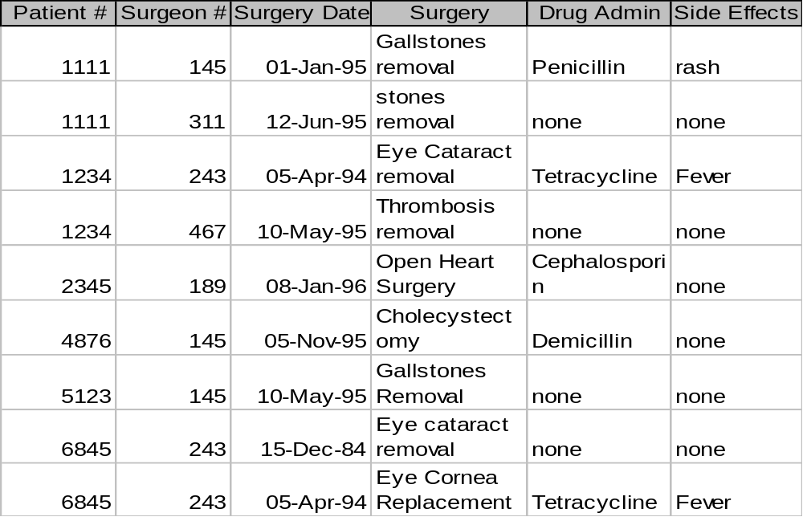
Second Normal Form
IS 257 – Fall 2008

Slide 23
1NF Storage Anomalies Removed
Insertion: Can now enter new patients without surgery.
Insertion: Can now enter Surgeons who have not operated.
Deletion (type 1): If Charles Brown dies, the corresponding tuples from Patient and Surgery tables can be deleted without losing information on David Rosen.
Update: If John White comes in for third time, and has moved, we only need to change the Patient table
IS 257 – Fall 2008

Slide 24
2NF Storage Anomalies
Insertion: Cannot enter the fact that a particular drug has a particular side effect unless it is given to a patient.
Deletion: If John White receives some other drug because of the penicillin rash, and a new drug and side effect are entered, we lose the information that penicillin can cause a rash
Update: If drug side effects change (a new formula) we have to update multiple occurrences of side effects.
IS 257 – Fall 2008

Slide 25
Third Normal Form
A relation is said to be in Third Normal Form if there is no transitive functional dependency between non-key attributes
  When one non-key attribute can be determined with one or more non-key attributes there is said to be a transitive functional dependency.
The side effect column in the Surgery table is determined by the drug administered
  Side effect is transitively functionally dependent on drug so Surgery is not 3NF
IS 257 – Fall 2008

Slide 26
Why is this not in 3NF?
IS 257 – Fall 2008

Slide 27
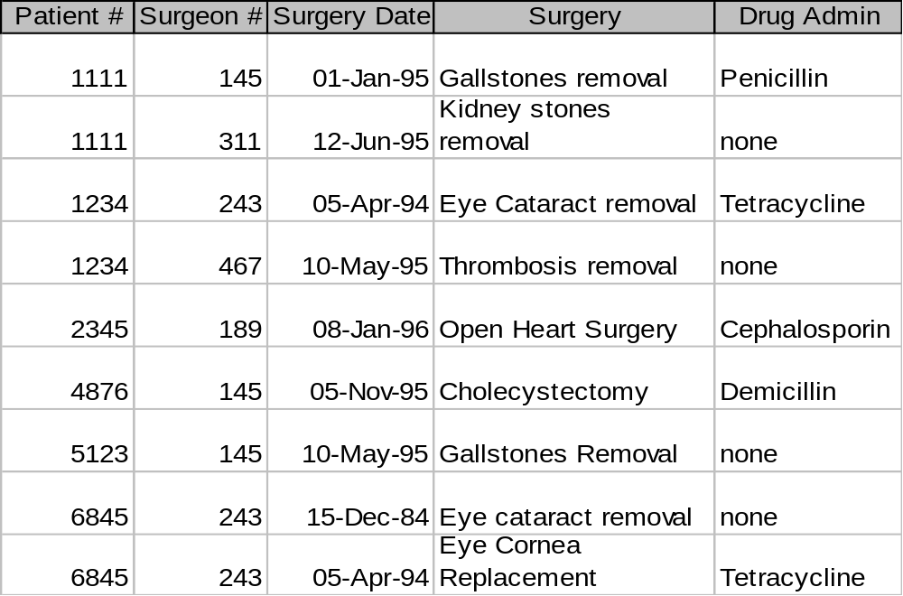
Third Normal Form
IS 257 – Fall 2008

Slide 28
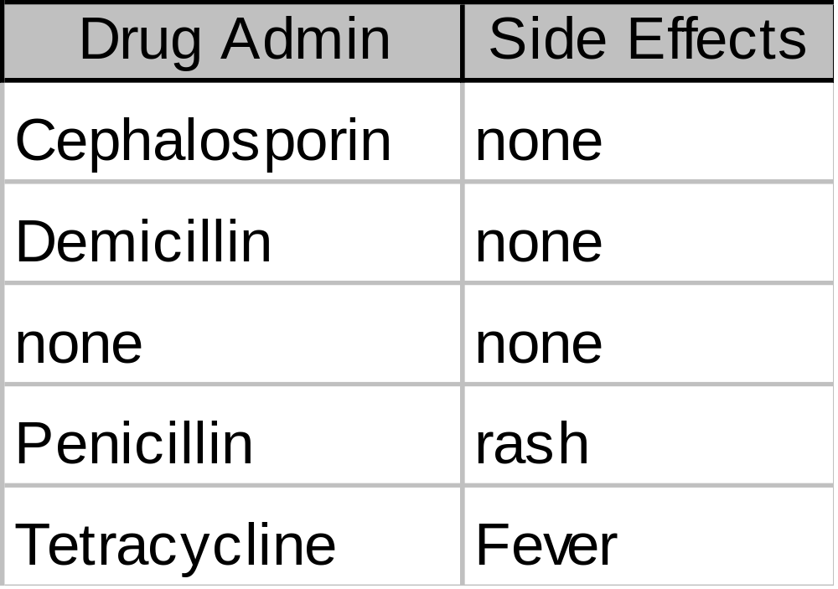
Third Normal Form
IS 257 – Fall 2008

Slide 29
2NF Storage Anomalies Removed
Insertion: We can now enter the fact that a particular drug has a particular side effect in the Drug relation.
Deletion: If John White receives some other drug as a result of the rash from penicillin, the information on penicillin and rash is maintained.
Update: The side effects for each drug appear only once.
IS 257 – Fall 2008

Slide 30
Boyce-Codd Normal Form
Most 3NF relations are also BCNF relations.
A 3NF relation is NOT in BCNF if:
  Candidate keys in the relation are composite keys (they are not single attributes)
  There is more than one candidate key in the relation, and
  The keys are not disjoint, that is, some attributes in the keys are common
IS 257 – Fall 2008

Slide 31
Fourth Normal Form
Any relation is in Fourth Normal Form if it is BCNF and any multivalued dependencies are trivial
Eliminate non-trivial multivalued dependencies by projecting into simpler tables
IS 257 – Fall 2008

Slide 32
Fifth Normal Form
A relation is in 5NF if every join dependency in the relation is implied by the keys of the relation
Implies that relations that have been decomposed in previous normal forms can be recombined via natural joins to recreate the original relation.
IS 257 – Fall 2008

Slide 33
Effectiveness and Efficiency Issues for DBMS
Focus on the relational model
Any column in a relational database can be searched for values.
To improve efficiency indexes using storage structures such as BTrees and Hashing are used
But many useful functions are not indexable and require complete scans of the the database
IS 257 – Fall 2008

Slide 34
Example: Text Fields
In conventional RDBMS, when a text field is indexed, only exact matching of the text field contents (or Greater-than and Less-than).
  Can search for individual words using pattern matching, but a full scan is required.
Text searching is still done best (and fastest) by specialized text search programs (Search Engines)
IS 257 – Fall 2008

Slide 35
Normalization
Normalization is performed to reduce or eliminate Insertion, Deletion or Update anomalies.
However, a completely normalized database may not be the most efficient or effective implementation.
“Denormalization” is sometimes used to improve efficiency.
IS 257 – Fall 2008

Slide 36
Normalizing to death
Normalization splits database information across multiple tables.
To retrieve complete information from a normalized database, the JOIN operation must be used.
JOIN tends to be expensive in terms of processing time, and very large joins are very expensive.
IS 257 – Fall 2008
Notes:
From wikipedia: denormalization is the process of attempting to optimise the read performance of a database by adding redundant data or by grouping data. In some cases, denormalization is a means of addressing performance or scalability in relational database software.
A normalized design will often store different but related pieces of information in separate logical tables (called relations). If these relations are stored physically as separate disk files, completing a database query that draws information from several relations (a join operation) can be slow. If many relations are joined, it may be prohibitively slow. There are two strategies for dealing with this. The preferred method is to keep the logical design normalized, but allow the database management system (DBMS) to store additional redundant information on disk to optimise query response. In this case it is the DBMS software's responsibility to ensure that any redundant copies are kept consistent. This method is often implemented in SQL as indexed views (Microsoft SQL Server) or materialised views (Oracle). A view represents information in a format convenient for querying, and the index ensures that queries against the view are optimised.
The more usual approach is to denormalize the logical data design. With care this can achieve a similar improvement in query response, but at a cost—it is now the database designer's responsibility to ensure that the denormalized database does not become inconsistent. This is done by creating rules in the database called constraints, that specify how the redundant copies of information must be kept synchronised. It is the increase in logical complexity of the database design and the added complexity of the additional constraints that make this approach hazardous. Moreover, constraints introduce a trade-off, speeding up reads (SELECT in SQL) while slowing down writes (INSERT, UPDATE, and DELETE). This means a denormalized database under heavy write load may actually offer worse performance than its functionally equivalent normalized counterpart.
A denormalized data model is not the same as a data model that has not been normalized, and denormalization should only take place after a satisfactory level of normalization has taken place and that any required constraints and/or rules have been created to deal with the inherent anomalies in the design. For example, all the relations are in third normal form and any relations with join and multi-valued dependencies are handled appropriately.

Slide 37
Downward Denormalization
Before:
Customer
ID
Address
Name
Telephone
After:
Customer
ID
Address
Name
Telephone
Order
Order No
Date Taken
Date Dispatched
Date Invoiced
Cust ID
Order
Order No
Date Taken
Date Dispatched
Date Invoiced
Cust ID
Cust Name
IS 257 – Fall 2008

Slide 38
Upward Denormalization
Order
Order No
Date Taken
Date Dispatched
Date Invoiced
Cust ID
Cust Name
Order
Order No
Date Taken
Date Dispatched
Date Invoiced
Cust ID
Cust Name
Order Price
Order Item
Order No
Item No
Item Price
Num Ordered
Order Item
Order No
Item No
Item Price
Num Ordered
IS 257 – Fall 2008

Slide 39
Denormalization
Usually driven by the need to improve query speed
Query speed is improved at the expense of more complex or problematic DML (Data manipulation language) for updates, deletions and insertions.
IS 257 – Fall 2008

