Slide 1

DATA WAREHOUSE
AND OLAP TECHNOLOGY
PART - 2
By Group No: 11
George John (105708964)
Sunil Prabhakar (105709103)
Lohit Vijayarenu (105709307)
Sathyanarayana Singh (105709185)
Prof. Anita Wasilewska

Slide 2

References
Data Mining Concepts and Techniques – Jiawei Han, Micheline Kamber
http://www-db.stanford.edu/~hgupta/ps/dawn.ps
http://www-db.stanford.edu/warehousing/index.html
http://www.otn.oracle.com
http://www.oracle.com/pls/cis/Profiles.print_html?p_profile_id=2315

Slide 3
Introduction
Data warehouse implementation
-George John
Further development of Data Cube Technology and
Data warehousing for Data Mining
-Sunil Prabhakar
Paper on Data warehouse of news groups
-Lohit Vijayrenu
Demo of a tool for Data Analysis
-Sathyanarayana Singh

Slide 4
Data Warehouse Implementation
George John (105708964)

Slide 5
“ What is the Challenge ? “
  Faster processing of OLAP queries
Requirements of a Data Warehouse system
  Efficient cube computation
  Better access methods
  Efficient query processing

Slide 6
Cube computation
COMPUTE CUBE OPERATOR
  Definition :
  “ It computes the aggregates over all subsets of the dimensions specified in the operation “
  Syntax :
  Compute cube cubename
Example
Consider we define the data cube for an electronic store “Best Electronics”
      Dimensions are :
    City
    Item
    Year
Measure :
  Sales_in_dollars

Slide 7
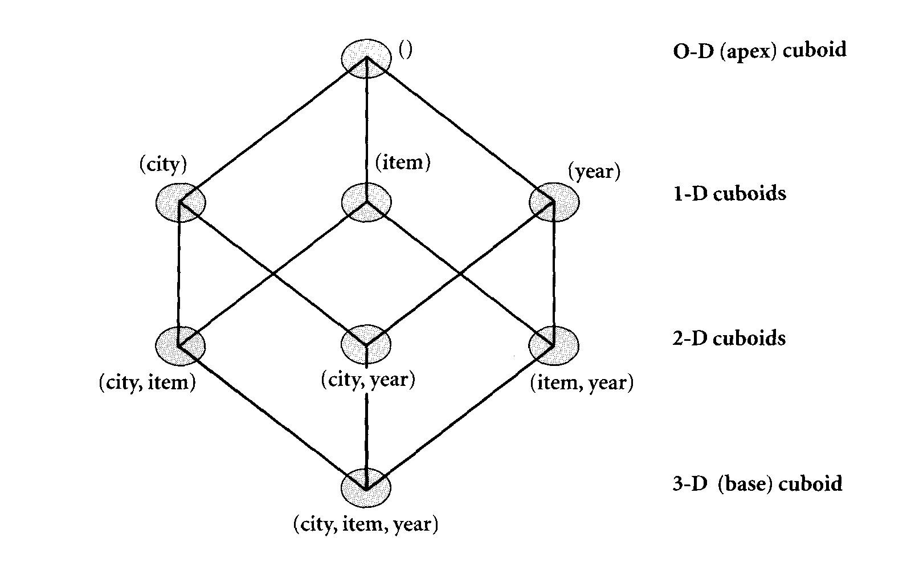
Compute cube operator
The statement “ compute cube sales “
It explicitly instructs the system to compute the sales aggregate cuboids for all the subsets of the set { item, city, year}
Generates a lattice of cuboids making up a 3-D data cube ‘sales’
Each cuboid in the lattice corresponds to a subset
Figure from Data Mining Concepts & Techniques
By Jiawei Han & Micheline Kamber
Page # 72

Slide 8
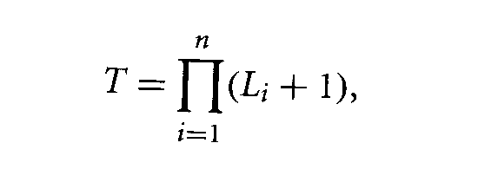
Compute cube operator
Advantages
  Computes all the cuboids for the cube in advance
  Online analytical processing needs to access different cuboids for different queries.
  Precomputation leads to fast response time
Disadvantages
  Required storage space may explode if all of the cuboids in the data cube are precomputed
Consider the following 2 cases for n-dimensional cube
  Case 1 : Dimensions have no hierarchies
    Then the total number of cuboids computed for a n-dimensional cube = 2 ^{n}
  Case 2: Dimensions have hierarchies
    Then the total number of cuboids computed for a n-dimensional cube =
        Where Li is the number of levels associated with dimension i

Slide 9
“ What is chunking ?”
Multiway Array Aggregation
MOLAP uses multidimensional array for data storage
Chunk is obtained by partitioning the multidimensional array such that it is small enough to fit in the memory available for cube computation
So from the above 2 points we get :
“ Chunking is a method for dividing the n-dimensional array into small n-dimensional chunks “

Slide 10
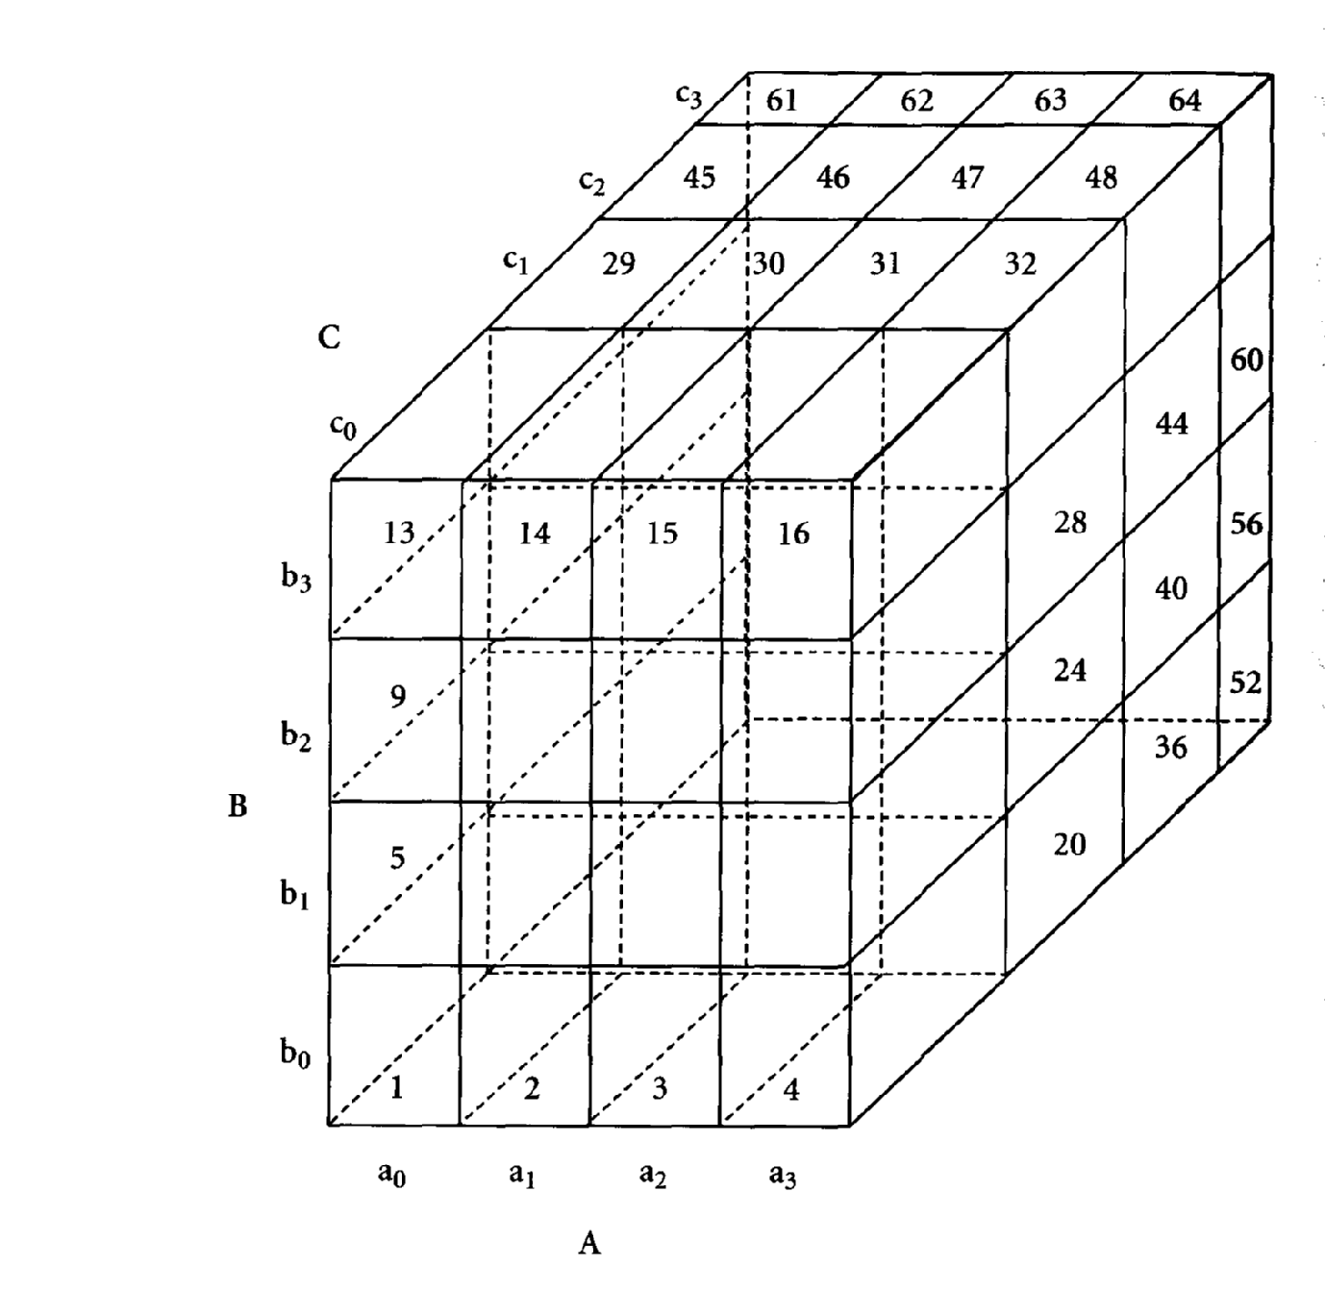
Multiway Array Aggregation
It is a technique used for the computation of data cube
It is used for MOLAP cube construction
Example
Consider 3-D data array
  Dimensions are A,B,C
  Each dimension is partitioned into 4 equalized partitions
    A : a₀,a₁,a₂,a₃
    B : b₀,b₁,b₂,b₃
    C : c₀,c₁,c₂,c₃
  3-D array is partitioned into 64 chunks as shown in the figure
Figure from Data Mining Concepts & Techniques
By Jiawei Han & Micheline Kamber
Page # 76

Slide 11
Multiway Array Aggregation (contd )
The cuboids that make up the cube are
  Base cuboid ABC
    From which all other cuboids are generated
    It is already computed and corresponds to given 3-D array
  2-D cuboids AB,AC,BC
  1-D cuboids A,B,C
  0-D cuboid (apex cuboid)
Figure from Data Mining Concepts & Techniques
By Jiawei Han & Micheline Kamber
Page # 76

Slide 12
Multiway Array Aggregation (contd )
To compute b₀c₀ chunk of BC cuboid
  Allocate space for this chunk in chunk memory
  Scan the chunks 1,2,3,4 of ABC to get b₀c₀ chunk
  Similarly for b₁c₀ by scanning chunks 5 to 8 of ABC
For the complete BC cuboid we would have scanned the 64 chunks
But in multiway when the chunk 1(a₀b₀c₀) is being scanned for b₀c₀ then the other 2 chunks a₀c₀,a₀b₀ is also computed
Hence rescanning of chunks for other cuboids is not required
Figure from Data Mining Concepts & Techniques
By Jiawei Han & Micheline Kamber
Page # 76

Slide 13
Better access methods
For efficient data accessing :
Materialized View
Index structures
    Bitmap Indexing – allows quick searching on Data Cubes, through record_ID lists.
    Join Indexing – creates a joinable rows of two relations from a relational database.

Slide 14
Materialized View
“ Materialized views contains aggregate data (cuboids) derived from a fact table in order to minimize the query response time “
There are 3 kinds of materialization
(Given a base cuboid )
1. No Materialization
  Precompute only the base cuboid
    “ Slow response time ”
2. Full Materialization
  Precompute all of the cuboids
    “ Large storage space “
3. Partial Materialization
  Selectively compute a subset of the cuboids
    “ Mix of the above “

Slide 15
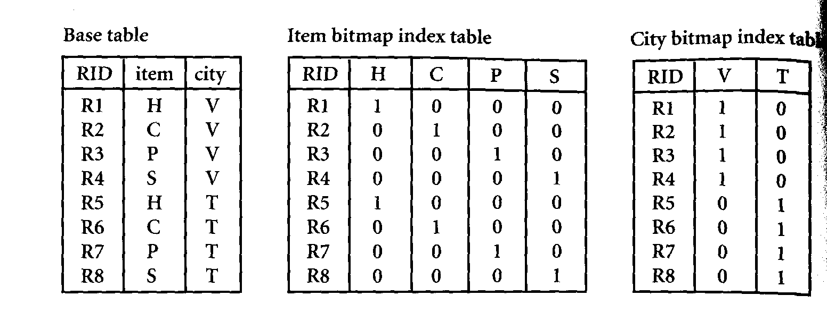
Bitmap Indexing
Used for quick searching in data cubes
Features
  A distinct bit vector Bv ,for each value v in the domain of the attribute
  If the domain has n values then the bitmap index has n bit vectors
Example
Dimensions
  Item
  city
Where:
H=Home entertainment, C=Computer
P=Phone, S=Security
V=Vancouver, T=Toronto

Slide 16
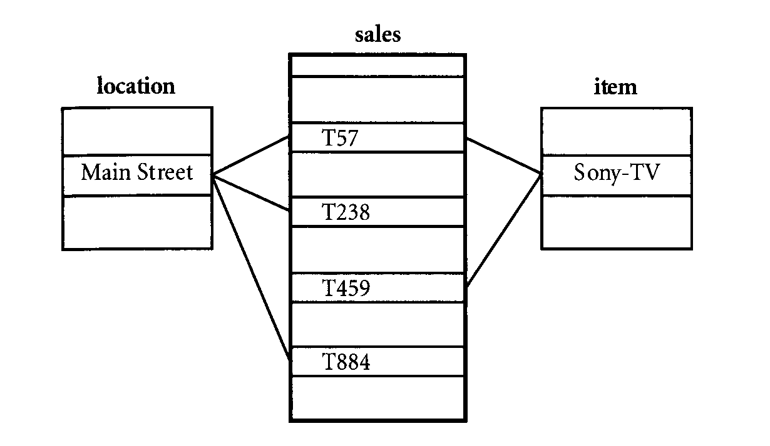
Join Indexing
It is useful in maintaining the relationship between the foreign key and its matching primary key
Consider the sales fact table and the dimension tables for location and item

Slide 17
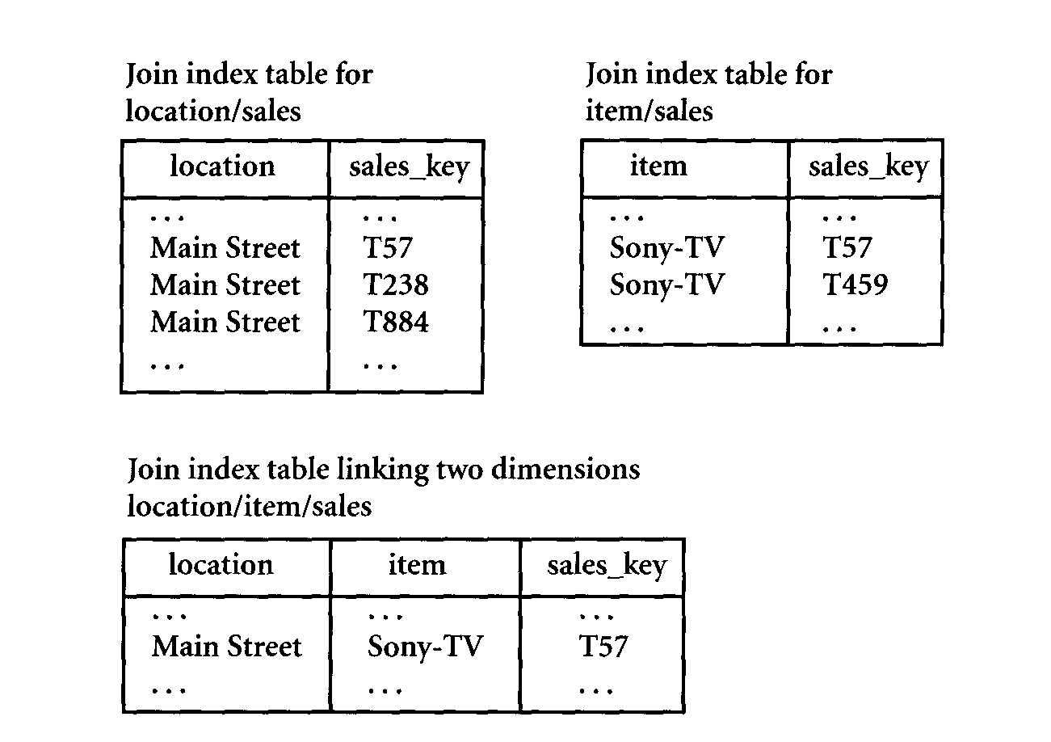
Join Indexing

Slide 18
Efficient query processing
Query processing proceeds as follows given materialized views :
  Determine which operations should be performed on the available cuboids
    Transforming operations (selection, roll-up, drill down,…) specified in the query into corresponding sql and/or OLAP operations.
  Determine to which materialized cuboid(s) the relevant operations should be applied
    Identifying the cuboids for answering the query
    Select the cuboid with the least cost

Slide 19
Consider a data cube for “Best Electronics” of the form
“sales [time, item, location]:sum(sales_in_dollars)
Dimension hierarchies used are :
  “ day<month<quarter<year ” for time
  “ item_name<brand<type” for item
  “ street<city<province_or_state<country “ for location
Query :{ brand,province_or_state} with year = 2000
Materialized cuboids available are
  Cuboid 1: { item_name,city,year}
  Cuboid 2: {brand,country,year}
  Cuboid 3: {brand,province_or_state,year}
  Cuboid 4: {item_name,province_or_state} where year=2000

Slide 20
“ Which of the above four cuboids should be selected to process the query ? “
Cuboid 2
  It cannot be used
        Since finer granularity data cannot be generated from coarser granularity data
        Here country is more general concept than province_or_state
Cuboid 1,3,4
  Can be used
        They have the same set or a superset of the dimensions in the query
        The selection clause in the query can imply the selection in the cuboid
        The abstraction levels for the item and location dimensions are at a finer level than brand and province_or_state respectively

Slide 21
“How would the cost of each cuboid compare if used to process the query”
Cuboid 1 :
  Will cost more
    Since both item_name and city are at a lower level than brand and province_or_state specified in the query
Cuboid 3 :
  Will cost least
    If there are not many year values associated with items in the cube but there are several item_names for each brand
    Cuboid 3 will be smaller than cuboid 4
Cuboid 4 :
  Will cost least
    If efficient indices are available
“Hence some cost based estimation is required in order to decide which set of cuboids must be selected for query processing “

Slide 22
Data Warehousing and OLAP for Data Mining
Further development to Data Cube technology
  Discovery-driven exploration of Data Cubes
  Multi-feature cubes
Data Warehousing for Data Mining
-Sunil Prabhakar
References:Data Mining: Concepts and Techniques
-Jiawei Han,
-Micheline Kamber

Slide 23
Discovery-driven Exploration of Data Cubes
Drawbacks of traditional data cubes:
  Anomaly discovery is manual
  Use of intuition & Hypothesis
  High level aggregations mask low level details
  Sheer volume of data to analyze

Slide 24
Discovery driven cubes Contd…
Guide the user in Data Analysis through Exception Indicators
  pre-computed measures that indicate exceptions in Data
All dimensions accounted during calculation
  “Exception – in a data cube cell is a significant deviation from anticipated value calculated through statistical measures”

Slide 25
Discovery driven cubes Contd…
Methods to indicate Exceptions in cube cell
  SelfExp – indicates degree of surprise for a cell value relative to others at the same level.
  InExp – indicates degree of surprise somewhere beneath the cell
  PathExp – indicates degree of surprise for each drill-down path from the cell.
Degree of surprise – defined as deviation from the anticipated value of a date cell

Slide 26
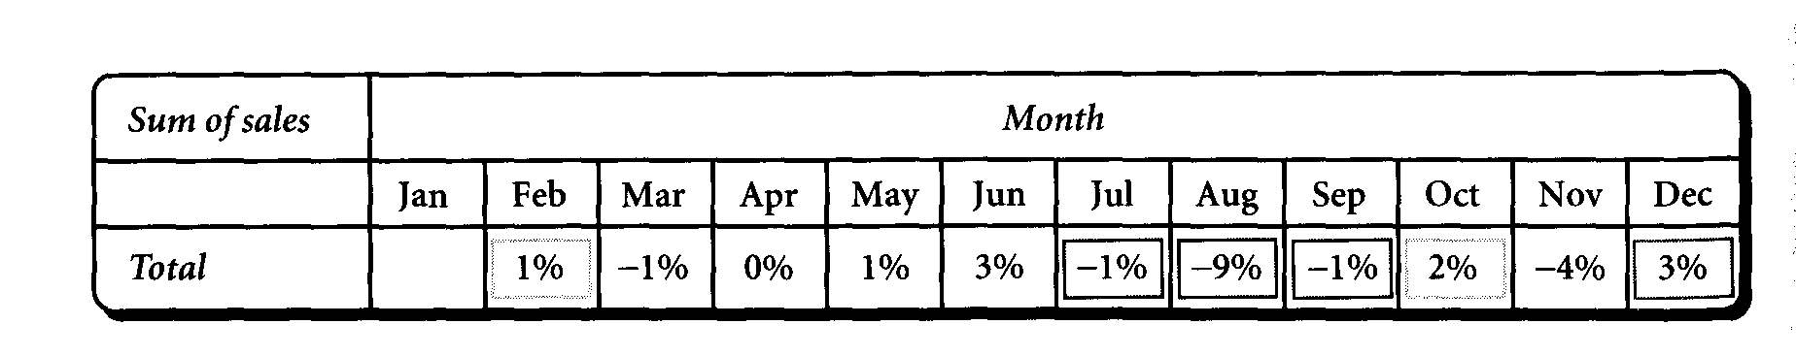
Change of sales over time

Slide 27
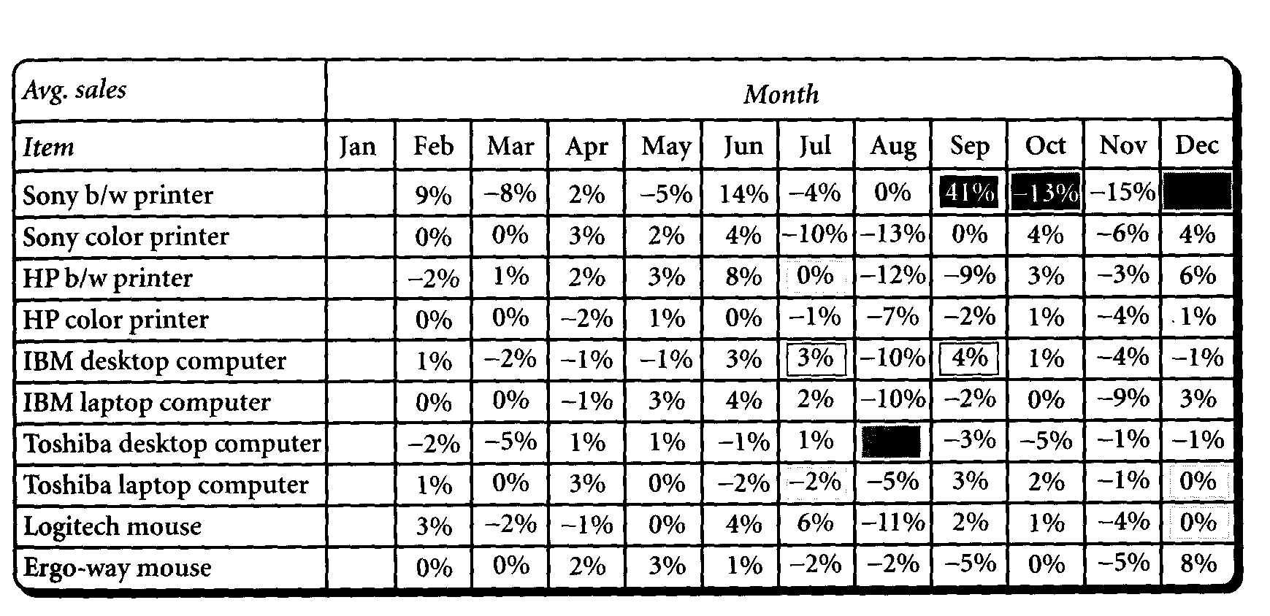
Change in sales for item-time combination

Slide 28
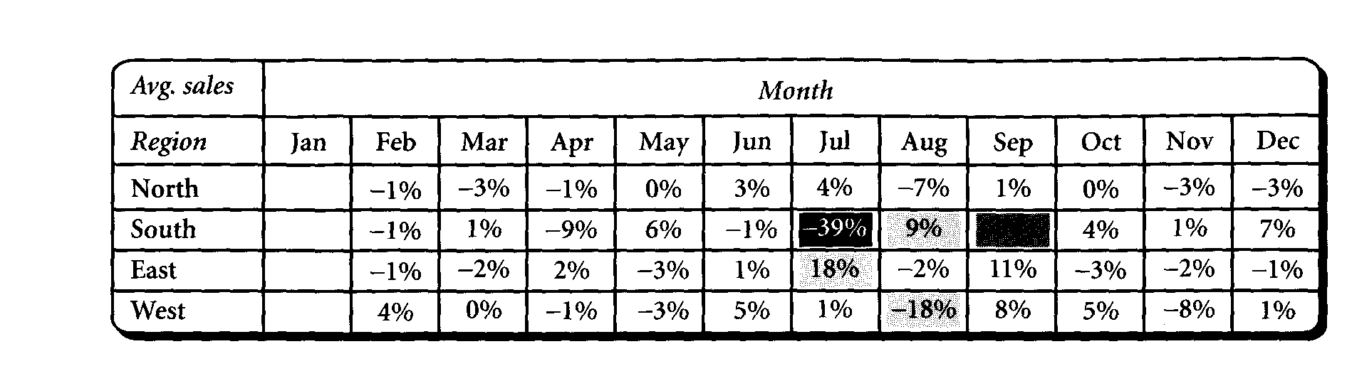
Changes in sales for a item per region

Slide 29
Complex Aggregations using Multi-featured Cubes
Facilitate data mining type queries
Allow computation of aggregates at different granularity levels.

Slide 30
Example: Simple data cube
Find total sales in 2000, broken down by item, region and month with subtotal for each dimension
  No dependent aggregates
  Uses simple data cubes

Slide 31
Complex query: dependent aggregate
Grouping by {item, region, month}, find the maximum price in 2000 for each group, and total sales among all max. price tuples
select item, region, month, MAX(price), SUM(R.sales)
from purchases
where year = 2000
cube by item, region, month: R
such that R.price = MAX(price)

Slide 32
Data Warehouses for Data Mining
Data warehouse usage:
  Information processing
  Analytical processing
  Data Mining

Slide 33
OLAP to On-Line Analytical Mining
OLAM (On-Line Analytical Mining) using OLAP and Data Warehouses:
  High quality of data
  Available information processing infrastructure
  OLAP provides exploratory data analysis
  On-Line selection of data mining

Slide 34
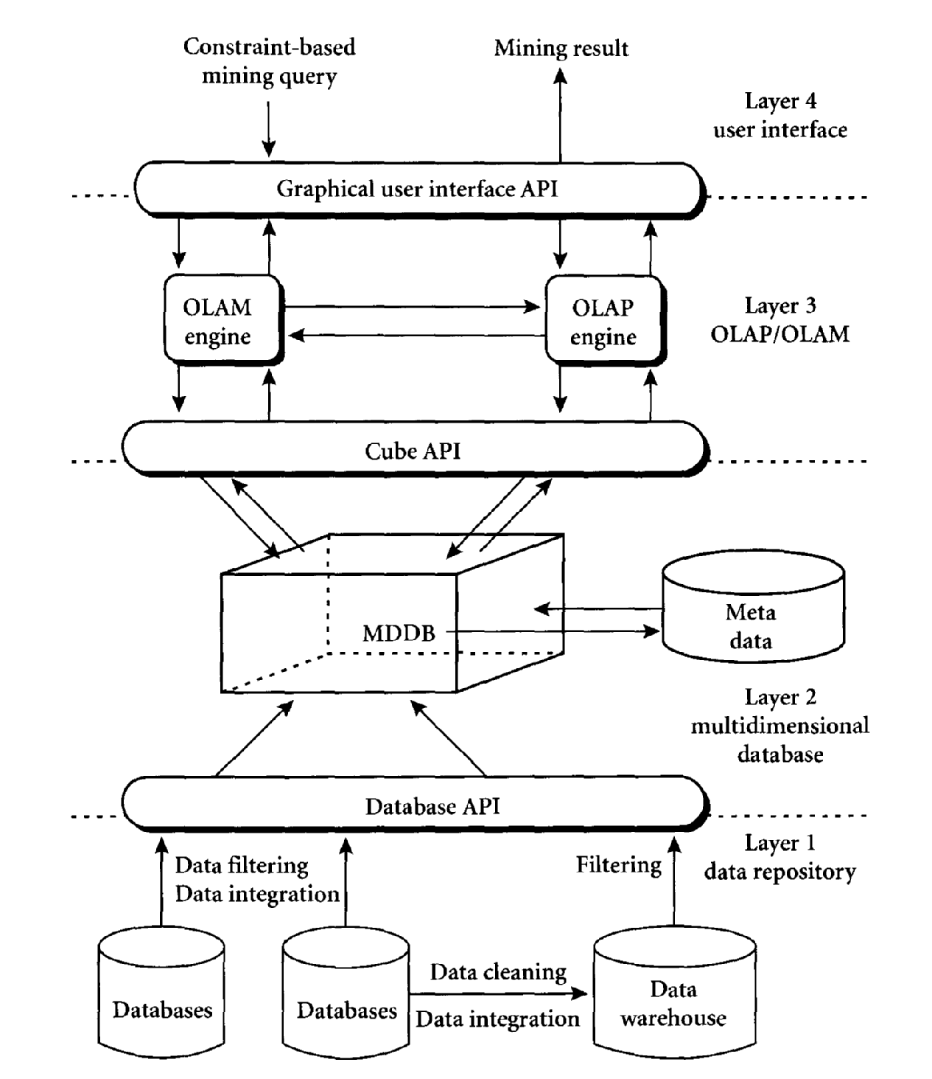
Architecture for OLAM

Slide 35
Data Warehouse of Newsgroups
(DaWN)
H. Gupta and D. Srivastava.
hgupta@db.stanford.edu, divesh@research.att.com
International Conference on Database Theory, Jerusalem, Israel, January 1999
References: http://www-db.stanford.edu/~hgupta/ps/dawn.ps
http://www-db.stanford.edu/warehousing/index.html

Slide 36
Introduction
Existing Model of Newsgroups
DaWN
Architecture
Newsgroups as views
Challenges

Slide 37
Existing Model of Newsgroup
The Author of the article is responsible to select the newsgroups to which an article belongs.
Problems:
Articles are often cross posted to irrelevant groups.
Articles may be missing for potentially relevant reader.
This situation will manifest as number of newsgroup increases.

Slide 38


Existing Model of newsgroup
algorithm
comp.lang.c
comp.lang.c++
comp.lang.perl
comp.os.linux
Flame wars / Irrelevant information
No Match

Slide 39
DaWN Model
Author of an article “posts” the article to the newsgroup management system.
All articles are stored in article store
Each newsgroup is modeled as a view over set of all articles posted to newsgroup management system.
It is the responsibility of the system to determine all the newsgroups into which a news article must be inserted

Slide 40
DaWN model
algorithm
Newsgroup Management System
comp.lang.c
comp.lang.c++
comp.lang.perl
comp.os.linux
Newsgroup as views

Slide 41
DaWN Architecture
Article Store: The Information Store
Stores all articles and each article is identified by attributes.
Attributes:
E.g. From, Organization, Date, Subject, Body
(defined as d = A₁, A₂………….A_{d} )
Newsgroup articles:
Header – Keyword (Attribute Name)/Values corresponding to attributes
Body – Unstructured Data (Attribute Body)
Indexes can be built over the article attributes. Article Store along with Index structures is the information source of the data warehouse.

Slide 42
DaWN Architecture (cont)
Newsgroup Views
Newsgroups are defined as views over the set of all articles stored in Article Store. The Articles in newsgroups are determined automatically by DaWN based on newsgroup definitions.
Atomic Conditions are the basis of newsgroup definitions are of form
  attribute similar-to typical-article-body with threshold threshold-value
  attribute contains value
  attribute {<, > ,=, ≤, ≥, ≠} value
Given an article attribute A_{i}, an attribute selection condition on A_{i} is a boolean expression of atomic conditions on A_{i}

Slide 43
DaWN Architecture (cont)
Newsgroup-view definition is a conjunction of attribute selection conditions on the article attributes. Newsgroup V is defined using selection conditions of the form
Λ _{j€I} (f_{j} (A_{j}) )
I is {1, 2,……d}, know as the index set of newsgroup
f_{j} (A_{j}) is an attribute selection condition on attribute A_{j}
Expected size of index set |I| could be small compared to attributes of articles.

Slide 44
DaWN Architecture (cont)
Design Decisions
DaWN allows users to request in any specific newsgroup and this request is referred to as a newsgroup query
Newsgroup Management System may decide to eagerly maintain (materialize) some of the newsgroups.
Selection of materialized views to be stored at the warehouse
Efficient Incremental maintenance of the materialized views.

Slide 45
Newsgroup as Views
Examples of newsgroup-view definition
att.sale
(Λ (Date ≥ 1 Jan 1998) (Organization = AT&T) (Subject contains Sale))
soc.culture.indian
(Λ (Date ≥ 1 Jan 1998) ( V (Body similar-to B₁ with-threshold T₁)…..(Body similar-to B₁₀₀ with-threshold T₁₀₀) ) )
where Bi are bodies of typical-articles that are representatives of the newsgroup. Ti are cosine similarity match* threshold values.
*G. Salton and C. Buckley. Term-weighting approaches in automatic text retrieval

Slide 46
Challenges
Newsgroup-maintenance problem
New articles must be efficiently inserted into appropriate large number of newsgroups
Solution is by Independent Search Tree Algorithm using the fact that there are relatively few attributes associated with article. Each newsgroup is represented as rectangular region in space and article as a point. Computation is of article belonging to newsgroup is modeled as a point on space problem.
Newsgroup-selection problem
Which views should be eager (materialized) and which should be lazy (computed on fly)
Modeled as graph problem with user queries and newsgroups to select the most frequently accessed newsgroup.
Reference : References of Paper describes possible approaches to address the problem

Slide 47
Other Possible Applications
Warehouse of scientific articles
Legal resolutions
Corporate email repositories

Slide 48
Oracle Discoverer
References:
http://www.otn.oracle.com
http://www.oracle.com/pls/cis/Profiles.print_html?p_profile_id=2315

Slide 49
Oracle Discoverer
What is Oracle Discoverer?
Oracle Discoverer is an intuitive ad-hoc query, reporting, analysis, and Web publishing toolset that gives business users immediate access to information in databases.
ad-hoc query: The users don’t need to know SQL
Reporting: Well formatted reports and graphs can be generated and exported to different file formats.
E.g.: excel, pdf, html, txt etc
Analysis: Perform Drill-up, drill-down and other complex calculations on your data measures
Web Publishing: Provides interfaces to publish your reports into the web portlets.
Can work with Relational as well as Multi-dimensional (OLAP) data sources.
Note: This is not a data warehousing tool. It is data analysis and reporting tool.
http://download-east.oracle.com/docs/html/B13915_04/intro_to_disc.htm

Slide 50
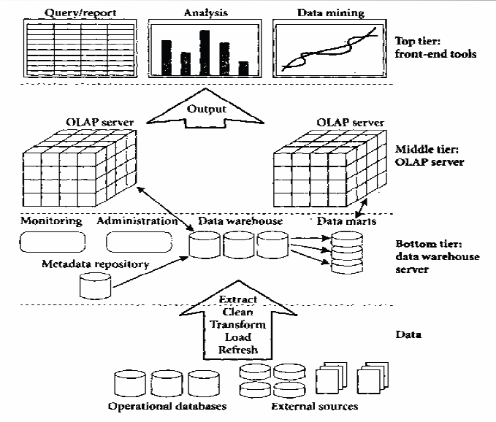
Where does Discoverer fit into our scheme of things?
Discoverer Clients
(Plus/Viewer)
Discoverer Server
OLAP and Relational
Data Base server
Warehouse Builder
ETL Tools

Slide 51
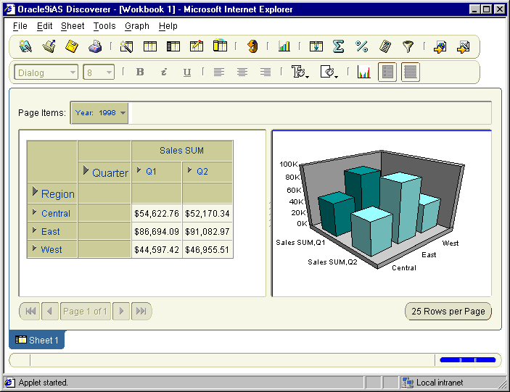

Discoverer Architecture
Data Warehouse
Manage EUL
Administrator
Oracle RDBMS
End User Layer
Application
Server
Viewer
Discoverer
server
Meta Data
OLAP
Plus Relational
catalogue
Plus OLAP

Slide 52
Some terminologies
Business Area
A business area is a collection of related information in the database. The Discoverer administrator works with the different departments in your organization to identify the information that each department requires from the database.
Folders
A folder is a collection of closely related information with in a business area. Typically a folder maps to a table in the database
Items
Items are different types of information within a folder. The items in a folder maps to the columns (attributes) of the table in the database.
Workbook
Collection of discoverer sheets. A work sheet is analogous to a page in excel.

Slide 53
What is a typical workflow with Oracle Discoverer?
Classify the data based on the business needs.
Create Business Areas.
Map data tables to your folders
Create concept hierarchies if there are any
Create Discoverer work books
Share among the different users (Users are generally Data Analysts, Business heads and Decision Makers)

Slide 54
Sample Example
Company A: Manages a chain of video stores
Sells and Rents out Video CDs
Outlets in various cities.
Data Available:
Transaction data from all the stores under the company.
Requirement:
Generate a report of revenues/profits for the video sales and rentals from all the stores under the company.
Ability to perform analysis over this report
Generate graphs to capture trends in the business

Slide 55
Sales fact
table
TIME_KEY
PRODUCT_KEY
STORE_KEY
SALES
UNIT_SALES
COST
CUSTOMER_COUNT
PROFIT
Product table
Time table
PRODUCT_KEY
DESCRIPTION
PRODUCT_TYPE
BRAND
PRODUCT_CATEGORY
AGE_CATEGORY
DEPARTMENT
TIME_KEY
TRANSACTION_DATE
DAY_OF_WEEK
Store table
STORE_KEY
STORE_NAME
CITY
REGION
REPORTS

Slide 56
Demo
How a business area is created
Defining a hierarchy
Data Analysis by drill down/drill-up
Graph generation
Exceptions

Slide 57

Real world example
Company Name: Henkel Consumer Adhesives
Annual Revenue: $500M
Key Benefits
Reduced infrastructure costs by $1 million and reduced IT costs by $200,000
Saved $150,000 in consulting fees by using in-house resources
Achieved ROI in little over an year
http://www.oracle.com/pls/cis/Profiles.print_html?p_profile_id=2315

Slide 58
Thank You!

