Slide 1
SESSION 01
Today's Agenda
Introduction
to Tableau
Meet your TA
What is Tableau & where is it used?
Download Tableau Public (live!)
What it looks like after install
Connect your first dataset
See it. Drag it. Understand it.
Data Warehousing & BI
Data Warehousing & Business Intelligence

Slide 2

MEET YOUR TA
Session 01
A little about me
🌏
Background
Originally from India, now building in the Bay!
💼
Experience
Former Area Manager at ICICI Prudential · Data Analyst Intern at Box
🤖
Currently
Product Manager @ NorthStar SP, building Saas platform for SMBs
🎓
Education
Mohini Yadav
MSIS @ Santa Clara University
🧘
Fun fact
in linkedin.com/in/mohini-yadav13
200-hr certified yoga instructor who runs on chai ☕
Tableau TA
MSIS @ SCU '26
PM @ NorthStar
Data Warehousing & BI · Tableau Session 01

Slide 3
WHAT IS TABLEAU?
Session 01
What is Tableau?
Owned by Salesforce
Tableau is a visual analytics platform that helps people see and understand their data — without writing code. Drag. Drop. Discover.
Used in 50,000+ companies
Connects to 90+ data sources
Free for students via Tableau Public
Where is Tableau used?
🏥 Healthcare
💰 Finance
🛒 Retail
🏭 Operations
Patient analytics, bed utilization
Revenue dashboards, risk analysis
Sales trends, inventory tracking
Supply chain, KPI monitoring
Data Warehousing & BI · Tableau Session 01

Slide 4
WHY DO BUSINESSES NEED TABLEAU?
Session 01
The problem: Companies have mountains of data but struggle to make sense of it fast enough to act.
🐢
Data is too slow
🤯
Too complex to read
🔗
Data lives everywhere
Analysts spend days in Excel cleaning data. Tableau connects live and refreshes instantly.
Raw numbers in spreadsheets mean nothing to a CEO. Tableau turns them into visual stories.
Sales in one system, HR in another. Tableau pulls it all into one unified view.
🎯
Decisions need speed
👥
Everyone needs access
📉
Mistakes cost money
Markets move fast. Leaders need answers in seconds, not week-old static reports.
Not just analysts. Tableau lets any team member explore data without coding.
Bad data decisions = lost revenue. Tableau makes patterns visible before they become problems.
💡 Bottom line: Tableau exists because good data, poorly communicated, is still bad data.
Data Warehousing & BI · Tableau Session 01

Slide 5
HOW TO DOWNLOAD TABLEAU
Session 01
Which version should you use?
Tableau Public
Tableau Desktop
✔ Free forever ✔ Perfect for learning & portfolio ✔ Publish to the web ⚠ Work is publicly visible
✔ Full-featured ✔ Free 1-year student license ✔ Private workbooks ⚠ Requires student email
👉 For this course: Download Tableau Public — it's free, instant, and has everything we need!
Step-by-Step: Download Tableau Public
1
Go to public.tableau.com in your browser
2
Click Sign In → Create a free account with your email
3
Once logged in, click Download Tableau Desktop Public Edition
4
Run the installer (Mac: .dmg | Windows: .exe) and follow the prompts
5
Open Tableau Public → Sign in → You're ready!
Data Warehousing & BI · Tableau Session 01

Slide 6
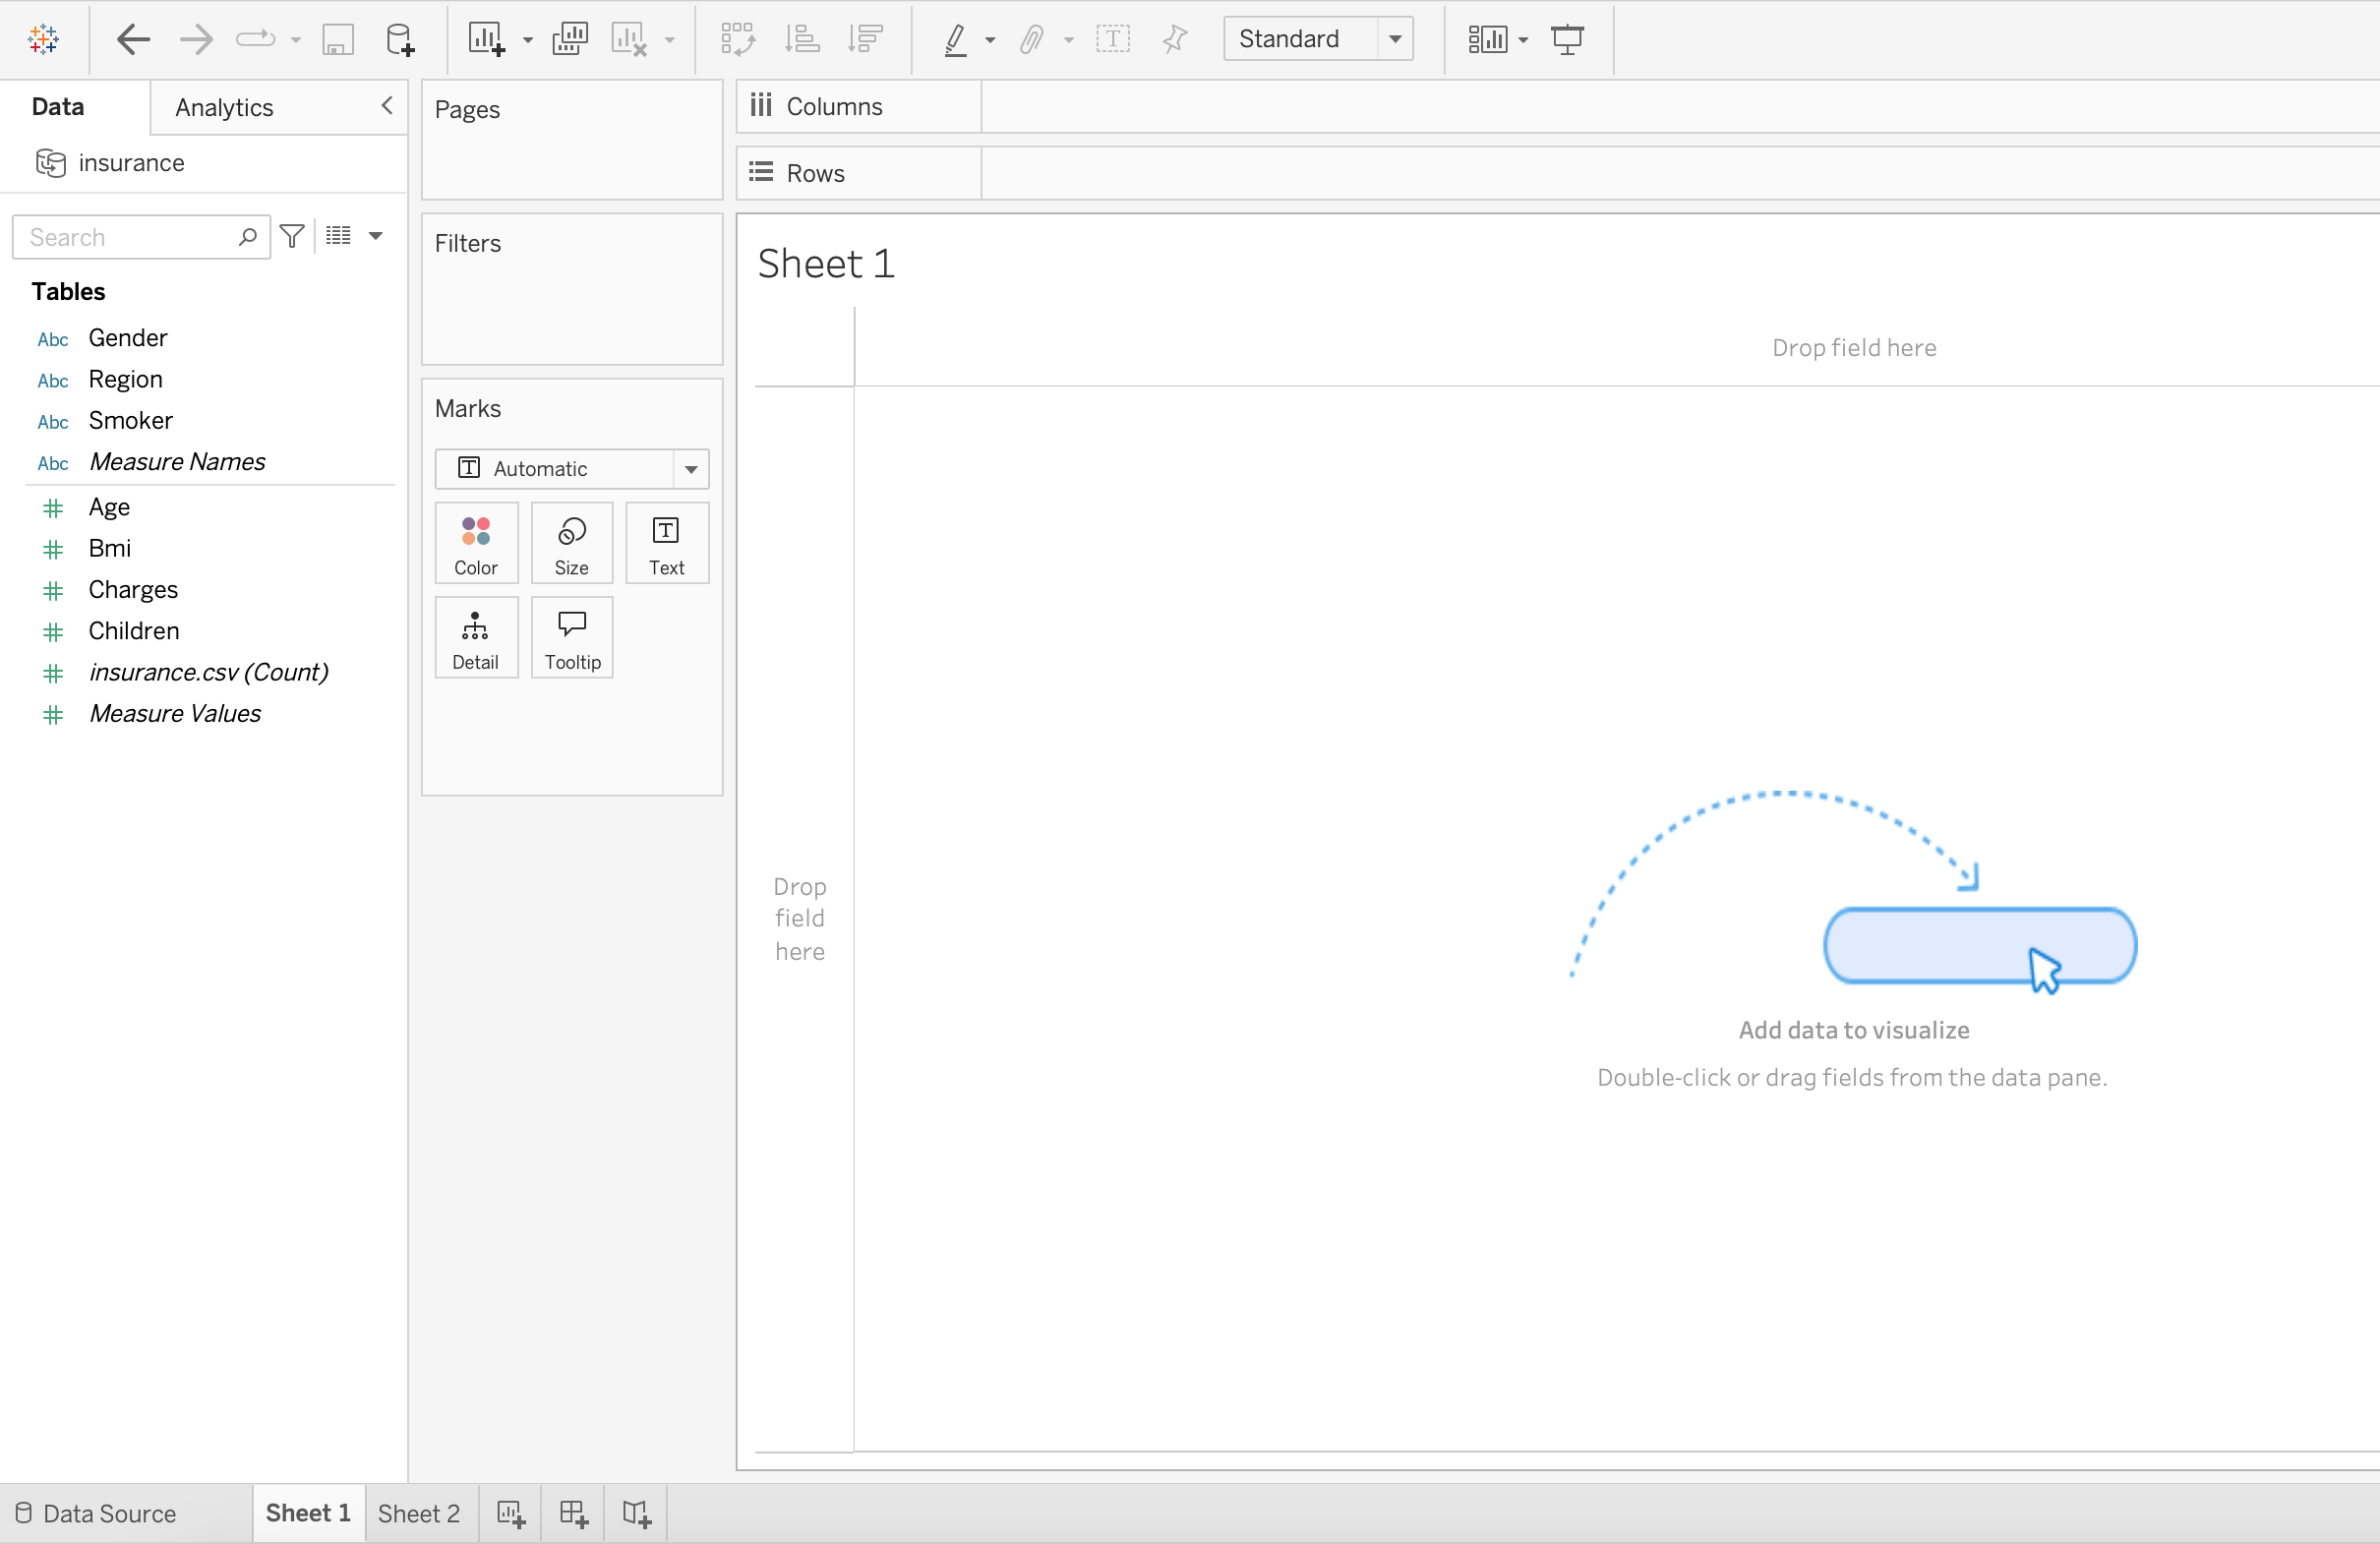
AFTER INSTALL — THE TABLEAU WORKSPACE
Session 01
The Start Page (what you see first)
Connecting Your First Dataset
Tableau Public — Start Page
insurance.csv — 1,338 rows x 7 columns
Open / Recent
# age
Aa gender
# bmi
# children
Aa smoker
Aa region
# charges
1
Click Text File in the Connect panel
Navigate to your downloaded insurance.csv and open it
2
Data Source tab opens automatically
You'll see a live preview of your data — all 1,338 rows!
3
Check column types
Blue # = numbers (measures) · Green Aa = text (dimensions)
4
Click Sheet 1 at the bottom
This takes you to the worksheet — your analysis canvas
5
Explore the Data pane on the left
All 7 fields appear here, ready to drag and drop next session!
Data Warehousing & BI · Tableau Session 01

