Slide 1
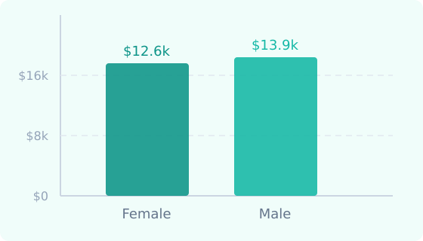
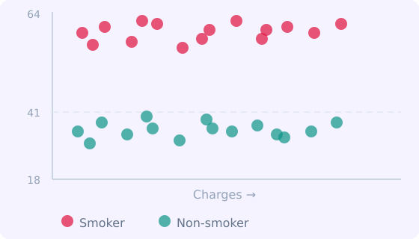
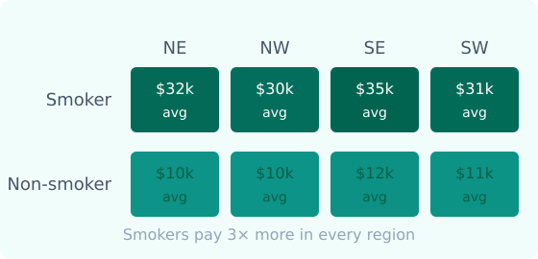
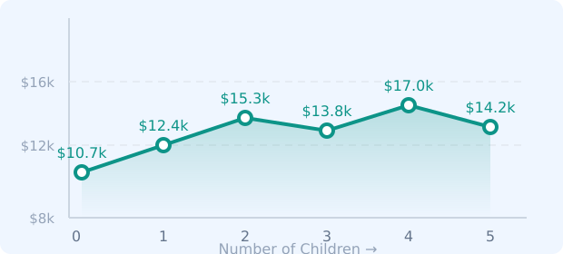
SESSION 02
Chart A — Bar
Chart B — Scatter
In-Class
Practice
4 Charts → 1 Dashboard
Chart C — Heat Map
Chart D — Line
Build each chart in class. Then combine them into a live, interactive dashboard.
📂 Dataset: insurance.csv
🛠️ Tool: Tableau Public
📊 4 worksheets + 1 dashboard
→ Then combine all 4 into a Dashboard
Data Warehousing & Business Intelligence · TTh 05:40 PM · SCU

Slide 2
CHART A — BAR: AVG CHARGES BY GENDER
Session 02
Business question: Do male and female patients pay different average insurance premiums?
Step-by-step
What it should look like
1
COLUMNS →
Abc Gender
2
ROWS →
# Charges
3
Right-click Charges on Rows →
Measure → Average
4
Click Sort Descending icon on the Y axis
5
Double-click title → Rename to:
"Average Insurance Charges by Gender"
What does this tell us?
Male patients pay slightly more on average ($13.9K vs $12.6K). This could reflect differences in BMI, smoking rates, or age distribution between genders.
Data Warehousing & BI · Tableau Session 02 · In-Class Practice

Slide 3
CHART B — SCATTER: AGE vs CHARGES
Session 02
Business question: Do older patients pay more? Does smoking change that relationship at every age?
Step-by-step
What it should look like
1
COLUMNS →
# Age
2
ROWS →
# Charges
3
Analysis menu →
Uncheck Aggregate Measures
4
Drag Smoker → Color (Marks card)
5
Right-click Age on Columns → Dimension
"Age vs Insurance Charges by Smoker Status"
⚠️ If you see 2 dots only → Analysis → uncheck Aggregate Measures
What does this tell us?
Both groups pay more as they age — but smokers pay dramatically more at every age. The two clusters are unmissable even without reading any numbers.
Data Warehousing & BI · Tableau Session 02 · In-Class Practice

Slide 4
CHART C — HEAT MAP: SMOKER STATUS vs REGION
Session 02
Business question: In which region do smokers pay the most? How much more than non-smokers in the same region?
Step-by-step
What it should look like
1
COLUMNS →
Abc Region
2
ROWS →
Abc Smoker
3
Drag to COLOR (Marks) →
# Charges
right-click → Measure → Average
4
Drag to LABEL (Marks) →
# Charges
right-click → Measure → Average
"Avg Insurance Charges: Smoker Status vs Region"
⚠️ Drag Charges TWICE — once to Color, once to Label. Two separate drops.
What does this tell us?
Smokers in the Southeast pay the most ($35.2K avg). Non-smokers pay ~3x less in every region. Color makes this comparison instant.
Data Warehousing & BI · Tableau Session 02 · In-Class Practice

Slide 5
CHART D — LINE: AVG CHARGES BY NUMBER OF CHILDREN
Session 02
Business question: Does having more dependents drive up insurance costs? Is the trend consistent or does it plateau?
Step-by-step
What it should look like
1
COLUMNS →
# Children
2
ROWS →
# Charges
3
Right-click Charges on Rows →
Measure → Average
4
Right-click Children on Columns → Dimension
5
In Show Me → click Line Chart if not auto-selected
"Average Insurance Charges by Number of Children"
⚠️ If Tableau shows a bar chart, click Show Me and select the Line Chart icon.
What does this tell us?
Patients with 2 children pay the most on average ($15.3K) while those with 4 children actually have the highest spike ($17K). Not a simple linear trend.
Data Warehousing & BI · Tableau Session 02 · In-Class Practice

Slide 6
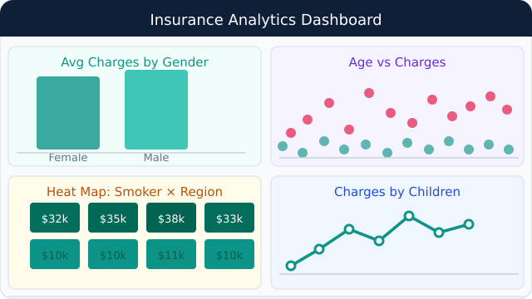
COMBINING IT ALL — YOUR FIRST DASHBOARD
Session 02
Now put all 4 worksheets on one screen — and make them talk to each other.
How to build it
What it should look like
1
Click the grid icon at the bottom → New Dashboard
2
Drag Chart A onto the canvas
3
Drag Chart B next to it
4
Drag Chart C below Chart A
5
Drag Chart D below Chart B
6
Click Chart A → hover → click Use as Filter (funnel icon)
7
Add a Region filter: Dashboard menu → Filters → Region
8
Add a title text box: type "Insurance Analytics Dashboard"
9
Test it: click a bar in Chart A — all others should update
💡 Click a bar in Chart A — watch all other charts filter automatically. That's the power of a dashboard.
Data Warehousing & BI · Tableau Session 02 · In-Class Practice

Slide 7
YOUR ASSIGNMENT — SAME SKILLS, DIFFERENT COMBINATIONS
Session 02
Same dataset. Same Tableau skills. Different business questions — using different columns and chart types.
In-Class Practice ✏️
Assignment 2 📝
Chart 1
Bar — Avg Charges by Gender
Bar — Avg Charges by Region + Smoker (color + label)
→ different
Chart 2
Scatter — Age vs Charges (color=Smoker)
Scatter — BMI vs Charges (color=Smoker)
→ different
Chart 3
Heat Map — Smoker vs Region
Heat Map — Region vs Gender
→ different
Chart 4
Line — Avg Charges by Children
Line — Avg Charges by Age (color=Smoker)
→ different
Final
Dashboard (Charts A+B+C+D)
Dashboard (all 4 + Region filter)
💡 The steps are identical — just different fields. If you can build today's charts, you can build the assignment. Due before Session 4.
Data Warehousing & BI · Tableau Session 02 · In-Class Practice

