Slide 1
SESSION AGENDA
SESSION 04
01
Filters
From Charts
to Insights
Dimension filters, measure filters, and quick filters visible on dashboards
02
Calculated Fields
Filters | Calculated Fields | Advanced Dashboards
IF/THEN logic and ELSEIF bucketing to create new columns from your data
Filters — dimension, measure & quick filters
Calculated Fields — IF/THEN logic & bucketing
Highlight Actions & dashboard polish
03
Advanced Dashboard
Build it all together — live in class
Highlight actions, multiple filters, and professional layout polish
Data Warehousing & Business Intelligence
30 min | insurance.csv | Tableau Public

Slide 2
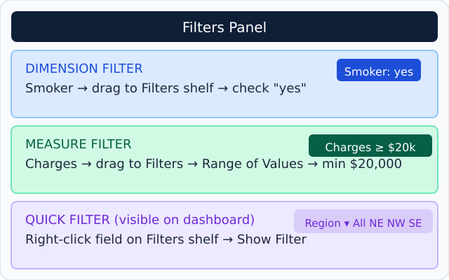
FILTERS — CONTROLLING WHAT YOUR CHART SHOWS
Session 04
Filters let you focus on a specific slice of data. They can live on a worksheet or be visible on a dashboard for users to control.
3 types you need to know
How it looks in Tableau
Dimension Filter
e.g. Show only smokers
or only one region
→ Drag field to Filters shelf → check/uncheck values
Measure Filter
e.g. Show only charges
over $20,000
→ Drag Charges to Filters → Range of Values → set min
Quick Filter
e.g. Visible dropdown on
the dashboard
→ Right-click field on Filters shelf → Show Filter
⚠️ Filters on a dashboard affect only that worksheet — unless you use Dashboard → Actions → Filter to link them all.
Data Warehousing & BI · Tableau Session 04 · insurance.csv

Slide 3
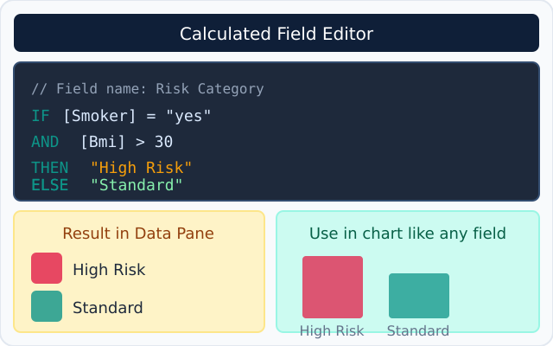
CALCULATED FIELDS — MAKING TABLEAU THINK FOR YOU
Session 04
A calculated field creates a brand new column from logic you write. It lives in your Data Pane like any other field — drag it, color it, filter it.
How to create one
Example: Risk Category field
1
Analysis menu → Create Calculated Field
2
Give it a name — e.g. Risk Category
3
Write your IF/THEN formula (see right)
4
Click OK → it appears in your Data Pane
5
Drag it to Columns, Color, or Rows — just like any field
The formula auto-validates. A green tick = correct. A red X = check your spelling or brackets.
Why this matters
You just created a field that doesn't exist in the raw data. Tableau calculated it from your logic. This is the bridge between raw data.
Data Warehousing & BI · Tableau Session 04 · insurance.csv

Slide 4
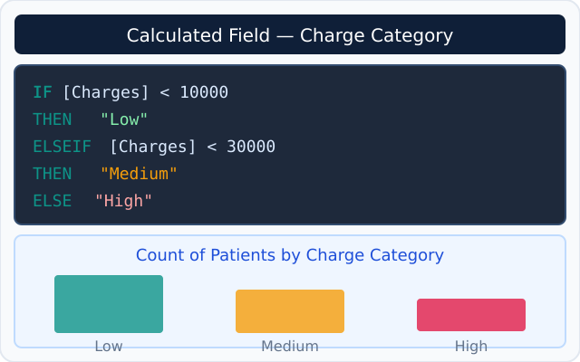
CALCULATED FIELDS — BUCKETING WITH ELSEIF
Session 04
ELSEIF lets you create multiple buckets from one numeric field — perfect for turning raw charges into business-friendly categories.
Formula: Charge Category
What you can build with it
IF
[Charges] < 10000
THEN
"Low"
ELSEIF
[Charges] < 30000
THEN
"Medium"
ELSE
"High"
END
The bucketing rules
Low
Medium
High
< $10,000
$10,000 – $30,000
> $30,000
Try it yourself
Create the Charge Category field, then drag it to Columns and count patients in each bucket. Which category has the most patients?
Data Warehousing & BI · Tableau Session 04 · insurance.csv

Slide 5
ADVANCED DASHBOARD — ACTIONS & POLISH
Session 04
You built a dashboard in Session 3. Now let's make it smarter — with highlight actions, better filters, and professional layout polish.
Level up your dashboard
How to do each one
Highlight Action
Highlight Action
Hover over a bar — related data glows in other charts
Dashboard menu → Actions → Add Action → Highlight
→ Dashboard menu → Actions → Add Action → Highlight
Source: any sheet Target: all sheets
Run on: Hover → click OK
Test: hover over a bar — others glow
Multiple Quick Filters
Multiple Quick Filters
Add Region, Smoker, and Risk Category dropdowns
Right-click Smoker on Filters shelf → Show Filter
→ Each filter: right-click on Filters shelf → Show Filter
Repeat for Region field
Both dropdowns appear on canvas
Drag them to dashboard — done
🎨 Layout Polish
Titles, dividers, padding, font sizes — it should look like a product
Layout Polish
→ Dashboard → Format → Shading, Borders, Fonts
Dashboard → Format → set background color
Add a Text object for the dashboard title
Resize charts by dragging their borders
⚠️ Filter Action vs Highlight Action — Filter removes non-matching data. Highlight dims it but keeps it visible. Both are powerful, use both!
Format → Font to standardize text size
Data Warehousing & BI · Tableau Session 04 · insurance.csv

Slide 6
HANDS-ON — BUILD IT ALL IN 30 MINUTES
Session 04
Open Tableau Public → insurance.csv is already connected. Follow the steps below in order.
Part 1 — Filters (8 min)
Part 3 — Advanced Dashboard (10 min)
1
Open Sheet 1 (bar chart) → drag Smoker to Filters shelf
1
Open your Session 3 dashboard
2
Keep both yes/no for now → Right-click → Show Filter
2
Dashboard menu → Actions → Add → Highlight
3
Add a Region filter → Show Filter on dashboard
3
Set: Source = any sheet · Target = all sheets
Part 2 — Calculated Fields (12 min)
4
Add Risk Category chart to the dashboard
1
Analysis → Create Calculated Field → name: Risk Category
5
Format → add a title at the top: Insurance Risk Dashboard
2
Type the IF [Smoker]="yes" AND [Bmi]>30 THEN formula
Test: hover over a bar — watch other charts highlight
6
3
Open new sheet → drag Risk Category to Columns
4
Drag Charges to Rows → change to Average → add to dashboard
By the end of this session your dashboard has: Filters · Calculated Field · Highlight Action · Multiple chart types. That is a real BI dashboard.
Data Warehousing & BI · Tableau Session 04 · insurance.csv

Slide 7
WHAT'S COMING IN SESSION 5
Session 04
You've now built real BI dashboards. Session 5 introduces Parameters — the most powerful feature in Tableau.
Quick recap — what we covered today
Filters
Calculated Fields
Advanced Dashboard
Dimension, Measure and Quick Filters on dashboard
IF/THEN logic + ELSEIF bucketing to create new data
Highlight actions, multiple filters, layout polish
Session 5 — Parameters
What is a Parameter?
Parameter + Calculated Field
Dynamic Chart Titles
A user-controlled variable — like a slider or dropdown that changes the chart logic in real time
Combine them so the user sets their own BMI threshold and the Risk Category updates instantly
Chart title changes automatically based on what the user selects — makes it feel like a real app
Assignment 3 will be posted after Session 5 — same insurance.csv, using your new calculated fields and filters.
Data Warehousing & BI · Tableau Session 04 · insurance.csv

