Slide 1
What are the steps for designing a Star Schema in a Data Warehouse? Source: LinkedIn
Mahmoud Parsian
Ph.D. in Computer Science

Slide 2
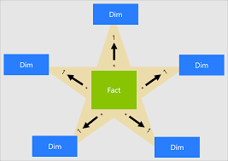
What is a Star Schema?

Slide 3
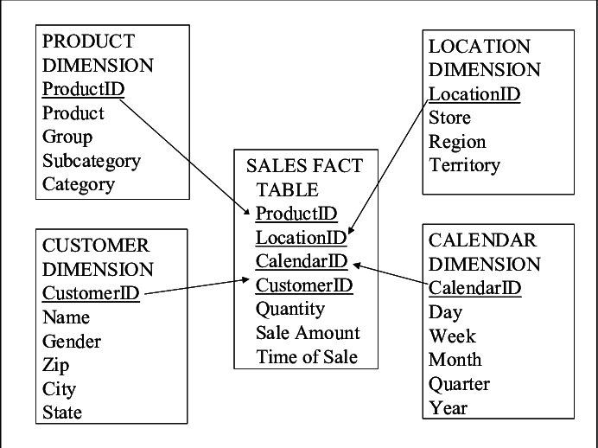
Star Schema Example

Slide 4
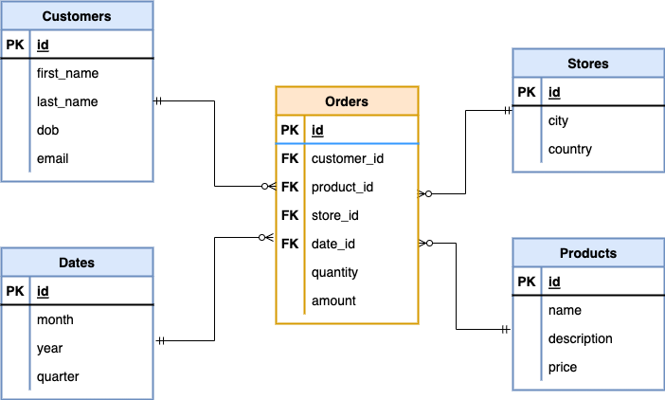
Star Schema Example

Slide 5
What are the steps for designing a star schema in a data warehouse?
1 Identify the business requirements
2 Define the fact table
3 Define the dimension tables
4 Apply the design principles
5 Validate and test the star schema
6 Here’s what else to consider…

Slide 6
1. Identify the business requirements
1. The first step is to understand the business requirements and
goals of the data warehouse.
2. What are the key performance indicators (KPIs) that the business wants to measure and analyze?
3. What are the dimensions and hierarchies that the business uses to slice and dice the data?
4. What are the sources and formats of the data that need to be integrated and transformed?
By answering these questions, you can define the scope and purpose of the star schema.

Slide 7
1. Identify the business requirements The key performance indicators (KPIs)
Key Performance Indicators (KPIs) in data warehouse design help measure the effectiveness, efficiency, and overall success of the data warehouse in delivering valuable insights to an organization. Here are some important KPIs to consider:
Data Load Time: Measures how quickly data is extracted, transformed, and loaded (ETL) into the data warehouse.
Query Performance: Assesses how fast queries return results to users.
Data Quality Metrics: Tracks data accuracy, completeness, consistency, and timeliness.
Storage Utilization: Monitors how efficiently storage space is used.
User Adoption Rate: Evaluates how frequently business users leverage the data warehouse for decision-making.
System Availability/Uptime: Ensures the data warehouse has minimal downtime and remains accessible.
Data Latency: Measures the delay between data generation and its availability in reports.

Slide 8
1. Identify the business requirements EXAMPLE: the key performance indicators (KPIs)
Imagine a retail company using a data warehouse to track sales performance.
One KPI they could implement is
"Query Performance: Average Query Response Time."
If their reports on daily sales trends take more than 5 seconds to execute, they might optimize indexing or restructure queries to improve efficiency..

Slide 9
1. Identify the business requirements
Identify Business Requirements
Understand the business needs and reporting requirements to determine what data will be stored in the data warehouse.
Information requirements define the information needs of the company. They describe the information and data, which the data. warehouse should deliver or should have access to. They specify the
provided data,
by what quality it should have,
where it comes.

Slide 10
2. Define the FACT Table
The next step is to define the fact table, which is the core of the star schema.
The fact table should contain the numeric measures that are relevant to the business requirements, such as sales, revenue, profit, or customer satisfaction.
The fact table should also have foreign keys that link to the dimension tables, which provide the context for the measures.
The fact table should have a high level of granularity, meaning that it should store the most detailed and atomic data possible.

Slide 11
2. Define the FACT Table
Select Dimensions and Facts:
Identify dimensions (descriptive attributes) and
Facts (measurable metrics) that are essential for reporting and analysis.

Slide 12
3. Define the Dimension tables
1. The third step is to define the dimension tables, which are the spokes of the star schema.
2. The dimension tables should contain the descriptive attributes that characterize the facts, such as product, customer, location, time, or channel.
3. The dimension tables should have primary keys that match the foreign keys in the fact table,
4. ..

Slide 13
3. Define the Dimension tables
4. The dimension tables should have descriptive names and labels for the attributes.
5. The dimension tables should also have a low level of granularity, meaning that they should store the most aggregated and summarized data possible..

Slide 14
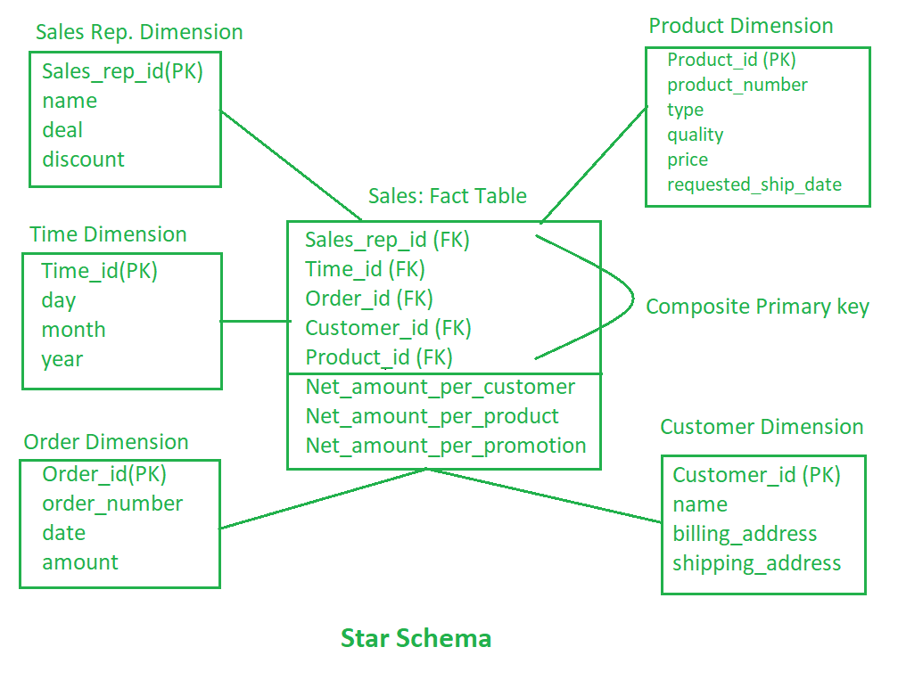
Star Schema Example

Slide 15
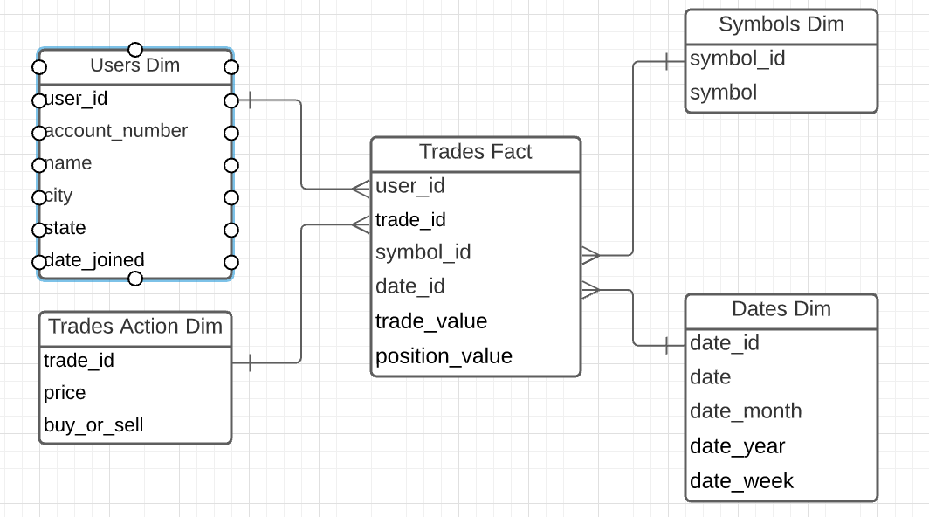
Star Schema Example

Slide 16
4. Apply the design principles
1. The fourth step is to apply the design principles that can optimize the star schema for performance and usability.
2. Surrogate keys should be used instead of natural keys for primary and foreign keys to avoid data inconsistencies and improve query speed.
3. Additionally, null values should be avoided and default values or flags should be used for missing or unknown data to ensure data quality and accuracy.
4. …

Slide 17
4. Apply the design principles
4. Consistent naming conventions and data types should be used for tables and columns to facilitate data integration and documentation.
5. Furthermore, dimension tables should be normalized and the fact table should be denormalized to reduce data redundancy and improve query efficiency.
6. Lastly, indexes, partitions, and compression techniques should be implemented to enhance data access and storage.

Slide 18
Surrogate keys
Surrogate keys are a game-changer in star schema design, as they prevent the pitfalls of using natural keys that can change over time, leading to data discrepancies.
By using surrogate keys, we ensure a stable and consistent key structure that significantly speeds up query performance, especially in large-scale data warehouse environments.

Slide 19
5. Validate and Test the Star Schema
The final step is to validate and test the star schema, to ensure that it meets the business requirements and expectations.
You can use various methods to do so, such as loading sample data from the source systems and verifying that the data is correctly transformed and loaded into the star schema.
Additionally, you should perform data quality checks and resolve any data issues or errors.
Sample queries and reports should be run and compared with the expected outcomes, while feedback from end users and stakeholders should be sought out and incorporated into the star schema.

Slide 20
6. Here’s what else to consider
This is a space to share examples, stories, or insights that don’t fit into any of the previous sections. What else would you like to add?
Creating a successful star schema isn't just about how it looks; it's about how it adapts and grows over time.
Knowing the quirks of where your data comes from is crucial; anomalies in the data can provide valuable insights, but they can also trip you up if you're not careful.

