Slide 1
MySQL Tutorial
Introduction to Database

Slide 2
Introduction of MySQL
MySQL is an SQL (Structured Query Language) based relational database management system (DBMS)
MySQL is compatible with standard SQL
MySQL is frequently used by PHP and Perl
Commercial version of MySQL is also provided (including technical support)

Slide 3
Resource
MySQL and GUI Client can be downloaded from
http://dev.mysql.com/downloads/
The SQL script for creating database ‘bank’ can be found at
http://www.cs.kent.edu/~mabuata/DB10_lab/bank_db.sql
http://www.cs.kent.edu/~mabuata/DB10_lab/bank_data.sql

Slide 4
Command for accessing MySQL
Access from DB server
>ssh dbdev.cs.kent.edu
Start MySQL
>mysql –u [username] –p
>Enter password:[password]
From a departmental machine
>mysql -u [username] -h dbdev.cs.kent.edu –p
>Enter password:[password]

Slide 5
Entering & Editing commands
Prompt mysql>
issue a command
Mysql sends it to the server for execution
displays the results
prints another mysql>
a command could span multiple lines
A command normally consists of SQL statement followed by a semicolon

Slide 6
Command prompt
prompt | meaning
mysql> | Ready for new command.
-> | Waiting for next line of multiple-line command.
‘> | Waiting for next line, waiting for completion of a string that began with a single quote (“'”).
“> | Waiting for next line, waiting for completion of a string that began with a double quote (“"”).
`> | Waiting for next line, waiting for completion of an identifier that began with a backtick (“`”).
/*> | Waiting for next line, waiting for completion of a comment that began with /*.

Slide 7
MySQL commands
help \h
Quit/exit \q
Cancel the command \c
Change database use
…etc

Slide 8
Info about databases and tables
Listing the databases on the MySQL server host
>show databases;
Access/change database
>Use [database_name]
Showing the current selected database
> select database();
Showing tables in the current database
>show tables;
Showing the structure of a table
> describe [table_name];

Slide 9
Banking Example
branch (branch-name, branch-city, assets)
customer (customer-name, customer-street, customer-city)
account (account-number, branch-name, balance)
loan (loan-number, branch-name, amount)
depositor (customer-name, account-number)
borrower (customer-name, loan-number)
employee (employee-name, branch-name, salary)

Slide 10
CREATE DATABASE
An SQL relation is defined using the CREATE DATABASE command:
create database [database name]
Example
create database mydatabase

Slide 11
SQL Script for creating tables
The SQL script for creating database ‘bank’ can be found at
http://www.cs.kent.edu/~mabuata/DB10_lab/bank_db.sql
http://www.cs.kent.edu/~mabuata/DB10_lab/bank_data.sql
Notice: we do not have permission to create database, so you have to type command “use [your_account]” to work on your database.

Slide 12
Query
To find all loan number for loans made at the Perryridge branch with loan amounts greater than $1100.
select loan_number from loan where branch_name = ‘Perryridge’ and amount>1100;
Find the loan number of those loans with loan amounts between $1,000 and $1,500 (that is, ≥$1,000 and ≤$1,500)
select loan_number from loan where amount between 1000 and 1500;

Slide 13
Query
Find the names of all branches that have greater assets than some branch located in Brooklyn.
select distinct T.branch_name
from branch as T, branch as S where T.assets > S.assets and S.branch_city = ‘Brooklyn’;
Find the customer names and their loan numbers for all customers having a loan at some branch.
select customer_name, T.loan_number, S.amount from borrower as T, loan as S where T.loan_number = S.loan_number;

Slide 14
Set Operation
Find all customers who have a loan, an account, or both:
(select customer_name from depositor) union (select customer_name from borrower);
Find all customers who have an account but no loan.
(no minus operator provided in mysql)
select customer_name from depositor
where customer_name not in (select customer_name from borrower);

Slide 15
Aggregate function
Find the number of depositors for each branch.
select branch_name, count (distinct customer_name) from depositor, account where depositor.account_number = account.account_number group by branch_name;
Find the names of all branches where the average account balance is more than $500.
select branch_name, avg (balance) from account group by branch_name having avg(balance) > 500;

Slide 16
Nested Subqueries
Find all customers who have both an account and a loan at the bank.
select distinct customer_name from borrower where customer_name in
(select customer_name from depositor);
Find all customers who have a loan at the bank but do not have an account at the bank
select distinct customer_name from borrower where customer_name not in
(select customer_name from depositor);

Slide 17
Nested Subquery
Find the names of all branches that have greater assets than all branches located in Horseneck.
select branch_name from branch where assets > all (select assets from branch where branch_city = ‘Horseneck’);

Slide 18
Create View (new feature in mysql 5.0)
A view consisting of branches and their customers
create view all_customer as (select branch_name, customer_name from depositor, account where depositor.account_number = account.account_number)
union (select branch_name, customer_name from borrower, loan where borrower.loan_number=loan.loan_number);

Slide 19
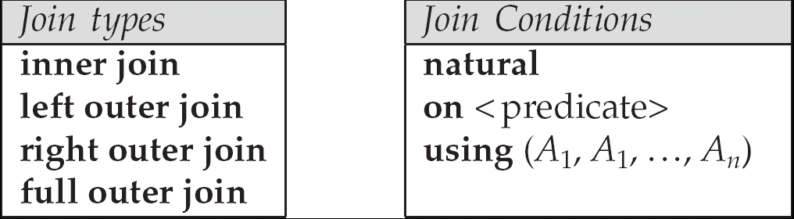
Joined Relations
Join operations take two relations and return as a result another relation.
These additional operations are typically used as subquery expressions in the from clause
Join condition – defines which tuples in the two relations match, and what attributes are present in the result of the join.
Join type – defines how tuples in each relation that do not match any tuple in the other relation (based on the join condition) are treated.

Slide 20
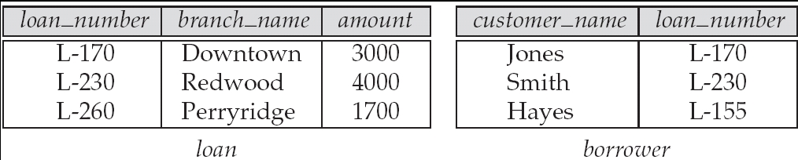
Joined Relations – Datasets for Examples
Relation loan
Relation borrower
Note: borrower information missing for L-260 and loan information missing for L-155

Slide 21

Joined Relations – Examples
Select * from loan inner join borrower on loan.loan-number = borrower.loan-number
loan-number
branch-name
amount
customer-name
loan-number
L-170
L-230
Downtown
Redwood
3000
4000
Jones
Smith
L-170
L-230

Slide 22
Example
Select * from loan left join borrower on loan.loan-number = borrower.loan-number
loan-number
branch-name
amount
customer-name
loan-number
L-170
L-230
L-260
Downtown
Redwood
Perryridge
3000
4000
1700
Jones
Smith
null
L-170
L-230
null

Slide 23
Modification of Database
Increase all accounts with balances over $800 by 7%, all other accounts receive 8%.
update account set balance = balance ∗ 1.07 where balance > 800;
update account set balance = balance ∗ 1.08 where balance ≤ 800;

Slide 24
Modification of Database
Increase all accounts with balances over $700 by 6%, all other accounts receive 5%.
update account set balance =case when balance <= 700 then balance *1.05 else balance * 1.06 end;

Slide 25
Modification of Database
Delete the record of all accounts with balances below the average at the bank.
delete from account where balance < (select avg (balance) from account);
Add a new tuple to account
insert into account
values (‘A-9732’, ‘Perryridge’,1200);

