Slide 1
Introduction to Data Warehousing and Business Intelligence Unlocking the Power of Your Data
Mahmoud Parsian
Ph.D. in Computer Science

Slide 2
Agenda
What is Data Warehousing?
Why Data Warehousing?
Key Components of a Data Warehouse
ETL Process
Business Intelligence (BI)
Benefits of BI
BI Tools and Techniques
Challenges and Considerations
Future Trends

Slide 3
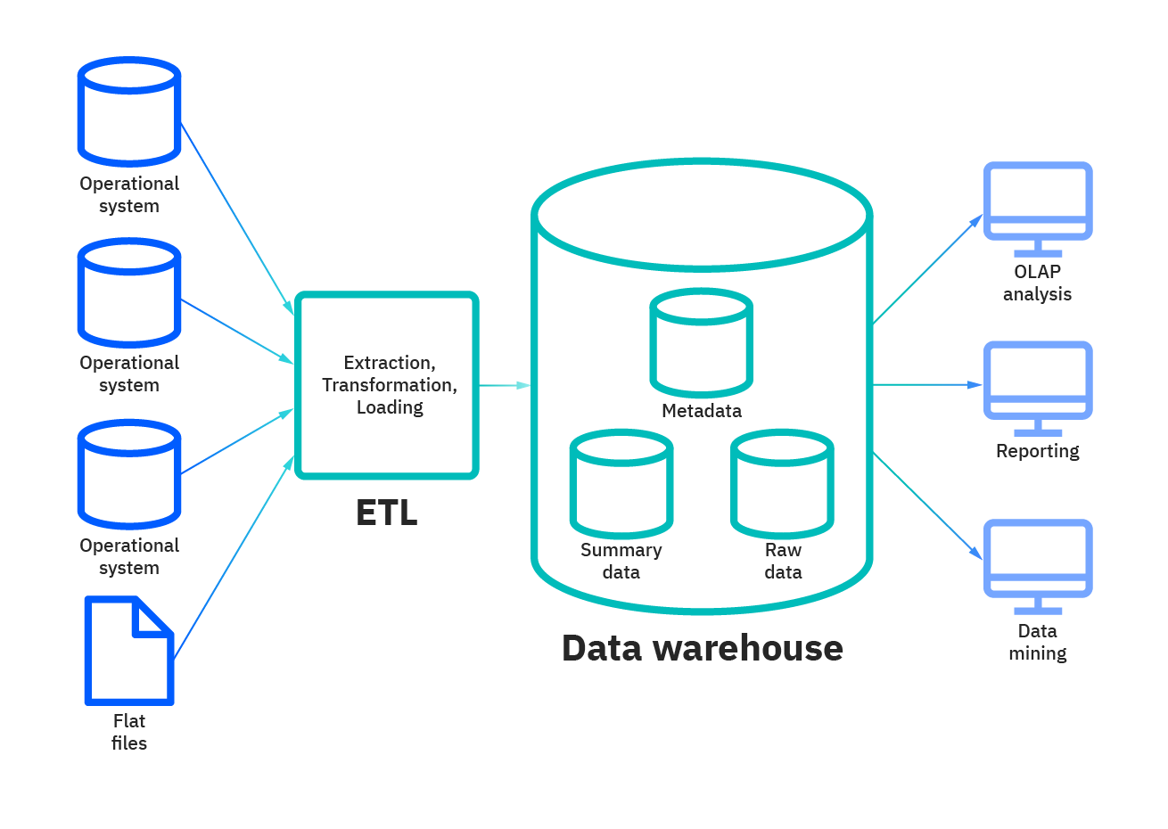
Data Warehousing

Slide 4
1. What is Data Warehousing?
Definition: A centralized repository of integrated, subject-oriented, historical data used to support decision-making processes.
Key Characteristics:
Subject-Oriented: Focuses on specific business areas (e.g., sales, finance, marketing)
Integrated: Data from various sources is integrated into a consistent format
Time-Variant: Historical data is stored for analysis over time
Non-Volatile: Data is not updated frequently, ensuring data consistency

Slide 5
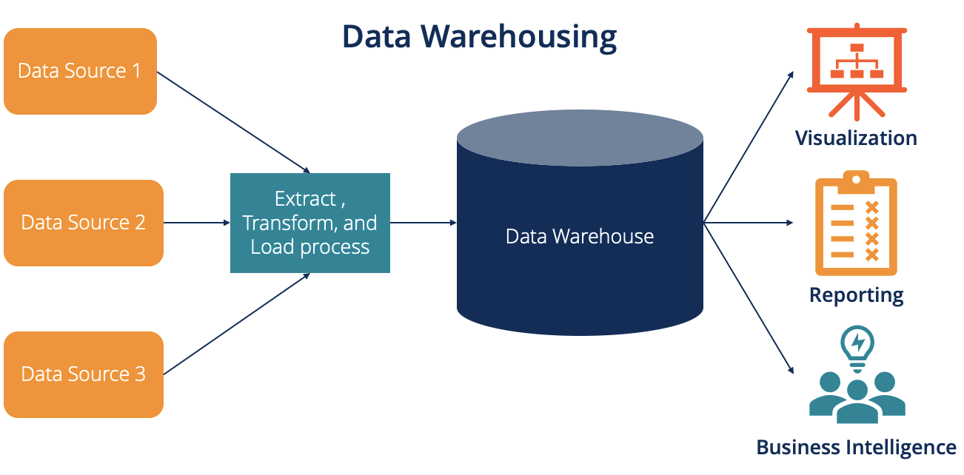
Data Warehousing

Slide 6
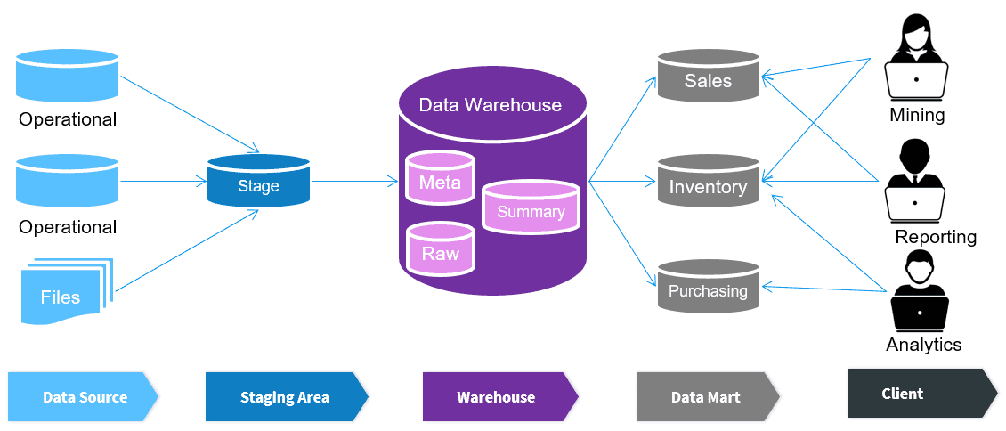
Data Warehousing

Slide 7
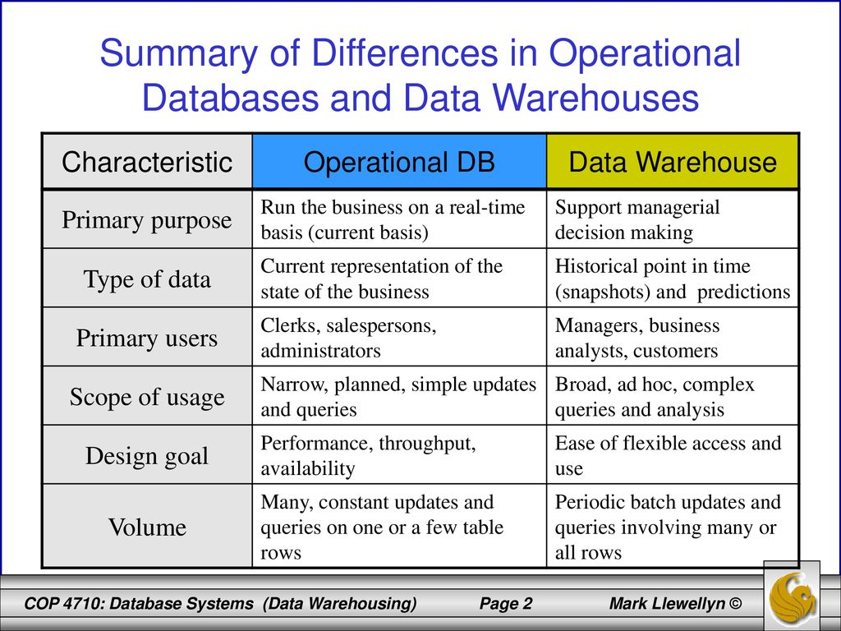
Difference of Data Warehousing and Operational Database

Slide 8
Why Data Warehousing
Improved Decision Making
Access to accurate and timely information
Ability to analyze historical trends
Support for strategic planning and forecasting
Enhanced Operational Efficiency:
Identify inefficiencies and bottlenecks
Optimize business processes
Improve customer satisfaction
Competitive Advantage
Gain insights into market trends and customer behavior
Make data-driven decisions faster
Innovate and differentiate from competitors

Slide 9
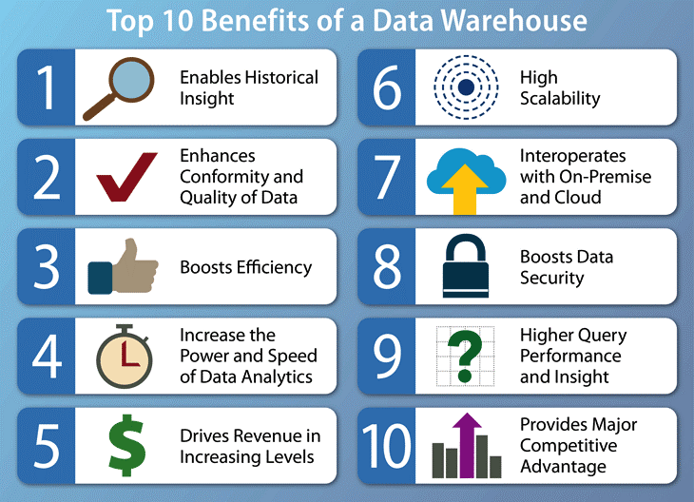
Top-10 Benefits of Data Warehousing

Slide 10
Key Components of a Data Warehouse
Data Source Systems: Operational systems (e.g., ERP, CRM, databases)
ETL Process: Extract, Transform, Load process to integrate data from various sources
Data Warehouse: The central repository for integrated data
Metadata: Information about the data (e.g., data definitions, relationships)
Business Intelligence Tools: Tools for analyzing and visualizing data (e.g., Power BI, Tableau)

Slide 11
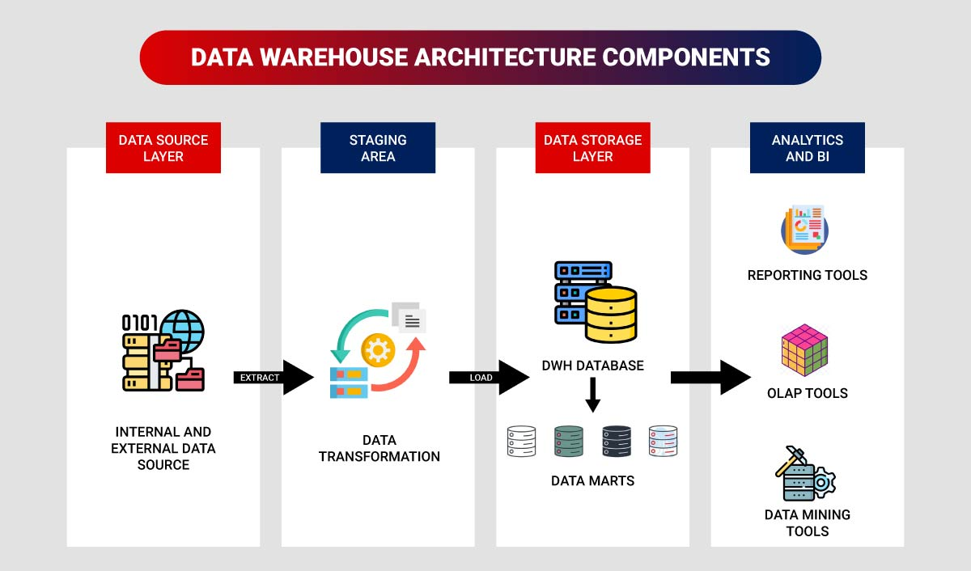
Key Components of a Data Warehouse
Data Source Systems: Operational systems (e.g., ERP, CRM, databases)
ETL Process: Extract, Transform, Load process to integrate data from various sources
Data Warehouse: The central repository for integrated data
Metadata: Information about the data (e.g., data definitions, relationships)
Business Intelligence Tools: Tools for analyzing and visualizing data (e.g., Power BI, Tableau)

Slide 12
ETL Process
Extract: Extract data from source systems
Transform: Clean, standardize, and integrate data
Load: Load the transformed data into the data warehouse

Slide 13
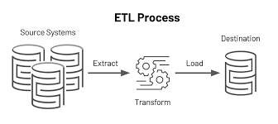
ETL Process

Slide 14
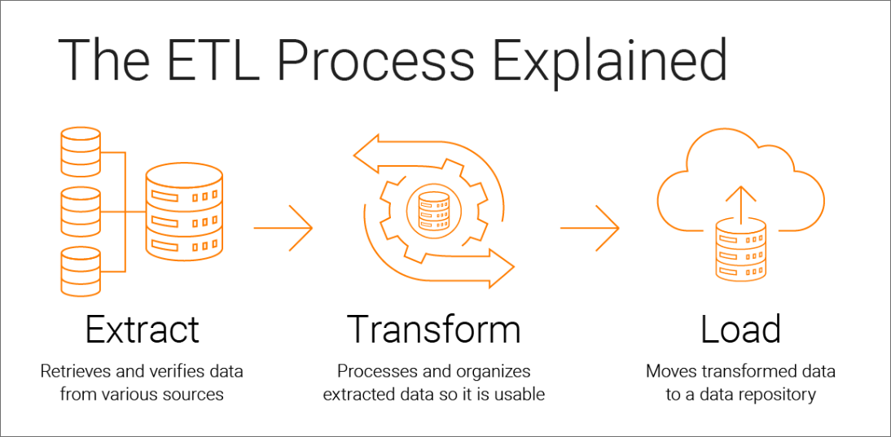
ETL Process

Slide 15
Business Intelligence
Definition: A set of tools and processes used to collect, integrate, analyze, and present business information.
Key Components: 1. Data Warehouse 2. Reporting Tools 3. Online Analytical Processing (OLAP) 4. Data Mining 4. Data Visualization

Slide 16
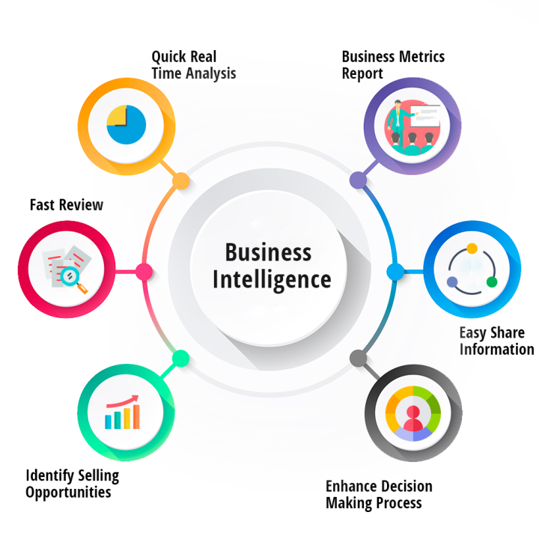
Business Intelligence

Slide 17
Benefits of Business Intelligence
Improved Decision Making
Enhanced Operational Efficiency
Increased Revenue
Reduced Costs
Competitive Advantage

Slide 18
Business Intelligence Tools and Techniques
Reporting Tools:
Create static reports and dashboards
2. OLAP Tools:
Analyze data from multiple dimensions
3. Data Mining Tools:
Discover patterns and trends in data
4. Data Visualization Tools:
Create interactive visualizations

Slide 19
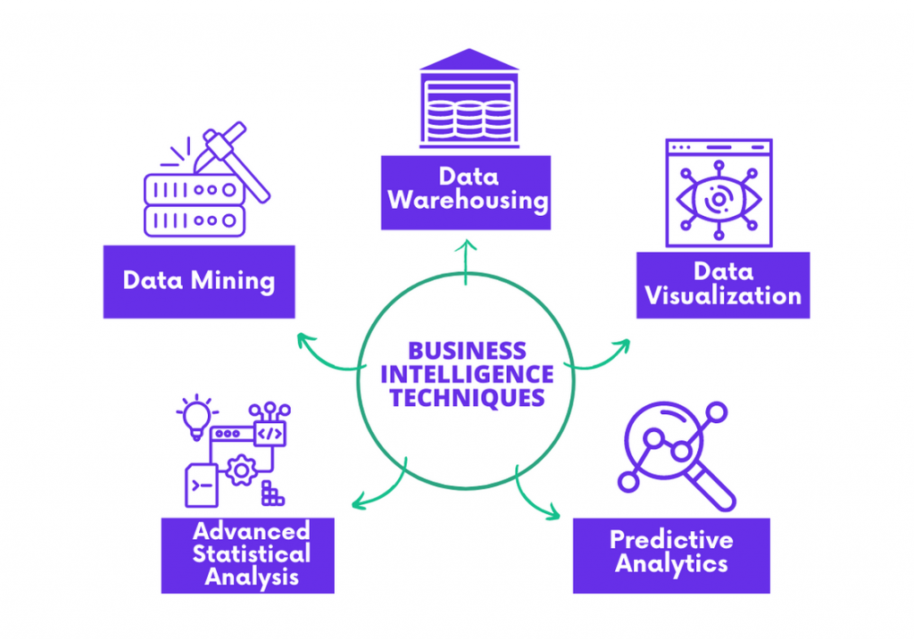
Business Intelligence Tools and Techniques

Slide 20
Challenges and Considerations
1. Data Quality: Ensure data accuracy and consistency
2. Data Integration Complexity: Combine data from various sources
3. Performance: Optimize query performance for large datasets
4. Security and Privacy: Protect sensitive data
5. Cost: Invest in hardware, software, and personnel

Slide 21
Future Trends
Cloud-Based BI
Artificial Intelligence and Machine Learning
Real-Time Analytics
Data Governance
Data Ethics

Slide 22
Where do you store a petabyte of data for business intelligence?
a Data Warehouse,
that’s where.

