Slide 1
Connect Mysql with Tableau
Xuelian Liu

Slide 2
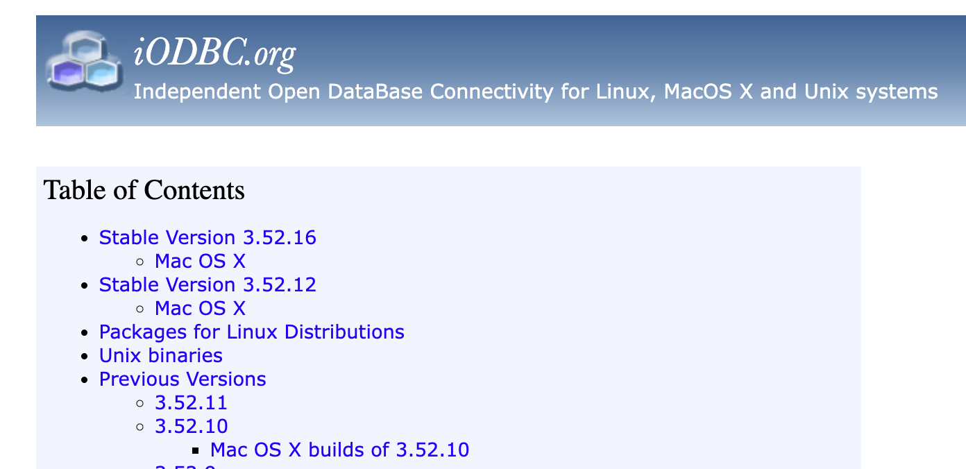
First Step: Install iODBC Driver Manager
Independent
Open
Database
Connectivity
Note: You must install iODBC before you install the MySQL ODBC connector.

Slide 3
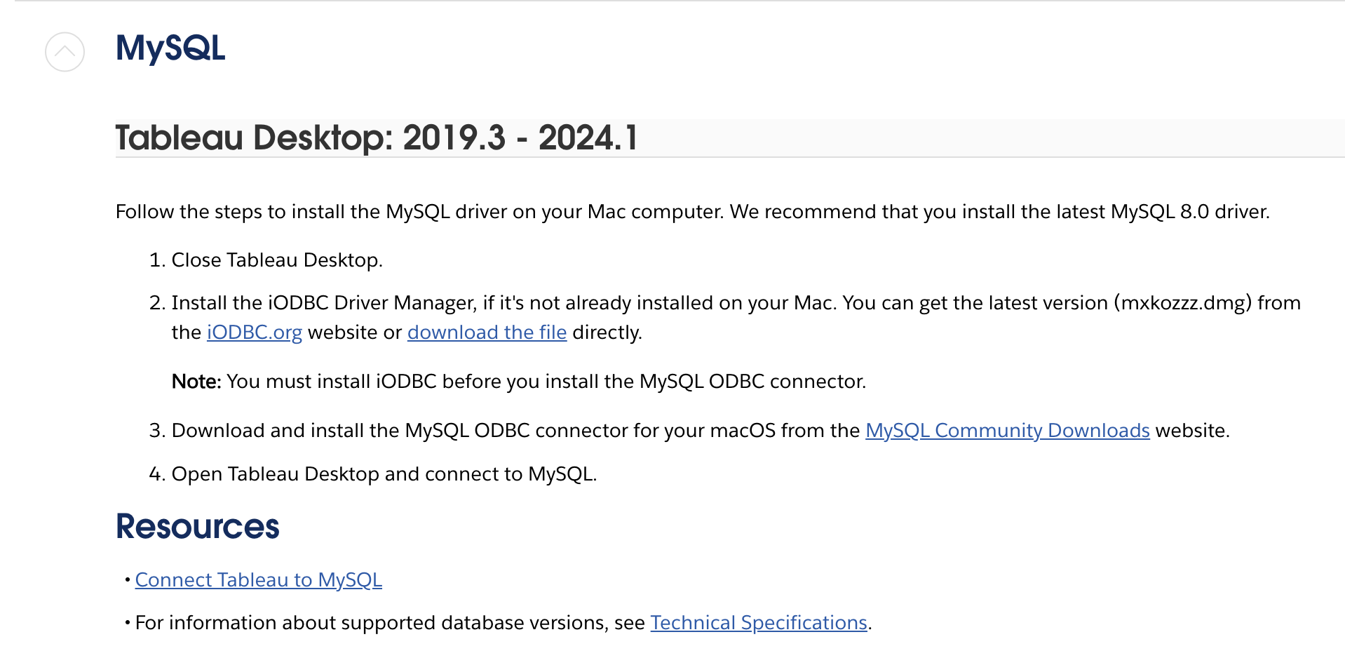
Second Step: Install Driver (Connector)
This connector requires a driver to talk to the database.

Slide 4


Third Step: Install Mysql and Tableau
Mysql workbench. 2. Tableau Desktop.

Slide 5
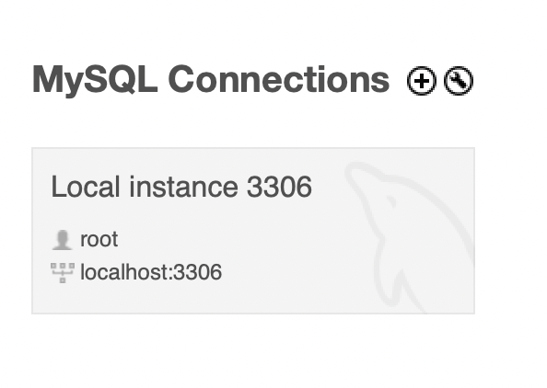
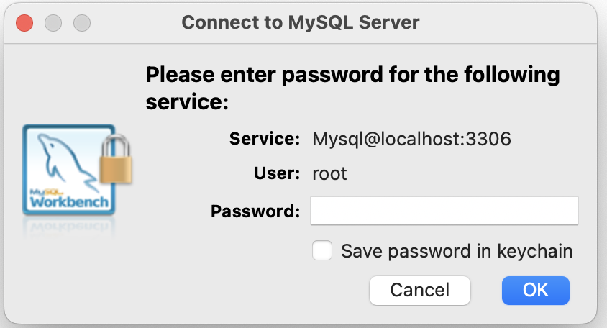
Before you begin, gather this connection information:
Name of the server that hosts the database you want to connect to (i.e. Mysql)
Username and password (i.e. localhost/password)

Slide 6
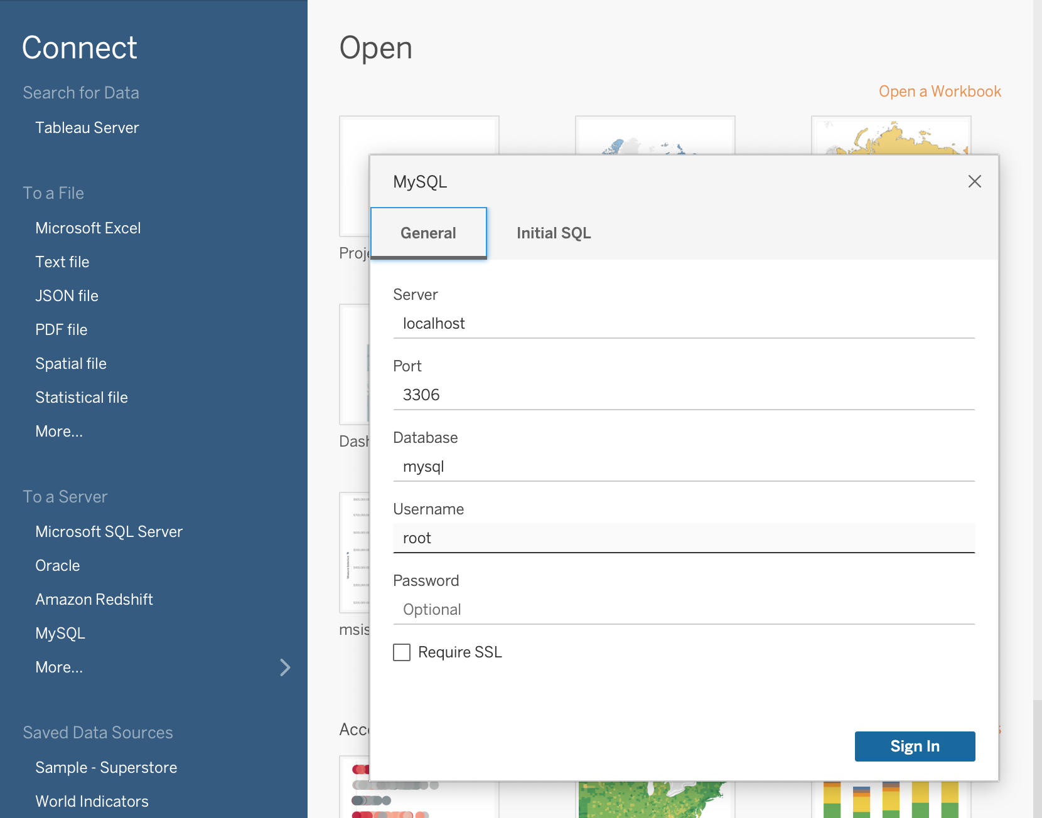
Before you begin, gather this connection information:
Name of the server that hosts the database you want to connect to (i.e. Mysql)
Username and password (i.e. localhost/password)

Slide 7
Demo

