Slide 1
Introduction to Data Visualization with Tableau
Jennifer L. Murray & Gordon F.M. Rakita
January 28, 2022

Slide 2

What is Tableau?
Tableau is an easy-to-use business intelligence software used for data analysis.
Tableau natively connects to dozens of data sources, including Oracle and MS-SQL, as well as local sources like MS-Access and Excel.
Once connected you use drag and drop tools to visualize and create interactive dashboards.
Visualizations can be presented to your audience via PDF, Tableau Reader, Tableau Server/Online or Tableau Public.

Slide 3
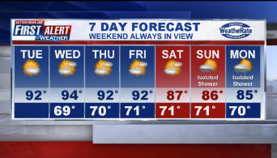
What is Visual Analytics?
It’s Storytelling
News4Jax tells a story every day

Slide 4
Tableau Desktop
Data visualization software that provides the ability to create interactive workbooks and dashboards to see and understand data in minutes.
Tableau Desktop License
$630/year for Desktop Professional License
FREE for full time students, instructors and non-profit researchers:
https://www.tableau.com/academic
https://www.tableau.com/academic/teaching/course-licenses

Slide 5
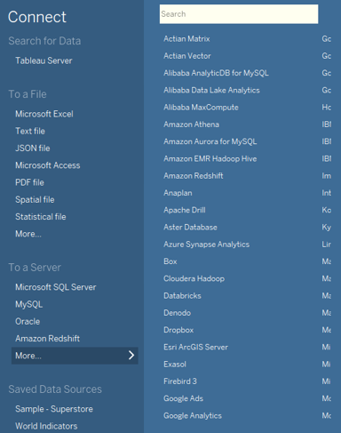
Tableau Desktop – Data Connections
Connections to a wide variety of data sources
File Systems such as CSV, Excel
Relational Systems such as Oracle, SQL Server, DB2
Cloud Systems such as Windows Azure, Google BigQuery
Other Sources such as ODBC
List of Supported Connectors: https://help.tableau.com/current/pro/desktop/en-us/exampleconnections_overview.htm

Slide 6
Tableau Desktop –
Graphic Types
Area Chart
Bar Chart
Box Plot
Bubble Chart
Bullet Graph
Density Marks (Heatmap)
Gantt Chart
Dot Plot
Highlight Table
Histogram
Line Chart
Maps (Geographical and Heat)
Pie Chart
Scatter Plot
Text Table
Treemap
Word Cloud

Slide 7

Tableau Desktop – Distributing Reports
PDF, JPG, Data
Tableau Reader
Tableau Server/Online
Tableau Mobile
Tableau Public
Embed on a webpage
Video recording – Skype or Camtasia
https://www.tableau.com/products

Slide 8

Tableau Public
Making your reports and potentially YOUR DATA available to 7 Billion of your closest friends
De-identify everything
Strip out non relevant data
Do not allow download
FREE with restrictions
Support for data sets of up to 10 million rows
Storage limit of 10 GB
Data source limitations – i.e., Excel, Text-based, Google Drive
Edit viz in browser (beta)

Slide 9
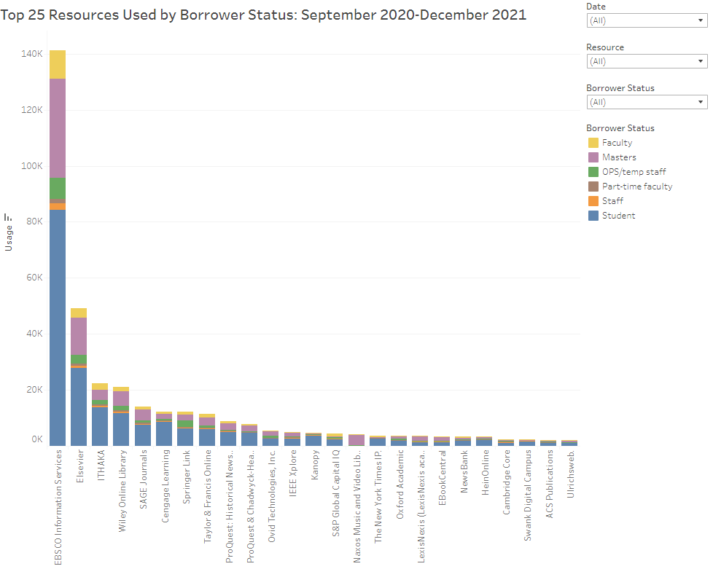
Electronic Resources Usage
Tableau Public: https://public.tableau.com/views/OpenAthensStatistics/ActiveUsers?:language=en-US&:display_count=n&:origin=viz_share_link
Embedded in Library Impact Dashboard: https://libguides.unf.edu/c.php?g=1164390&p=8500072

Slide 10
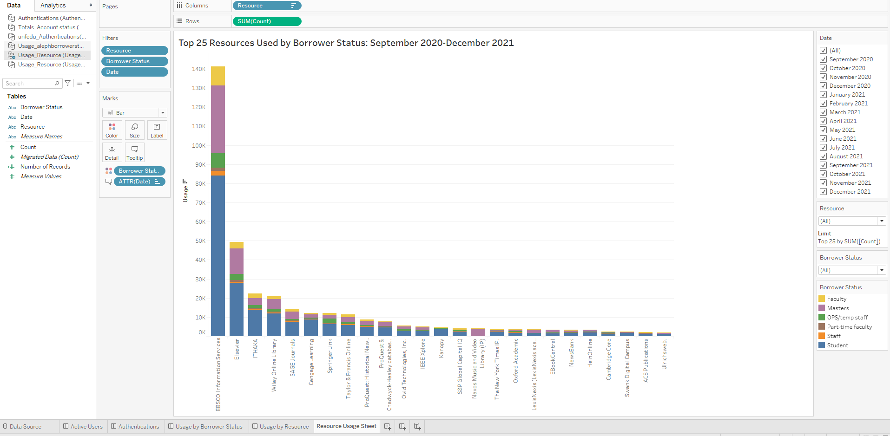
Tableau Worksheet Overview
Pages shelf: Creates a set of pages with a different view on each page
Filters shelf: Allows you to specify which data to include and exclude
Dimensions: Fields that cannot be aggregated
Marks card: Add context and detail to your view
Measures: Fields that can be measured, aggregated or used for mathematical operations
Story: Sequence of worksheets or dashboards that work together to convey information
Dashboard: Collection of views from multiple worksheets

Slide 11
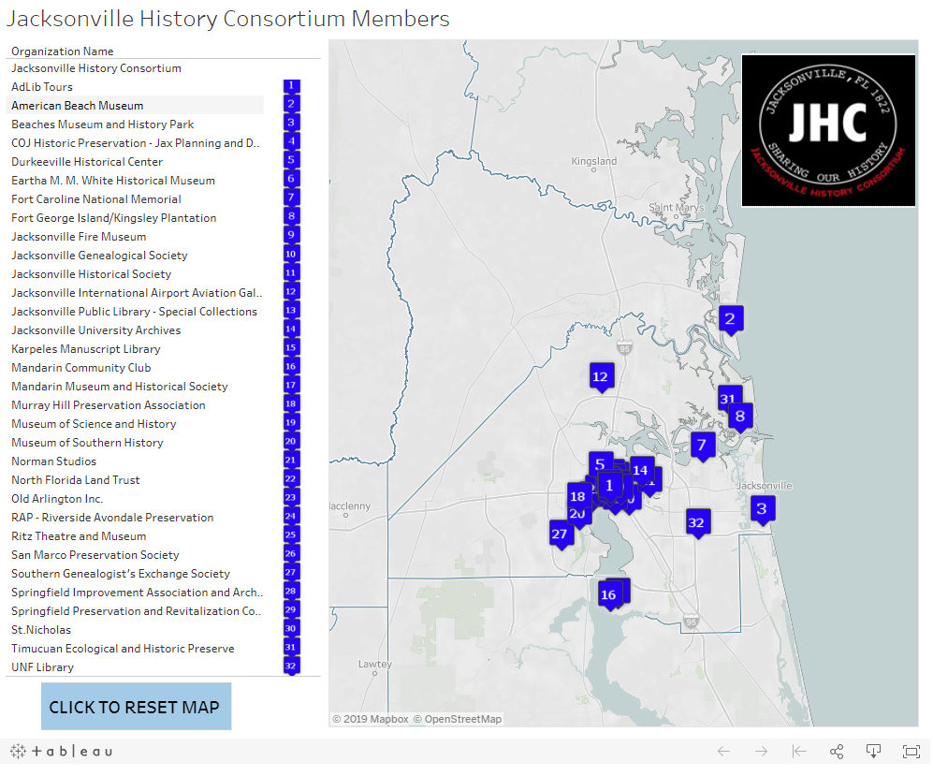
Mapping with Tableau
Tableau Public: https://public.tableau.com/views/Jacksonville-History-Consortium-Map/Jax?:display_count=y&:origin=viz_share_link
Embedded in Library Guide: https://libguides.unf.edu/jhc

Slide 12
Additional Tableau Examples
Tracking Survey Responses (here)
Tracking 2FA Enrollment (here)
Anthropology enrollments (here)
ITS Project Dashboards (here)
COVID-19 Test Positivity Rates (here)

Slide 13
Tableau Resources
Free Trial
https://www.tableau.com/en-gb/products/trial
Getting Started
https://help.tableau.com/current/pro/desktop/en-us/gettingstarted_overview.htm
Free Training Videos
https://www.tableau.com/learn/training
Tableau Add-In for Reshaping Data in Excel https://community.tableau.com/docs/DOC-10394
Higher Ed Analytics
https://www.tableau.com/solutions/education-higher-ed-analytics
Viz of the Day
https://public.tableau.com/en-us/gallery/?tab=viz-of-the-day&type=viz-of-the-day

Slide 14
“The greatest value of a picture is when it forces us to notice what we never expected to see.”
(John Tukey)
“Visualization gives you answers to questions you didn’t know you had.”
(Ben Schneiderman)
Bernard Marr. (March 21, 2018). 20 Best Data Visualization Quotes. Retrieved from
https://www.qlik.com/blog/20-best-data-visualization-quotes.

Slide 15
Thank you! Questions?
Jennifer L. Murray
Library Associate Dean
jennifer.murray@unf.edu
Gordon F.M. Rakita
Professor of Anthropology & Associate Vice President of Faculty Development
grakita@unf.edu

