Slide 1
What is Data Modeling

Slide 2
Table of Contents
What is Data Modeling
Types of Data Models
Data Modeling Process
Types of Data Modeling
Benefits of Data Modeling
How to Create a Data Model in 9 Steps

Slide 3
What is Data Modeling?
Process of creating a data model for the data to be stored in a database.
It is a conceptual representation of Data objects, the associations between different data objects, and the rules.

Slide 4
What is a Data Model?
A data model is an
abstract model that organizes elements of data and
standardizes how they relate to one another and to the properties of real-world entities.

Slide 5
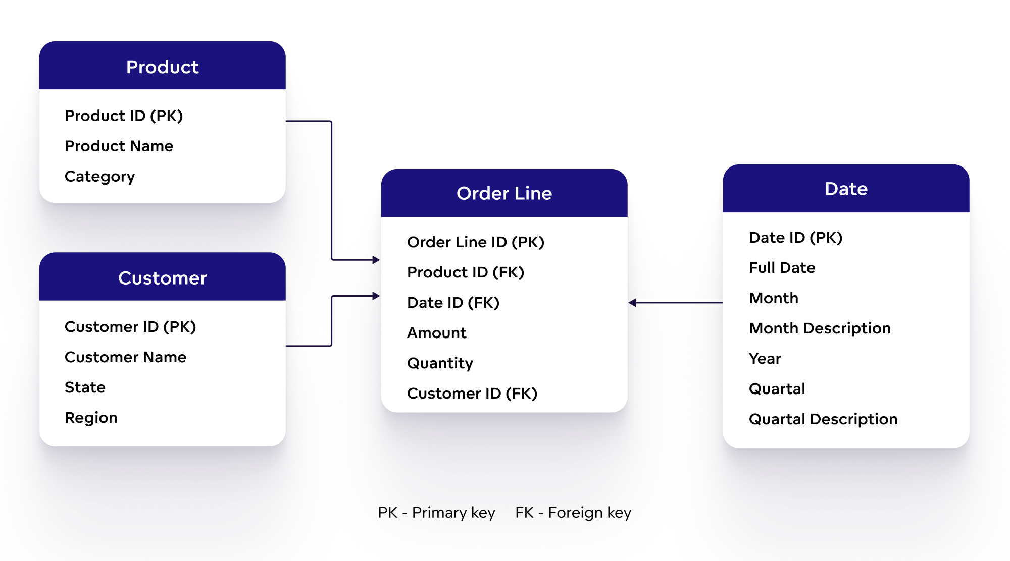
What is a Data Model?

Slide 6
Abstraction
Data modeling uses abstraction
to represent and better understand
the nature of data flow within an
enterprise information system.

Slide 7
What is Data modeling?
visual representation :
1. Data modeling is the process of creating a visual representation of either a whole information system or parts of it to communicate connections between data points and structures.

Slide 8
What is Data modeling?
Goal of Data modeling:
2. The goal is to illustrate the types of data used and stored within the system, the relationships among these data types, the ways the data can be grouped and organized and its formats and attributes.

Slide 9
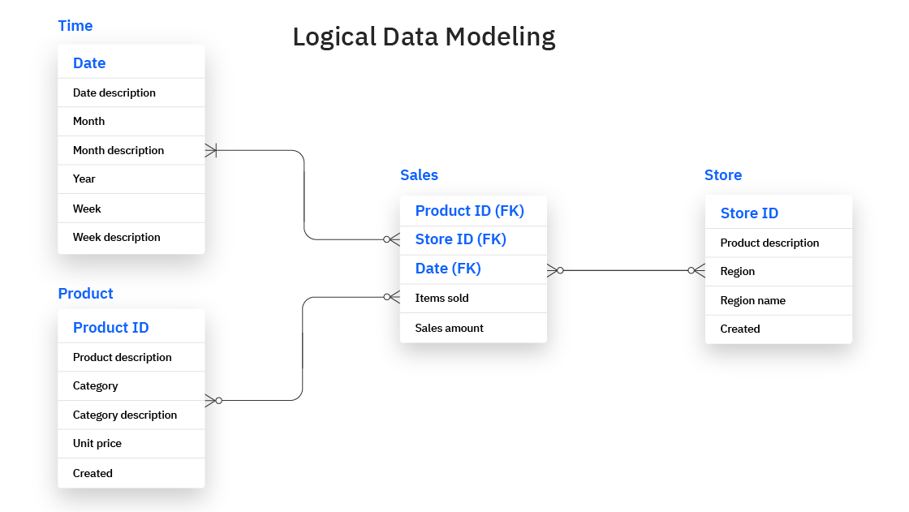
Data Modeling Example

Slide 10
Data Modeling: as a Process…
1. Data Modeling is the process of creating data models by which data associations and constraints are described and eventually coded to reuse.
2. Data Modeling conceptually represents data with diagrams, symbols, or text to visualize the interrelation

Slide 11
Why to Build Data Models
Data models are built around business needs.
Rules and requirements are defined upfront through feedback from business stakeholders so they can be incorporated into the design of a new system or adapted in the iteration of an existing one.
Data Models must be validated by business stakeholders

Slide 12
Example: Data and Level of Abstraction
Example-1:
parquet_file = “green_cab_2023_01.parquet”
df = pd.read_parquet(parquet_file, engine='auto')
# df abstracts your Parquet data
Example-2:
-- create a view over the Parquet file in DuckDB
CREATE VIEW sales AS SELECT * FROM read_parquet(‘sales.parquet’);
-- query the Parquet file
SELECT * FROM sales;
-- table sales abstracts your Parquet data

Slide 13
Data Model as a Road Map
Data can be modeled at various levels of abstraction.
The process begins by collecting information about business requirements from stakeholders and end users.
These business rules are then translated into data structures to formulate a concrete database design.
A data model can be compared to a roadmap, an architect’s blueprint or any formal diagram that facilitates a deeper understanding of what is being designed.

Slide 14
Data Modeling Techniques
Data modeling employs standardized schemas and formal techniques.
These formal techniques provides a common, consistent, and predictable way of defining and managing data resources across an organization, or even beyond.

Slide 15
Is a Data Model an Important Document
Data Models are living documents that evolve along with changing business needs.
Data Models play an important role in supporting business processes and planning IT architecture and strategy.
Data models can be shared with vendors, partners, and/or industry peers.

Slide 16
Types of Data Models
Conceptual model
Logical model
Physical model
The process will
start with a conceptual model,
progress to a logical model and
conclude with a physical model.

Slide 17
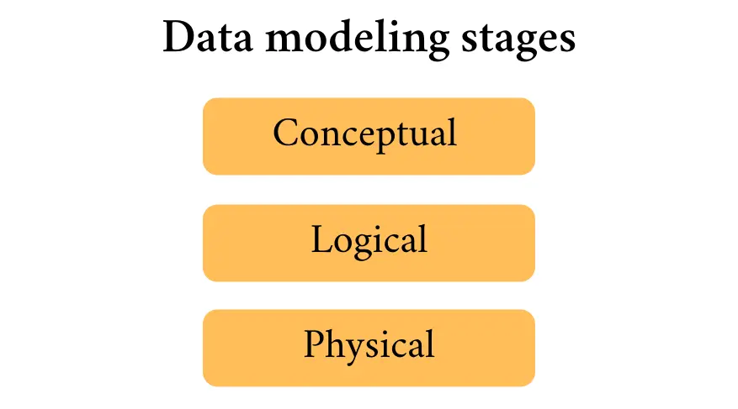

Slide 18
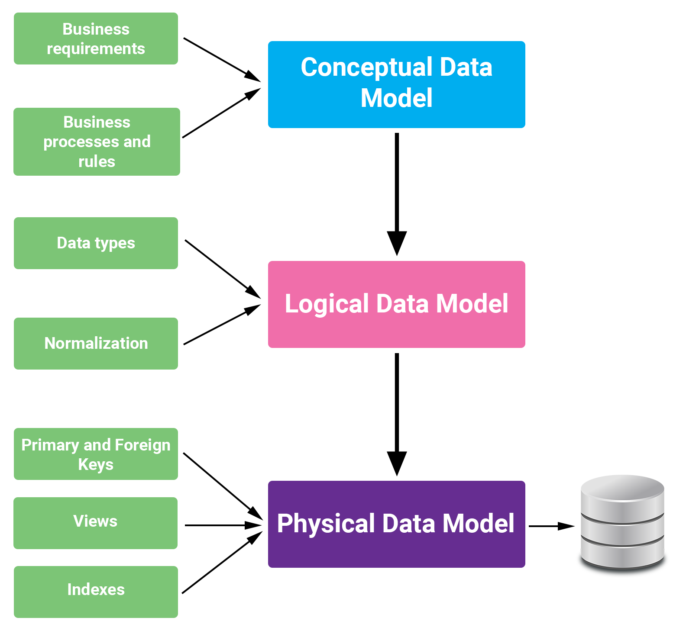

Slide 19
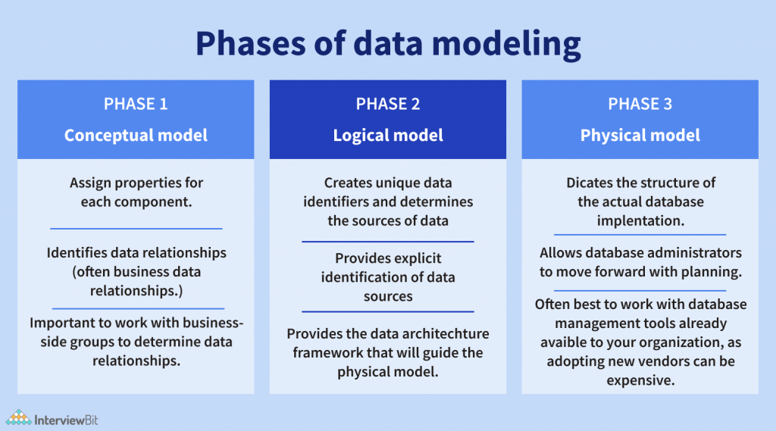

Slide 20
Conceptual data models
Conceptual data models are also referred to as domain models and offer a big-picture view of what the system will contain, how it will be organized, and which business rules are involved.
Conceptual models are usually created as part of the process of gathering initial project requirements.

Slide 21
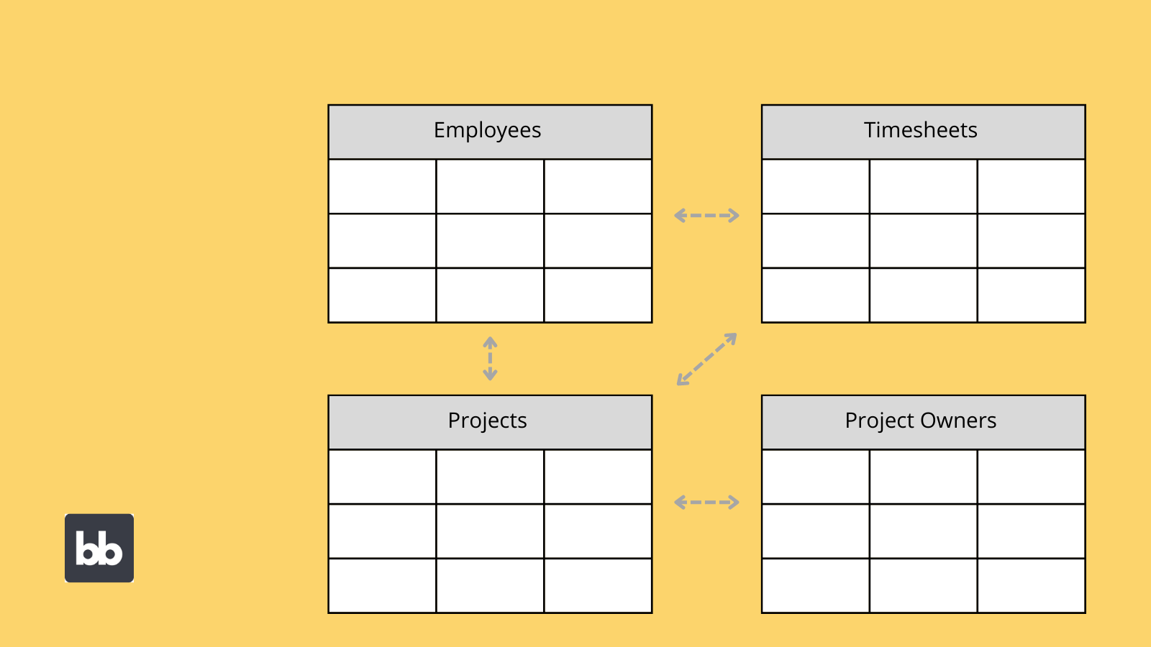
Example: Conceptual Data Model

Slide 22
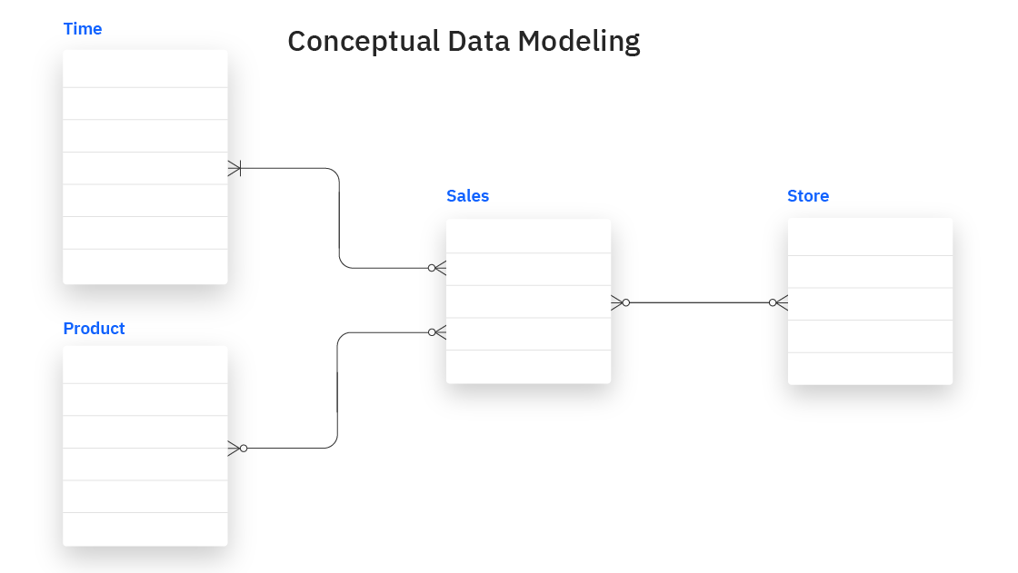

Slide 23
Conceptual data models
Conceptual models are usually created as part of the process of gathering initial project requirements.
Typically, they include entity classes (defining the types of things that are important for the business to represent in the data model), their characteristics and constraints, the relationships between them and relevant security and data integrity requirements.
Notation is typically simple.

Slide 24
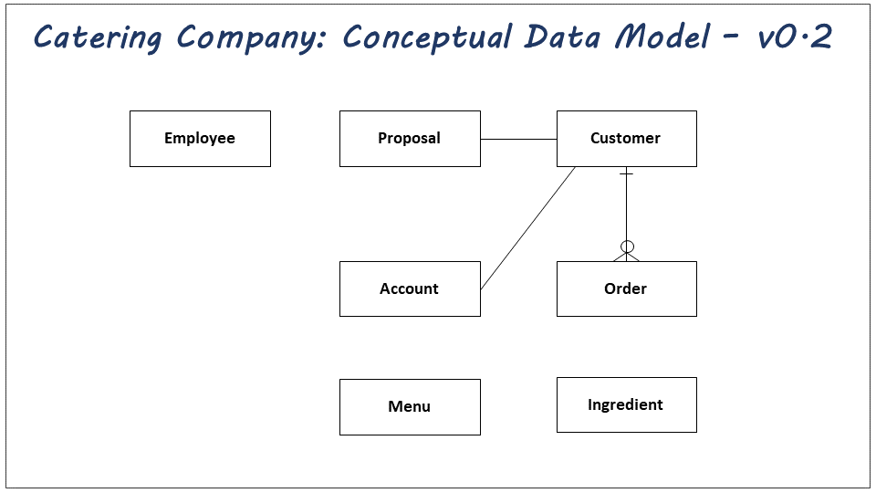

Slide 25
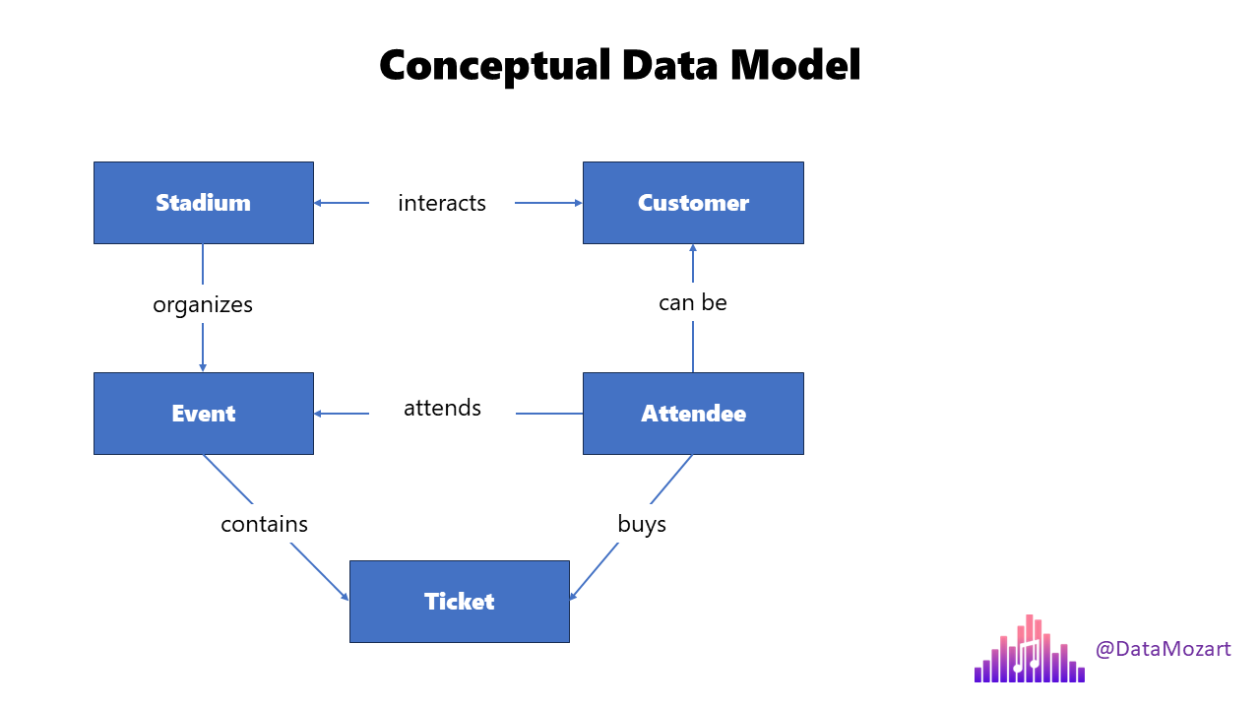

Slide 26
Conceptual Data Model
Conceptual data models
Are built at the first stage of the data modeling process
They provide a summary-level perspective
Omitting finer details in favor of a more readily digestible format

Slide 27
Benefits of conceptual data models
1. Help define a common language and populate the business glossary
2. Help shape the roadmap and define project scope
3. Provide a basis for future models
4. Foster an inclusive form of communication

Slide 28
Example of Conceptual Data Models
3 examples of conceptual data models:
What is a Conceptual Data Model (CDM)?
The value of conceptual data modeling

Slide 29
Logical Data Models
1. They are less abstract and provide greater detail about the concepts and relationships in the domain under consideration.
2. One of several formal data modeling notation systems is followed. These indicate data attributes, such as data types and their corresponding lengths, and show the relationships among entities.
3. Logical data models don’t specify any technical system requirements.
4. Logical data models can be useful in highly procedural implementation environments, or for projects that are data-oriented by nature, such as data warehouse design or reporting system development.

Slide 31
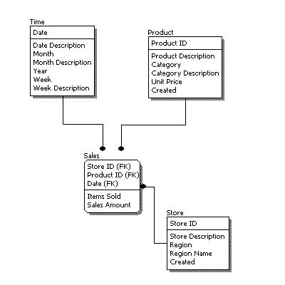
EXAMPLE: Logical Data Model

Slide 32
Purpose of Logical Data Model
1. A logical data model establishes the structure of data elements and the relationships among them.
2. It is independent of the physical database that details how the data will be implemented.
3. The logical data model serves as a blueprint for used data.

Slide 33
Physical Data Models
1. Physical Data Models provide a schema for how the data will be physically stored within a database.
2. They’re the least abstract of all.
3. They offer a finalized design that can be implemented as a relational database, including associative tables that illustrate the relationships among entities as well as the primary keys and foreign keys that will be used to maintain those relationships.
4. Physical data models can include database management system (DBMS)-specific properties, including performance tuning.

Slide 34
Physical Data Model
1. A physical data model is a database-specific model that represents relational data objects (for example, tables, columns, primary and foreign keys) and their relationships.
2. A physical data model can be used to generate DDL statements which can then be deployed to a database server.
DDL = Data Definition Language

Slide 35
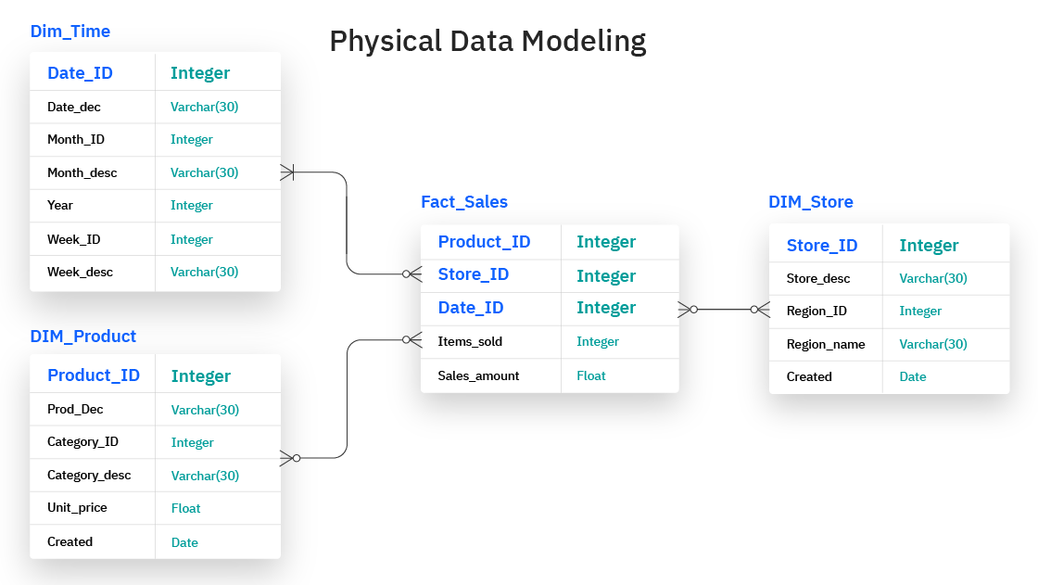

Slide 36
Data Modeling Process
Identify the entities.
Identify key properties of each entity.
Identify relationships among entities.
Map attributes to entities completely.
Assign keys as needed, and decide on a degree of normalization that balances the need to reduce redundancy with performance requirements.
Finalize and validate the data model.

Slide 37
Data Modeling Process
Identify the Entities.
An entity represents a specific object (such as a specific customer or order or employee). Each entity must have a unique entity key within an entity set.
The process of data modeling begins with the identification of the entities, things, events or concepts that are represented in the data set that is to be modeled.
Each entity should be cohesive and logically discrete from all others.

Slide 38
What are Entities and Attributes?
Entities and attributes are the basic building blocks of any data model.
An entity is a person, place, thing, event, or concept that you want to store data about.
For example, a customer, a product, a sale, or a location.
An attribute is a characteristic or property of an entity that describes it or distinguishes it from other entities.
For example, a customer's name, a product's price, a sale's date, or a location's address. Entities and attributes are often represented by nouns in your data sources or business documents.

Slide 39
Data Modeling Process
2. Identify key properties of each entity.
Each entity type can be differentiated from all others because it has one or more unique properties, called attributes. For instance, an entity called “customer” might possess such attributes as a first name, last name, telephone number and salutation, while an entity called “address” might include a street name and number, a city, state, country and zip code.
Customer:
first_name
last_name
address
…

Slide 40
Data Modeling Process
3. Identify relationships among entities.
The earliest draft of a data model will specify the nature of the relationships each entity has with the others.
For example, each customer “lives at” an address. If that model were expanded to include an entity called “orders,” each order would be shipped to and billed to an address as well.
These relationships are usually documented via unified modeling language (UML) or Entity-Relationship-Diagram (ERD)

Slide 41
Data Modeling Process
4. Map attributes to entities completely.
This will ensure the model reflects how the business will use the data.
Several formal data modeling patterns are in widespread use. Object-oriented developers often apply analysis patterns or design patterns, while stakeholders from other business domains may turn to other patterns.

Slide 42
Data Modeling Process
5. Assign keys as needed, and decide on a degree of normalization that balances the need to reduce redundancy with performance requirements.
Normalization is a technique for organizing data models (and the databases they represent) in which numerical identifiers, called keys, are assigned to groups of data to represent relationships between them without repeating the data.
For instance, if customers are each assigned a key, that key can be linked to both their address and their order history without having to repeat this information in the table of customer names. Normalization tends to reduce the amount of storage space a database will require, but it can at cost to query performance.

Slide 43
Data Modeling Process
6. Finalize and validate the data model.
Data modeling is an iterative process that should be repeated and refined as business needs change.
Data Models are dynamic entities, and they change as business models change

Slide 44
Types of Data Modeling
Hierarchical data models
Relational data models
Entity-relationship (ER) data models
Object-oriented data models
Graph Model
Key-Value Model (HBase)
Dimensional data models (in Data Warehousing)
Star Schema
Snowflake Schema

Slide 45
Benefits of Data Modeling
Data modeling makes it easier for developers, data architects, and business analysts to view and understand relationships among the data in a database or data warehouse. In addition, it can:
Reduce errors in software and database development.
Increase consistency in documentation and system design across the enterprise.
Improve application and database performance.
Ease data mapping throughout the organization.
Improve communication between developers and business intelligence teams.
Ease and speed the process of database design at the conceptual, logical and physical levels.

Slide 46
Data Modeling Tools
erwin Data Modeler
Enterprise Architect
ER/Studio
Free data modeling tools:
Open-Source

Slide 47
Free data modeling tools: Open-Source
Dbdiagram.io
HeidiSQL
Archi
ArgoUML
PgModeler
MySQL Workbench
Umbrello
ModelSphere
DBDesigner4
DBDesigner
Oracle SQL Developer Data Modeler
DbSchema
ERBuilder

Slide 48
How to Create a Data Model in 10 Steps
1. Gather business requirements
2. Define business processes
3. Create a conceptual data model
4. Define entities and attributes
5. Identify data sources
6. Establish relationships between entities
7. Physical modeling
8. Normalization and ensuring the integrity of data
9. Maintaining your data model
10. Validation and POC

Slide 49
How to Create a Data Model
1. How to Create a Data Model in 9 Steps
2. A Guide for Data Modeling
3. What is Data Modelling? Overview, Basic Concepts
4. Data Modeling Explained in 10 Minutes
5. Data Modeling 101: An Introduction
6. Data Modeler Tutorial: Modeling for a Small Database

