Slide 1
Introduction to Business Intelligence

Slide 2
What is Business Intelligence (BI)?
Business intelligence (BI) refers to
collecting,
analyzing, and
interpreting data
to gain insights and make informed decisions within an organization.

Slide 3
What is Business Intelligence (BI)?
Business intelligence is
the set of tools and systems
used to collect and analyze business data
to gain insights that allow businesses to make informed decisions.
Business intelligence tools give customers insights into how a company performs now and in the past.
By using business intelligence and analytic tools, you can help companies predict what can happen in the future.

Slide 4
What is Business Intelligence (BI)?
BI is a set of
processes,
architectures, and
technologies
that convert raw data into meaningful information that drives profitable business actions.
It is a suite of software and services to transform data into actionable intelligence and knowledge.

Slide 5
What is Business Intelligence?
Data → transform → actionable intelligence and knowledge.
BI has a direct impact on organization's strategic, tactical and operational business decisions.
BI supports fact-based decision making, using historical data rather than assumptions and gut feeling.
BI tools perform data analysis and create reports, summaries, dashboards, maps, graphs, and charts to provide users with detailed intelligence about the nature of the business

Slide 6
Example of Business Intelligence Tools
Data Warehouse (store data by subjects)
Database Systems (store data)
SQL (analyze data)
Tableau (Visualize data)
Pentaho (ETL, …)

Slide 7
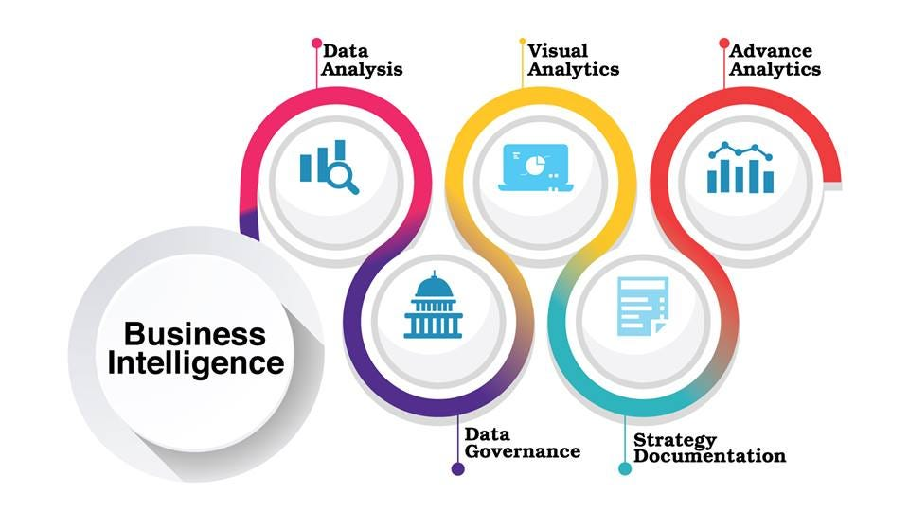
Business Intelligence

Slide 8
Business Intelligence (BI) systems
Business Intelligence systems have grown more powerful and comprehensive, mainly due to:
1. Increased Data Collection
2. Greater Capacity Storage
3. Power of Database Systems and SQL

Slide 9
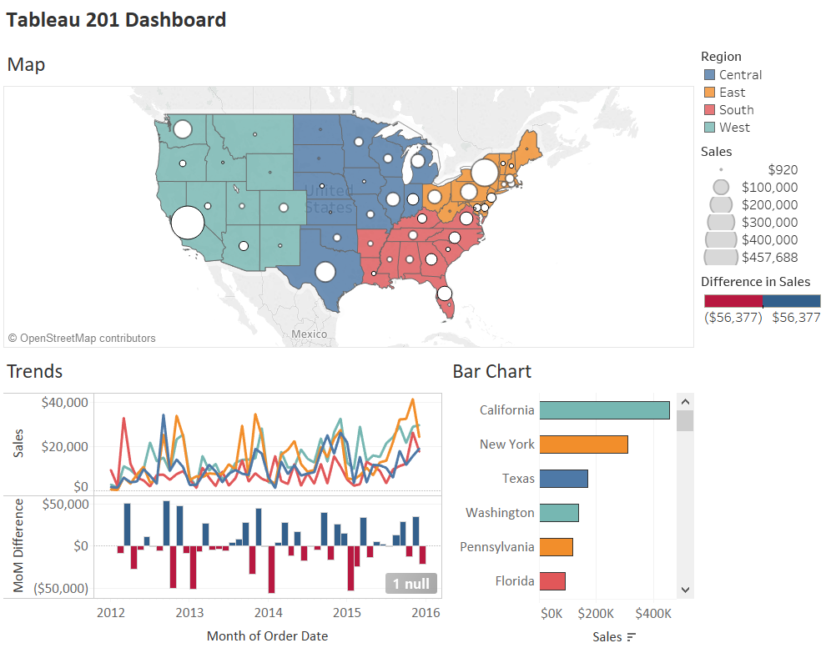
BI: Product Sales by States

Slide 10
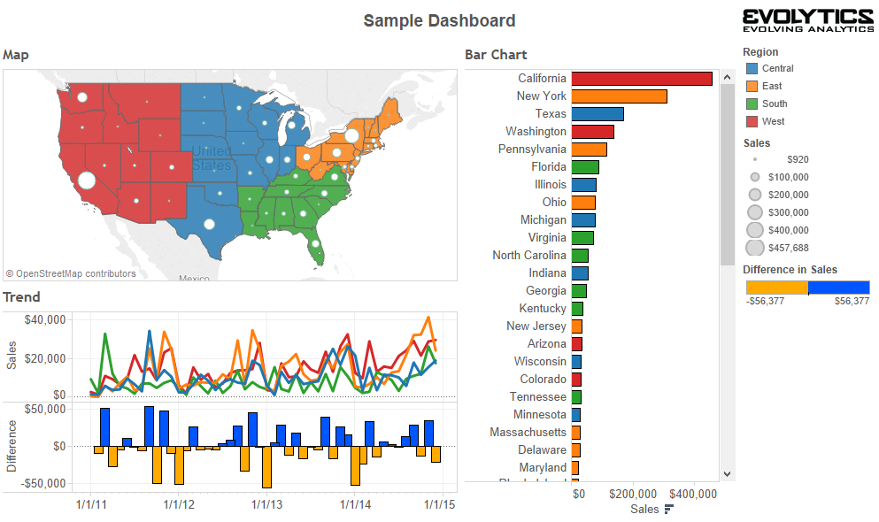
BI: Samples by States

Slide 11
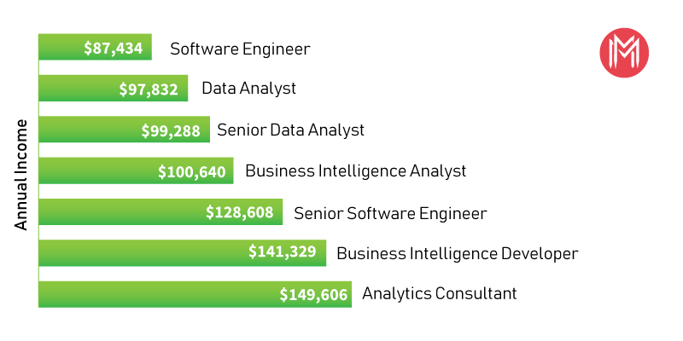
BI: Annual Income Analysis

Slide 12
Data Types
• Structured
Fixed form such as name collection forms on websites
Relational Database Tables
Parquet file formats
• Semi-structured
JSON, XML, non-reliable CSVs
• Unstructured
Information that can't be read by computers easily
Text format
Phone conversations
Customer service logs

Slide 13
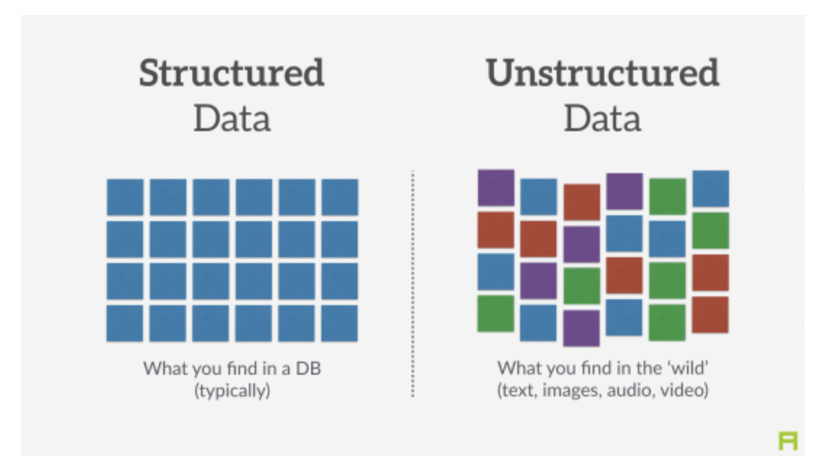
Structured vs Unstructured

Slide 14
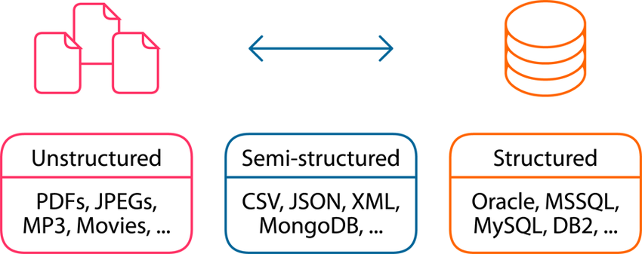
Structured, Semi-Structured, Unstructured

Slide 15
How Companies store and manage all this data
Data isn't always in one location.
Data is usually found across:
CRM programs
Marketing automation systems
Social media platforms
The first step in Business Intelligence is taking Inventory of the data the company produces.
CRM = Customer Relationship Management

Slide 16
Data Warehouse
Data Warehouse is used to consolidate disparate data in a central location.
Using a process known as Extract, Transform, and Load (ETL), warehouse standardize data across systems, which allows it to be queried.
Data Warehouse Queries => Business Intelligence

Slide 17
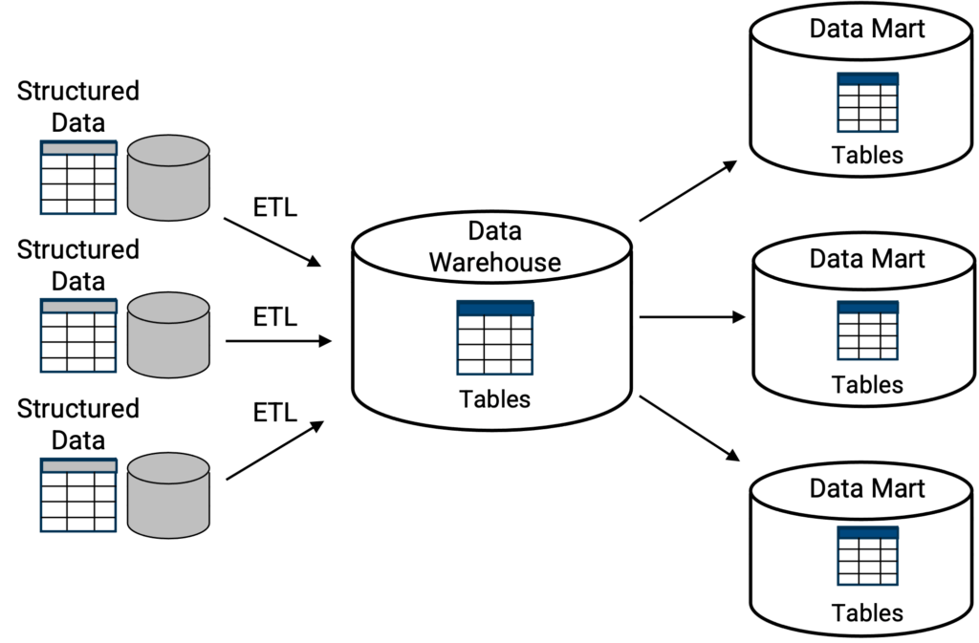
Data Warehouse Example

Slide 18
definition: Data Warehouse
Bill Inmon's definition of a data warehouse is that it is a
1. subject-oriented,
2. non-volatile,
3. integrated,
4. time-variant
collection of data in support of management's decisions.

Slide 19
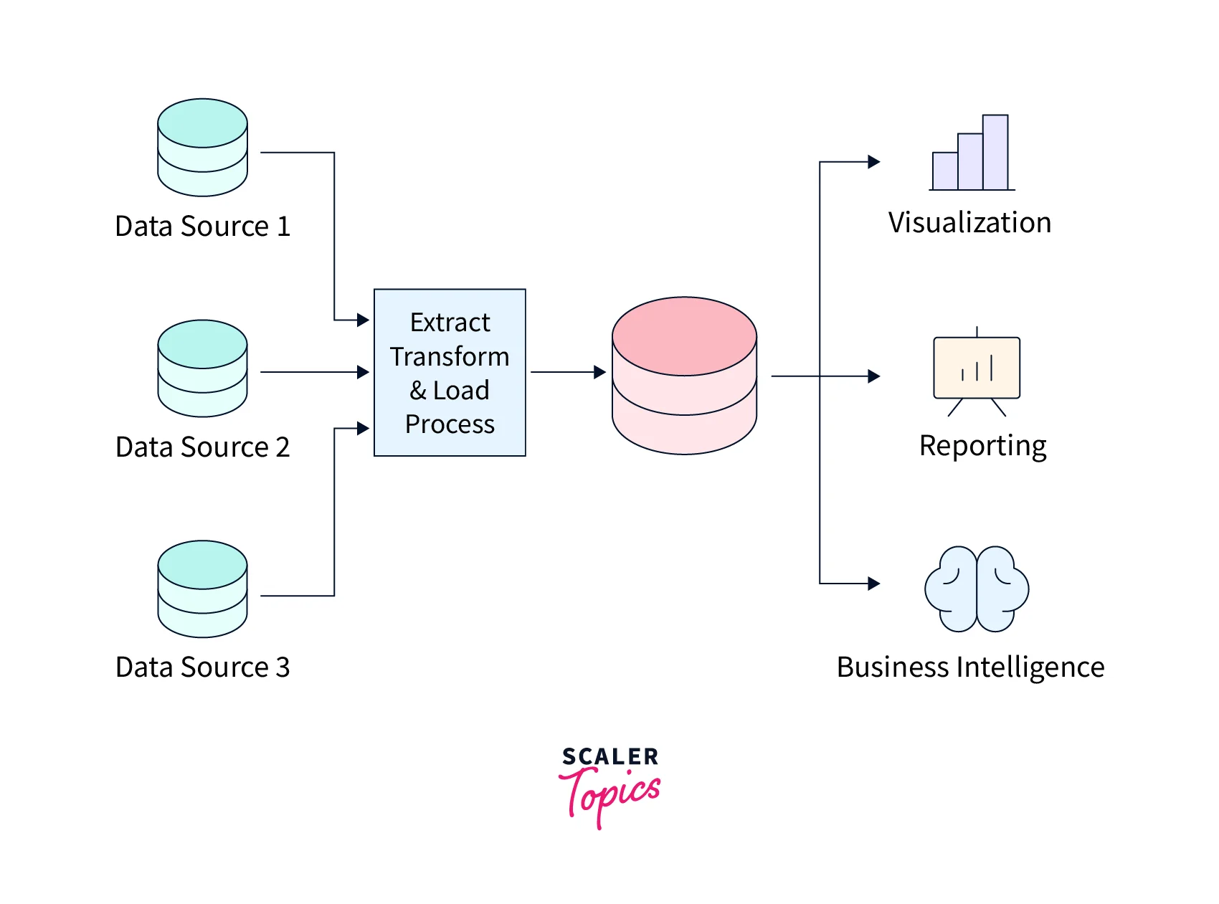
Data Warehouse Example

Slide 20
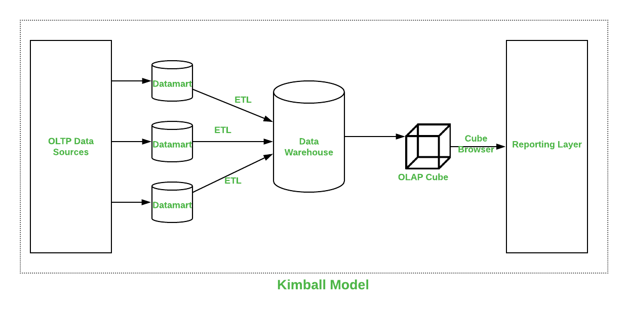
Kimball Data Warehouse Model

Slide 21
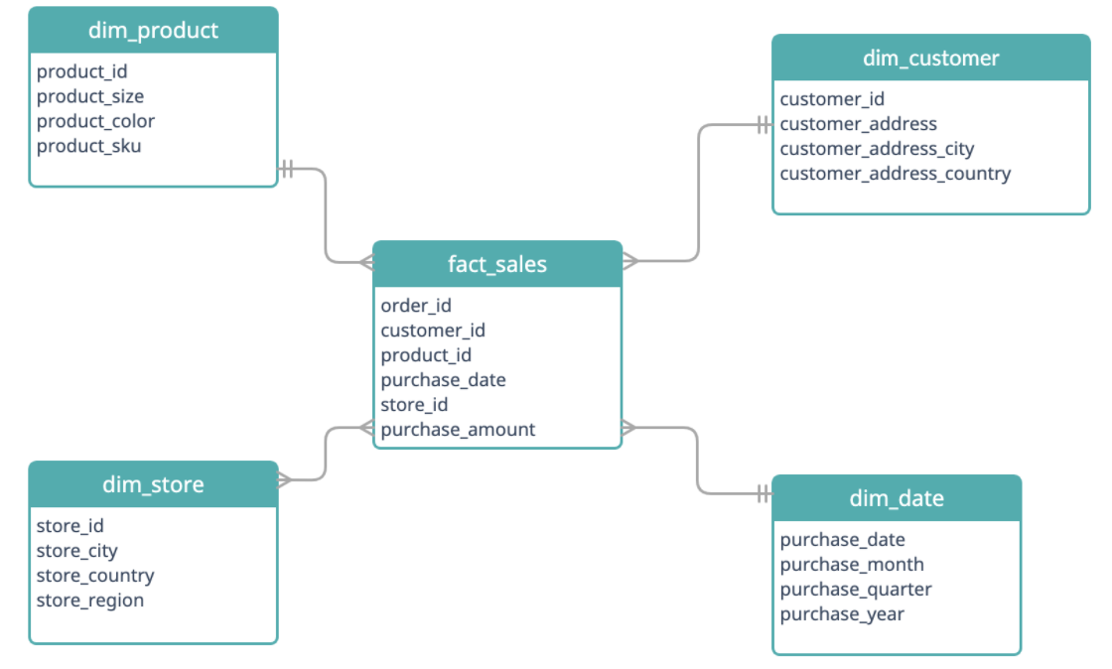
Data Warehouse → Star Schema

Slide 22
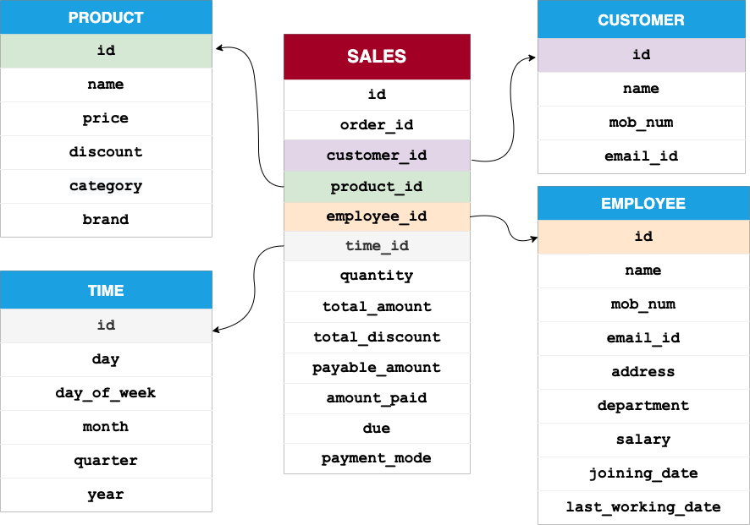
Example of a Star Schema

Slide 23
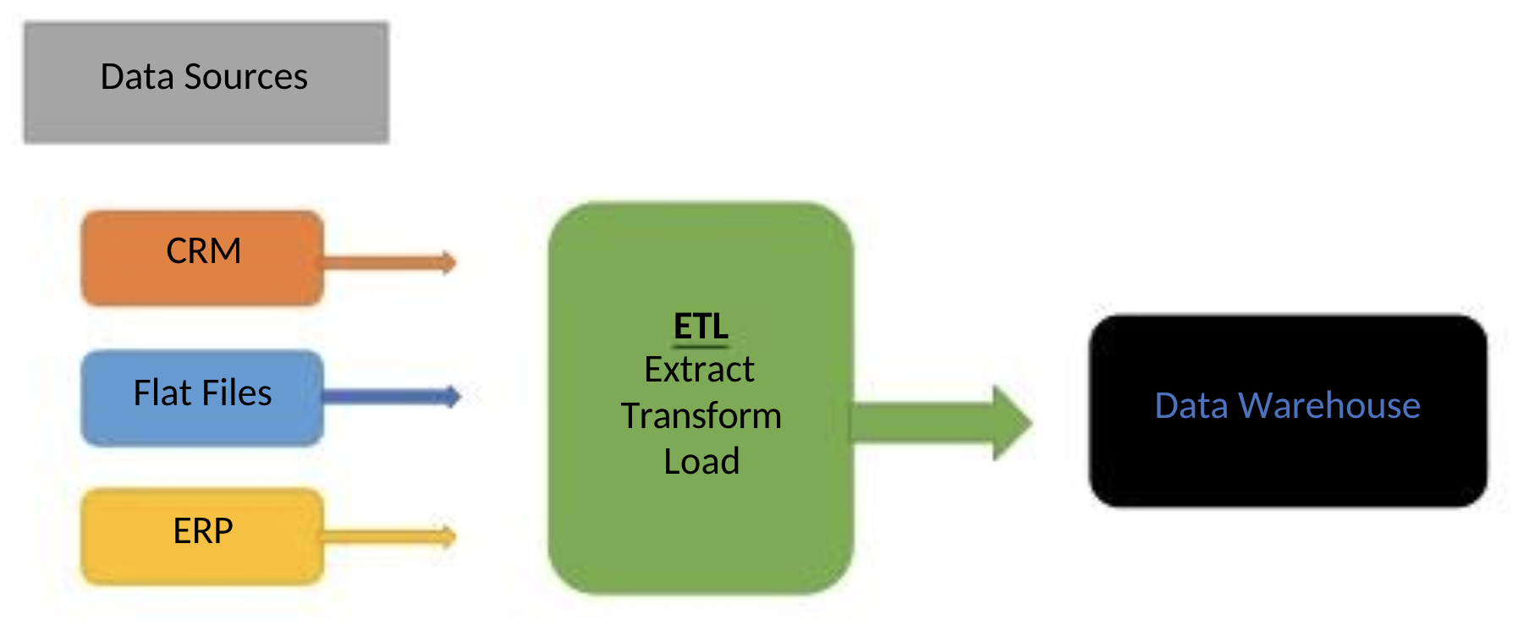
How Data/Information gets to a central Location?

Slide 24
What are some examples of questions that business intelligence might be asked to answer?
What are the top-5 best selling products in the past 2 months?
What products are not selling well?
What are our best-selling products or services?
What is our customer churn rate, and what are the reasons for it?
How are our marketing campaigns performing in different regions?
What are the key factors driving our sales growth or decline?
How effective are our pricing strategies?
What are the patterns and trends in customer behavior?
How efficient are our supply chain and inventory management processes?
What are the opportunities for cost savings or revenue generation?

Slide 25
Netflix BI questions?
How many users did we add per month by state for 2023?
How many users did we lose on a monthly basis?
What was the net profit per month for year 2023?
What was the IT cost per quarter for year 2022 & 2023.
Recommendations per user based on their movie selections?

Slide 26
Why is BI important?
Measurement: creating KPI (Key Performance Indicators) based on historic data
Identify and set benchmarks for varied processes.
With BI systems organizations can identify market trends and spot business problems that need to be addressed.
BI helps on data visualization that enhances the data quality and thereby the quality of decision making.
BI systems can be used not just by enterprises but SME (Small and Medium Enterprises)

Slide 27
Key Performance Indicators (KPIs)
1. Key performance indicators (KPIs) measure a company's success vs. a set of targets, objectives, or industry peers.
2. KPIs can be financial, including net profit (or the bottom line, net income), revenues minus certain expenses, or the current ratio (liquidity and cash availability).

Slide 28
Key Performance Indicators (KPIs) Example: Customer Experience Metrics and KPI
Examples of customer-centric metrics include:
Number of new ticket requests: This KPI counts customer service requests and measures how many new and open issues customers are having.
Number of resolved tickets: This KPI counts the number of requests that have been successfully taken care of. By comparing the number of requests to the number of resolutions, a company can assess its success rate in getting through customer requests.
Average resolution time: This KPI is the average amount of time needed to help a customer with an issue. Companies may choose to segment average resolution time across different requests (i.e., technical issue requests vs. new account requests).
Average response time

Slide 29
How BI systems are implemented?
Step 1: Raw Data from corporate databases is extracted. The data could be spread across multiple systems.
Step 2: The data is cleaned and transformed into the data warehouse. The table can be linked, and data cubes are formed.
Step 3: Using BI system the user can ask queries, request ad-hoc reports or conduct any other analysis.

Slide 30
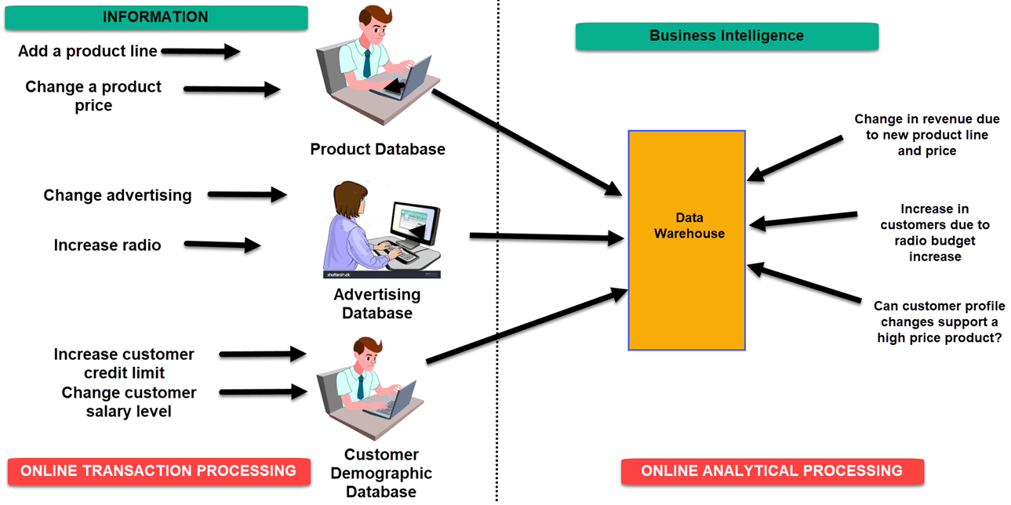
BI System in Practice

Slide 31
Types of BI Users: 1, 2, 3, 4
1. The Professional Data Analyst: The data analyst needs to drill deep down into data. BI system helps them to get fresh insights to develop unique business strategies.
2. The IT users: The IT user also plays a dominant role in maintaining the BI infrastructure.
3. The head of the company: CEO can increase the profit of their business by improving operational efficiency in their business.

Slide 32
Types of BI Users: 4
4. The Business Users
Business intelligence users can be found from across the organization. There are mainly two types of business users
Casual business intelligence user
use dashboards to evaluate predefined sets of data.
The power user.
the capability of working with complex data sets

Slide 33
Advantages of BI
• Boost productivity
• To improve visibility
• Fix Accountability
• It gives a bird's eye view
• It streamlines business processes
• It allows for easy analytics.

Slide 34
Disadvantages of BI
• Cost
• Complexity
• Limited Use
• Time consuming Implementation

Slide 35
Trends in Business Analytics
• Artificial Intelligence
• Collaborative BI
• Embedded BI
• Cloud Analytics

Slide 36
What is Business Intelligence?
1. Business intelligence (BI) is software and set of tools and processes that ingests business data and presents it in user-friendly views such as
reports,
dashboards,
charts and
graphs.
2. Analyzing this data helps businesses
gain actionable insights, and
make inform decision-making.

