Slide 1
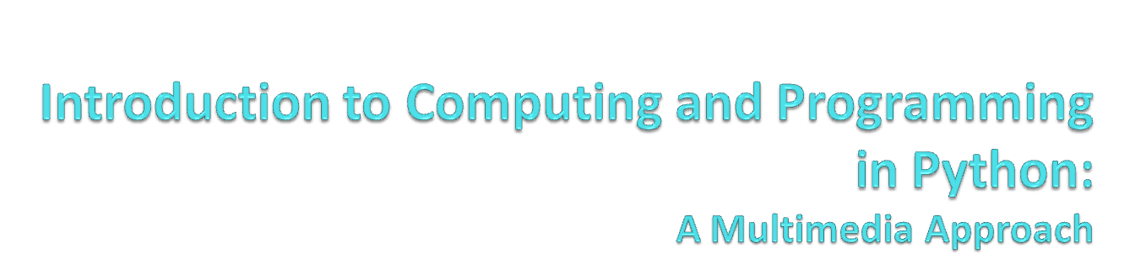
Chapter 12:
Making Text for the Web
Notes:
Thanks to John Sanders of Suffolk University for contributions to these slides!

Slide 2

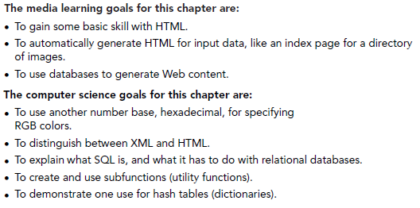

Slide 3
Hypertext Markup Language (HTML)
HTML is a kind of SGML (Standardized general markup language)
  SGML was invented by IBM and others as a way of defining parts of a document COMPLETELY APART FROM HOW THE DOCUMENT WAS FORMATTED.
HTML is a simpler form of SGML, but with a similar goal.
  The original idea of HTML was to define the parts of the document and their relation to one another without defining what it was supposed to look like.
  The look of the document would be decided by the client (browser) and its limitations.
    For example, a document would look different on a PDA than on your screen or on your cellphone.
    Or in IE vs. Netscape vs. Opera vs….

Slide 4
Evolution of HTML
But with the explosive growth of the Web, HTML has become much more.
  Now, people want to control the look-and-feel of the page down to the pixels and fonts.
  Plus, we want to grab information more easily out of Web pages.
    Leading to XML, the eXtensible Markup Language.
    XML allows for new kinds of markup languages (that, say, explicitly identify prices or stock ticker codes) for business purposes.

Slide 5
Three kinds of HTML languages
Original HTML: Simple, what the earliest browsers understood.
CSS, Cascading Style Sheets
  Ways of defining more of the formatting instructions than HTML allowed.
XHTML: HTML re-defined in terms of XML.
  A little more complicated to use, but more standardized, more flexible, more powerful.
  It’s the future of where the Web is going.

Slide 6
When use each?
Bigger sites should use XHTML and CSS
XHTML enforces accessibility requirements so that your documents can be read by Braille browsers and audio browsers.
HTML is easiest for simple websites.
For most of this lecture, we’ll be focusing on XHTML, but we’ll just use “HTML” generically.
  We’re not going to get into much of the formatting side of XHTML nor CSS—detailed, and isn’t the same on all browsers.

Slide 7
Markup means adding tags
A markup language adds tags to regular text to identify its parts.
A tag in HTML is enclosed by <angle brackets>.
Most tags have a starting tag and an ending tag.
  A paragraph is identified by a <p> at its start and a </p> at its end.
  A heading is identified by a <h1> at its start and a </h1> at its end.

Slide 8
HTML is just text in a file
We enter our text and our tags in just a plain ole ordinary text file.
Use an extension of “.html” (“.htm” if your computer only allows three characters) to indicate HTML.
JES works just fine for editing and saving HTML files.
  Just don’t try to load them!

Slide 9
Parts of a Web Page
You start with a DOCTYPE
  It tells browsers what kind of language you’re using below.
  It’s gorey and technical—copy it verbatim from somewhere.
The whole document is enclosed in <html> </html> tags.
  The heading is enclosed with <head> </head>
    That’s where you put the <title> </title>
  The body is enclosed with <body> </body>
    That’s where you put <h1> headings and <p> paragraphs.

Slide 10
The Simplest Web Page
<!DOCTYPE HTML PUBLIC "-//W3C//DTD HTML 4.01 Transition//EN" "http://wwww.w3.org/TR/html4/loose.dtd">
<html>
<head>
<title>The Simplest Possible Web Page</title>
</head>
<body>
<h1>A Simple Heading</h1>
<p>This is a paragraph in the simplest
possible Web page.</p>
</body>
</html>
Yes, that whole thing is the DOCTYPE
No, it doesn’t matter where you put returns, or extra spaces
Notes:
Notice the nesting, just like loops.

Slide 11
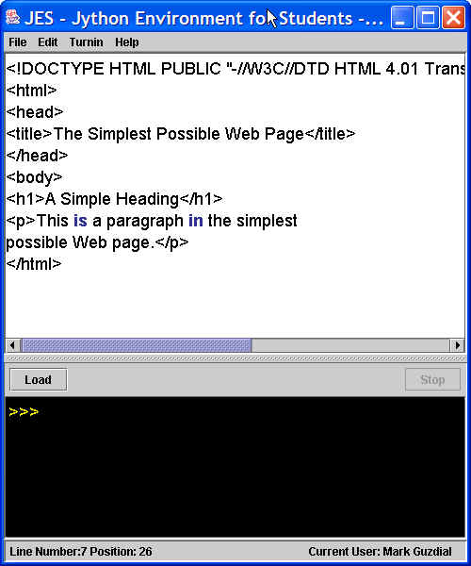
Editing in JES

Slide 12
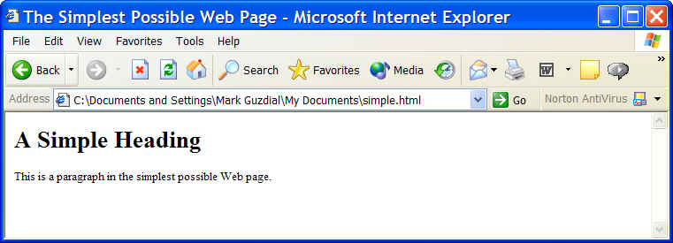
What it looks like in IE

Slide 13
Is this a Web page?
Of course, it is!
The only difference between this page and one on the Web is that the one on the Web (a) has been uploaded to a Web server and (b) placed in a directory that the Web server can access.
  See the Networking lecture

Slide 14
What if you forget the DOCTYPE? Or an ending tag?
It’ll probably work.
Browsers have developed to deal with all kinds of weird HTML.
  But if the browser has to guess, then it may guess wrong
    That is, not what you expected or meant.
  Which is when your document may look different on different browsers.

Slide 15
Other things in there
We’re simplifying these tags a bit.
More can go in the <head>
  Javascript
  References to documents like cascading style sheets
The <body> tag can also set colors.
  <body bgcolor="#ffffff" text="#000000" link="#3300cc" alink="#cc0033" vlink="#550088">
  These are actually setting RGB values!

Slide 16
A tiny tutorial on hexadecimal
You know decimal numbers (base 10)
  0,1,2,3,4,5,6,7,8,9,10,11,12,13,14,15,16
You’ve heard a little about binary (base 2)
  0000,0001,0010,0011,0100,0101…
Hexadecimal is base 16
  0,1,2,3,4,5,6,7,8,9,A,B,C,D,E,F,10 (16 base 10)

Slide 17
Hexadecimal colors in HTML
#FF0000 is Red
  255 for red (FF), 0 for green, 0 for blue
#0000FF is Blue
  0 for red, 0 for green, 255 for blue
#000000 is black
  0 for red, 0 for green, 0 for blue
#FFFFFF is white
  255 for red, 255 for green, 255 for blue

Slide 18
Emphasizing your text
There are six levels of headings defined in HTML.
  <h1>…<h6>
  Lower numbers are larger, more prominent.
Styles
  <em>Emphasis</em>, <i>Italics</i>, and <b>Boldface</b>
  <big>Bigger font</big> and <small>Smaller font</small>
  <tt>Typewriter font</tt>
  <pre>Pre-formatted</pre>
  <blockquote>Blockquote</blockquote>
  <sup>Superscripts</sup> and <sub>Subscripts</sub>

Slide 19
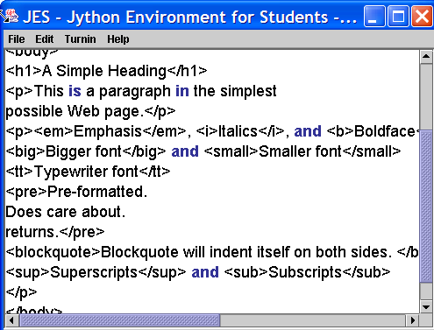
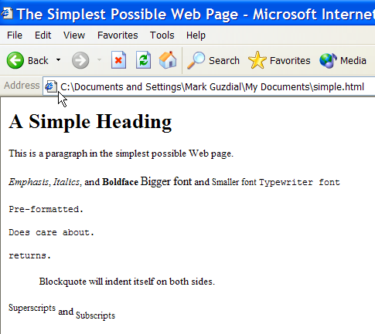
Examples of styles

Slide 20
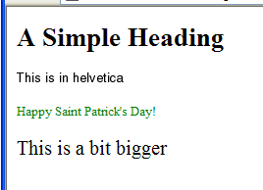
Finer control: <font>
Can control type face, color, or size
<body>
<h1>A Simple Heading</h1>
<p><font face="Helvetica">This is in helvetica</font></p>
<p><font color="green">Happy Saint Patrick's Day!</font></p>
<p><font size="+2">This is a bit bigger</font></p>
</body>
Can also use hexadecimal RGB specification here.

Slide 21
Breaking a line
Line breaks are part of formatting, not content, so they were added grudgingly to HTML.
Line breaks don’t have text within them, so they include the ending “\” within themselves.
  <br \>

Slide 22
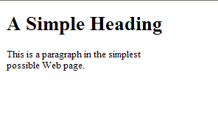
Adding a break
<!DOCTYPE HTML PUBLIC "-//W3C//DTD HTML 4.01 Transition//EN" "http://wwww.w3.org/TR/html4/loose.dtd">
<html>
<head>
<title>The Simplest Possible Web Page</title>
</head>
<body>
<h1>A Simple Heading</h1>
<p>This is a paragraph in the simplest
<br \>
possible Web page.</p>
</body>
</html>

Slide 23
Adding an image
Like break, it’s a standalone tag.
  <image src="flower1.jpg“ />
What goes inside the quotes is the path to the image.
  If it’s in the same directory, don’t need to specify the path.
  If it’s in a subdirectory, you need to specify the subdirectory and the base name.
  You can walk a directory by going up to a parent directory with “..”
  You can also provide a complete URL to an image anywhere on the Web.

Slide 24
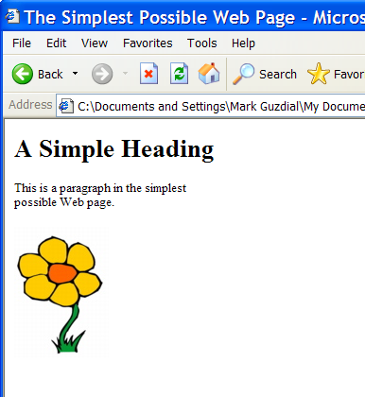
An example image tag use
<!DOCTYPE HTML PUBLIC "-//W3C//DTD HTML 4.01 Transition//EN" "http://wwww.w3.org/TR/html4/loose.dtd">
<html>
<head>
<title>The Simplest Possible Web Page</title>
</head>
<body>
<h1>A Simple Heading</h1>
<p>This is a paragraph in the simplest <br \>
possible Web page.</p>
<image src="mediasources/flower1.jpg“ />
</body>
</html>
Notes:
This is sitting in my main directory, above mediasources

Slide 25
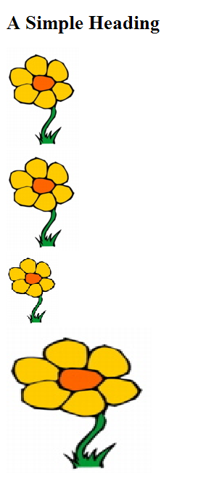
Parameters to image tags
You can specify width and height in image tags.
<h1>A Simple Heading</h1>
<image src="mediasources/flower1.jpg" /> <br />
<image src="mediasources/flower1.jpg" width="100" /> <br />
<image src="mediasources/flower1.jpg" height="100" /> <br />
<image src="mediasources/flower1.jpg" width="200" height="200" /> <br />
</body>
</html>

Slide 26
Alt in images
Some browsers (like audio or Braille) can’t show images.
You can include alternative text to be displayed instead of the image in those cases.
  <image src="mediasources/flower1.jpg" alt="A Flower" />

Slide 27
Other options in image tags
align=“left” or align=“right” to float an image
hspace=“10” or vspace=“10” to add 10 pixels to left and right, or top and bottom
align=“texttop” will align with top of corresponding text.
  Try these out!

Slide 28
Creating links
Links have two main parts to them:
  A destination URL.
  Something to be clicked on to go to the destination.
The link tag is “a” for “anchor”
<a href="http://www.cc.gatech.edu/~mark.guzdial/">Mark Guzdial</a>

Slide 29
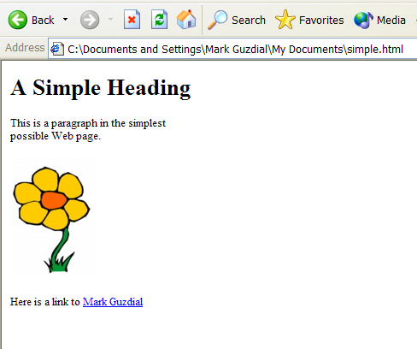
What it looks like
<body>
<h1>A Simple Heading</h1>
<p>This is a paragraph in the simplest
<br \>
possible Web page.</p>
<image src="mediasources/flower1.jpg" alt="A Flower" />
<p>Here is a link to
<a href="http://www.cc.gatech.edu/~mark.guzdial/">Mark Guzdial</a>
</body>

Slide 30

Labels can be images!
<h1>A Simple Heading</h1>
<p><a href="http://www.cc.gatech.edu/">
<image src="http://www.cc.gatech.edu/images/main_files/goldmain_01.gif" \>
</a>

Slide 31
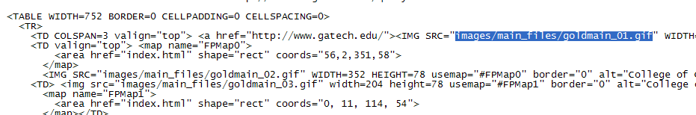

Getting the path to an image

Slide 32
Lists
Ordered lists (numbered)
  <ol>
    <li>First item </li>
    <li>Next item</li>
  </ol>
Unordered lists (bulleted)
  <ul>
    <li>First item</li>
    <li>Second item</li>
  </ul>

Slide 33
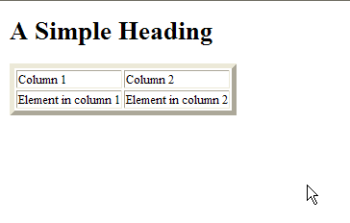
Tables
<table border="5">
<tr><td>Column 1</td><td>Column 2</td></tr
<tr><td>Element in column 1</td><td>Element in column 2</td></tr>
</table>

Slide 34
There is lots more to HTML
Frames
  Can have subwindows within a window with different HTML content.
  Anchors can have target frames.
Divisions <div />
Horizontal rules <hr />
  With different sizes, colors, shading, etc.
Applets, Javascript, etc.

Slide 35
Best way to learn HTML:
Look at pages!
View source all the time, especially when there’s something new and cool that you’ve never seen before.
There are lots of good on-line tutorials.
There are many good books.

Slide 36
HTML is not a programming language
Using HTML is called “coding” and it is about getting your codes right.
But it’s not about coding programs.
HTML has no
  Loops
  IFs
  Variables
  Data types
  Ability to read and write files
Bottom line: HTML does not communicate process!

Slide 37
We can use programs to generate HTML
def makePage():
file=open("generated.html","wt")
file.write("""<!DOCTYPE HTML PUBLIC "-//W3C//DTD HTML 4.01 Transition//EN" "http://wwww.w3.org/TR/html4/loose.dtd">
<html>
<head>
<title>The Simplest Possible Web Page</title>
</head>
<body>
<h1>A Simple Heading</h1>
<p>Some simple text.</p>
</body>
</html>""")
file.close()

Slide 38
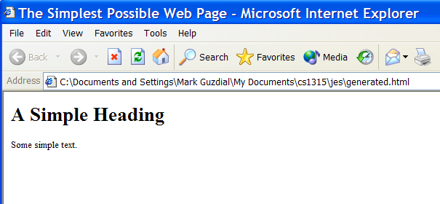
A Generated Page
<!DOCTYPE HTML PUBLIC "-//W3C//DTD HTML 4.01 Transition//EN" "http://wwww.w3.org/TR/html4/loose.dtd">
<html>
<head>
<title>The Simplest Possible Web Page</title>
</head>
<body>
<h1>A Simple Heading</h1>
<p>Some simple text.</p>
</body>
</html>

Slide 39
Tailoring the output
That works, but that’s boring.
Why would you want to just put in a file what you can put in via a text editor?
  Why you write a program: Replicability, communicating process…and tailorability!
Let’s make a homepage creator!
  A home page should have your name,
  and at least one of your interests.

Slide 40
A homepage editor
def makeHomePage(name, interest):
file=open("homepage.html","wt")
file.write("""<!DOCTYPE HTML PUBLIC "-//W3C//DTD HTML 4.01 Transition//EN" "http://wwww.w3.org/TR/html4/loose.dtd">
<html>
<head>
<title>"""+name+"""'s Home Page</title>
</head>
<body>
<h1>Welcome to """+name+"""'s Home Page</h1>
<p>Hi! I am """+name+""". This is my home page!
I am interested in """+interest+"""</p>
</body>
</html>""")
file.close()

Slide 41
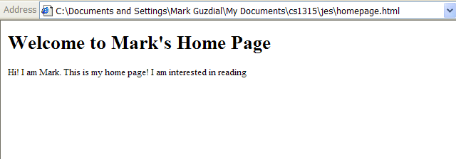
makeHomePage("Mark","reading")
<!DOCTYPE HTML PUBLIC "-//W3C//DTD HTML 4.01 Transition//EN" "http://wwww.w3.org/TR/html4/loose.dtd">
<html>
<head>
<title>Mark's Home Page</title>
</head>
<body>
<h1>Welcome to Mark's Home Page</h1>
<p>Hi! I am Mark. This is my home page!
I am interested in reading</p>
</body>
</html>

Slide 42
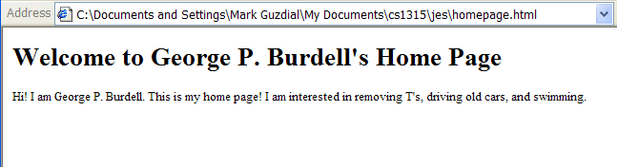
makeHomePage("George P. Burdell","removing T's, driving old cars, and swimming.")
<!DOCTYPE HTML PUBLIC "-//W3C//DTD HTML 4.01 Transition//EN" "http://wwww.w3.org/TR/html4/loose.dtd">
<html>
<head>
<title>George P. Burdell's Home Page</title>
</head>
<body>
<h1>Welcome to George P. Burdell's Home Page</h1>
<p>Hi! I am George P. Burdell. This is my home page!
I am interested in removing T's, driving old cars, and swimming.</p>
</body>
</html>
George P. Burdell is a Georgia Tech tradition. Look him up!

Slide 43
Works…but painful
Try to change the home page code.
  Maybe insert a picture, or another line about interests, or a favorite URL.
It’s hard, isn’t it?
  It’s hard to track down all those quotes,
  insert the +’s and variables in the right place,
  and it’s one loooooong string.
Can we make it easier to work with?
  Sure! Let’s use more functions!

Slide 44
New Homepage Program
def makeHomePage(name, interest):
file=open("homepage.html","wt")
file.write(doctype())
file.write(title(name+"'s Home Page"))
file.write(body("""
<h1>Welcome to """+name+"""'s Home Page</h1>
<p>Hi! I am """+name+""". This is my home page!
I am interested in """+interest+"""</p>"""))
file.close()
def doctype():
return '<!DOCTYPE HTML PUBLIC "-//W3C//DTD HTML 4.01 Transition//EN" "http://wwww.w3.org/TR/html4/loose.dtd">'
def title(titlestring):
return "<html><head><title>"+titlestring+"</title></head>"
def body(bodystring):
return "<body>"+bodystring+"</body></html>"
Up here on top is where we deal with the parts that we might likely change.
Bury the yucky doctype here—may we never deal with it again!
Here are more details we don’t really want to deal with.

Slide 45
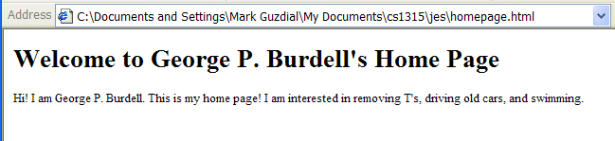
makeHomePage("George P. Burdell","removing T's, driving old cars, and swimming.")
<!DOCTYPE HTML PUBLIC "-//W3C//DTD HTML 4.01 Transition//EN" "http://wwww.w3.org/TR/html4/loose.dtd"><html><head><title>George P. Burdell's Home Page</title></head><body>
<h1>Welcome to George P. Burdell's Home Page</h1>
<p>Hi! I am George P. Burdell. This is my home page!
I am interested in removing T's, driving old cars, and swimming.</p></body></html
Works the same, even though the program structure has changed.

Slide 46
Where can we get Web content from? ANYWHERE WE WANT!
We’ve learned a lot of ways of generating textual information over the last weeks.
We can use these to create all kinds of Web pages.
  Grabbing information out of directories using the os module
  Grabbing information out of other Web pages
  Generating random sentences
  Generating Web pages from databases

Slide 47
Generating a samples page
import os
def makeSamplePage(directory):
samplesfile=open(directory+"//samples.html","wt")
samplesfile.write(doctype())
samplesfile.write(title("Samples from "+directory))
# Now, let's make up the string that will be the body.
samples="<h1>Samples from "+directory+" </h1>\n"
for file in os.listdir(directory):
if file.endswith(".jpg"):
samples=samples+"<p>Filename: "+file
samples=samples+'<image src="'+file+'" height="100" /></p>\n'
samplesfile.write(body(samples))
samplesfile.close()
def doctype():
return '<!DOCTYPE HTML PUBLIC "-//W3C//DTD HTML 4.01 Transition//EN" "http://wwww.w3.org/TR/html4/loose.dtd">'
def title(titlestring):
return "<html><head><title>"+titlestring+"</title></head>"
def body(bodystring):
return "<body>"+bodystring+"</body></html>"

Slide 48
Just the part we care about
def makeSamplePage(directory):
samplesfile=open(directory+"//samples.html","wt")
samplesfile.write(doctype())
samplesfile.write(title("Samples from "+directory))
# Now, let's make up the string that will be the body.
samples="<h1>Samples from "+directory+" </h1>\n"
for file in os.listdir(directory):
if file.endswith(".jpg"):
samples=samples+"<p>Filename: "+file
samples=samples+'<image src="'+file+'" height="100" /></p>\n'
samplesfile.write(body(samples))
samplesfile.close()
Why samplesfile? Can’t use file here and here.
We don’t need \n, but it makes the pages easier to read.

Slide 49
“Just the part I care about” is how you should think about it.
Once you write the utility functions, remember them just the way you remember functions like open() and getSampleValueAt()
They do a job for you.
  Don’t worry about how they do it.
This allows you to focus on the important parts.
  The parts you care about.

Slide 50
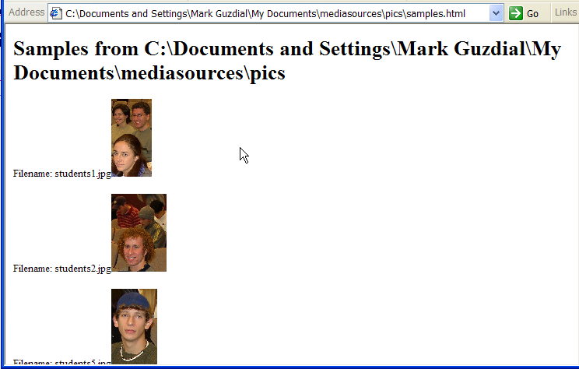
makeSamplePage("C:\Documents and Settings\Mark Guzdial\My Documents\mediasources\pics")
<!DOCTYPE HTML PUBLIC "-//W3C//DTD HTML 4.01 Transition//EN" "http://wwww.w3.org/TR/html4/loose.dtd"><html><head><title>Samples from C:\Documents and Settings\Mark Guzdial\My Documents\mediasources\pics</title></head><body><h1>Samples from C:\Documents and Settings\Mark Guzdial\My Documents\mediasources\pics </h1>
<p>Filename: students1.jpg<image src="students1.jpg" height="100" /></p>
<p>Filename: students2.jpg<image src="students2.jpg" height="100" /></p>
<p>Filename: students5.jpg<image src="students5.jpg" height="100" /></p>
<p>Filename: students6.jpg<image src="students6.jpg" height="100" /></p>
<p>Filename: students7.jpg<image src="students7.jpg" height="100" /></p>
<p>Filename: students8.jpg<image src="students8.jpg" height="100" /></p>
</body></html>
Notes:
Should do this for mediasources directory as a real test.

Slide 51
Remember getting the live temperature?
def findTemperatureLive():
# Get the weather page
import urllib
connection=urllib.urlopen("http://www.ajc.com/weather")
weather = connection.read()
connection.close()
#weatherFile = getMediaPath("ajc-weather.html")
#file = open(weatherFile,"rt")
#weather = file.read()
#file.close()
# Find the Temperature
curloc = weather.find("Currently")
if curloc <> -1:
# Now, find the "<b>&deg;" following the temp
temploc = weather.find("<b>&deg;",curloc)
tempstart = weather.rfind(">",0,temploc)
print "Current temperature:",weather[tempstart+1:temploc]
if curloc == -1:
print "They must have changed the page format -- can't find the temp"
Sure, printing was fine here, but if we returned the value, then we could use it elsewhere…like in new Web pages!

Slide 52
Making the temperature reusable
def findTemperatureLive():
# Get the weather page
import urllib
connection=urllib.urlopen("http://www.ajc.com/weather")
weather = connection.read()
connection.close()
#weatherFile = getMediaPath("ajc-weather.html")
#file = open(weatherFile,"rt")
#weather = file.read()
#file.close()
# Find the Temperature
curloc = weather.find("Currently")
if curloc <> -1:
# Now, find the "<b>&deg;" following the temp
temploc = weather.find("<b>&deg;",curloc)
tempstart = weather.rfind(">",0,temploc)
return weather[tempstart+1:temploc]
if curloc == -1:
return "They must have changed the page format -- can't find the temp"
We return instead of printing

Slide 53
Adding it in to our homepage generator
import urllib
def makeHomePage(name, interest):
file=open("homepage.html","wt")
file.write(doctype())
file.write(title(name+"'s Home Page"))
file.write(body("""
<h1>Welcome to """+name+"""'s Home Page</h1>
<p>Hi! I am """+name+""". This is my home page!
I am interested in """+interest+"""</p>
<p>Right here and right now it's """+findTemperatureLive()+""" degrees.
(If you're in the North, nyah-nyah!)"""))
file.close()
def findTemperatureLive():
# Get the weather page
import urllib
connection=urllib.urlopen("http://www.ajc.com/weather")
weather = connection.read()
connection.close()
#weatherFile = getMediaPath("ajc-weather.html")
#file = open(weatherFile,"rt")
#weather = file.read()
#file.close()
# Find the Temperature
curloc = weather.find("Currently")
if curloc <> -1:
# Now, find the "<b>&deg;" following the temp
temploc = weather.find("<b>&deg;",curloc)
tempstart = weather.rfind(">",0,temploc)
return weather[tempstart+1:temploc]
if curloc == -1:
return "They must have changed the page format -- can't find the temp"

Slide 54
Again, just the part we care about
def makeHomePage(name, interest):
file=open("homepage.html","wt")
file.write(doctype())
file.write(title(name+"'s Home Page"))
file.write(body("""
<h1>Welcome to """+name+"""'s Home Page</h1>
<p>Hi! I am """+name+""". This is my home page!
I am interested in """+interest+"""</p>
<p>Right here and right now it's """+findTemperatureLive()+""" degrees.
(If you're in the North, nyah-nyah!)"""))
file.close()

Slide 55
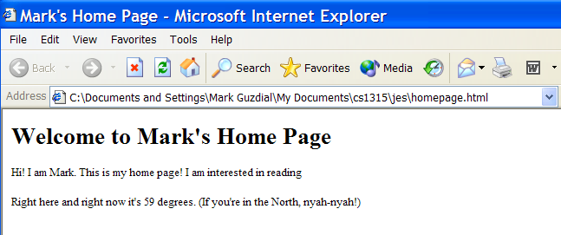
makeHomePage("Mark","reading")
<!DOCTYPE HTML PUBLIC "-//W3C//DTD HTML 4.01 Transition//EN" "http://wwww.w3.org/TR/html4/loose.dtd"><html><head><title>Mark's Home Page</title></head><body>
<h1>Welcome to Mark's Home Page</h1>
<p>Hi! I am Mark. This is my home page!
I am interested in reading</p>
<p>Right here and right now it's 59 degrees.
(If you're in the North, nyah-nyah!)</body></html>

Slide 56
Remember the random sentence generator?
import random
def sentence():
nouns = ["Mark", "Adam", "Angela", "Larry", "Jose", "Matt", "Jim"]
verbs = ["runs", "skips", "sings", "leaps", "jumps", "climbs", "argues", "giggles"]
phrases = ["in a tree", "over a log", "very loudly", "around the bush", "while reading the Newspaper."]
phrases = phrases + ["very badly", "while skipping","instead of grading", "while typing on the Internet."]
#print random.choice(nouns), random.choice(verbs), random.choice(phrases),".“
return random.choice(nouns)+" "+random.choice(verbs)+" "+random.choice(phrases)+"."

Slide 57
Adding to the Homepage Generator: Just the important part
import urllib
import random
def makeHomePage(name, interest):
file=open("homepage.html","wt")
file.write(doctype())
file.write(title(name+"'s Home Page"))
file.write(body("""
<h1>Welcome to """+name+"""'s Home Page</h1>
<p>Hi! I am """+name+""". This is my home page!
I am interested in """+interest+"""</p>
<p>Right here and right now it's """+findTemperatureLive()+""" degrees.
(If you're in the North, nyah-nyah!).</p>
<p>Random thought for the day: """+sentence()+"</p>"))
file.close()

Slide 58
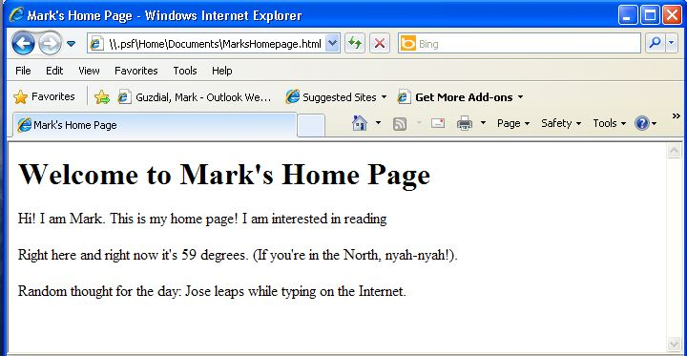
makeHomePage("Mark","reading")
<!DOCTYPE HTML PUBLIC "-//W3C//DTD HTML 4.01 Transition//EN" "http://wwww.w3.org/TR/html4/loose.dtd"><html><head><title>Mark's Home Page</title></head><body>
<h1>Welcome to Mark's Home Page</h1>
<p>Hi! I am Mark. This is my home page!
I am interested in reading</p>
<p>Right here and right now it's 59 degrees.
(If you're in the North, nyah-nyah!).</p>
<p>Random thought for the day: Jose leaps while typing on the Internet.</p></body></html>

Slide 59
Thought experiment:
Timed generation
Imagine that you could have this program run every 30 minutes, and immediately copy (FTP) the result up to your Web site.
  The temperature would be updated every 30 minutes.
  A random sentence would be generated every 30 minutes.
Suggestion: You could do this now!
  Most operating systems have some way to do tasks like this (see the Scheduled Tasks control panel in Windows, crontab in Macs and Linux)
  You’ve seen how to do FTP automatically.

Slide 60
2nd Thought Experiment:
Look how complicated it’s getting!
On the right is all the code for the home page program.
  Barely fits on the screen at 8 point font size!
But we only had to worry about a dozen lines of it!
Why?
  We used more functions that allowed us to hide away detail that we didn’t want to see anymore!
import urllib
import random
def makeHomePage(name, interest):
file=open("homepage.html","wt")
file.write(doctype())
file.write(title(name+"'s Home Page"))
file.write(body("""
<h1>Welcome to """+name+"""'s Home Page</h1>
<p>Hi! I am """+name+""". This is my home page!
I am interested in """+interest+"""</p>
<p>Right here and right now it's """+findTemperatureLive()+""" degrees.
(If you're in the North, nyah-nyah!).</p>
<p>Random thought for the day: """+sentence()+"</p>"))
file.close()
def sentence():
nouns = ["Mark", "Adam", "Angela", "Larry", "Jose", "Matt", "Jim"]
verbs = ["runs", "skips", "sings", "leaps", "jumps", "climbs", "argues", "giggles"]
phrases = ["in a tree", "over a log", "very loudly", "around the bush", "while reading the newspaper"]
phrases = phrases + ["very badly", "while skipping","instead of grading", "while typing on the Internet."]
return random.choice(nouns)+" "+random.choice(verbs)+" "+random.choice(phrases)+"."
def findTemperatureLive():
connection = urllib.urlopen("http://www.accessatlanta.com/weather")
weather = connection.read()
connection.close()
# Find the Temperature
humloc = weather.find("Humidity")
if humloc <> -1:
# Now, find the "," where the temp starts
temploc = weather.rfind(",",0,humloc)
endline = weather.find("<",temploc)
return weather[temploc+1:endline]
if humloc == -1:
return "Temperature not currently available"
def doctype():
return '<!DOCTYPE HTML PUBLIC "-//W3C//DTD HTML 4.01 Transition//EN" "http://wwww.w3.org/TR/html4/loose.dtd">'
def title(titlestring):
return "<html><head><title>"+titlestring+"</title></head>"
def body(bodystring):
return "<body>"+bodystring+"</body></html>"

Slide 61
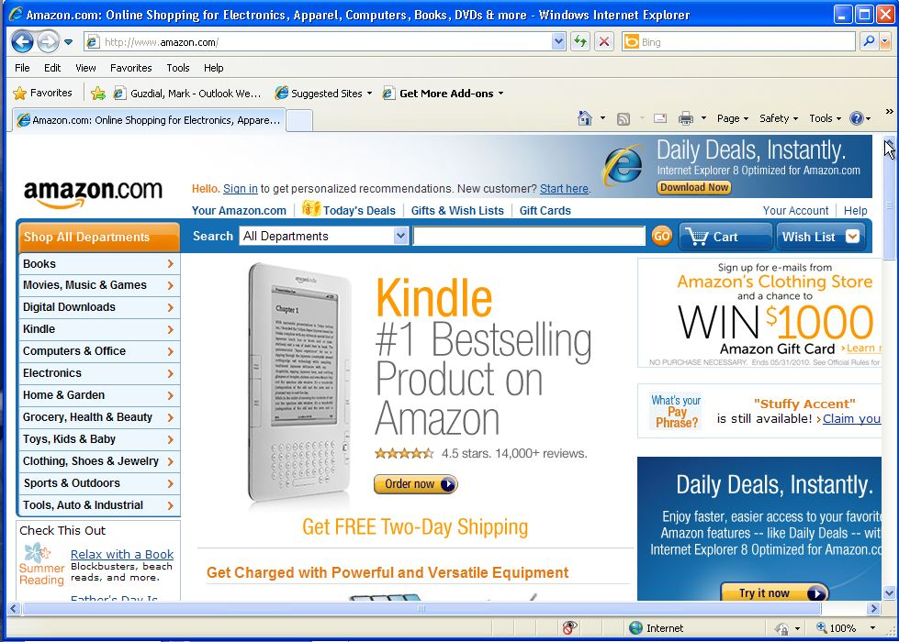
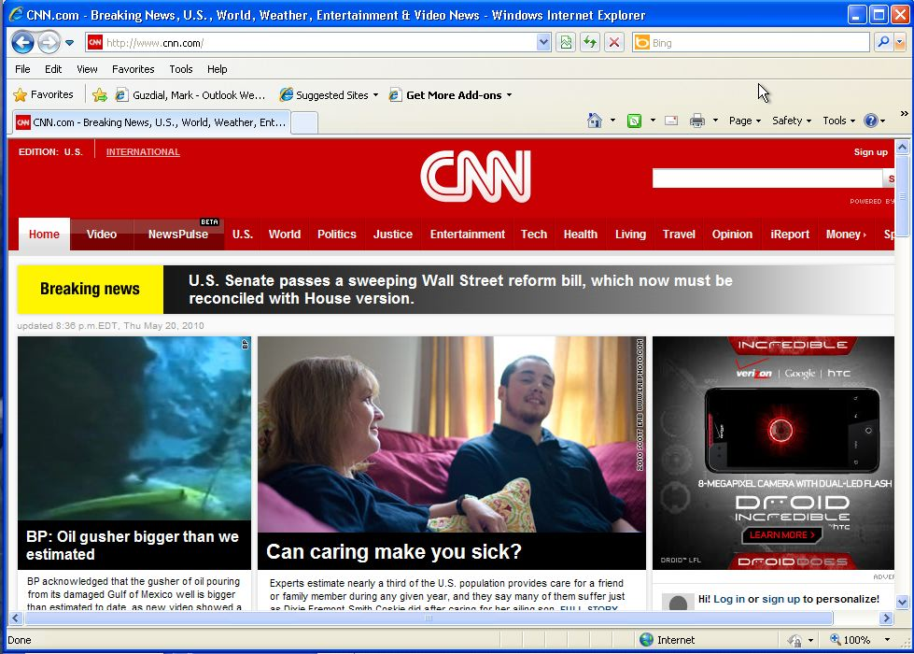
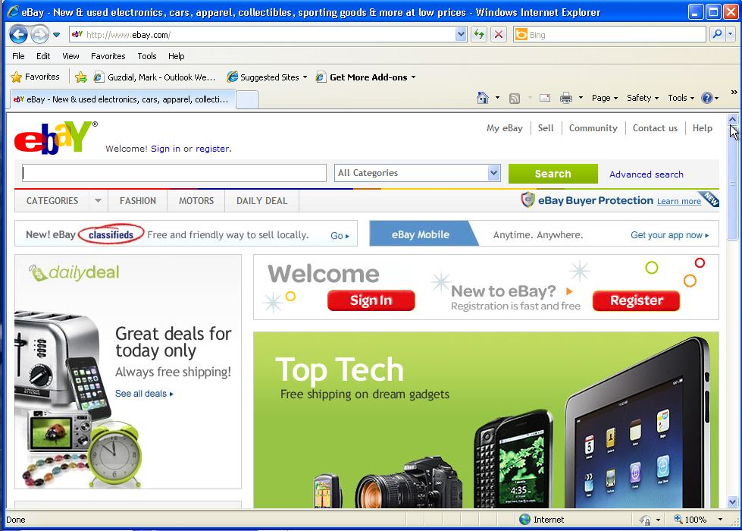
Information can come from anywhere
But it mostly comes from databases.
Every major website generates its web pages from a database.

Slide 62
Generating from a database:
Put a story in the database.
>>> import anydbm
>>> db=anydbm.open("news","c")
>>> db["headline"]="Katie turns 8!"
>>> db["story"]="""My daughter, Katie, turned 8 years old yesterday. She had a great birthday. Grandma and Grandpa came over. The previous weekend, she had three of her friends over for a sleepover then a morning run to Dave and Buster's."""
>>> db.close()

Slide 63
Add news to the homepage
def makeHomePage(name, interest):
file=open("homepage.html","wt")
file.write(doctype())
file.write(title(name+"'s Home Page"))
# Import the database content
db=anydbm.open("news","r")
file.write(body("""
<h1>Welcome to """+name+"""'s Home Page</h1>
<p>Hi! I am """+name+""". This is my home page!
I am interested in """+interest+"""</p>
<p>Right here and right now it's """+findTemperatureLive()+""" degrees.
(If you're in the North, nyah-nyah!).</p>
<p>Random thought for the day: """+sentence()+"""</p>
<h2>Latest news: """+db["headline"]+"""</h2>
<p>"""+db["story"]+"</p>"))
file.close()
db.close()
Database additions

Slide 64
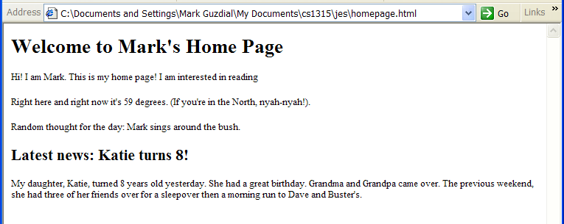
makeHomePage("Mark","reading")
<!DOCTYPE HTML PUBLIC "-//W3C//DTD HTML 4.01 Transition//EN" "http://wwww.w3.org/TR/html4/loose.dtd"><html><head><title>Mark's Home Page</title></head><body>
<h1>Welcome to Mark's Home Page</h1>
<p>Hi! I am Mark. This is my home page!
I am interested in reading</p>
<p>Right here and right now it's 59 degrees.
(If you're in the North, nyah-nyah!).</p>
<p>Random thought for the day: Mark sings around the bush.</p>
<h2>Latest news: Katie turns 8!</h2>
<p>My daughter, Katie, turned 8 years old yesterday. She had a great birthday. Grandma and Grandpa came over. The previous weekend, she had three of her friends over for a sleepover then a morning run to Dave and Buster's.</p></body></html>

Slide 65
Another thought experiment: Database handled elsewhere
Imagine that you have a bunch of reporters who are entering stories and headlines into a shared database.
Or just imagine a separate interface to let you enter stories into your own database.
And again, at regular intervals, HTML pages are generated and uploaded via FTP onto Web servers.
  Now you know how CNN.com works!
  Now you know why databases are a big deal for Web developers!

Slide 66
Why is a database useful for a big web site?
For CNN.com:
  Can have multiple authors and editors creating multiple stories distributed all over a network.
  Can pull the content automatically via a program and merge all the stories into one big website
Works similarly for other kinds of large websites
  Amazon.com
    Where do you think their catalog and review is stored?
  EBay.com
    Where do you think all those pictures and descriptions and bid information is stored?

Slide 67
Why databases?
Rather: Why not just use files?
  Why do we care about using some extra software for storing our bytes?
Databases provide efficient access to data in a standardized mechanism.
  Databases are fast.
  Databases can be accessed from more than one place in more than one way.
  Databases store relations between data

Slide 68
Databases are fast because of indices
Filenames are indexed just by name.
Usually, you care about information that is found by something other than a filename.
  For example, you may care about someone’s information identified by last name or by SSN or even birthdate or city/state of residence.

Slide 69
Databases are standardized
There are many different standard databases.
  In the UNIX and open source markets: bsddb, gdbm, MySQL
  In the commercial markets: Microsoft Access, Informix, Oracle, Sybase
Information stored in a standard database can be accessed and manipulated via many different tools and languages.

Slide 70
Databases store relations
Recall our list representation of pixels.
  It was just a list of five numbers.
  Who knew that the first two numbers were x and y positions, and the last three were RGB values?
  Only us—it wasn’t recorded anywhere.
Databases can store names for the fields of data
They can store which fields are important (and thus indexed for rapid access), and how fields are related (e.g., that each pixel has three color components, that each student has one transcript)

Slide 71
Simplest databases in Python
anydbm is a built-in database to Python.
>>> import anydbm
>>> db = anydbm.open("mydbm","c")
>>> db["fred"] = "My wife is Wilma."
>>> db["barney"] = "My wife is Betty."
>>> db.close()
“C” for “create” the database
Keys on which the database is indexed.

Slide 72
Accessing our simple database
>>> db = anydbm.open("mydbm","r")
>>> print db.keys()
['barney', 'fred']
>>> print db['barney']
My wife is Betty.
>>> for k in db.keys():
... print db[k]
...
My wife is Betty.
My wife is Wilma.
>>> db.close()
Now, open for Reading

Slide 73
Disadvantages of the simple database
Keys and values can only be simple strings.
Can only have a single index.
  Can’t index, say, on last name and SSN.
Doesn’t store field names.
There’s no real search or manipulation capability built in other than simply using Python.

Slide 74
Shelves store anything
>>> import shelve
>>> db=shelve.open("myshelf","c")
>>> db["one"]=["This is",["a","list"]]
>>> db["two"]=12
>>> db.close()
>>> db=shelve.open("myshelf","r")
>>> print db.keys()
['two', 'one']
>>> print db['one']
['This is', ['a', 'list']]
>>> print db['two']
12
Can use shelves to store in standardized database formats, but not really useful for Python-specific data.

Slide 75
Well, not quite anything
Can we use the shelve module to store and retrieve our media?
It’s not made for data like that.
  Lists of pictures didn’t come back from the database the way they were stored.
    Lists got mangled: Sub-lists in sub-lists, etc.
  Media have many, many more elements than simple databases can handle.

Slide 76
Powerful, relational databases
Modern databases are mostly relational
Relational databases store information in tables where columns of information are named and rows of data are assumed to be related.
You work with multiple tables to store complex relationships.

Slide 77
A simple table
Fields
The implied relation of this row is Mark is 40 years old.
Name | Age
Mark | 40
Matthew | 11
Brian | 38

Slide 78
More complex tables
Picture | PictureID
Class1.jpg | P1
Class2.jpg | P2
StudentName | StudentID
Katie | S1
Brittany | S2
Carrie | S3
PictureID | StudentID
P1 | S1
P1 | S2
P2 | S3

Slide 79
How to use complex tables
What picture is Brittany in?
  Look up her ID in the student table
  Look up the corresponding PictureID in the PictureID-StudentID table
  Look up the picture in the Picture table
    Answer: Class1.jpg
StudentName | StudentID
Katie | S1
Brittany | S2
Carrie | S3
Picture | PictureID
Class1.jpg | P1
Class2.jpg | P2
PictureID | StudentID
P1 | S1
P1 | S2
P2 | S3

Slide 80
Another Use
Who is in “Class1.jpg”?
  Look up the picture in the Picture table to get the ID
  Look up the corresponding PictureID in the PictureID-StudentID table
  Look up the StudentNames in the Student picture
    Answer: Katie and Brittany
StudentName | StudentID
Katie | S1
Brittany | S2
Carrie | S3
Picture | PictureID
Class1.jpg | P1
Class2.jpg | P2
PictureID | StudentID
P1 | S1
P1 | S2
P2 | S3

Slide 81
A Database Join
We call this kind of access across multiple tables a join
By joining tables, we can represent more complex relationships than with just a single table.
Most database systems provide the ability to join tables.
Joining works better if the tables are well-formed:
  Simple
  Containing only a single relation per row

Slide 82
Creating Relational Databases using Simple Python Databases
We can create structures like relational databases using our existing Python tools.
We start by introducing hash tables (also called associative arrays)
  Think of these as arrays whose indices are strings, not numbers

Slide 83
Hash tables in Python
>>> row={'StudentName':'Katie','StudentID':'S1'}
>>> print row
{'StudentID': 'S1', 'StudentName': 'Katie'}
>>> print row['StudentID']
S1
>>> print row['StudenName']
Attempt to access a key that is not in a dictionary.
>>> print row['StudentName']
Katie

Slide 84
Building a Hash Table more Slowly
>>> picturerow = {}
>>> picturerow['Picture']='Class1.jpg'
>>> picturerow['PictureID']='P1'
>>> print picturerow
{'Picture': 'Class1.jpg', 'PictureID': 'P1'}
>>> print picturerow['Picture']
Class1.jpg

Slide 85
Building relational database out of shelves of hash tables
For each row of the table, we can use a hash table.
We can store collections of rows in the same database.
  We search for something by using a for loop on the keys() of the database

Slide 86
Creating a database
import shelve
def createDatabases():
#Create Student Database
students=shelve.open("students.db","c")
row = {'StudentName':'Katie','StudentID':'S1'}
students['S1']=row
row = {'StudentName':'Brittany','StudentID':'S2'}
students['S2']=row
row = {'StudentName':'Carrie','StudentID':'S3'}
students['S3']=row
students.close()
#Create Picture Database
pictures=shelve.open("pictures.db","c")
row = {'Picture':'Class1.jpg','PictureID':'P1'}
pictures['P1']=row
row = {'Picture':'Class2.jpg','PictureID':'P2'}
pictures['P2']=row
pictures.close()
#Create Picture-Student Database
pictures=shelve.open("pict-students.db","c")
row = {'PictureID':'P1','StudentID':'S1'}
pictures['P1S1']=row
row = {'PictureID':'P1','StudentID':'S2'}
pictures['P1S2']=row
row = {'PictureID':'P2','StudentID':'S3'}
pictures['P2S3']=row
pictures.close()
The keys in the database really don’t matter in this example.

Slide 87
Doing a join: Who is in Class1.jpg?
def whoInClass1():
# Get the pictureID
pictures=shelve.open("pictures.db","r")
for key in pictures.keys():
row = pictures[key]
if row['Picture'] == 'Class1.jpg':
id = row['PictureID']
pictures.close()
# Get the students' IDs
studentslist=[]
pictures=shelve.open("pict-students.db","c")
for key in pictures.keys():
row = pictures[key]
if row['PictureID']==id:
studentslist.append(row['StudentID'])
pictures.close()
print "We're looking for:",studentslist
# Get the students' names
students = shelve.open("students.db","r")
for key in students.keys():
row = students[key]
if row['StudentID'] in studentslist:
print row['StudentName'],"is in the picture"
students.close()
This can be made MUCH easier with some sub-functions! Like: findStudentWithID()

Slide 88
Running the Join
>>> whoInClass1()
We're looking for: ['S2', 'S1']
Brittany is in the picture
Katie is in the picture

Slide 89
An Example using MySQL
We’re going to use an example using MySQL
  MySQL is a popular open source database that runs on many platforms.
  It’s powerful and can handle large, complex table manipulations.
The goal is not for you to learn to use MySQL.
  Very similar things can be done with Microsoft Access, SimpleDB/InstantDB, Oracle, Informix.
Just using MySQL as an example.

Slide 90
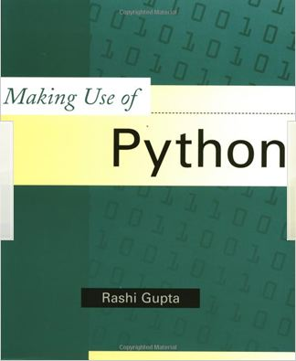
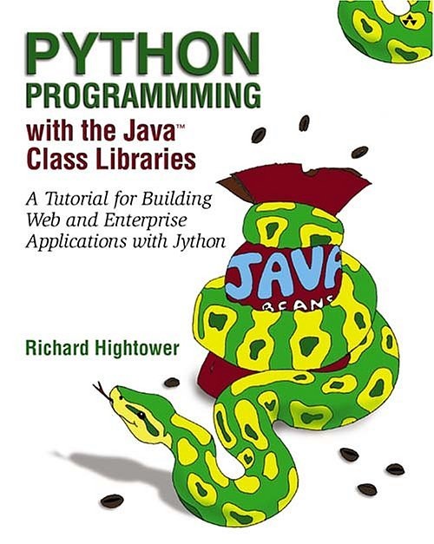
For More Information on Databases and SQL in Python (and Jython)
Making Use of Python by Rashi Gupta (Wiley: 2002)
Python Programming with the Java Class Libraries by Richard Hightower (Addison-Wesley: 2003)
Notes:
Key point: What we’re talking about here is not just for JES, or even just for Jython. You can do this in any Python implementation anywhere.

Slide 91
WARNING: We’re Going to Get Detailed and Technical Here!
If we ask you to do any database work on assignment, it will only be with anydbm and shelve.
However, if you do any database work in your professional life, you will be using relational databases and SQL.
  We won’t be asking you to do that for homework in this class.
The next few slides give you the pointers on how to set up MySQL on your own computer.
  But it’s not for the faint of heart!
  If you’d like to avoid technical details, ignore the next FOUR slides

Slide 92
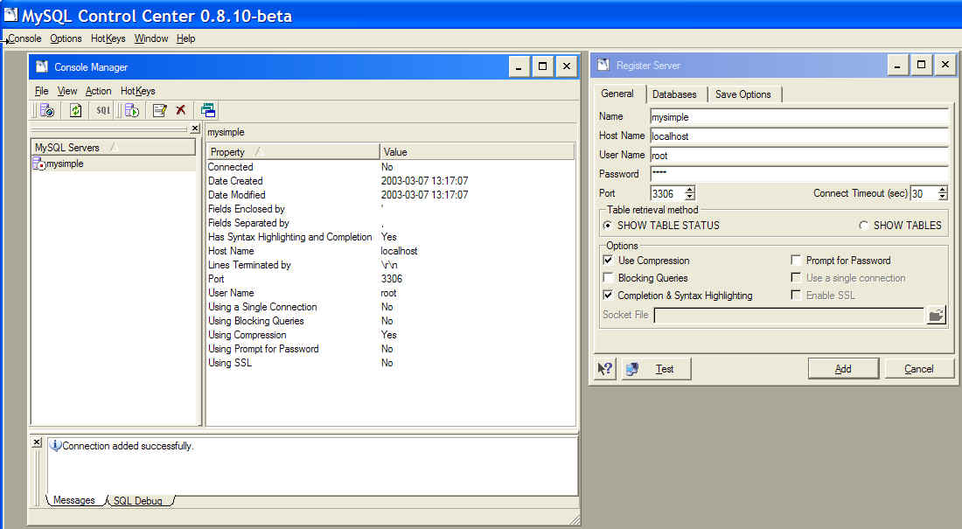
Installing mySQL
Go to http://www.mysql.com/downloads/index.html
  Download and install mySQL
  Suggestion: Download and install mySQLcc (Command Center)
Run the Command Center to create a connection
  Automatically also creates a database connection named “Test”
Run “mysqld” to get MySQL running (in the background)

Slide 93
Getting Python to talk to MySQL
You have to modify your JES to work with MySQL
  anydbm and shelve are built into JES, but not the MySQL connection
Download the MySQL connection for Java from the MySQL web site.
  Place the .jar file that you download in your JES\jython “Lib” folder

Slide 94
Setting up the database connection
The following is how you do it in Jython to talk to MySQL.
  Talking to Python is different only for this slide. The rest is the same.
from com.ziclix.python.sql import zxJDBC
db =zxJDBC.connect("jdbc:mysql://localhost/test", "root", None, "com.mysql.jdbc.Driver")
#This is the name of your database connection, the database “username” you used, the password you used, and the Driver you need.
con = db.cursor()

Slide 95
Put it in a function
All these details are hard to remember, so hide it all in a function and just say con = getConnection()
from com.ziclix.python.sql import zxJDBC
def getConnection():
db =zxJDBC.connect("jdbc:mysql://localhost/test", "root", None, "com.mysql.jdbc.Driver")
con = db.cursor()
return con

Slide 96
Executing SQL Commands
(Back to the generally relevant lecture)
Once you have a database connection (called a cursor in SQL), you can start executing commands in your database using the execute method, e.g.
con.execute("create table Person (name VARCHAR(50), age INT)")

Slide 97
SQL: Structured Query Language
SQL is usually pronounced “S.Q.L.” or “Sequel”
It’s a language for database creation and manipulation.
  Yes, a whole new language, like Python or Java
  It actually has several parts, such as DDL (Data Definition Language) and DML (Data Manipulation Language), but we’re not going to cover each part.
We’re not going to cover all of SQL
  There’s a lot there
  And what’s there depends, on part, on the database you’re using.

Slide 98
Creating tables in SQL
Create table tablename (columnname datatype,…)
  Tablename is the name you want to use for the table
  Columnname is what you want to call that field of information.
  Datatype is what kind of data you’re going to store there.
    Examples: NUMERIC, INT, FLOAT, DATE, TIME, YEAR, VARCHAR(number-of-bytes), TEXT
We can define some columns as index fields, and then create an index based on those fields, which speeds access.
Notes:
Numeric is a general number. By specifying the kind of the number, SQL can be more efficient with memory or execution speed.
Varchar is up to a maximum size.
Text is any size.

Slide 99
Inserting data via SQL
Insert into tablename values (columvalue1, columnvalue2…)
  For our Person table:
  con.execute('insert into Person values ("Mark",40)')
Here’s where those two kinds of quotes comes in handy!

Slide 100
Selecting data in a database
Select column1,column2 from tablename
Select column1,column2 from tablename where condition
Select * from Person
Select name,age from Person
Select * from Person where age>40
Select name,age from Person where age>40

Slide 101
Doing this from Python
When you use a select from Python,
  Your cursor has a variable rowcount that tells you how many rows were selected.
    This is called an instance variable
    It’s a variable known just to that object, similar to how a method is a function known just to that object.
  Method fetchone() gives you the next selected row.
Fetchone() returns a list

Slide 102
Selecting from the command area
>>> con.execute("select name,age from Person")
>>> print con.rowcount
3
>>> print con.fetchone()
('Mark', 40)
>>> print con.fetchone()
('Barb', 41)
>>> print con.fetchone()
('Brian', 36)

Slide 103
Selecting and printing from a function
def showPersons(con):
con.execute("select name, age from Person")
for i in range(0,con.rowcount):
results=con.fetchone()
print results[0]+" is "+str(results[1])+" years old"

Slide 104
Running our selection function
>>> showPersons(con)
Mark is 40 years old
Barb is 41 years old
Brian is 36 years old

Slide 105
Selecting and printing with a condition
def showSomePersons(con, condition):
con.execute("select name, age from Person "+condition)
for i in range(0,con.rowcount):
results=con.fetchone()
print results[0]+" is "+str(results[1])+" years old"

Slide 106
Running the conditional show
>>> showSomePersons(con,"where age >= 40")
Mark is 40 years old
Barb is 41 years old

Slide 107
The Point of the Conditional Show
Why are we doing the conditional show?
  First, to show that we can have tests on our queries which makes processing easier.
  Second, because this is how we’re going to generate HTML: By assembling pieces as strings.

Slide 108
We can do joins, too
(But more complicated)
Answering: What picture is Brittany in?
Select
  p.picture,
  s.studentName
From
  Students as s,
  IDs as i,
  Pictures as p
Where
  (s.studentName=“Brittany”) and
  (s.studentID=i.studentID) and
  (i.pictureID=p.pictureID)
StudentName | StudentID
Katie | S1
Brittany | S2
Carrie | S3
Picture | PictureID
Class1.jpg | P1
Class2.jpg | P2
PictureID | StudentID
P1 | S1
P1 | S2
P2 | S3

