Slide 1
Normalization, Functional Dependencies, and Data Anomalies

Slide 2
Introduction to Normalization
The normal forms defined in relational database theory represent guidelines for record design.
The guidelines corresponding to first through fifth normal (1NF, 2NF, 3NF, BCNF, 4NF, 5NF) forms are presented here, in terms that do not require an understanding of relational theory.
The design guidelines are meaningful even if one is not using a relational database system.

Slide 3
Introduction to Normalization
Normalization: Process of decomposing unsatisfactory "bad" relations by breaking up their attributes into smaller relations
Normal form: Condition using keys and FDs of a relation to certify whether a relation schema is in a particular normal form
1NF deals with the structure of a relation
2NF, 3NF, BCNF based on keys and FDs of a relation schema
4NF based on keys, multi-valued dependencies

Slide 4
Purpose of Normalization
The normalization rules are designed to prevent update anomalies and data inconsistencies. With respect to performance tradeoffs, these guidelines are biased toward the assumption that all non-key fields will be updated frequently.
They tend to penalize retrieval, since data which may have been retrievable from one record in an unnormalized design may have to be retrieved from several records in the normalized form.
There is no obligation to fully normalize all records when actual performance requirements are taken into account.

Slide 5
Normalization Definition
This is the process which allows you to remove out redundant data within your database.
This involves restructuring the tables to successively meeting higher forms of Normalization.
A properly normalized database should have the following characteristics
Scalar values in each fields
Absence of redundancy.
Minimal use of null values.
Minimal loss of information.

Slide 6
Levels of Normalization
Levels of normalization based on the amount of redundancy in the database.
Various levels of normalization are:
First Normal Form (1NF)
Second Normal Form (2NF)
Third Normal Form (3NF)
Boyce-Codd Normal Form (BCNF)
Fourth Normal Form (4NF)
Fifth Normal Form (5NF)
Domain Key Normal Form (DKNF)
Redundancy
Number of Tables
Complexity
Most databases should be 3NF or BCNF in order to avoid the database anomalies.

Slide 7
Levels of Normalization
1NF
2NF
3NF
4NF
5NF
DKNF
Each higher level is a subset of the lower level

Slide 8
Normalization is a Process
Normalization is the process of organizing data in a database.
It includes creating tables and establishing relationships between those tables according to rules designed both to protect the data and to make the database more flexible by
1. eliminating redundancy and
2. inconsistent dependency.

Slide 9
Normalization & Redundant Data
Redundant Data cause problems:
Wastes disk space and
Creates maintenance problems.
If data that exists in more than one place must be changed, THEN
the data must be changed
in exactly the same way in
all locations.

Slide 10
Normalization & Redundant Data
Redundant data
Wastes disk space and
Creates maintenance problems.
EXAMPLE: customer address
A customer address change is easier to implement if that data is stored only in the Customers table and nowhere else in the database.

Slide 11
What are Normal Forms?
There are a few rules for database normalization.
Each Rule is called a "normal form"
If the first rule is observed, the database is said to be in "first normal form." (1NF)
If the first three rules are observed, the database is considered to be in "third normal form." (3NF)

Slide 12
Normalization Process
Normalization is the process of minimizing redundancy from a relation or set of relations.
Redundancy in relation may cause insertion, deletion, and update anomalies.
So, it helps to minimize the redundancy in relations.
Normal forms are used to eliminate or reduce redundancy in database tables.

Slide 13
Normalization Theory
Normalization theory is based on the observation that relations with certain properties are more effective in inserting, updating and deleting data than other sets of relations containing the same data
Normalization is a multi-step process beginning with an “unnormalized”relation
Hospital example from Atre, S. Data Base: Structured Techniques for Design, Performance, and Management.

Slide 14
Normalization of DBMS
In database management systems (DBMS), normal forms are a series of guidelines that help to ensure that the design of a database is efficient, organized, and free from data anomalies.
There are several levels of normalization, each with its own set of guidelines, known as normal forms.

Slide 15
Normal Forms
First Normal Form (1NF)
Second Normal Form (2NF)
Third Normal Form (3NF)
Boyce-Codd Normal Form (BCNF)
Fourth Normal Form (4NF)
Fifth Normal Form (5NF)

Slide 16
Normalization
Unnormalized Relations
First normal form
Functional dependencyof nonkey attributes on the primary key - Atomic values only
No transitive dependency between nonkey attributes
Second normal form
Third normal form
Boyce-
Codd and
Higher
All determinants are candidate keys - Single multivalued dependency
Full Functional dependencyof nonkey attributes on the primary key

Slide 17
FD: Functional Dependencies
Functional dependencies (FDs) are used to specify formal measures of the "goodness" of relational designs
FDs and keys are used to define normal forms for relations
FDs are constraints that are derived from
the meaning and
interrelationships
of the data attributes

Slide 18
Functional Dependency in Simple Terms
In simple terms, a functional dependency is a relationship between two sets of attributes in a database table: set X and set Y.
FD describes how the value of one attribute determines the value of another attribute.
Basically, a functional dependency is represented as
X → Y
where X and Y are sets of attributes. This notation implies that for any two rows in the table with the same value for X, they will also have the same value for Y.
In other words, the value of Y is functionally dependent on the value of X.

Slide 19
Functional Dependency Example
Suppose we have a relation as:
Employees(emp_id, emp_name, position, department, salary)
If we define a functional dependency as "department → salary," it means that for any two employees who belong to the same department, their salaries will be the same. This allows us to infer the salary of an employee based on their department alone.
It's important to note that functional dependencies can exist between multiple attributes as well. For instance, we could have a functional dependency like {department, position} → salary, which means that the salary of an employee is determined not only by their department but also by their position within that department.

Slide 20
Importance of Functional Dependencies
Functional dependencies play a crucial role in database management systems.
They allow us to establish relationships between attributes, which in turn enables efficient storage, retrieval, and manipulation of data.
By understanding functional dependencies, we can identify potential anomalies, such as update, insertion, and deletion anomalies, which may occur when modifying data in the database.
Functional dependencies are vital for maintaining data integrity and minimizing redundancy in a database system.
When we have a functional dependency between two attributes, we only need to store one of them, as the other can be derived from the first. This reduces storage requirements and improves overall database efficiency.

Slide 21
Functional Dependency Definition
A set of attributes X functionally determines a set of attributes Y if the value of X determines a unique value for Y
X →Y holds if whenever two tuples have the same value for X, they must have the same value for Y
If t1[X]=t2[X], then t1[Y]=t2[Y] in any relation instance r(R)
X → Y in R specifies a constraint on all relation instances r(R)
FDs are derived from the real-world constraints on the attributes

Slide 22
Examples of FD constraints
Social Security Number determines employee name
SSN → ENAME
2. Project Number determines project name and location
PROJECT_NUMBER → {PNAME, PLOCATION}
3. Employee SSN and project number determines the hours per week that the employee works on the project
{SSN, PROJECT_NUMBER} → HOURS

Slide 23
Functional Dependencies and Keys
An FD is a property of the attributes in the schema R
The constraint must hold on every relation instance r(R)
If K is a key of R, then K functionally determines all attributes in R (since we never have two distinct tuples with t1[K]=t2[K])

Slide 24
Inference Rules for FDs
Given a set of FDs F, we can infer additional FDs that hold whenever the FDs in F hold
Armstrong's inference rules
A1. (Reflexive) If Y subset-of X, then X → Y
A2. (Augmentation) If X → Y, then XZ → YZ
(Notation: XZ stands for X U Z)
A3. (Transitive) If X → Y and Y → Z, then X → Z
A1, A2, A3 form a sound and complete set of inference rules

Slide 25
Additional Useful Inference Rules
Decomposition
If X → YZ, then X → Y and X → Z
Union
If X → Y and X → Z, then X → YZ
Psuedo-transitivity
If X → Y and WY → Z, then WX → Z
Closure of a set F of FDs is the set F+ of all FDs that can be inferred from F

Slide 26
What is a Primary Key (PK)
A primary key (PK) is the column or columns that contain values that uniquely identify each row in a table.
A database table must have a primary key for insert, update, restore, or delete data from a database table
CREATE TABLE table_name (
id INT PRIMARY KEY,
name CHARACTER VARYING(20), ...
);

Slide 27
What is a Primary Key (PK)
A primary key (PK) is the column or columns that contain values that uniquely identify each row in a table.
CREATE TABLE table_name (
id INT PRIMARY KEY,
name VARCHAR(20),
... )

Slide 28
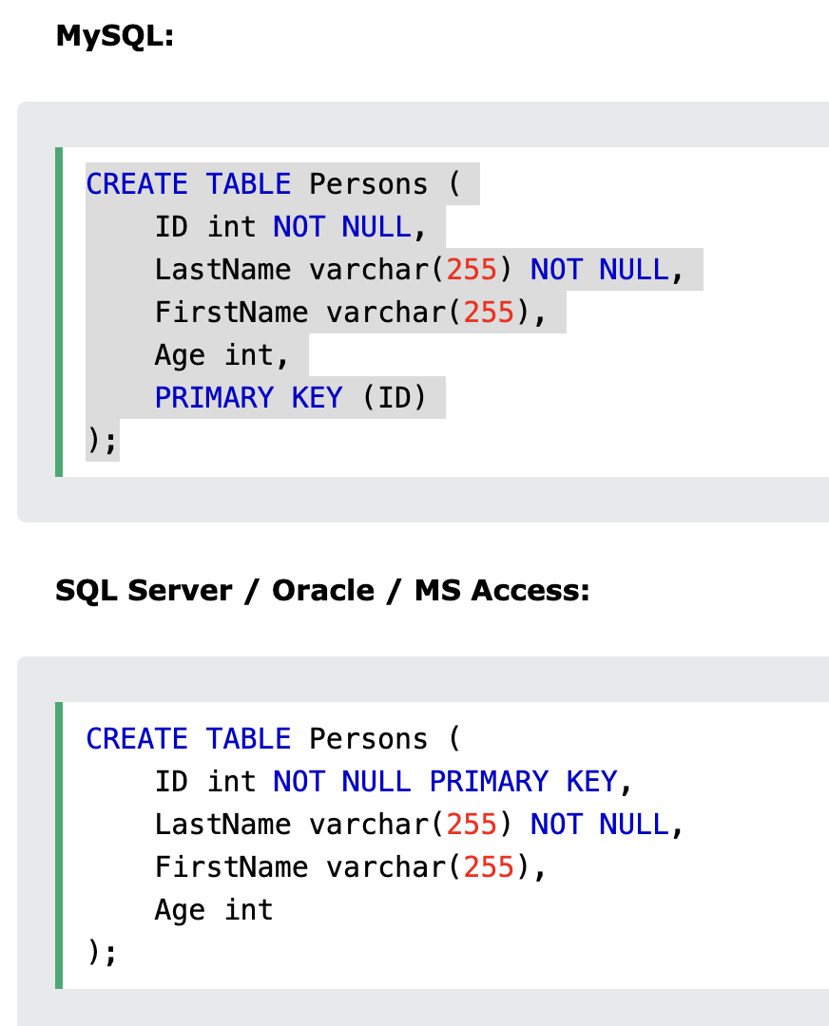
What is a Primary Key (PK)

Slide 29
Unnormalized Relations
First step in normalization is to convert the data into a
two-dimensional table
Rows
Columns
In unnormalized relations data can repeat within a column

Slide 30
Unnormalized Relation

Slide 31
First Normal Form (1NF)
To move to First Normal Form
a relation must contain only atomic values at each row and column.
No repeating groups
A column or set of columns is called a Candidate Key when its values can uniquely identify the row in the relation.

Slide 32
First Normal Form

Slide 33
1NF Storage Anomalies
Insertion: A new patient has not yet undergone surgery -- hence no surgeon # -- Since surgeon # is part of the key, we cannot insert.
Insertion: If a surgeon is newly hired and has not operated yet -- there will be no way to include that person in the database.
Update: If a patient comes in for a new procedure, and has moved, we need to change multiple address entries.
Deletion (type 1): Deleting a patient record may also delete all info about a surgeon.
Deletion (type 2): When there are functional dependencies (like side effects and drug) changing one item eliminates other information.

Slide 34
What is First Normal Form (1NF)?
A database is said to be in First Normal Form if it satisfies the following conditions:
Rule 1 (Atomic Values) − Every column of a table should contain only atomic values. An atomic value is a value that cannot be divided further.
Rule 2 (No Repeating Groups) − There are no repeating groups of data. This means a table should not contain repeating columns.

Slide 35
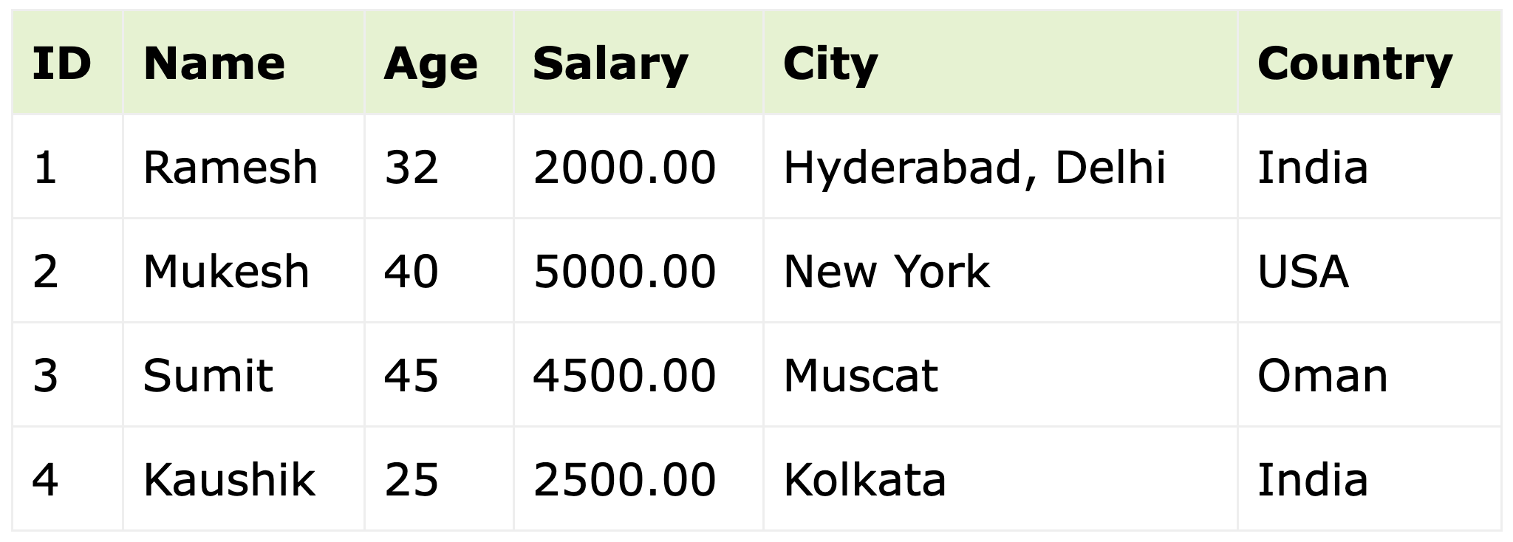
1NF: Rule 1 - Atomic Values This table is NOT in first normal form because the City column can contain multiple values.

Slide 36
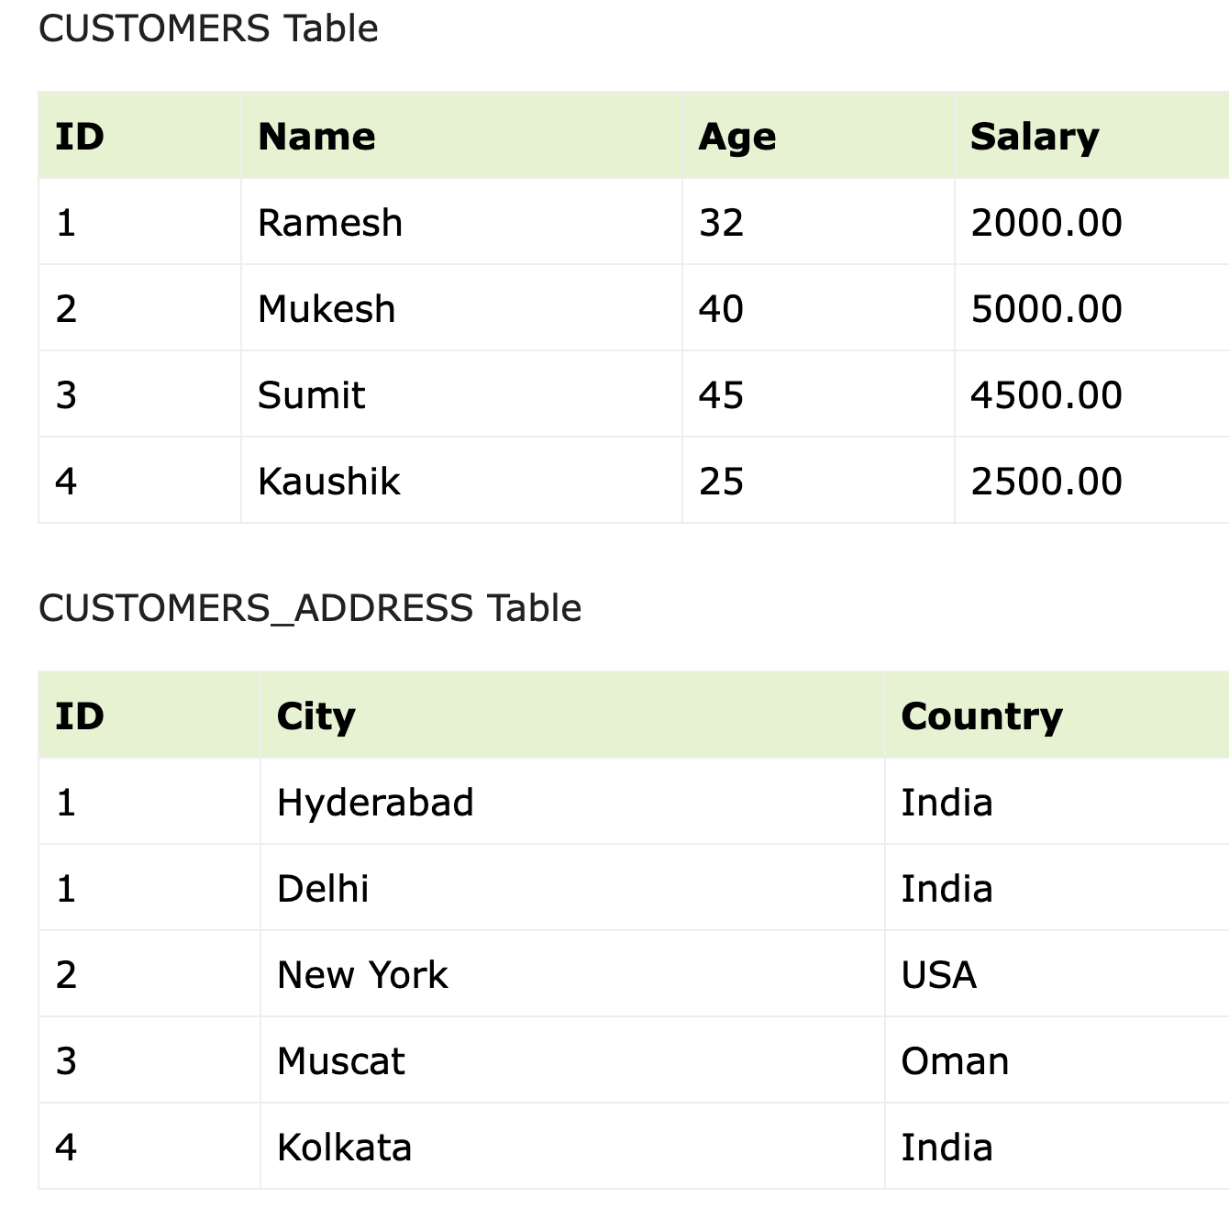
Bring this table to 1NF: Split table into 2 tables

Slide 37
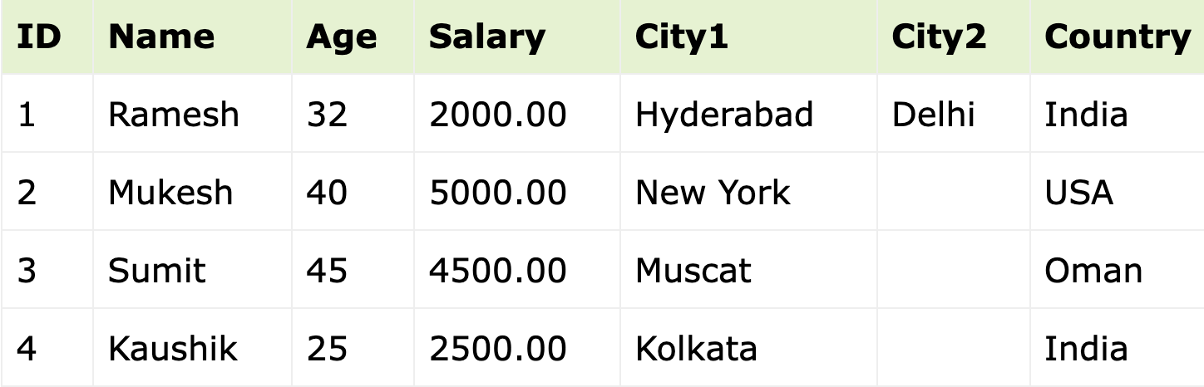
Rule 2 - No Repeating Groups There are no repeating groups of data. This means a table should not contain repeating columns.

Slide 38
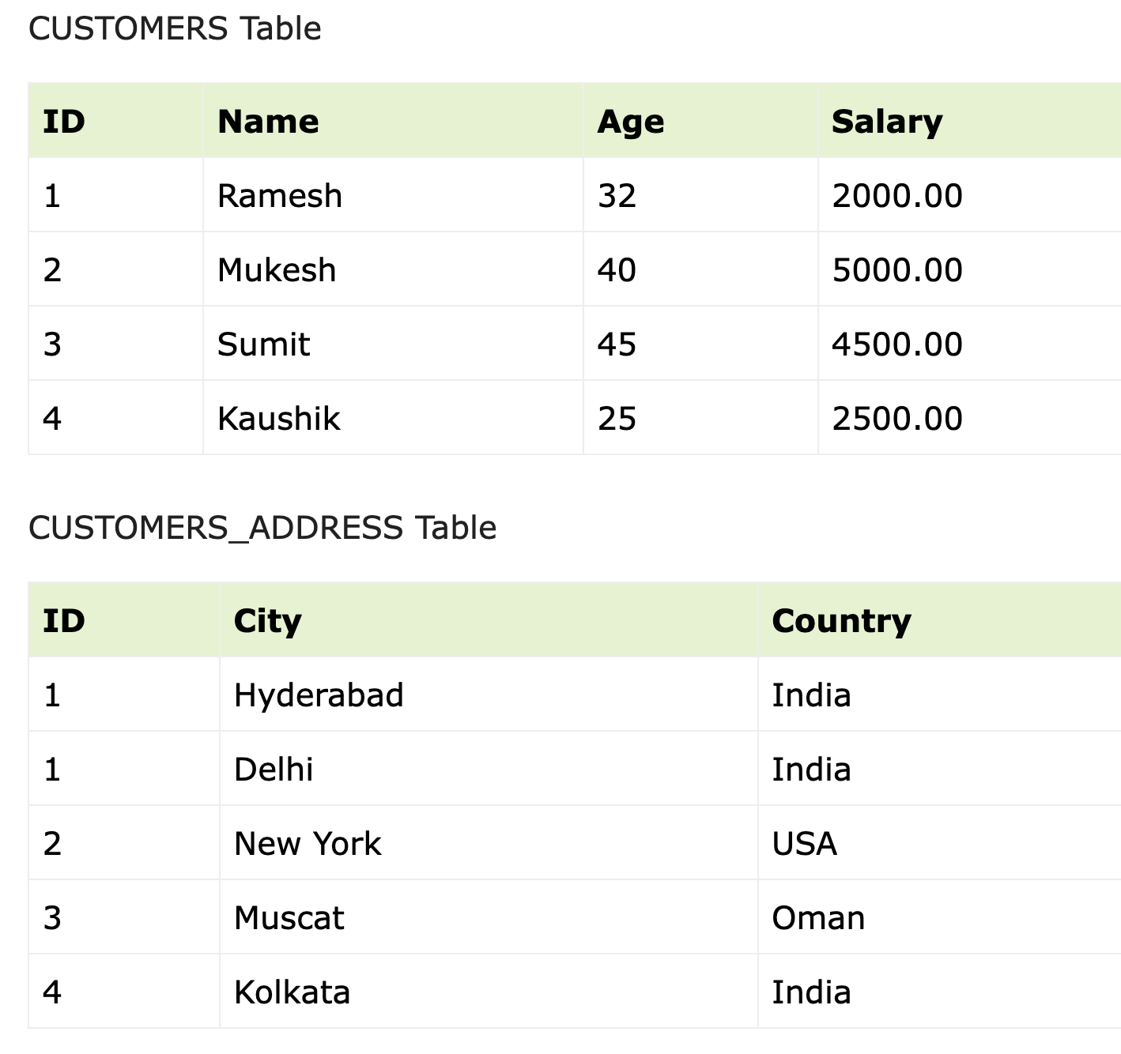
Alternate Solution: 1NF

Slide 39
First Normal Form (1NF)
A table is considered to be in 1NF if all the fields contain
only scalar values (as opposed to list of values).
Example (Not 1NF)
ISBN
Title
AuName
AuPhone
PubName
PubPhone
Price
0-321-32132-1
Balloon
Sleepy, Snoopy, Grumpy
321-321-1111, 232-234-1234, 665-235-6532
Small House
714-000-0000
$34.00
0-55-123456-9
Main Street
Jones, Smith
123-333-3333, 654-223-3455
Small House
714-000-0000
$22.95
0-123-45678-0
Ulysses
Joyce
666-666-6666
Alpha Press
999-999-9999
$34.00
1-22-233700-0
Visual Basic
Roman
444-444-4444
Big House
123-456-7890
$25.00
Author and AuPhone columns are not scalar
Notes:
Having scalar values also means that all instances of a record type must contain the same number of fields.
A table not in first normal form is called un normalized

Slide 40
1NF - Decomposition
Place all items that appear in the repeating group in a new table
Designate a primary key for each new table produced.
Duplicate in the new table the primary key of the table from which the repeating group was extracted or vice versa.
Example (1NF)
ISBN
AuName
AuPhone
0-321-32132-1
Sleepy
321-321-1111
ISBN
Title
PubName
PubPhone
Price
0-321-32132-1
Snoopy
232-234-1234
0-321-32132-1
Balloon
Small House
714-000-0000
$34.00
0-321-32132-1
Grumpy
665-235-6532
0-55-123456-9
Main Street
Small House
714-000-0000
$22.95
0-55-123456-9
Jones
123-333-3333
0-123-45678-0
Ulysses
Alpha Press
999-999-9999
$34.00
0-55-123456-9
Smith
654-223-3455
1-22-233700-0
Visual Basic
Big House
123-456-7890
$25.00
0-123-45678-0
Joyce
666-666-6666
1-22-233700-0
Roman
444-444-4444
Notes:
1. The designated key will be the primary key of the original table concatenated with one or more data items from the new table.
For the first table the primary key is ISBN
For the second table the primary key is ISBN + Author Name

Slide 41
1NF Summary
1. First normal form deals with the "shape" of a record type.
2. Under first normal form, all occurrences of a record type must contain the same number of fields.
3. First normal form excludes variable repeating fields and groups.
Notes:
Notes to Instructor: Need more rigor in the functional dependencies. With a few examples. May be create a class assignment for functional dependencies.

Slide 42
Review Functional Dependencies
If one set of attributes in a table determines another set of attributes in the table, then the second set of attributes is said to be functionally dependent on the first set of attributes.
Example 1
ISBN
Title
Price
Table Scheme: {ISBN, Title, Price}
Functional Dependencies:
{ISBN} → {Title}
{ISBN} → {Price}
0-321-32132-1
Balloon
$34.00
0-55-123456-9
Main Street
$22.95
0-123-45678-0
Ulysses
$34.00
1-22-233700-0
Visual Basic
$25.00
Notes:
Notes to Instructor: Need more rigor in the functional dependencies. With a few examples. May be create a class assignment for functional dependencies.

Slide 43
Functional Dependencies
Example 2
PubID
PubName
PubPhone
Table Scheme: {PubID, PubName, PubPhone}
Functional Dependencies:
{PubId} → {PubPhone}
{PubId} → {PubName}
{PubName, PubPhone} → {PubID}
1
Big House
999-999-9999
2
Small House
123-456-7890
3
Alpha Press
111-111-1111
Example 3
AuID
AuName
AuPhone
Table Scheme: {AuID, AuName, AuPhone}
Functional Dependencies:
{AuId} → {AuPhone}
{AuId} → {AuName}
{AuName, AuPhone} → {AuID}
1
Sleepy
321-321-1111
2
Snoopy
232-234-1234
3
Grumpy
665-235-6532
4
Jones
123-333-3333
5
Smith
654-223-3455
6
Joyce
666-666-6666
7
Roman
444-444-4444

Slide 44
FD – Example
Database to track reviews of papers submitted to an academic conference. Prospective authors submit papers for review and possible acceptance in the published conference proceedings. Details of the entities
Author information includes a unique author number, a name, a mailing address, and a unique (optional) email address.
Paper information includes the primary author, the paper number, the title, the abstract, and review status (pending, accepted, rejected)
Reviewer information includes the reviewer number, the name, the mailing address, and a unique (optional) email address
A completed review includes the reviewer number, the date, the paper number, comments to the authors, comments to the program chairperson, and ratings (overall, originality, correctness, style, clarity)

Slide 45
Functional Dependencies – Example
AuthNo → AuthName, AuthEmail, AuthAddress
AuthEmail → AuthNo
PaperNo → Primary-AuthNo, Title, Abstract, Status
RevNo → RevName, RevEmail, RevAddress
RevEmail → RevNo
RevNo, PaperNo → AuthComm, Prog-Comm, Date, Rating1, Rating2, Rating3, Rating4, Rating5

Slide 46
2NF & 3NF are about what?
2NF and 3NF deal with
the relationship between
non-key and key fields.

Slide 47
Second Normal Form (2NF)
Under 2NF and 3NF, a non-key field must provide a fact about the key, the whole key, and nothing but the key.
In addition, the record must satisfy first normal form.

Slide 48
Second Normal Form (2NF)
A relation is said to be in Second Normal Form when every non-key attribute is fully functionally dependent on the primary key (PK)
That is, every non-key attribute needs the full primary key for unique identification

Slide 49
Why is this not in 2NF?

Slide 50
Second Normal Form

Slide 51
Second Normal Form

Slide 52
Second Normal Form

Slide 53
2NF: explained primary key, then the relation is in Second Normal Form (2NF).
A relation that is in First Normal Form and
Every non-primary-key attribute is fully functionally dependent on the primary key, then the relation is in Second Normal Form (2NF).n

Slide 54

2NF: Example, then the relation is in Second Normal Form (2NF).
1. Let STUD_NO be a Primary Key (PK)
2. COURSE_FEE does not depend on PK
3. FD: COURSE_NO -> COURSE_FEE

Slide 55
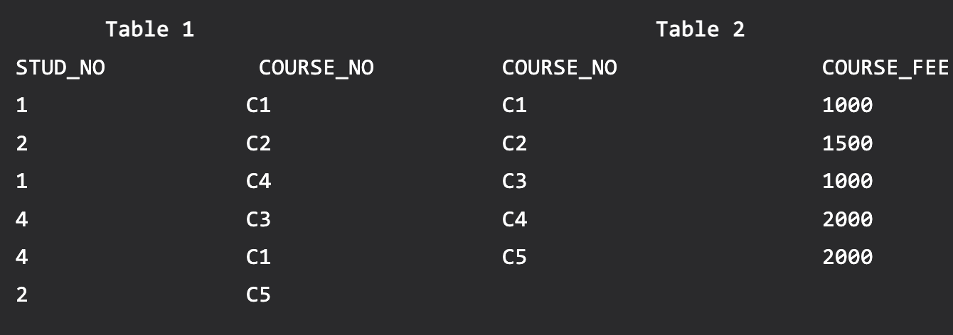
Convert to 2NF: 2 tables

Slide 56
Violation of 2NF
Consider following functional dependencies in relation R (A, B, C, D )
AB -> C [A and B together determine C]
BC -> D [B and C together determine D]
In this case, we can see that the relation R has a composite candidate key {A,B} as AB->C.
Therefore, A and B together uniquely determine the value of C.
Similarly, BC -> D shows that B and C together uniquely determine the value of D.
The relation R is already in 1NF because it does not have any repeating groups or nested relations.
However, we can see that the non-prime attribute D is functionally dependent on only part of a candidate key, BC. This violates the 2NF condition.

Slide 57
2NF: what does it provide?
In conclusion, 2NF is a fundamental concept of database normalization that helps remove partial dependencies in your relational database.
Following 2NF rules helps organize your database to avoid anomalies and ensure data integrity, making it easier to store and retrieve data.

Slide 58
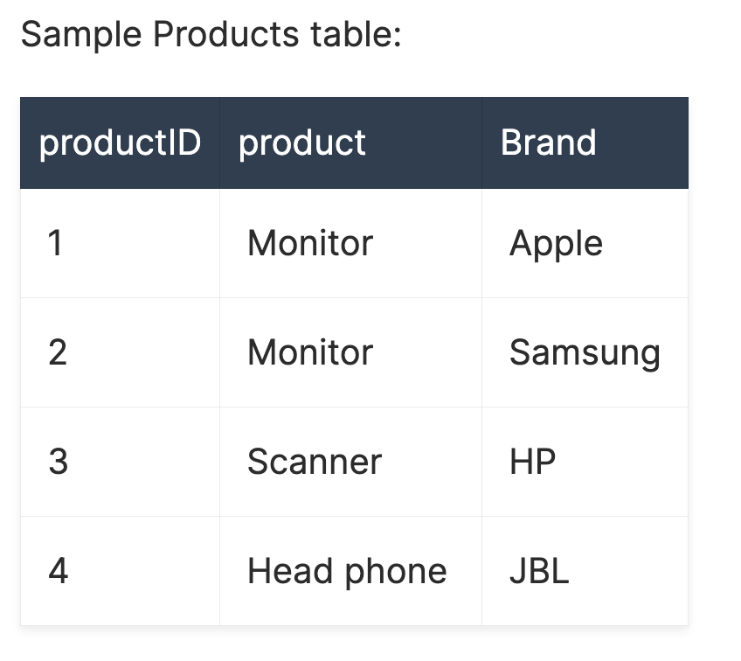
2NF: Example
The following table is NOT is 2NF, because Brand does not depend on ProductID (as PK).

Slide 59
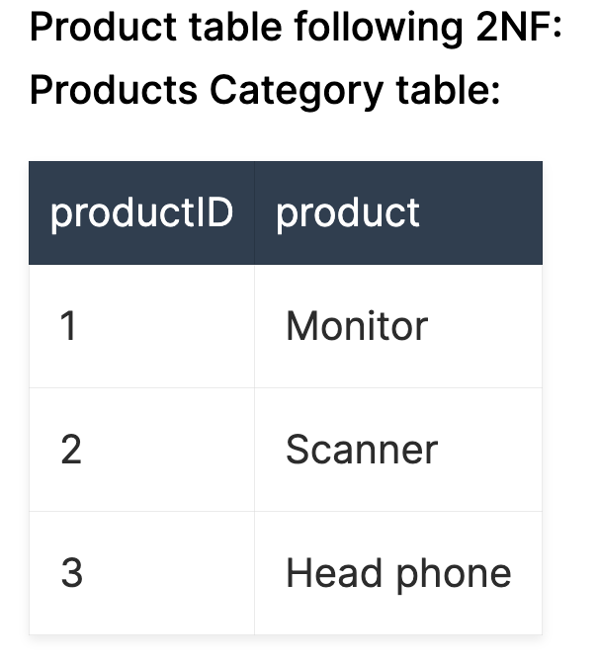
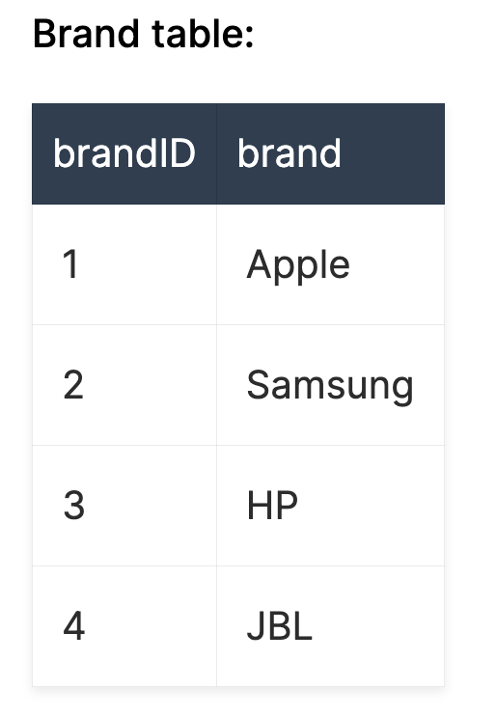
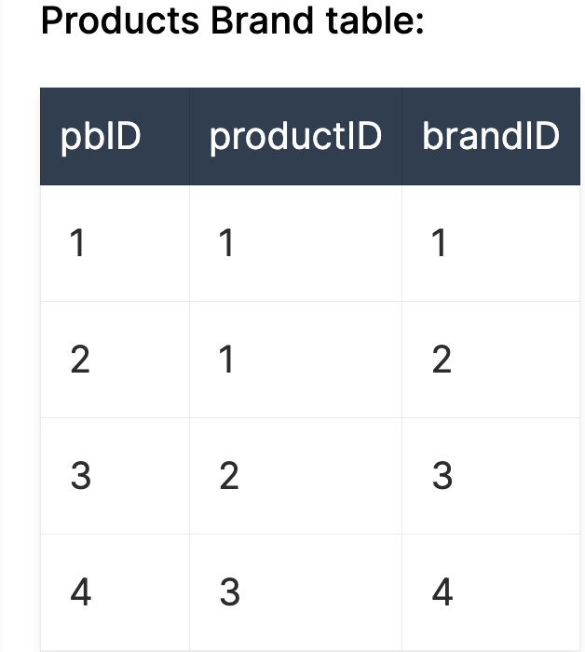
Convert to 2NF:

Slide 60
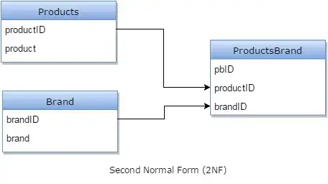
2NF Solution

Slide 61
2NF Example: warehouse relation
(PART, WAREHOUSE, QUANTITY, WAREHOUSE_ADDRESS)
Where (PART, WAREHOUSE) is a KEY.
The key here consists of the PART and WAREHOUSE fields together, but WAREHOUSE_ADDRESS is a fact about the WAREHOUSE alone. The basic problems with this design are:
The warehouse_address is repeated in every record that refers to a part stored in that warehouse.
If the address of the warehouse changes, every record referring to a part stored in that warehouse must be updated.
Because of the redundancy, the data might become inconsistent, with different records showing different addresses for the same warehouse.
If at some point in time there are no parts stored in the warehouse, there may be no record in which to keep the warehouse's address.

Slide 62
2NF Example: How?
To satisfy second normal form, the record should be decomposed into (replaced by) the two records:
(PART, WAREHOUSE, QUANTITY, WAREHOUSE_ADDRESS)
=>
1. Parts:
(PART, WAREHOUSE, QUANTITY)
2. Warehouses
(WAREHOUSE, WAREHOUSE_ADDRESS)

Slide 63
1NF Storage Anomalies Removed
Insertion: Can now enter new patients without surgery.
Insertion: Can now enter Surgeons who have not operated.
Deletion (type 1): If Charles Brown dies, the corresponding tuples from Patient and Surgery tables can be deleted without losing information on David Rosen.
Update: If John White comes in for third time, and has moved, we only need to change the Patient table

Slide 64
2NF Storage Anomalies
Insertion: Cannot enter the fact that a particular drug has a particular side effect unless it is given to a patient.
Deletion: If John White receives some other drug because of the penicillin rash, and a new drug and side effect are entered, we lose the information that penicillin can cause a rash
Update: If drug side effects change (a new formula) we have to update multiple occurrences of side effects.

Slide 65
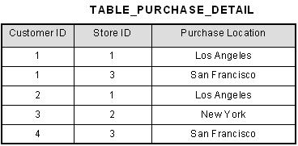
2NF Example
This table has a composite primary key [Customer ID, Store ID]. The non-key attribute is [Purchase Location]. In this case, [Purchase Location] only depends on [Store ID], which is only part of the primary key. Therefore, this table does not satisfy second normal form.

Slide 66
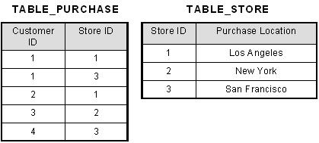
Convert to 2NF Table_Purchase: PK: (Customer_ID, Store_ID) Table_Store: PK: Store_ID

Slide 67
Second Normal Form (2NF)
For a table to be in 2NF, there are two requirements
The database is in first normal form
All non-key attributes in the table must be functionally dependent on the entire primary key
Note: Remember that we are dealing with non-key attributes

Slide 68
2NF - Example 1
Example 1 (Not 2NF)
Scheme → {Title, PubId, AuId, Price, AuAddress}
Key → {Title, PubId, AuId}
{Title, PubId, AuID} → {Price}
{AuID} → {AuAddress}
AuAddress does not belong to a key
AuAddress functionally depends on AuId which is a subset of a key

Slide 69
2NF - Decomposition
If a data item is fully functionally dependent on only a part of the primary key, move that data item and that part of the primary key to a new table.
If other data items are functionally dependent on the same part of the key, place them in the new table also
Make the partial primary key copied from the original table the primary key for the new table. Place all items that appear in the repeating group in a new table
Example 1 (Convert to 2NF)
Old Scheme → {Title, PubId, AuId, Price, AuAddress}
New Scheme → {Title, PubId, AuId, Price}
New Scheme → {AuId, AuAddress}
Notes:
If there is a table with columns A,B,C,D with Primary Key (A,B) & D is dependant on A (alone) then to be 2NF, you should reduce (split) tables as:
Table with columns A,D with Primary Key (A)
Table with columns A,B,C with Primary Key (A,B)

Slide 70
2NF – Example 2
Example 2 (Not 2NF)
Scheme →
{City, Street, HouseNumber, HouseColor, CityPopulation}
key → {City, Street, HouseNumber}
{City, Street, HouseNumber} → {HouseColor}
{City} → {CityPopulation}
CityPopulation does not belong to any key.
CityPopulation is functionally dependent on the City which is a proper subset of the key
Notes:
Let us consider the problems with the movie studio database:
Redundancy – City Population is repeated many times
Insertion anomaly – Whenever we add a new record we have to add unnecessary information. We can not add record until we know information about the city population
Deletion anomaly – Whenever we delete a record, useful information is deleted.
Update anomaly – The City Population needs to be updated in more than one location if it changes.

Slide 71
2NF – Decomposition
Example 2 Solution
Example 3 (Convert to 2NF)
Old Scheme → {City, Street, HouseNumber, HouseColor, CityPopulation}
New Scheme → {City, Street, HouseNumber, HouseColor}
New Scheme → {City, CityPopulation}

Slide 72
2NF – Example 3
Example 3 (Not 2NF)
Scheme → {studio, movie, budget, studio_city}
Key → {studio, movie}
{studio, movie} → {budget}
{studio} → {studio_city}
studio_city is not a part of a key
studio_city functionally depends on studio which is a proper subset of the key
Notes:
Let us consider the problems with the movie studio database:
Redundancy – City Population is repeated many times
Insertion anomaly – Whenever we add a new record we have to add unnecessary information. We can not add record until we know information about the city population
Deletion anomaly – Whenever we delete a record, useful information is deleted.
Update anomaly – The City Population needs to be updated in more than one location if it changes.

Slide 73
2NF – Example 3 Solution
Example 3 (Convert to 2NF)
Old Scheme → {Studio, Movie, Budget, StudioCity}
New Scheme → {Movie, Studio, Budget}
New Scheme → {Studio, City}
Notes:
Let us consider the problems with the movie studio database:
Redundancy – City Population is repeated many times
Insertion anomaly – Whenever we add a new record we have to add unnecessary information. We can not add record until we know information about the city population
Deletion anomaly – Whenever we delete a record, useful information is deleted.
Update anomaly – The City Population needs to be updated in more than one location if it changes.

Slide 74
3NF: Third Normal Form
A relation is said to be in 3NF if there is no transitive functional dependency between non-key attributes
When one non-key attribute can be determined with one or more non-key attributes there is said to be a transitive functional dependency.
The side effect column in the Surgery table is determined by the drug administered
Side effect is transitively functionally dependent on drug so Surgery is not 3NF

Slide 75
Why is this not in 3NF?

Slide 76
Third Normal Form

Slide 77
Third Normal Form

Slide 78
2NF Storage Anomalies Removed
Insertion: We can now enter the fact that a particular drug has a particular side effect in the Drug relation.
Deletion: If John White receives some other drug as a result of the rash from penicillin, the information on penicillin and rash is maintained.
Update: The side effects for each drug appear only once.

Slide 79
3NF in a Nutshell
The entity should be considered already in 2NF, and no column entry should be dependent on any other entry (value) other than the key for the table.
If such an entity exists, move it outside into a new table.
3NF is achieved, considered as the database is normalized.

Slide 80
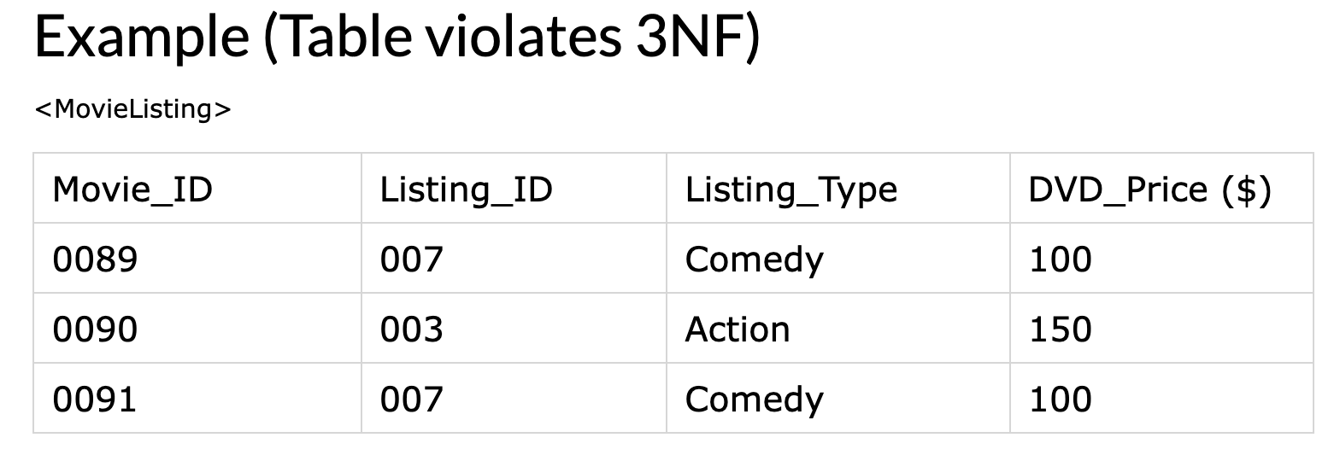
3NF Example-1
A table is in 3NF, only if a relation is in 2NF and it has no Transitive Functional Dependency.
The below table is not in 3NF because it has a transitive functional dependency
Movie_ID -> Listing_ID Listing_ID -> Listing_Type
Therefore, Movie_ID -> Listing_Type i.e. transitive functional dependency.

Slide 81
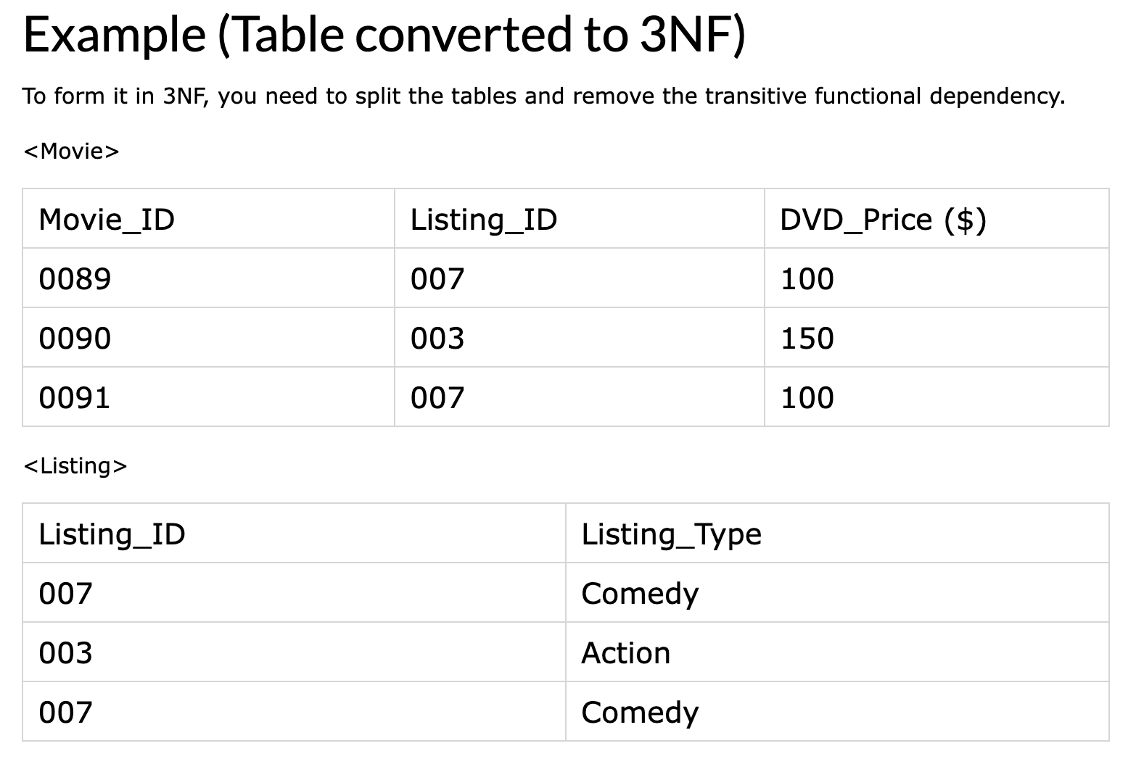
Convert to 3NF

Slide 82
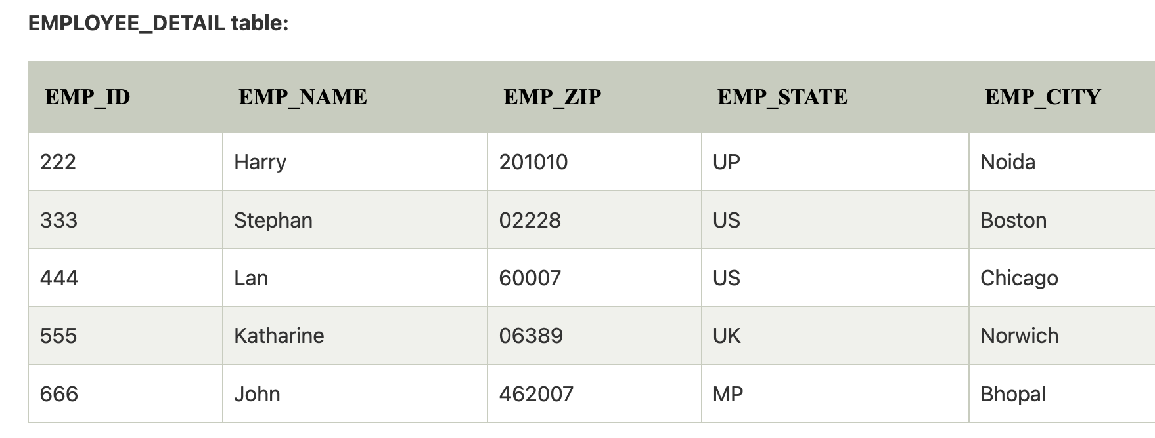
3NF Example-2
Here, EMP_STATE & EMP_CITY dependent on EMP_ZIP and EMP_ZIP dependent on EMP_ID. The non-prime attributes (EMP_STATE, EMP_CITY) transitively dependent on super key(EMP_ID). It violates the rule of third normal form.

Slide 83
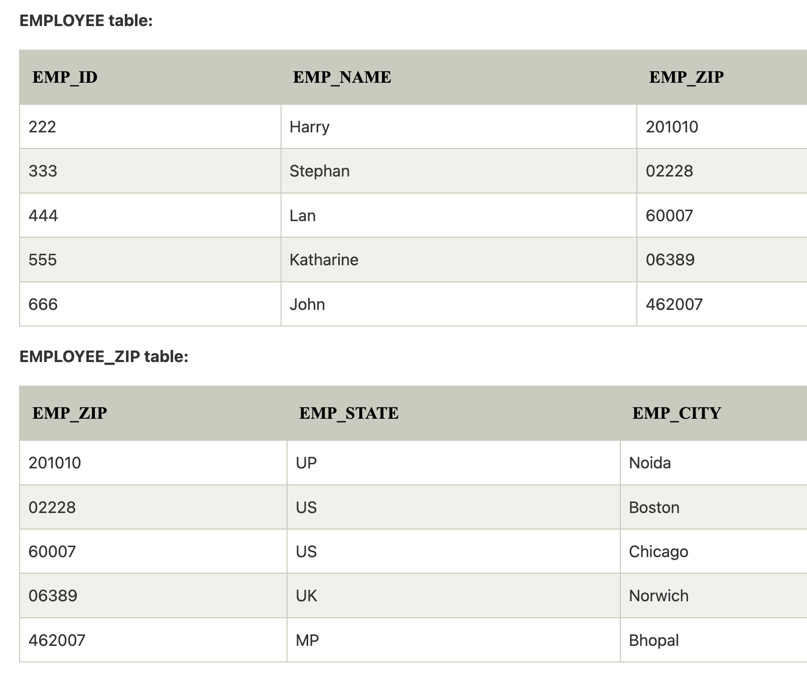
3NF Solution

Slide 84
3NF Summary …1
Third normal form is violated when a non-key field is a fact about another non-key field, as in
(EMPLOYEE, DEPARTMENT, LOCATION)
The EMPLOYEE field is the key.
If each department is located in one place, then the LOCATION field is a fact about the DEPARTMENT -- in addition to being a fact about the EMPLOYEE.
The problems with this design are the same as those caused by violations of second normal form:

Slide 85
3NF Summary … 2
Third normal form is violated when a non-key field is a fact about another non-key field, as in
(EMPLOYEE, DEPARTMENT, LOCATION)
The problems with this design are the same as those caused by violations of second normal form:
The department's location is repeated in the record of every employee assigned to that department.
If the location of the department changes, every such record must be updated.
Because of the redundancy, the data might become inconsistent, with different records showing different locations for the same department.
If a department has no employees, there may be no record in which to keep the department's location.

Slide 86
3NF Summary … 3
3NF is violated when a non-key field is a fact about another non-key field, as in
(EMPLOYEE, DEPARTMENT, LOCATION)
To satisfy 3NF, the record shown above should be decomposed into the two records:
(EMPLOYEE, DEPARTMENT)
(DEPARTMENT, LOCATION)

Slide 87
Boyce-Codd Normal Form
Boyce–Codd normal form (or BCNF or 3.5NF) is a normal form used in database normalization.
It is a slightly stronger version of the third normal form (3NF).

Slide 88
Boyce-Codd Normal Form
Most 3NF relations are also BCNF relations.
A 3NF relation is NOT in BCNF if:
Candidate keys in the relation are composite keys (they are not single attributes)
There is more than one candidate key in the relation, and
The keys are not disjoint, that is, some attributes in the keys are common

Slide 89
Rules for BCNF
For a table to satisfy the Boyce-Codd Normal Form, it should satisfy the following two conditions:
It should be in the Third Normal Form.
And, for any dependency A → B, A should be a super key.
The second point sounds a bit tricky, right? In simple words, it means, that for a dependency A → B, A cannot be a non-prime attribute, if B is a prime attribute.

Slide 90
BCNF Form One student can enroll for multiple subjects. For example, student with student_id 101, has opted for subjects - Java & C++ For each subject, a professor is assigned to the student. And, there can be multiple professors teaching one subject like we have for Java. What do you think should be the Primary Key? Well, in the table above (student_id, subject) together form the primary key, because using student_id and subject, we can find all the columns of the table.
student_id | subject | professor
101 | Java | P.Java
101 | C++ | P.Cpp
102 | Java | P.Java2
103 | C# | P.Chash
104 | Java | P.Java

Slide 91
BCNF …?
This table satisfies the 1st Normal form because all the values are atomic, column names are unique and all the values stored in a particular column are of same domain.
This table also satisfies the 2nd Normal Form as their is no Partial Dependency.
And, there is no Transitive Dependency, hence the table also satisfies the 3rd Normal Form.
But this table is not in Boyce-Codd Normal Form.

Slide 92
BCNF … why not?
Why this table is not in BCNF?
In the table above, student_id, subject form primary key, which means subject column is a prime attribute.
But, there is one more dependency, professor → subject.
And while subject is a prime attribute, professor is a non-prime attribute, which is not allowed by BCNF.

Slide 93
BCNF Solution
Student table:
(student_id, professor_id)
Professor table:
(professor_id, professor, subject)

Slide 94
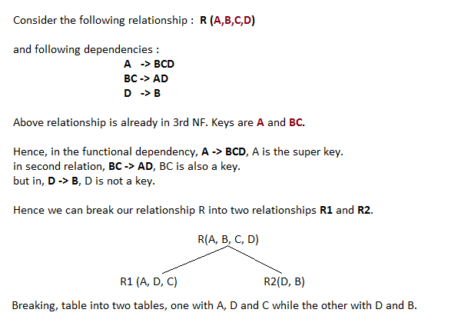
BCNF example

Slide 95
BCNF Example 2
BCNF is the advance version of 3NF.
It is stricter than 3NF.
A table is in BCNF if every functional dependency X → Y, X is the super key of the table.
For BCNF, the table should be in 3NF, and for every FD, LHS is super key.

Slide 96
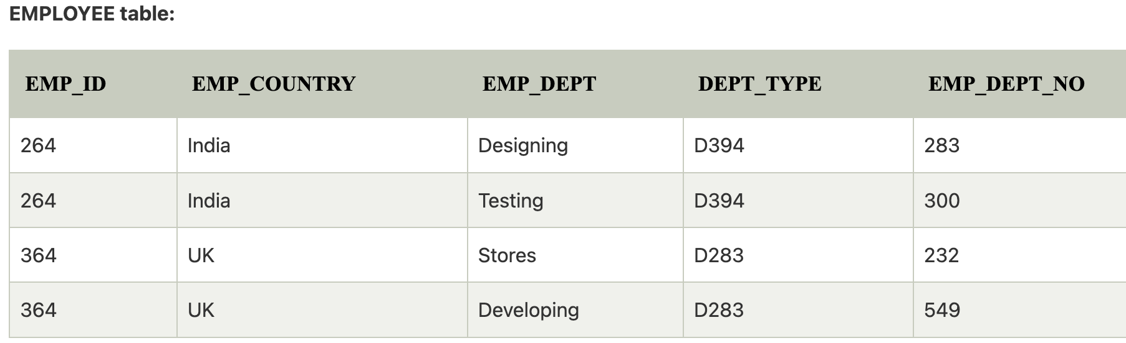
BCNF Example 2
Example: Let's assume there is a company where employees work in more than one department.
(emp_id, emp_country, emp_dept, dept_type, emp_dept_no)

Slide 97
BCNF Example 2
EMP_ID → EMP_COUNTRY
EMP_DEPT → {DEPT_TYPE, EMP_DEPT_NO}
Candidate key: {EMP_ID, EMP_DEPT}
The table is not in BCNF because neither EMP_DEPT nor EMP_ID alone are keys.
To convert the given table into BCNF, we decompose it into three tables:

Slide 98
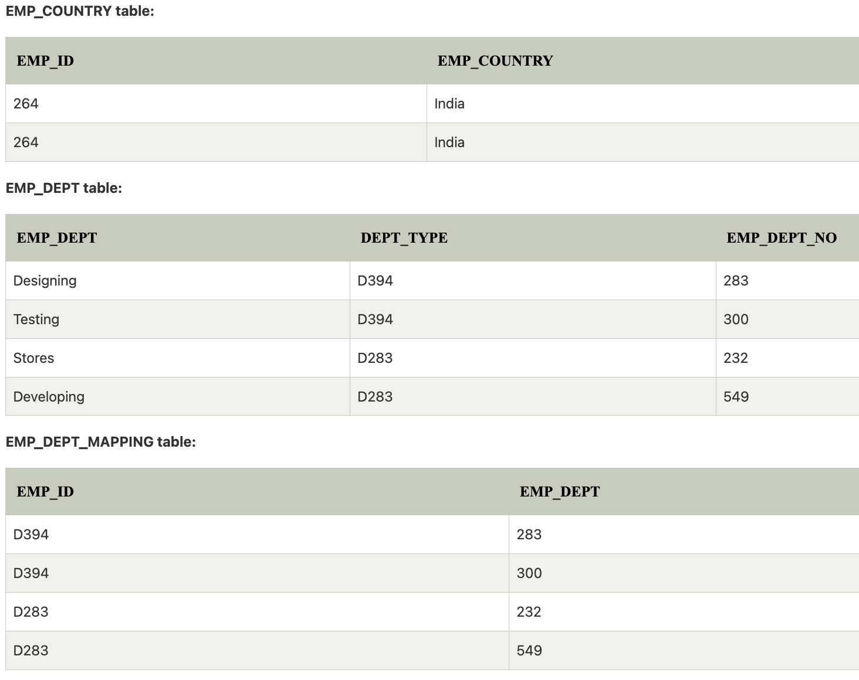
BCNF Example 2: solution

Slide 99
BCNF Example 2: solution
Functional dependencies:
EMP_ID → EMP_COUNTRY
EMP_DEPT → {DEPT_TYPE, EMP_DEPT_NO}
Candidate keys:
For the first table: EMP_ID
For the second table: EMP_DEPT
For the third table: {EMP_ID, EMP_DEPT}
Now, this is in BCNF because left side part of both the functional dependencies is a key.

Slide 100
Fourth Normal Form
Any relation is in Fourth Normal Form if it is BCNF and any multivalued dependencies are trivial
Eliminate non-trivial multivalued dependencies by projecting into simpler tables

Slide 101
Fifth Normal Form
A relation is in 5NF if every join dependency in the relation is implied by the keys of the relation
Implies that relations that have been decomposed in previous normal forms can be recombined via natural joins to recreate the original relation.

Slide 102
Effectiveness and Efficiency Issues for DBMS
Focus on the relational model
Any column in a relational database can be searched for values.
To improve efficiency indexes using storage structures such as BTrees and Hashing are used
But many useful functions are not indexable and require complete scans of the the database

Slide 103
Example: Text Fields
In conventional RDBMS, when a text field is indexed, only exact matching of the text field contents (or Greater-than and Less-than).
Can search for individual words using pattern matching, but a full scan is required.
Text searching is still done best (and fastest) by specialized text search programs (Search Engines)

Slide 104
Normalization
Normalization is performed to reduce or eliminate Insertion, Deletion or Update anomalies.
However, a completely normalized database may not be the most efficient or effective implementation.
“Denormalization” is sometimes used to improve efficiency.

Slide 105
Normalizing to death
Normalization splits database information across multiple tables.
To retrieve complete information from a normalized database, the JOIN operation must be used.
JOIN tends to be expensive in terms of processing time, and very large joins are very expensive.
Notes:
From wikipedia: denormalization is the process of attempting to optimise the read performance of a database by adding redundant data or by grouping data. In some cases, denormalization is a means of addressing performance or scalability in relational database software.
A normalized design will often store different but related pieces of information in separate logical tables (called relations). If these relations are stored physically as separate disk files, completing a database query that draws information from several relations (a join operation) can be slow. If many relations are joined, it may be prohibitively slow. There are two strategies for dealing with this. The preferred method is to keep the logical design normalized, but allow the database management system (DBMS) to store additional redundant information on disk to optimise query response. In this case it is the DBMS software's responsibility to ensure that any redundant copies are kept consistent. This method is often implemented in SQL as indexed views (Microsoft SQL Server) or materialised views (Oracle). A view represents information in a format convenient for querying, and the index ensures that queries against the view are optimised.
The more usual approach is to denormalize the logical data design. With care this can achieve a similar improvement in query response, but at a cost—it is now the database designer's responsibility to ensure that the denormalized database does not become inconsistent. This is done by creating rules in the database called constraints, that specify how the redundant copies of information must be kept synchronised. It is the increase in logical complexity of the database design and the added complexity of the additional constraints that make this approach hazardous. Moreover, constraints introduce a trade-off, speeding up reads (SELECT in SQL) while slowing down writes (INSERT, UPDATE, and DELETE). This means a denormalized database under heavy write load may actually offer worse performance than its functionally equivalent normalized counterpart.
A denormalized data model is not the same as a data model that has not been normalized, and denormalization should only take place after a satisfactory level of normalization has taken place and that any required constraints and/or rules have been created to deal with the inherent anomalies in the design. For example, all the relations are in third normal form and any relations with join and multi-valued dependencies are handled appropriately.

Slide 106
Downward Denormalization
Before:
Customer
ID
Address
Name
Telephone
After:
Customer
ID
Address
Name
Telephone
Order
Order No
Date Taken
Date Dispatched
Date Invoiced
Cust ID
Order
Order No
Date Taken
Date Dispatched
Date Invoiced
Cust ID
Cust Name

Slide 107
Upward Denormalization
Order
Order No
Date Taken
Date Dispatched
Date Invoiced
Cust ID
Cust Name
Order
Order No
Date Taken
Date Dispatched
Date Invoiced
Cust ID
Cust Name
Order Price
Order Item
Order No
Item No
Item Price
Num Ordered
Order Item
Order No
Item No
Item Price
Num Ordered

Slide 108
Denormalization
Usually driven by the need to improve query speed
Query speed is improved at the expense of more complex or problematic DML (Data manipulation language) for updates, deletions and insertions.

