Slide 1
ETL: Extract, Transform, Load
The process of updating
the Data Warehouse.

Slide 2
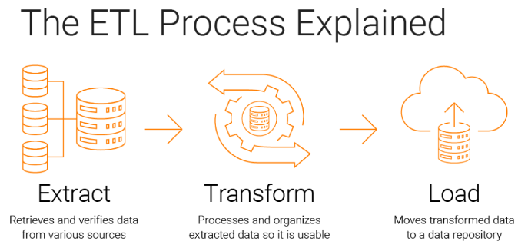
Notes:
There is still debate over which approach is best.

Slide 3
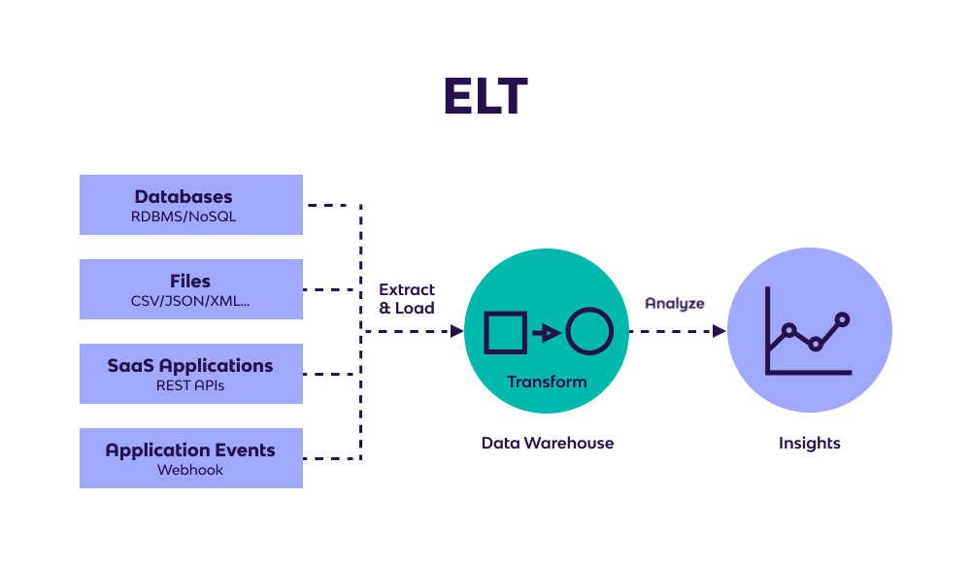
Notes:
There is still debate over which approach is best.

Slide 4
Two Data Warehousing Strategies
1. Enterprise-wide warehouse,
top-down, the Inmon methodology
2. Data mart, bottom-up, the Kimball methodology
When properly executed, both result in an enterprise-wide data warehouse
Notes:
There is still debate over which approach is best.

Slide 5
The Data Mart Strategy: start with a small POC
The most common approach
Begins with a single mart and architected marts are added over time for more subject areas
Relatively inexpensive and easy to implement
Can be used as a proof of concept for data warehousing
Can perpetuate the “silos of information” problem
Can postpone difficult decisions and activities
Requires an overall integration plan
Notes:
The key is to have an overall plan, processes, and technologies for integrating the different marts. The marts may be logically rather than physically separate.

Slide 6
The Enterprise-wide Strategy
A comprehensive warehouse is built initially
An initial dependent data mart is built using a subset of the data in the warehouse
Additional data marts are built using subsets of the data in the warehouse
Like all complex projects, it is expensive, time consuming, and prone to failure
When successful, it results in an integrated, scalable warehouse
Notes:
Even with the enterprise-wide strategy, the warehouse is developed in phases and each phase should be designed to deliver business value.

Slide 7
Data Sources and Types
Primarily from legacy, operational systems
Almost exclusively numerical data at the present time
External data may be included, often purchased from third-party sources
Technology exists for storing unstructured data and expect this to become more important over time
Notes:
It is not unusual to extract data from over 100 source systems. While the technology is available to store structured and unstructured data together, the reality is that warehouse data is almost exclusively structured -- numerical with simple textual identifiers.

Slide 8
Extraction, Transformation, and Loading (ETL) Processes
The “plumbing” work of data warehousing
Data are moved from source to target data bases
A very costly, time consuming part of data warehousing
Notes:
ETL tends to be “pick and shovel” work. Most organization’s data is even worse than imagined.

Slide 9
Recent Development: More Frequent Updates
Updates can be done in bulk and trickle modes
Business requirements, such as trading partner access to a Web site, requires current data
For international firms, there is no good time to load the warehouse
Notes:
As data warehousing becomes more critical to decision making and operational processes, the pressure is to have more current data, which leads to trickle updates.

Slide 10
Data Extraction
Data extraction is the process of collecting and retrieving data from various sources, like
1. databases,
2. websites,
3. documents, files,
…
and transferring it to a single location for further analysis and storage;
Notes:
It’s changing, but COBOL extracts are still the most common ETL process. There are multiple reasons for this -- the cost of specialized ETL software, in-house programmers who have a good knowledge of the COBOL based source systems that will be used, and the peculiarities of the source systems that make the use of ETL software difficult.

Slide 11
Sample ETL Tools
Python-ETL
petl - Extract, Transform and Load
Teradata Warehouse Builder from Teradata
DataStage from Ascential Software
SAS System from SAS Institute
Power Mart/Power Center from Informatica
Sagent Solution from Sagent Software
Hummingbird Genio Suite from Hummingbird Communications
Notes:
You might go to the vendors’ web sites to find a good demo to show your students.

Slide 12
Reasons for “Dirty” Data
Dummy Values
Absence of Data
Multipurpose Fields
Cryptic Data
Contradicting Data
Inappropriate Use of Address Lines
Violation of Business Rules
Reused Primary Keys,
Non-Unique Identifiers
Data Integration Problems
Notes:
Here’s a couple of examples:
Dummy data -- a clerk enters 999-99-9999 as a SSN rather than asking the customer for theirs.
Reused primary keys -- a branch bank is closed. Several years later, a new branch is opened, and the old identifier is used again.

Slide 13
Data Cleansing
Source systems contain “dirty data” that must be cleansed
ETL software contains rudimentary data cleansing capabilities
Specialized data cleansing software is often used. Important for performing name and address correction and householding functions
Leading data cleansing vendors include Vality (Integrity), Harte-Hanks (Trillium), and Firstlogic (i.d.Centric)
Notes:
Data cleansing is critical to customer relationship management initiatives.

Slide 14
Steps in Data Cleansing
Parsing
Correcting
Standardizing
Matching
Consolidating
Notes:
A good example to use is cleansing customer data. Most students can identify with receiving multiple copies of the same catalog because the company is not doing a good data cleansing job.

Slide 15
Parsing
Parsing locates and identifies individual data elements in the source files and then isolates these data elements in the target files.
Examples include parsing the first, middle, and last name; street number and street name; and city and state.
Notes:
The record is broken down into atomic data elements.

Slide 16
Correcting
Corrects parsed individual data components using sophisticated data algorithms and secondary data sources.
Example include replacing a vanity address and adding a zip code.
Notes:
External data, such as census data, is often used in this process.

Slide 17
Standardizing
Standardizing applies conversion routines to transform data into its preferred (and consistent) format using both standard and custom business rules.
Examples include adding a pre name, replacing a nickname, and using a preferred street name.
Notes:
Companies decide on the standards that they want to use.

Slide 18
Matching
Searching and matching records within and across the parsed, corrected and standardized data based on predefined business rules to eliminate duplications.
Examples include identifying similar names and addresses.
Notes:
Commercial data cleansing software often uses AI techniques to match records.

Slide 19
Consolidating
Analyzing and identifying relationships between matched records and consolidating/merging them into ONE representation.
Notes:
All of the data are now combined in a standard format.

Slide 20
Data Staging
Often used as an interim step between data extraction and later steps
Accumulates data from asynchronous sources using native interfaces, flat files, FTP sessions, or other processes
At a predefined cutoff time, data in the staging file is transformed and loaded to the warehouse
There is usually no end user access to the staging file
An operational data store may be used for data staging
Notes:
Data staging is used in cleansing, transforming, and integrating the data.

Slide 21
Data Transformation
Transforms the data in accordance with the business rules and standards that have been established
Example include: format changes, deduplication, splitting up fields, replacement of codes, derived values, and aggregates
Notes:
Aggregates, such as sales totals, are often precalculated and stored in the warehouse to speed queries that require summary totals.

Slide 22
Data Loading
Data are physically moved to the data warehouse
The loading takes place within a “load window”
The trend is to near real time updates of the data warehouse as the warehouse is increasingly used for operational applications
Notes:
Most loads involve only change data rather than a bulk reloading of all of the data in the warehouse.

Slide 23
Meta Data
Data about data
Needed by both information technology personnel and users
IT personnel need to know data sources and targets; database, table and column names; refresh schedules; data usage measures; etc.
Users need to know entity/attribute definitions; reports/query tools available; report distribution information; help desk contact information, etc.
Notes:
The importance of meta data is now realized, even though creating it is not glamorous work.

Slide 24
Recent Development: Meta Data Integration
A growing realization that meta data is critical to data warehousing success
Progress is being made on getting vendors to agree on standards and to incorporate the sharing of meta data among their tools
Vendors like Microsoft, Computer Associates, and Oracle have entered the meta data marketplace with significant product offerings
Notes:
Historically, each vendor had their own meta data solution -- which was incompatible with other vendors’ solutions. This is changing.

