Slide 1

G.Anuradha

Slide 2
Objectives
Understand how requirements definition determines data design
Introduction of dimensional modeling /contrast with E-R modeling
Basics of star schema
Contents of fact/dimension tables
Advantages of star schema for DW

Slide 3
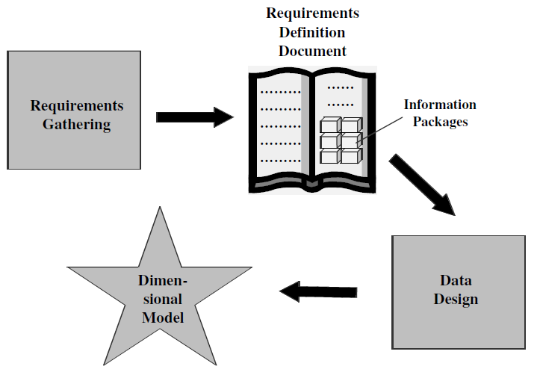
Requirements to Design

Slide 4
Design decisions to be taken
Choosing the process:-deciding subjects
Choosing the grain
Identifying and confirming dimensions
Choosing the facts
Choosing the duration of the database

Slide 5
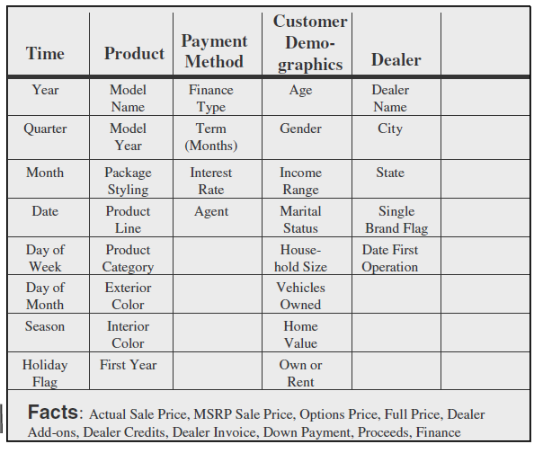
Dimensional modeling basics

Slide 6
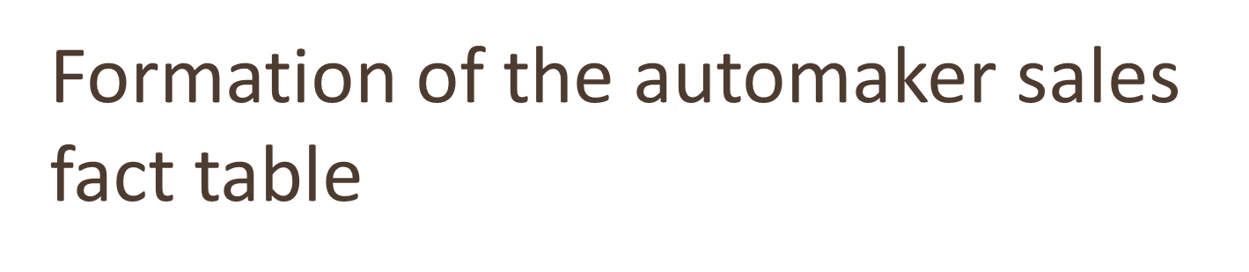
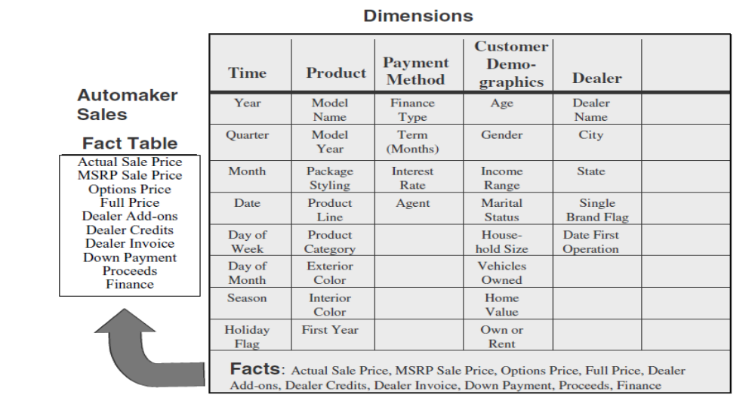

Slide 7
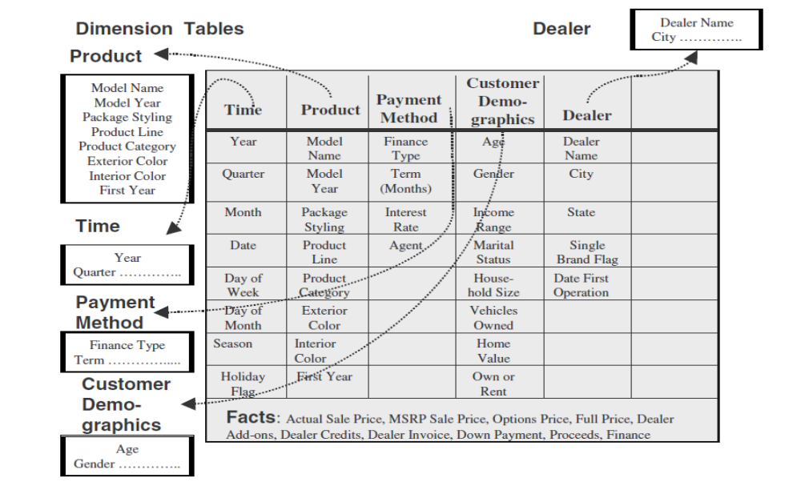
How much sales proceeds did the jeep tata mahindra, 2005 model with vxi options, generate in january 2000 at spectra auto dealership for buyers who owned their homes, financed by icici prudential financing?

Slide 8
Tips for combining data into dimensional model
  Provide best data access
  Model should be query-centric
  Model should be optimized for queries and analyses
  Model should reveal the interactions between the dimension and fact tables
  There should be drilling down or rolling up along dimension hierarchies

Slide 9

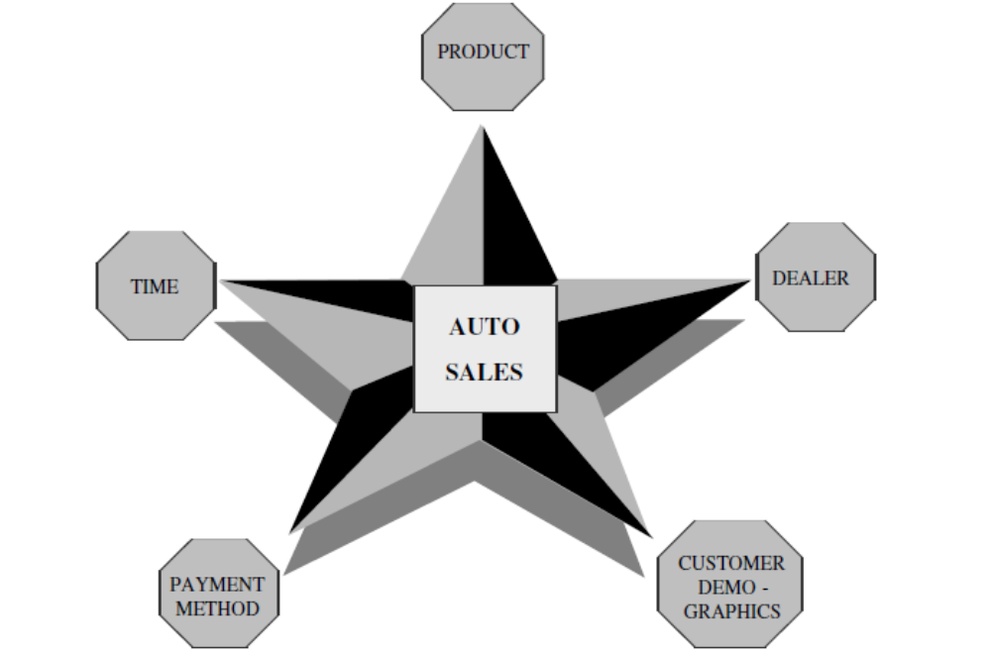

Slide 10
ER Model v/s Dimension Model
ER diagram is a complex diagram, used to represent multiple processes. A single ER diagram can be broken down into several DM diagrams.
In DM, we prefer keeping the tables de-normalized, whereas in a ER diagram, our main aim is to remove redundancy
ER model is designed to express microscopic relationships between elements. DM captures the business measures
DM is designed to answer queries on business process, whereas the ER model is designed to record the business processes via their transactions.

Slide 11
Entity-Relationship vs. Dimensional Models
E-R DIAGRAM
One table per entity
Minimize data redundancy
Optimize update
The Transaction Processing Model
DIMENSIONAL MODEL
One fact table for data organization
Maximize understandability
Optimized for retrieval
The data warehousing model

Slide 12
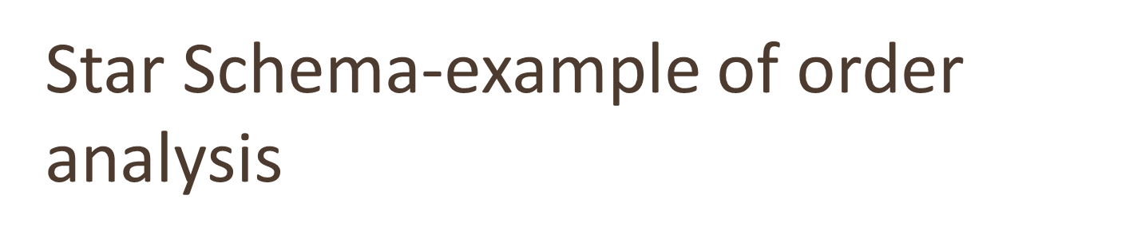
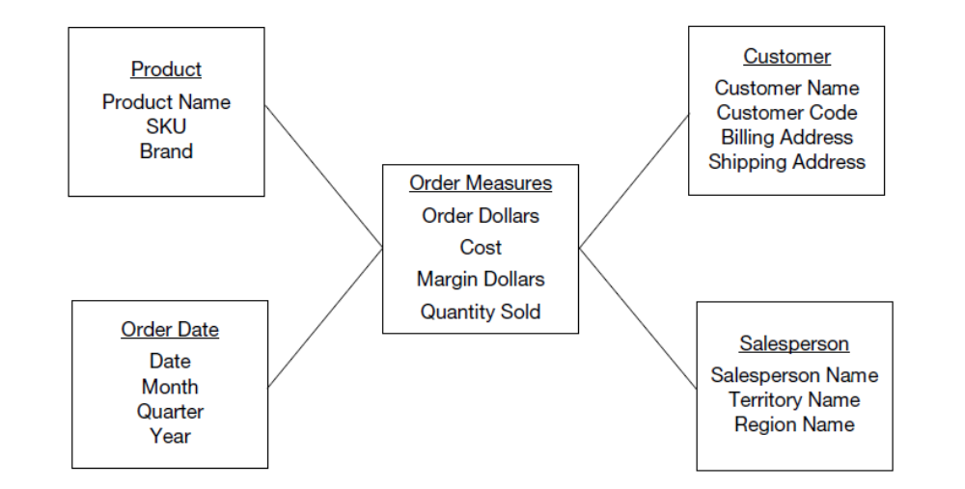
Query result

Slide 13
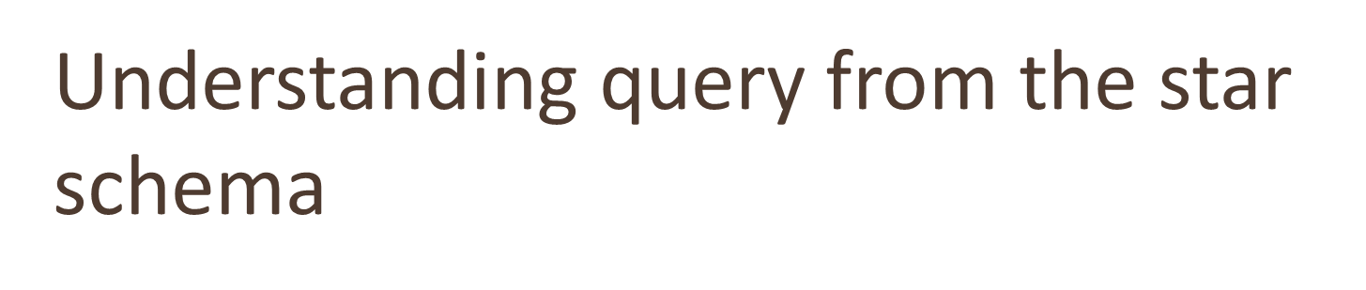
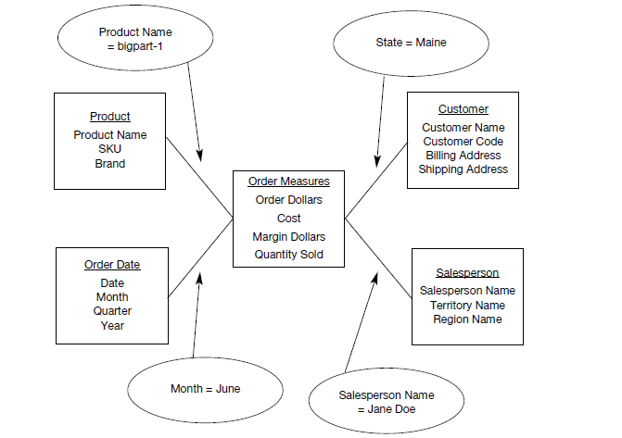

Slide 14
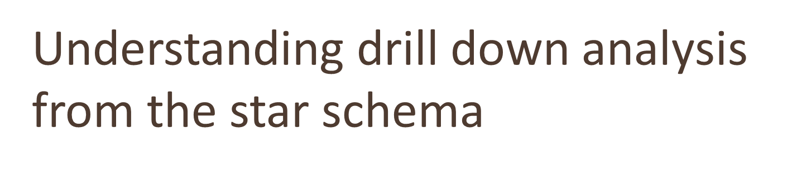
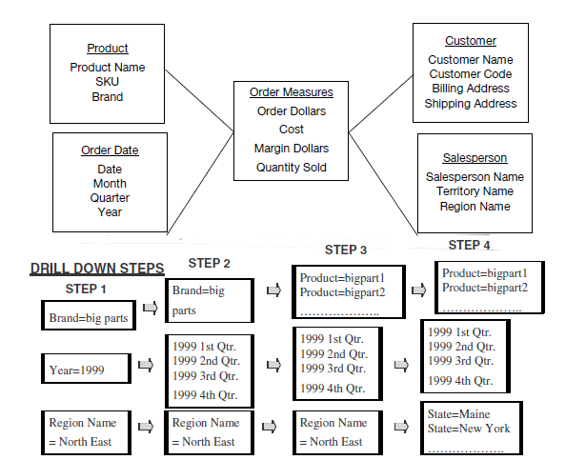

Slide 15
Dimension table
Contain information about a particular dimension.
  Dimension table key
  Table is wide
  Textual attributes
  Attributes not directly related
  Not normalized
  Drilling down, rolling up
  Multiple hierarchies
  Fewer number of records

Slide 16
Facts
Numeric measurements (values) that represent a specific business aspect or activity
Stored in a fact table at the center of the star scheme
Contains facts that are linked through their dimensions
Can be computed or derived at run time
Updated periodically with data from operational databases

Slide 17
Fact table
Contains primary information of the warehouse
  Concatenated key
  Data grain
  Fully additive measures
  Semi-additive measures(derived attributes)
  Table deep, not wide
  Sparse data
  Degenerate dimensions(attributes which are neither fact or a dimension)

Slide 18
Star schema for a retail chain
Time Dimension Table
Time key
Year
Quarter
Month
Week
Date
Sales Fact Table
Time key
Product key
Customer key
Store key
Mode key
Actual sales
Forecast sales
Price
Discount
Customer Dimension Table
Customer key
Name
Age
Income
Gender
Marital status
Store Dimension Table
Store key
Name
City
State
Op from year
Product Dimension Table
Product key
Name
Brand
Category
Colour
Price
Payment Mode Dimension Table
Mode key
Payment mode
Interest rate

Slide 19
Star Schema characteristics
Star schema is a relational model with one-to-many relationship between the fact table and the dimension tables.
De-normalized relational model
Easy to understand. Reflects how users think. This makes it easy for them to query and analyse the data.
Optimizes navigation.
Enhances query extraction.
Ability to drill down or roll up.

Slide 20
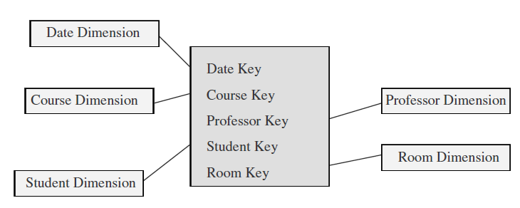
Factless fact table
A fact table is said to be empty if it has no measures to be displayed. Fact table represents events
Contains no data, only keys.

Slide 21
Data Granularity
When fact table at the lowest grain, the users can as well drill down to the lowest grain of details
But when data is kept till the lowest level of data, we have to compromise on the storage and maintenance of DW
Advantages
  Easier to extract from operational data and load into DW
  Can be feed directly to the DM application

Slide 22

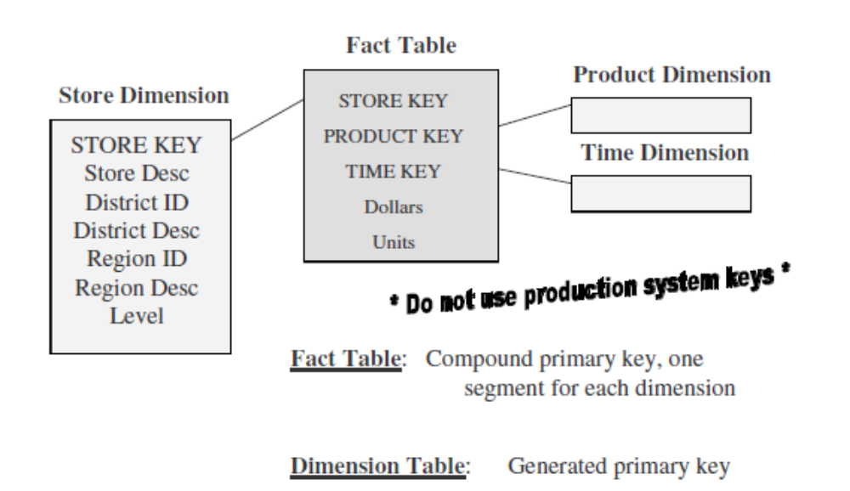

Slide 23
Star schema keys contd…
Primary keys: should not be same as production system
Surrogate keys: System generated sequence numbers having no built-in meanings
Foreign keys: primary key of each dimension table must be a foreign key in the fact table.

Slide 24
Primary key for Fact table
A single compound primary key whose length is the total length of the keys of the individual dimension tables
Concatenated primary key that is the concatenation of all the primary keys of the dimension tables.
A generated primary key independent of the keys of the dimension tables.

Slide 25
Advantages of the star schema
Easy for users to understand
Optimizes navigation
Most suitable for query processing

Slide 26
Starjoin and Starindex
Star join:- high-speed, single pass parallelizable, multitable join.
  Boots query performance
Star index:- specialized index to accelerate join performance
  Speed up joins between the dimension tables and fact tables

Slide 27
Summing up
Derived from the information packages in the requirements definition.
The STAR schema used for data design is a relational model consisting of fact and dimension tables.
The fact table contains the business metrics or measurements; the dimensional tables contain the business dimensions. Hierarchies within each dimension table are used for drilling down to lower levels of data.
STAR schema advantages are: easy for users to understand, optimizes navigation, most suitable for query processing, and enables specific performance schemes.

Slide 28
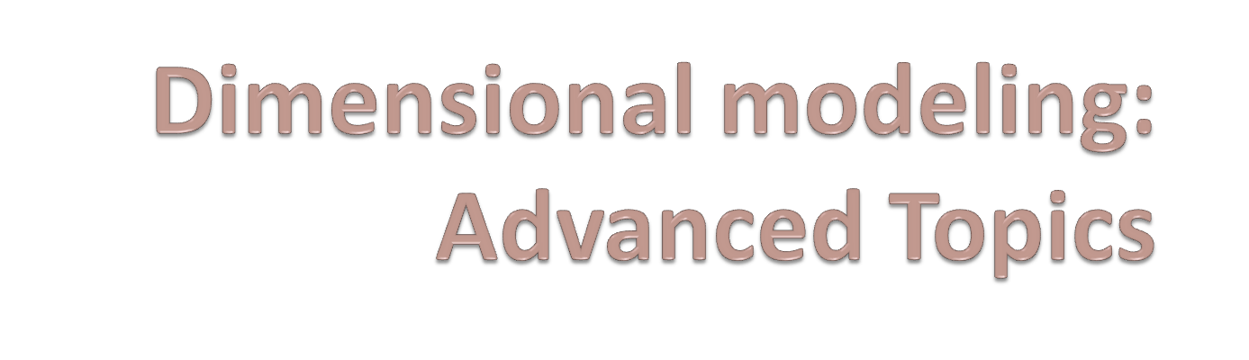
G.Anuradha

Slide 29
Objectives
Slowly changing dimensions
Large dimensions
Snowflake schema
Aggregate tables
Family of starts and their applications

Slide 30
Updating the Dimension table
Dimension tables are non-volatile and mostly read-only.
More rows are added to the Dimension tables over time.
Changes to certain attributes of a row become eminent at times.
There are many types of changes that affect the dimension tables.

Slide 31
Slowly changing dimensions
Most dimensions are generally constant over time
Many dimensions change slowly
Though the key does not change other description and attributes change slowly over time
Dimension table attributes are not overwritten
The ways changes are made in dimension tables depend on the types of changes and what information must be preserved.

Slide 32
Type 1: Correction of errors
Usually relate to correction of errors in the source systems.
E.g., spelling error in customer names; change of names of customers;
There is no need to preserve the old values here.
The old value in the source system needs to be discarded.
The changes made need not be preserved or noted.

Slide 33
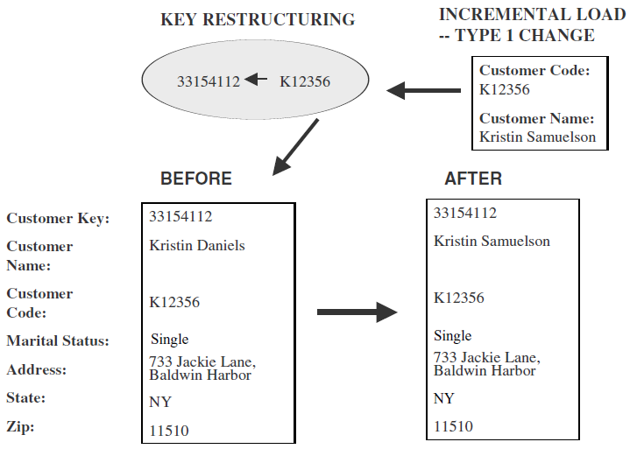
Type 1.. continued
Overwrite attribute value in the dimension table row with new value
No other changes are made to the dimension table row.
The key is not disturbed
Easiest type of change to implement.

Slide 34
Type 2: preservation of history
True changes in the source systems.
E.g., change of marital status; change of address
There is a need to preserve history
This type of changes partition the warehouse
Every change for the same attribute must be preserved.
Applying these changes:
  Add a new dimension table row with new value of the changed attribute
  No changes are made to the existing row.
  New rows are inserted with a new surrogate key.

Slide 35
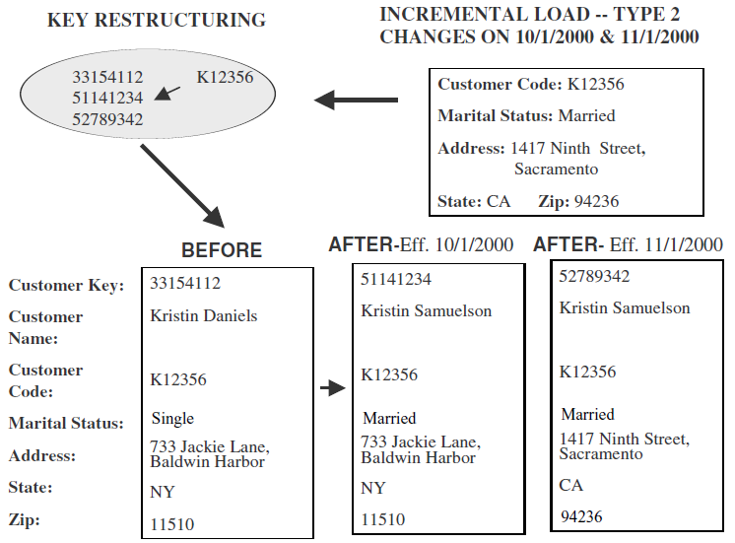
Type 2.. continued

Slide 36
Type 3: tentative soft revision
Tentative changes in the source system
E.g., if an employee will get posted for a short period to a different location
Need to keep track of history with old and new values
Used to compare performances across the transition
Applying these changes
  An “old” field is added in the dimension table
  Push existing value of attribute from “current” to “old”
  Update the “current” field with the new value with effective date

Slide 37
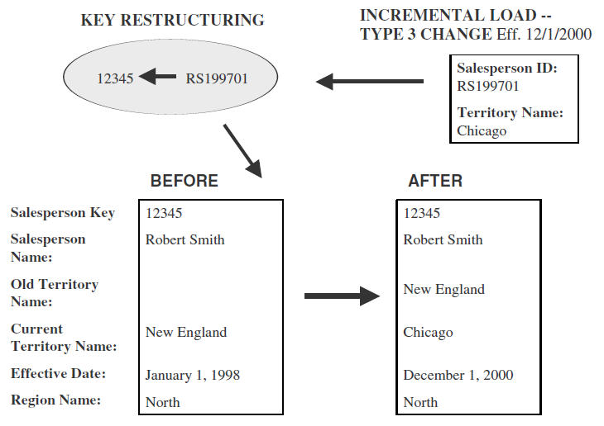
Type 3.. continued

Slide 38
Large dimensions
Very deep(large number of rows)
Very wide(large number of attributes)
Have multiple hierarchies
Rapidly changing dimensions
Junk dimensions

Slide 39

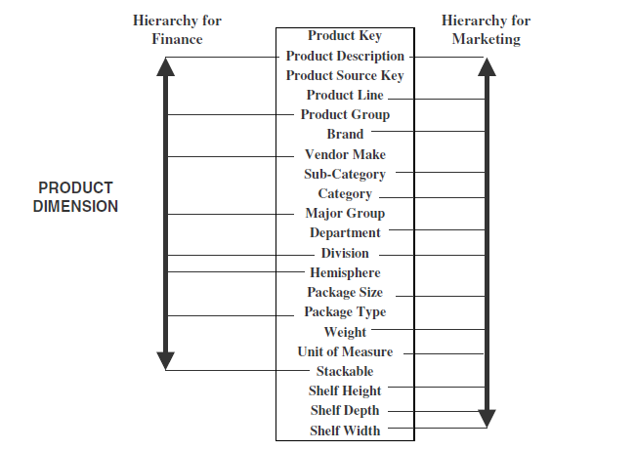

Slide 40

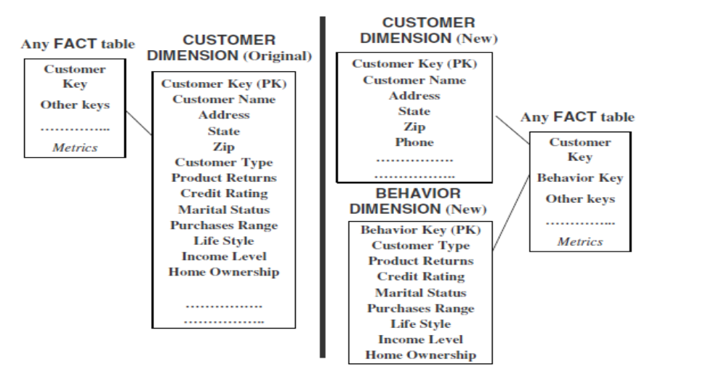

Slide 41
Snowflake schema
A variation of the star schema, in which all or some of the dimension tables may be normalized.
Eliminates redundancy
Generally used when a dimension table is wide.
Saves space
Complex querying is required.

Slide 42

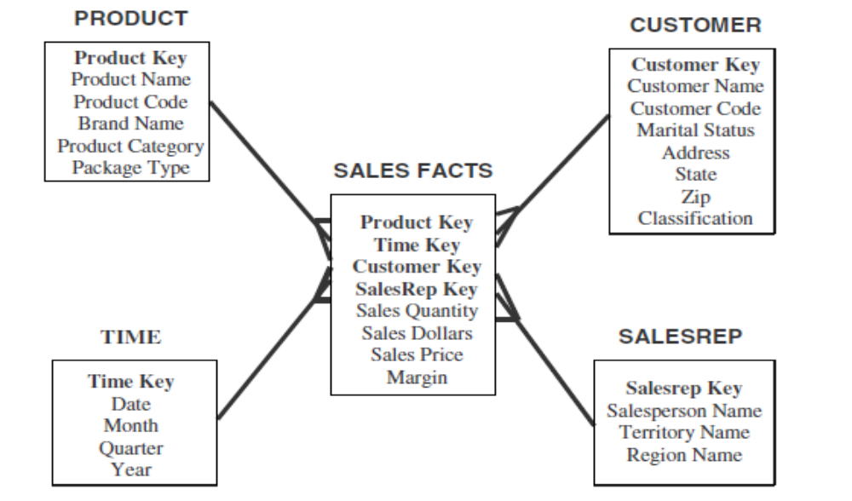

Slide 43

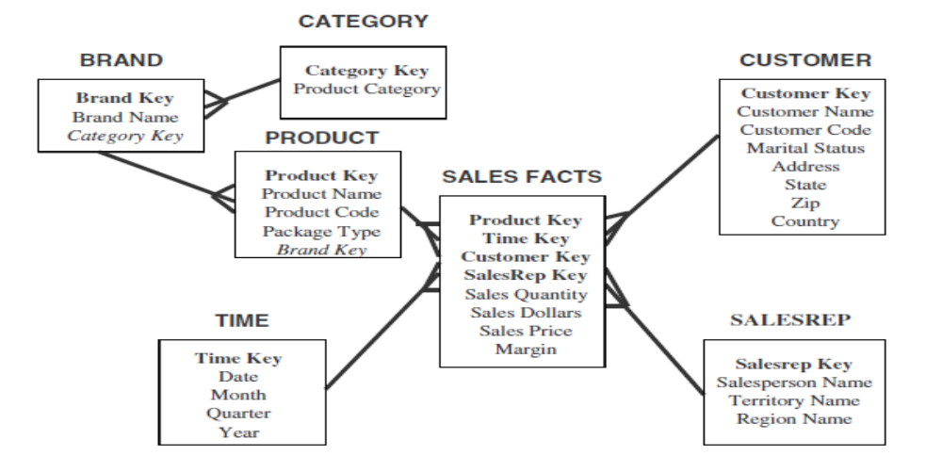

Slide 44

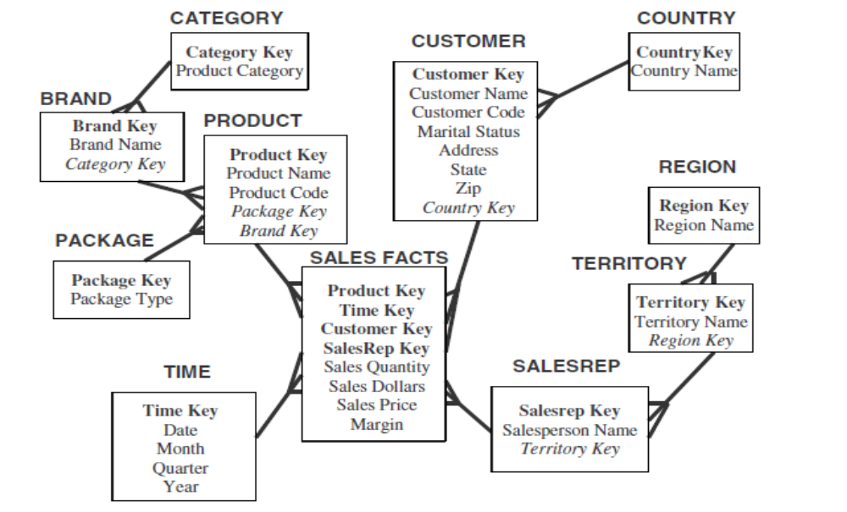

Slide 45
Advantages and disadvantages
Advantages
  Small savings in storage space
  Normalized structures are easier to update and maintain
Disadvantages
  Schema is less intuitive
  Browsing becomes difficult
  Degraded query performance because of additional joins

Slide 46

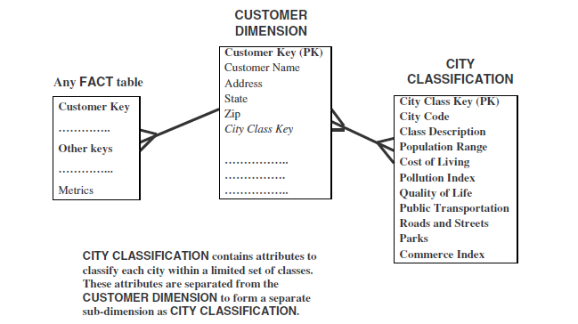

Slide 47
Aggregate fact tables
Contain pre-calculated summaries derived from the most granular (detailed) fact table.
Created as a specific summarization across any number of dimensions.
Reduces runtime processing.

Slide 48
Why need aggregate fact tables?
Large size of the fact table
To speed up query extraction
Limitations
  Must be re-aggregated each time there is a change in the source data
  Do not support exploratory analysis
  Limited interactive use.

Slide 49
Fact Constellation
Multiple fact tables share dimension tables.
This schema is viewed as collection of stars hence called galaxy schema or fact constellation.
Sophisticated application requires such schema.

Slide 50

Sales
Fact Table
Shipping
Fact Table
Store Key
Product Key
Period Key
Units
Price
Product Dimension
Shipper Key
Store Key
Product Key
Period Key
Units
Price
Product Key
Product Desc
Store Dimension
Store Key
Store Name
City
State
Region

Slide 51
Fact Constellation
Multiple fact tables share dimension tables.
This schema is viewed as collection of stars hence called galaxy schema or fact constellation.
Sophisticated application requires such schema.

Slide 52
Sales
Fact Table
Shipping
Fact Table
Store Key
Product Key
Period Key
Units
Price
Product Dimension
Shipper Key
Store Key
Product Key
Period Key
Units
Price
Product Key
Product Desc
Store Dimension
Store Key
Store Name
City
State
Region

