Slide 1
An Introduction to Logistic Regression
JohnWhitehead
Department of Economics
East Carolina University

Slide 2
Outline
Introduction and Description
Some Potential Problems and Solutions
Writing Up the Results

Slide 3
Introduction and Description
Why use logistic regression?
Estimation by maximum likelihood
Interpreting coefficients
Hypothesis testing
Evaluating the performance of the model

Slide 4
Why use logistic regression?
There are many important research topics for which the dependent variable is "limited."
For example: voting, morbidity or mortality, and participation data is not continuous or distributed normally.
Binary logistic regression is a type of regression analysis where the dependent variable is a dummy variable: coded 0 (did not vote) or 1(did vote)

Slide 5
The Linear Probability Model
In the OLS regression:
Y = γ + ϕX + e ; where Y = (0, 1)
The error terms are heteroskedastic
e is not normally distributed because Y takes on only two values
The predicted probabilities can be greater than 1 or less than 0

Slide 6
An Example: Hurricane Evacuations
Q: EVAC
Did you evacuate your home to go someplace safer before Hurricane Dennis (Floyd) hit?
1 YES
2 NO
3 DON'T KNOW
4 REFUSED

Slide 7
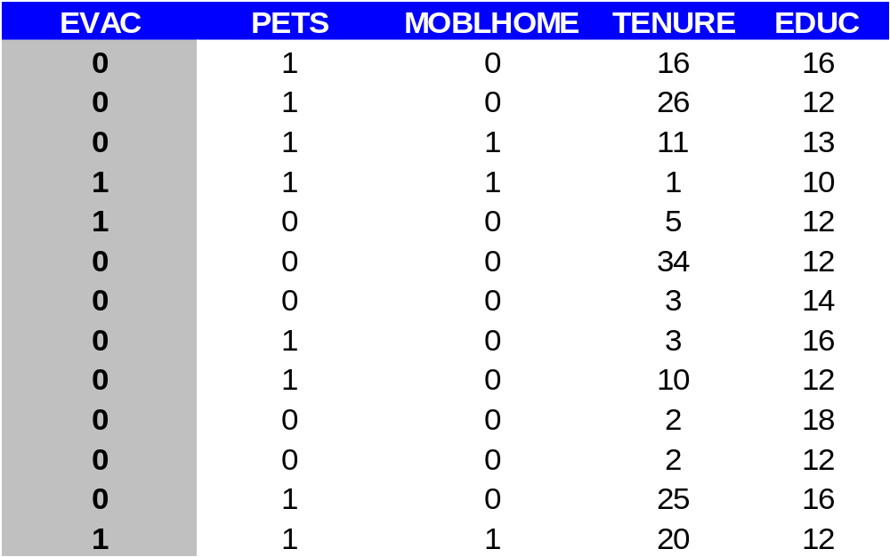
The Data

Slide 8
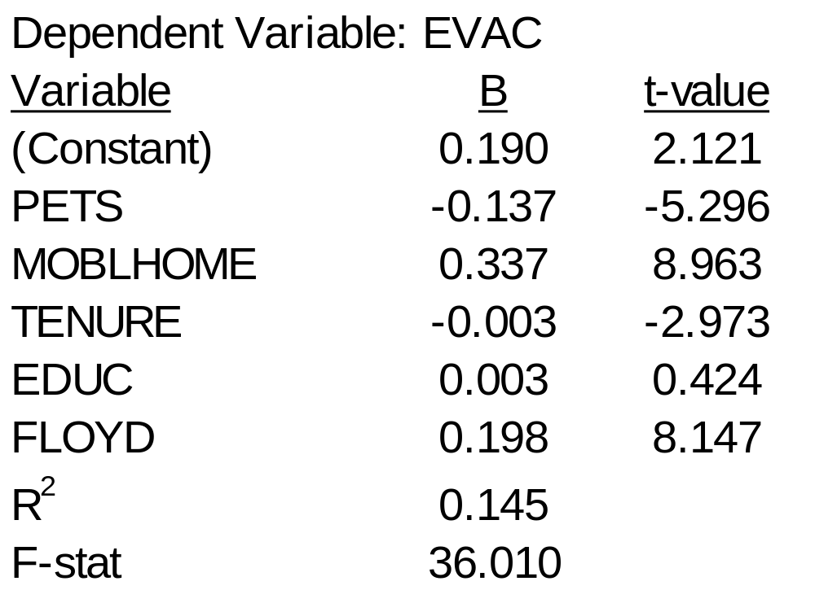
OLS Results

Slide 9
Problems:
Predicted Values outside the 0,1 range
Descriptive Statistics
Std.
N
Minimum
Maximum
Mean
Deviation
Unstandardized
1070
-.08498
.76027
.2429907
.1632534
Predicted Value
Valid N (listwise)
1070

Slide 10
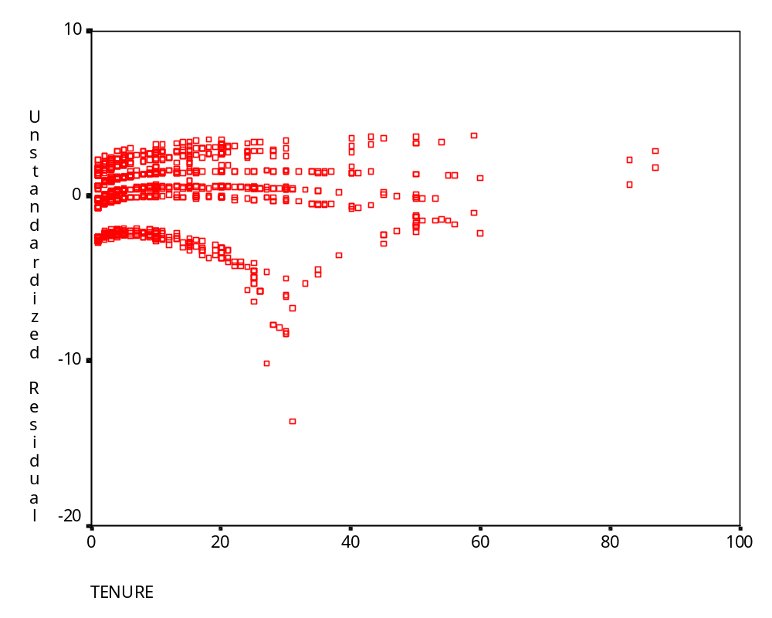
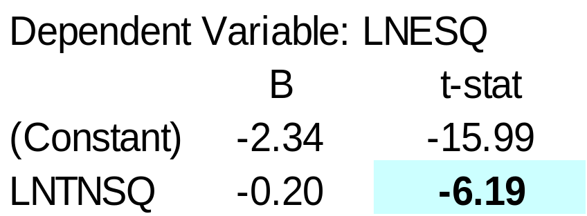
Heteroskedasticity
Park Test

Slide 11
The Logistic Regression Model
The "logit" model solves these problems:
ln[p/(1-p)] = α + βX + e
p is the probability that the event Y occurs, p(Y=1)
p/(1-p) is the "odds ratio"
ln[p/(1-p)] is the log odds ratio, or "logit"

Slide 12
More:
The logistic distribution constrains the estimated probabilities to lie between 0 and 1.
The estimated probability is:
p = 1/[1 + exp(-α - β X)]
if you let α + β X =0, then p = .50
as α + β X gets really big, p approaches 1
as α + β X gets really small, p approaches 0

Slide 13
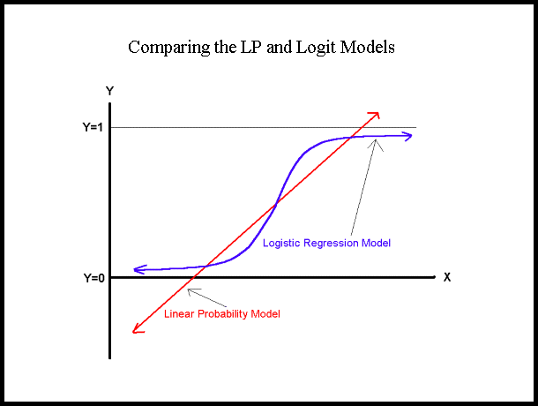

Slide 14
Comparing LP and Logit Models
Y
LP Model
1
Logit Model
0
X

Slide 15
Maximum Likelihood Estimation (MLE)
MLE is a statistical method for estimating the coefficients of a model.
The likelihood function (L) measures the probability of observing the particular set of dependent variable values (p₁, p₂, ..., p_{n}) that occur in the sample:
L = Prob (p₁* p₂* * * p_{n})
The higher the L, the higher the probability of observing the ps in the sample.

Slide 16
MLE involves finding the coefficients (α, β) that makes the log of the likelihood function (LL < 0) as large as possible
Or, finds the coefficients that make -2 times the log of the likelihood function (-2LL) as small as possible
The maximum likelihood estimates solve the following condition:
{Y - p(Y=1)}X_{i} = 0
summed over all observations, i = 1,…,n

Slide 17
Interpreting Coefficients
Since:
ln[p/(1-p)] = α + βX + e
The slope coefficient (β) is interpreted as the rate of change in the "log odds" as X changes … not very useful.
Since:
p = 1/[1 + exp(-α - β X)]
The marginal effect of a change in X on the probability is: p/X = f(β X) β

Slide 18
An interpretation of the logit coefficient which is usually more intuitive is the "odds ratio"
Since:
[p/(1-p)] = exp(α + βX)
exp(β) is the effect of the independent variable on the "odds ratio"

Slide 19
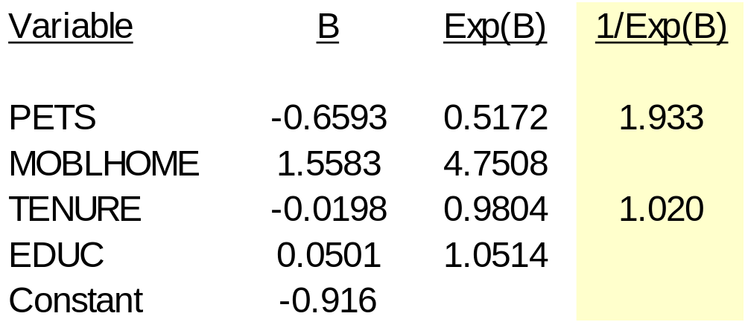
From SPSS Output:
  “Households with pets are 1.933 times more likely to evacuate than those without pets.”

Slide 20
Hypothesis Testing
The Wald statistic for the β coefficient is:
Wald = [β /s.e._{B}]²
which is distributed chi-square with 1 degree of freedom.
The "Partial R" (in SPSS output) is
R = {[(Wald-2)/(-2LL(α)]}^{1/2}

Slide 21
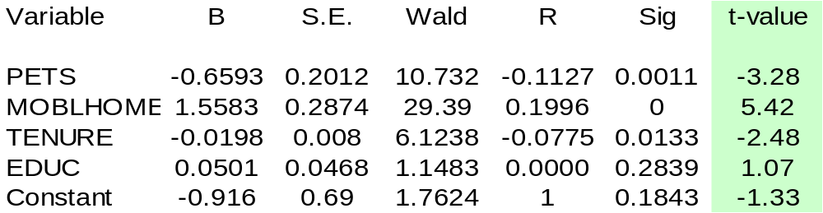
An Example:

Slide 22
Evaluating the Performance of the Model
There are several statistics which can be used for comparing alternative models or evaluating the performance of a single model:
  Model Chi-Square
  Percent Correct Predictions
  Pseudo-R²

Slide 23
Model Chi-Square
  The model likelihood ratio (LR), statistic is
  LR[i] = -2[LL(α) - LL(α, β) ]
  {Or, as you are reading SPSS printout:
  LR[i] = [-2LL (of beginning model)] - [-2LL (of ending model)]}
  The LR statistic is distributed chi-square with i degrees of freedom, where i is the number of independent variables
  Use the “Model Chi-Square” statistic to determine if the overall model is statistically significant.

Slide 24
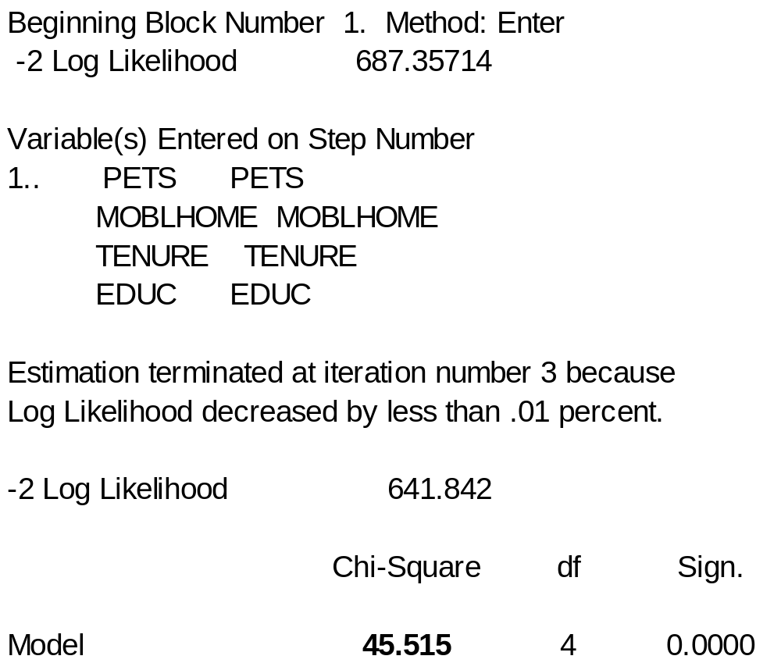
An Example:

Slide 25
Percent Correct Predictions
The "Percent Correct Predictions" statistic assumes that if the estimated p is greater than or equal to .5 then the event is expected to occur and not occur otherwise.
By assigning these probabilities 0s and 1s and comparing these to the actual 0s and 1s, the % correct Yes, % correct No, and overall % correct scores are calculated.

Slide 26
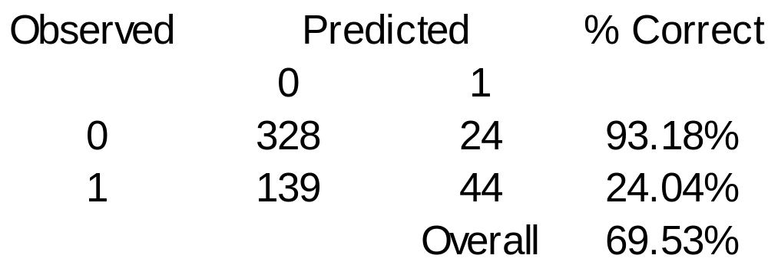
An Example:

Slide 27
Pseudo-R²
One psuedo-R² statistic is the McFadden's-R² statistic:
McFadden's-R² = 1 - [LL(α,β)/LL(α)]
{= 1 - [-2LL(α, β)/-2LL(α)] (from SPSS printout)}
where the R² is a scalar measure which varies between 0 and (somewhat close to) 1 much like the R² in a LP model.

Slide 28
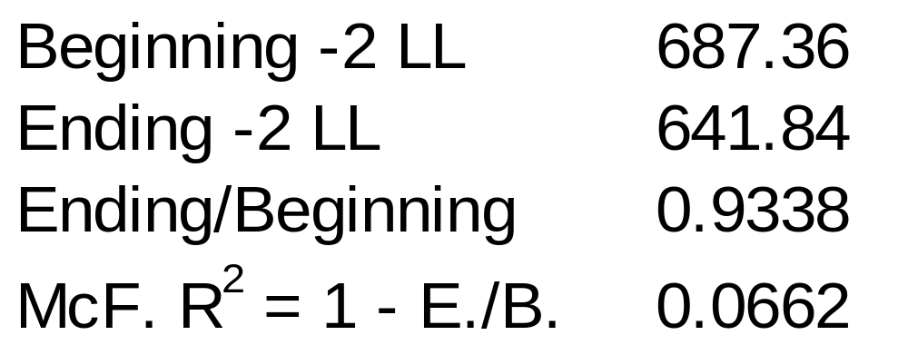
An Example:

Slide 29
Some potential problems and solutions
Omitted Variable Bias
Irrelevant Variable Bias
Functional Form
Multicollinearity
Structural Breaks

Slide 30
Omitted Variable Bias
Omitted variable(s) can result in bias in the coefficient estimates. To test for omitted variables you can conduct a likelihood ratio test:
LR[q] = {[-2LL(constrained model, i=k-q)]
- [-2LL(unconstrained model, i=k)]}
where LR is distributed chi-square with q degrees of freedom, with q = 1 or more omitted variables
{This test is conducted automatically by SPSS if you specify "blocks" of independent variables}

Slide 31
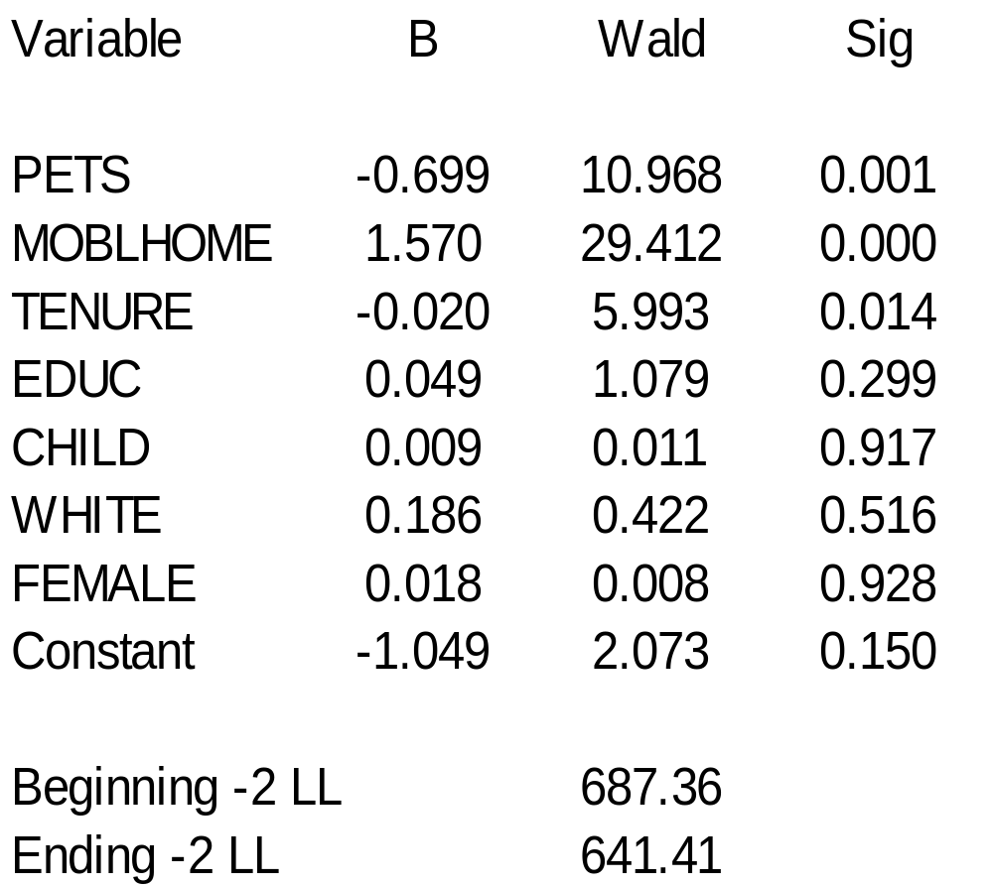
An Example:
Notes:
Variable
B
Wald
Sig
PETS
-0.699
10.968
0.001
MOBLHOME
1.570
29.412
0.000
TENURE
-0.020
5.993
0.014
EDUC
0.049
1.079
0.299
CHILD
0.009
0.011
0.917
WHITE
0.186
0.422
0.516
FEMALE
0.018
0.008
0.928
Constant
-1.049
2.073
0.150
Beginning -2 LL
687.36
Ending -2 LL
641.41

Slide 32
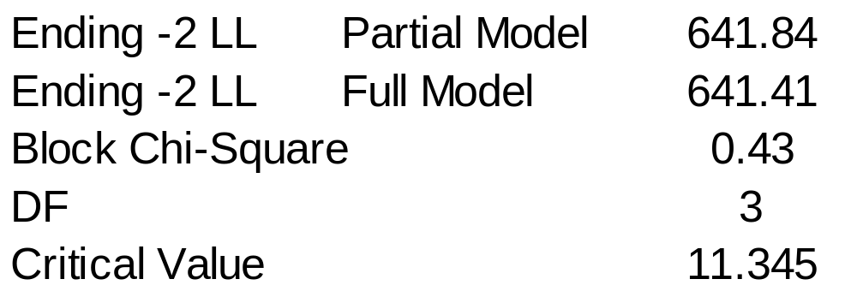
Constructing the LR Test
“Since the chi-squared value is less than the critical value the set of coefficients is not statistically significant. The full model is not an improvement over the partial model.”

Slide 33
Irrelevant Variable Bias
The inclusion of irrelevant variable(s) can result in poor model fit.
You can consult your Wald statistics or conduct a likelihood ratio test.

Slide 34
Functional Form
Errors in functional form can result in biased coefficient estimates and poor model fit.
You should try different functional forms by logging the independent variables, adding squared terms, etc.
Then consult the Wald statistics and model chi-square statistics to determine which model performs best.

Slide 35
Multicollinearity
The presence of multicollinearity will not lead to biased coefficients.
But the standard errors of the coefficients will be inflated.
If a variable which you think should be statistically significant is not, consult the correlation coefficients.
If two variables are correlated at a rate greater than .6, .7, .8, etc. then try dropping the least theoretically important of the two.

Slide 36
Structural Breaks
You may have structural breaks in your data. Pooling the data imposes the restriction that an independent variable has the same effect on the dependent variable for different groups of data when the opposite may be true.
You can conduct a likelihood ratio test:
LR[i+1] = -2LL(pooled model)
[-2LL(sample 1) + -2LL(sample 2)]
where samples 1 and 2 are pooled, and i is the number of dependent variables.

Slide 37
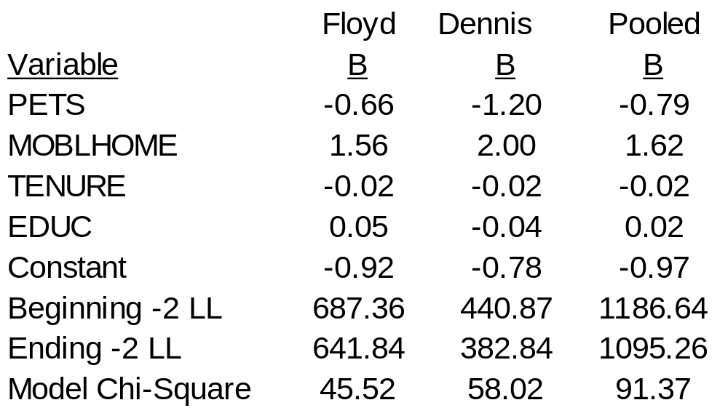
An Example
Is the evacuation behavior from Hurricanes Dennis and Floyd statistically equivalent?

Slide 38
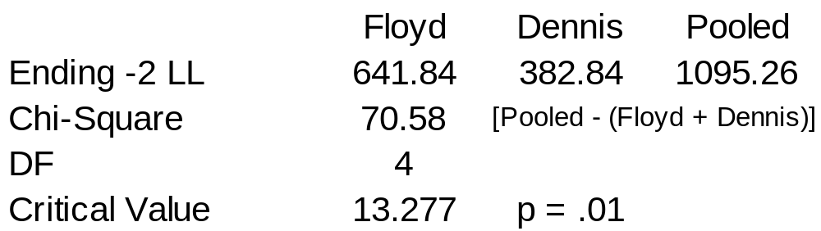
Constructing the LR Test
Since the chi-squared value is greater than the critical value the set of coefficients are statistically different. The pooled model is inappropriate.

Slide 39
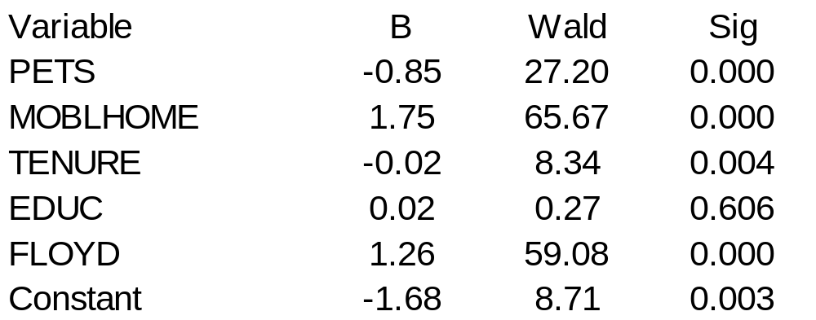
What should you do?
Try adding a dummy variable:
FLOYD = 1 if Floyd, 0 if Dennis

Slide 40
Writing Up Results
Present descriptive statistics in a table
Make it clear that the dependent variable is discrete (0, 1) and not continuous and that you will use logistic regression.
Logistic regression is a standard statistical procedure so you don't (necessarily) need to write out the formula for it. You also (usually) don't need to justify that you are using Logit instead of the LP model or Probit (similar to logit but based on the normal distribution [the tails are less fat]).

Slide 41
An Example:
"The dependent variable which measures the willingness to evacuate is EVAC. EVAC is equal to 1 if the respondent evacuated their home during Hurricanes Floyd and Dennis and 0 otherwise. The logistic regression model is used to estimate the factors which influence evacuation behavior."

Slide 42
Organize your regression results in a table:
In the heading state that your dependent variable (dependent variable = EVAC) and that these are "logistic regression results.”
Present coefficient estimates, t-statistics (or Wald, whichever you prefer), and (at least the) model chi-square statistic for overall model fit
If you are comparing several model specifications you should also present the % correct predictions and/or Pseudo-R² statistics to evaluate model performance
If you are comparing models with hypotheses about different blocks of coefficients or testing for structural breaks in the data, you could present the ending log-likelihood values.

Slide 43
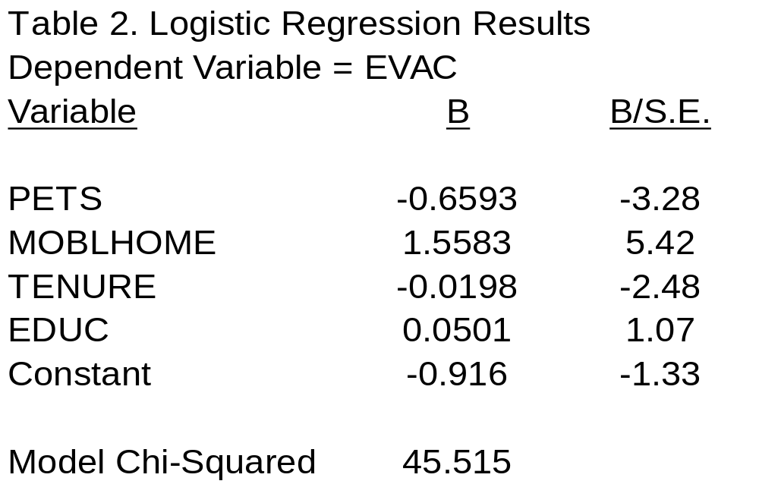
An Example:

Slide 44
  When describing the statistics in the tables, point out the highlights for the reader.
  What are the statistically significant variables?
"The results from Model 1 indicate that coastal residents behave according to risk theory. The coefficient on the MOBLHOME variable is negative and statistically significant at the p < .01 level (t-value = 5.42). Mobile home residents are 4.75 times more likely to evacuate.”

Slide 45
  Is the overall model statistically significant?
“The overall model is significant at the .01 level according to the Model chi-square statistic. The model predicts 69.5% of the responses correctly. The McFadden's R² is .066."

Slide 46
Which model is preferred?
"Model 2 includes three additional independent variables. According to the likelihood ratio test statistic, the partial model is superior to the full model of overall model fit. The block chi-square statistic is not statistically significant at the .01 level (critical value = 11.35 [df=3]). The coefficient on the children, gender, and race variables are not statistically significant at standard levels."

Slide 47
Also
You usually don't need to discuss the magnitude of the coefficients--just the sign (+ or -) and statistical significance.
If your audience is unfamiliar with the extensions (beyond SPSS or SAS printouts) to logistic regression, discuss the calculation of the statistics in an appendix or footnote or provide a citation.
Always state the degrees of freedom for your likelihood-ratio (chi-square) test.

Slide 48
References
http://personal.ecu.edu/whiteheadj/data/logit/
http://personal.ecu.edu/whiteheadj/data/logit/logitpap.htm
E-mail: WhiteheadJ@mail.ecu.edu

