Slide 1
Introduction
Overview of Oracle SCM Process Setup.

Slide 2
User and Responsibility Setup
Step 1: Create new user and assign relevant responsibilities including Global Super HRMS Manager, General Ledger Super User, Inventory, and more.
Global Super HRMS Manager
General Ledger Super User
Inventory
Purchasing, Vision Operations (USA)_
Order Management Super User, Vision Operations (USA)
Oracle Pricing Manager, Global_
CRM Administrator, Vision Enterprises

Slide 3
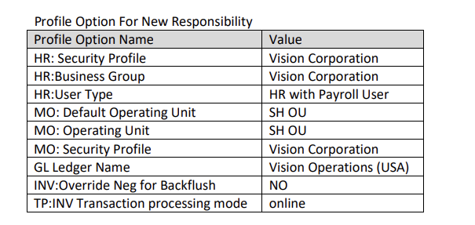
Profile Options
Step 2: Configure profile options for assigned responsibilities then assign responsibilities.

Slide 4
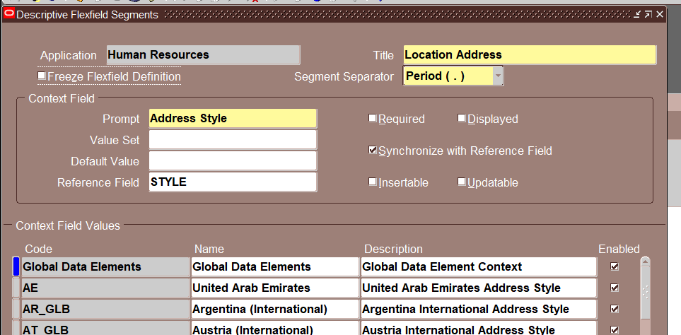
Define Location
Step 3: Define location through Sys Admin > Application > Flex Field > Descriptive > Human Resource > Location addresses.

Slide 5
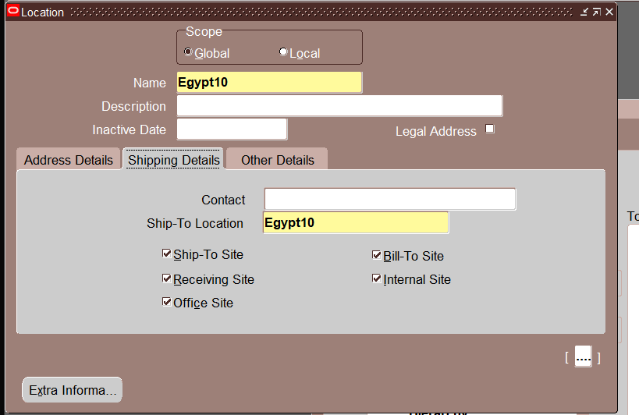
Operating Unit Setup
Step 4: Create operating unit via Global Super HRMS Manager Responsibility.
If there is an Error appear check profile option: IRC: Geocode Hos and clear Geocode Host.
And then go back to Define location from HRMS

Slide 6
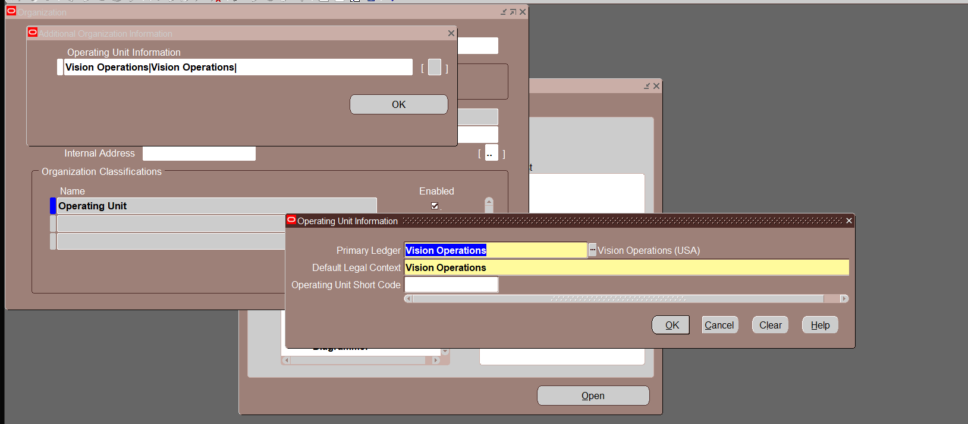
Create Operating unit from HRMS responsibility
Open Global Super HRMS Manager Responsibility to Define new location

Slide 7
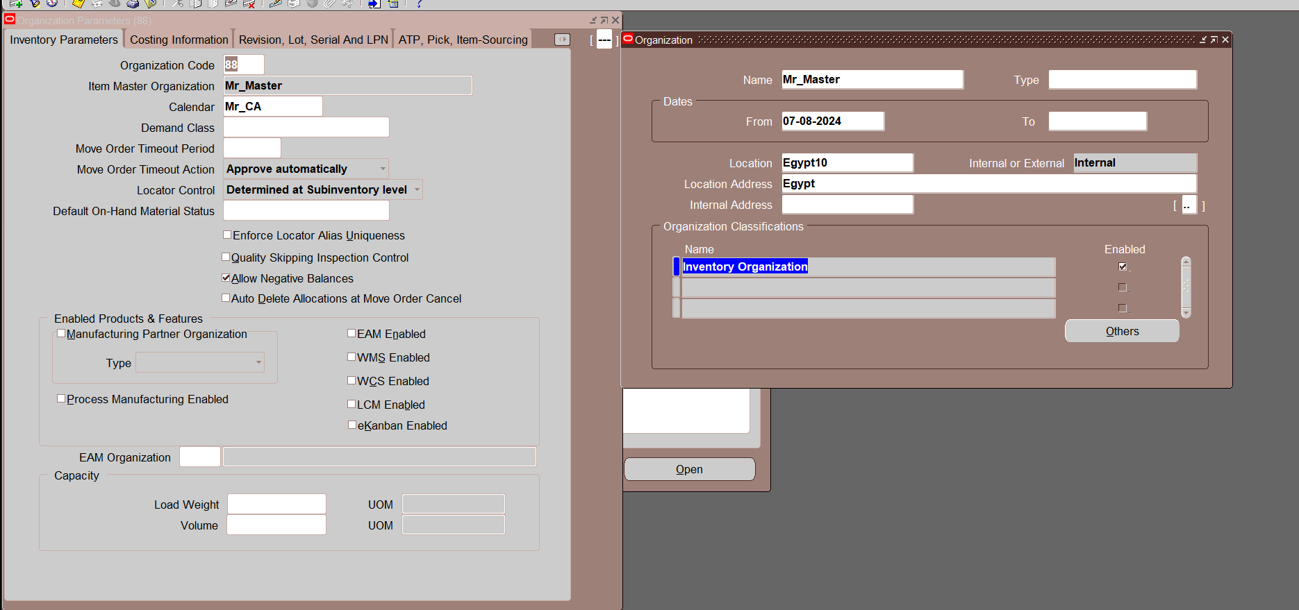
Inventory Organization Creation
Step 5: Define inventory organization, set profile options for Material Status Control.
The profile option "INV: Material Status Support" must be set to Yes at the site level to enforce Material Status Control.

Slide 8
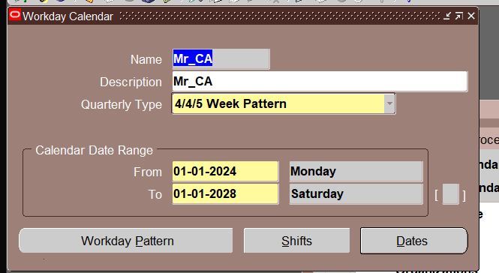
Define workday Calander

Slide 9
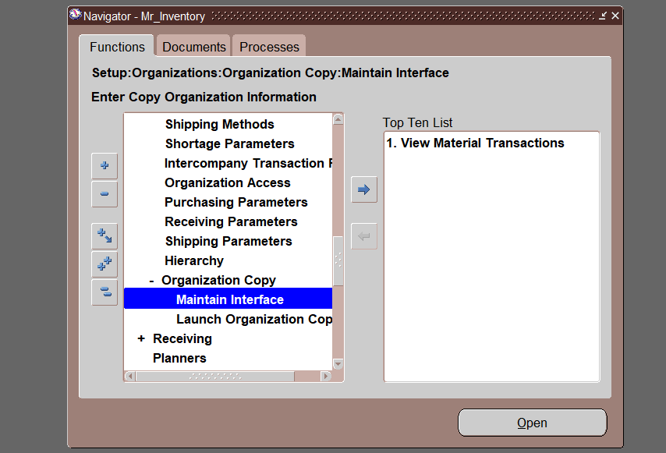
Organization copy from non-master one

Slide 10
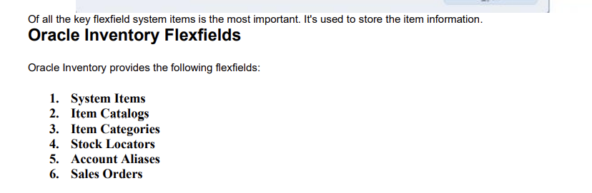
Inventory Key Flex Fields
Step 6: Define key flex fields such as System Items, Item Catalogs, and more.

Slide 11
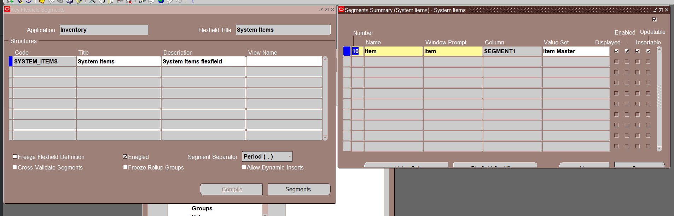
1. System Items

Slide 12
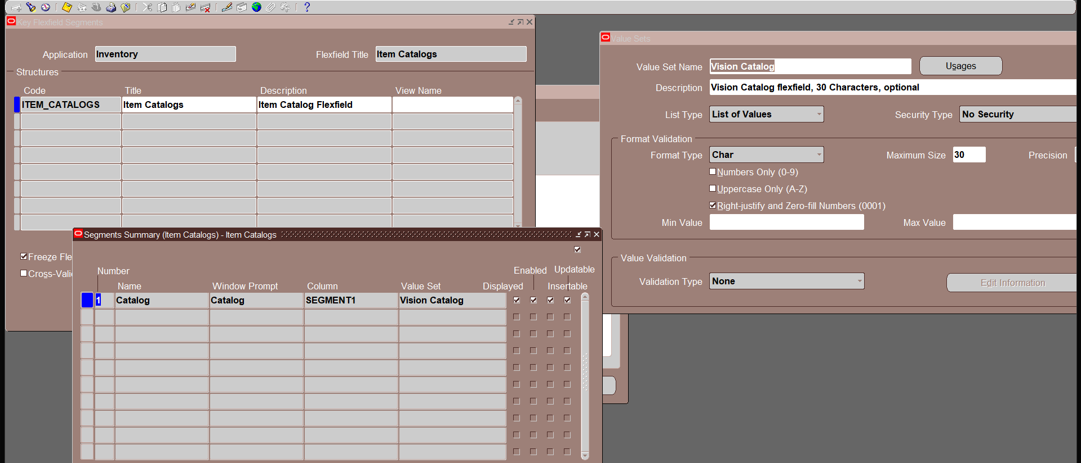
2. Item Catalogs

Slide 13
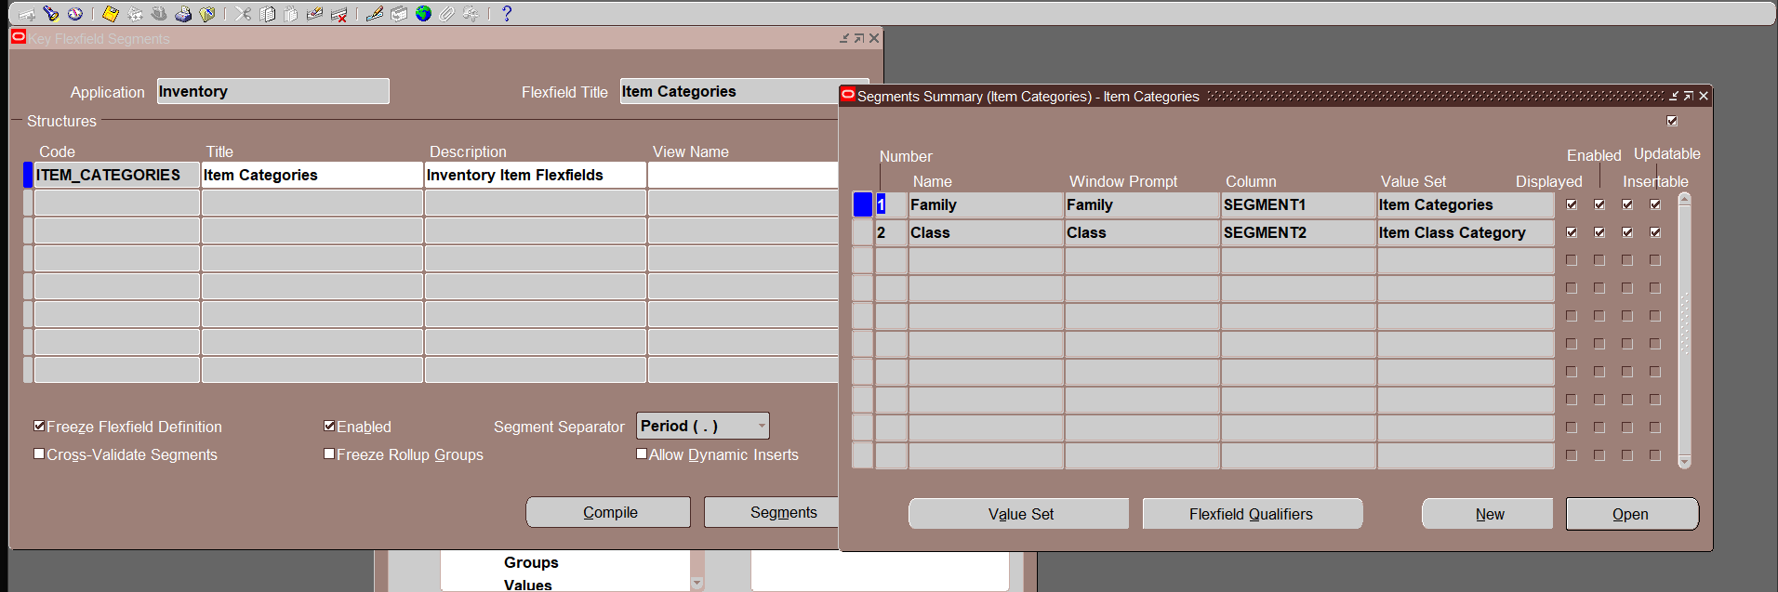
3. Item Categories

Slide 14
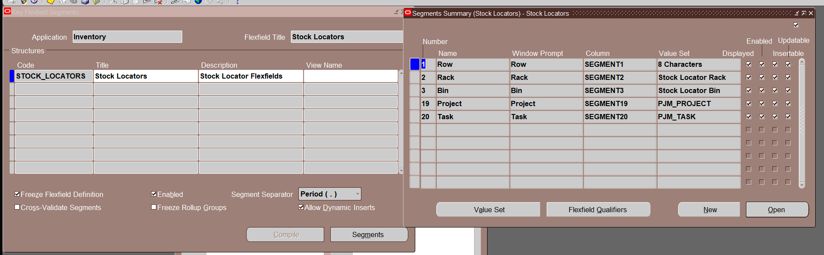
4. Stock Locators

Slide 15
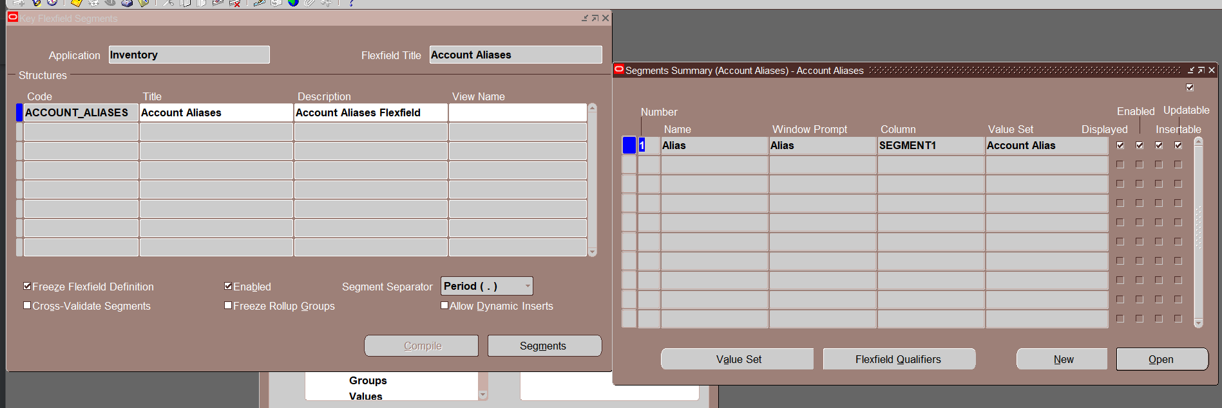
5. Account Aliases

Slide 16
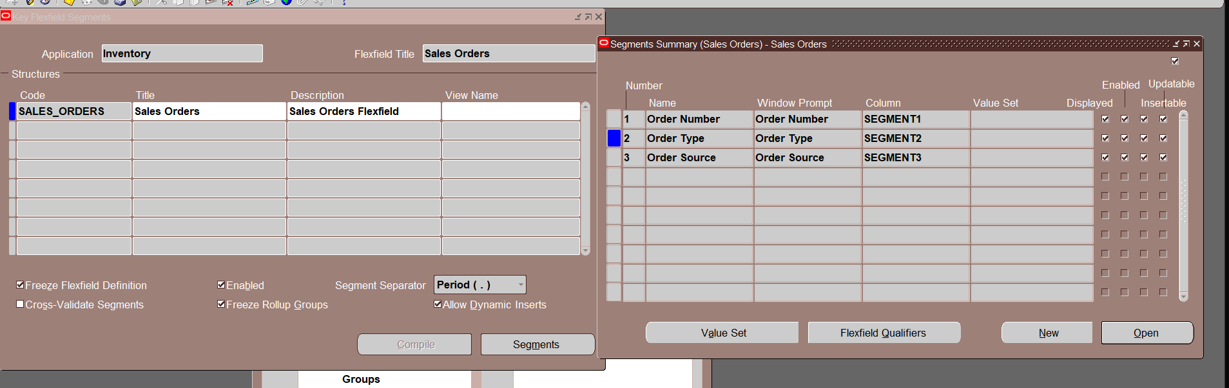
6. Sales Orde

Slide 17
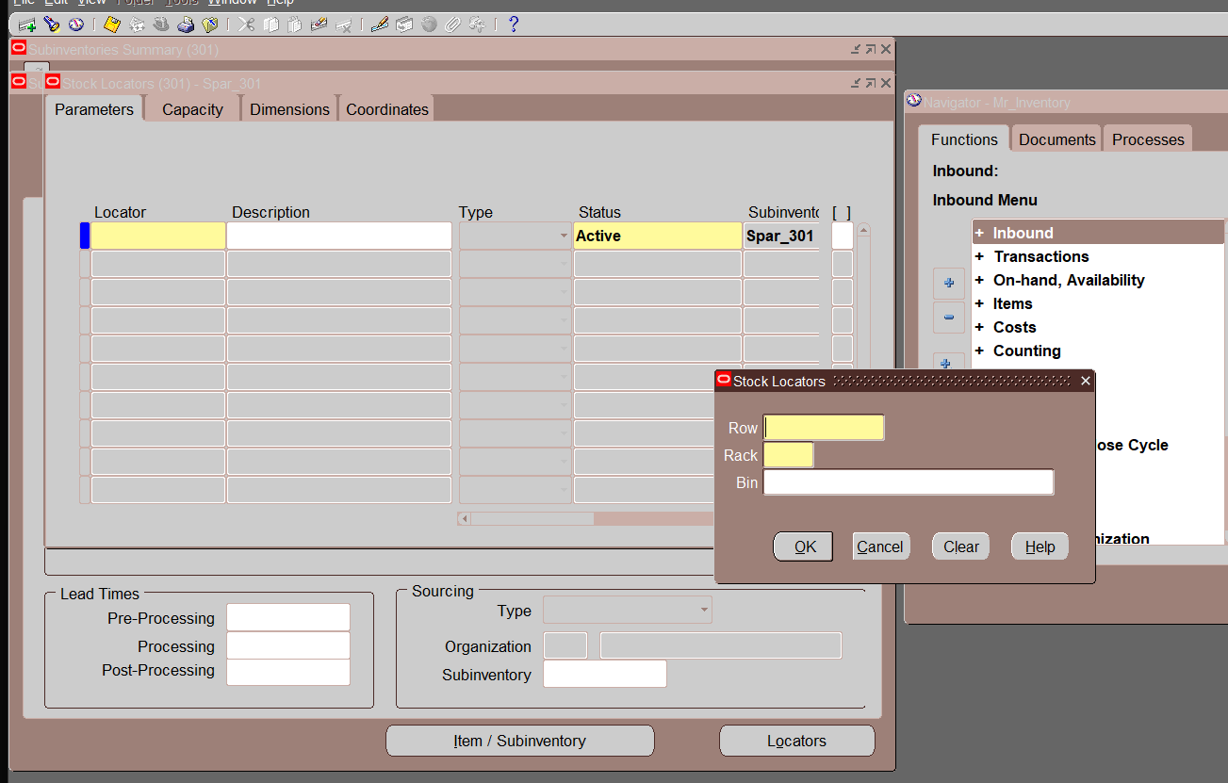
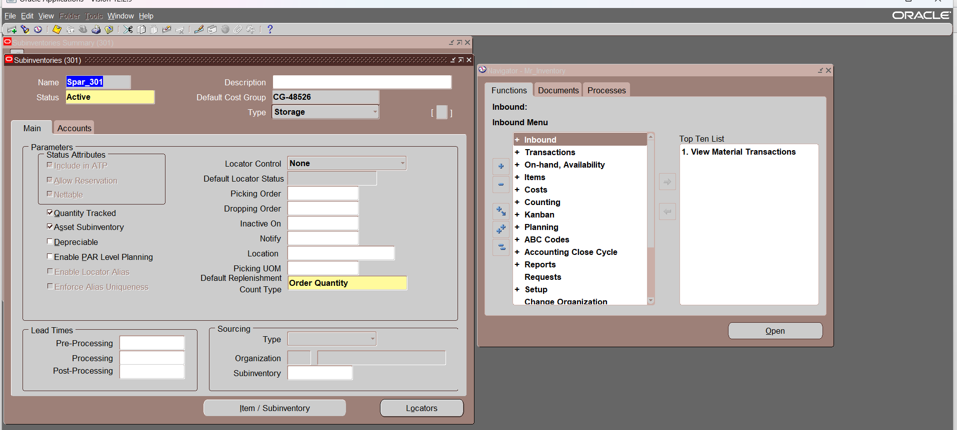
Sub-inventory Setup
Step 7: Define sub-inventory, set locators with options such as Prespecified and Dynamic Entry.

Slide 18
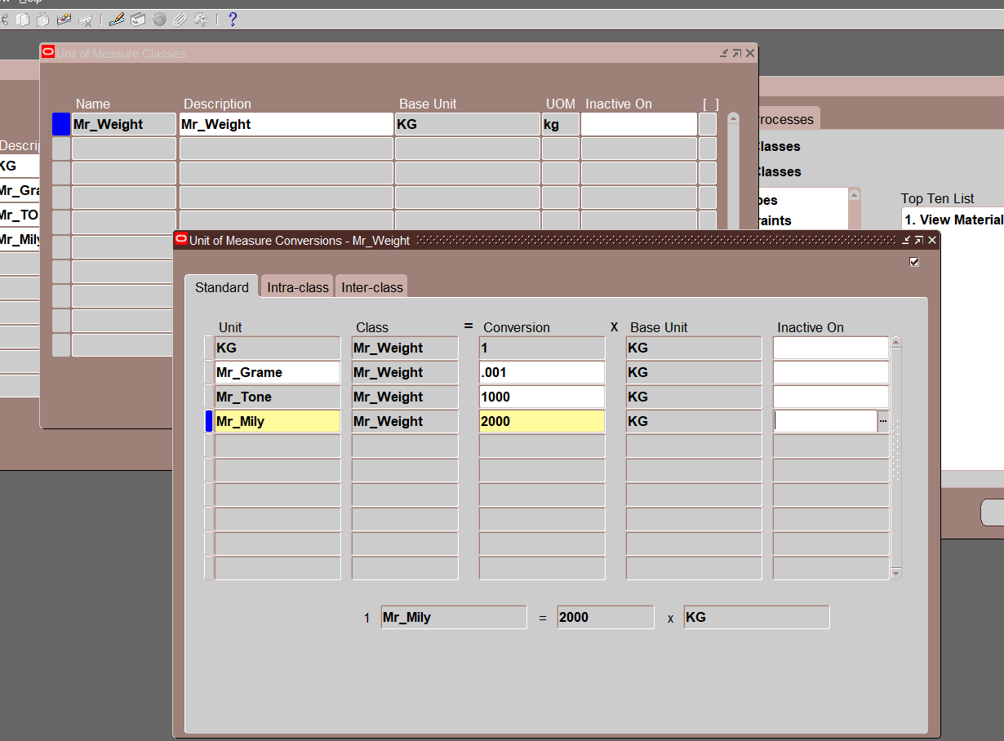
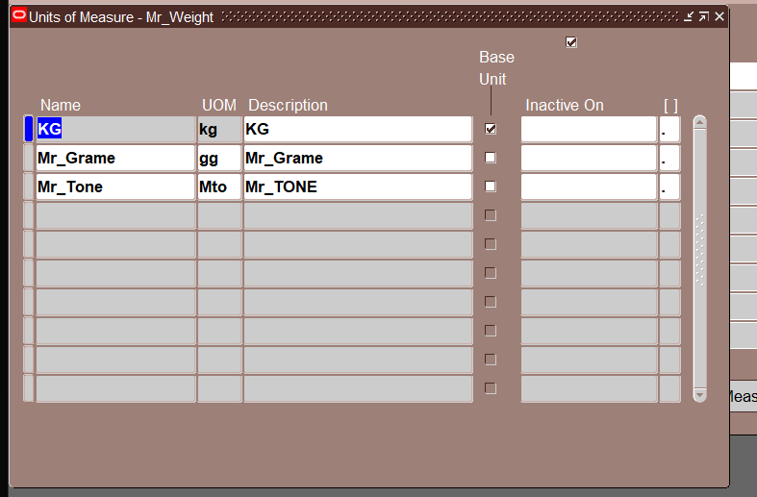
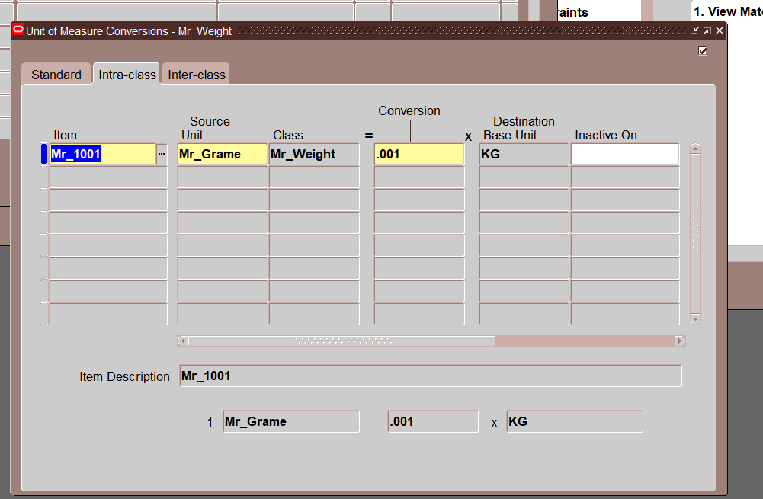
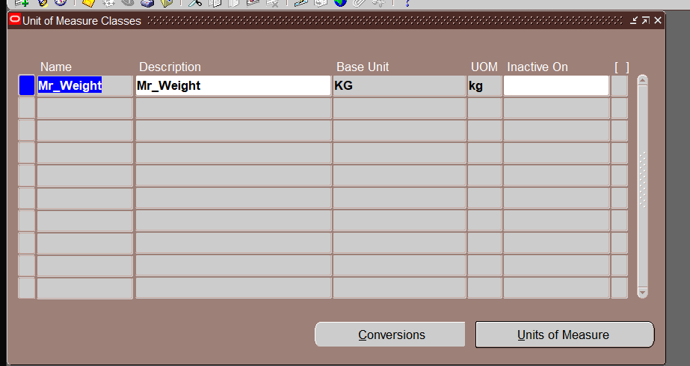
Unit of Measure (UOM) Setup
Step 8: Define UOM classes, open UOM, and set conversions.

Slide 19
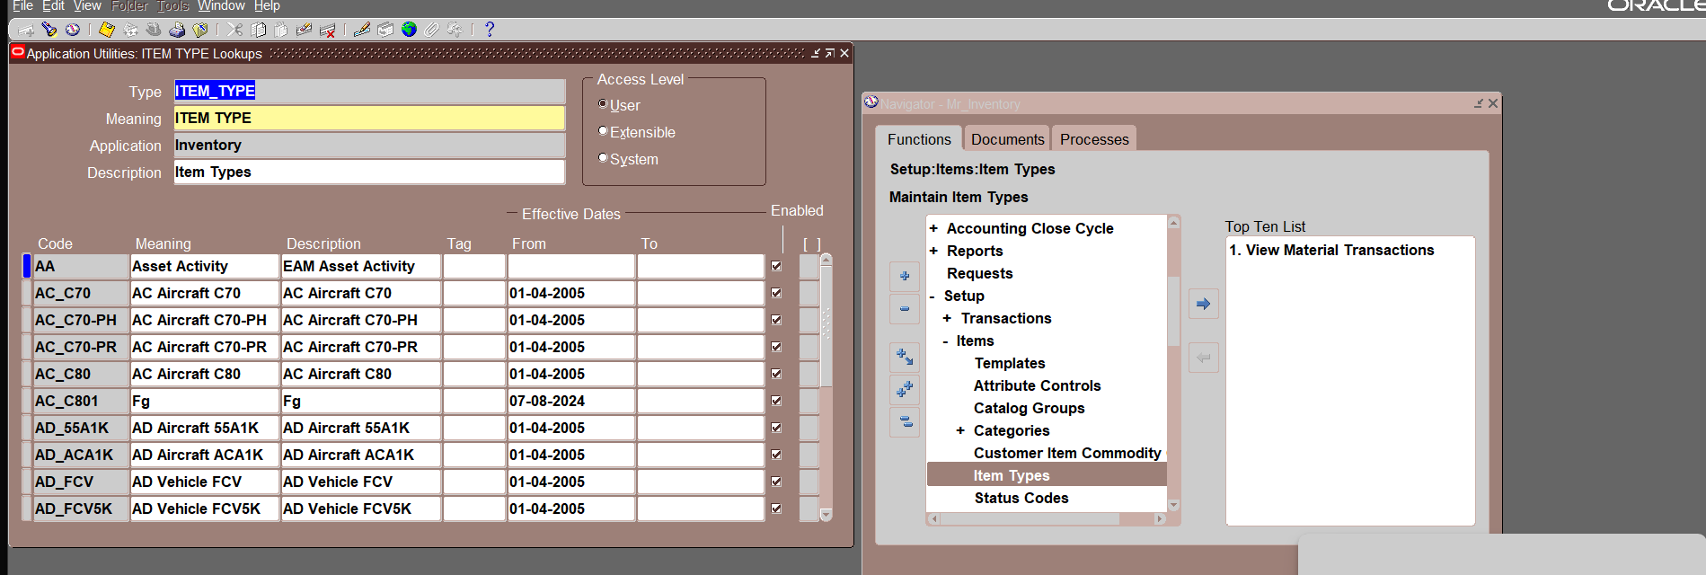
User Item Type Setup

Slide 20
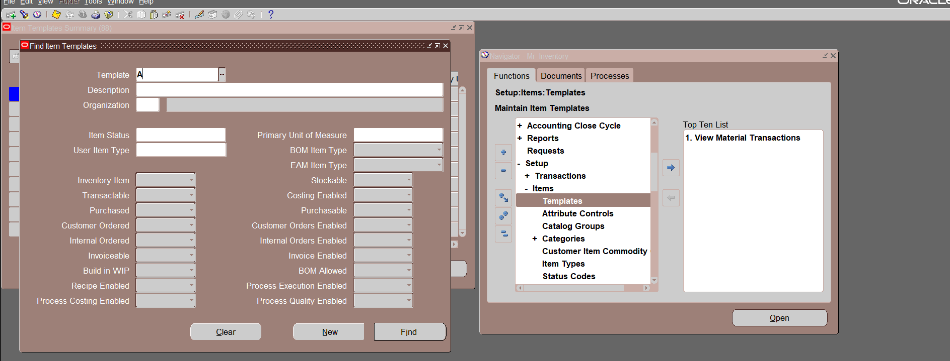
Item Master Setup
Step 9: Create item master with templates, set category codes.
(Copy From another templet tools)

Slide 21
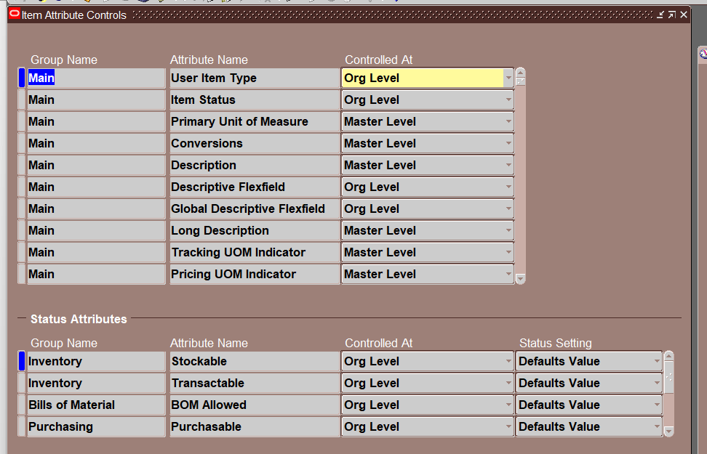
Item Attribute Control

Slide 22
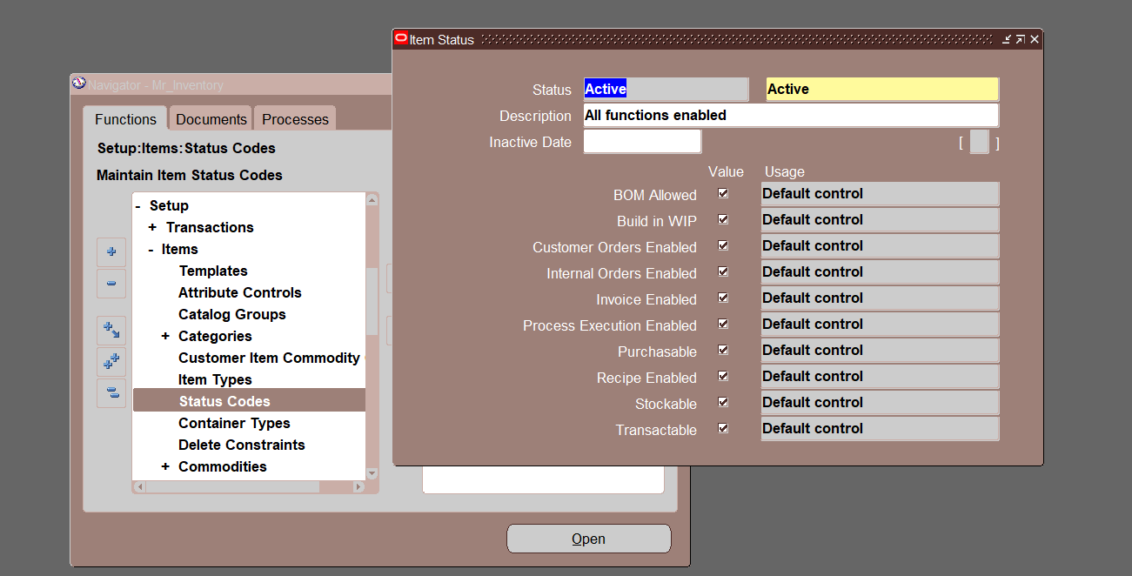
Status Code

Slide 23
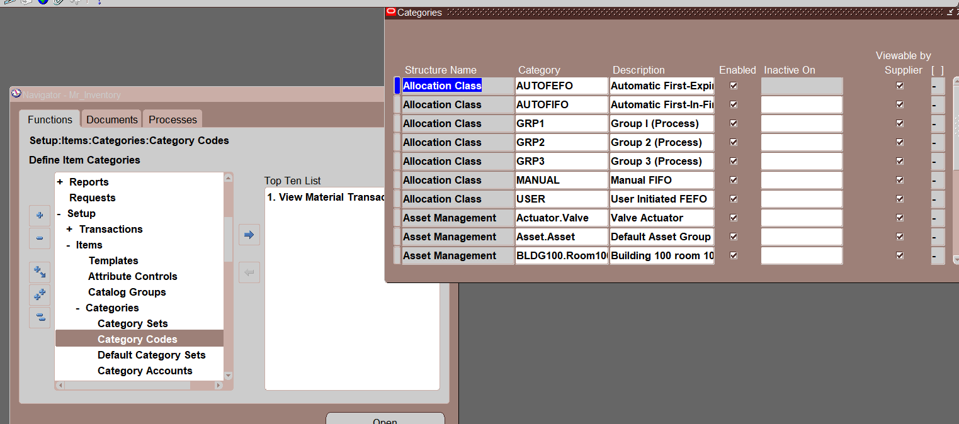
Category Code

Slide 24
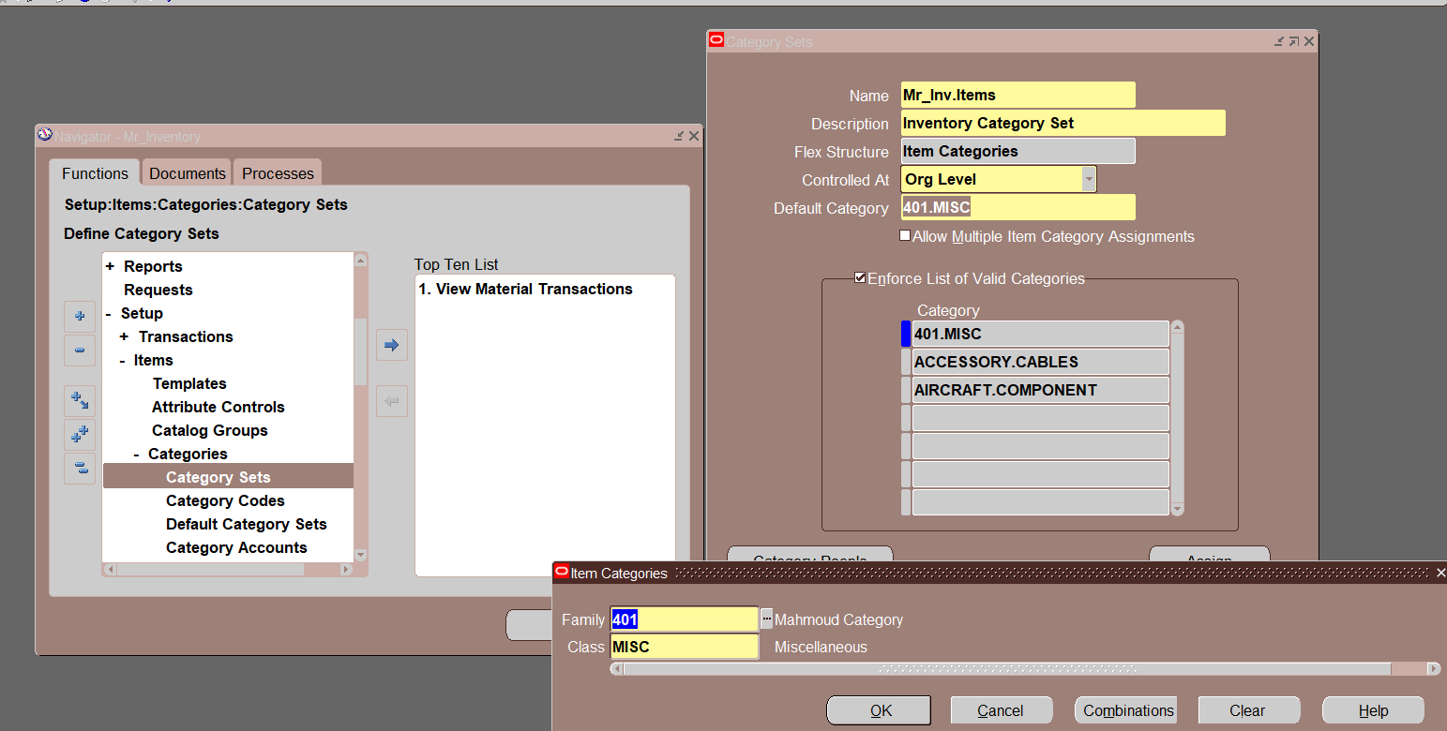
Category Set

Slide 25
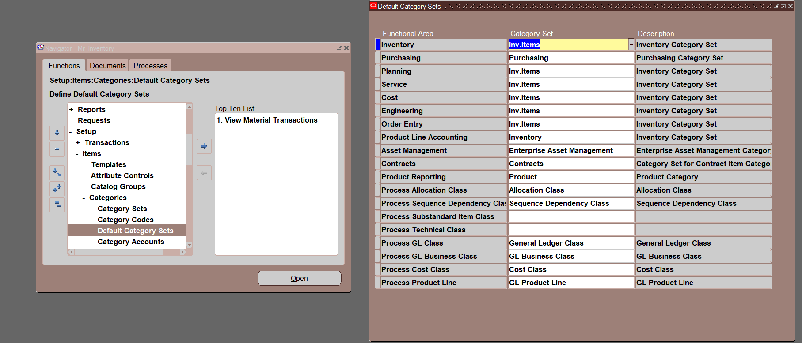
Default Category Set

Slide 26
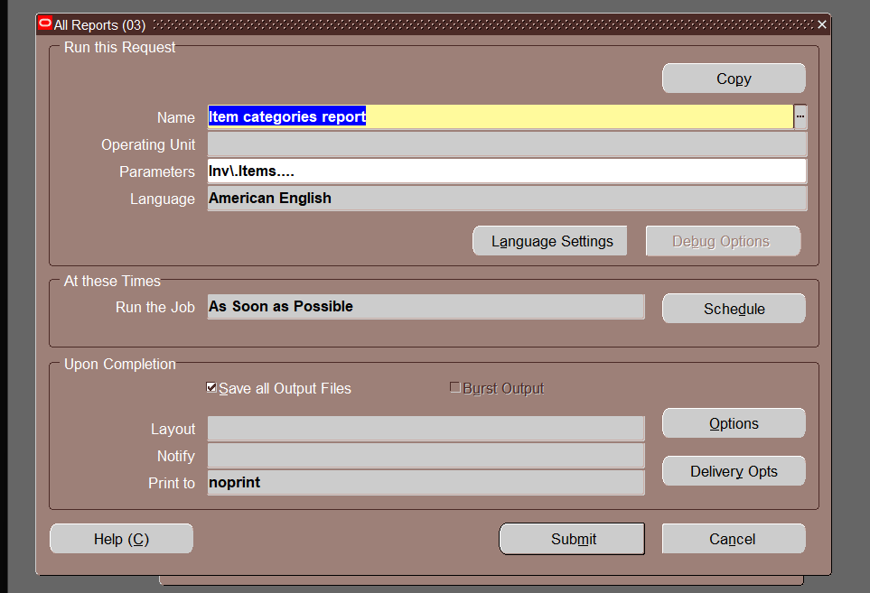
Item categories Report request

Slide 27
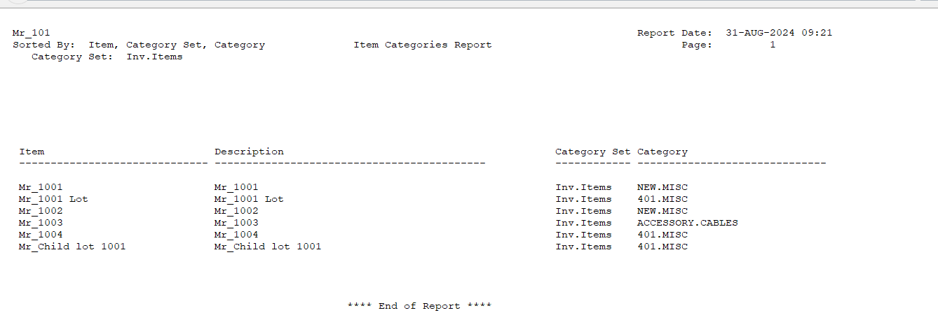
Report Example

Slide 28
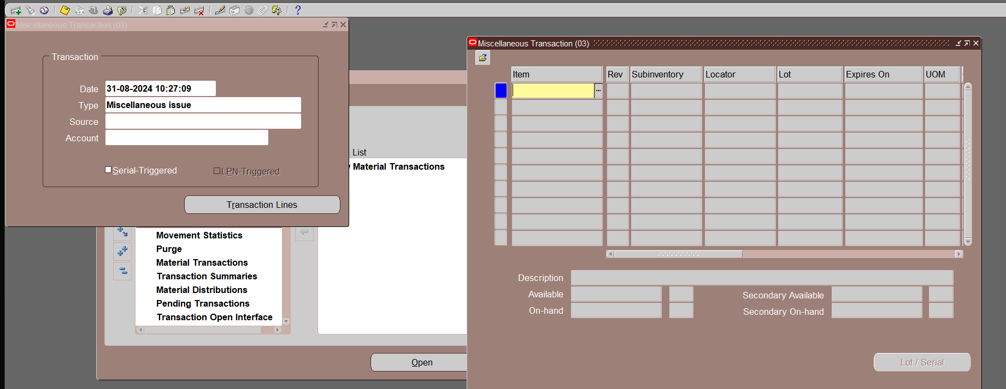
Inventory Transactions
Step 10: Open periods for inventory, purchasing, and ledger transactions.
Misalliances Issue 2- Misalliance receipt

Slide 29
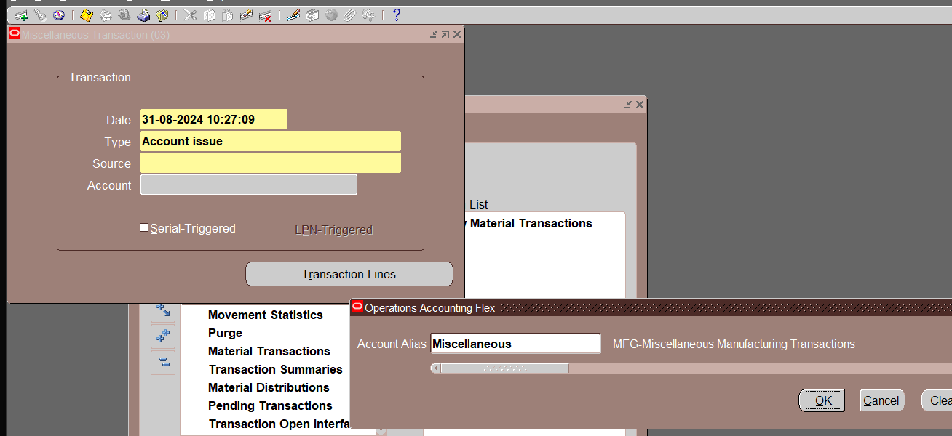
Inventory Transactions
2. Misalliances source type Account

Slide 30
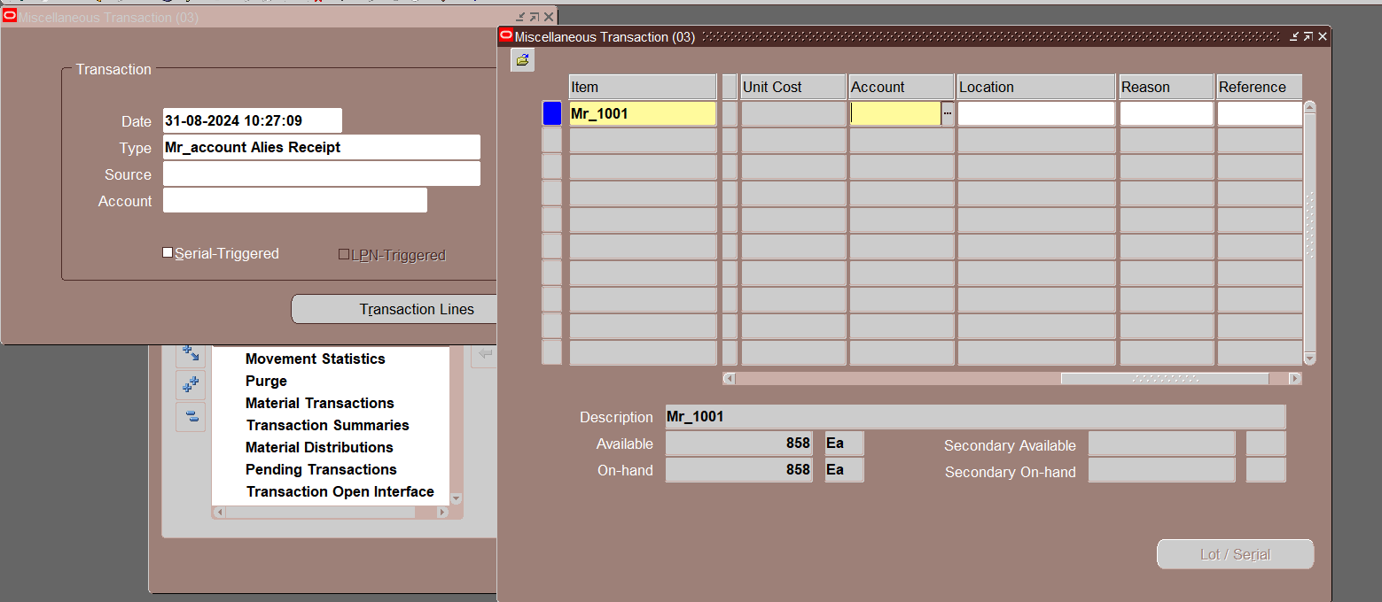
Inventory Transactions
3. Account allies

Slide 31
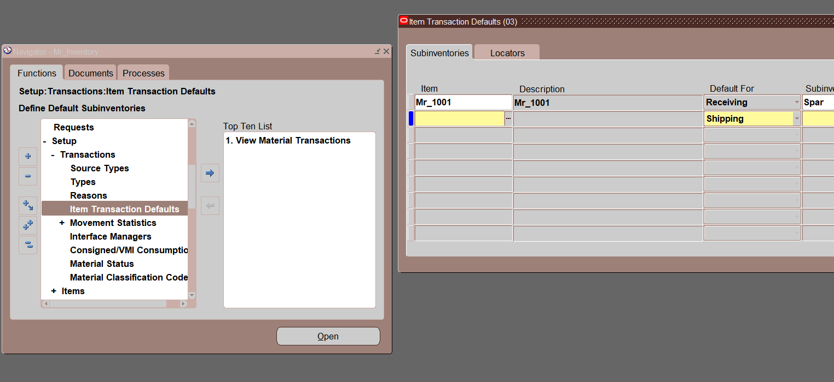
Inventory Transactions
4. Item Transaction default

Slide 32
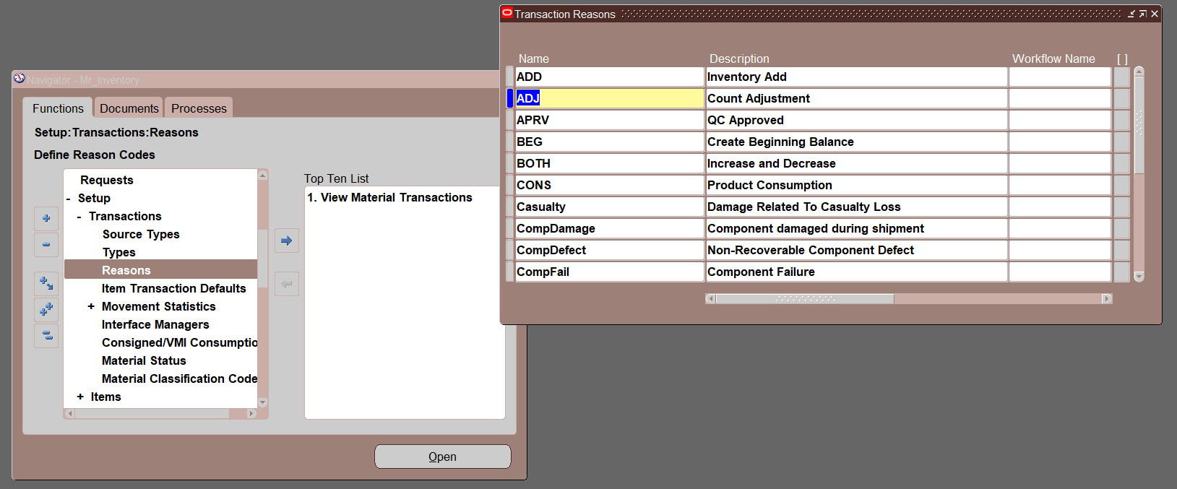
Inventory Transactions
Transaction reason

Slide 33
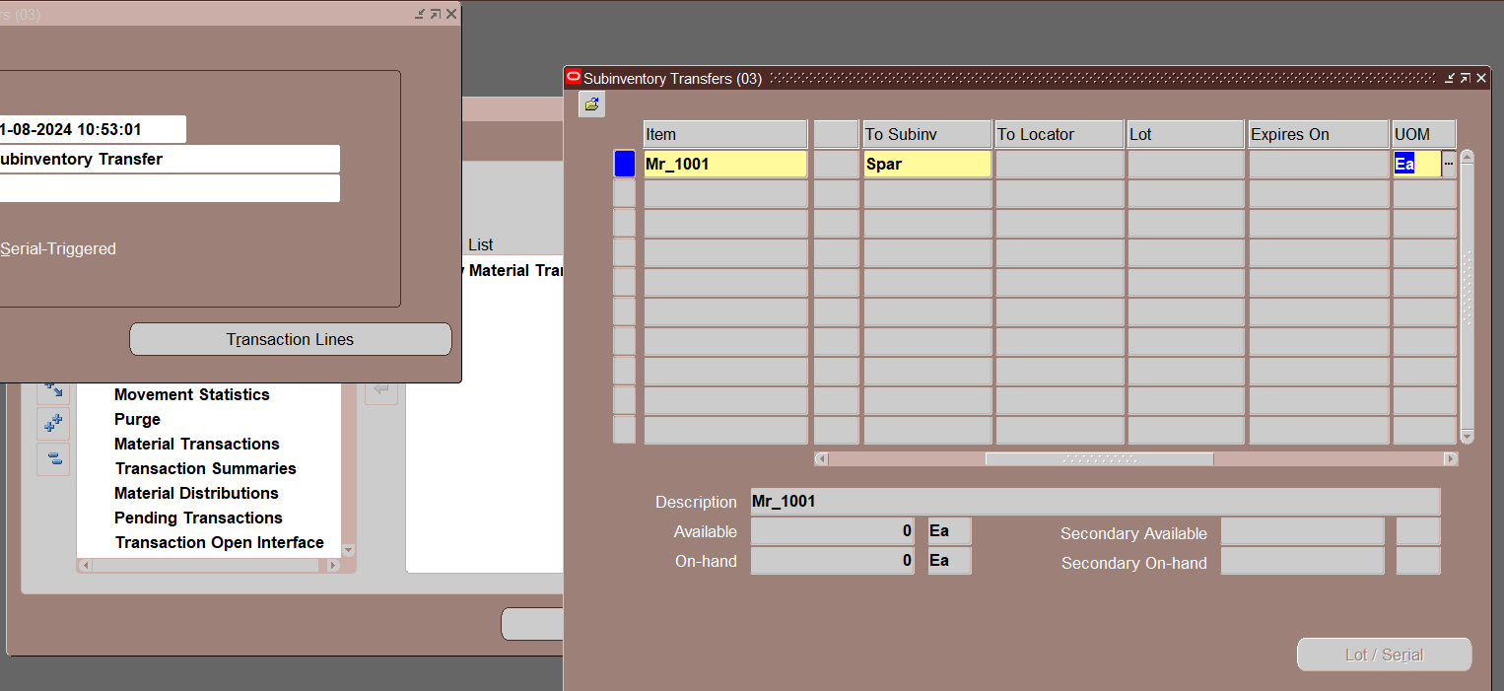
Sub-inventory Transfer
Step 11: Transfer inventory between sub-inventories in the same organization.

Slide 34
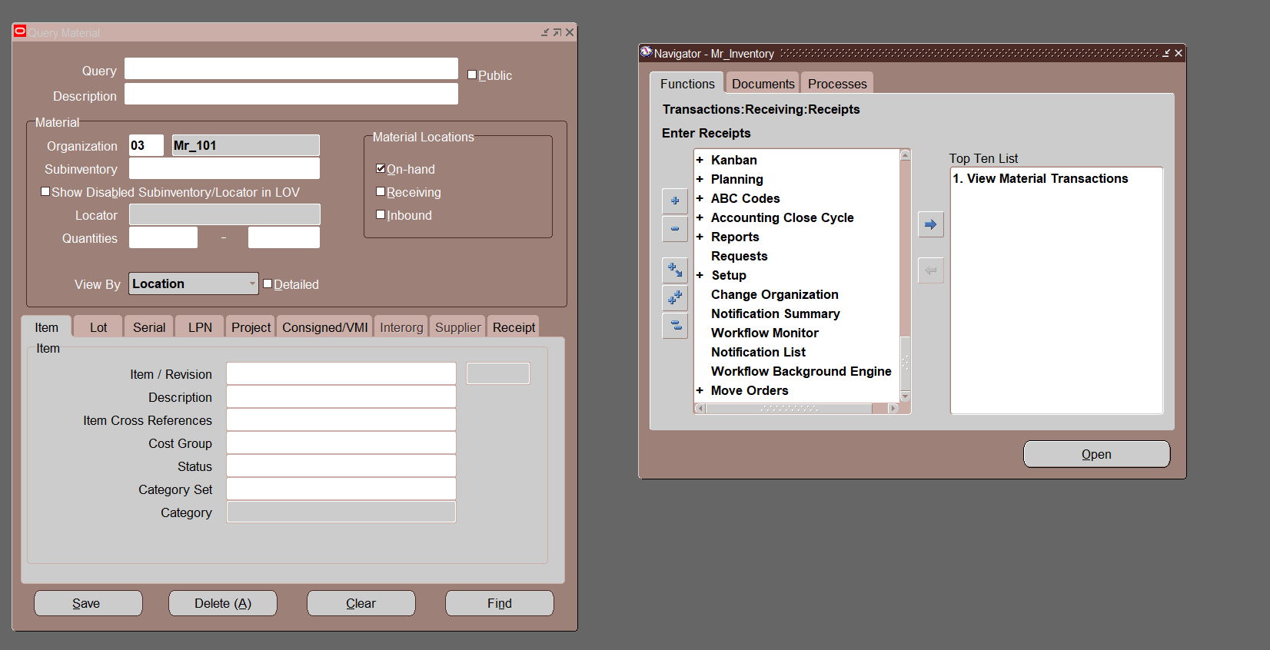
Material Workbench
Step 12: Overview of material workbench features and functions.

Slide 35
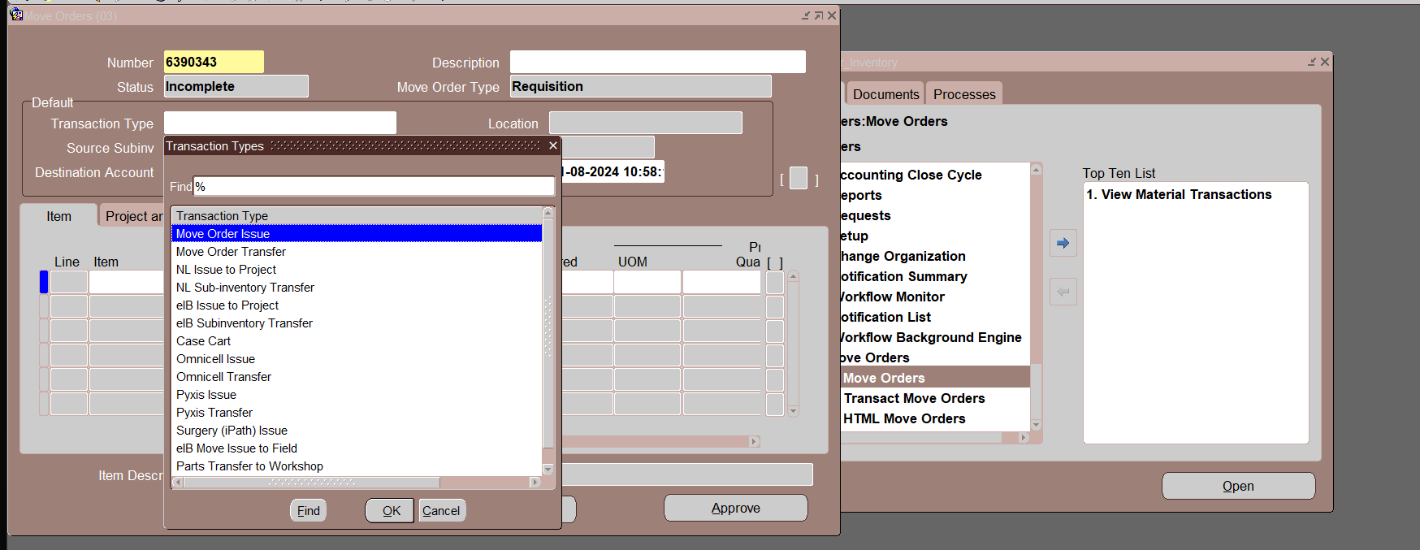
Move Order Setup
Step 13: Setup move orders for issue and transfer items.
If you assign planer for the item, he should approve to complete the process whatever issuing or transfer and so on
Picking rules (Rank the picking rule lot_ sub inventory _locator)

Slide 36
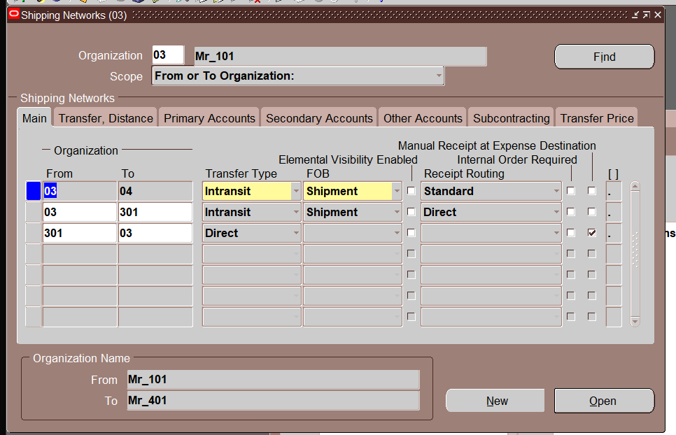
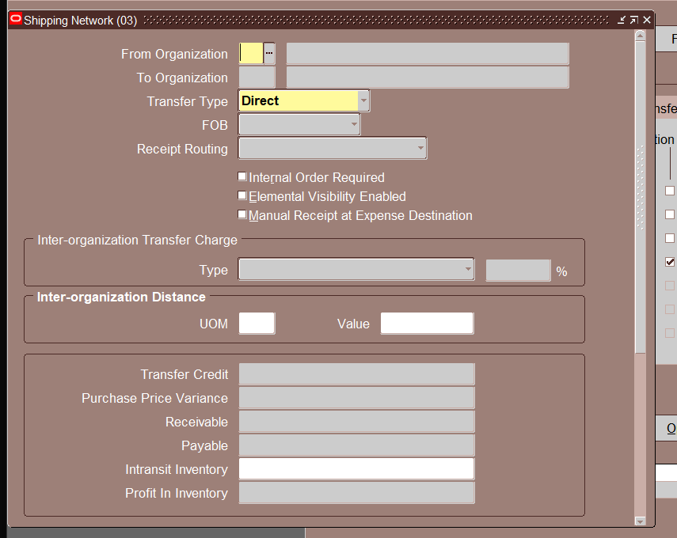
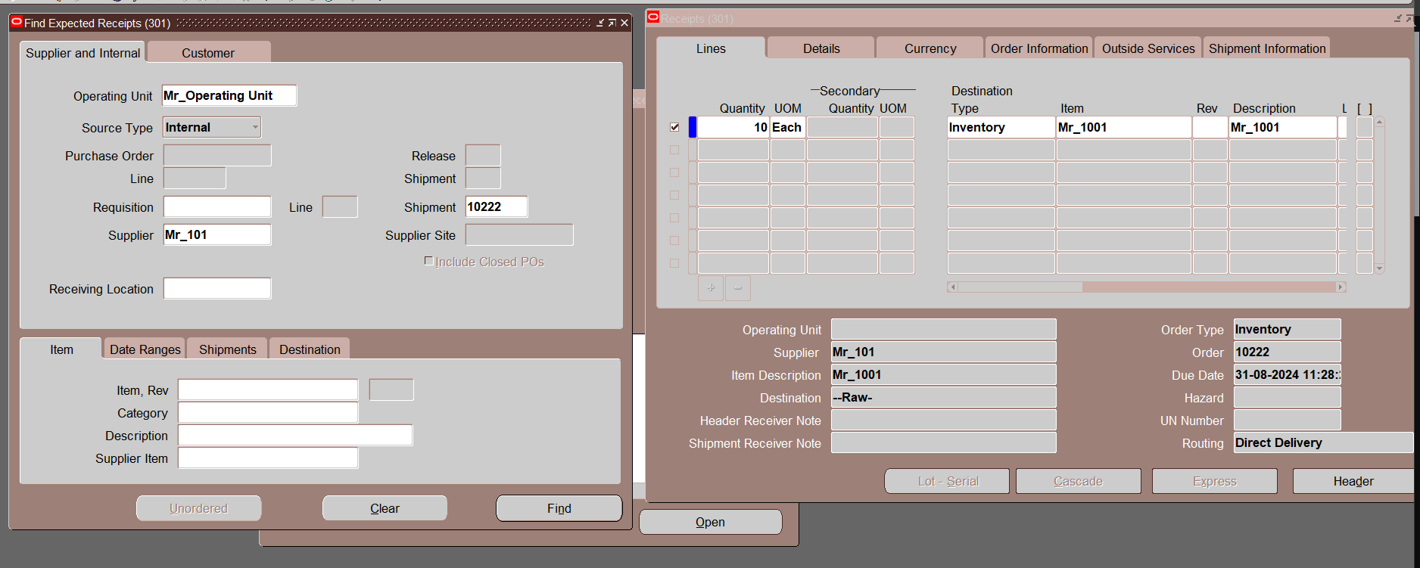
Inter-Organization Transfer
Step 14: Configure inter-organization transfers including direct shipment and in-transit.

Slide 37
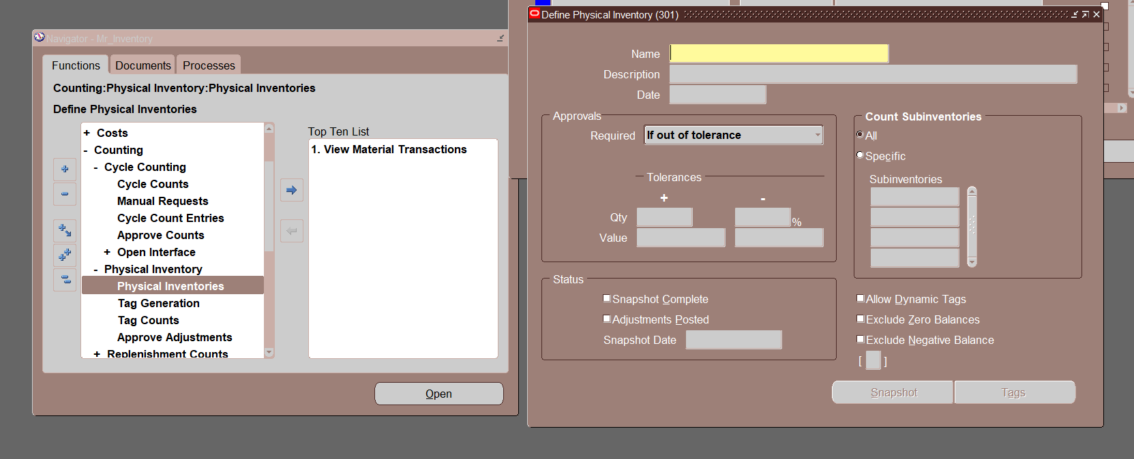
Cycle Count
Step 15: Overview of cycle counting, physical inventories, and snapshots.
Counting _ Physical inventories _ snapshot _
Generate Tag (Request physical inventory)
Tag count (physical inventory tag listing)
Sub inventory quantity report
Approve adjustment

Slide 38
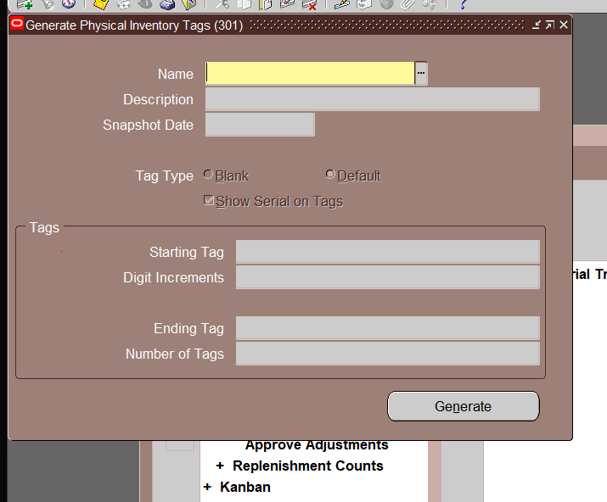

Slide 39
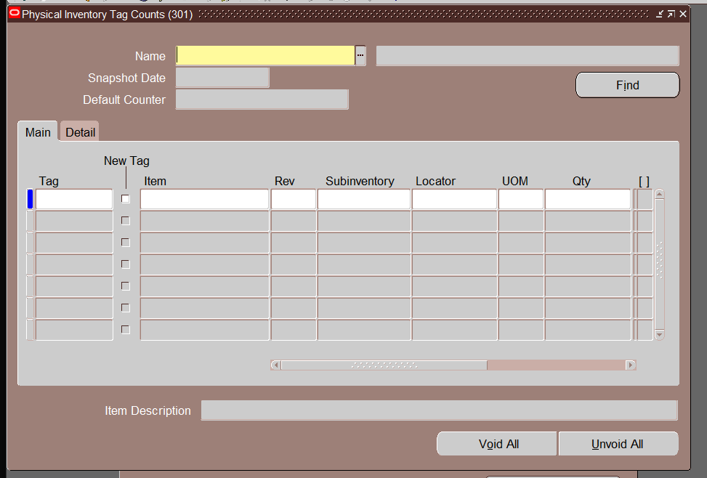

Slide 40
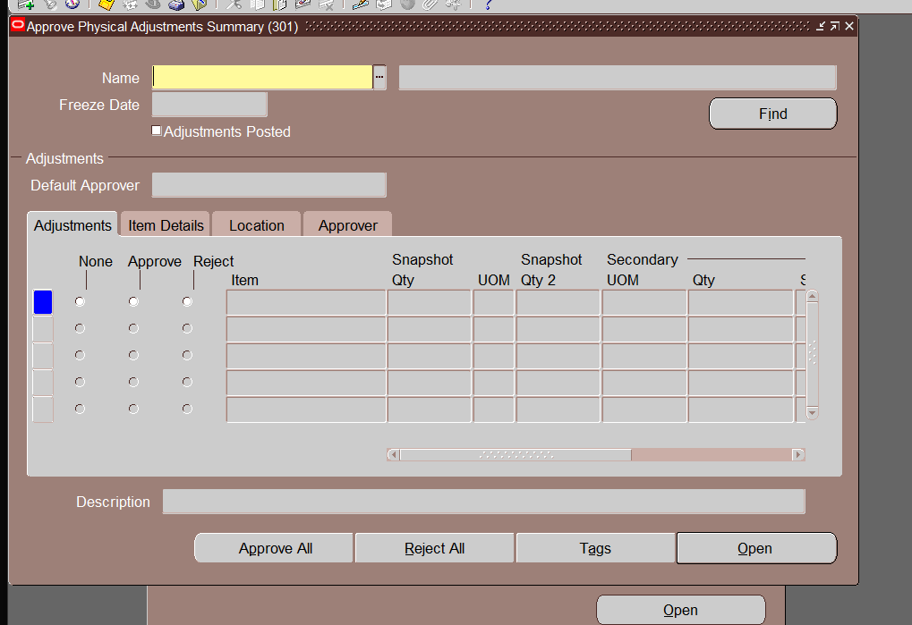

Slide 41
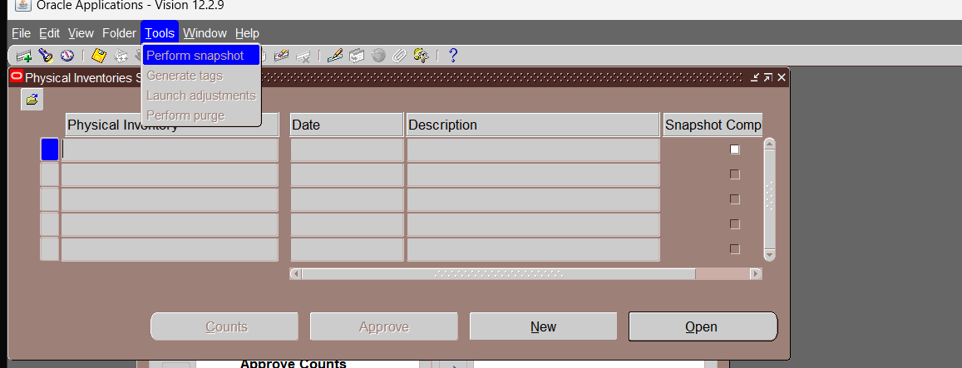

Slide 42
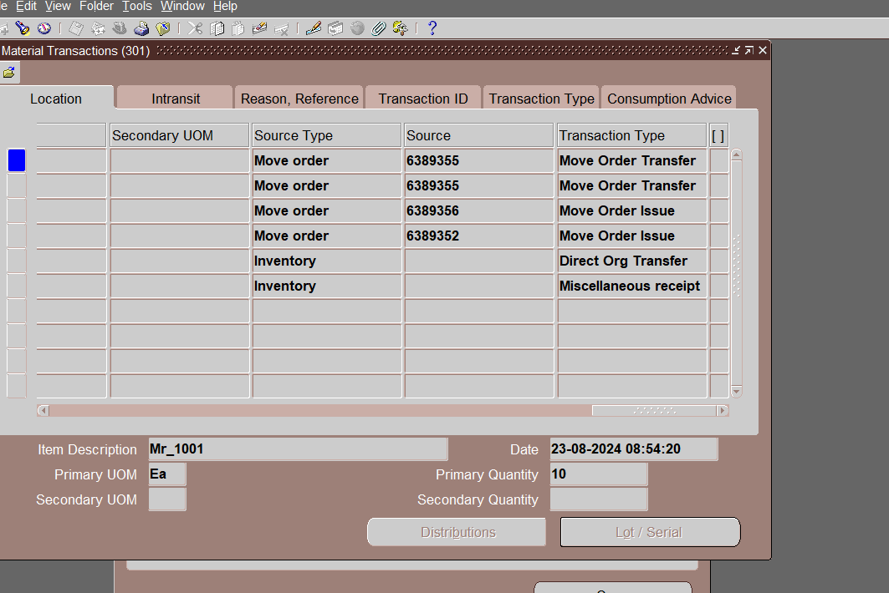

Slide 43
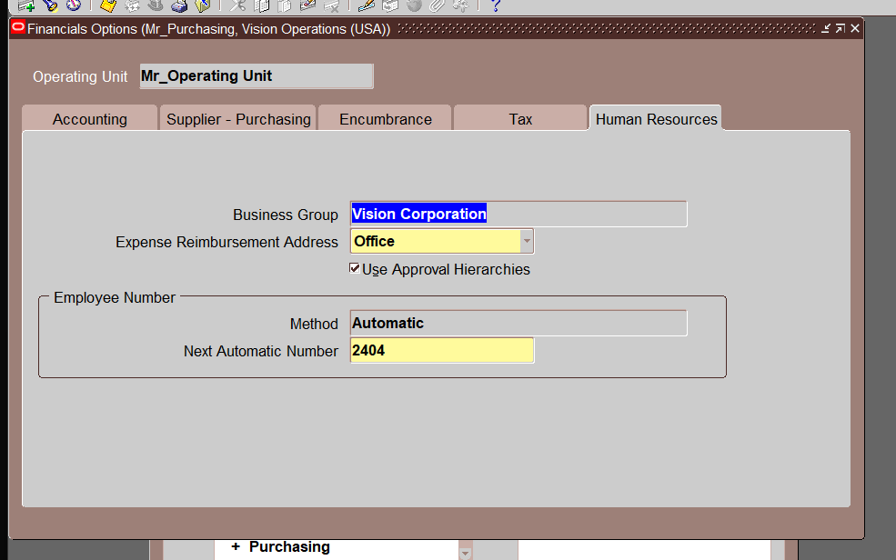
Purchasing Options
Step 16: Configure financial, purchasing, and receiving options for transactions.
Financial option

Slide 44
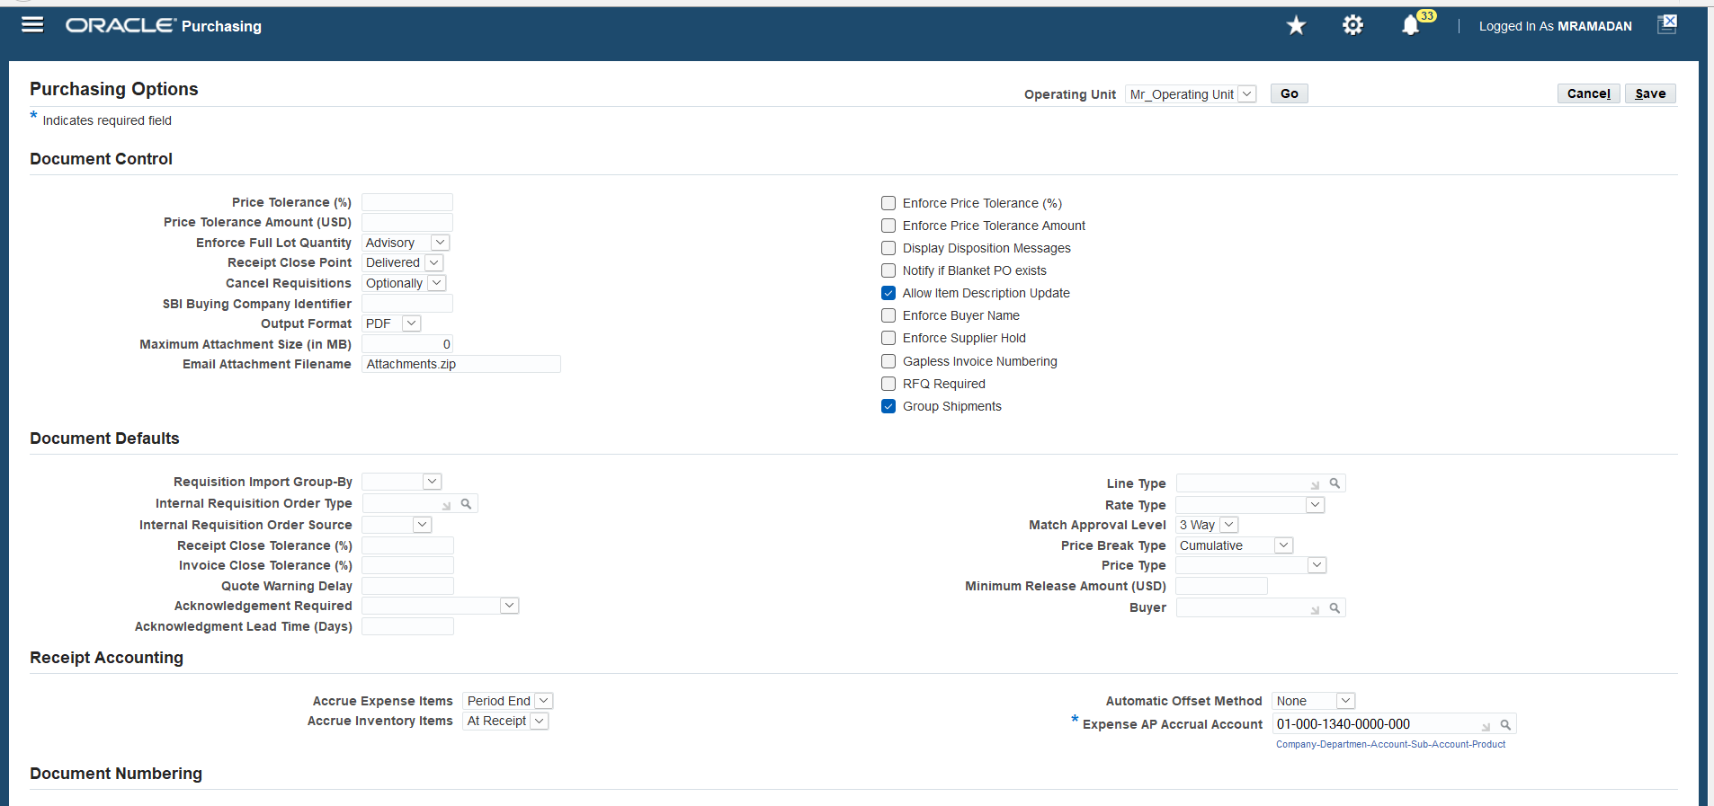
Purchasing Options
Step 16: Configure financial, purchasing, and receiving options for transactions.
2. Purchasing option

Slide 45
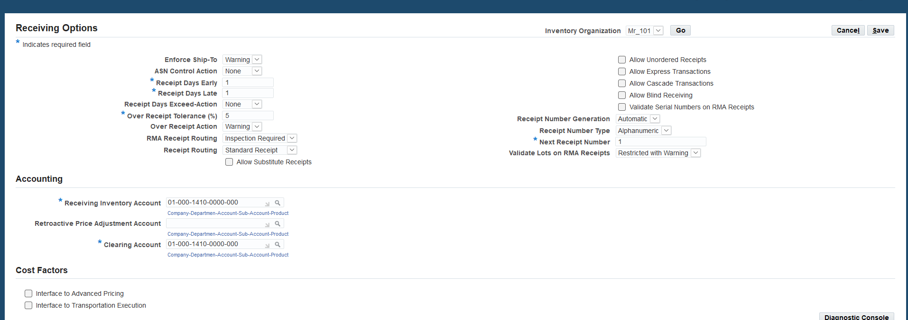
Purchasing Options
Step 16: Configure financial, purchasing, and receiving options for transactions.
3. Receiving option

Slide 46
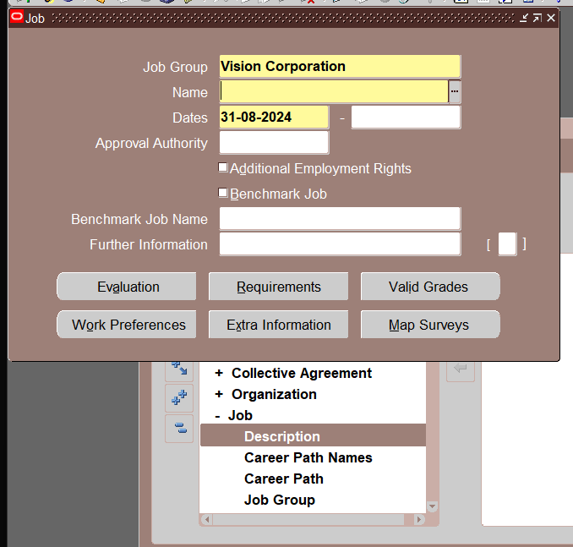
Approval Hierarchy Setup
Step 17: Define position hierarchy, create positions, assign to persons, and link with document types.
- Create a job

Slide 47

Approval Hierarchy Setup
Step 17: Define position hierarchy, create positions, assign to persons, and link with document types.
- Create positions

Slide 48
Approval Hierarchy Setup
Step 17: Define position hierarchy, create positions, assign to persons, and link with document types.
- Create a job

Slide 49

Approval Hierarchy Setup
Step 17: Define position hierarchy, create positions, assign to persons, and link with document types.
- Assign position to persons

Slide 50
Approval Hierarchy Setup
Step 17: Define position hierarchy, create positions, assign to persons, and link with document types.
- Position Hierarchy

Slide 51

Request fill employe hierarchy
Approval Groub

Slide 52

Request fill employe hierarchy
Approval Assignment

Slide 53

Request fill employe hierarchy
Then link your position hierarchy with document types
Define Buyer
Setup _ Personal _ Buyer

Slide 54

Request fill employe hierarchy
Profile option RCV: Allow routing override
Cannot Edit Receipt Routing column when receiving

Slide 55

Oracle iProcurement Setup
Step 24: Configure Oracle iProcurement settings and profile options.

Slide 56

Closing Remarks
Modular Solutions: Tailorable modules for specific business needs.
Real-Time Visibility: Enhanced analytics for supply chain operations.
Integration: Seamless connections with Oracle and third-party systems.
Scalability: Accommodates growth in data and users.
User-Friendly Interface: Intuitive design for better user experience.
Best Practices: Incorporates industry standards for process optimization.
Ongoing Support: Post-go-live assistance and continuous improvement feedback.

