Slide 1
UART(tx)
Universal Asynchronous Receiver / Transmitter RTL Design, Testbench Development & Functional Verification Report
Name/ Mahmoud Shawky
S26-B8-FPGA-G8

Slide 2
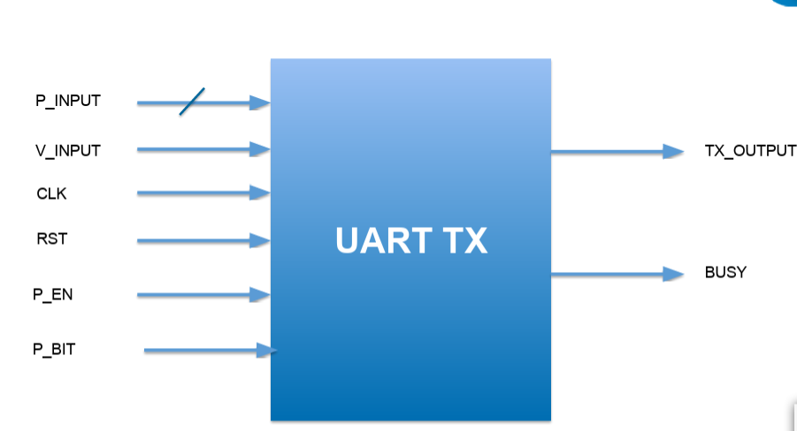
Objective_tx
Design a configurable UART Transmiter.
Transmit 8-bit parallel data serially.
Support optional parity bit.
Support Even and Odd parity.
Generate Start and Stop bits.
Control transmission using an FSM.

Slide 3
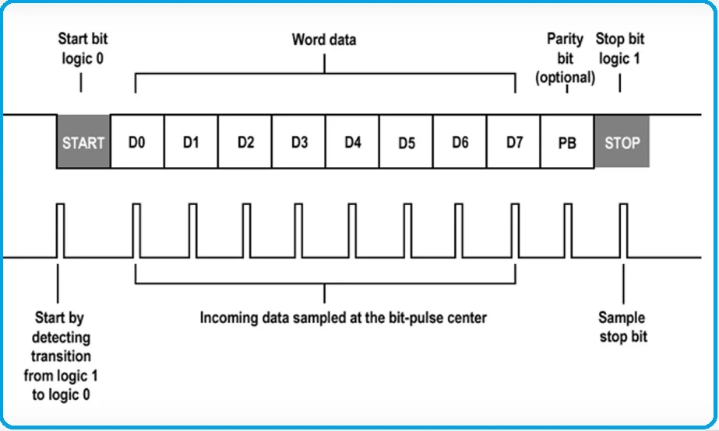
uart_tx — Required Behaviour
Out of reset: o_tx = 1, o_busy = 0
A byte is accepted only when i_valid = 1 AND o_busy = 0 — same cycle, both true
i_valid while o_busy = 1 is ignored — no queuing
After acceptance, o_tx carries the frame one bit per cycle, then returns to idle-high
o_busy = 1 for exactly the frame duration (10 or 11 cycles), 0 otherwise
Changing i_data after the accept cycle must not affect the frame already in flight

Slide 4
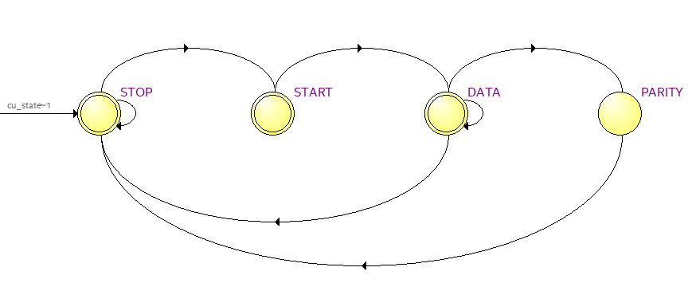
FSM(Controller )

Slide 5
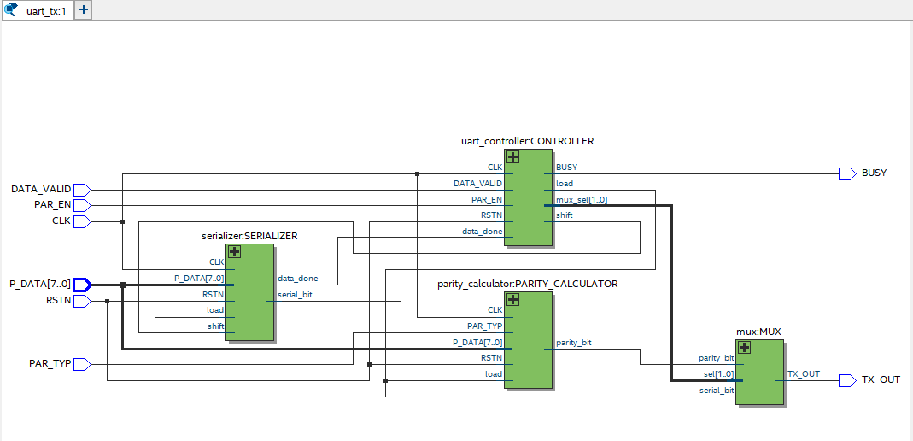
System Architecture _tx

Slide 6
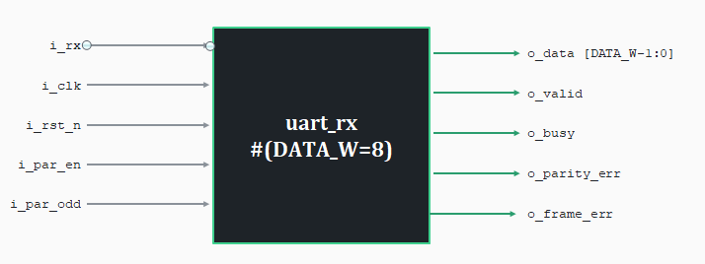
Objective_rx

Slide 7
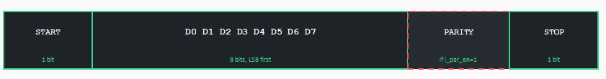
uart_rx — Required Behaviour
Out of reset: o_busy = 0, outputs low
Detects the start bit only while idle — a 0 inside the data byte is never a new start
After a full frame, o_valid pulses for exactly 1 cycle with o_data holding the received byte
Flag-and-deliver: even on error, o_valid still pulses and o_data still carries the byte
o_frame_err pulses (same cycle as o_valid) when the stop-bit position isn't 1
o_parity_err pulses when i_par_en=1 and received parity disagrees — always 0 when i_par_en=0

Slide 8
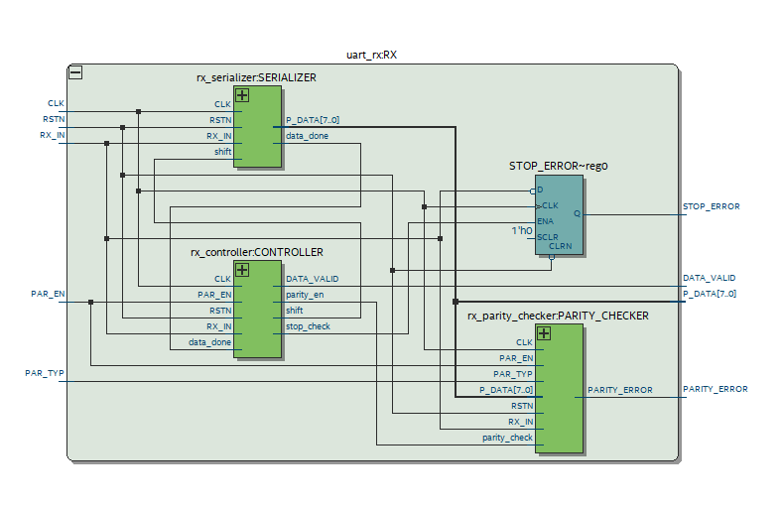
System Architecture _rx

Slide 9
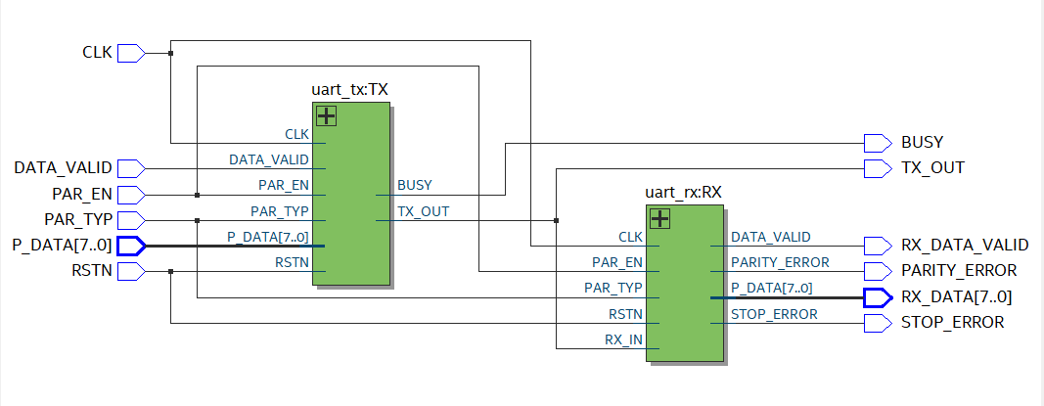
Uart(full)
RX and TX communicate through shared timing (same clock) and a pre-agreed frame format (START, DATA, PARITY, STOP). TX places bits on the wire one by one, and RX reads them at the exact same times using its own FSM and counters. RX then validates the data using parity and stop bit checking. RX sends no direct feedback to TX; both operate independently based on the clock and the protocol agreemen

Slide 10
How RX Talks to TX – UART Communication
- Pre-Communication Agreement (The Handshake Before Starting)
For RX to understand TX, both must agree on two things beforehand:
1 Baud Rate (Speed)
Both operate on the same clock signal.
Each bit takes one clock cycle to transmit/receive.
2 Frame Format (Structure)
Both agree that the frame consists of:
START | DATA (8 bits) | [PARITY] | STOP
Only TX_OUT ↔ RX_IN is the direct connection.
All other signals are status/error reports to the outside world, not feedback to the other side.
TX does not know if RX received correctly; RX simply listens, decodes, and reports errors.

Slide 11
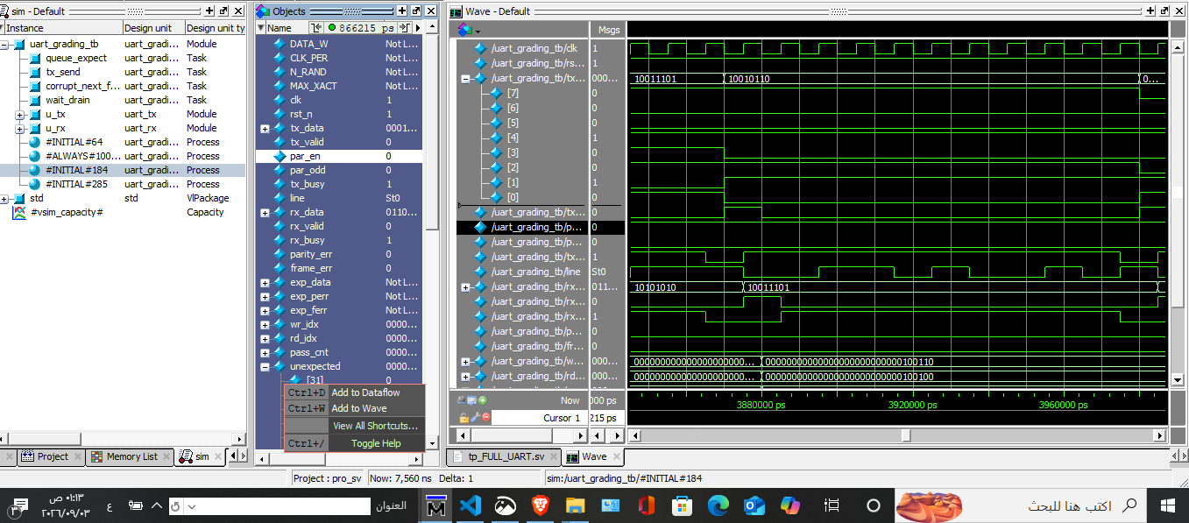
Wave form

Slide 12
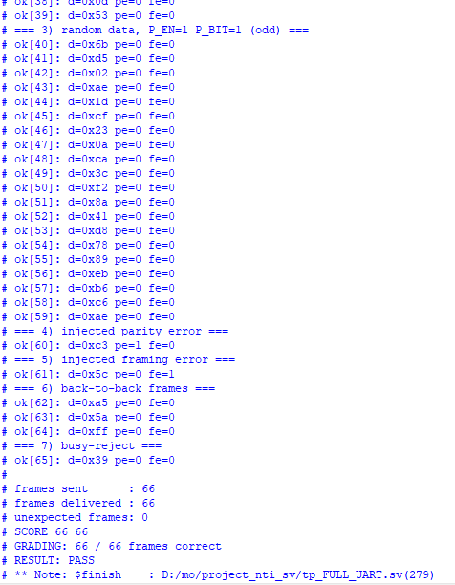
Output

