Slide 1
Applying Parallel Processing Approach for Interactive Global Illumination
By
Mahmoud Moustafa Zidan
Under Supervision of
Prof. Dr. Taymoor Nazmy
Prof. Dr. Mohamed Hashem
Dr. Haytham El-Messiry

Slide 2
Agenda
Introduction
Motivation
Objective
Proposed Algorithm for Building Binned SAH BVH
Proposed Approach for Parallel Ray Tracing and Photon Mapping
Results
Conclusion
Future Work

Slide 3
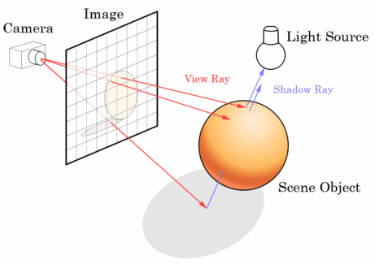
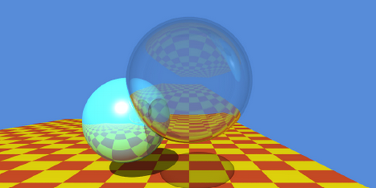
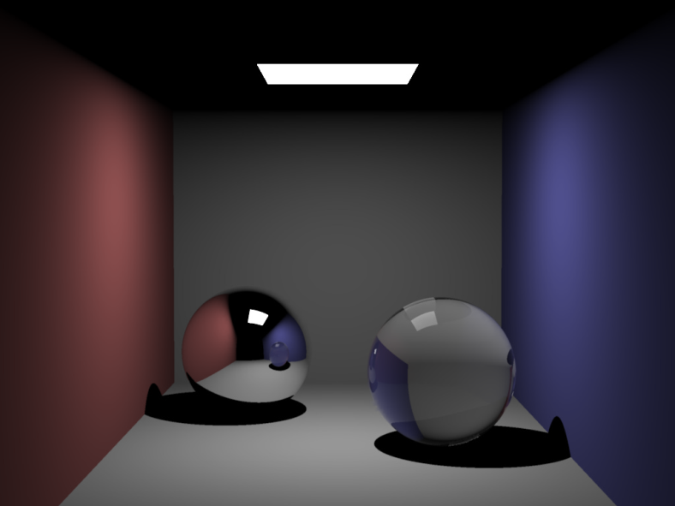
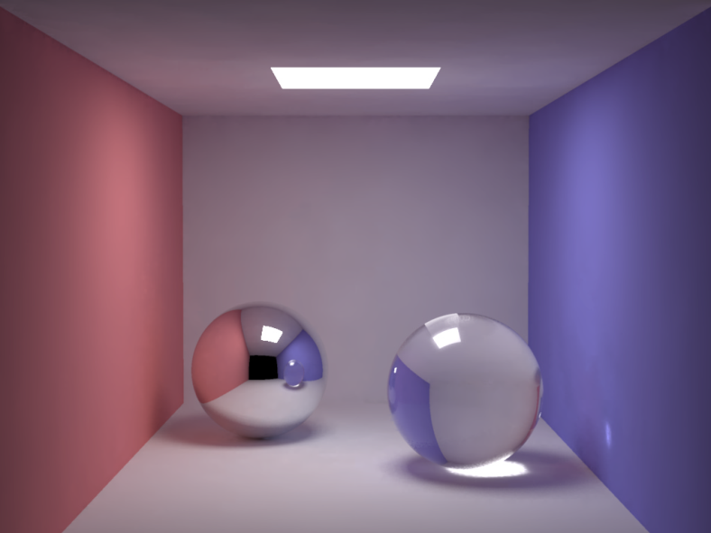
Introduction
Ray tracing concept Image from [1]
Ray tracing output -Image from [2] -
Local illumination -Image from [3] -
Global illumination - Image from [3] -

Slide 4
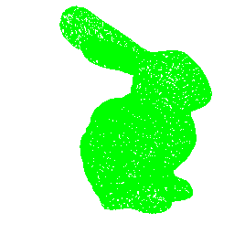
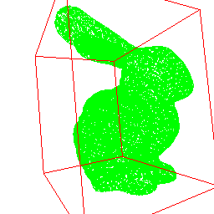
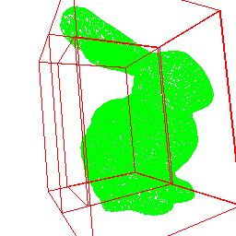
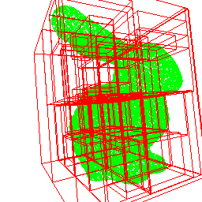
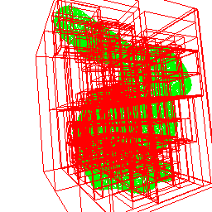
Motivation
Most global illumination (GI) and ray tracing (RT) algorithms seek for primitives intersection
Primitives intersection is the main bottleneck
Spatial partitioning data structures (DS) are used to speed up the rendering performance

Slide 5
Spatial Partitioning Data Structures (1D)
Most GI and RT algorithms use spatial partitioning data structures (e.g. grid , BVHs, KD-trees, Octrees)
Level 0
Level 1
Level 2

Slide 6
Spatial Partition DS Approaches
Spatial partitioning f(space)
Object partitioning f(# of objects)
SAH partitioning f(space, # of objects)
Fast
Low tree quality
many objects for a ray
Fast
Low tree quality
much space for a ray
Slow
Good tree quality

Slide 7
Objective
Fast and high quality spatial partitioning data structures
A new parallel binned surface area heuristic (SAH) bounding volume hierarchy (BVH) algorithm on GPU
Fast ray tracing and global illumination
Parallel ray tracer and photon mapping (PM) implementation on GPU

Slide 8
Background: GPU
Parallel code on GPU
Each thread executes a simple program (kernel) in parallel
Thread
0,0
1,0
…
31,0
32,0
33,0
…
63,0
0,1
1,1
…
31,1
32,1
33,1
…
63,1
Shared Memory
Global
Memory
Block (0,0)
Block (0,1)
SM
SM
Texture
Memory
Block (1,0)
Block (1,1)
Constant
Memory
SM
SM
Serial code on CPU
Mange GPU memory
Launch millions of parallel threads

Slide 9
Proposed Algorithm for Building Binned SAH BVH
GPU SAH BVH [Lauterbach et al. 2009]
Evaluate the SAH at many locations independently
…

Slide 10
Proposed Algorithm for Building Binned SAH BVH
Binned SAH BVH (our algorithm)
Evaluate the SAH at relatively small locations collectively

Slide 11
Proposed Algorithm for Building Binned SAH BVH
Binned SAH BVH
Evaluate the SAH at a relatively small locations collectively
Sort triangles into bins

Slide 12
Proposed Algorithm for Building Binned SAH BVH
Binned SAH BVH
Evaluate the SAH at a relatively small locations collectively
Sort triangles into bins
Partition each bin into fixed-sized chunks

Slide 13
Proposed Algorithm for Building Binned SAH BVH
Binned SAH BVH
Evaluate the SAH at a relatively small locations collectively
Sort triangles into bins
Partition each bin into fixed-sized chunks
Evaluate AABB for each chunk in parallel

Slide 14
Proposed Algorithm for Building Binned SAH BVH
Binned SAH BVH
Evaluate the SAH at a relatively small locations collectively
Sort triangles into bins
Partition each bin into fixed-sized chunks
Evaluate AABB for each chunk in parallel
Run left/right scans for AABB, left scan for bin size

Slide 15
Proposed Algorithm for Building Binned SAH BVH
Binned SAH BVH
Evaluate the SAH at a relatively small locations collectively
Sort triangles into bins
Partition each bin into fixed-sized chunks
Evaluate AABB for each chunk in parallel
Run left/right scans for AABB, left scan for bin size

Slide 16
Proposed Algorithm for Building Binned SAH BVH
Binned SAH BVH
Evaluate the SAH at a relatively small locations collectively
Sort triangles into bins
Partition each bin into fixed-sized chunks
Evaluate AABB for each chunk in parallel
Run left/right scans for AABB, left scan for bin size

Slide 17
Proposed Algorithm for Building Binned SAH BVH
Binned SAH BVH
Evaluate the SAH at a relatively small locations collectively
Sort triangles into bins
Partition each bin into fixed-sized chunks
Evaluate AABB for each chunk in parallel
Run left/right scans for AABB, left scan for bin size

Slide 18
Proposed Algorithm for Building Binned SAH BVH
Binned SAH BVH
Evaluate the SAH at a relatively small locations collectively
Sort triangles into bins
Partition each bin into fixed-sized chunks
Evaluate AABB for each chunk in parallel
Run left/right scans for AABB, left scan for bin size

Slide 19
Proposed Algorithm for Building Binned SAH BVH
Binned SAH BVH
Evaluate the SAH at a relatively small locations collectively
Sort triangles into bins
Partition each bin into fixed-sized chunks
Evaluate AABB for each chunk in parallel
Run left/right scans for AABB, left scan for bin size

Slide 20
Proposed Algorithm for Building Binned SAH BVH
Binned SAH BVH
Evaluate the SAH at a relatively small locations collectively
Sort triangles into bins
Partition each bin into fixed-sized chunks
Evaluate AABB for each chunk in parallel
Run left/right scans for AABB, left scan for bin size
Evaluate bins’ SAH as f(AABB scans, bin size scans )

Slide 21
Proposed Algorithm for Building Binned SAH BVH
Binned SAH BVH
Work efficient algorithm
Better construction time
Comparable tracing time
More optimizations
Hybrid binned SAH BVH
Higher levels build using LBVH
Better construction time
Lower tree quality

Slide 22
Proposed Approach for RT, PM
All rendering stages of the entire mapping on GPU
A simple reformulation of previous approaches for both ray tracing and photon mapping using proposed API

Slide 23
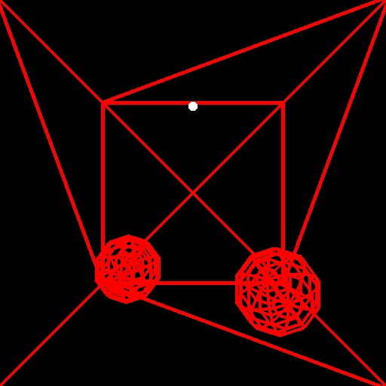
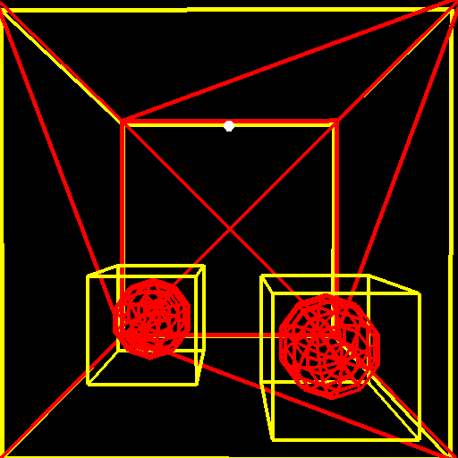
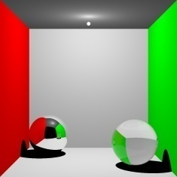
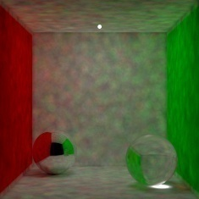
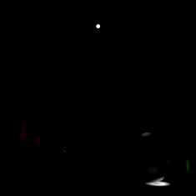
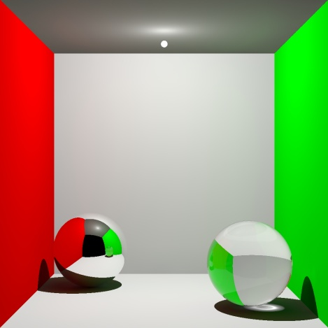
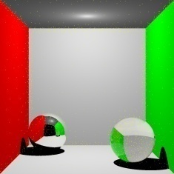
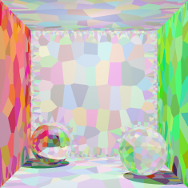
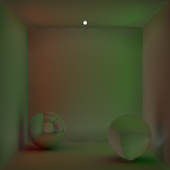
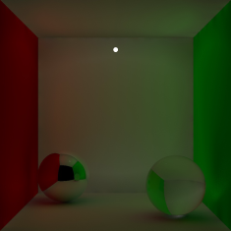
Parallel photon mapping on GPU
Input Model
Build Scene Hierarchy
Scene hierarchy
Ray tracing
Photon tracing
Direct lighting
Global photon map
Caustics photon map
Global Illumination
Adaptive seeding
K-Means clustering
Irradiance evaluation
Irradiance interpolation
Initial seed samples
Refined seed samples
Irradiance tree
Indirect lighting

Slide 24
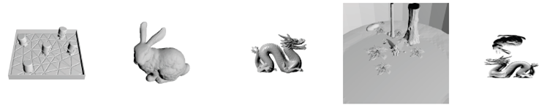
Results
Ray tracing evaluation using ray casting
Toasters 11 K Tri.
Bunny 69 K Tri.
Dragon 100 K Tri.
Fairy 178 K Tri.
Dragon / Bunny 252 K Tri.
 | Toaster | Bunny | Dragon | Fairy | Dragon/Bunny
SAH BVH | 36 | 144 | 219 | 522 | 554
Binned BVH | 37 | 47 | 64 | 95 | 84
Hybrid SAH BVH | 11 | 29 | 57 | 196 | 127
Hybrid binned BVH | 30 | 36 | 43 | 76 | 74
Construction time
All images rendered using nVidia GTX 285 at resolution 1014 x 1024

Slide 25
Tracing Time
Toasters 11 K Tri.
Bunny 69 K Tri.
Dragon 100 K Tri.
Fairy 178 K Tri.
Dragon / Bunny 252 K Tri.
 | Toaster | Bunny | Dragon | Fairy | Dragon/Bunny
SAH BVH | 21 | 29 | 23 | 48 | 38
Binned BVH | 703 | 31 | 27 | 147 | 84
Hybrid SAH BVH | 27 | 32 | 28 | 52 | 44
Hybrid binned BVH | 503 | 31 | 27 | 153 | 42
Tracing time
All images rendered using nVidia GTX 285 at resolution 1014 x 1024

Slide 26
Construction + Tracing time
Toasters 11 K Tri.
Bunny 69 K Tri.
Dragon 100 K Tri.
Fairy 178 K Tri.
Dragon / Bunny 252 K Tri.
 | Toaster | Bunny | Dragon | Fairy | Dragon/Bunny
SAH BVH | 58 | 273 | 243 | 570 | 593
Binned BVH | 741 | 79 | 91 | 242 | 123
Hybrid SAH BVH | 31 | 41 | 39 | 75 | 66
Hybrid binned BVH | 532 | 67 | 71 | 230 | 117
Construction + Tracing time
All images rendered using nVidia GTX 285 at resolution 1014 x 1024

Slide 27
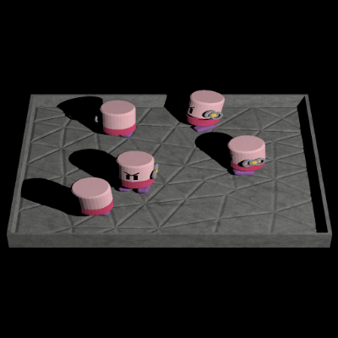
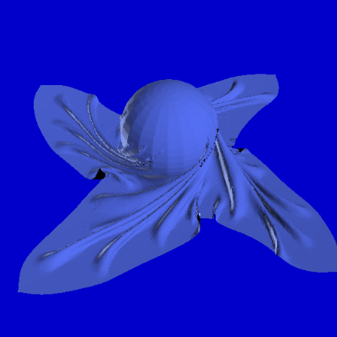
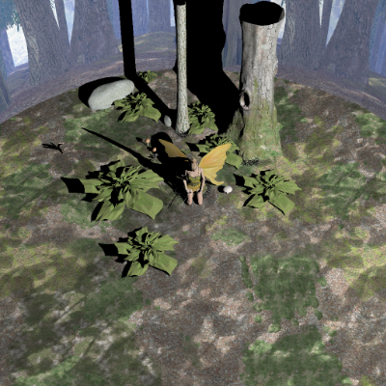
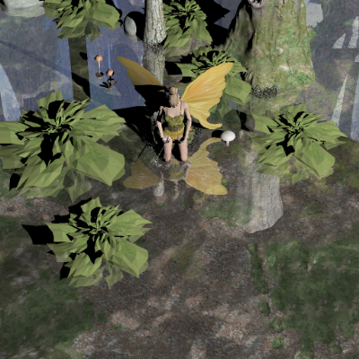
Ray tracing evaluation using Witted ray tracing
Toasters 38 fps
Cloth/ball 30 fps
Fairy (single bounce) 20 fps
Fairy (reflection) 11fps
All images rendered using nVidia GTX 285 at resolution 1014 x 1024

Slide 28
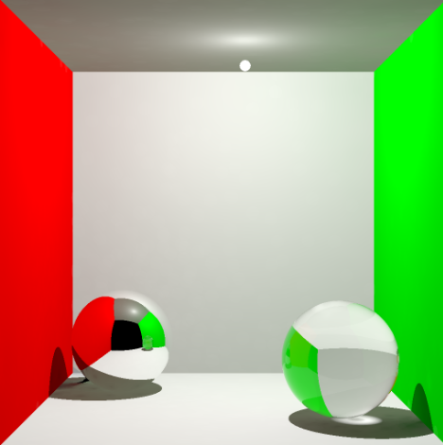
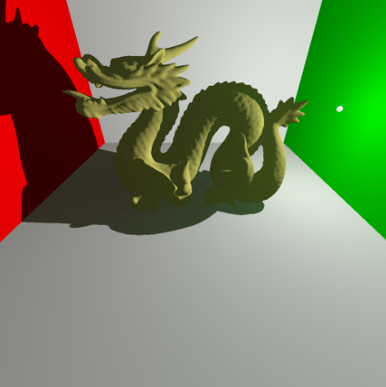
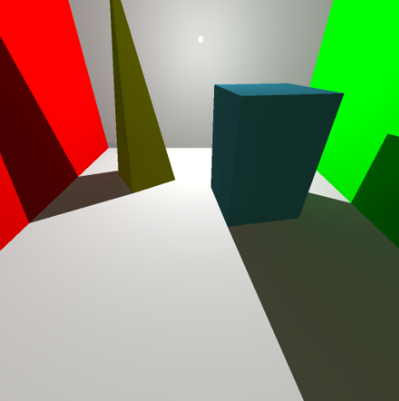
Photon mapping performance
Cornel box 2 fps
Dragon 2 fps
Simple box 2 fps
All images rendered using nVidia GTX 285 at resolution 1014 x 1024

Slide 29
Demo

Slide 30
Conclusion
Proposed a fast algorithm for building BVH
Extended primitive algorithms toolbox to include efficient algorithms required for constructing hierarchal trees
New approach for GPU parallel code which simplifies previous proposed algorithms
Implemented a complete global illumination pipeline on GPU

Slide 31
Future work
New or extend current parallel template library (e.g. thrust)
Use the LBVH approach for fast point-based KD-tree construction
Enhance ray tracer for distributed ray tracing effects
Enhance photon mapping for area light and other global illumination effects

Slide 32
References
[1] Ray tracing http://en.wikipedia.org/wiki/Ray_tracing_%28graphics%29
[2] PARKER, S. G., BIGLER, J., DIETRICH, A., FRIEDRICH, H., HOBEROCK, J., LUEBKE, D., MCALLISTER, D., MCGUIRE, M., MORLEY, K., ROBISON, A., AND STICH, M. 2010. Optix: a general purpose ray tracing engine. ACM Trans. Graph. 29, 66:1–66:13.
[3] JENSEN, H. W. 2001. Realistic Image Synthesis Using Photon Mapping. AK Peters.

Slide 33
Thank you ☺

