Slide 1
GPU-based Out-of-Core HLBVH Construction
Mahmoud Zeidan, Taymoor Nazmy, and Mostafa Aref
Faculty of Computer and Information Sciences
Ain Shams University

Slide 2
Motivation
Ray tracing massively large models
Existing Indexing structures
Support “relatively” small models
“Relatively” slow for large models

Slide 3
State-of-the-art BVH construction on GPU
HLBVH [Ape14, Kar12, GPM11, PL10,LGS09]
Binned SAH BVH [LGS09, HSZ11]
SBVH[WHY13]

Slide 4
Out-of-Core HLBVH
Challenges
Accessing data blocks larger than device memory
Out-of-core paging
Sorting (Morton codes) keys
Out-of-core sorting

Slide 5
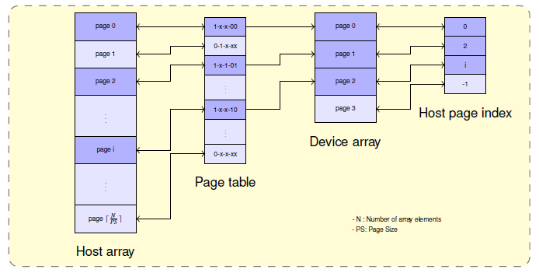
Out-of-core paging
In each page table entry the three most significant bits from left to right:
In-core flag
Page request flag
Page modified flag
Remaining bits are used to store page start address relative to GPU array start address.
The host page index array is used to link GPU pages to the corresponding CPU pages.

Slide 6

Out-of-core sorting
Two main steps
Partition keys into $N_{b}$ small buckets and sort them in in-core memory
Merge buckets together in $\left\lceil \log_{2}{N_{b}}\right\rceil$ steps
Merge step 3
Merge step 2
Merge step 1
In-core sorting

Slide 7
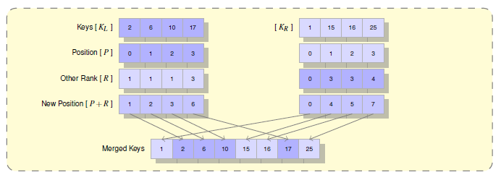
In-core merge sort
Each element at position P in an array finds its rank R in the other array using binary search.
The key’s new location in the output array will be at position P+R.

Slide 8
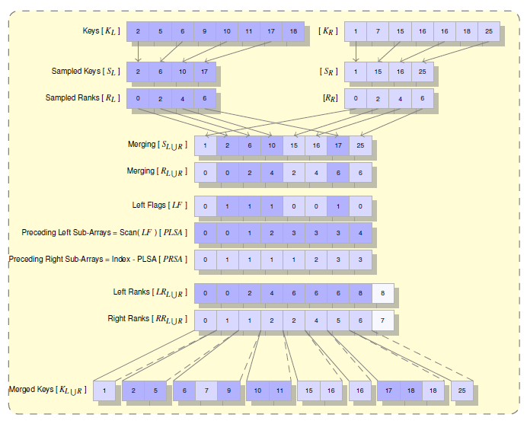
Out-of-core merge sort
sparsely sampling the b-th keys and ranks
Merge samples
Set a flag if key sample from left array
Scans of flags define the search range for the ranks
Upload sub-arrays, fill ranks, and merge

Slide 9
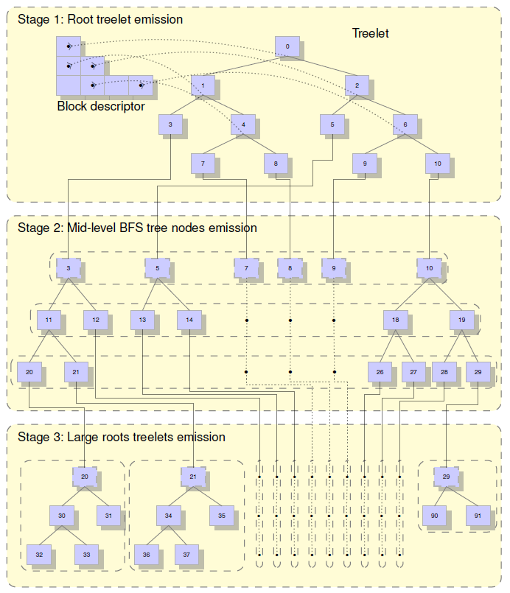
Out-of-Core HLBVH
PBFS emission
Three stages
Stage 1: Emit root treelet for the first 20 bits
Stage 2: out-of-core BFS emission using out-of-core binary search
Stage 3: Localized BFS emission for nodes having primitives less than certain threshold

Slide 10
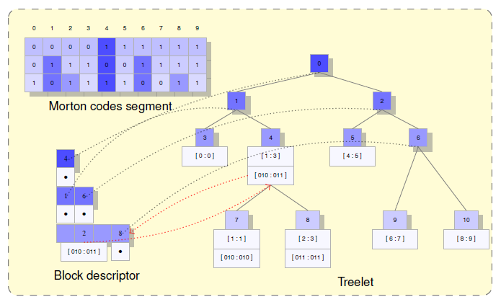

Stage one : Root treelet emission
Iteratively upload Morton codes
Fill block descriptor for the first 20 bits, need $2^{20}−1$ cells
Emit corresponding treelet for the root node

Slide 11
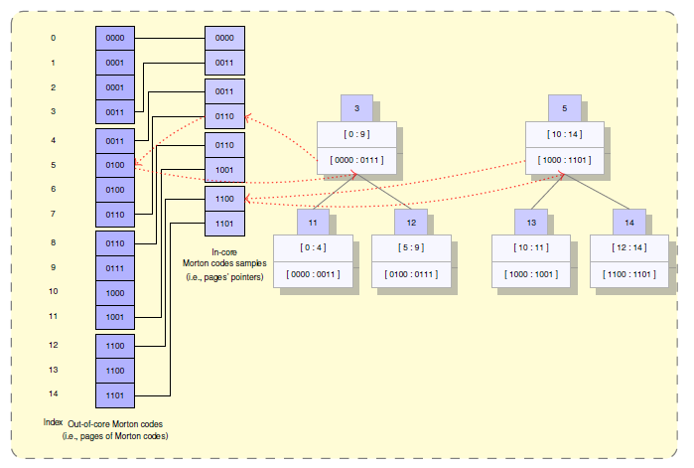
Stage two : Mid-level BFS tree nodes emission
Similar to [] but using out-of-core binary search
Before binary search
Sample keys at the start and end of each page
Out-of-core binary search
Search for split plane at the samples
Load corresponding out-of-core keys' page and search for the split

Slide 12
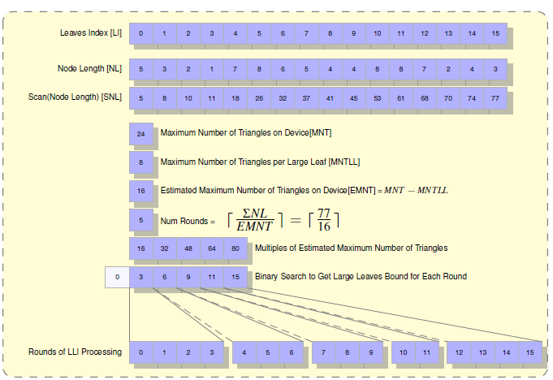
Stage three : Large Roots Treelets Emission
Split Geometry
Emit Hierarchy

Slide 13
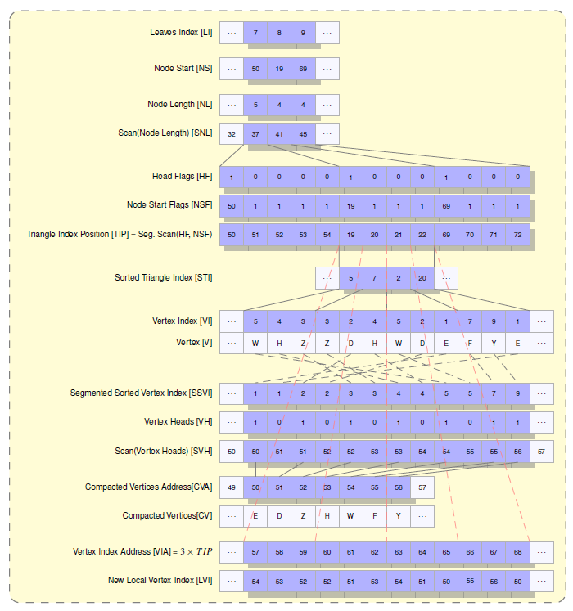
Geometry splitting
Split and upload Geometry
Build local hierarchy
Dump treelets to CPU

Slide 14
Out-of-core ray traversal
do
{
for each ray in parallel
{
while (queue not empty)
{
if (node is large root)
{
if (node inside in-core memory)
{
seek for nearest hit
}
else
{
request node
push node into queue
}
}
else
{
traverse the ray inside in-core top tree nodes
}
}
}
// supply page requests
} while (page_request != null)

Slide 15
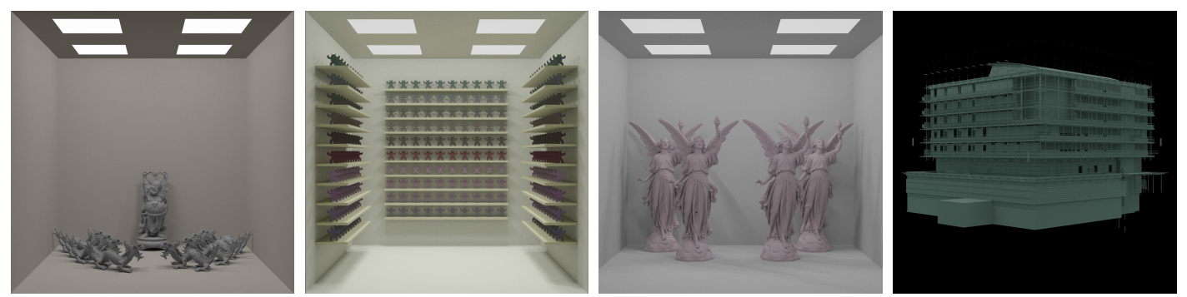
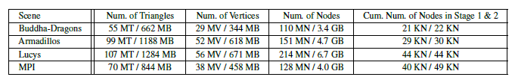
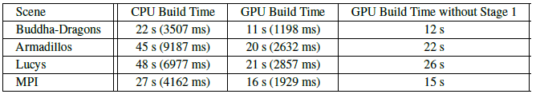
Results

Slide 16
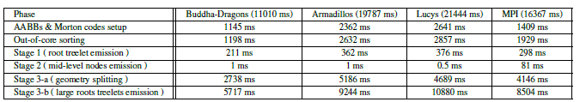
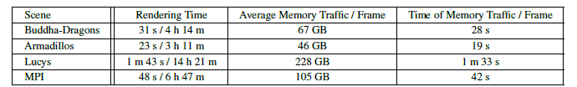
Results
Time breakdown
Rendering time

Slide 17
Future work
Add support of SAH in the construction process
Enhance ray traversal performance
Support photon mapping and progressive photon mapping

Slide 18
Thank you

