Slide 1

Realistic Images Using Photon Mapping
Under Supervision of :
Dr. Zaki Taha
Project Team
Ahmed Ismaiel Mahmoud Zidan
Ahmed Hamdy
Assistants
Amr Gamgom Salma Hamdy

Slide 2
Agenda
History
Objective
Applications
Project phases
Photon Mapping Algorithm
Features
Screen Shots

Slide 3
Computer Graphics Approaches
3D Computer Graphics Development Split into two Approaches
Available Approaches
API Kits
Rendering Tools
Microsoft :DirectX
SGI: OpenGL
Discreet: 3D Studio Max
Alias Software : Maya
Advantages
Real Time Response
Non Real Time Response
Disadvantages
Low Special Effects
No Geometric Description
Speed

Slide 4
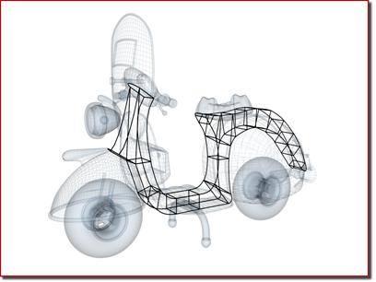
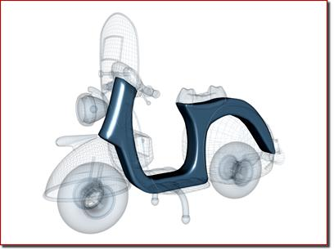
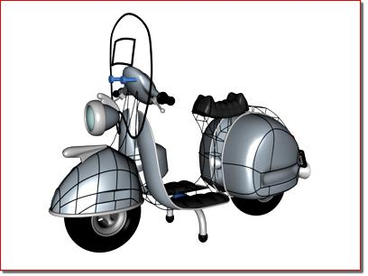
Objective
Mix Software & Hardware Capabilities
Is to develop a modeling tool produces high realistic images using Different Global illumination algorithms
Modeling
Intermediate Steps
Rendering

Slide 5
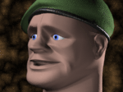
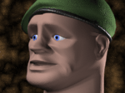
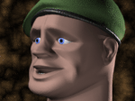
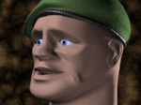

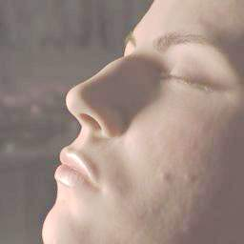
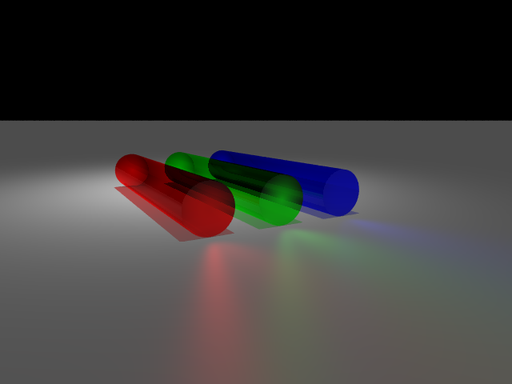
Applications
Character modeling and Facial animation
Particle Real life Simulation(fog , fire,smoke ..etc)
Virtual reality
CAD/CAM designing
Games And movies
laser lighting Simulation applications

Slide 6
Project Phases
Analysis
  Problem definition
Developing 3D Engine for support both hardware drivers (DirectX & OpenGL)
Developing 3D Modeling Tool Above the Engine
Developing Basic Ray Tracer for Software Support
Implementing The photon Mapping Algorithm
Add Features To Complete the Realism of the Generated Images

Slide 7
Algorithms Evaluation
Category | BRDF | Solutions
Radiosity | Diffuse Only | HemiCube Radiosity Progressive Radiosity
Ray Tracing | Diffuse And Specular | Kajia's Path Tracing Radiance Method
Photon Mapping By Henrik Wann Jensen (Monte Carlo Simulation 2002 ) | Bi Directional Photon Tracing | Photon Map Method
BRDF : Bi Directional Reflectance Distribution Function
Time Complexity
Pervious Algorithms : 2 ^{p (n)}
Photon Mapping : O(n²)

Slide 8
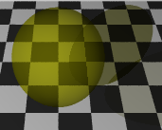
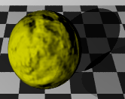
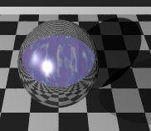
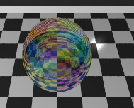
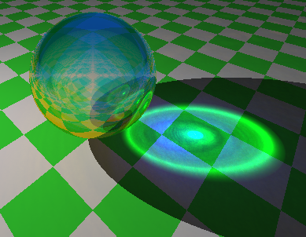
What is Photon Mapping
Is a new method to achieve global illumination (Indirect Light ) effects
And Simulates the transport of individual photons
Video Demo
Ray Tracing Specifications
Pigment
Normal
Finish
Interior
=
+
Photon Mapping

Slide 9
Why Photon Mapping
Viewer independent
Can be saved for later use
The photon tracing procedure enables modeling of participatory media.
Enables selectively ignoring photons in the process of rendering caustics
The fastest algorithm and best output

Slide 10
What is a Photon?
  A photon p is a particle of light that carries flux ΔΦ_{p}(x_{p}, ω_{p})
  Power: ΔΦ_{p} – magnitude (in Watts) and color of the flux it carries, stored as an RGB triple
  Position: x_{p} – location of the photon
  Direction: ω_{p} – the incident direction ω_{i} used to compute irradiance
Photons propagate flux
ΔΦ_{p}
x_{p}

Slide 11
The Photon Mapping Algorithm
Consist of two passes
The First Pass:
  Creating the Global Photon Map
  collect photons in k-d tree structure
The Second Pass:
  Generating the Image

Slide 12
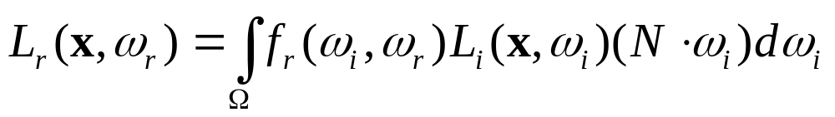
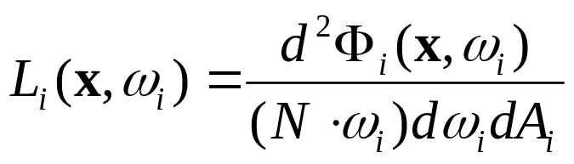
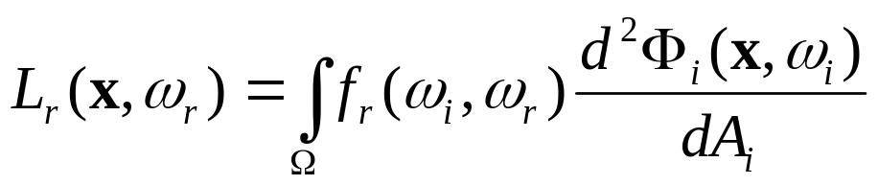
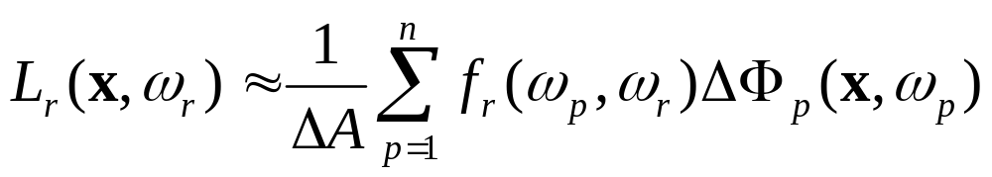
Reflected Radiance
Recall the reflected radiance equation
Convert incident radiance into incident flux
Reflected radiance in terms of incident flux
Numerically
DA = pr²

Slide 13
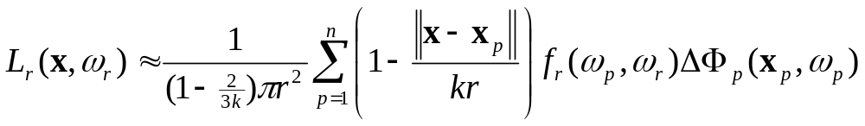
Filtering
Too few photons cause blurry results
Simple averaging produces a box filtering of photons
Photons nearer to the sample should be weighted more heavily
Results in a cone filtering of photons

Slide 14
Storing Photons
Uses a kd-tree – a sequence of axis-aligned partitions
  2-D partitions are lines
  3-D partitions are planes
Average access time is O(log n)
Worst case O(n) when tree is severely lopsided
Need to maintain a balanced tree, which can be done in
  T(n) = kn + 2T(n=2), so the algorithm takes O(n log n) time.

Slide 15
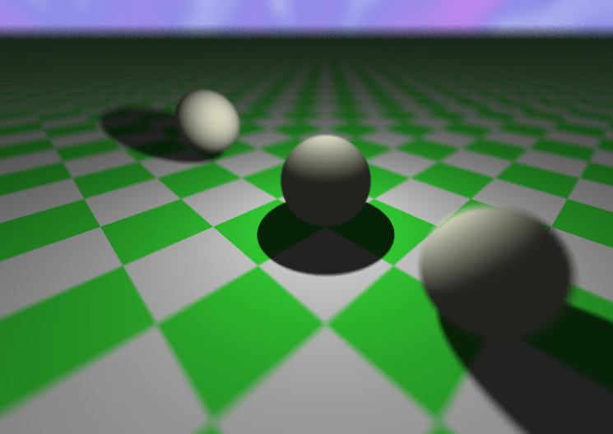
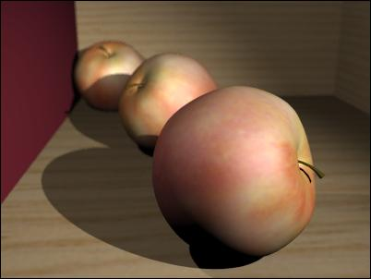


Focal Blur
Simulate Human Eye by Rendering Object differently based on distance
Original, No focal
Aperture .5, 3rd apple
Aperture 3 ,1st apple

Slide 16
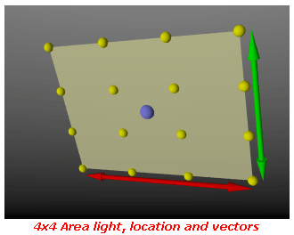
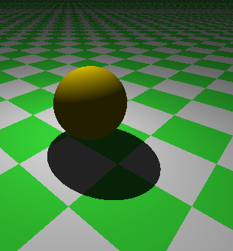
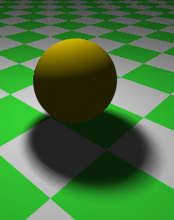
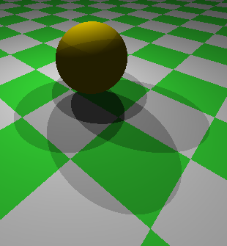
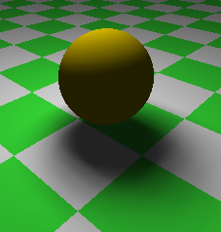
Soft Shadows
2 x 2

Slide 17
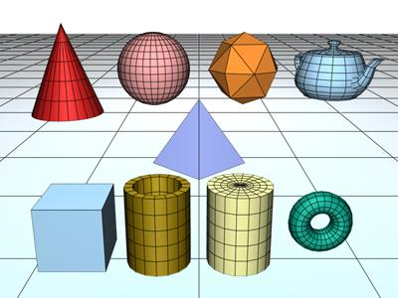
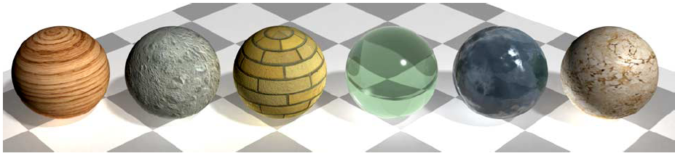
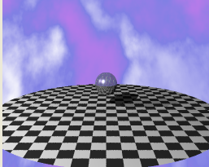
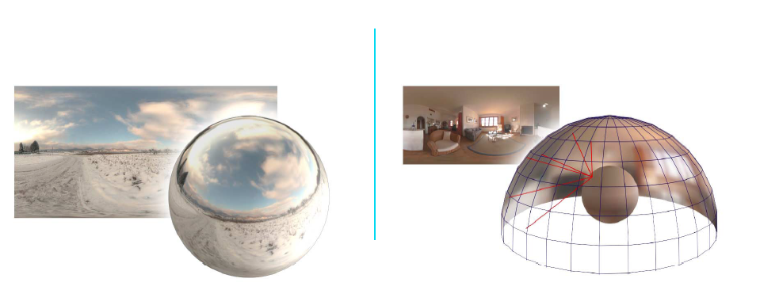
Objects , Texturing And Sky Spheres
Library with largely used pattern and textures
Supports Basic Primitives
and complex one through
loading model files
Sky Sphere Mapping

Slide 18
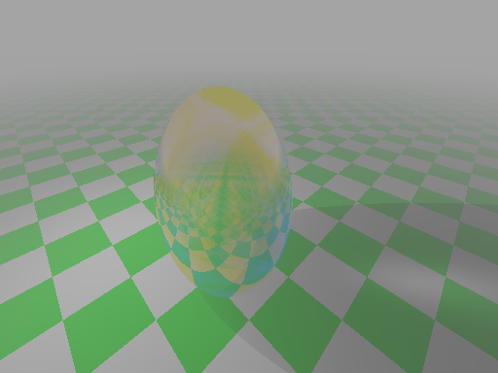
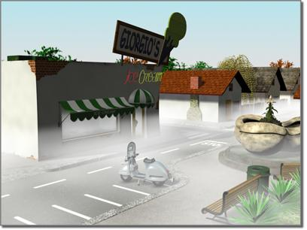
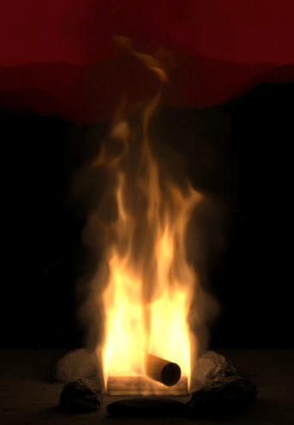
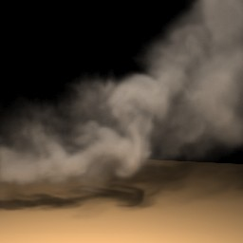
Participating Media
Fog
Ground Fog
Other Particles Can Be Simulated the same way
Fire Simulation
Virtual Smoke

Slide 19
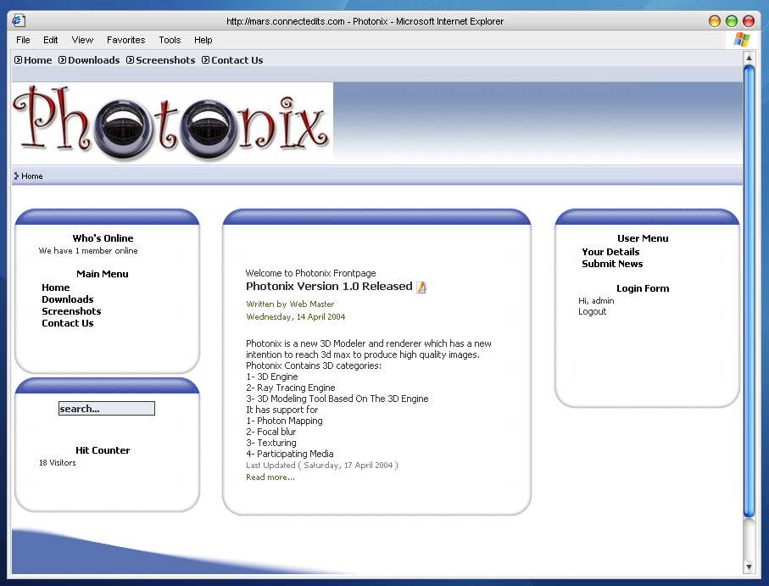
Open Source Project Development
Web Site for updates, bug tracking ,Help

Slide 20
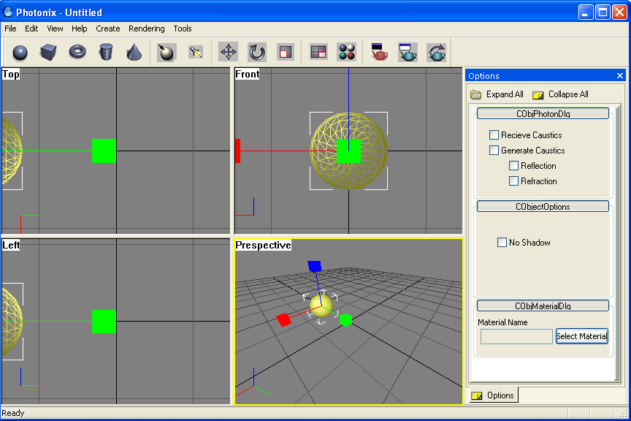
Application Screen Shot
Famous Interface, Easy Manipulation, neat features

Slide 21
Tools
Language
C++
Microsoft Visual Studio
nVidia Cg SDK (6.0)
DirectX SDK (9.0)

Slide 22
Thank You

