Slide 1
Meet inPace
Slides open right inside a lesson

Slide 2
What you can add to a course
Videos, audio and YouTube links
PDFs, and parts of a book
Word, PowerPoint and Excel files
  Only to view: edit them in Office
Web pages, pictures and code

Slide 3
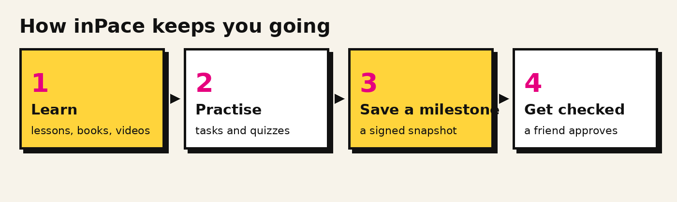
The inPace loop

