Slide 1


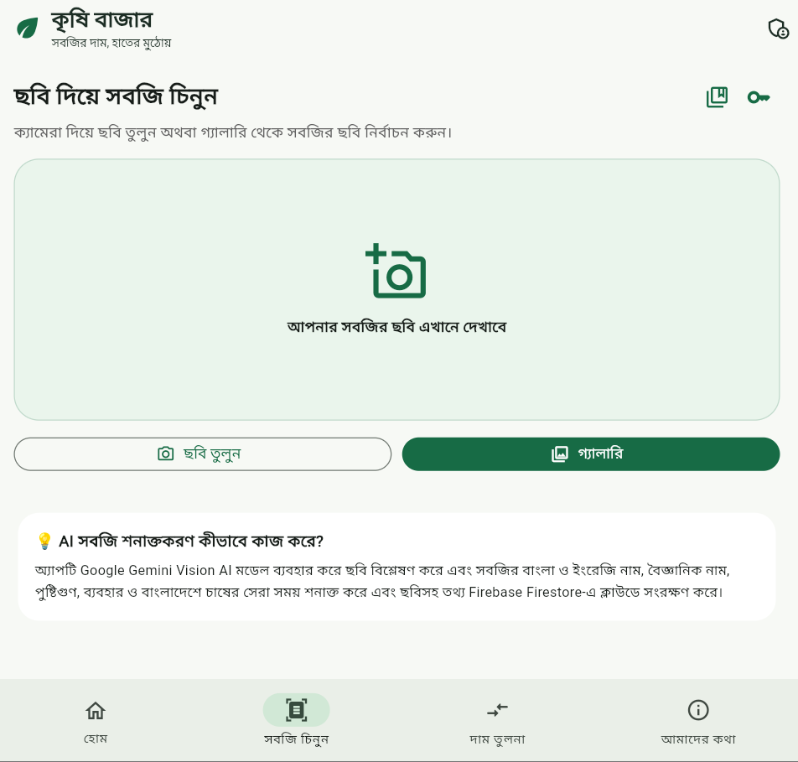
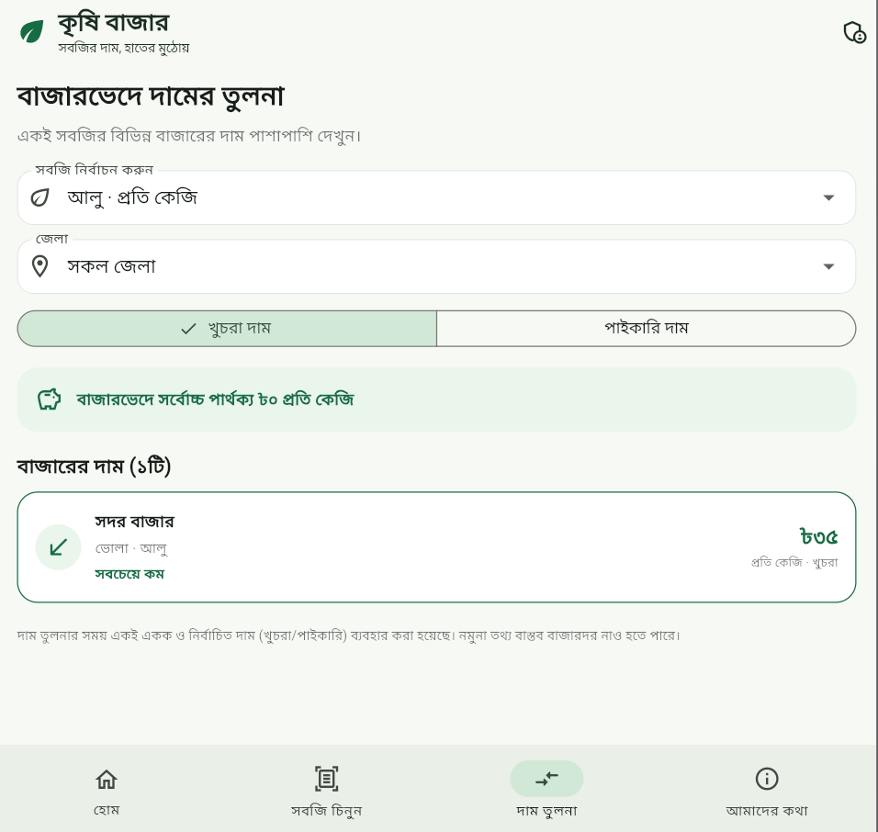
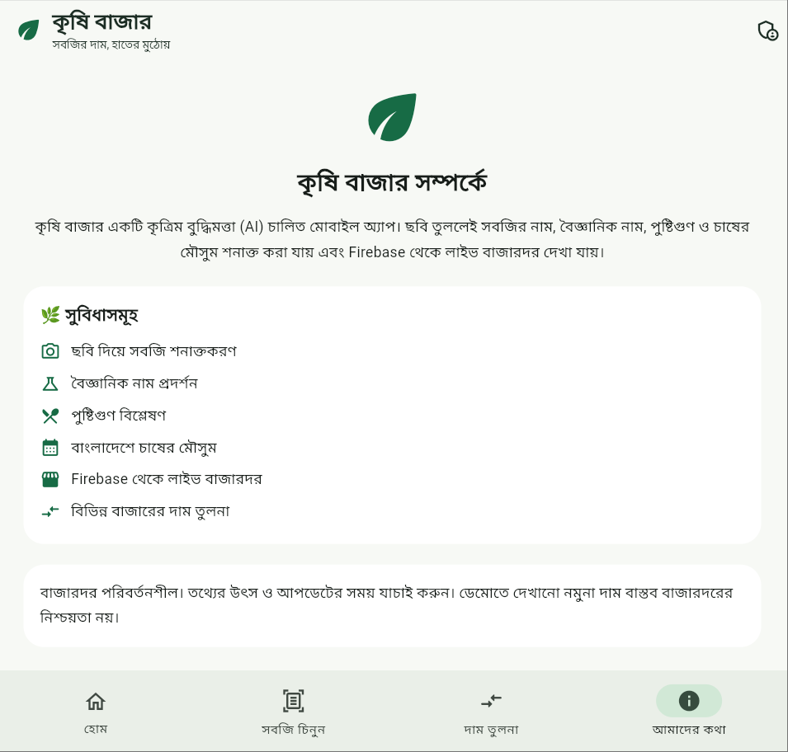
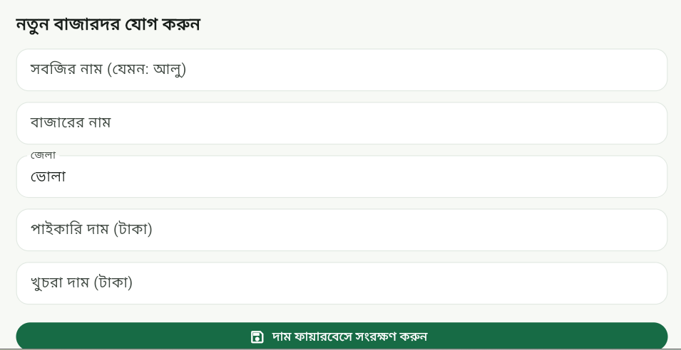



Mawlana Bhashani Science and Technology University
Department of Information and Communication Technology
B.Sc. (Engg.) in ICT • Course Project • Session 2023–24
কৃষি বাজার
Krishi Bazar
Know the price, Know the vegetable.
AI-Powered Vegetable Recognition, Market Price Tracking, and Agricultural Decision Support
PRESENTED BY
SUPERVISED BY
Md. Mahmudur Rahman
Dr. Nazrul Islam
ID: IT-24024 • 2nd Year, 2nd Semester
Associate Professor, Department of ICT, MBSTU
01
Introduction
04
AI scan pipeline
07
Application results
Farmers and consumers in Bangladesh need accessible information on wholesale and retail vegetable prices. Krishi Bazar combines prices by market and district with photo-based vegetable identification in a Bengali interface.
1
Capture or select a photo
2
Call Gemini SDK, with REST fallback across three models
3
Extract and parse the 11-field JSON response
Market prices
AI scan interface
02
Objectives
1. Compare wholesale and retail prices by market and district.
2. Identify vegetables from photos using Gemini Vision.
3. Let an authenticated admin manage Firestore records.
4. Display digits, prices and dates in Bengali.
4
Show vegetable details and matching prices, then save the scan
05
Data model
Price comparison
About & features
Each price record stores 11 fields, including local market name, unit, source label and a three-level availability status.
03
Architecture
Testing: default counter test only. AI accuracy is unmeasured. Empty live data uses demo prices.
Admin price-entry form
Flutter interface
08
Analysis & limitations
MarketService
AuthService
AiService
06
Prototype results
The interface supports market browsing, image input, comparison and admin entry. Screenshots show the interface. Recognition accuracy still needs evaluation.
Cloud Firestore
Firebase Auth
Gemini API
≈3,900
5
Dart 3.4+ • Material 3
lines of Dart / 14 files
application screens
18
11
09
Conclusion & next steps
seed price records
fields per AI response
Next: secure the AI proxy, deploy Firestore rules and validate recognition with labelled images.
References: Flutter docs · Cloud Firestore docs · Gemini API docs · Mohanty, Hughes & Salathé (2016), Front. Plant Sci. 7:1419
Notes:
Source: user-supplied Krishi Bazar poster image. Rewritten for clarity without independent verification. Original limitations: only default counter test exists; no recognition accuracy dataset has been run; empty live collection falls back to demo prices. References supplied in source: Flutter documentation (flutter.dev), Cloud Firestore documentation (firebase.google.com), Gemini API documentation (ai.google.dev), Mohanty, Hughes & Salathé (2016), Frontiers in Plant Science 7:1419. Logo cropped from supplied image. All content except the logo is native editable PowerPoint text and shapes.

