Slide 1
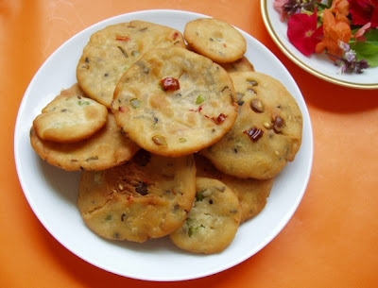
ZANDU BALM
EK BALM TEEN KALM

Slide 2
Features
MS PowerPoint Tutorial
100% Ayurvedic
Conference video

Slide 3
Prices
50 GM
100 GM
150 GM
200 GM
1 KG
TK. 50/-
TK. 100/-
TK. 150/-
TK. 150/-
TK. 200/-

Slide 4

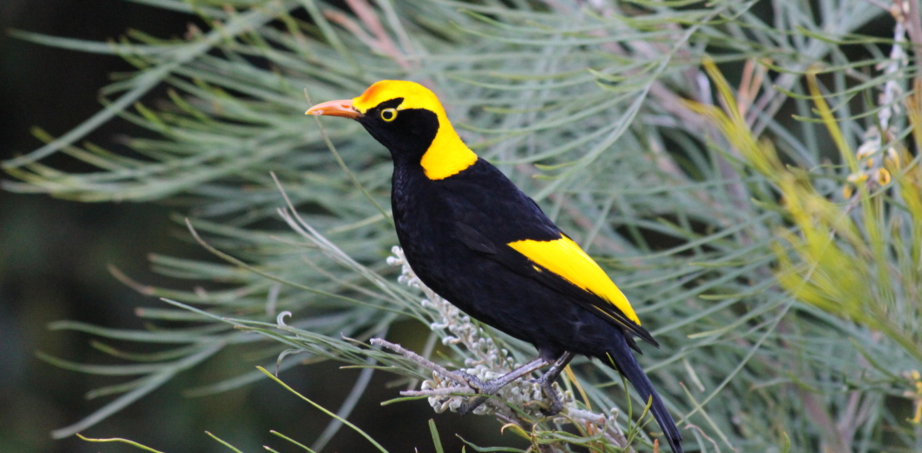
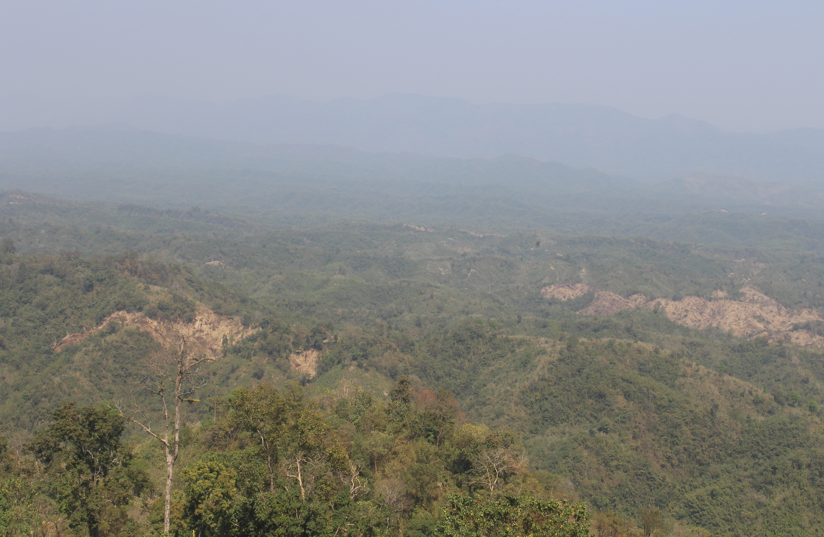
People Review
Bird
mcsd
Sajek

Slide 5
Thank you for watching

