Slide 1
1
Accounting in Action
Learning Objectives
1
Identify the activities and users associated with accounting.
2
Explain the building blocks of accounting: ethics, principles, and assumptions.
3
4
Analyze the effects of business transactions on the accounting equation.
State the accounting equation, and define its components.
5
Describe the four financial statements and how they are
prepared.

Slide 2
LEARNING
OBJECTIVE
Identify the activities and users
associated with accounting.
1
Accounting consists of three basic activities—it
identifies,
records, and
communicates
the economic events of an organization to interested users.
LO 1

Slide 3
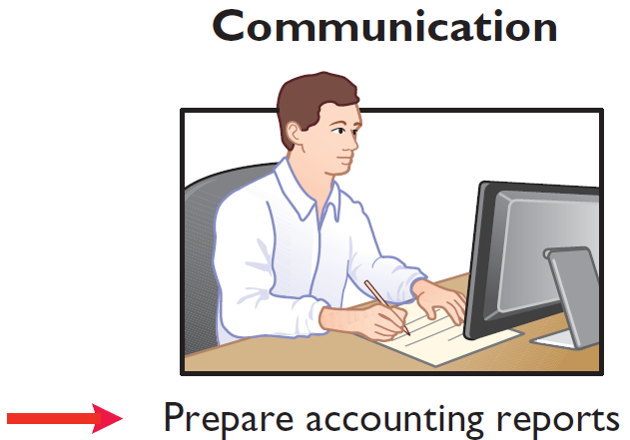
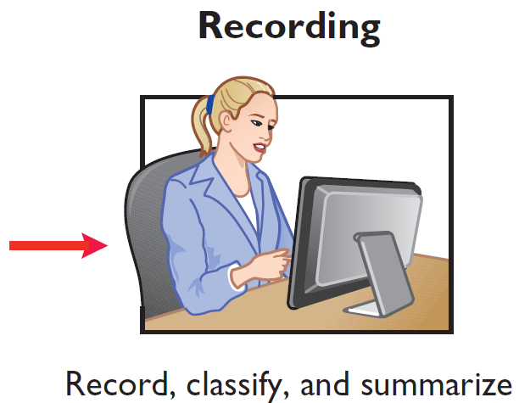
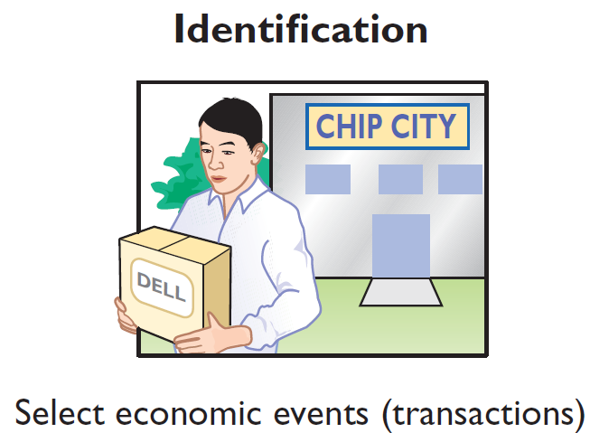
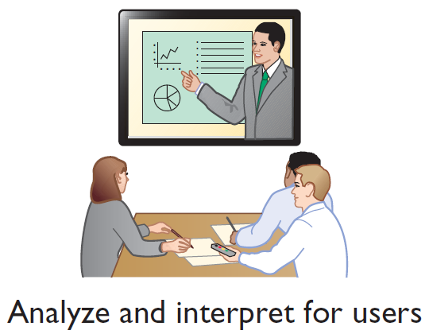
Three Activities
Illustration 1-1
The activities of the accounting process
The accounting process includes
the bookkeeping function.
LO 1

Slide 4
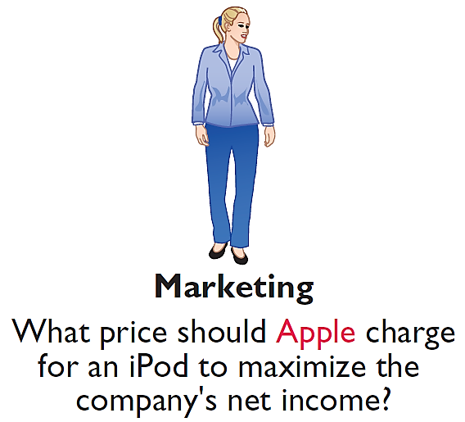
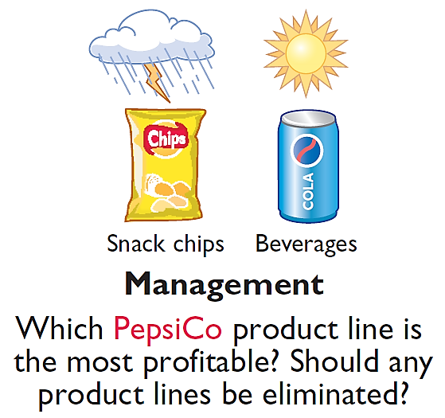
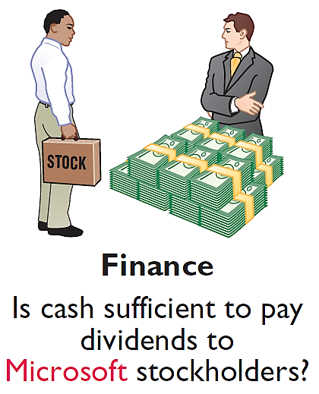

Who Uses Accounting Data
INTERNAL USERS
Illustration 1-2
Questions that internal users ask
LO 1

Slide 5
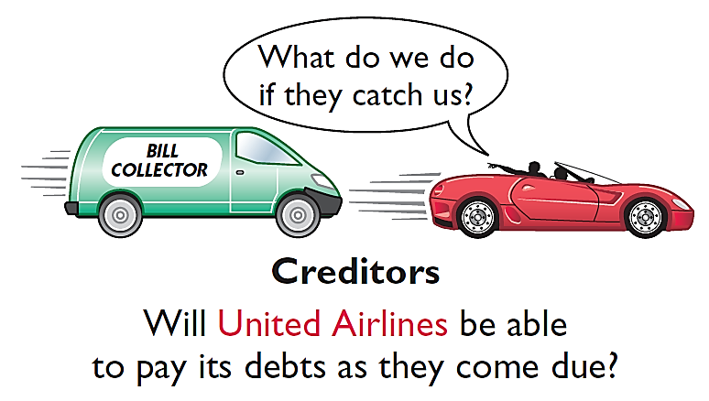

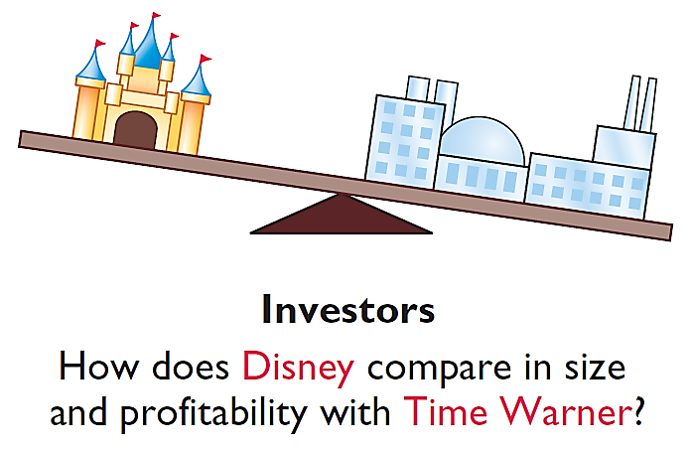
Who Uses Accounting Data
EXTERNAL USERS
Illustration 1-3
Questions that external users ask
LO 1

Slide 6
Generally Accepted Accounting Principles
Financial Statements
Balance Sheet
Income Statement
Statement of Owner's Equity
Statement of Cash Flows
Note Disclosure
Various users need financial information
The accounting profession has developed standards that are generally accepted and universally practiced.
Generally Accepted Accounting Principles (GAAP)
LO 2

Slide 7
Forms of Business Ownership
Proprietorship
Partnership
Corporation
Owned by one person
Owner is often manager/operator
Owner receives any profits, suffers any losses, and is personally liable for all debts
Owned by two or more persons
Often retail and service-type businesses
Generally unlimited personal liability
Partnership agreement
Ownership divided into shares of stock
Separate legal entity organized under state corporation law
Limited liability
LO 2

Slide 8
Assumptions
Question
Combining the activities of Kellogg and General Mills would violate the
cost principle.
economic entity assumption.
monetary unit assumption.
ethics principle.
LO 2

Slide 9
Assumptions
Question
A business organized as a separate legal entity under state law having ownership divided into shares of stock is a
proprietorship.
partnership.
corporation.
sole proprietorship.
LO 2

Slide 10
LEARNING
OBJECTIVE
State the accounting equation, and define its components.
3
Assets
Liabilities
Owner's Equity
=
+
Basic Accounting Equation
Provides the underlying framework for recording and summarizing economic events.
Assets are claimed by either creditors or owners.
If a business is liquidated, claims of creditors must be paid before ownership claims.
LO 3

Slide 11
Basic Accounting Equation
Assets
Liabilities
Owner's Equity
=
+
Assets
Resources a business owns.
Provide future services or benefits.
Cash, Supplies, Equipment, etc.
LO 3

Slide 12
Basic Accounting Equation
Assets
Liabilities
Owner's Equity
=
+
Liabilities
Claims against assets (debts and obligations).
Creditors (party to whom money is owed).
Accounts Payable, Notes Payable, Salaries and Wages Payable, etc.
LO 3

Slide 13
Basic Accounting Equation
Assets
Liabilities
Owner's Equity
=
+
Owner's Equity
Ownership claim on total assets.
Referred to as residual equity.
Investment by owners and revenues (+)
Drawings and expenses (-).
LO 3

Slide 14
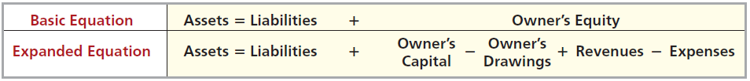
Owner’s Equity
Illustration 1-6
Expanded accounting equation
Increases in Owner’s Equity
Investments by owner are the assets the owner puts into the business.
Revenues result from business activities entered into for the purpose of earning income.
Common sources of revenue are: sales, fees, services, commissions, interest, dividends, royalties, and rent.
LO 3

Slide 15
Owner’s Equity
Illustration 1-6
Expanded accounting equation
Decreases in Owner’s Equity
Drawings An owner may withdraw cash or other assets for personal use.
Expenses are the cost of assets consumed or services used in the process of earning revenue.
Common expenses are: salaries expense, rent expense, utilities expense, tax expense, etc.
LO 3

Slide 16
DO IT!
3
Owner's Equity Effects
Classify the following items as investment by owner, owner’s drawings, revenue, or expenses. Then indicate whether each item increases or decreases owner’s equity.
Classification
Effect on Equity
Rent Expense
Service Revenue
Drawings
Salaries and Wages Expense
Expense
Decrease
Revenue
Increase
Drawings
Decrease
Expense
Decrease
LO 3

Slide 17
LEARNING
OBJECTIVE
Analyze the effects of business transactions on the accounting equation.
4
Transactions are a business’s economic events recorded by accountants.
May be external or internal.
Not all activities represent transactions.
Each transaction has a dual effect on the accounting equation.
LO 4

Slide 18


Transaction Analysis
Illustration: Are the following events recorded in the accounting records?
Illustration 1-7
Discuss product design with potential customer
Purchase computer
Event
Pay rent
Criterion
Is the financial position (assets, liabilities, or owner’s equity) of the company changed?
Record/
Don’t Record
LO 4

Slide 19
Transaction Analysis
TRANSACTION 1. INVESTMENT BY OWNER Ray Neal decides to start a smartphone app development company which he names Softbyte. On September 1, 2017, he invests $15,000 cash in the business. This transaction results in an equal increase in assets and owner’s equity.
Assets = Liabilities + Owner's Equity
Trans-
action
Cash
+
Accounts
Receivable
+
Supplies
+
Equipment
=
Accounts
Payable
+
Owner's Capital
+
Owner's Drawings
+
Rev.
-
Exp.
1. +15,000 +15,000
Illustration 1-8
Tabular summary of Softbyte transactions
LO 4

Slide 20
TRANSACTION 2. PURCHASE OF EQUIPMENT FOR CASH Softbyte Inc. purchases computer equipment for $7,000 cash.
Illustration 1-8
Assets = Liabilities + Owner's Equity
Trans-
action
Cash
+
Accounts
Receivable
+
Supplies
+
Equipment
=
Accounts
Payable
+
Owner's Capital
+
Owner's Drawings
+
Rev.
-
Exp.
1. +15,000 +15,000
2. -7,000 +7,000
3. +1,600 +1,600
4. +1,200 +1,200
5. +250 -250
6. +1,500 +2,000 +3,500
7. -1,700 -600
-900
-200
8. -250 -250
9. +600 -600
10. -1,300 -1,300
+
+
+
=
+
+
-
-
$8,050 $1,400 $1,600 $7,000 $1,600 $15,000 $4,700 $1,950 $1,300
LO 4

Slide 21
TRANSACTION 3. PURCHASE OF SUPPLIES ON CREDIT Softbyte Inc. purchases for $1,600 headsets and other accessories expected to last several months. The supplier allows Softbyte to pay this bill in October.
Illustration 1-8
Assets = Liabilities + Owner's Equity
Trans-
action
Cash
+
Accounts
Receivable
+
Supplies
+
Equipment
=
Accounts
Payable
+
Owner's Capital
+
Owner's Drawings
+
Rev.
-
Exp.
1. +15,000 +15,000
2. -7,000 +7,000
3. +1,600 +1,600
4. +1,200 +1,200
5. +250 -250
6. +1,500 +2,000 +3,500
7. -1,700 -600
-900
-200
8. -250 -250
9. +600 -600
10. -1,300 -1,300
+
+
+
=
+
+
-
-
$8,050 $1,400 $1,600 $7,000 $1,600 $15,000 $4,700 $1,950 $1,300
LO 4

Slide 22
TRANSACTION 4. SERVICES PERFORMED FOR CASH Softbyte Inc. receives $1,200 cash from customers for app development services it has performed.
Illustration 1-8
Assets = Liabilities + Owner's Equity
Trans-
action
Cash
+
Accounts
Receivable
+
Supplies
+
Equipment
=
Accounts
Payable
+
Owner's Capital
+
Owner's Drawings
+
Rev.
-
Exp.
1. +15,000 +15,000
2. -7,000 +7,000
3. +1,600 +1,600
4. +1,200 +1,200
5. +250 -250
6. +1,500 +2,000 +3,500
7. -1,700 -600
-900
-200
8. -250 -250
9. +600 -600
10. -1,300 -1,300
+
+
+
=
+
+
-
-
$8,050 $1,400 $1,600 $7,000 $1,600 $15,000 $4,700 $1,950 $1,300
LO 4

Slide 23
TRANSACTION 5. PURCHASE OF ADVERTISING ON CREDIT Softbyte Inc. receives a bill for $250 from the Daily News for advertising on its online website but postpones payment until a later date.
Illustration 1-8
Assets = Liabilities + Owner's Equity
Trans-
action
Cash
+
Accounts
Receivable
+
Supplies
+
Equipment
=
Accounts
Payable
+
Owner's Capital
+
Owner's Drawings
+
Rev.
-
Exp.
1. +15,000 +15,000
2. -7,000 +7,000
3. +1,600 +1,600
4. +1,200 +1,200
5. +250 -250
6. +1,500 +2,000 +3,500
7. -1,700 -600
-900
-200
8. -250 -250
9. +600 -600
10. -1,300 -1,300
+
+
+
=
+
+
-
-
$8,050 $1,400 $1,600 $7,000 $1,600 $15,000 $4,700 $1,950 $1,300
LO 4

Slide 24
TRANSACTION 6. SERVICES PERFORMED FOR CASH AND CREDIT. Softbyte performs $3,500 of services. The company receives cash of $1,500 from customers, and it bills the balance of $2,000 on account.
Illustration 1-8
Assets = Liabilities + Owner's Equity
Trans-
action
Cash
+
Accounts
Receivable
+
Supplies
+
Equipment
=
Accounts
Payable
+
Owner's Capital
+
Owner's Drawings
+
Rev.
-
Exp.
1. +15,000 +15,000
2. -7,000 +7,000
3. +1,600 +1,600
4. +1,200 +1,200
5. +250 -250
6. +1,500 +2,000 +3,500
7. -1,700 -600
-900
-200
8. -250 -250
9. +600 -600
10. -1,300 -1,300
+
+
+
=
+
+
-
-
$8,050 $1,400 $1,600 $7,000 $1,600 $15,000 $4,700 $1,950 $1,300
LO 4

Slide 25
TRANSACTION 7. PAYMENT OF EXPENSES Softbyte Inc. pays the following expenses in cash for September: office rent $600, salaries and wages of employees $900, and utilities $200.
Illustration 1-8
Assets = Liabilities + Owner's Equity
Trans-
action
Cash
+
Accounts
Receivable
+
Supplies
+
Equipment
=
Accounts
Payable
+
Owner's Capital
+
Owner's Drawings
+
Rev.
-
Exp.
1. +15,000 +15,000
2. -7,000 +7,000
3. +1,600 +1,600
4. +1,200 +1,200
5. +250 -250
6. +1,500 +2,000 +3,500
7. -1,700 -600
-900
-200
8. -250 -250
9. +600 -600
10. -1,300 -1,300
+
+
+
=
+
+
-
-
$8,050 $1,400 $1,600 $7,000 $1,600 $15,000 $4,700 $1,950 $1,300
LO 4

Slide 26
TRANSACTION 8. PAYMENT OF ACCOUNTS PAYABLE Softbyte Inc. pays its $250 Daily News bill in cash. The company previously (in Transaction 5) recorded the bill as an increase in Accounts Payable.
Illustration 1-8
Assets = Liabilities + Owner's Equity
Trans-
action
Cash
+
Accounts
Receivable
+
Supplies
+
Equipment
=
Accounts
Payable
+
Owner's Capital
+
Owner's Drawings
+
Rev.
-
Exp.
1. +15,000 +15,000
2. -7,000 +7,000
3. +1,600 +1,600
4. +1,200 +1,200
5. +250 -250
6. +1,500 +2,000 +3,500
7. -1,700 -600
-900
-200
8. -250 -250
9. +600 -600
10. -1,300 -1,300
+
+
+
=
+
+
-
-
$8,050 $1,400 $1,600 $7,000 $1,600 $15,000 $4,700 $1,950 $1,300
LO 4

Slide 27
TRANSACTION 9. RECEIPT OF CASH ON ACCOUNT Softbyte Inc. receives $600 in cash from customers who had been billed for services (in Transaction 6).
Illustration 1-8
Assets = Liabilities + Owner's Equity
Trans-
action
Cash
+
Accounts
Receivable
+
Supplies
+
Equipment
=
Accounts
Payable
+
Owner's Capital
+
Owner's Drawings
+
Rev.
-
Exp.
1. +15,000 +15,000
2. -7,000 +7,000
3. +1,600 +1,600
4. +1,200 +1,200
5. +250 -250
6. +1,500 +2,000 +3,500
7. -1,700 -600
-900
-200
8. -250 -250
9. +600 -600
10. -1,300 -1,300
+
+
+
=
+
+
-
-
$8,050 $1,400 $1,600 $7,000 $1,600 $15,000 $4,700 $1,950 $1,300
LO 4

Slide 28
TRANSACTION 10. WITHDRAWAL OF CASH BY OWNER Ray Neal withdraws $1,300 in cash in cash from the business for his personal use.
Illustration 1-8
Assets = Liabilities + Owner's Equity
Trans-
action
Cash
+
Accounts
Receivable
+
Supplies
+
Equipment
=
Accounts
Payable
+
Owner's Capital
+
Owner's Drawings
+
Rev.
-
Exp.
1. +15,000 +15,000
2. -7,000 +7,000
3. +1,600 +1,600
4. +1,200 +1,200
5. +250 -250
6. +1,500 +2,000 +3,500
7. -1,700 -600
-900
-200
8. -250 -250
9. +600 -600
10. -1,300 -1,300
+
+
+
=
+
+
-
-
$8,050 $1,400 $1,600 $7,000 $1,600 $15,000 $1,300 $4,700 $1,950
$18,050
$18,050
LO 4

Slide 29
Summary of Transactions
Each transaction is analyzed in terms of its effect on:
The three components of the basic accounting equation.
Specific of items within each component.
The two sides of the equation must always be equal.
LO 4

Slide 30
LEARNING
OBJECTIVE
Describe the four financial statements
and how they are prepared.
5
Companies prepare four financial statements :
Income Statement
Owner’s Equity Statement
Balance Sheet
Statement of Cash Flows
LO 5

Slide 31
Financial Statements
Question
Net income will result during a time period when:
assets exceed liabilities.
assets exceed revenues.
expenses exceed revenues.
revenues exceed expenses.
LO 5

Slide 32
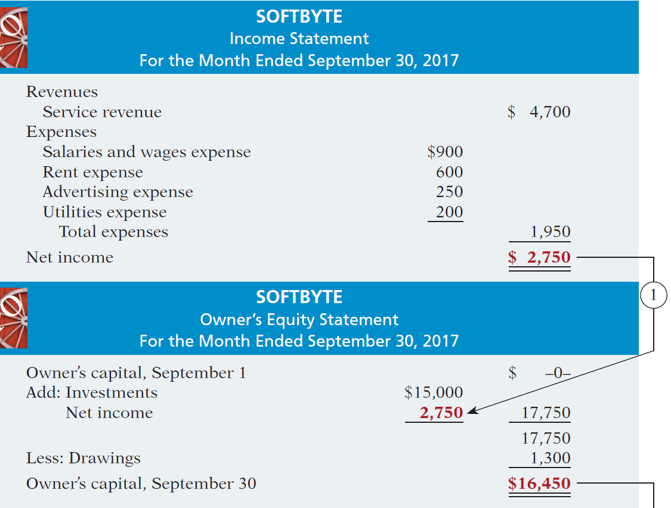
Net income is needed to determine the ending balance in owner’s equity.
Financial Statements
SOFTBYTE
Income Statement
For the Month Ended September 30, 2017
Illustration 1-9
Financial statements and
their interrelationships
SOFTBYTE
Owner’s Equity Statement
For the Month Ended September 30, 2017
LO 5

Slide 33
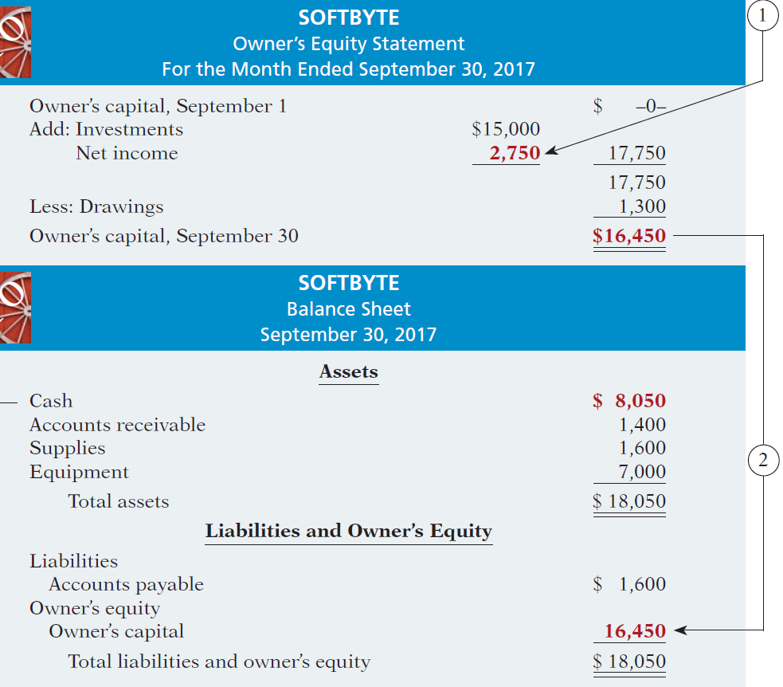
SOFTBYTE
Owner’s Equity Statement
For the Month Ended September 30, 2017
The ending balance in owner’s equity is needed in preparing the balance sheet.
Illustration 1-9
SOFTBYTE
Balance Sheet
September 30, 2017
Illustration 1-9
Financial statements and their interrelationships

Slide 34
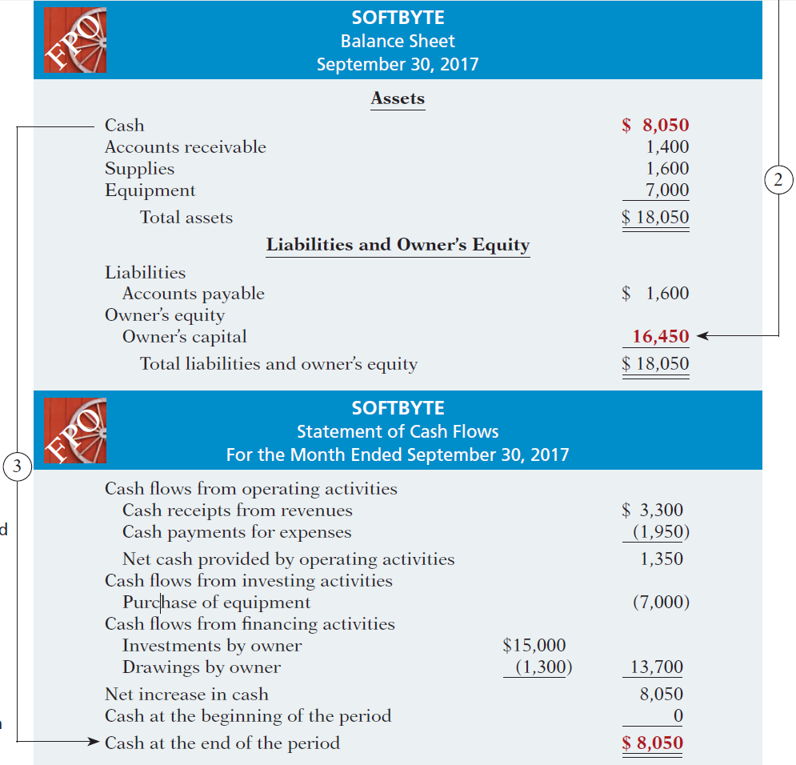
Financial Statements
SOFTBYTE
Balance Sheet
September 30, 2017
Balance sheet and income statement are needed to prepare statement of cash flows.
SOFTBYTE
Statement of Cash Flows
For the Month Ended September 30, 2017
Illustration 1-9
Financial statements and their interrelationships

Slide 35
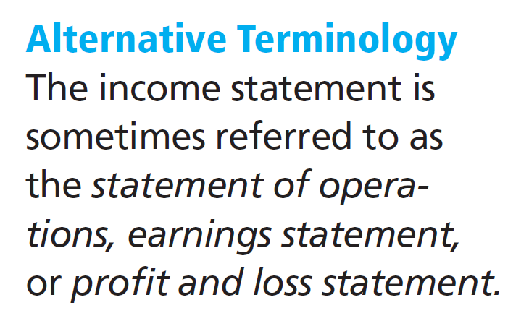
Income Statement
Reports the revenues and expenses for a specific period of time.
Lists revenues first, followed by expenses.
Shows net income (or net loss).
Does not include investment and withdrawal transactions between the owner and the business in measuring net income.
LO 5

Slide 36
Owner’s Equity Statement
Reports the changes in owner’s equity for a specific period of time.
The time period is the same as that covered by the income statement.
LO 5

Slide 37
Balance Sheet
Reports the assets, liabilities, and owner's equity at a specific date.
Lists assets at the top, followed by liabilities and owner’s equity.
Total assets must equal total liabilities and owner's equity.
Is a snapshot of the company’s financial condition at a specific moment in time (usually the month-end or year-end).
LO 5

Slide 38
Statement of Cash Flows
Information on the cash receipts and payments for a specific period of time.
Answers the following:
Where did cash come from?
What was cash used for?
What was the change in the
cash balance?
LO 5

Slide 39
Financial Statements
Question
Which of the following financial statements is prepared as of a specific date?
Balance sheet.
Income statement.
Owner's equity statement.
Statement of cash flows.
LO 5

