Slide 1
4
Completing the Accounting Cycle
Learning Objectives
1
Prepare a worksheet.
2
Prepare closing entries and a post-closing trial balance.
Explain the steps in the accounting cycle and how to prepare correcting entries.
3
4
Identify the sections of a classified balance sheet.

Slide 2
LEARNING
OBJECTIVE
Prepare a worksheet.
1
Worksheet
Multiple-column form used in preparing financial statements.
Not a permanent accounting record.
May be a computerized worksheet using an electronic spreadsheet program such as Excel.
Prepared using a five step process.
Use of worksheet is optional.
LO 1

Slide 3
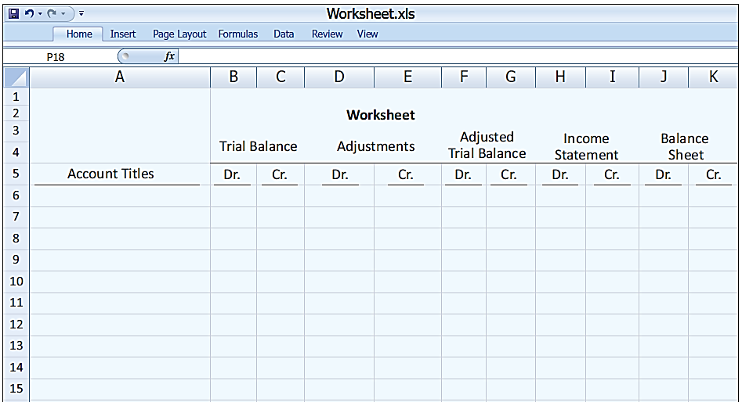
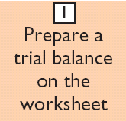
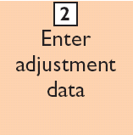
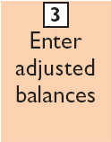
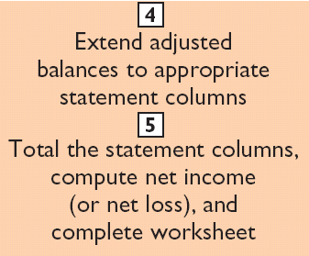
Steps in Preparing a Worksheet
Illustration 4-1

Slide 4
Steps in Preparing a Worksheet
Illustration 4-2
STEP 1: PREPARE A TRIAL BALANCE ON THE WORKSHEET
Trial balance amounts come directly from ledger accounts.
Include all accounts with balances.
LO 1

Slide 5
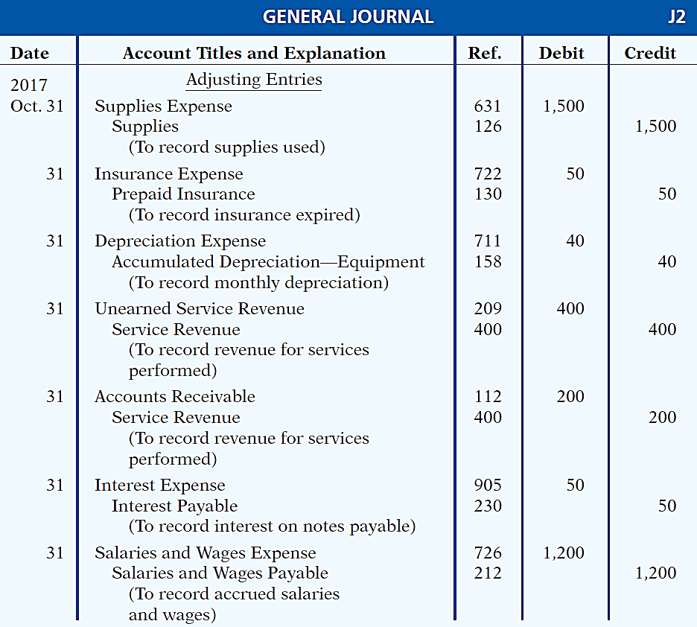
Steps in Preparing a Worksheet
Illustration 3-23
General journal showing adjusting entries
Adjusting Journal Entries
(Chapter 3)
LO 1

Slide 6
Steps in Preparing a Worksheet
Illustration 4-3
STEP 2: ENTER THE ADJUSTMENTS IN THE ADJUSTMENTS COLUMNS
(a)
(b)
Adjustments Key:
(a) Supplies Used.
(b) Insurance Expired.
(c) Depreciation Expensed.
(d) Service Revenue Recognized.
(e) Service Revenue Accrued.
(f) Interest Accrued.
(g) Salaries Accrued.
(d)
(d)
(e)
(g)
(a)
(b)
(c)
(c)
(e)
Enter adjustment amounts, total adjustments columns,
and check for equality.
(f)
(f)
(g)
Add additional accounts as needed.
LO 1

Slide 7
Steps in Preparing a Worksheet
Illustration 4-4
STEP 3: COMPLETE THE ADJUSTED TRIAL BALANCE COLUMNS
(a)
(b)
(d)
(d)
(e)
(g)
(a)
(b)
(c)
(c)
(e)
(f)
(f)
(g)
Total the adjusted trial balance columns and check for equality.
LO 1

Slide 8
Steps in Preparing a Worksheet
Illustration 4-5
STEP 4: EXTEND AMOUNTS TO FINANCIAL STATEMENT COLUMNS
(a)
(b)
(d)
(d)
(e)
(g)
(a)
(b)
(c)
(c)
(e)
(f)
(f)
(g)
Extend adjusted trial balance amounts to appropriate financial statement columns.
LO 1

Slide 9
Steps in Preparing a Worksheet
Illustration 4-6
STEP 5: TOTAL COLUMNS, COMPUTE NET INCOME (LOSS)
(a)
(b)
(d)
(d)
(e)
(g)
(a)
(b)
(c)
(c)
(e)
(f)
(f)
(g)
Compute Net Income or Net Loss.
LO 1

Slide 10
Steps in Preparing a Worksheet
Question
Net income is shown on a worksheet in the:
income statement debit column only.
balance sheet debit column only.
income statement credit column and balance sheet debit column.
income statement debit column and balance sheet credit column.
LO 1

Slide 11
Preparing Financial Statements from a Worksheet
Income statement is prepared from the income statement columns.
Balance sheet and owner’s equity statement are prepared from the balance sheet columns.
Companies can prepare financial statements before they journalize and post adjusting entries.
LO 1

Slide 12

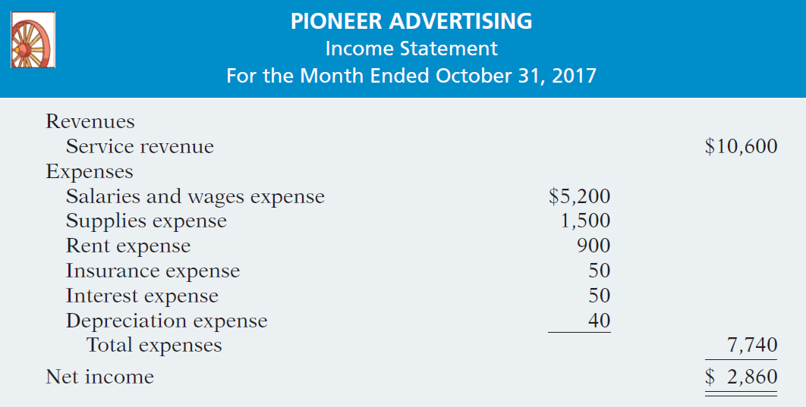
Preparing Statements from a Worksheet
Illustration 4-7
Financial statements from a worksheet
LO 1

Slide 13
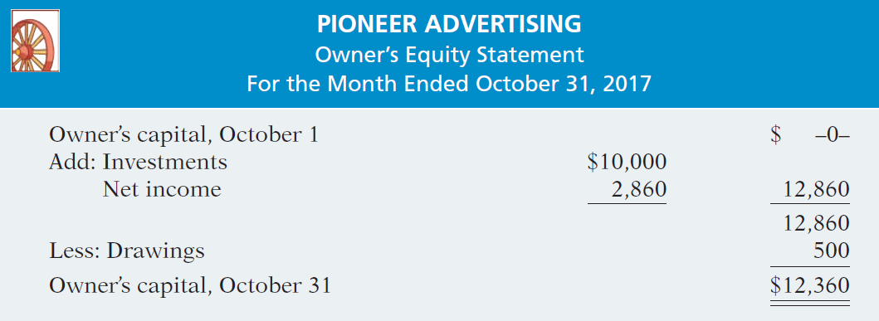

Preparing Statements from a Worksheet
Illustration 4-7
Financial statements from a worksheet
LO 1

Slide 14
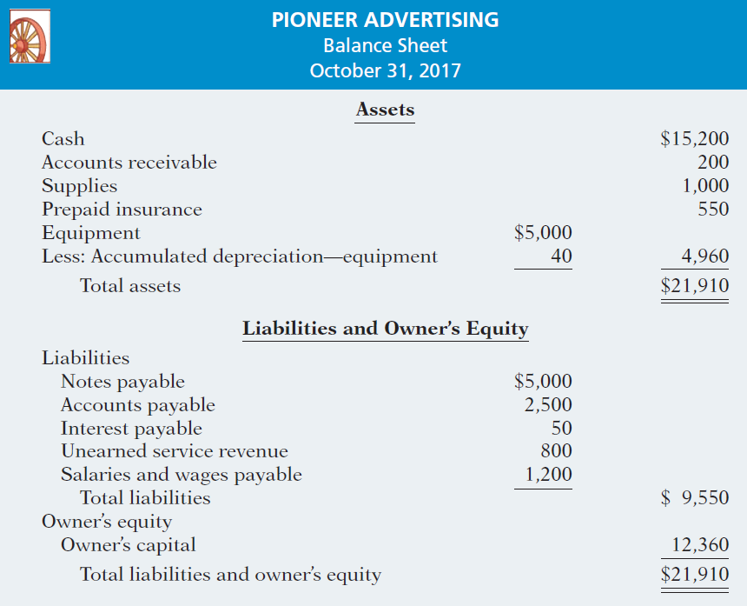
Illustration 4-7
LO 1

Slide 15
Preparing Adjusting Entries from a Worksheet
Adjusting entries are prepared from the adjustments columns of the worksheet.
Journalizing and posting of adjusting entries follows the preparation of financial statements when a worksheet is used.
LO 1

Slide 16
DO IT!
1
Worksheet
Susan Elbe is preparing a worksheet. Explain to Susan how she should extend the following adjusted trial balance accounts to the financial statement columns of the worksheet.
Cash
Balance sheet (debit column)
Accumulated Depreciation
Balance Sheet (credit column)
Accounts Payable
Balance Sheet (credit column)
Owner’s Drawings
Balance sheet (debit column)
Service Revenue
Income statement (credit column)
Salaries and Wages Expense
Income statement (debit column)
LO 1

Slide 17
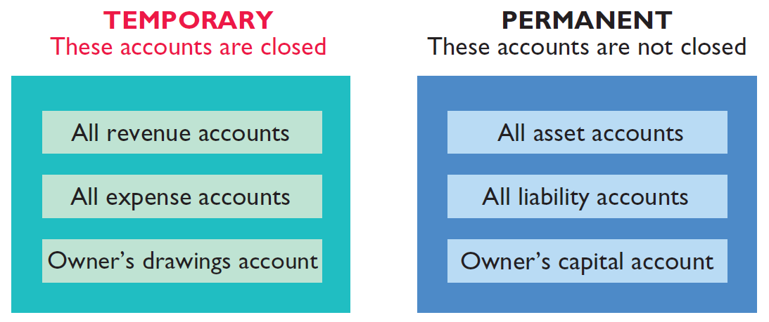
LEARNING
OBJECTIVE
Prepare closing entries and a post-closing trial balance.
2
At the end of the accounting period, the company makes the accounts ready for the next period.
Illustration 4-8
Temporary versus permanent accounts
LO 2

Slide 18
Preparing Closing Entries
Closing entries formally recognize in the ledger the transfer of
net income (or net loss) and
owner’s drawings
to owner’s capital.
Companies generally journalize and post closing entries only at the end of the annual accounting period.
Closing entries produce a zero balance in each temporary account.
LO 2

Slide 19
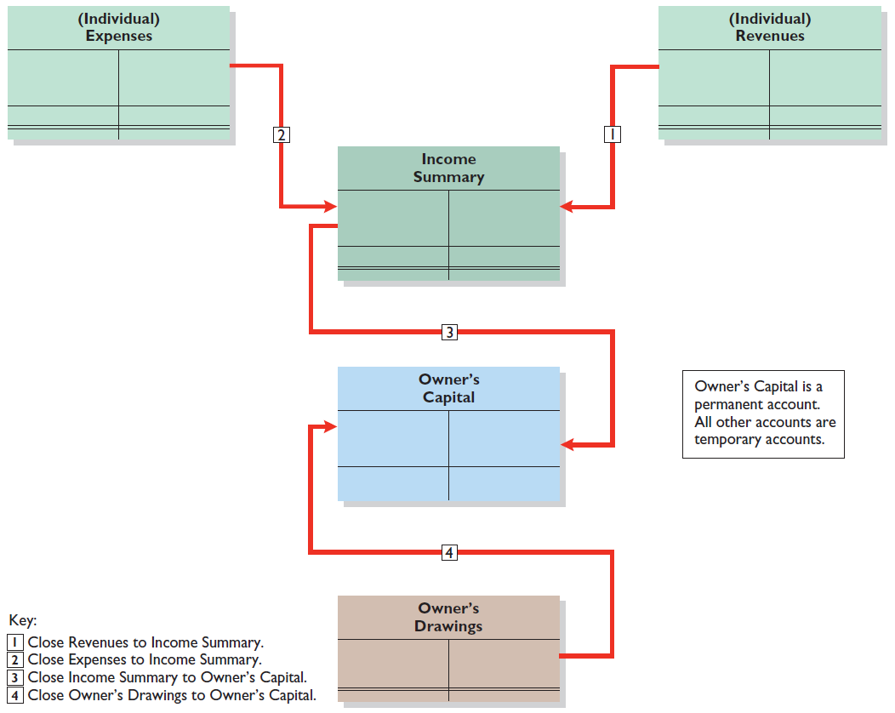
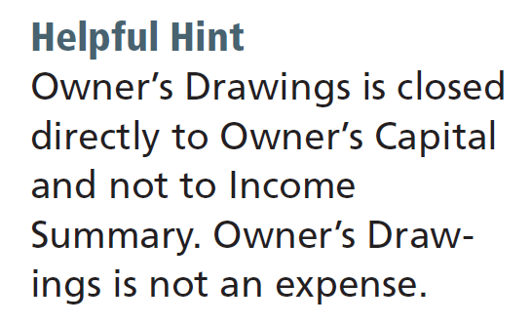
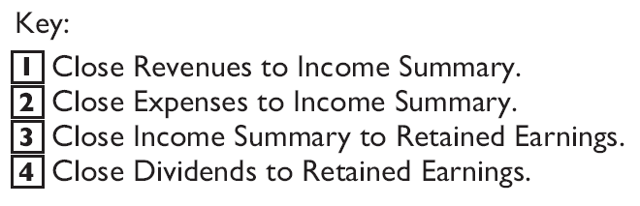
Preparing Closing Entries
Illustration 4-9
Diagram of closing process—proprietorship
Owner’s Capital is a permanent account. All other accounts are temporary accounts.
LO 2

Slide 20
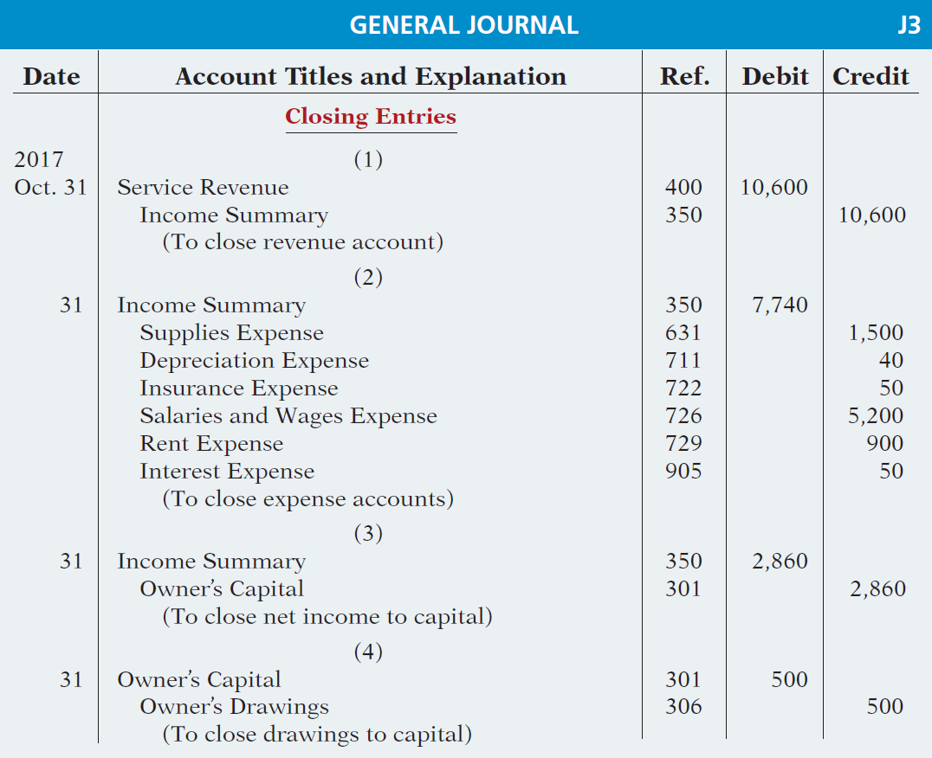
Preparing Closing Entries
CLOSING ENTRIES ILLUSTRATED
Illustration 4-10
Closing entries journalized

Slide 21
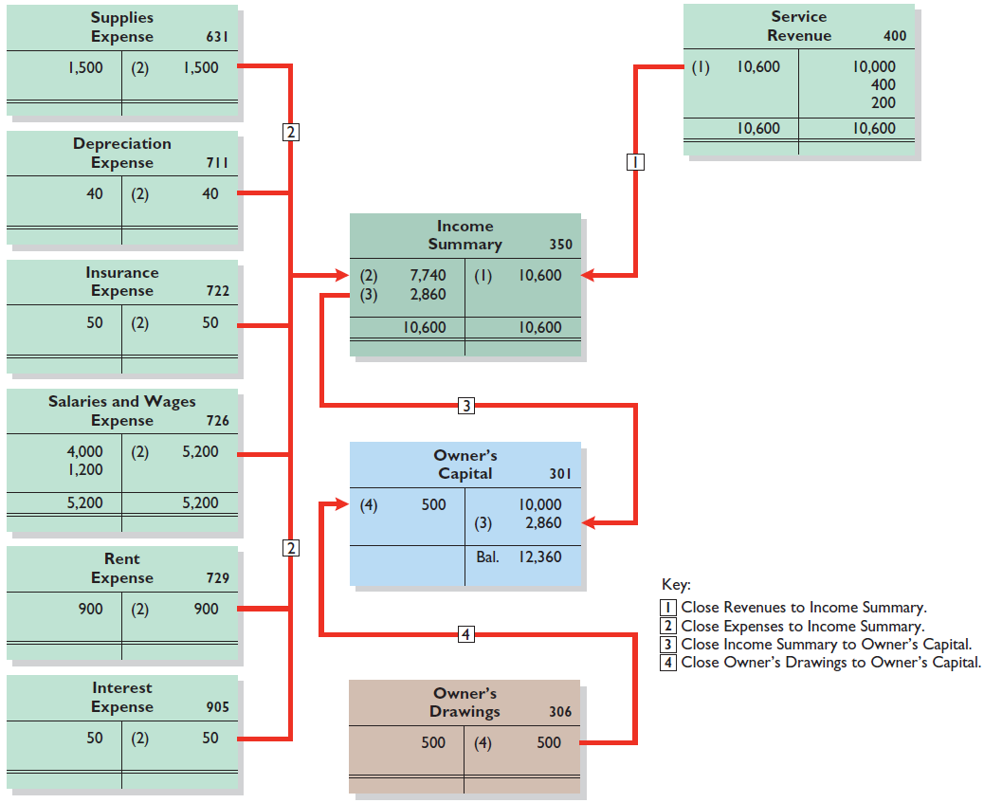
Posting Closing Entries
Illustration 4-11
LO 2

Slide 22
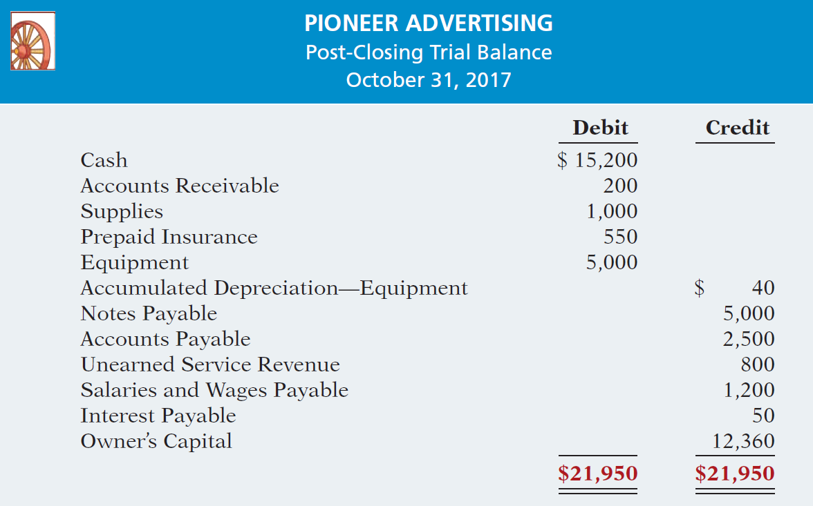
Preparing a Post-Closing Trial Balance
Purpose is to prove the equality of the permanent account balances carried forward into the next accounting period.
Illustration 4-12
Post-closing trial balance
LO 2

Slide 23
LEARNING
OBJECTIVE
Explain the steps in the accounting cycle and how to prepare correcting entries.
3
Illustration 4-15
1. Analyze business transactions
9. Prepare a post-closing trial balance
2. Journalize the transactions
8. Journalize and post closing entries
3. Post to ledger accounts
7. Prepare financial statements
4. Prepare a trial balance
6. Prepare an adjusted trial balance
5. Journalize and post adjusting entries
LO 3

